Slide 1


Development of Polarization-Sensitive Positron Emission Tomography Demonstrator based on Single-layer gamma-ray polarimeters
Siddharth Parashari*,‡, Tomislav Bokulić*, Damir Bosnar*, Ana Marija Kožuljević*, Zdenka Kuncic†, Luka Pavelić#, Petar Žugec* and Mihael Makek*
*Department of Physics, Faculty of Science, University of Zagreb
†School of Physics, University of Sydney
#Institute for Medical Research and Occupational Health
13-Jul-2022, Krakow
4th Jagiellonian Symposium on Advances in Particle Physics and Medicine
‡siddharth@phy.hr

Slide 2

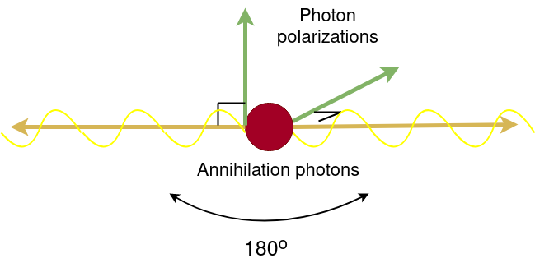
Introduction
Positron annihilation may result in two entangled and orthogonally polarized gamma photons.
It is found that the polarization correlations can be utilized as an additional handle to improve Signal to Noise Ratio (SNR) which may improve medical imaging with Positron Emission Tomography (PET).
[Z. Kuncic et al., NIM A648 (2011), A.L. McNamara, et. al., Phys. Med. Bio. 59 (2014) 7587, M. Toghyani et. al., Phys. Med. Bio. 61 (2016) 5803, D. Watts et. al., Nat. Commun. 12 (2021) 2646]
Photon polarization in positron annihilation event
Question ?
How to measure gamma-ray polarization in PET ?
Compton scattering
The gamma polarization is related to the azimuthal angle in the Compton scattering process, so the initial correlation of polarization translates to the correlation of azimuthal angles in true coincidence events, which is not present in the background.
How to implement polarization measurement in PET cost efficiently?
2
4th Jagiellonian Symposium on Advances in Particle Physics and Medicine

Slide 3
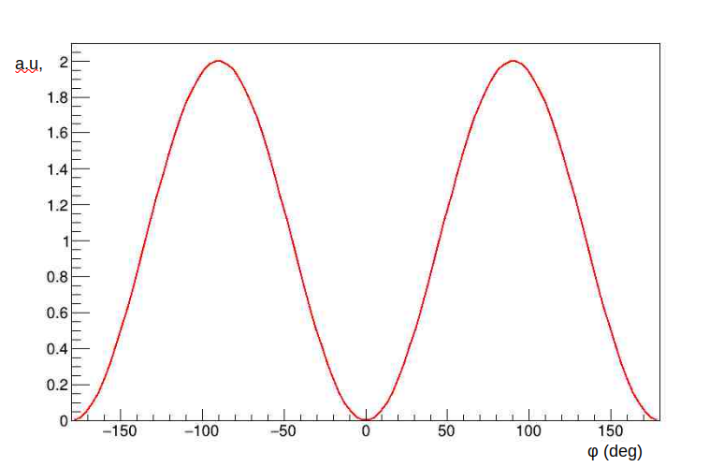
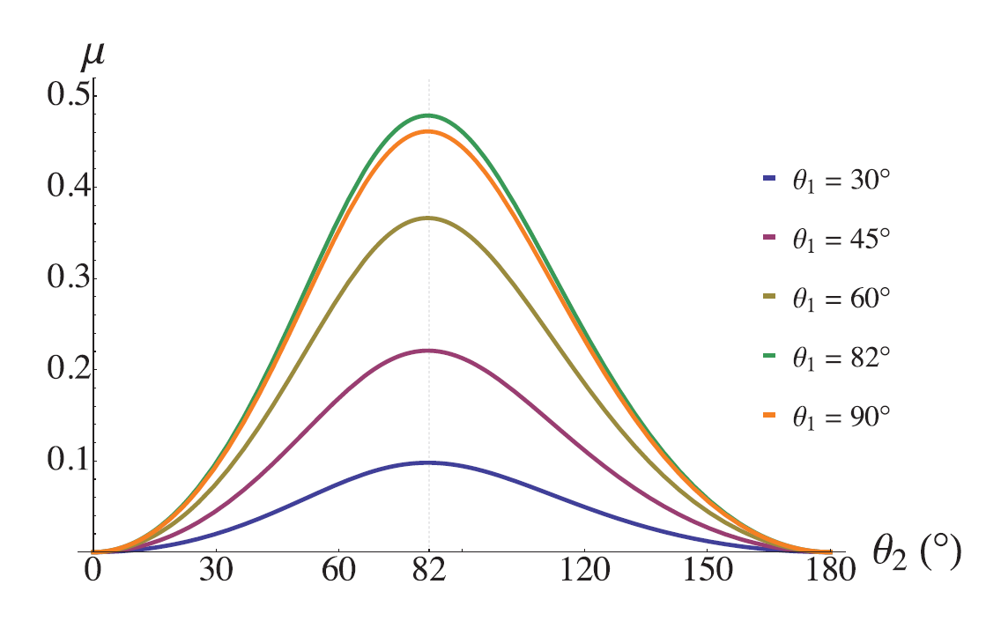
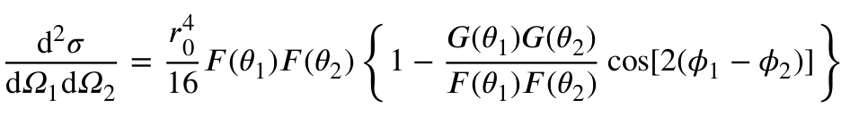

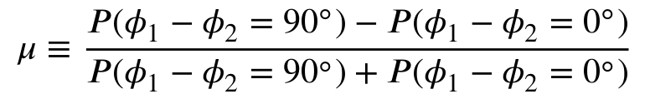

Gamma polarization measurement via Compton scattering
Klein-Nishina differential cross-section for scattering of linearly polarized gamma photon
$$\frac{dσ}{dΩ}=\frac{1}{2}r_{0}^{2}{\left(\frac{k′}{k_{0}}\right)}^{2}⟦\frac{k_{0}}{k′}+\frac{k′}{k_{0}}−2\sin^{2}θ\cos^{2}φ⟧$$
Arbitrary Unit
Arbitrary Unit
Arbitrary Unit
where θ is the scattering angle and φ is the angle between the scattering plane and the polarization vector
$$\left(\vec{k_{0}},\vec{k}′\right)$$
Gamma is most likely to be scattered at azimuthal angle φ perpendicular to the polarization vector (cos φ = 0)
The sensitivity to polarization is the largest for scattering at θ = 90°
Polarization is correlated to the azimuthal scattering angle φ.
ΔΦ (deg)
Φ (deg)
Polarization correlations in paired Compton events
The cross-section for scattering of two linearly polarized γ-particles is given by
The cross-section has maxima when ; keeping θ fixed.
[Pryce and Ward, Nature 160 435; Snyder, Pasternak, Hornbostel, Phys. Rev. 73 (1948) 440-8]
[M. Toghyani et. al., Phys. Med. Biol. 61 (2016) 5803]
μ reaches maximum μ = 0.48 when θ₁ = θ₂ = 82º
The Polarimetric Modulation Factor μ is defined as,
3
4th Jagiellonian Symposium on Advances in Particle Physics and Medicine

Slide 4
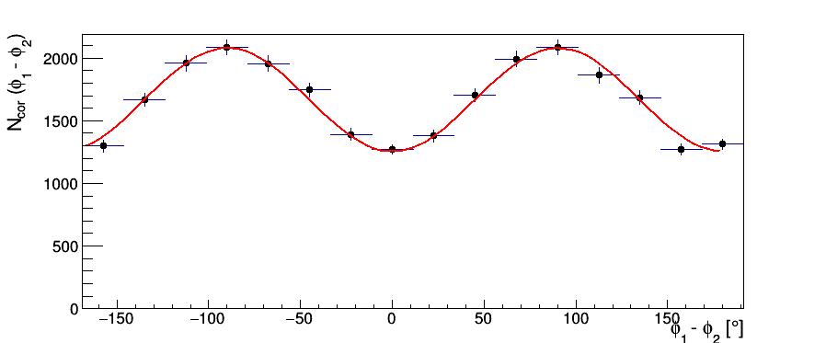
Motivation
Drawbacks
Modern PET detectors : Highly segmented, large coverage
Most common setups
to detect azimuthal :
polarization
A PET system based on 2 (or more)-layer detectors would dramaticaly increase the cost of the apparatus
Detectors with 2 senisitive layers – 1st for measuring the recoil electron, 2nd for the scattered gamma
Detection of recoil electron and scattered photon
Single layer detectors
Feasibility of the measurement of polarization correlations using single layer detectors
Proof of concept using 4x4 LFS
crystals 3 x 3 x 20 mm³
μ = 0.29 ± 0.04; 72º<θ_{1,2} <90º
M. Makek et. al., Nucl. Instr. Meth. A 958 (2020) 162835.
Energy resolution of detectors determines θ precision,
Segmentation and material determine φ resolution and acceptance
1. Improving energy resolution Choosing suitable detector material
2. Improving azimuthal resolution Small pixel dimensions in a detector
4
4th Jagiellonian Symposium on Advances in Particle Physics and Medicine

Slide 5
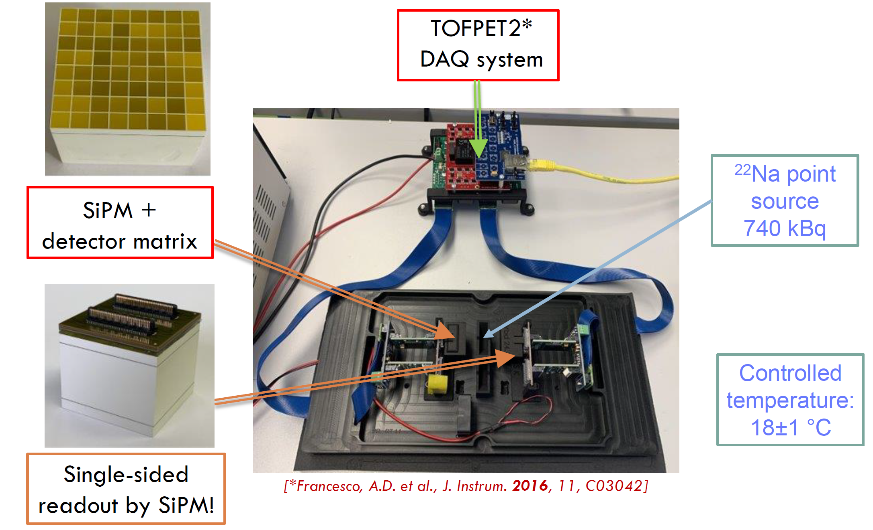
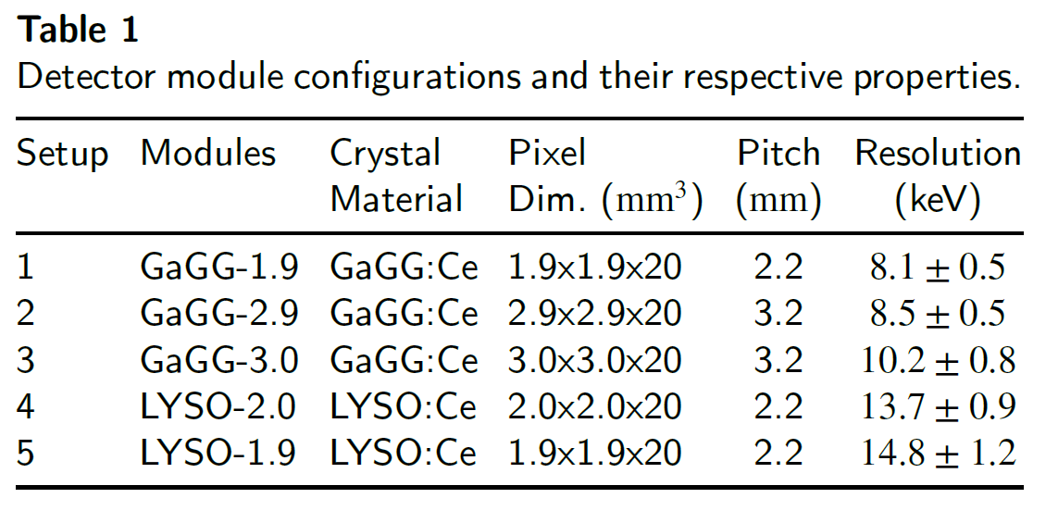
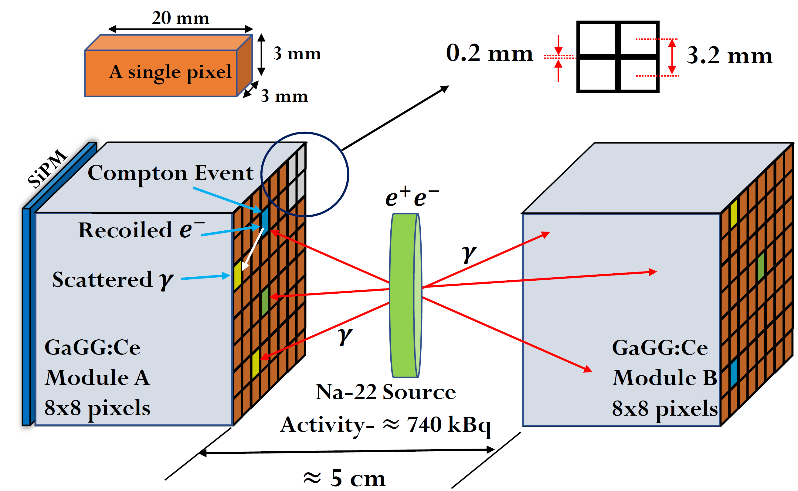
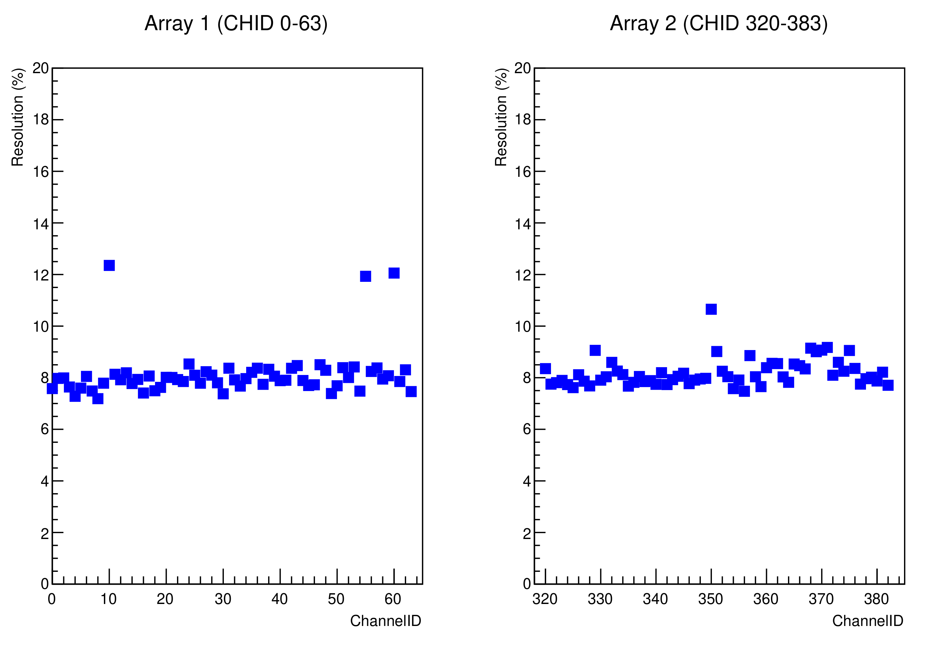
Comparison of different setups for measurements of gamma polarization correlations
Pixel Array – 13
Pixel Array – 14
Fig. 2. Individual pixel resolution (%) at 511 keV in the GaGG 1.9 mm detector modules.
TOFPET2 DAQ system from PETSys
Fig. 1. Schematic diagram of experimental setup – example for GaGG:Ce 8x8 matrix
S. Parashari et al.,“Optimization of detector modules for measuring gamma-ray polarization in PET”, [Accepted in NIM A.] PET”, arXiv:2205.0107]
5
4th Jagiellonian Symposium on Advances in Particle Physics and Medicine

Slide 6
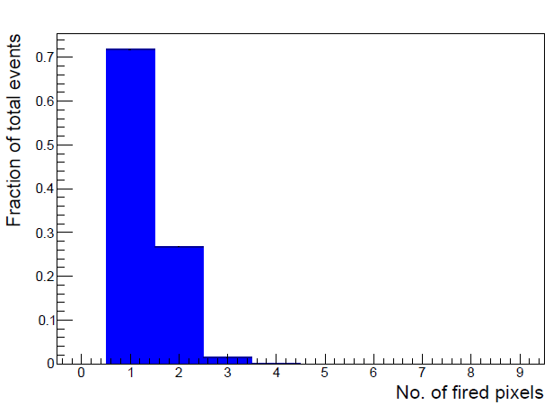
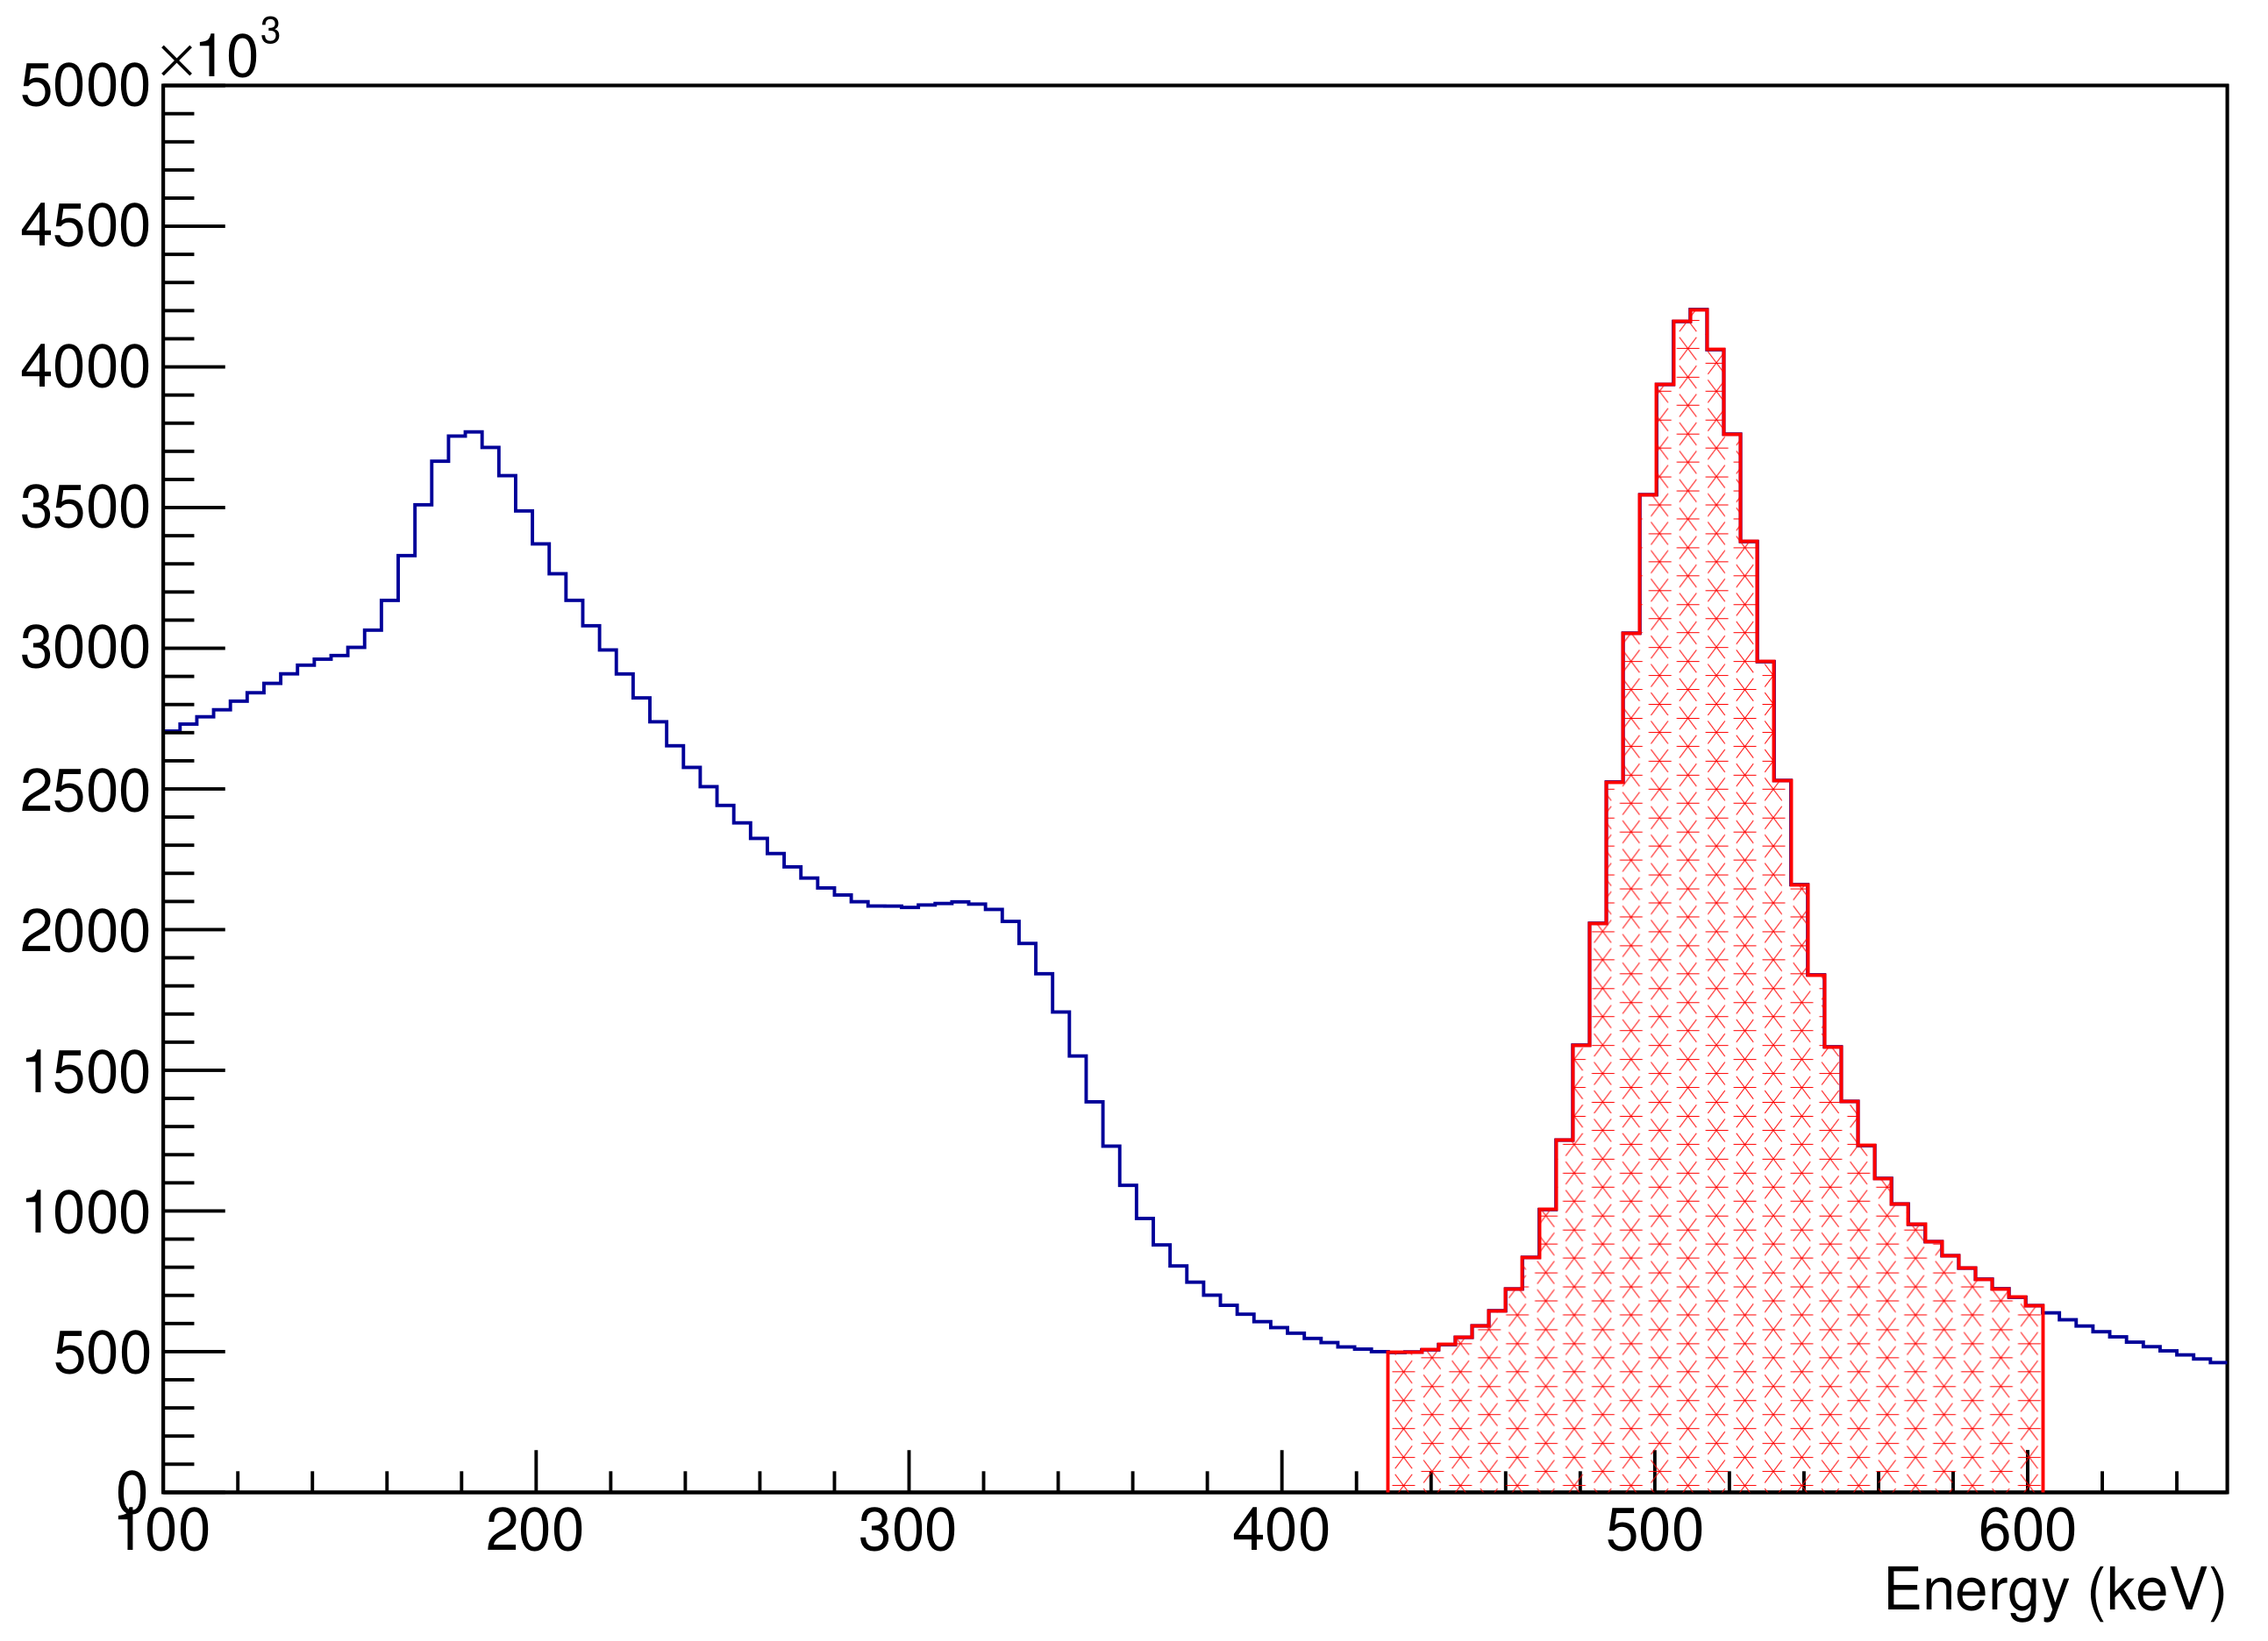
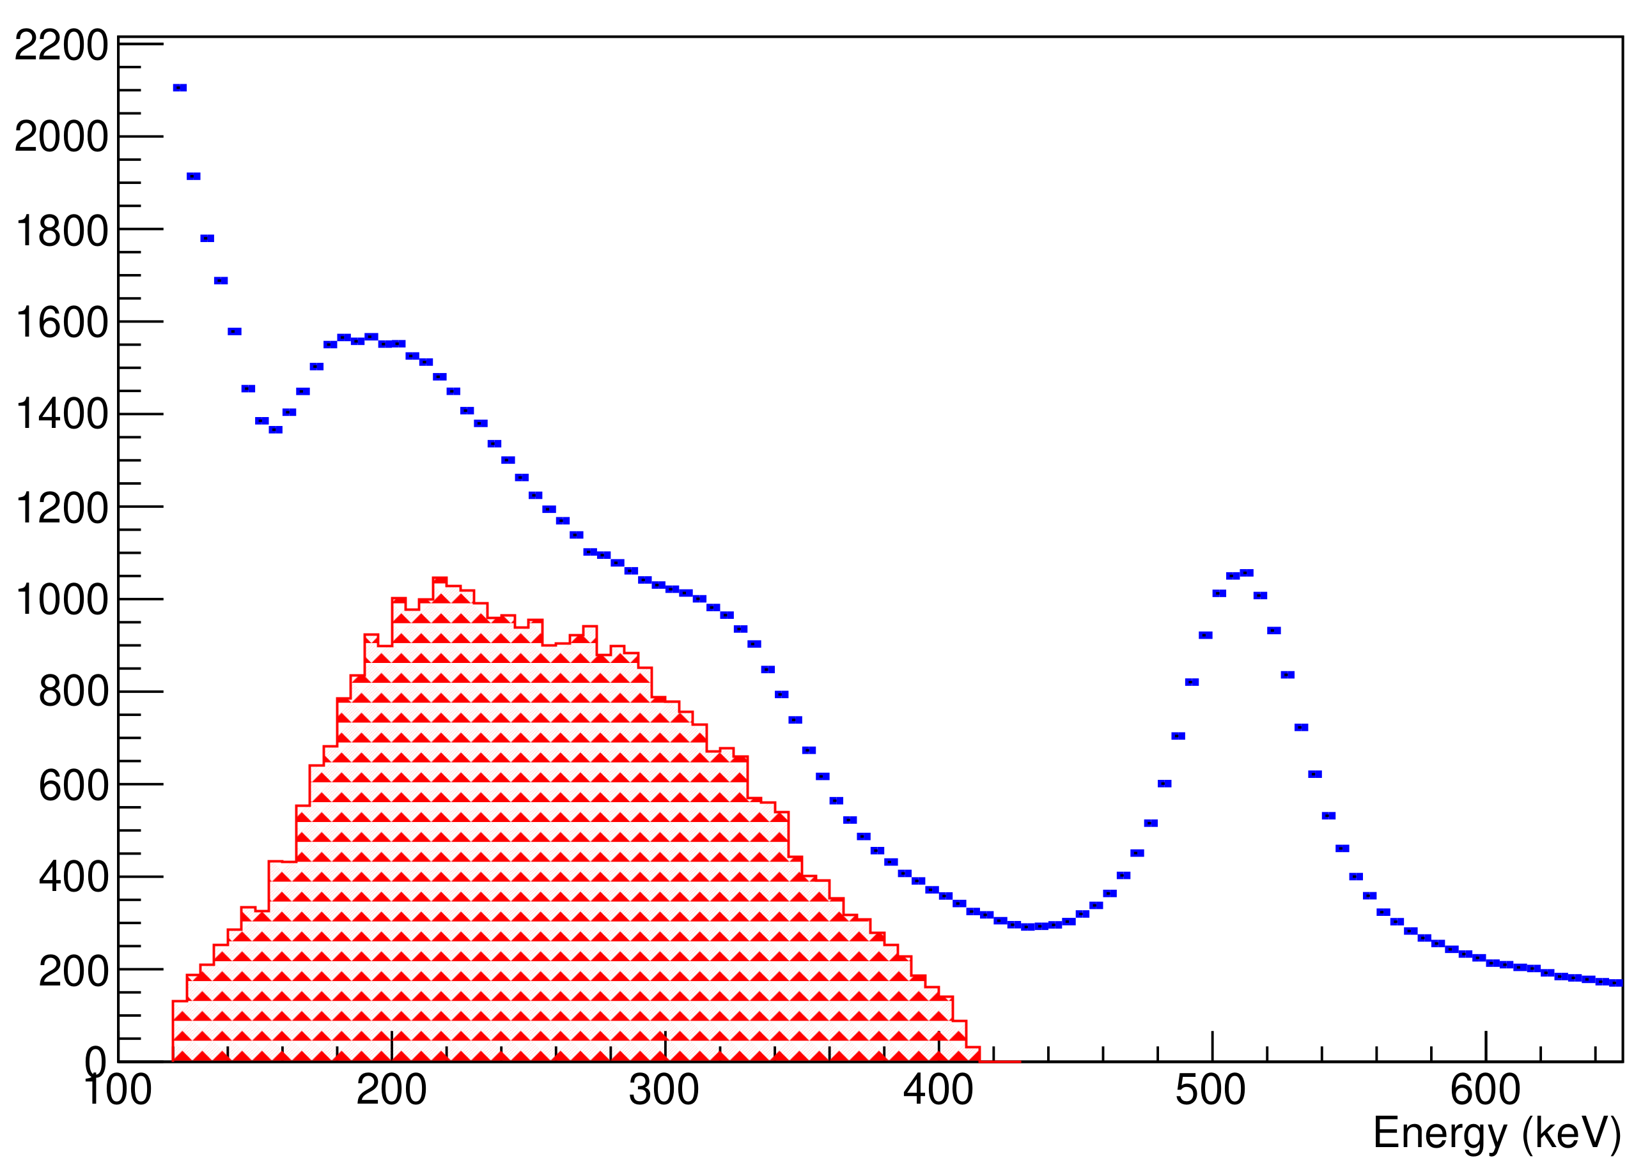
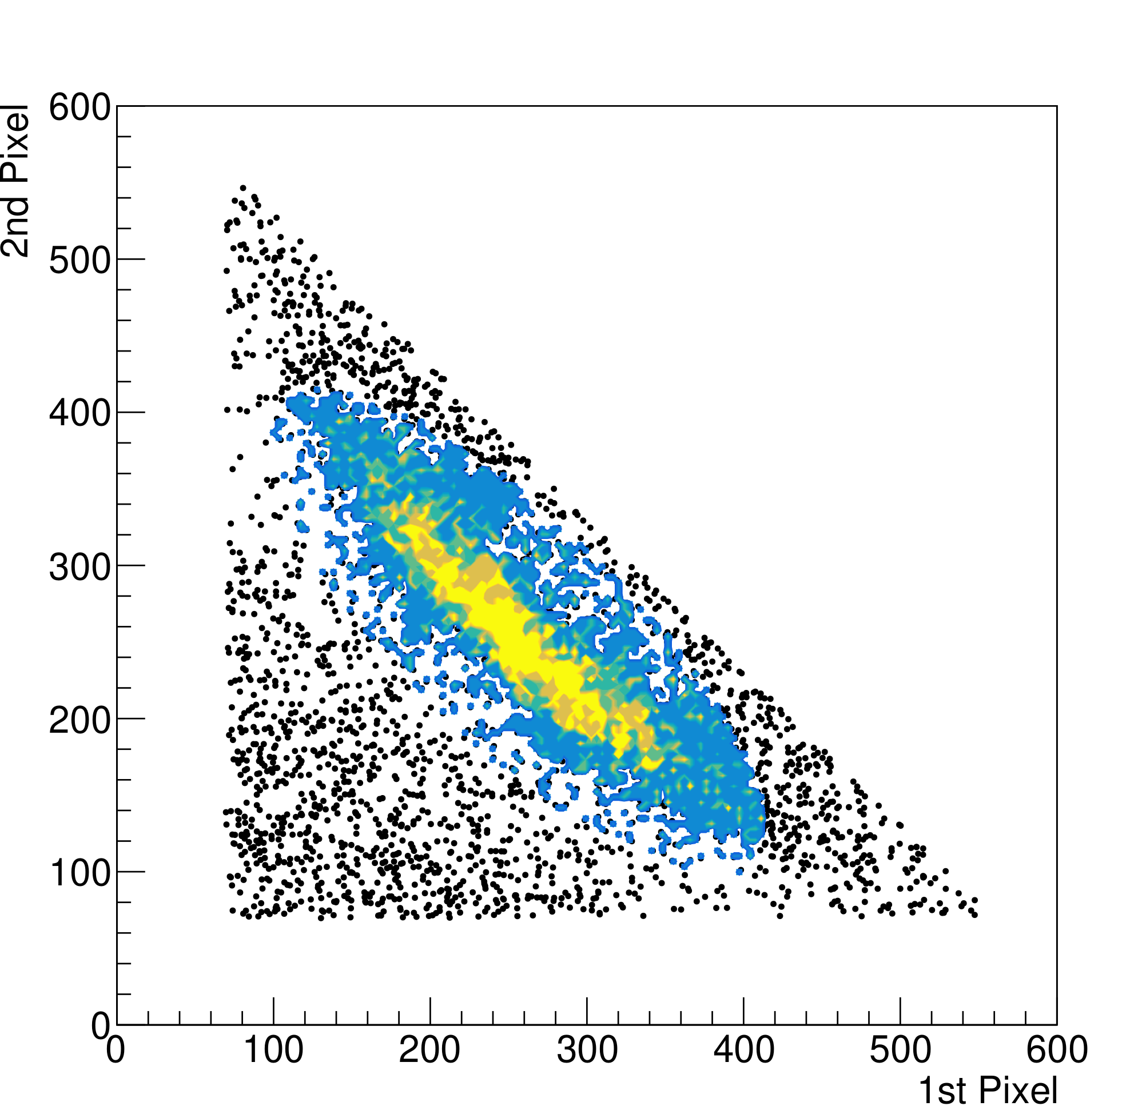
Data analysis
Two Pixel fired per event
Sum of Pixel Energies
Selection of Compton Events –
The Compton events in each module are selected requiring that exactly two pixels fire [Fig. 3(a)], that the energy deposited in the module is within 511 keV±3σ [Fig. 3(b)] and that pixel energies correspond to Compton kinematics, [Fig. (c), (d)].
( a )
( b )
For ex. Pixels 10 & 12 fired in a Compton Event
Energy deposition in Selected Pixel
Selected Compton Events
(Color Region)
12
( d )
10
( c )
Fig. 3. (a) Number of pixel fired in all events; (b) sum of pixel energies in Compton events; (c) energy deposited in an individual pixel fired in Compton event; (d) selected Compton events
6
4th Jagiellonian Symposium on Advances in Particle Physics and Medicine

Slide 7
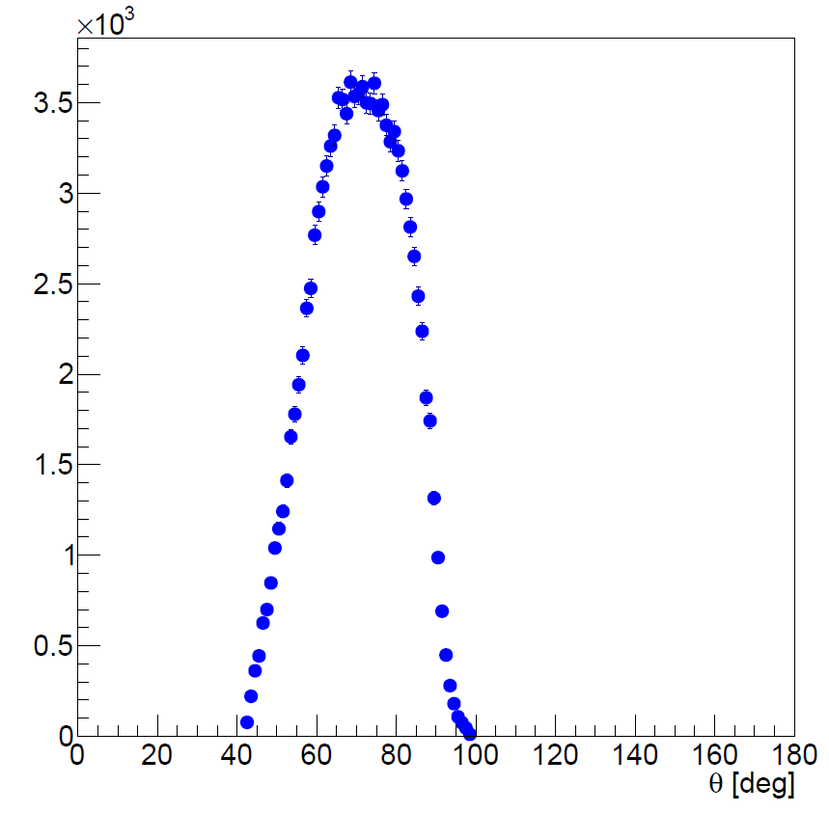


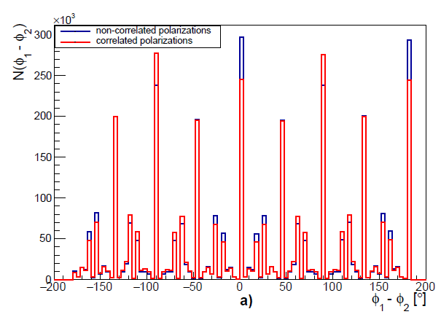
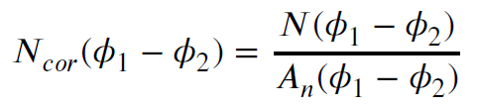
Data analysis
GaGG 3(mm) x 3(mm)
Reconstruction of Compton Scattering Angles –
The Scattering angle reconstruction,
+
(a)
Reconstruction of azimuthal angles,
Detector Acceptance –
The acceptance-corrected φ distribution is obtained as
where A_{n} is obtained with φ₁ and φ₂ from different (uncorrelated) events.
(b)
Fig. 4. Reconstructed (a) 𝜃 and (b) 𝝓₁- 𝝓₂ (correlated vs uncorrelated)
[A. M. Kožuljević et. al., Condensed Matter 2021, 6, 43]
7
4th Jagiellonian Symposium on Advances in Particle Physics and Medicine

Slide 8
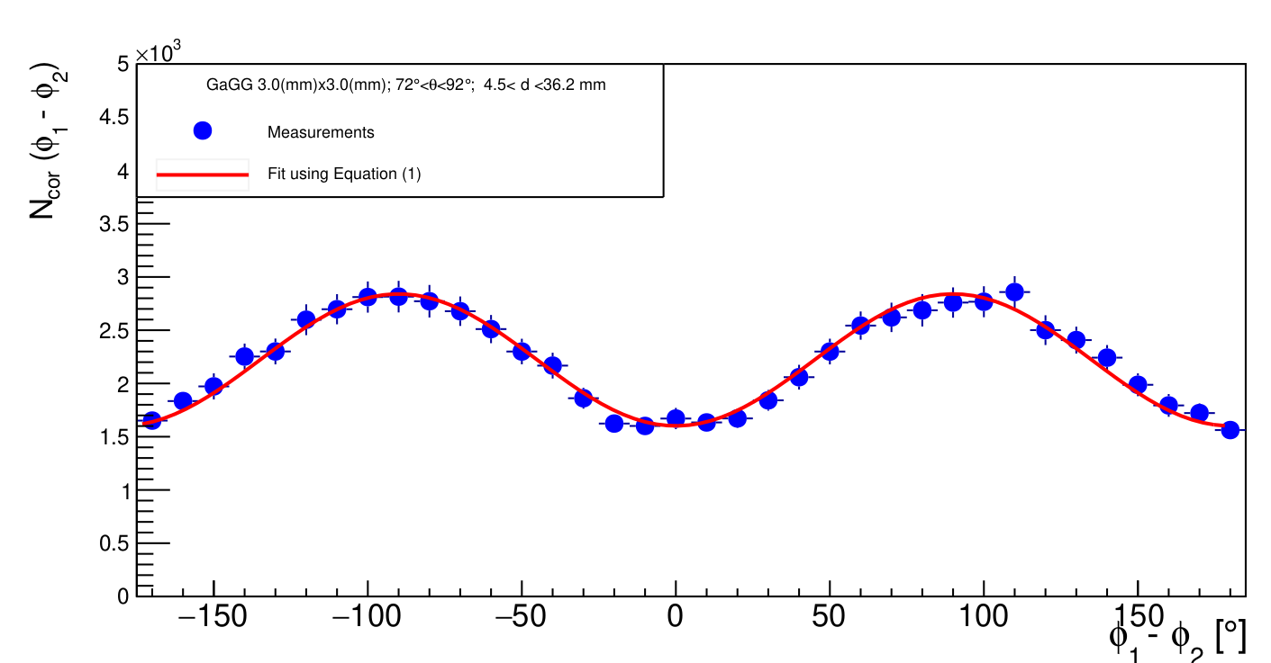
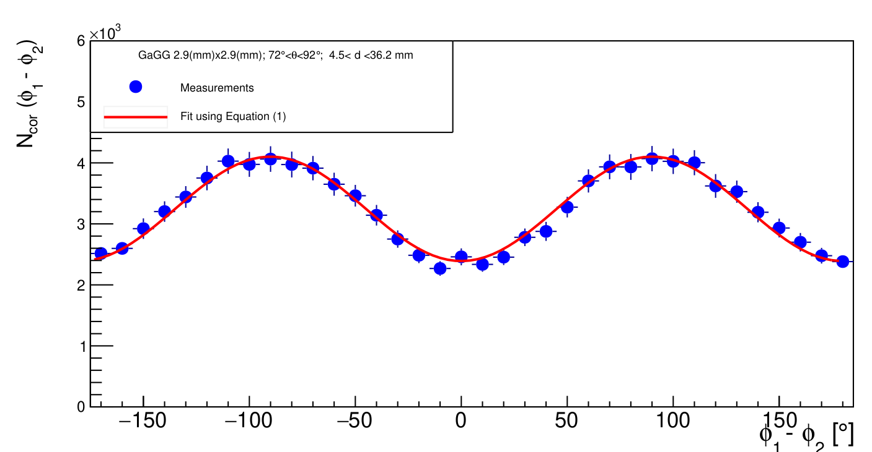
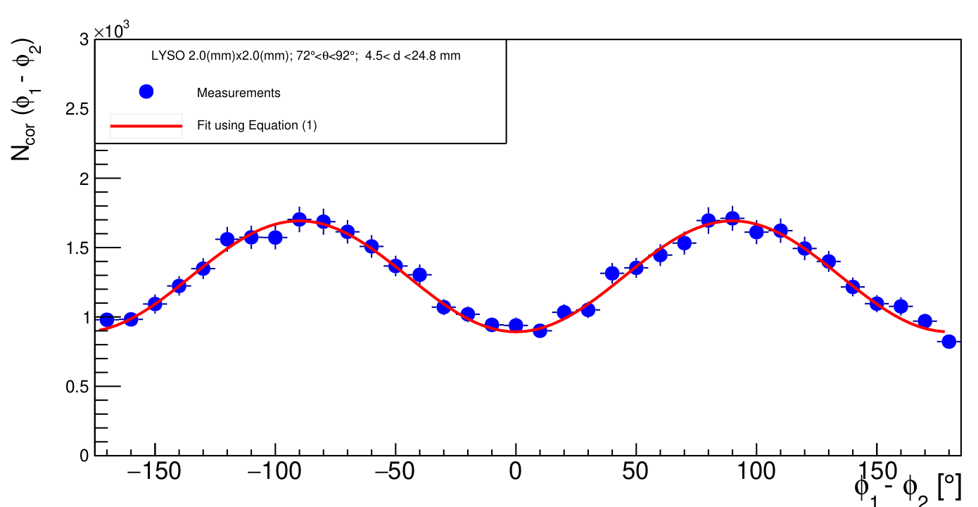
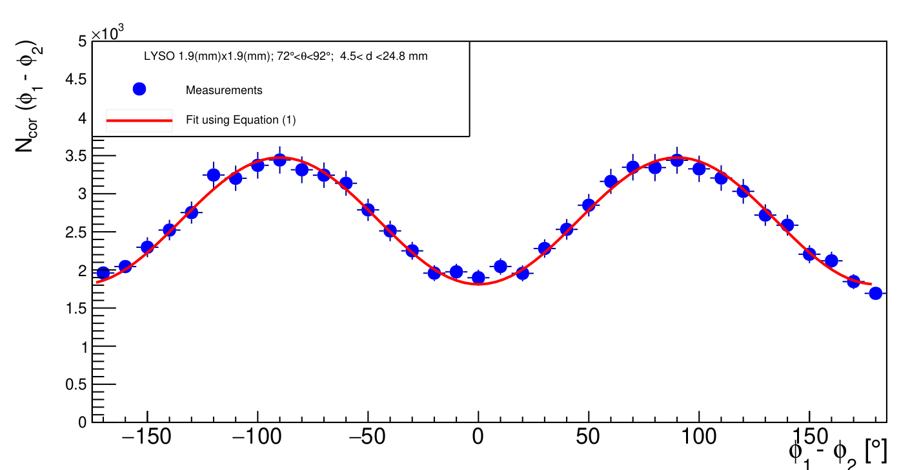
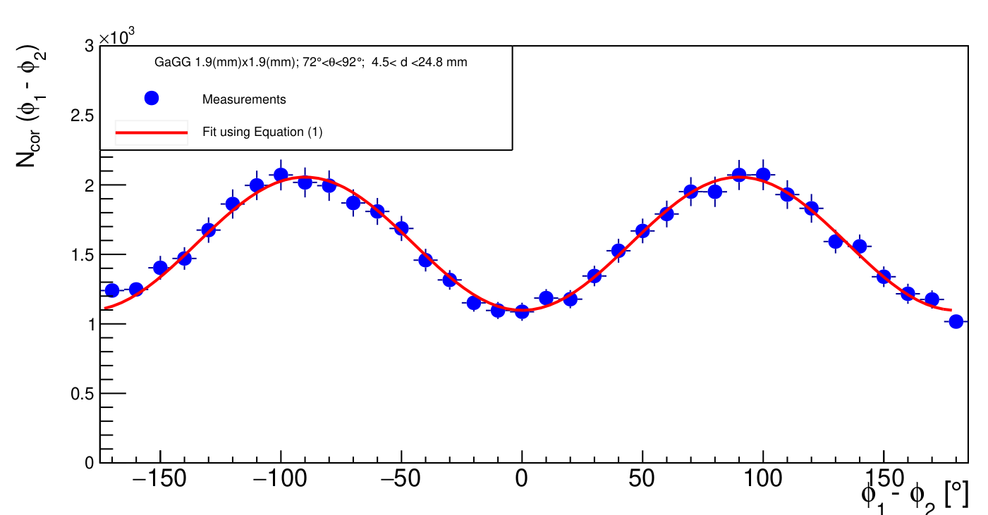

Polarization correlations of gamma-ray from positron annihilation
Distributions : For various inter-pixel distances d_{1,2} > 4.5 mm for different angular range in 72º < 𝜃_{1,2} < 90º .
Modulation factor μ extracted by fit :
$$φ_{1}−φ_{2}$$
$$N_{cor}\left(φ_{1}−φ_{2}\right)=M\left[1−μ cos2\left(φ_{1}−φ_{2}\right)\right]$$
GaGG 3.0 mm
GaGG 2.9 mm
LYSO 2.0 mm
(a)
(b)
(c)
LYSO 1.9 mm
GaGG 1.9 mm
(d)
(e)
Fig 5. Observed azimuthal difference distributions for (a) GaGG_3.0mm (b) GaGG_2.9mm (c) LYSO_2.0mm (d) LYSo_1.9mm &
(e) GAGG_1.9mm for 72º < 𝜃_{1,2} < 90º
8
[S. Parashari et al., PET”, arXiv:2205.0107]

Slide 9
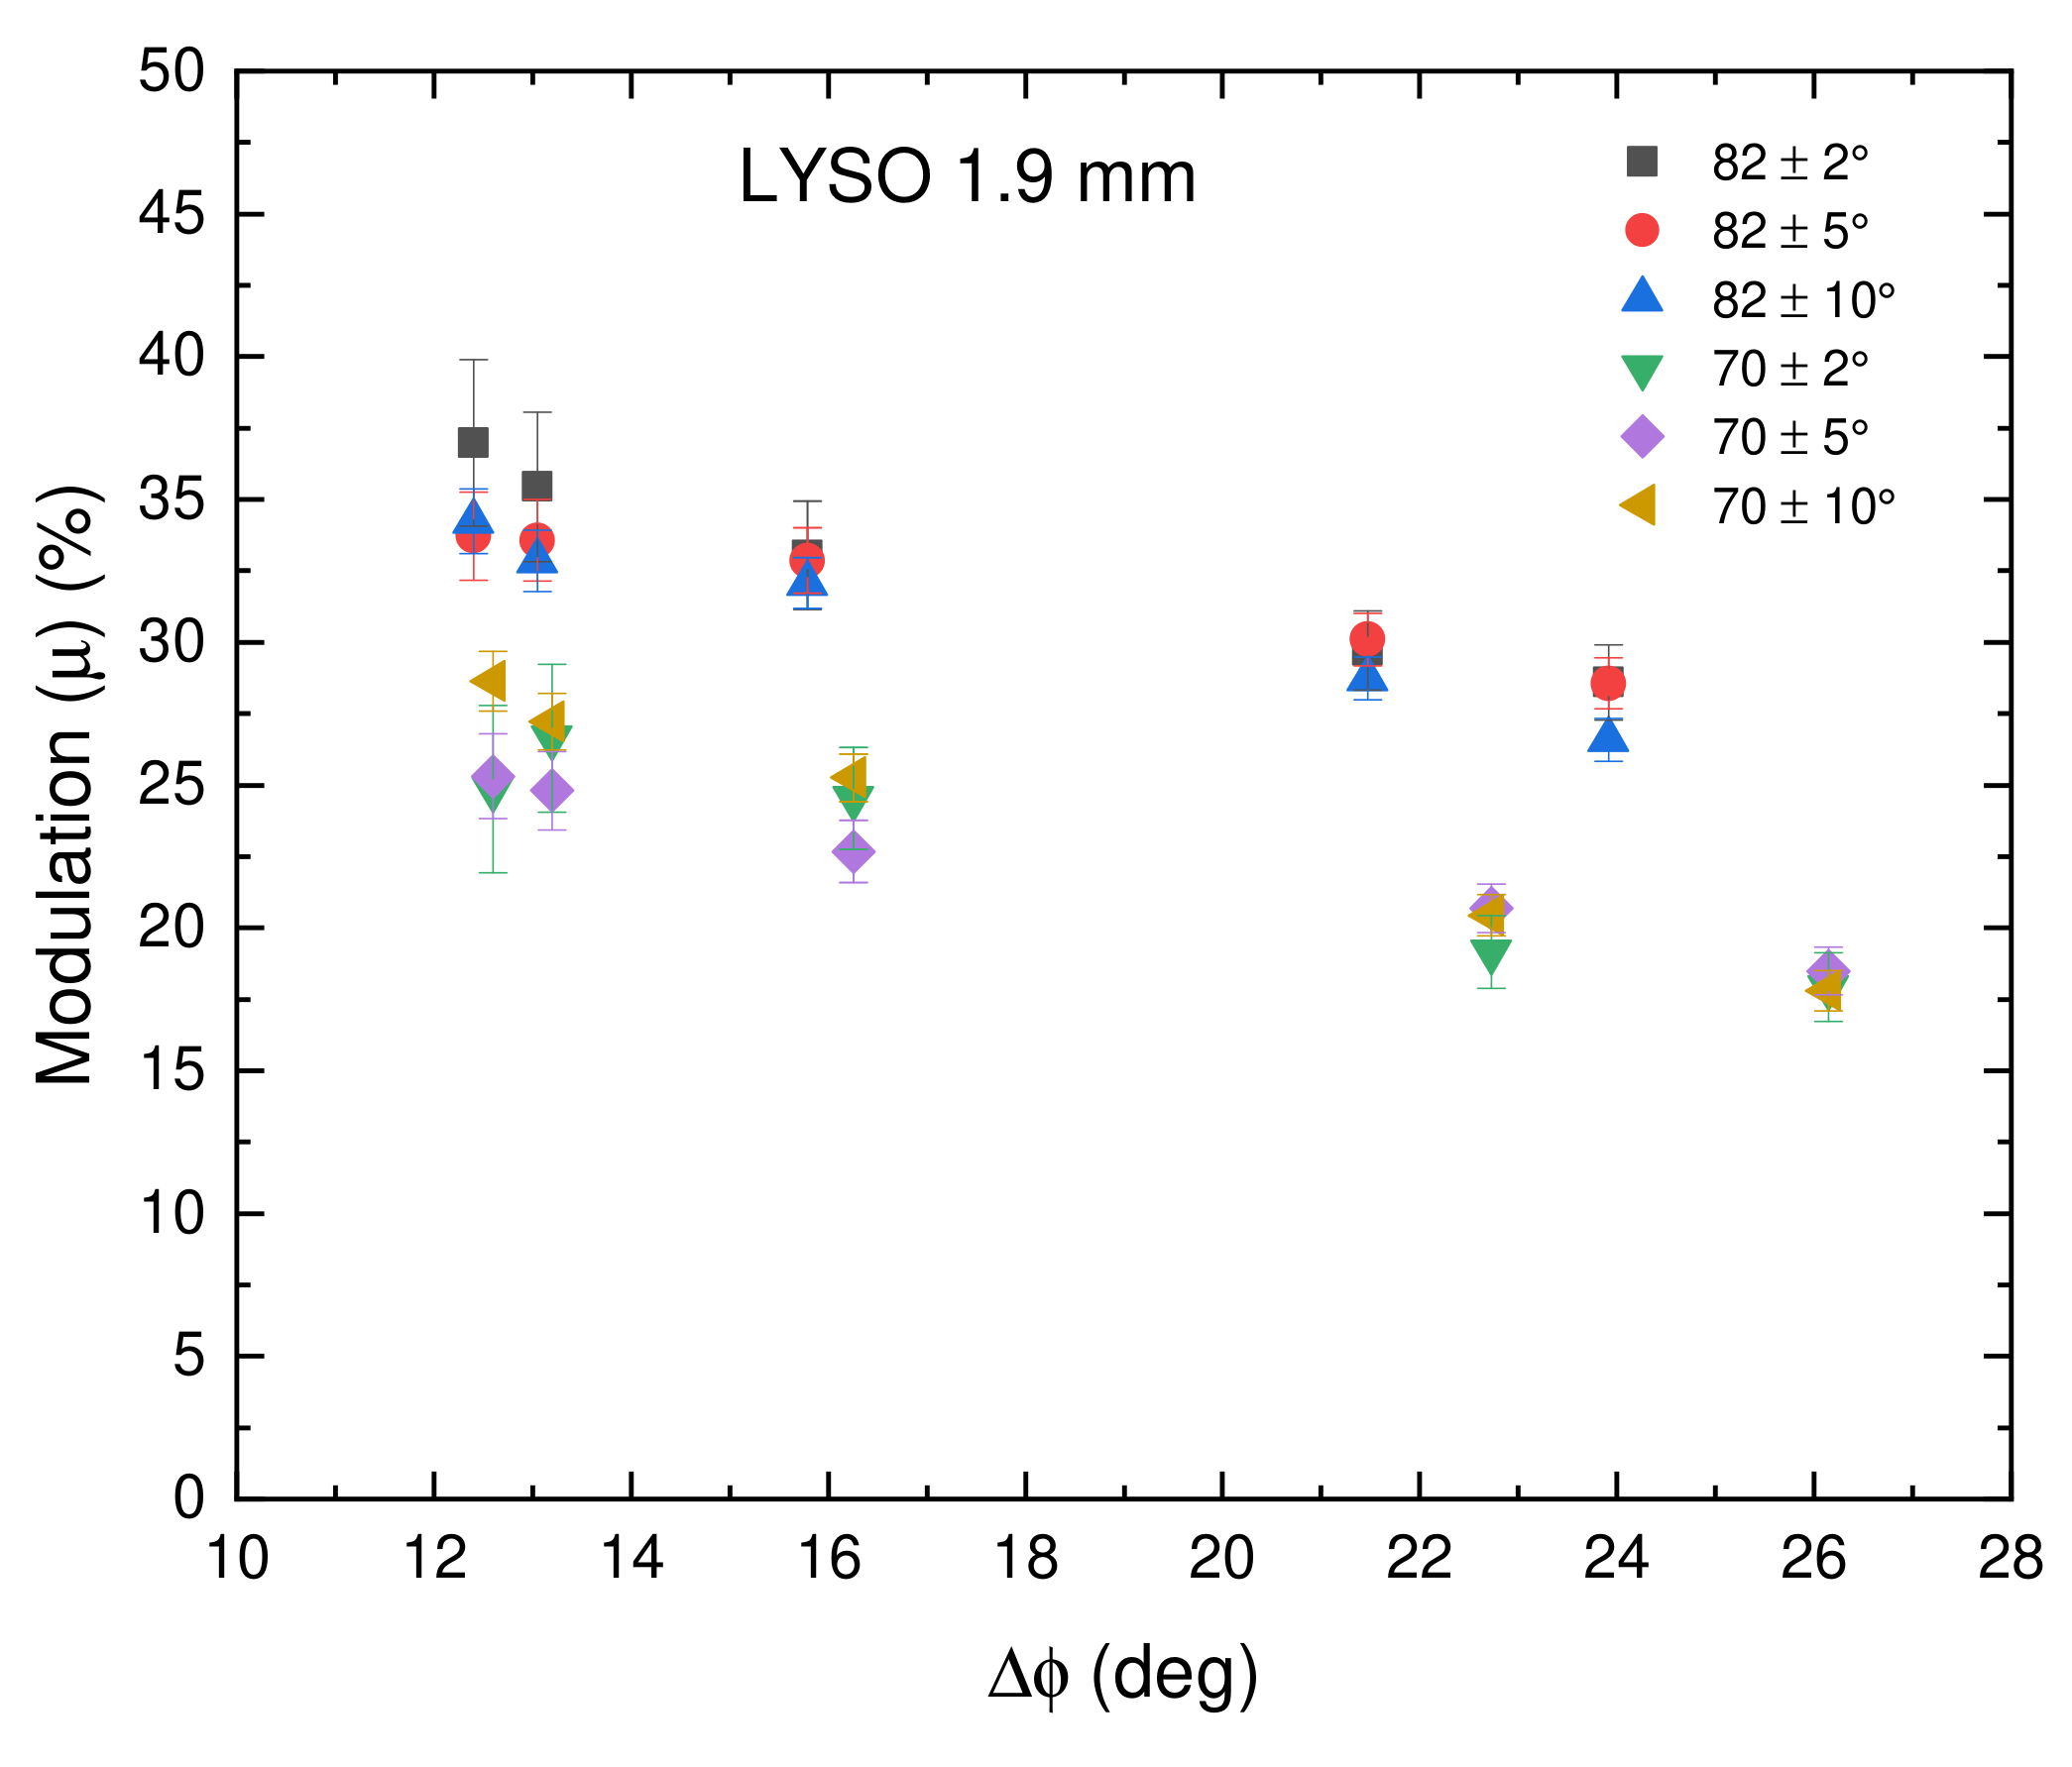
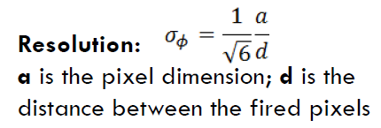
Modulation factors in LYSO 1.9 mm
at different scattering angles
The dependence of the modulation factor, 𝜇, on the azimuthal resolution <Δφ> at different 𝜃_{1,2} is explored in each detector configuration. An examples of obtained Modulation factors, 𝜇 with azimuthal resolution <Δφ> for LYSO 1.9 mm detector is shown in figure.
Observations –
Larger modulation factors are observed for angular ranges closer to 82º in comparison to 70º.
Rising modulation amplitude is observed with lower Azimuthal Resolution <Δφ> or larger inter-pixel distances d(mm).
<Δφ>º
We have achieved a well pronounced polarimetric performance of finer segmented detector modules.
Fig. 6. Modulation (%) vs azimuthal resolution <Δφ> at different angular ranges for LYSO 1.9 mm detector.
[S. Parashari et al.,“Optimization of detector modules for measuring gamma-ray polarization in PET”, [Accepted in NIM A.] PET”, arXiv:2205.0107]
9
4th Jagiellonian Symposium on Advances in Particle Physics and Medicine

Slide 10
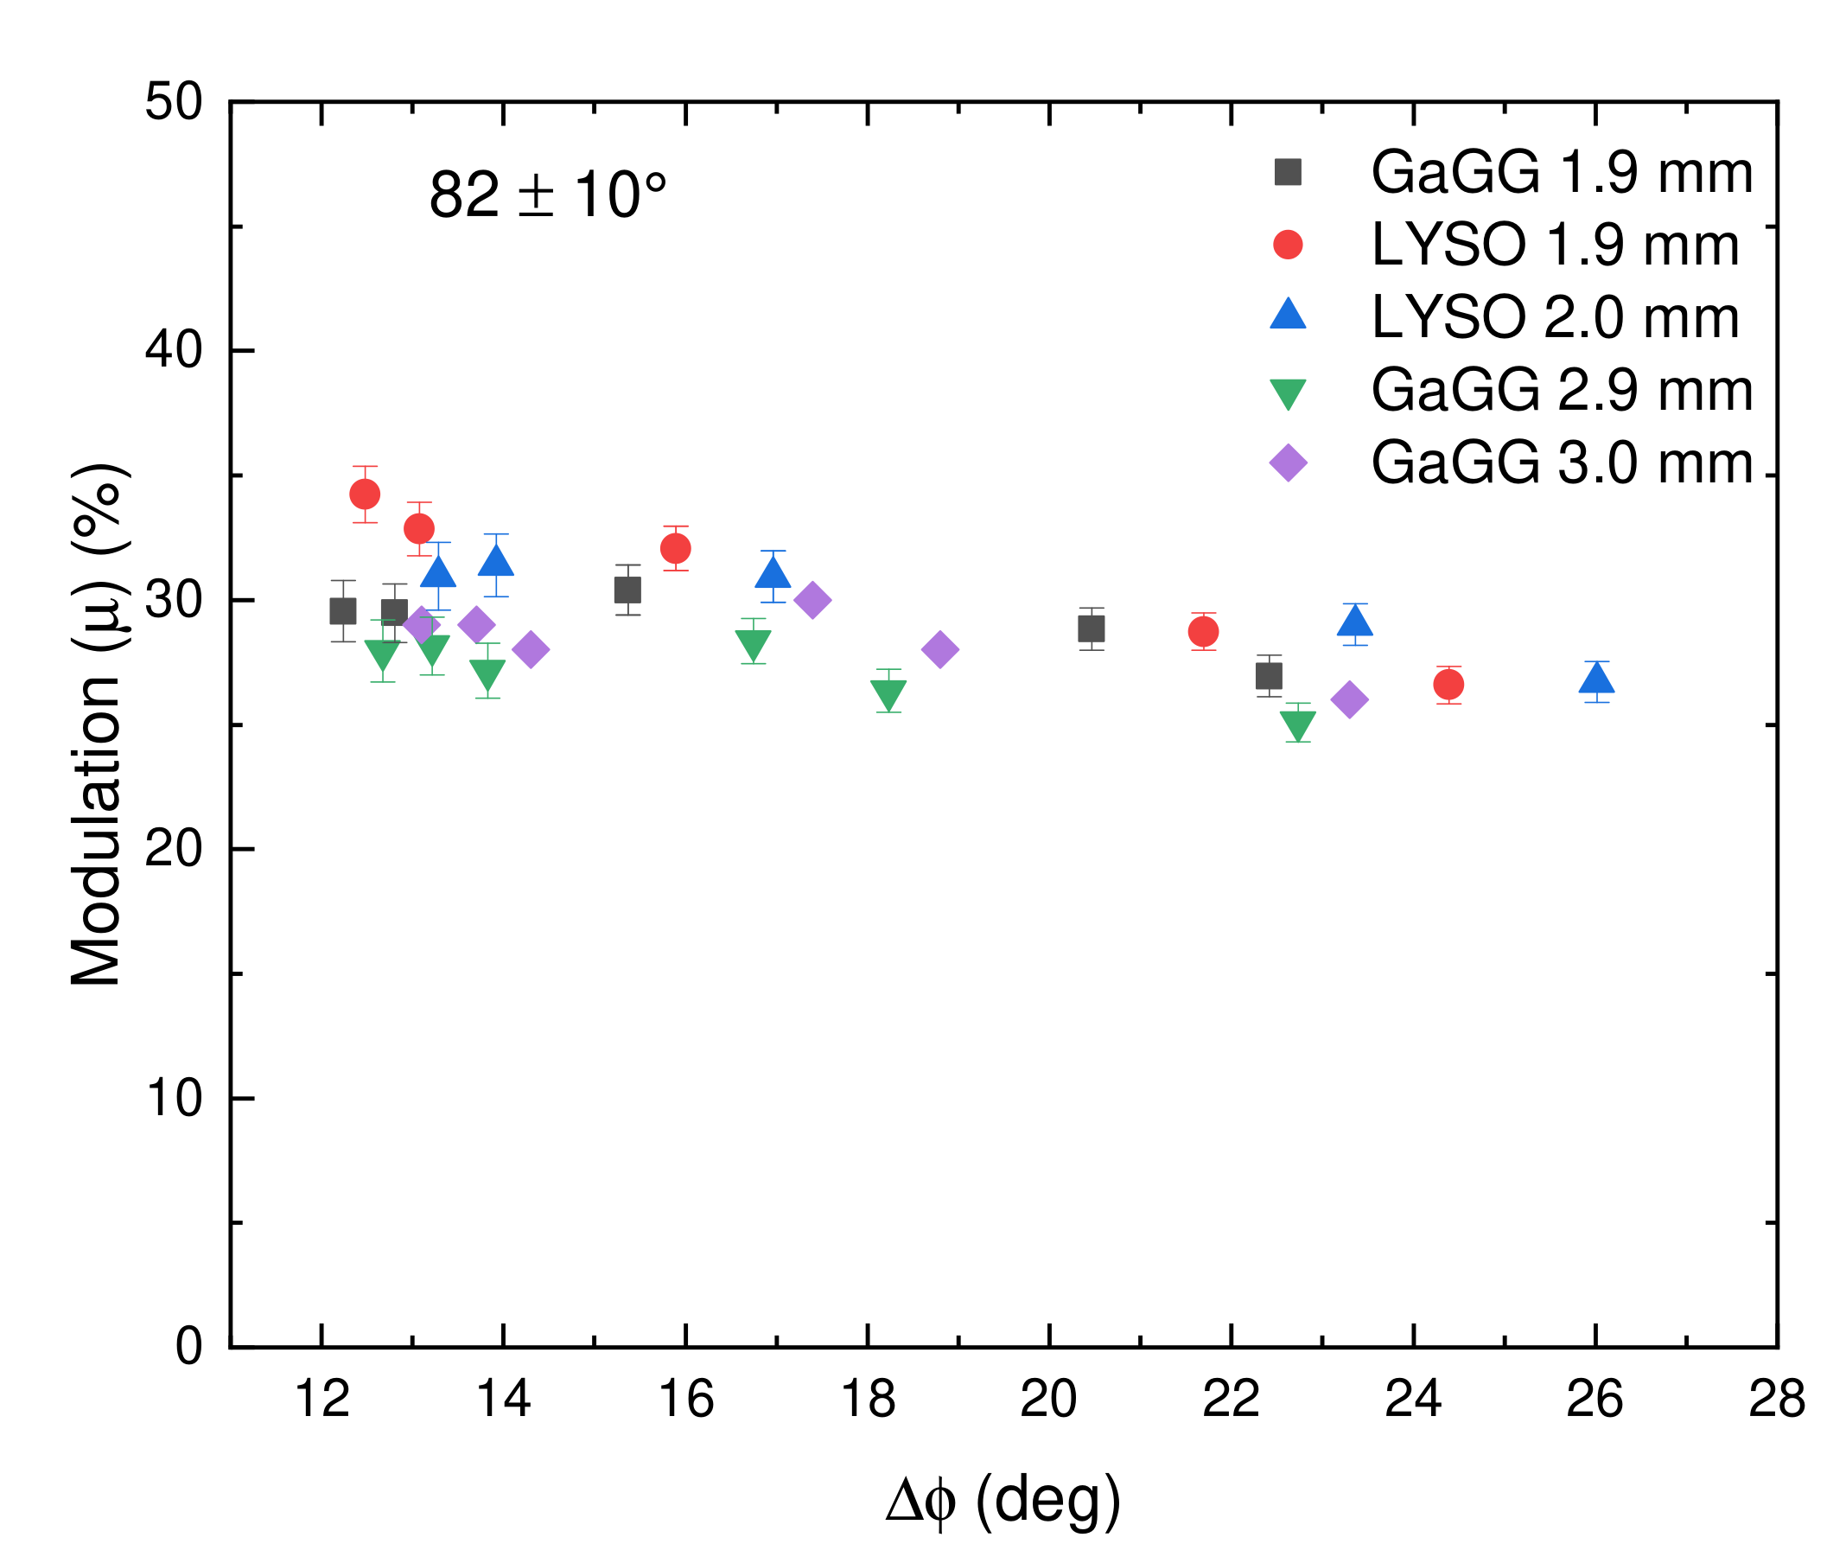
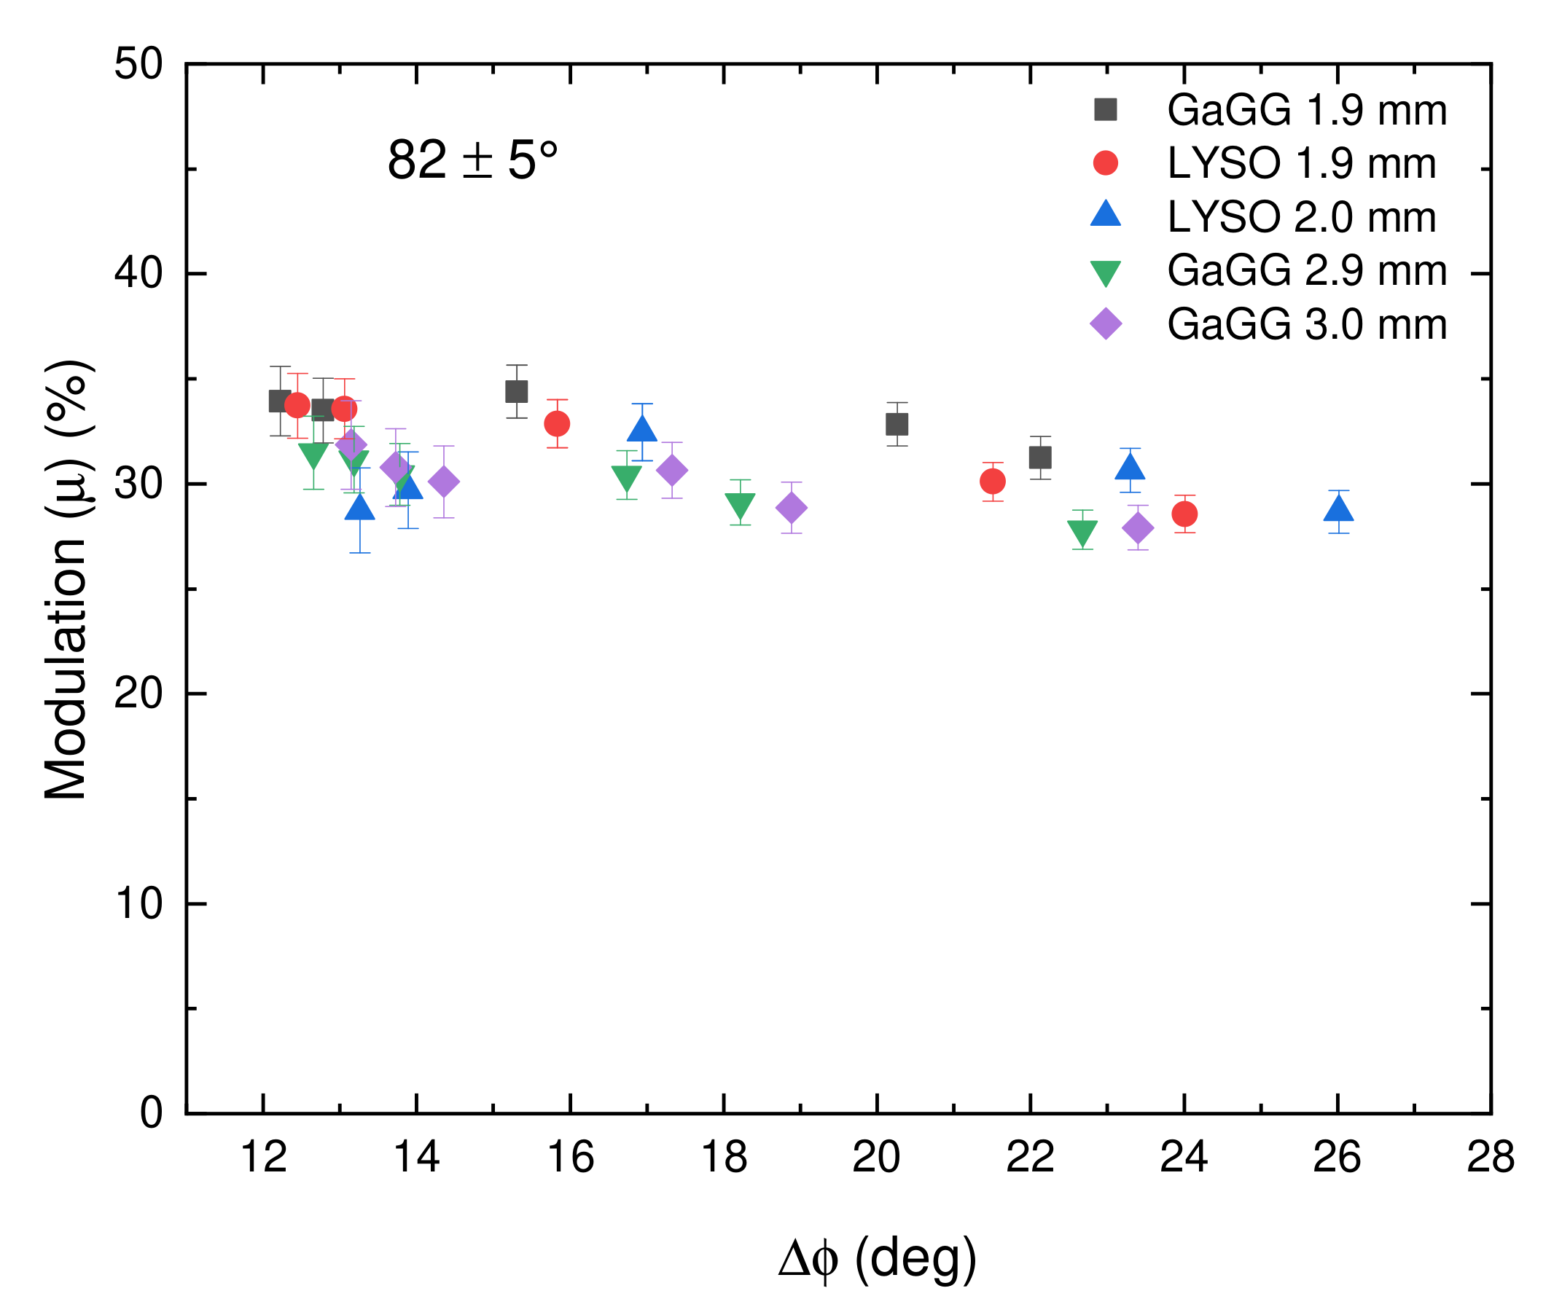
Comparison of μ vs Δφ among modules at different scattering angles
We compared the polarimetric performance μ of individual detectors with azimuthal resolution <Δφ> at different angular ranges.
Observations –
Modulation factors increases further for
77º < 𝜃_{1,2} < 87º as we select events closer to
scattering angle 82º.
(a)
(b)
<Δφ>º
<Δφ>º
Fig. 7. Comparison of modulation (%) vs azimuthal resolution <Δφ> for all detectors at angular ranges (a) 72º < 𝜃_{1,2} < 92º and (b) 77º < 𝜃_{1,2} < 87º
[S. Parashari et al.,“Optimization of detector modules for measuring gamma-ray polarization in PET”, [Accepted in NIM A.] PET”, arXiv:2205.0107]
10
4th Jagiellonian Symposium on Advances in Particle Physics and Medicine

Slide 11
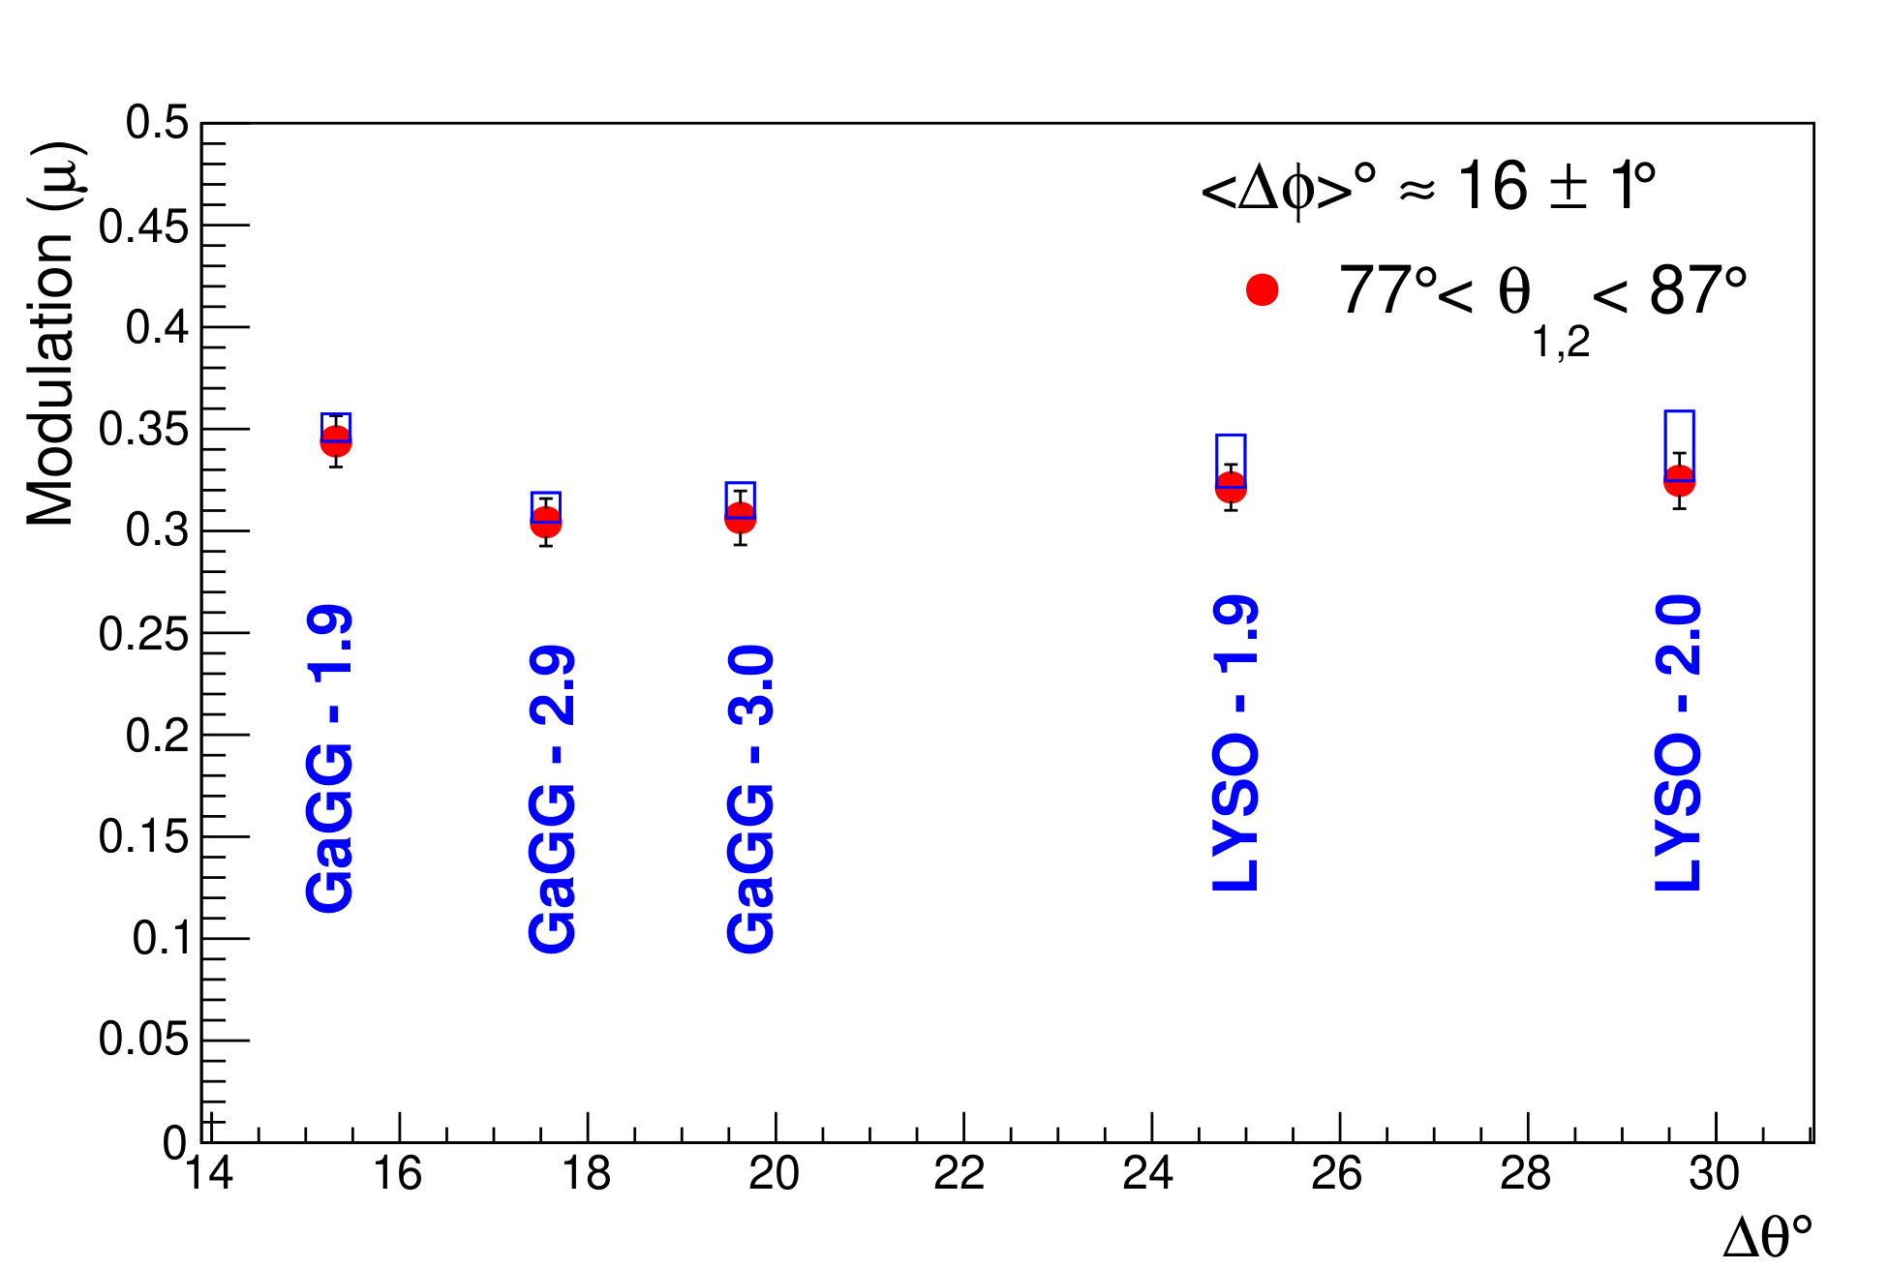
Comparison of μ vs Δθ among modules at scattering angle 77º<θ_{1,2}<87º
We compared the polarimetric performance μ of individual detectors with scattering angle resolution Δθ at scattering angle 77º<𝜃_{1,2}<87º and ⟨Δ𝜙⟩ ≈ 16 ± 1º.
Observations –
Energy Resolution of the detectors translates into the uncertainty in the scattering angle θ, which results in the under-estimation of the modulation factors.
Fig. 8. Modulation amplitude vs. Δ𝜃 at scattering angles 77º<𝜃_{1,2}<87º and ⟨Δ𝜙⟩ ≈ 16 ± 1º for all configurations. The systematic uncertainty is shown by the blue boxes.
[S. Parashari et al.,“Optimization of detector modules for measuring gamma-ray polarization in PET”, [Accepted in NIM A.] PET”, arXiv:2205.0107]
11
4th Jagiellonian Symposium on Advances in Particle Physics and Medicine

Slide 12
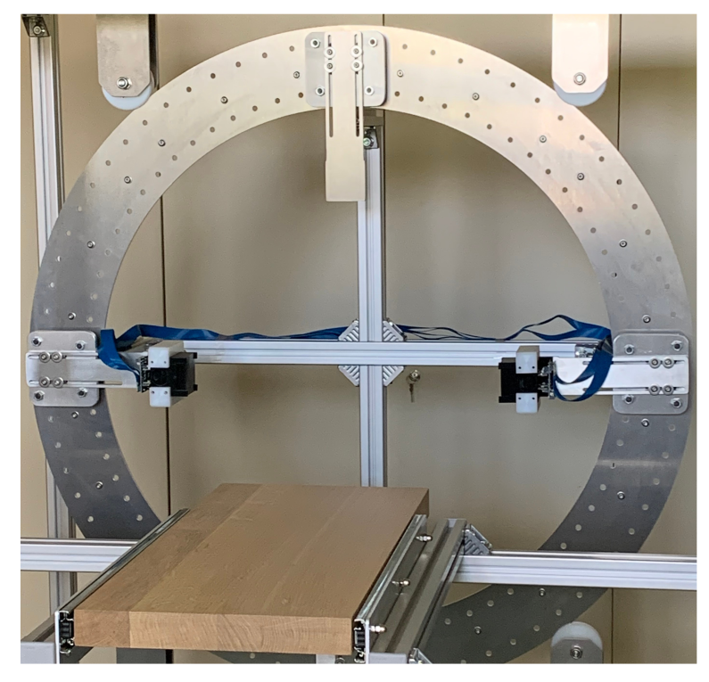
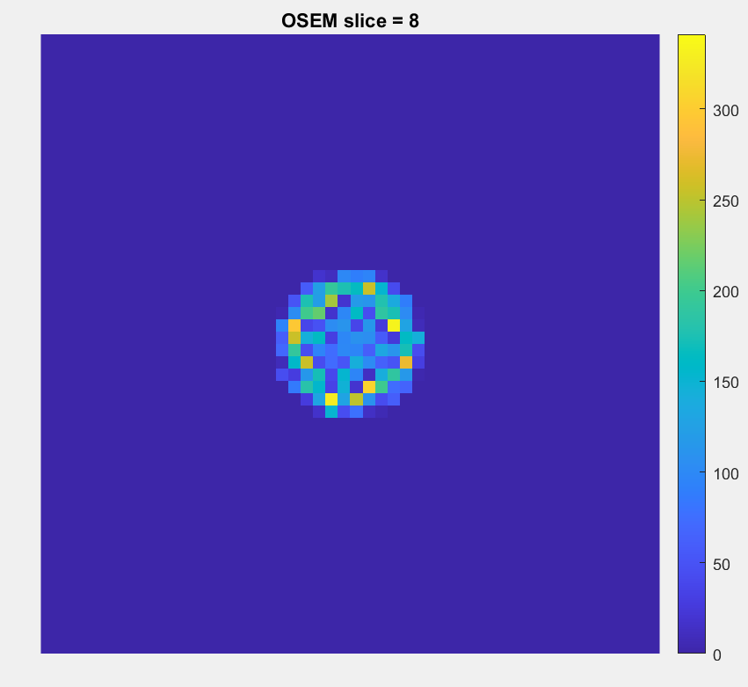
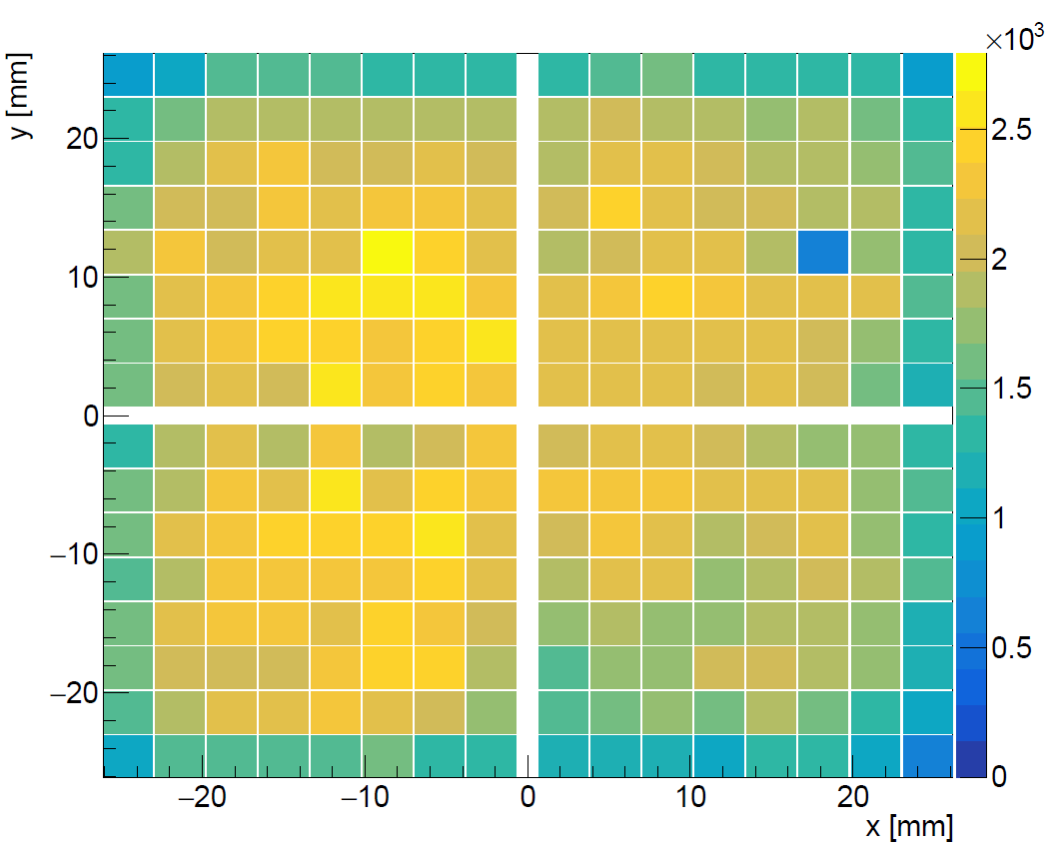
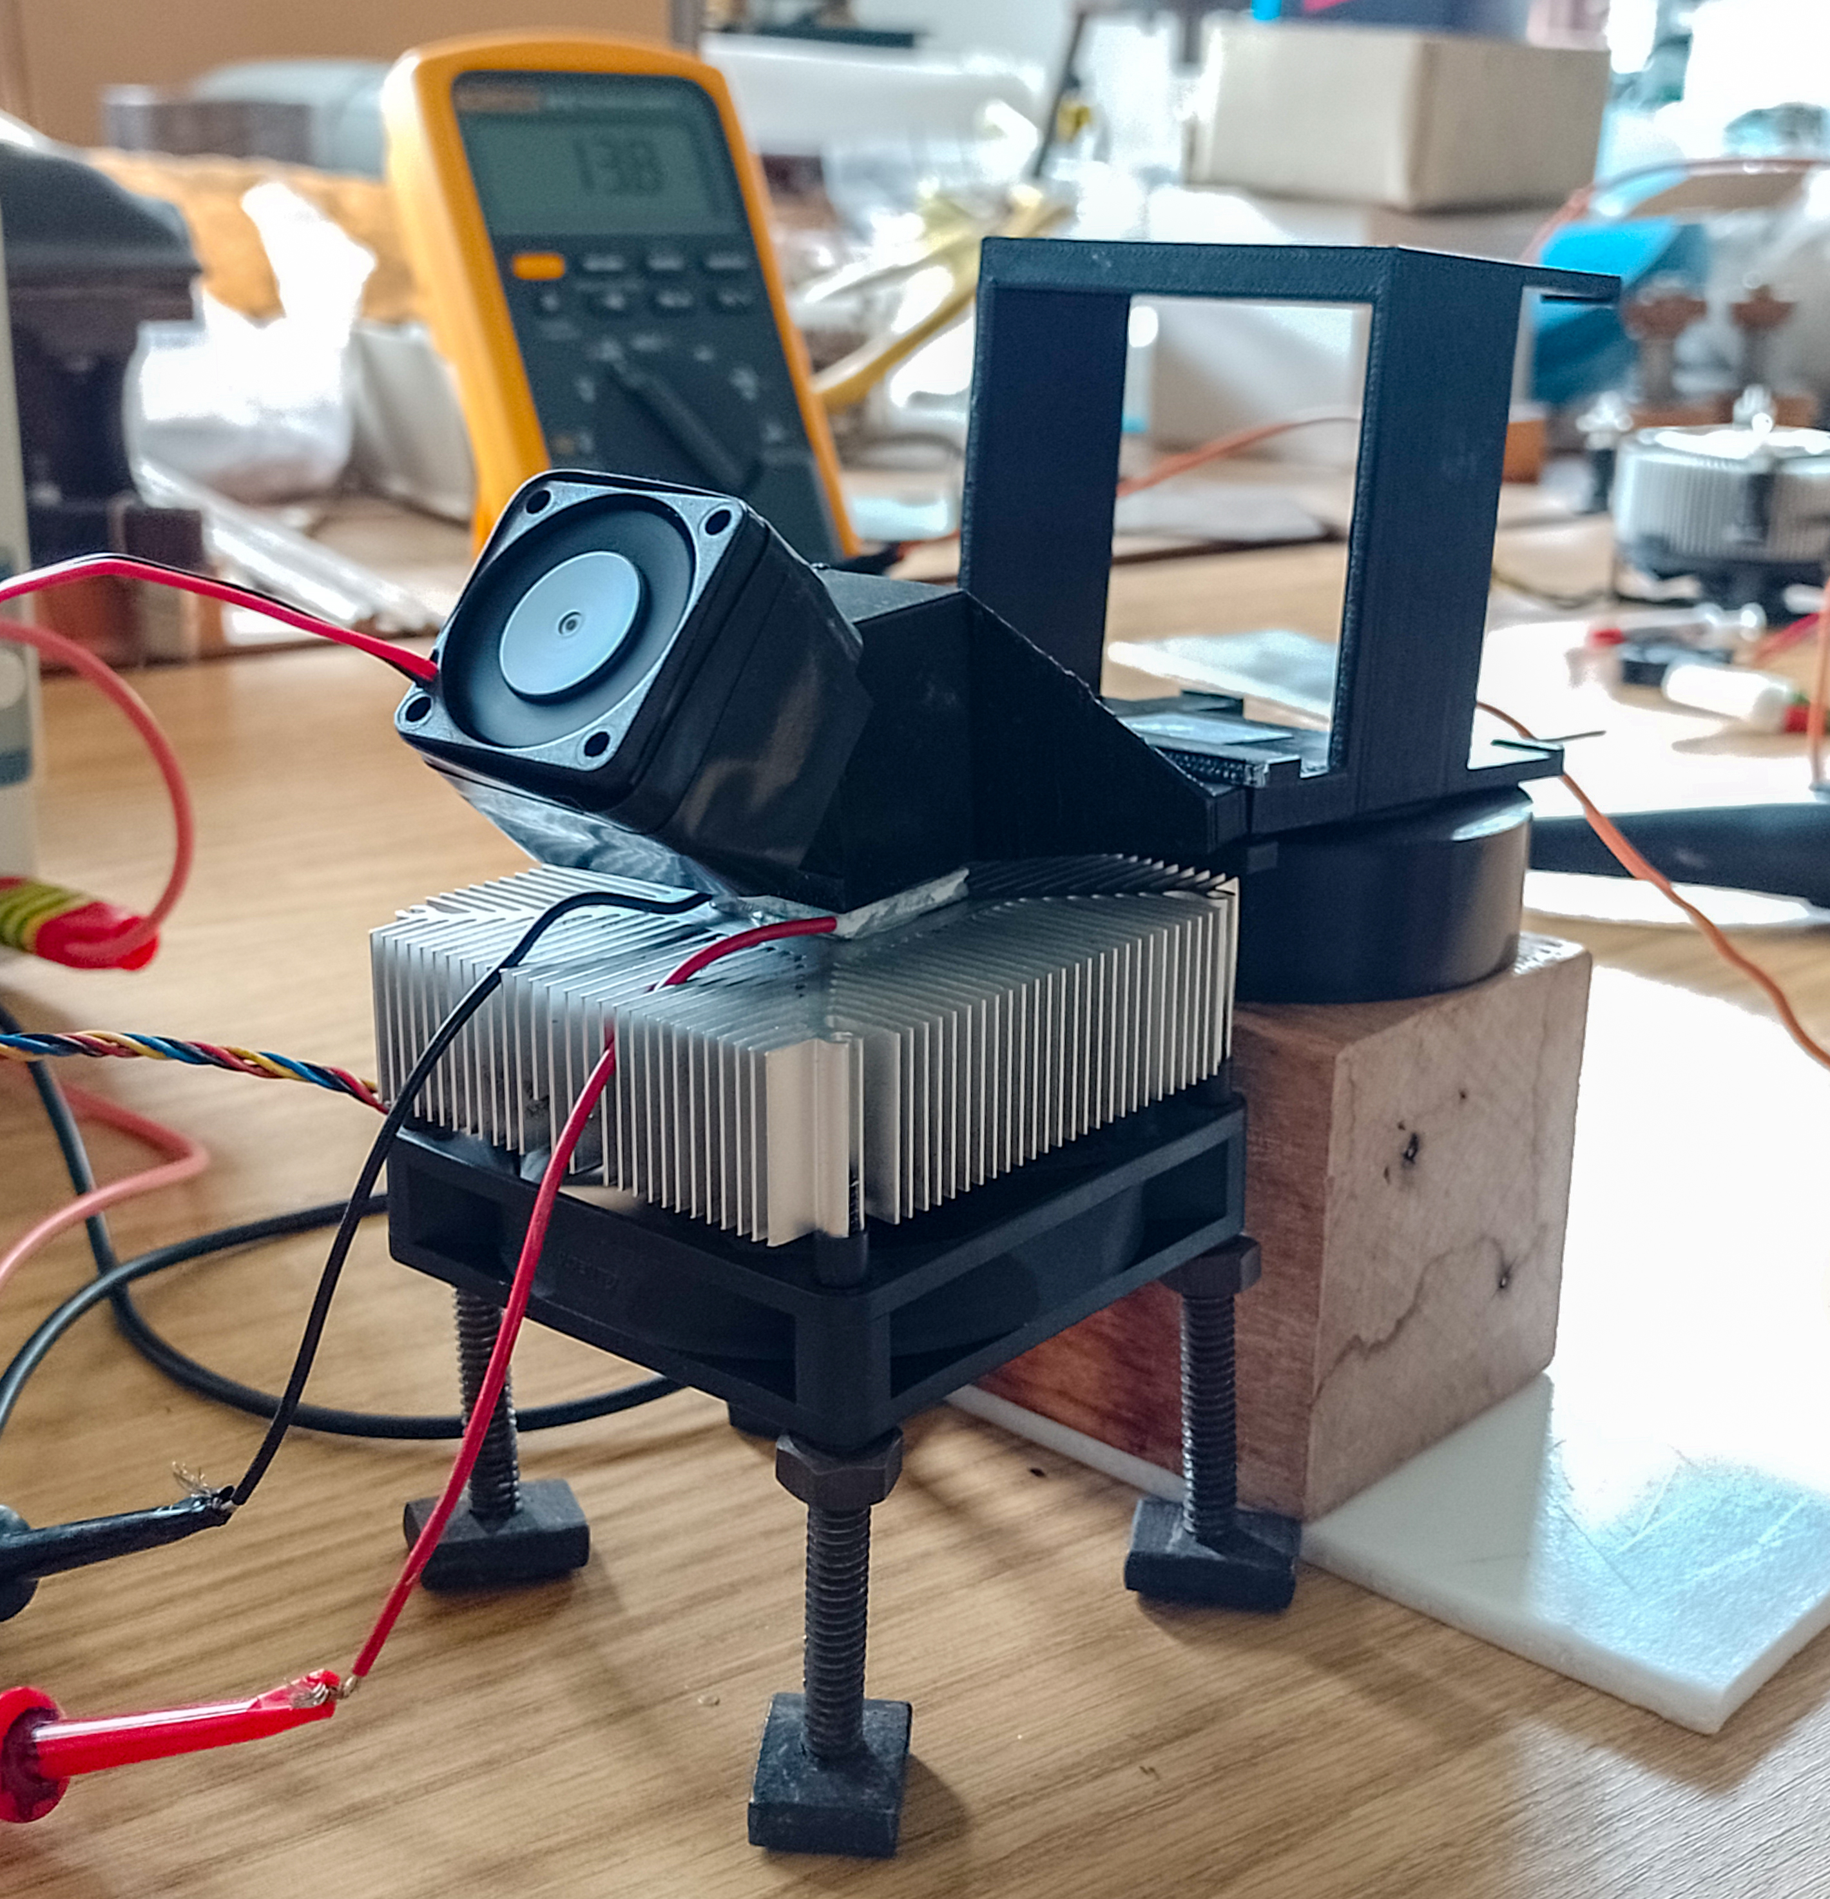
Development of PET Demonstrator
Four super-modules16 x 16 scintillator pixels each
Diameter range: 420 –700 mm
Rotation around the scanner axis
Super-Modules
(16x16 pixels)
12
4th Jagiellonian Symposium on Advances in Particle Physics and Medicine

Slide 13
Summary
Angular correlation of annihilation quanta were successfully measured with the single-layer pixelated scintillation detectors (cost-efficient scalability to larger systems).
Polarimetric performance of 5 module types from 1.9 – 3.0 mm pixel sizes were assessed.
Higher modulation was obtained with finely segmented pixel detectors.
The measured modulation amplitude shows a rising trend with better azimuthal resolution.
The dependance on the energy resolution of the material is not pronounced, LYSO and GAGG perform comparably.
Next: Commission of the demonstrator and test its performance with extended sources.
13
4th Jagiellonian Symposium on Advances in Particle Physics and Medicine

Slide 14


Thank you for your attention !!!
This work is supported by the “Research Cooperability” Program of the Croatian Science Foundation co-funded by the European Union from the European Social Fund under the Operational Programme Efficient Human Resources 2014–2020, Grant number PZS-2019-02-5829.
14
4th Jagiellonian Symposium on Advances in Particle Physics and Medicine

Slide 16
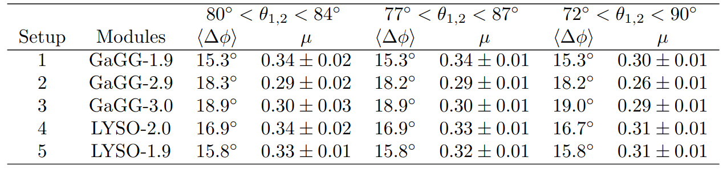
Comparison of modulation factors in detector modules
at different scattering angles (θ ± dθ)
The dependence of the modulation factor, 𝜇, at different 𝜃_{1,2} ranges is explored in each detector configuration.
The obtained modulation factors, 𝜇 for 72º < 𝜃_{1,2} < 90º and 77º < 𝜃_{1,2} < 87º and 80º < 𝜃_{1,2} < 84º at inter-pixel distance d > 4.5 (mm) is shown for all modules.
Larger modulation are observed for 80º < 𝜃_{1,2} < 84º as compared to 72º < 𝜃_{1,2} < 90º angular range, which is expected from the theory [ Nature, vol. 160, Sep. 1947 ]
S. Parashari et al.,“Optimization of detector modules for measuring gamma-ray polarization in PET”, [Accepted in NIM A.] PET”, arXiv:2205.0107]
Better Modulations are achieved within a narrower angular range 80º < 𝜃_{1,2} < 84º i.e. closer to the maxima condition .
16
4th Jagiellonian Symposium on Advances in Particle Physics and Medicine

Slide 17
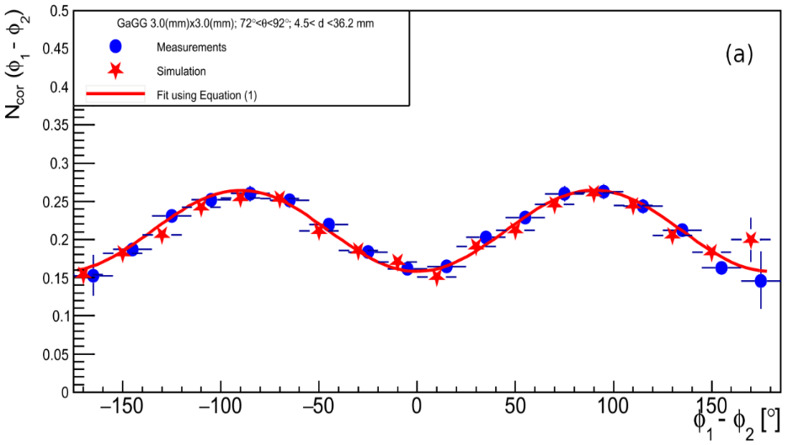
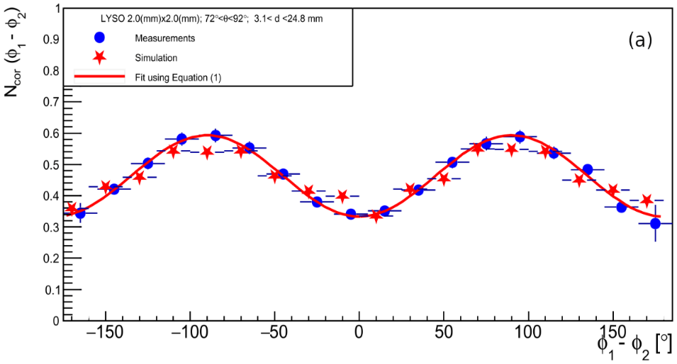
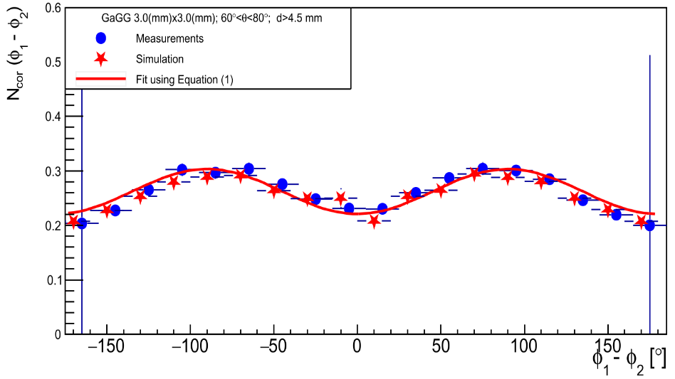
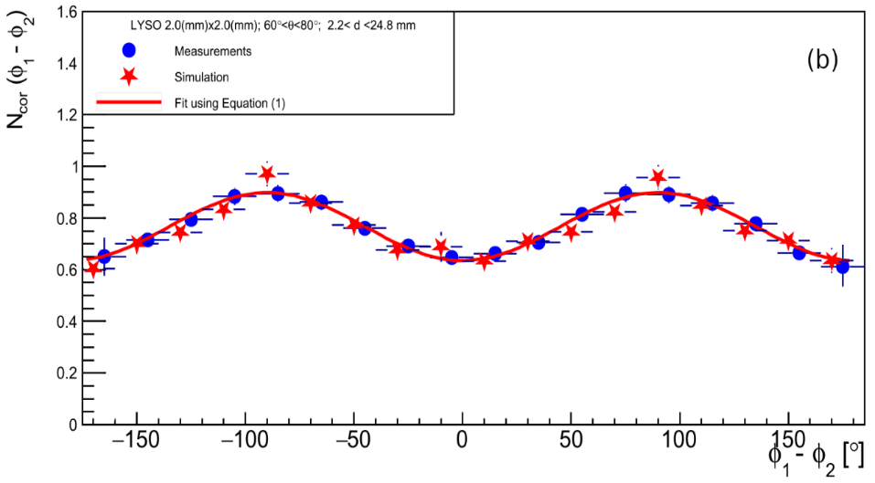
Comparison of the experiment data with simulations
GAGG-2.9
LYSO-2.0
Measurement
Fit to data
Simulation
70° < θ_{1,2} < 90°
Measurement
Fit to data
Simulation
70° < θ_{1,2} < 90°
Measurement
Fit to data
Simulation
60° < θ_{1,2} < 80°
Measurement
Fit to data
Simulation
60° < θ_{1,2} < 80°
M. Makek et. al., 2021 Virtual IEEE Nuclear Science Symposium And Medical Imaging Conference
Sydney, 21/6/2022
The SiLGaP project
17

Slide 18
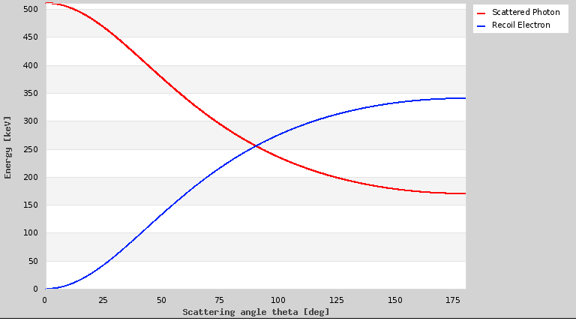
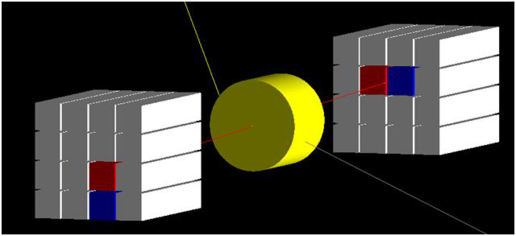
The “θ – ambiguity”
511 keV gamma Compton energies
Which of the two pixels fired first?
Ambiguous for θ > 60°
γ
18
4th Jagiellonian Symposium on Advances in Particle Physics and Medicine
Notes:
Correct the footer

Slide 19
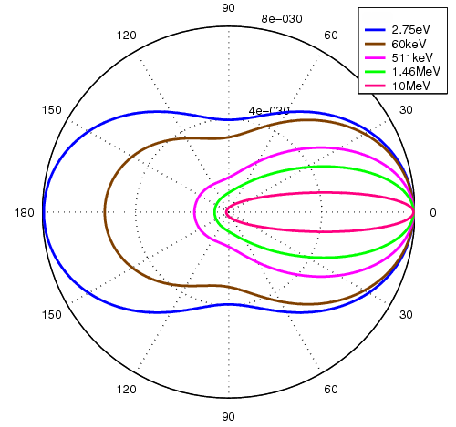
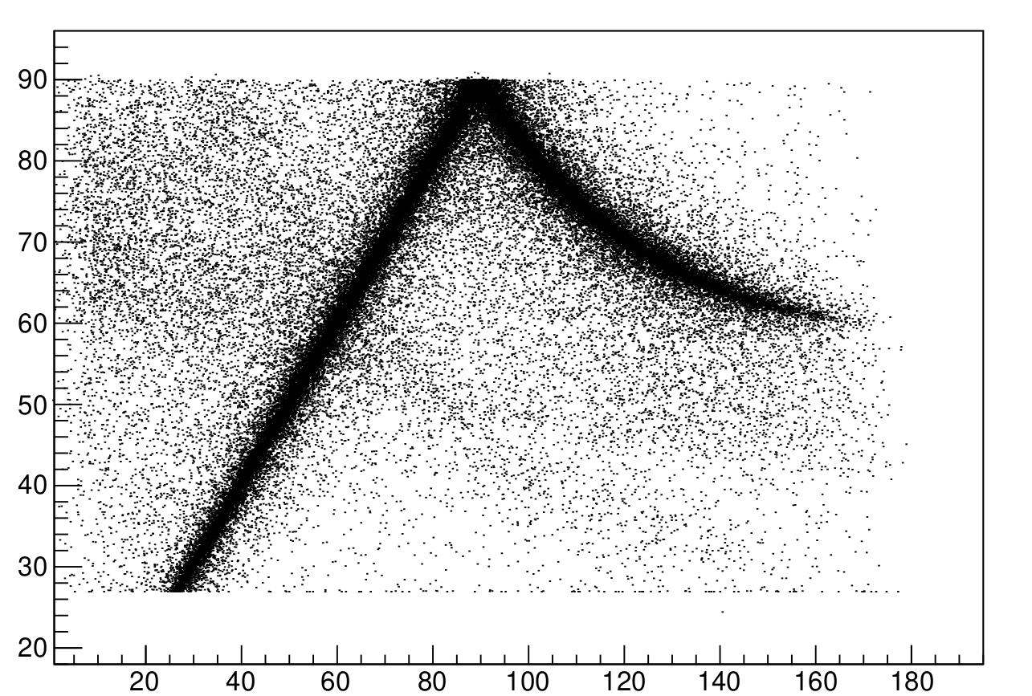
The “θ – ambiguity”
The cross section favors forward angles
Backward scattered gammas, θ >90°:
  Lower energy
  Shorther absorption length
Always assume forward scenario
(i.e. the pixel with lower energy corresponds to e⁻)
θ_{Reco} (deg)
SIMULATION
[A. M. Kožuljević et. al., Condensed Matter 2021, 6, 43]
160 140 120 100 80 60 40 20 0
θ_{Sim} (deg)
19
4th Jagiellonian Symposium on Advances in Particle Physics and Medicine

Slide 20
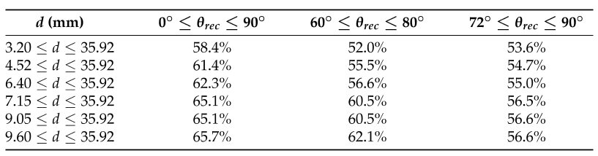
The „θ−ambiguity”
Event topology helps: events with larger inter-pixel distances d have a higher fraction of correctly determined angles
Implication on LOR determination:
  30% correct pixel in both modules
  50% correct pixel in only one module
  20% incorrect LOR
Table: the fraction of correctly determined θ in GAGG, assuming forward scattering
[A. M. Kožuljević et. al., Condensed Matter 2021, 6, 43]
LORs
20
4th Jagiellonian Symposium on Advances in Particle Physics and Medicine

