Slide 1

New developments and human imaging experience with the PennPET Explorer
Suleman Surti
University of Pennsylvania, Philadelphia, PA
Funding Support - NIH R01 CA113941, NIH R01-CA225874, NIH R01 CA196528, NIH R01 CA206187, and Philips Healthcare
Physics & Instrumentation Group
Department of Radiology, University of Pennsylvania
4th Jagiellonian Symposium on Advances in Particle Physics and Medicine, Cracow, Poland: July 13, 2022

Slide 2
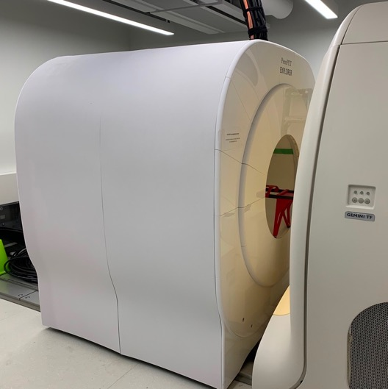
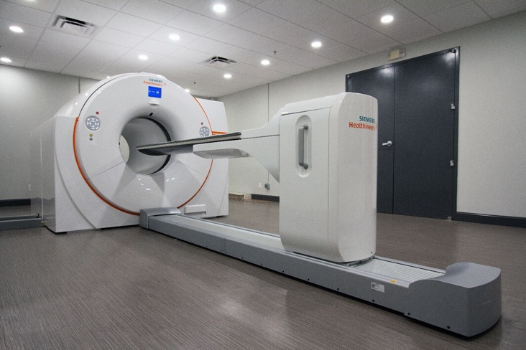
Currently developed long axial FOV systems
United Imaging uEXPLORER
PennPET Explorer
Siemens Vision Quadra
194 cm AFOV
505 ps CTR
142 cm AFOV
250 ps CTR
106 cm AFOV
225 ps CTR

Slide 3
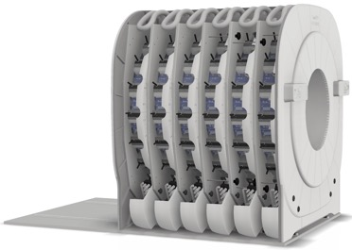
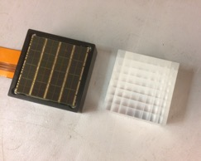
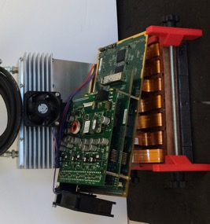
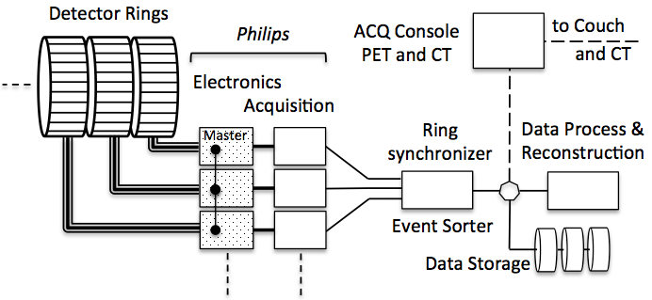
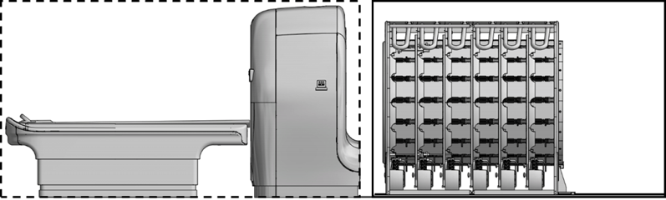
PennPET Explorer design
(modular and programmable)
Full System
(6 rings)
23.9 cm
Detector Tile
Detector Module
(4x7 tile array)
  3.86 x 3.86 x 19 mm³ LYSO
  PDPC digital SiPM
  64-channel array
  1-to-1 coupling
Detector Ring
(18 modules)
PET (6 rings)
In-line CT + bed)

Slide 4
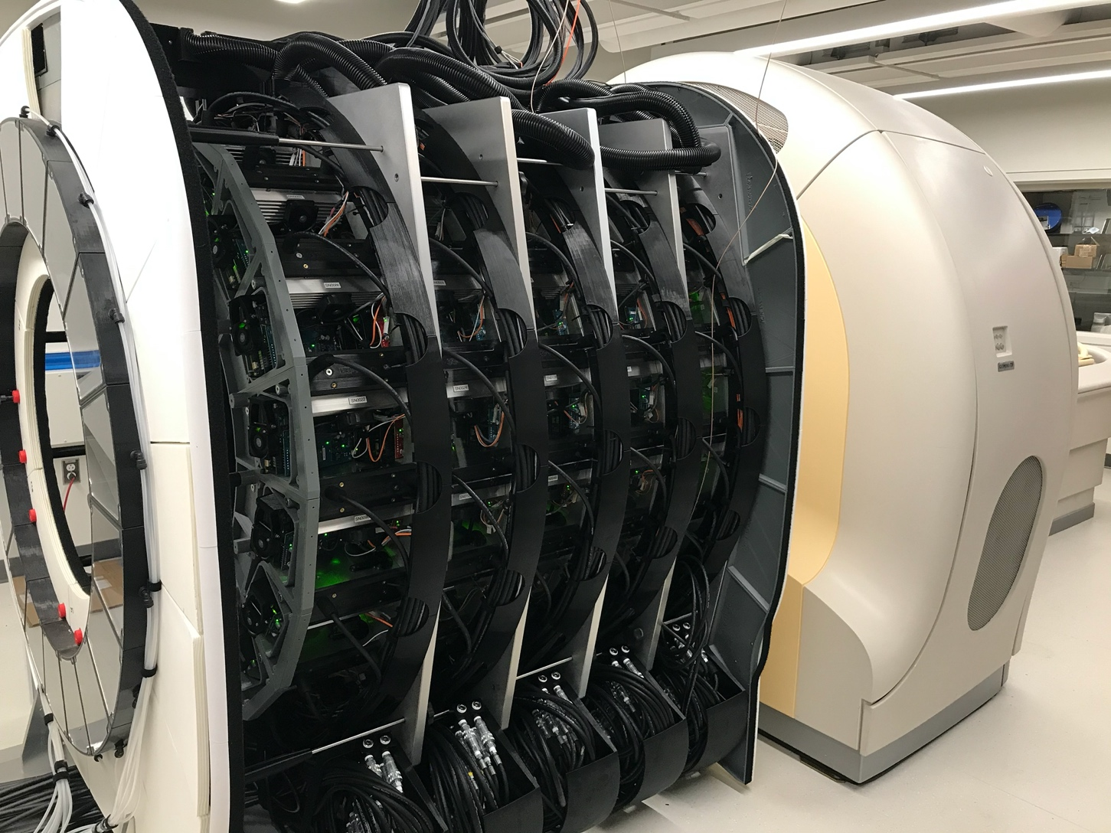
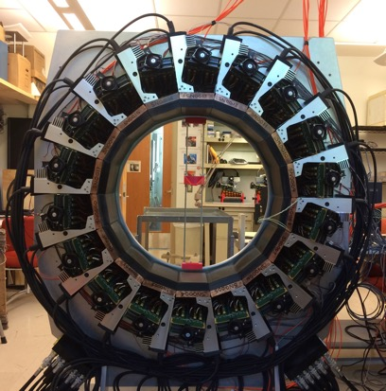
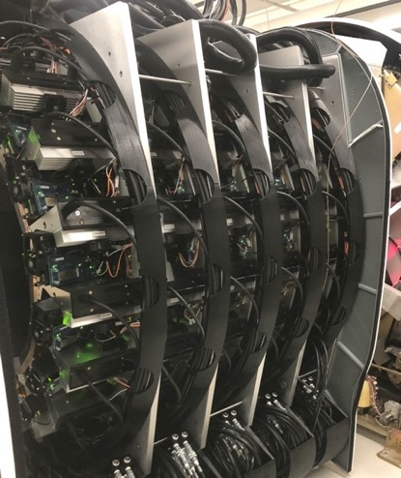
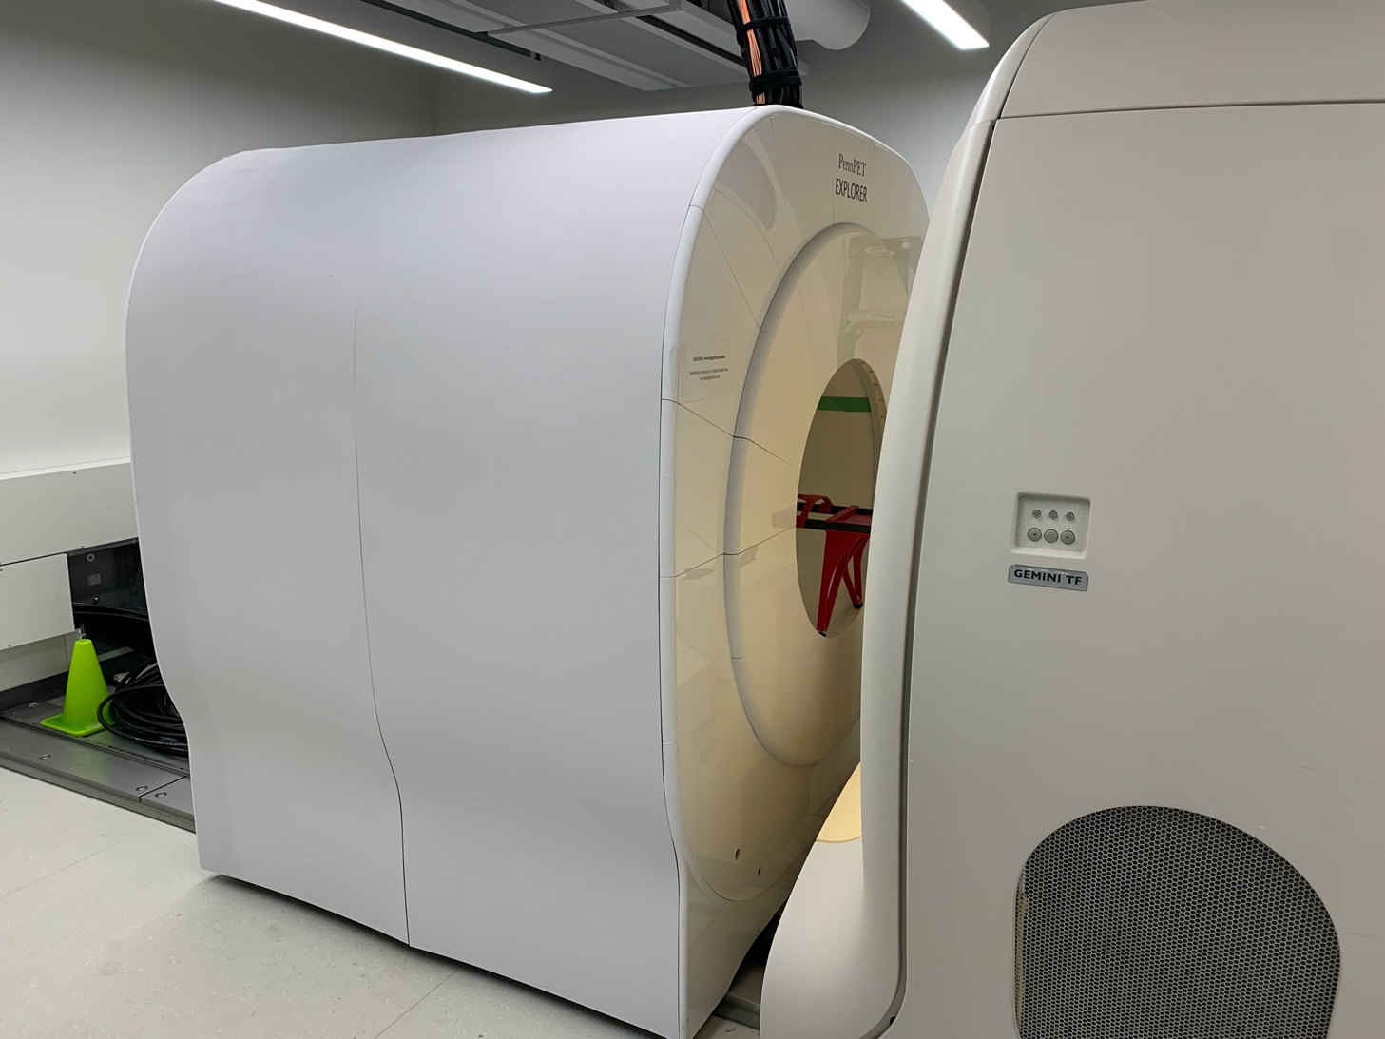
PennPET Explorer evolution
Sep/Feb 2022
(6 rings, 136/142 cm)
May 2018
(3 rings, 64 cm)
Aug 2020
(5 rings, 112 cm, with CT)

Slide 5
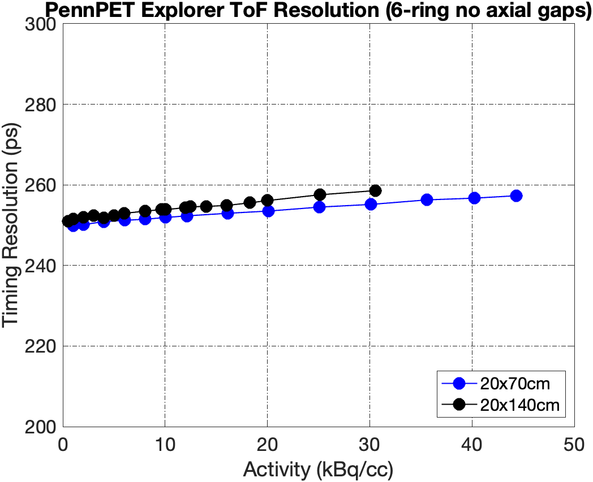
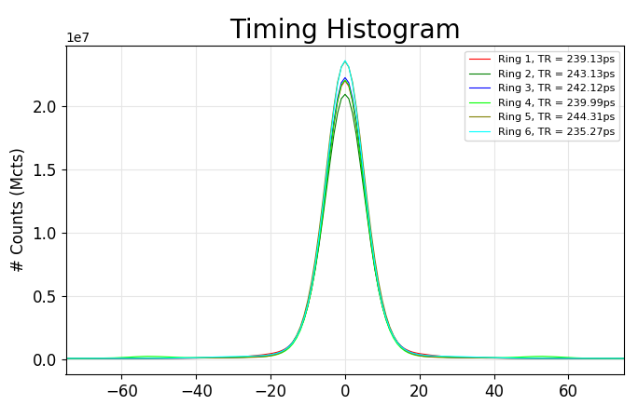
System TOF resolution
Single Rings Daily QC
Average TR = 241 ps
Stable performance with a wide range of activity
Slightly worse performance with longer phantom possibly due to more oblique LORs
ToF resolution at low activity is comparable to single ring daily QC (250 ps vs 241 ps)
Notes:
We also extract TOF resolution from count rate measurements.
The timing resolution is stable over a wide range of activity
The 140-cm phantom has slightly worse performance possibly due to increased oblique LORs.
ToF resolution at low activity is comparable to single ring daily QC
---
20x140cm slightly worse… but overall the performance is stable…
Likely that no changes are needed for standard measurement
for total body system.
---Increased activity and more LORs affect the ToF timing resolution but significant. Lowest conc comparable to QC. And it’s reasonable
Timing resolution of 5R 5-row, 6R 5-row and 6R 7-row. We can see that Increasing AFOV from 112 cm (5- ring 5-row) to 142 cm (6-ring 7-row) has no significant impact on timing resolution, although the STD is slightly larger.
Oblique LORs have worse resolution than non-oblique ones… 235 ps for 5R. Make plot w/o errbar. 6R 5row vs 6R 7row. 5ps difference from where? From AFOV, or bad tiles, or ? – check QC for these measurements. Significant change to count rate
5Ring: 140 cm was just a tad worse, probably from more oblique LORs(?)

Slide 6
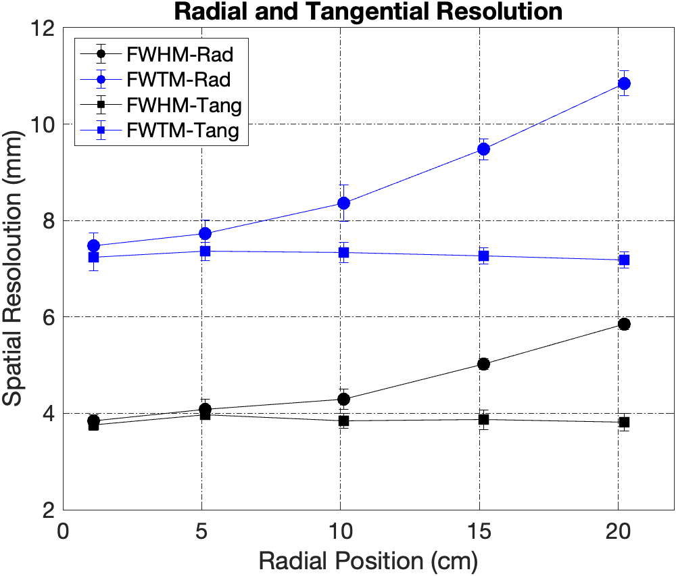
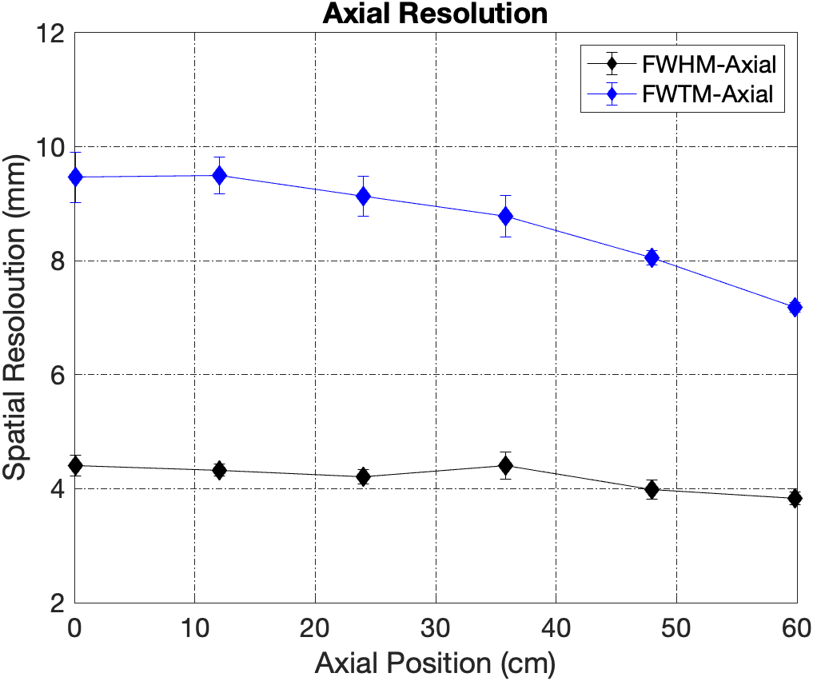
System spatial resolution
FWHM_Rad
4.4 mm
FWHM_Axial
FWHM_Tang
3.8 mm
Iterative recon w/
parameters (3-mm blobs, 1-mm voxels)
chosen to match resolution of analytic recon of a single ring
20 cm
}
15 cm
20 cm
10 cm
15 cm
5 cm
10 cm
1 cm
5 cm
1 cm
Very small degradation of axial resolution in center due to larger acceptance angle (+/- 62 degree)
Notes:
We use more positions than standard NEMA required to reliably measure whether there is degradation of spatial resolution along radial, tangential and axial direction.
tangential resolution does not change much
Radial resolution degrades when moving away from the center. This is as expected in a cylindrical system due to parallax (not particular for total-body PET, i.e., long AFOV).
Axial resolution degrades in the center of AFOV. Because the center position corresponds to a larger acceptance angle, which leads to more depth-of-interaction uncertainties for oblique LORs.
Nevertheless the degradation is only 0.6 mm with such a large acceptance angle
---
Standard NEMA: In the axial direction, at the center and 3/8 of the axial FOV. In the transverse direction, 1 cm, 10 cm, and 20 cm from the center. The limited number of positions incompletely characterizes performance throughout the AFOV.
Axial resolution is due to long AFOV (large acceptance angle , 62 degree)
To better characterize total-body systems like PennPET Explorer:
X = 0; radial Y = 1, 5, 10, 15, 20 (5 positions); axial Z = 0, 12, 24, 36, 48, 60 (6 positions)
Radial position: add additional radial position @ 5 cm from center to better characterize radial performance in the central ±10 cm
Axial positions: place point source at between rings and in the center of 4th, 5th, and 6th ring corresponding to 1-ring (smallest acceptance angle), 3-ring, and 6-ring (largest acceptance angle) configuration, to characterize axial dependence more fully, especially the FWTM
Clinical reconstruction algorithm/parameters instead of filtered back-projection (the analytic recon) because analytic reconstruction is subject to PSF distortions from rebinning or undersampling.
*Analytic reconstruction requires complete and uniform sampling → not appropriate for systems with significant gaps in detector coverage
Axial resolution degrades in the center of AFOV as the larger acceptance angle leads to more depth-of-interaction uncertainties for oblique lines of response

Slide 7
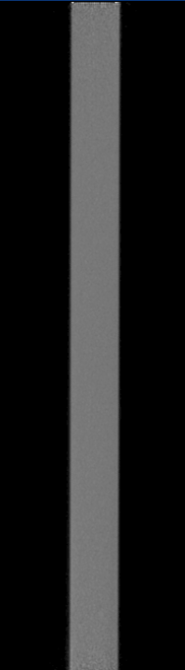
Axial gaps and image quality
Axial FOV: 136 cm (with 7.6-cm inter-ring gaps) → 142 cm (without axial gaps)
Total sensitivity with gaps ~ ½ that without gaps
Physics & Instrumentation Group
Department of Radiology, University of Pennsylvania
SNMMI, June 13, 2022
Notes:
Really want 3-ring with gaps also. Also want the %SD plots for 6R5, as well as 6R7 shown. Also want to make the point about why 30-60 cm isn’t interesting?

Slide 8
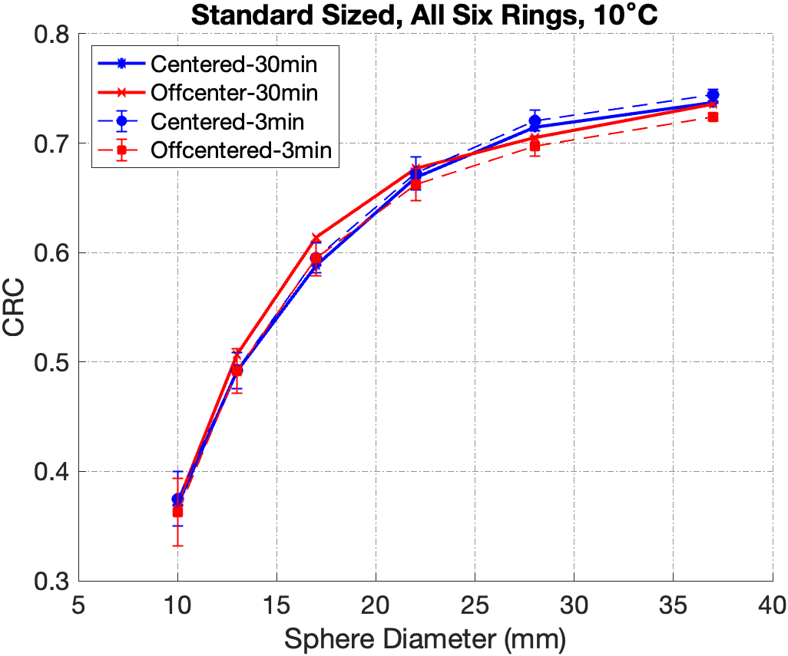
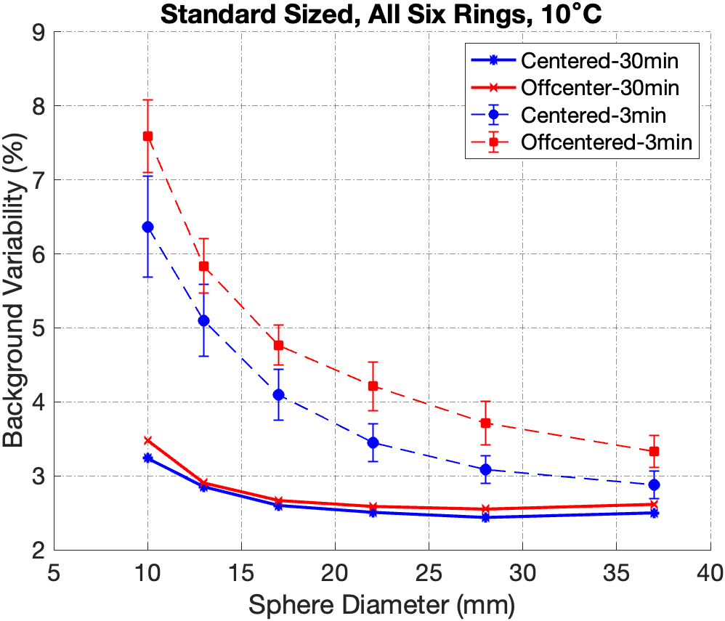
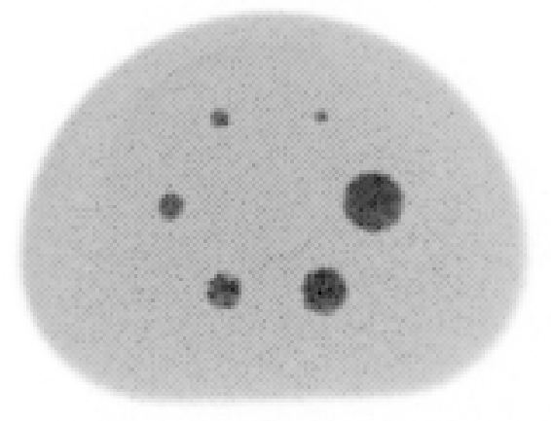
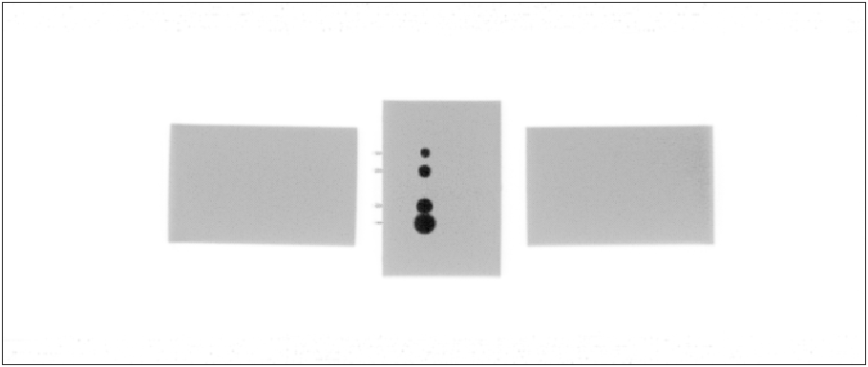
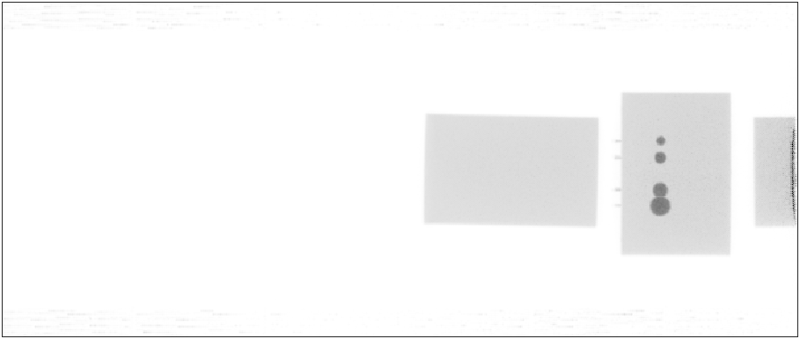
Quantitative imaging
2-mm slice
13 mm
10 mm
17 mm
37 mm
22 mm
28 mm
AFOV: 142 cm
Measurement at two axial positions with 3-min and 30-min scans (NEMA specification) to capture variation in axial resolution, sensitivity, and scan duration on IQ
Lower noise (BV) at center position with longer scan
CRC is insensitive to scan duration or axial position – good lesion quantitative accuracy
18 cm
Notes:
We then measured the image quality phantom at two axial positions, center of AFOV, and off-center, between the first two rings, and with 30-min scan and 3-min scan, to evaluate how the variation in axial resolution, sensitivity, and scan duration affect the image quality.
CRC does not change with scan time (as expected);
More importantly, as shown with the red vs blue curves in the plot on the left, CRC is very similar at center and off-center position, despite of the variation of axial resolution.
BV plot on the right shows that, the noise is lower at the center position with longer scan.
However, note that 30-min scan is a NEMA standard (to scan 1 meter), which is much longer than typical FDG scans on total-body PET systems.
In fact, our result shows that even with a much shorter, 3-min scan, our system still has reasonable noise – indicating good sensitivity for total-body PET.
Overall, good lesion quantification is demonstrated throughout AFOV
---
10-mm to 37-mm. blue vs red curves center vs offcenter – despite of change of axial resolution (62 degree)
Image quality phantom (hot spheres: 10, 13, 17, 22, 28, and 37 mm diam. + 5-cm central “lung” cylinder) with spheres centered in AFOV
two 20x30-cm uniform phantoms (matching the activity concentration in the background of the IQ phantom) placed on each end of the IQ phantom to measure out-of-field effects)
Standard scan duration is 30 min, which is much longer than typical FDG scans on these systems. Here we first study 3-min scans.
How scan duration affects image quality?
Do sensitivity and spatial resolution variations with axial position affect image quality?
2nd position: 24 cm from the front of R1 (between rings 1-2, which is 1/6 AFOV). To capture impacts of variation in axial resolution and sensitivity on image quality
Background variability is lower with 30-min scan.
However, contrast recovery is not significantly affected by scan durations or axial positions -- our total-body system has good lesion detection capability thus suitable for human studies
---
37-mm non-uniformity took over.

Slide 9
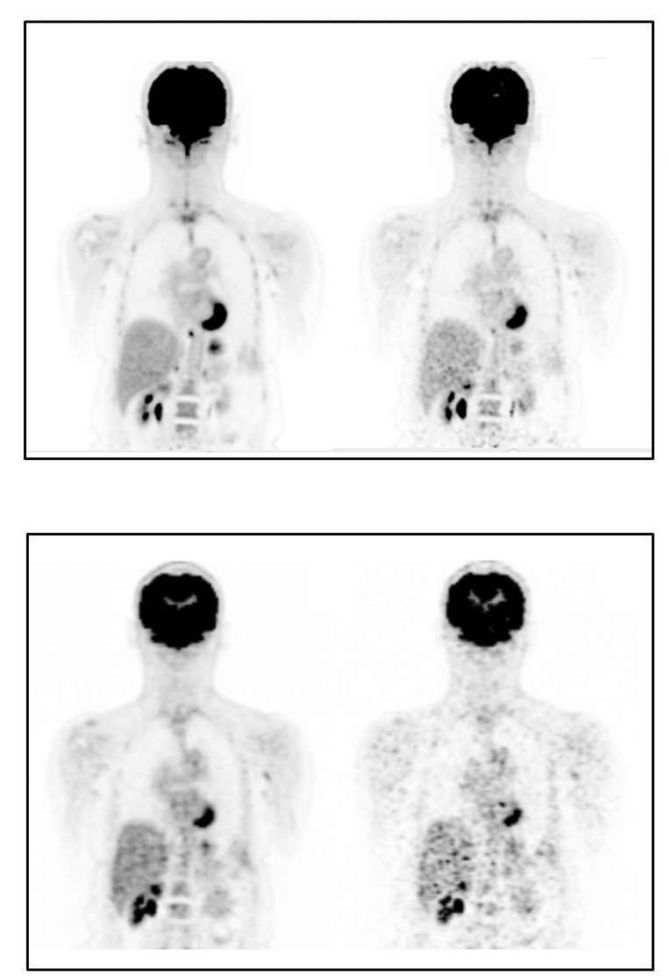
Improved image quality
16 min
2 min
PennPET Explorer
*prototype 3-ring PET an active 64-cm AFOV
16 min
2 min
Philips Ingenuity
TF PET/CT
Pantel AR. J Nucl Med. 2020;61(1):144-151.
Notes:
Here we see a first comparison of the PennPET Explorer with a state-of-the-art commercial PET scanner. On the top we see a coronal image of a healthy volunteer on the PennPET acquired at 1.5 h after injection of ¹⁸F-FDG for 16 min on the left and subsampled to 2 min on the right. On the bottom we see coronal images from clinical PET acquired at 45 minutes after injection for 16 min left and subsampled to 2 min on the right.
From these scans, we easily the superb image quality of the Explorer. The 16 minute image on the top left demonstrates a combination of less noise and better anatomic detail compared to the clinical image. The Subsampled 2 minute scan from the PennPET shows image quality compared to, if not better than the clinical image obtained over 16 minutes. Lastly, the subsampled 2 minute clinical scan is markedly degraded.
From these images, we can clearly see three applications of the Explorer: great image quality, the ability to scan quicker, or, alternatively, with less injected activity.
--
Qualitatively superior image quality—a combination of less noise and better anatomic detail—is seen in the 16-min PennPET scan compared with the clinical scan; the subsampled 2-min PennPET image demonstrates image quality comparable to, if not better then, that of the 16-min SOC clinical scan. In comparison, marked image degradation is seen in the subsampled 2-min clinical scan. The transverse slices of the PennPET data through the liver (Fig. 1B) illustrate the low noise and uniformity in the scans from 16 min to as short as 37 s (⅟32 subsampled data).

Slide 10
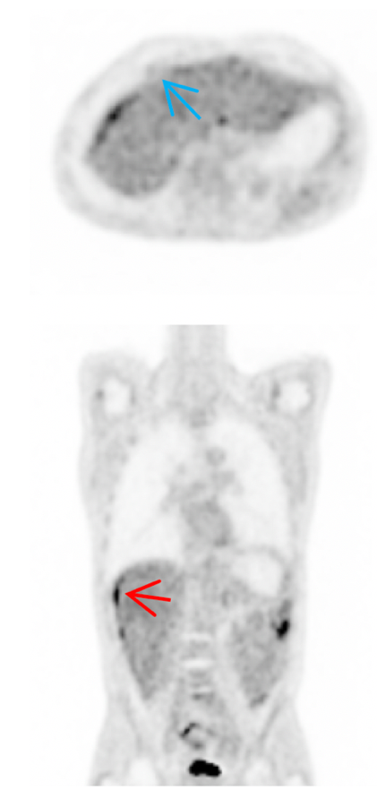
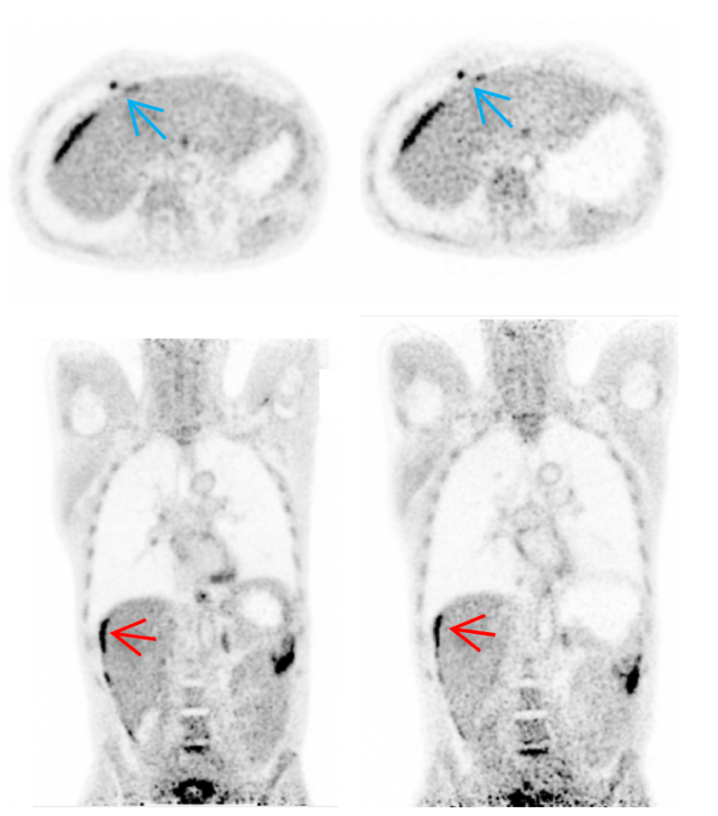
Improved disease delineation with delayed imaging
Philips Ingenuity
TF PET/CT
PennPET
Explorer
*prototype 3-ring PET an active 64-cm AFOV
1 hour
2.75 hours
4.2 hours
2.5 half lives
*Delayed Imaging*
(courtesy, Dr. Austin Pantel, U. Penn)
Pantel AR. J Nucl Med. 2020;61(1):144-151.
Notes:
Delayed imaging on the PennPET Explorer in combination with superior image quality, may lead to better delineation of disease as shown here. On the left we see images from a clinical scanner of a a patient with colon cancer demonstrating perihepatic disease. On the right, we see images from the PennPET explorer taken hours after the clinical image. The Explorer images better demonstrate the extent of disease and also show a diaphgragmatic lymph node. With trapping of FDG in diseased tissue and washout from normal tissues, such as the liver, disease contrast increases and become more conspicuous. High sensitivity and possible delayed imaging could be utilized for several clinical applications.
Other:
A patient with metastatic colon cancer was scanned twice on the PennPET with 18F-FDG, before (subject 5) and after treatment (subject 10) (Fig. 5). On both PennPET scans, perihepatic disease is more conspicuous than on the SOC PET scan, in part because of clearance of 18F-FDG from the nondiseased
15 minute clinical scan versus a 10 minute PennPET scan.

Slide 11
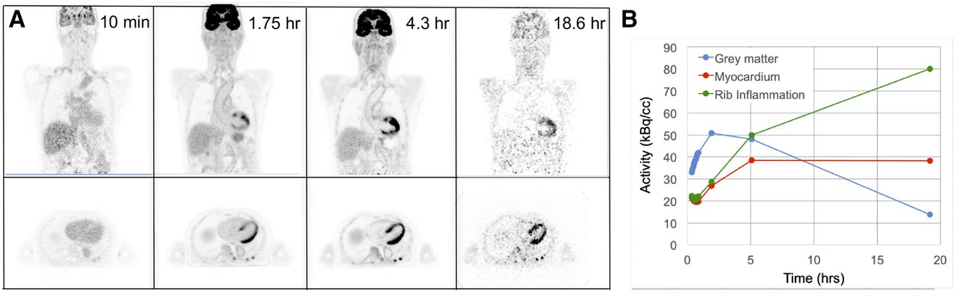
Delayed imaging to characterize biology
>10 half lives
(A) 18F-FDG PET coronal images of subject 3 acquired at 4 time points after injection. Austin R. Pantel et al. J Nucl Med 2020;61:144-151
Notes:
¹⁸F-FDG PET coronal images of subject 3 acquired at 4 time points after injection. First time point is 3-min scan; other time points are as noted in Table 1. (B) Time–activity curves for brain, myocardium, and rib fracture from same subject. Plotted points are at mid time of each scan.
the activity in the brain decreases over time implying that k4 is non-zero and that G6Pase is activated to break down FDG-6P, whereas activity in the myocardium decreases more slowly over time implying that k4 is near zero and that G6Pase is not active in the myocardium. In other words, this shows that the extent to which G6P is in the brain, but not the myocardium.

Slide 12
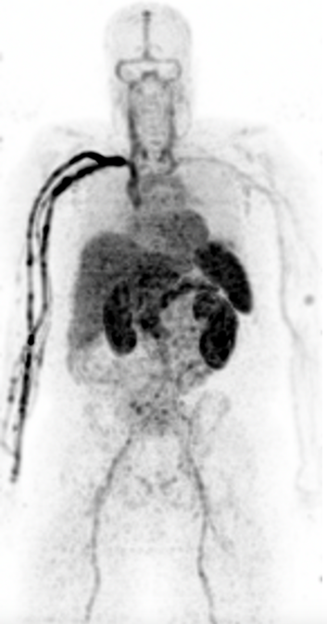
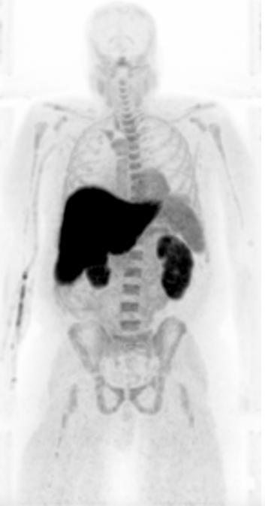
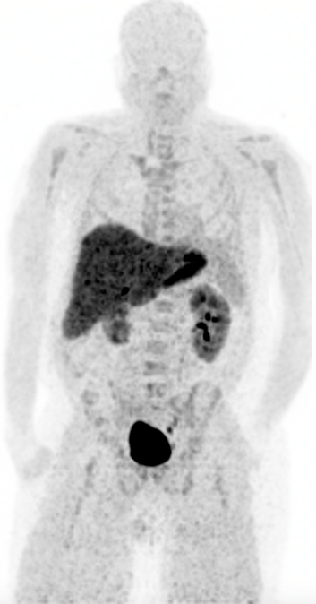
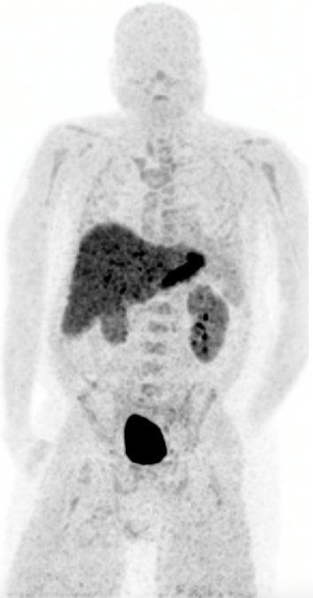
¹¹C-TMP whole-body imaging of infection
[¹¹C]-labeled antibiotic (20-min half-life)
Dynamic imaging over 2 hours in 1 bed position
The high sensitivity of the PennPET Explorer permits imaging of a short-lived radiotracer over an extended time to better visualize infection.
50-60 sec
7-8 min
90-95 min
120-130 min
>6 half lives
(courtesy, Dr. Mark Sellmyer, U. Penn)
Notes:
Details on this tracer?
There is increased washout from the blood over time, allowing for increased sensitivity to detect infection.
In this patient, there was, in fact, no infection, but the excellent image quality, even 2 hours post-injection, allowed for greater confidence in that decision.
About the C11 study, we did a funky protocol, 0-8 min in bed 1 (as shown in image), then 9-61 min in bed 2 to get the legs, then 62-95 min back to bed 1. So, for the slide just say 1 bed…unless you really want to show the legs.

Slide 13
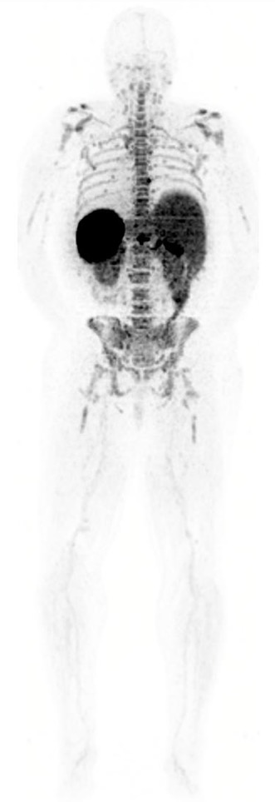
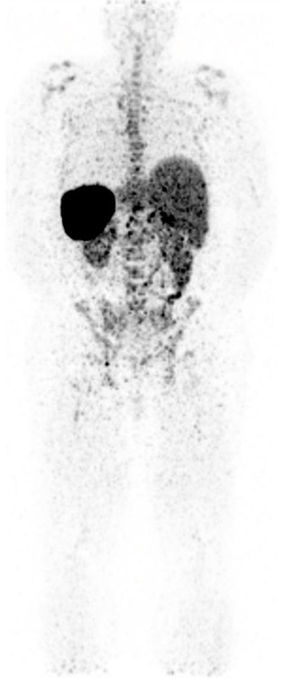
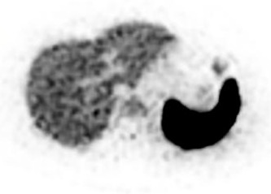
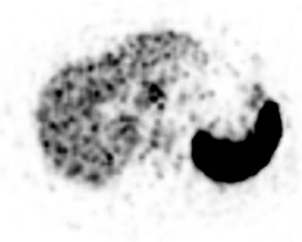
CD8+ T-cell imaging with [⁸⁹Zr]-Df-Crefmirlimab
PennPET Explorer
22 hours p.i.
2 bed positions
60-min scan
SOC PET/CT
24 hours p.i.
18 bed positions
90-min scan
½ life: 78 hours
0.7 mCi injected dose
Extended imaging of long-lived radiotracer with slow biology
We acknowledge ImaginAb for the
development of the radiotracer.
(courtesy, Dr. Mike Farwell, U. Penn)
Notes:
Figure 3: CD8 PET imaging on the PennPET Explorer, demonstrating the benefit of imaging isotopes with low positron faction and low dose. The patient was injected with 1 mCi of ⁸⁹Zr-Df-IAB22M2C, and scanned 24 hours p.i. The images were acquired with two bed positions, for a total acquisition time of 60 min. The patient has inclusion-body myositis, an inflammatory myopathy with CD8 T-cell infiltration of the muscles. A whole-body MIP image shows the normal biodistribution of the CD8 probe in the spleen, liver, and bone marrow, and the normal lymph nodes in the neck / axilla on this scan. There is increased uptake in all of the extremity musculature, as expected, most notably in the calf muscles. We acknowledge ImaginAb for the development of ⁸⁹Zr-Df-IAB22M2C, an anti-CD8 minibody.
Uptake time of 22 hrs on explorer, 23 h 40 min on ingenuity
0.66 of Zr injected

Slide 14
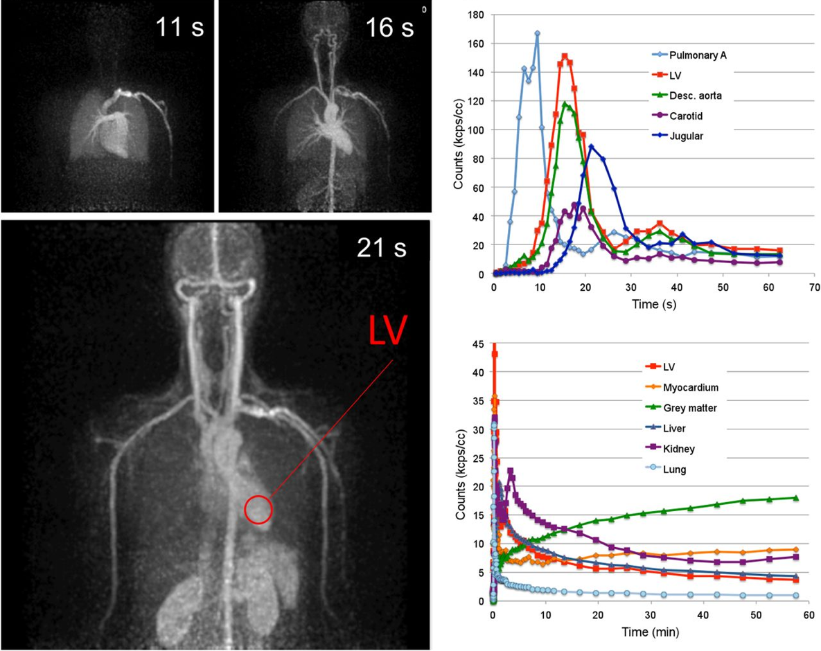
TB-PET for Kinetic Analysis

Slide 15
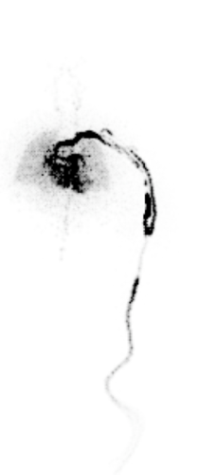
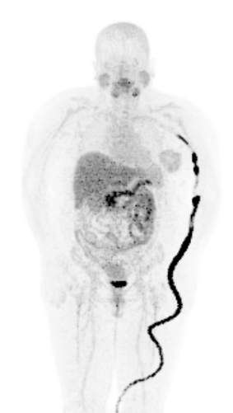
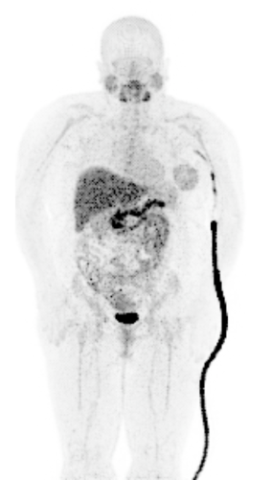
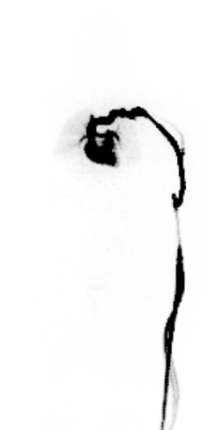
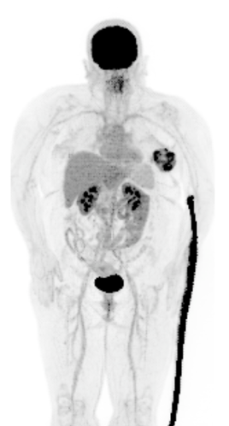
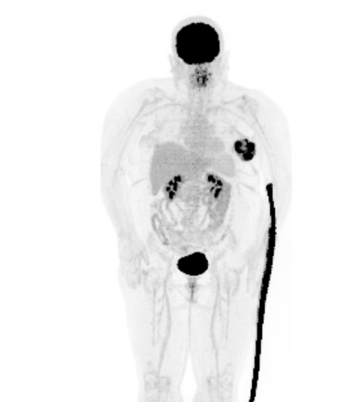
Dual-Tracer [¹⁸F](2S,4R)4-Fluoroglutamine / [¹⁸F] FDG PET in Breast Cancer
t=10 s (5 s frame)
t=10 min (5 min)
t=25 min (4 min)
30 min + 10 s (5 s)
60 min (5 min)
90 min (5 min)
1 mCi [¹⁸F]F-Gln injected at t=0
Dynamic imaging of 1 mCi [¹⁸F]F-Gln for 30 min
10 mCi FDG injected at t=30 min
Dynamic imaging of 10 mCi FDG + residual [¹⁸F]F-Gln for 60 min
(courtesy, Dr. Austin Pantel, U. Penn)
Notes:
Major Points:
The volume of distribution of F-gln as a measure of glutamine pool size, and an indirect measure of glutamine metabolism, is the kinetic parameter of interest for F-Gln. Based on these simulations, we determined we could accurately calculate the volume of distribution with a dose as low as 1.0 mCi in 30 minutes.
This led to the protocol on the right, where after 30 minutes of F-Gln imaging, we inject FDG 10 mCi

Slide 16
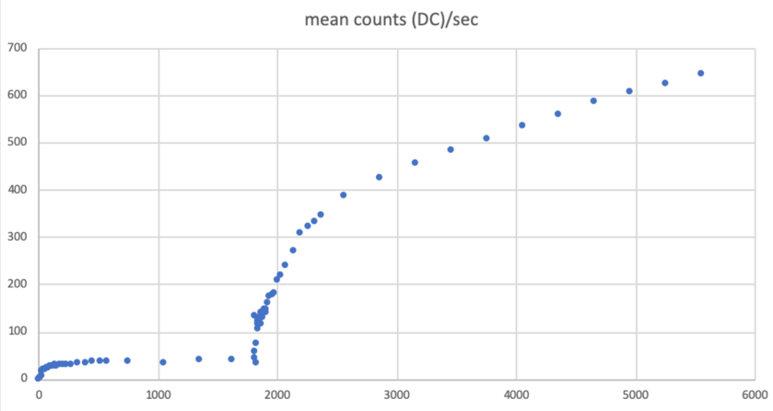
Dual-Tracer [¹⁸F](2S,4R)4-Fluoroglutamine / [¹⁸F] FDG PET in Breast Cancer
Mean counts / second in breast tumor
(decay corrected)
1 mCi [¹⁸F]F-Gln
10 mCi FDG
(courtesy, Dr. Austin Pantel, U. Penn)
Notes:
Major Points:
The volume of distribution of F-gln as a measure of glutamine pool size, and an indirect measure of glutamine metabolism, is the kinetic parameter of interest for F-Gln. Based on these simulations, we determined we could accurately calculate the volume of distribution with a dose as low as 1.0 mCi in 30 minutes.
This led to the protocol on the right, where after 30 minutes of F-Gln imaging, we inject FDG 10 mCi

Slide 17
Alternative, inexpensive designs with LSO/LYSO
  Achieve long AFOV imaging capability without significant gains in sensitivity
  Use thinner crystal (Surti, et. al., PMB 2013, 3995-4012)
    Reduction in scintillator cost only
    Potential to recover effective sensitivity with gains in TOF resolution
  Introduce axial or transverse gaps (Yamaya, et. al., PMB 2008, 757-773, Zein, et. al., IEEE TRPMS 2020, 331-342, Daube-Witherspoon, et. al, Proc. of Fully 3D meeting 2019, Zhang, et. al., Mol. Imag. Biol. 2019, 447-453)
    Reduction in scintillator and photosensor cost
    Utilize TOF information to overcome issues due to missing data
    Demonstrated in PennPET Explorer where initial electronics readout introduced data readout gaps axially

Slide 18
Alternative design with BGO
  Replace L(Y)SO with BGO
    30% higher efficiency with BGO (for 20 mm thick crystal) at 1/3 the cost
    Lower cost 1 m long Non-TOF design with BGO investigated in the past
    (Wong, et. al. IEEE NSS/MIC Conf. Rec., 2007, Zhang and Wong, IEEE NSS/MIC Conf. Rec., 2016)
    TOF capability using Cerenkov light - ~450 ps FWHM with Lorentzian kernel

Slide 19
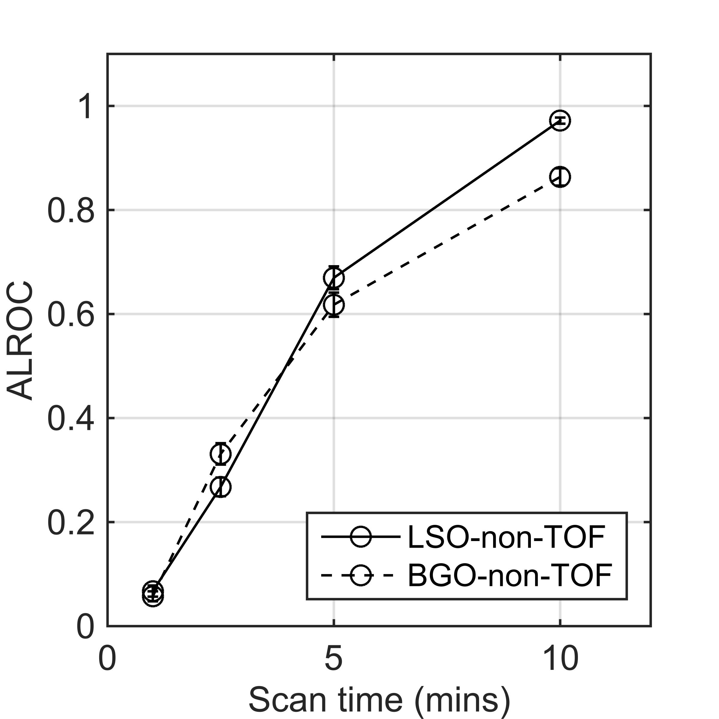
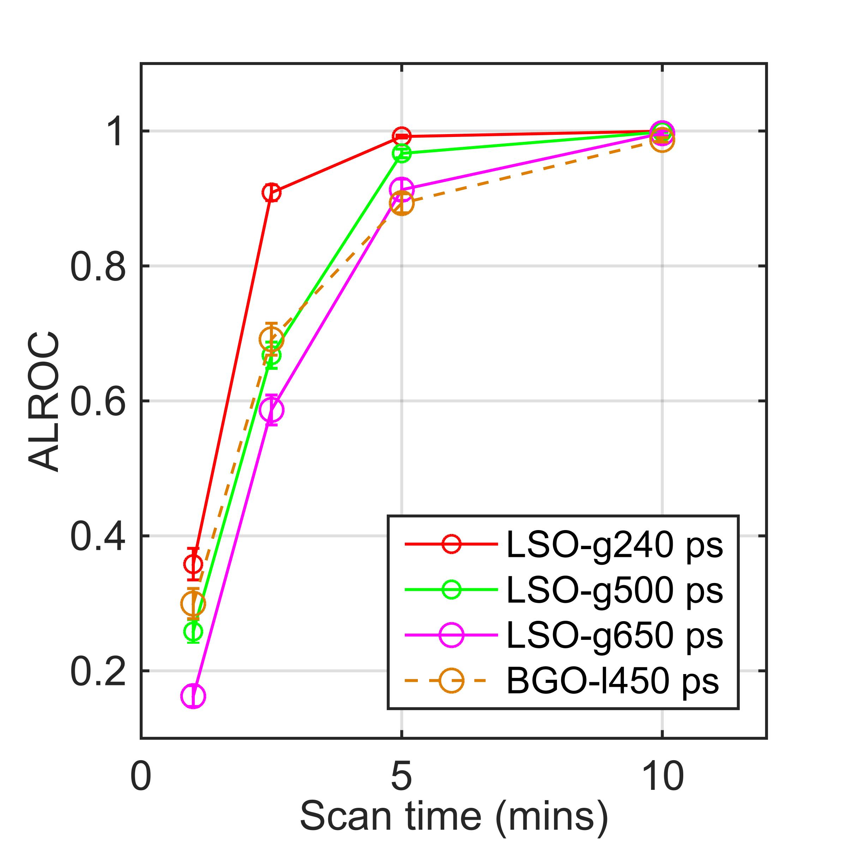
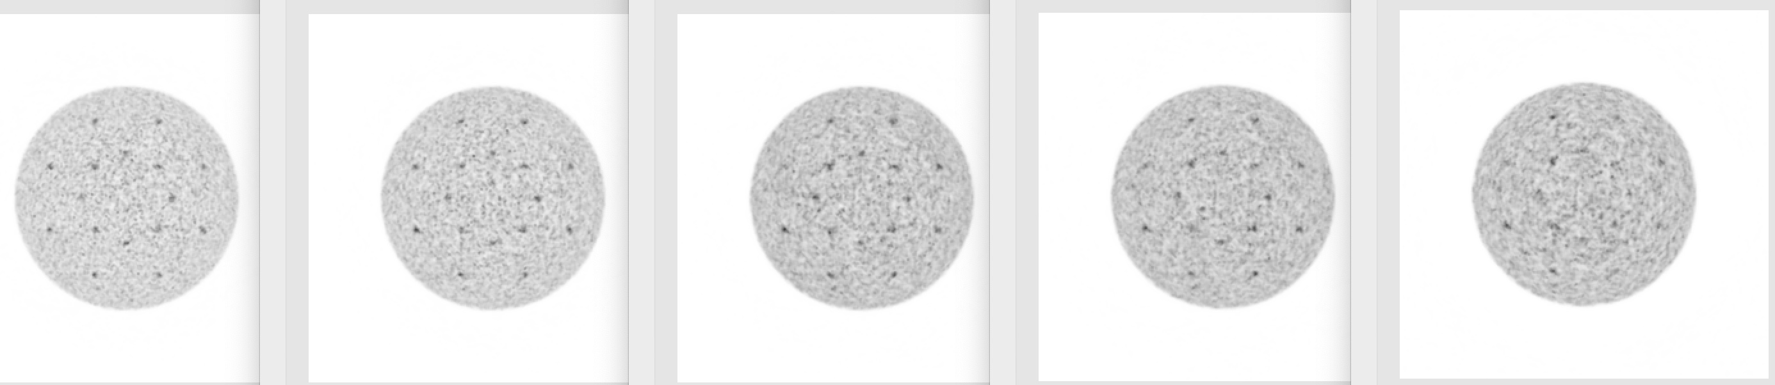
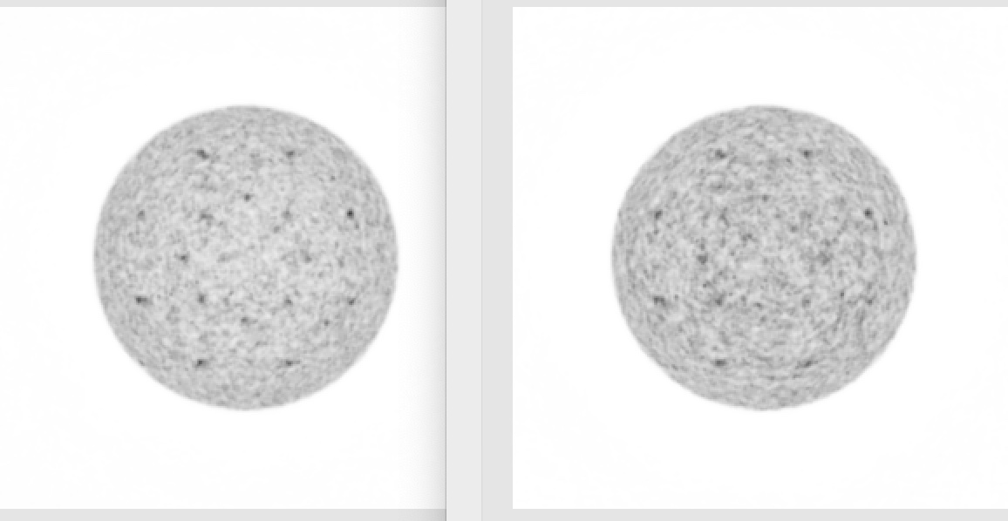
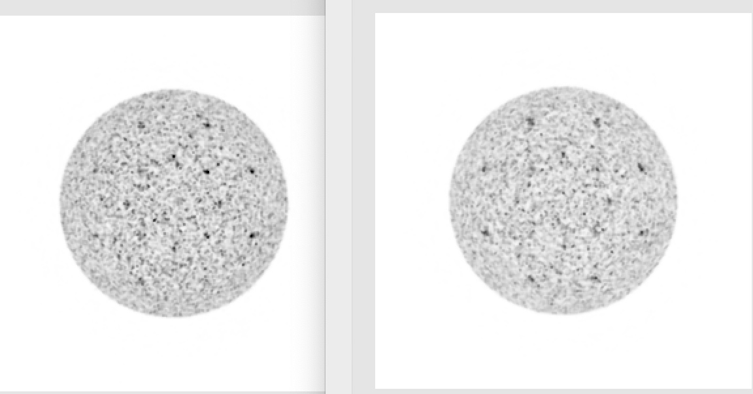
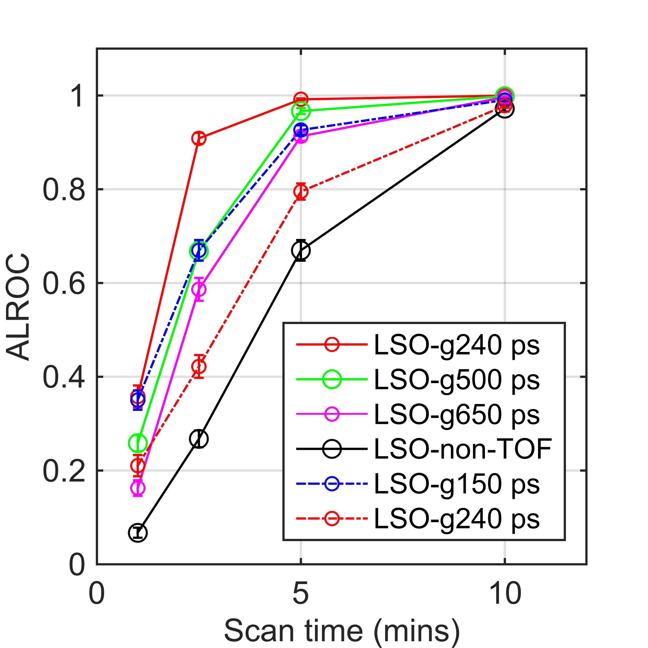
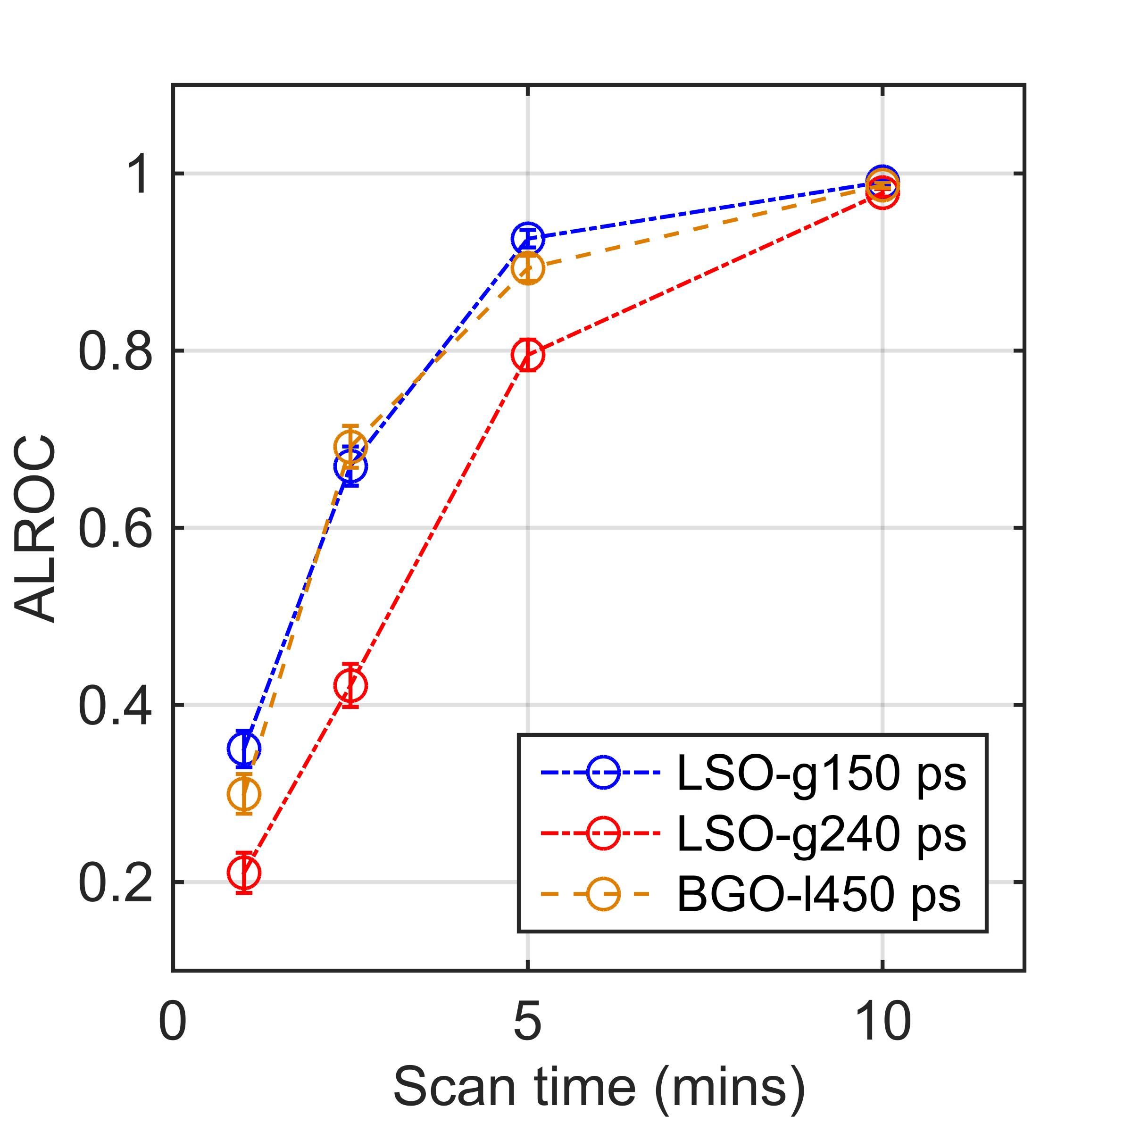
Alternative design simulations
20mm LSO
20 mm BGO
10mm LSO
240ps
500ps
L-450ps
150ps
650ps
240ps
non-TOF
non-TOF
Attenuation and scatter corrected, no randoms in data

Slide 20
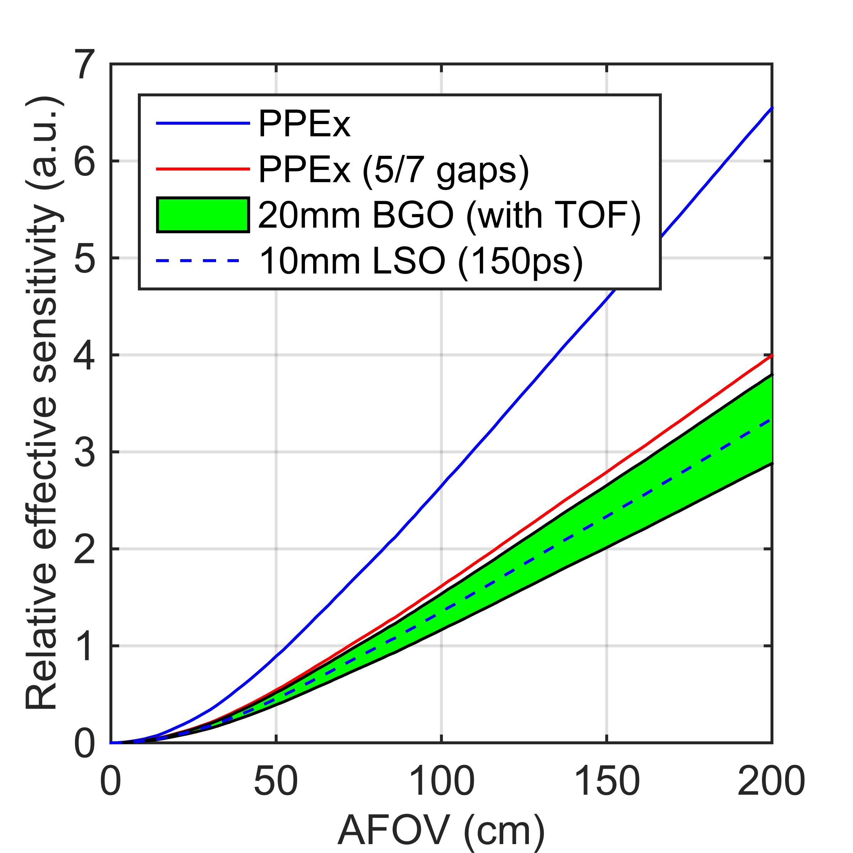
Sensitivity vs cost comparison
 | Relative total cost | Relative effective sensitivity
PPEx (no gaps) | 1 | 1
PPEx (5/7 gaps) | 0.72 | 0.51
20mm BGO | 0.67 | 0.58/0.44*
10 mm LSO | 0.75 | 0.61
*Impact of increased deadtime and randoms fraction not accounted for here

Slide 21
Conclusions
Currently 3 versions of TB-PET are in operation with varying AFOV
The choice of AFOV is driven by applications where the longest AFOV (~2 m) has the widest applications, but at a premium cost
Spatial resolution degradation in the axial direction is not any more than that routinely seen in the the radial blurring of standard commercial PET scanners
Modular and programmable design of PPEx has shown
  Improved image quality, shorter scan time or reduced dosage
  Delayed imaging can improve disease delineation or characterize biology
  Improved quantitative imaging of low-yield isotopes
  Multi-organ dynamic imaging and kinetic analysis
  Dual tracer imaging

Slide 22
Conclusions
Current detectors with LSO and 240ps TOF resolution can be utilized cost-effectively with axial gaps
There is value to considering thin (10 mm) LSO with better TOF resolution (150 ps)
BGO with 450ps Lorentzian distribution is competitive - similar to 500/650 ps LSO scanner, or 150 ps LSO scanner with 10 mm crystals
BGO simulations do not consider the impact of increased randoms and deadtime, and the potential to achieve TOF capability in a full system

Slide 23
Acknowledgments
JS Karp
B Dai
ME Daube-Witherspoon
MJ Geagan
S McDonald
G Muehllehner
MJ Parma
AE Perkins
JP Schmall
V Viswanath
ME Werner

Slide 24
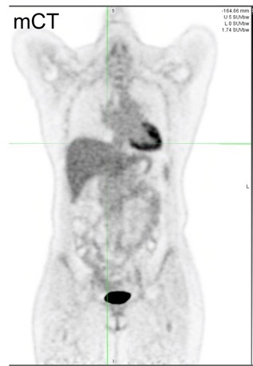

Current Status of PET technology
Pre-therapy 616 s scan
Post-therapy 426 s scan
Siemens Biograph mCT
Sp. Res.: 4.2 mm
Timing res.: 538 ps
Sensitivity: 10 kcps/MBq
Point source sens.: 6.7%
Siemens Biograph Vision
Sp. Res.: 3.6 mm
Timing res.: 216 ps
Sensitivity: 15.6 kcps/MBq
Point source sens.: 8.3%
Notes:
Same patient first scanned on mCT (12.4 mCi, uptake: 51 min, CBM, scan duration: 616 s) and 6 months post-treatment scanned on the Vision (15.0 mCi, uptake 66 min, CBM, scan duration: 426 s) showing disease progression.
Both used a 5 mm Gaussian post-reconstruction filter.
Despite a shorter imaging time, reduced noise and sharper rib definition in the Vision image visible due to improved physical performance.

Slide 25
What does long AFOV get us?
θ
Axial length
Increased geometric sensitivity

Slide 26
What does long AFOV get us?
θ
Axial length
Geometric sensitivity for single organ limited due to attenuation

Slide 27
Previously developed long axial FOV systems
  M. Watanabe, et al., 2004 Watanabe, et. al., TNS 2004, 796-800
    BGO, 68.5-cm axial FOV,
    ±15 deg θ_{max} (coarse septa)
  M. Conti, et al., 2006 Conti, et. al., TNS 2006, 1136-1142
    LSO, 53-cm axial FOV,
    rotating research scanner

Slide 28



PennPET Explorer count-rates
20x140cm
AFOV: 142 cm
5 kBq/cc
~5.5 kBq/cc
20x70cm
140 cm
NECR peak
at 25 kBq/cc
(2) 70-cm phantoms
140-cm long phantom, more reflective of the range where activity accumulates in the body
Trues rate is higher with 140-cm phantom due to increased LORs
Random fraction is higher with 140-cm phantom
NECR with 140-cm phantom is similar at lower activity (<5.5 kBq/cc) and lower at higher activity due to increased random fraction
Notes:
to address the issue, we put two 70-cm phantoms back-to-back to form a 140-cm phantom, which better represents the activity distribution in human study (which is a more realistic representation for human study).
We can see that the trues rate is higher with the longer phantom due to increased number of LORs.
The random fraction is higher as well.
NEC rates is similar at lower activity but becomes lower with the longer phantom due to increased random fraction.
Nevertheless, NEC rates is ~ 1 Mcps at 5 kBq/cc with both phantoms, indicating high count rates for human studies.
---
NECR with 140-cm phantom peaks at 25 kBq/cc
Trues cross randoms at 3.6 kBq/cc
NEC rates ~1 Mcps and trues rate ~2.6 Mcps at 5 kBq/cc with 140-cm phantom
Higher random fraction than 70-cm phantom
Scatter fraction doesn’t change. The main change in the NECR with the longer phantom is due to the change of random fraction.

Slide 29

Impact of gaps on count-rates
25 kBq/cc
No gaps
No gaps
5 kBq/cc
NECR peak
25 kBq/cc
5 kBq/cc
7.6-cm gaps
7.6-cm gaps
Compared to 6-ring with axial gaps, the trues gain is ~1.8x and NEC gain is ~1.8x, both at 5 kBq/cc and at ~25 kBq/cc (where NECR peaks for both phantoms) – agree with 1.8x gain in sensitivity
NECR trends similarly for both configurations due to small deadtime from detectors
Notes:
Still using the 140-cm phantom, we compare the system performance with and without axial gaps.
Both the trues and the NEC rates increased by 1.8x without the axial gaps. This agrees well with the 1.8x increase in measured sensitivity.
NEC rates have similar trends, e.g., peaks at the same activity, with and without gaps, because of the small deadtime from the detectors.

Slide 30
Sensitivity vs cost comparison
 | Relative xtal cost | Relative SiPM+elect cost | Relative total cost | Relative sensitivity | TOF resolution (ps) | Relative effective sensitivity
PPEx (no gaps) | 1 | 1 | 1 | 1 | 240 | 1
PPEx (5/7 gaps) | 5/7 | 5/7 | 0.72 | 0.51 | 240 | 0.51
20mm BGO | 1/3 | 1 | 0.67 | 1.2 | 450, Lor | 0.58/0.44*
10 mm LSO | 1/2 | 1 | 0.75 | 0.38 | 150 | 0.61
*Impact of increased deadtime and randoms fraction not accounted for here

