Slide 1
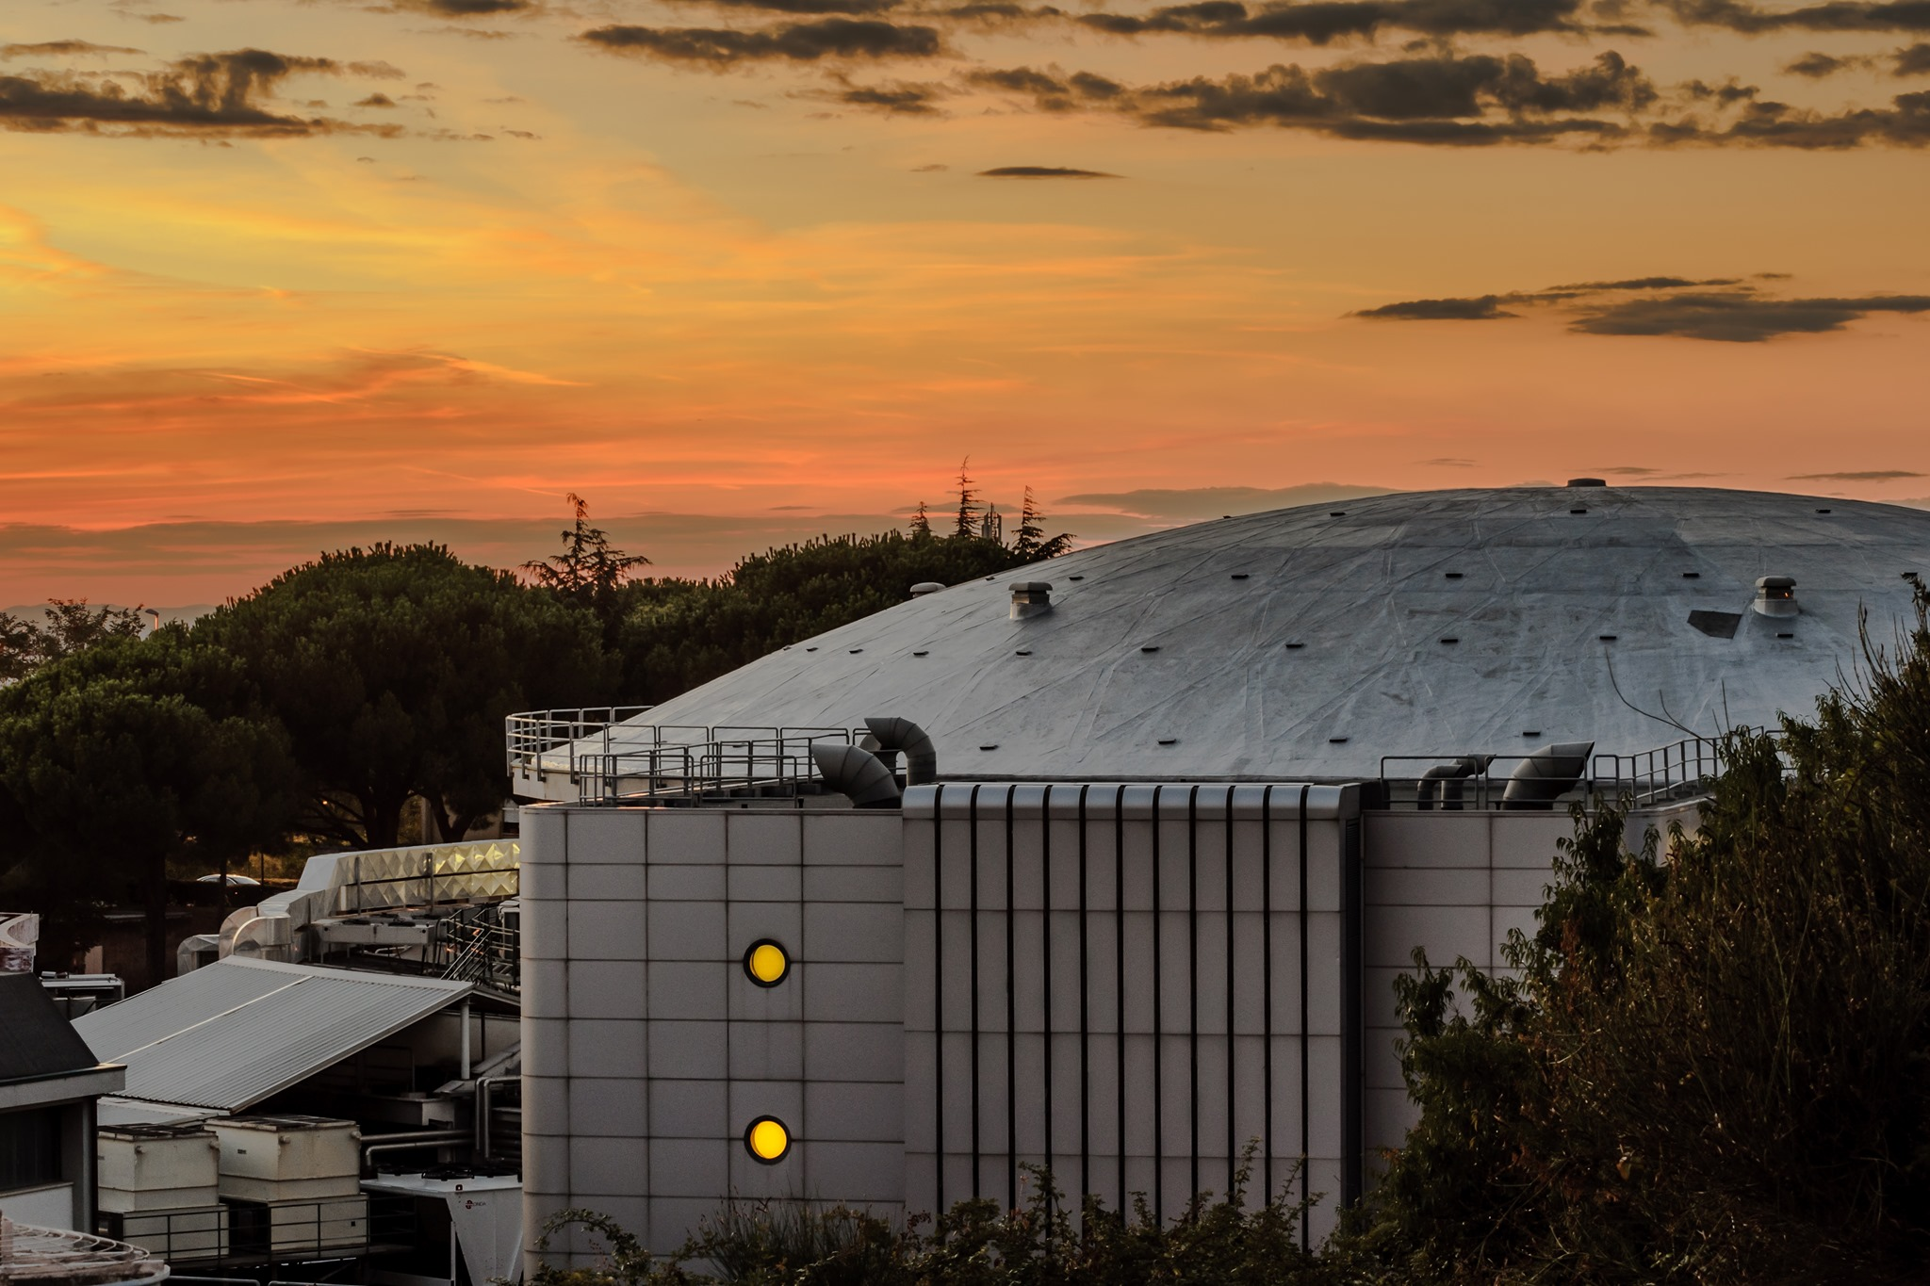

4th Jagiellonian Symposium on Advances in Particle Physics and Medicine
Kaonic atoms at DAΦNE:
where we are and where we go?
Catalina Curceanu (Alessandro Scordo)
on behalf of the SIDDHARTA-2 Collaboration

Slide 2
On self-gravitating strange dark matter halos around galaxies
Phys.Rev.D 102 (2020) 8, 083015
Fundamental physics
New Physics
Dark Matter studies
The modern era of light kaonic atom experiments
Rev.Mod.Phys. 91 (2019) 2, 025006
Kaonic atoms
Kaon-nuclei interactions (scattering and nuclear interactions)
Kaonic Atoms to Investigate
Global Symmetry Breaking
Astrophys.J. 881 (2019) 2, 122
Merger of compact stars in
the two-families scenario
Symmetry 12 (2020) 4, 547
Part. and Nuclear physics
QCD @ low-energy limit
Chiral symmetry, Lattice
Astrophysics
EOS Neutron Stars
The equation of state of dense matter:
Stiff, soft, or both?
Astron.Nachr. 340 (2019) 1-3, 189

Slide 3
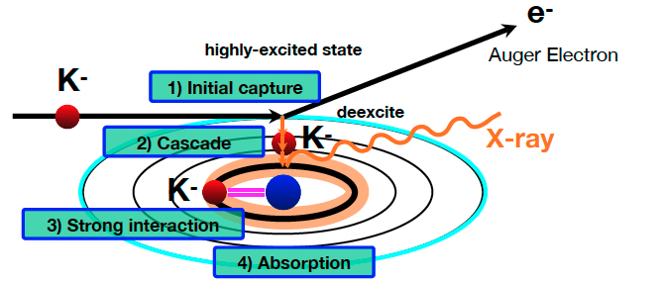
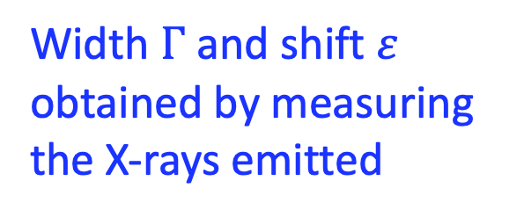
Kaonic atom Formation
Width $Γ$ and shift $ε$ obtained by measuring the X-rays emitted
Catalina Curceanu (A. Scordo)
A new renaissance for kaonic atoms at DAΦNE: future measurements and perspectives

Slide 4






SIDDHARTA-2
SIlicon Drift Detector for Hadronic Atom Research by Timing Applications
LNF-INFN, Frascati, Italy
SMI-ÖAW, Vienna, Austria
Politecnico di Milano, Italy
IFIN –HH, Bucharest, Romania
TUM, Munich, Germany
RIKEN, Japan
Univ. Tokyo, Japan
Victoria Univ., Canada
Univ. Zagreb, Croatia
Univ. Jagiellonian Krakow, Poland
ELPH, Tohoku University
CERN, Switzerland
Helmholtz Inst. Mainz, Germany
Francesco Sgaramella
A new renaissance for kaonic atoms at DAΦNE: future measurements and perspectives

Slide 5
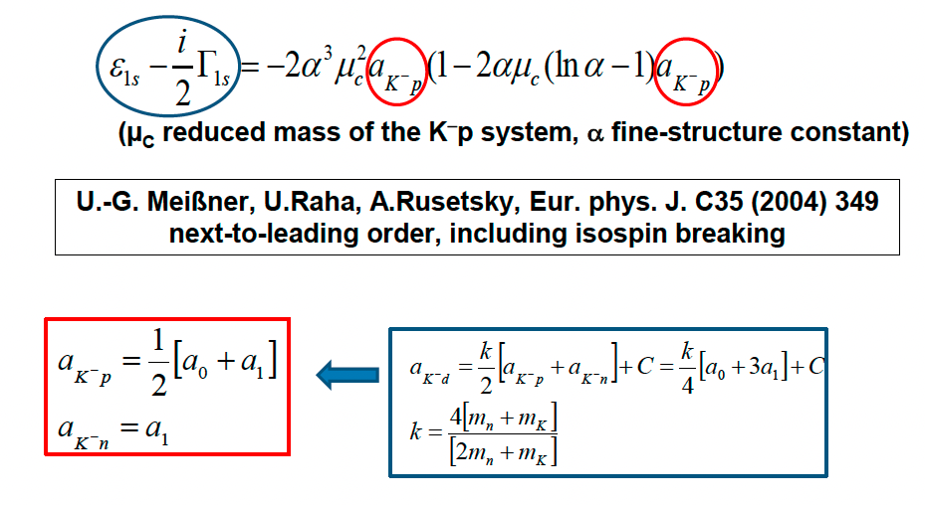
SIDDHARTA-2 Scientific Goal
To perform the first measurement ever of kaonic deuterium X-ray transition to the ground state (1s-level) such as to determine its shift and width induced by the presence of the strong interaction.
Analysis of the combined measurements of kaonic deuterium and kaonic hydrogen
Experimental determination of the isospin-dependent
K-N scattering length
Catalina Curceanu (A. Scordo)
A new renaissance for kaonic atoms at DAΦNE: future measurements and perspectives

Slide 6
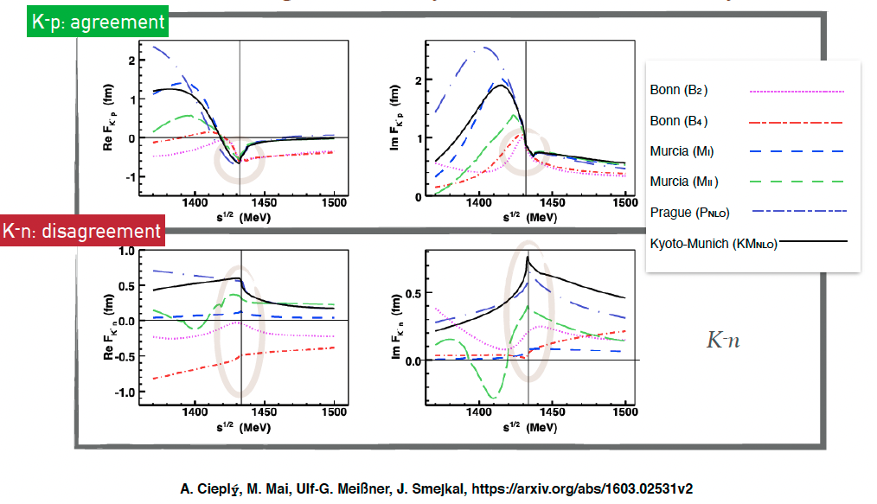
Kaonic atoms – scattering amplitudes
A new renaissance for kaonic atoms at DAΦNE: future measurements and perspectives

Slide 7
Kaonis atoms are fundamental tools for understanding QCD in non-perturbative regime:
Explicit and spontaneous chiral symmetry breaking (mass of nucleons)
Dense baryonic matter ->
Neutron (strange?) stars EOS
Role of Strangeness in the Universe from particle and nuclear physics to astrophysics

Slide 8
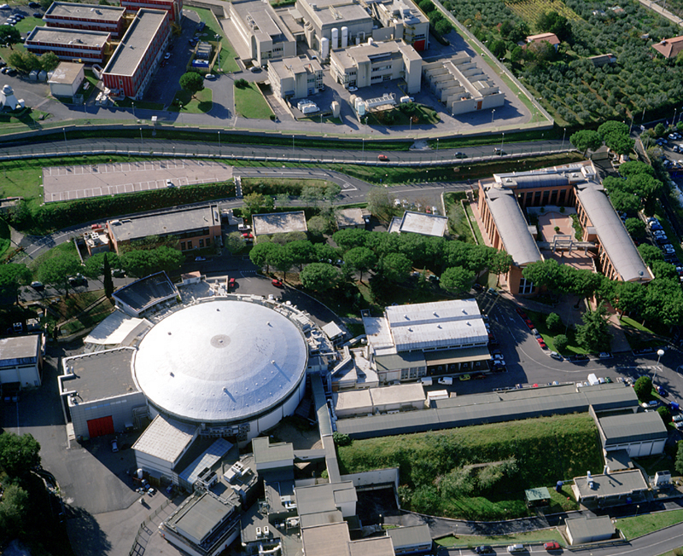



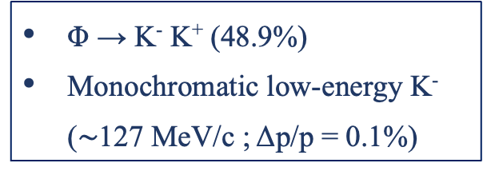


LNF - ${ e}^{+}e^{−}$ Accelerator Complex
Φ → K⁻ K⁺ (48.9%)
Monochromatic low-energy K⁻ ($\sim$127 MeV/c ; Δp/p = 0.1%)
DA$Φ$NE
LINAC
$$e^{+}$$
$$Φ$$
$$e^{−}$$
DAMPING RING
Catalina Curceanu (A. Scordo)
A new renaissance for kaonic atoms at DAΦNE: future measurements and perspectives

Slide 9
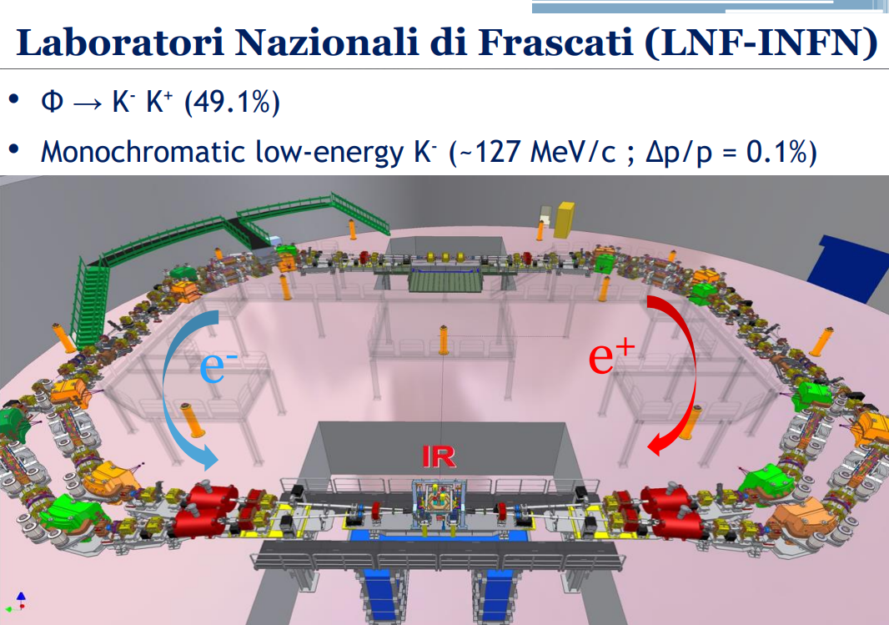

Slide 10
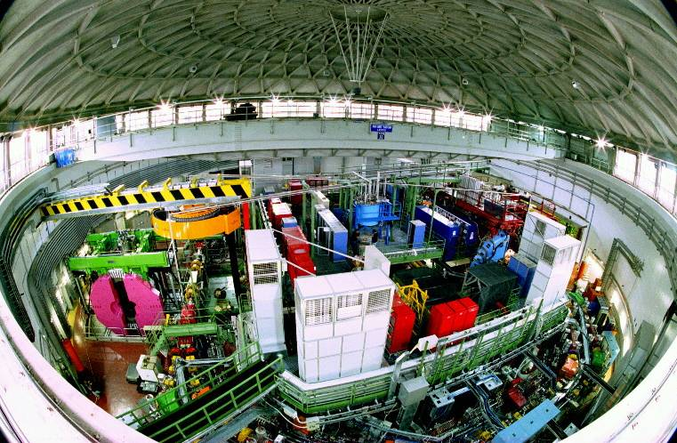
DAΦNE

Slide 11
The DAFNE principle
K+
e⁺
e⁻
e⁺
e⁻
e⁺
Φ
e⁻
e⁻
e⁻
e⁺
e⁺
e⁺
e⁻
e⁺
e⁻
e⁻
e⁺
e⁻
e⁻
K-
Flux of produced kaons: about 1000/second

Slide 12
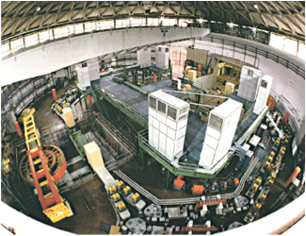

Φ → K⁻ K⁺ (49.1%)
Monochromatic low-energy K⁻ (~127MeV/c)
Less hadronic background due to the beam
( compare to hadron beam line : e.g. KEK /JPARC)
Suitable for low-energy kaon physics:
kaonic atoms
Kaon-nucleons/nuclei interaction studies

Slide 13
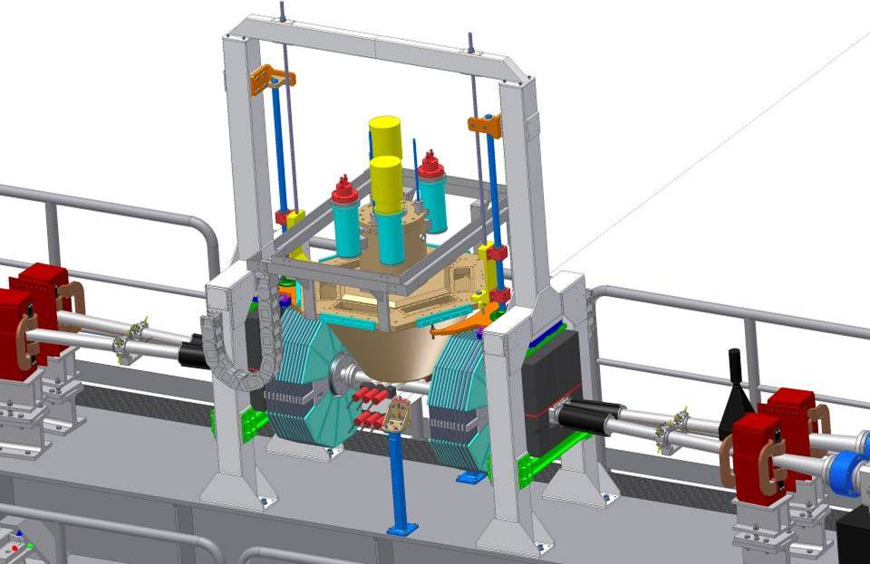

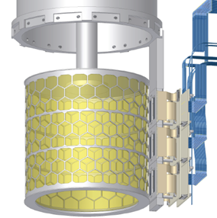

SIDDHARTA overview
Target
Detect
by SDDs
K⁻
e⁻
Detect by two scintillators
Φ
510 MeV/c
e⁺
127 MeV/c
Δp/p=0.1%
K⁺
510 MeV/c
y
x
z
13

Slide 14
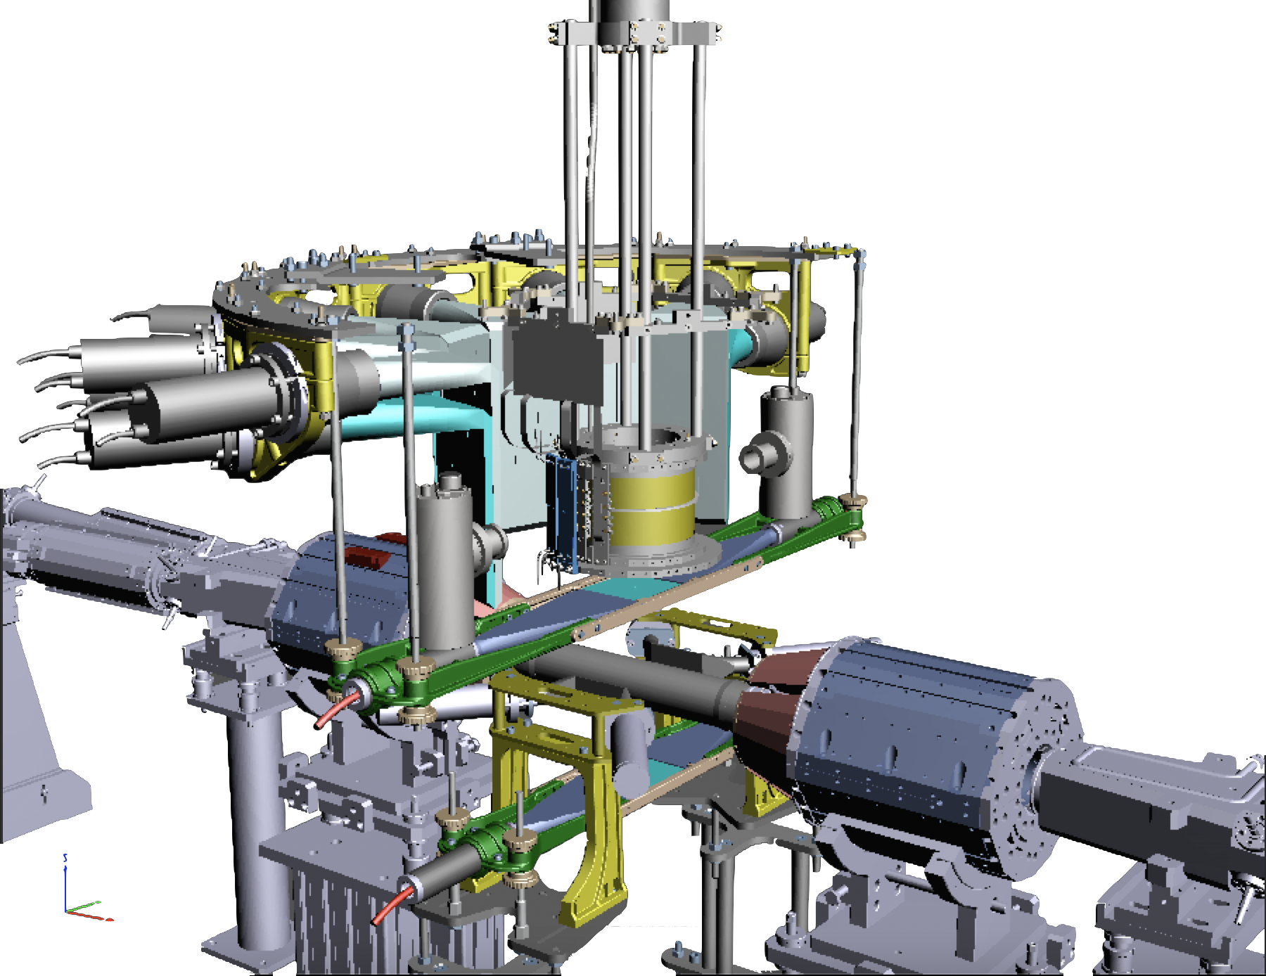


SIDDHARTA-2 setup
Cooling line
Luminosity Monitor
Kaon Trigger
Cryogenic gaseous target
SDD detectors
Veto-2 system
Veto-1 system
Veto-1
384 SDDs
Target
$$π$$
Veto-2
DAFNE luminosity monitor
$$Φ$$
Kaon Trigger
SIDDHARTA-2 luminosity monitor
Francesco Sgaramella
A new renaissance for kaonic atoms at DAΦNE: future measurements and perspectives

Slide 15
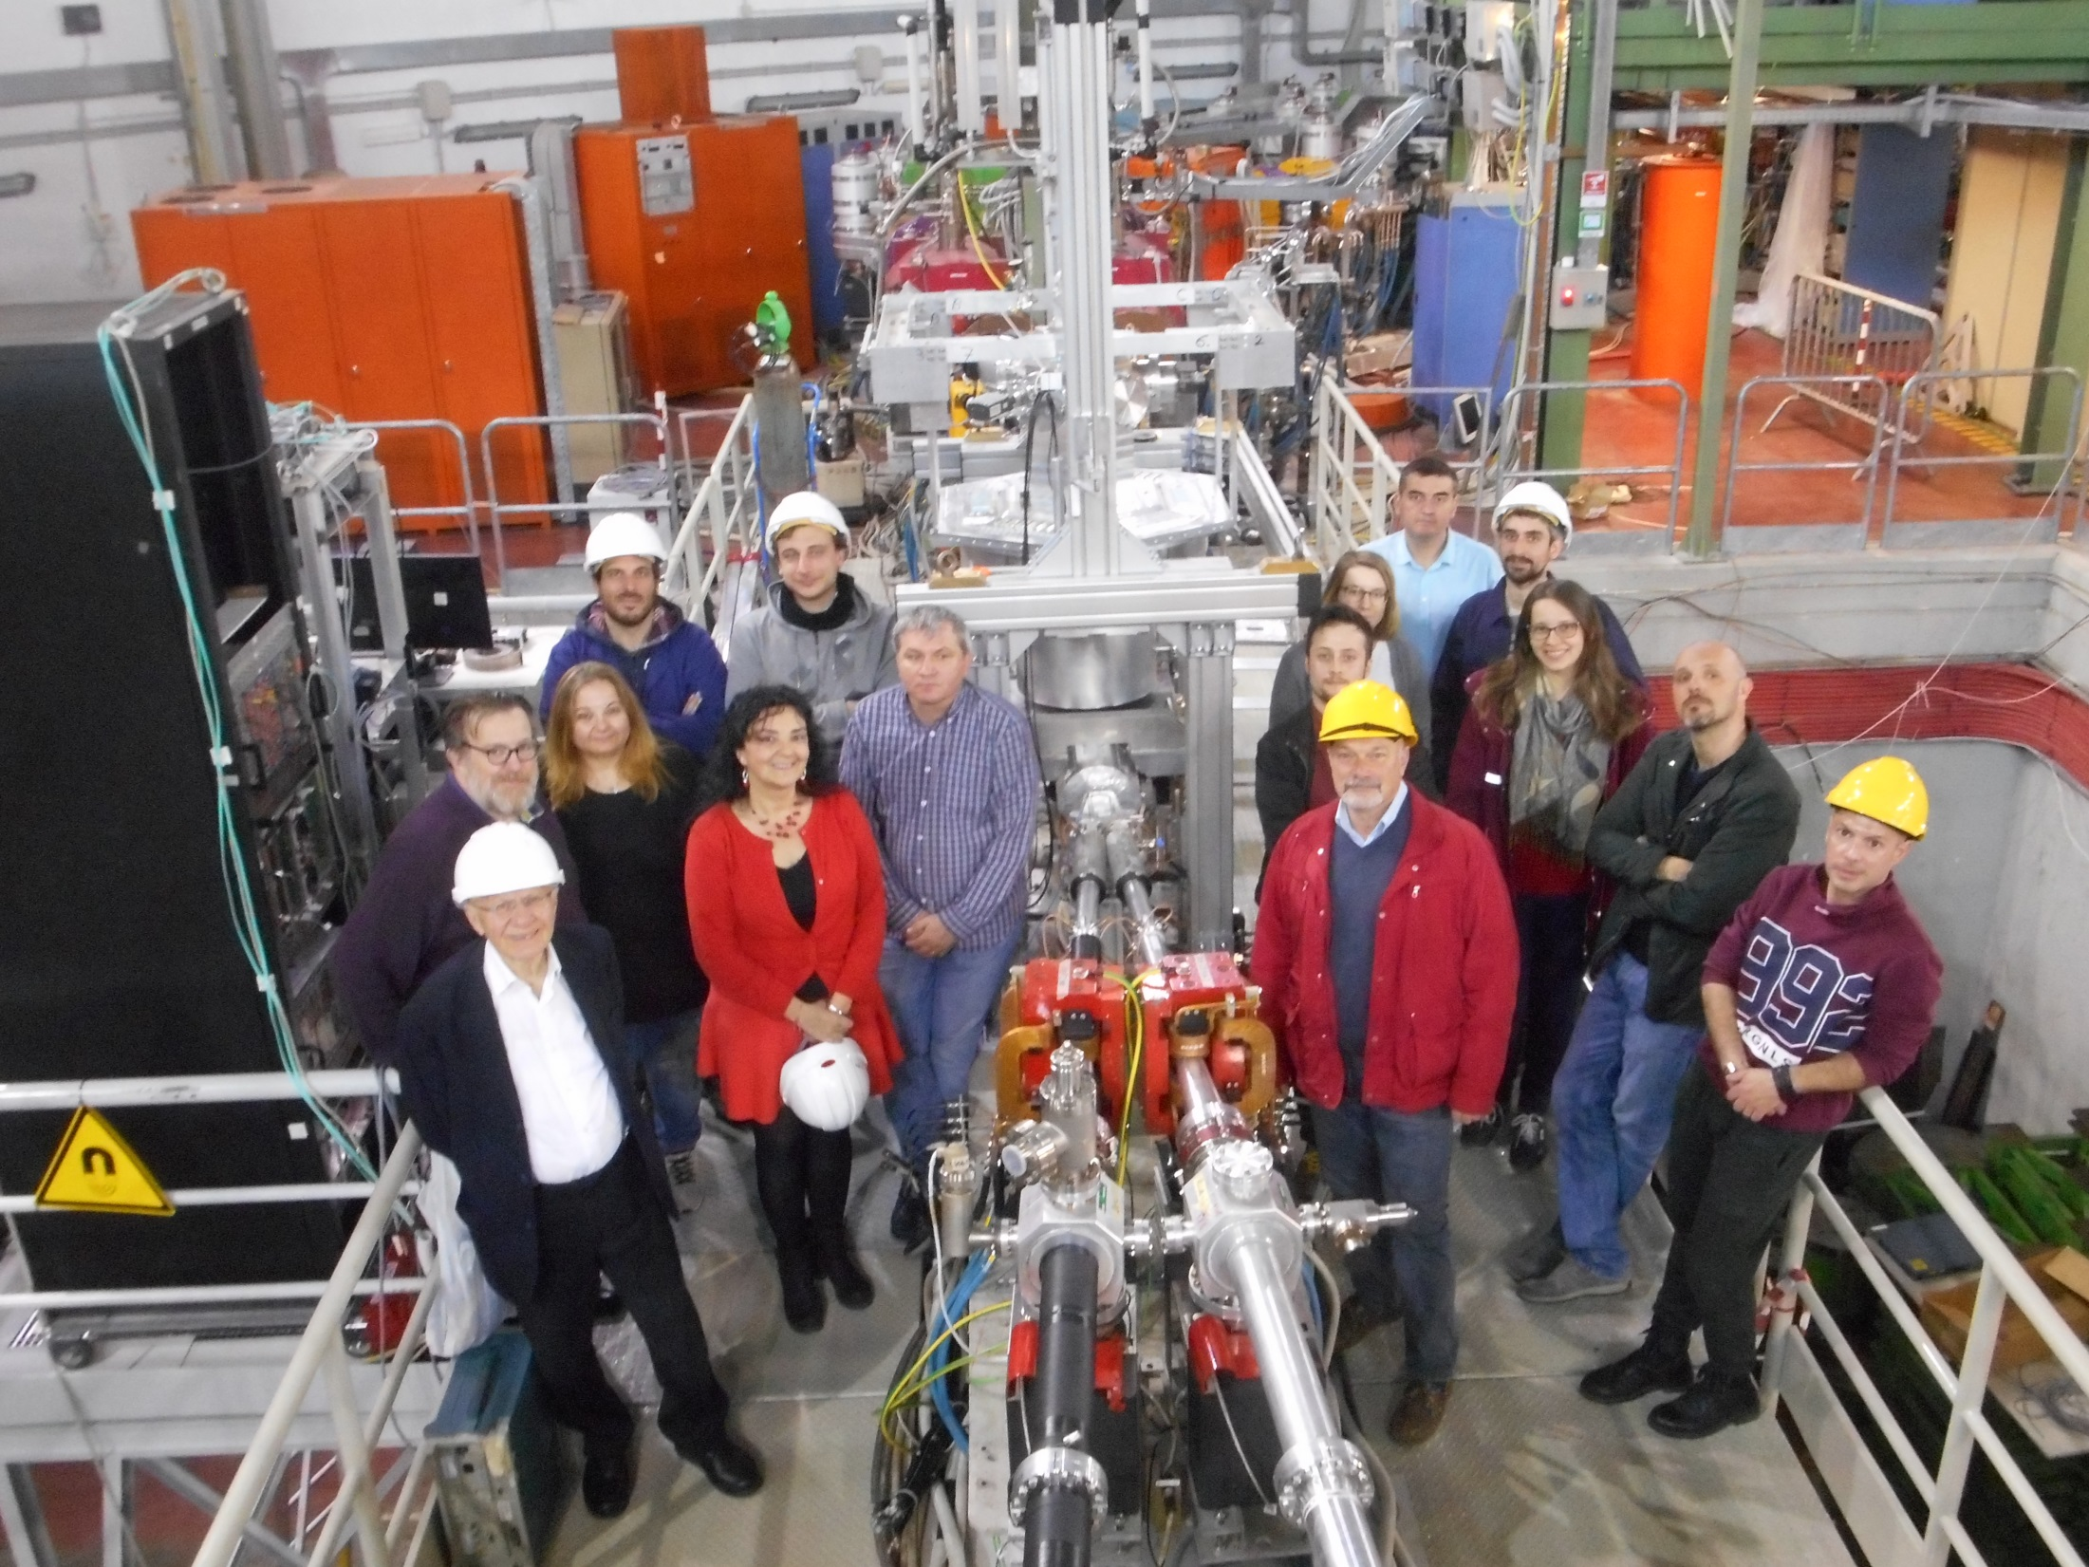
SIDDHARTINO installed on DAFNE (17 April 2019)

Slide 16
SIDDHARTINO
SIDDHARTINO: phase 1 of SIDDHARTA-2
1/6 of SIDDHARTA-2
Evaluation of the machine background during the DAΦNE beams commissioning phase in preparation for the K-d run through the measurement of K-⁴He 3d->2p transition
Detector tuning for SIDDHARTA-2:
    SDDs
    Kaon Trigger
  Concluded in July 2021
A new renaissance for kaonic atoms at DAΦNE: future measurements and perspectives

Slide 17



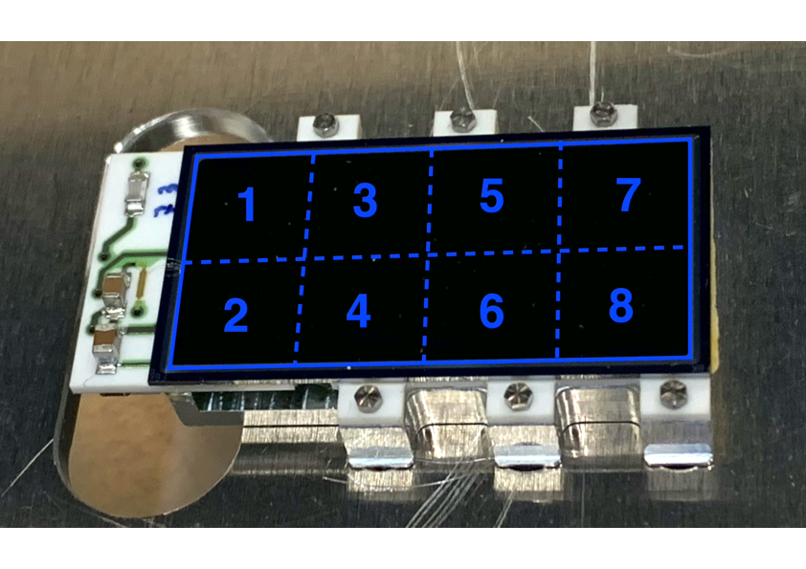
Silicon Drift Detectors
SDD cross section
8 SDD units (0.64 cm²)
for a total active area of 5.12 cm²
Thickness of 450 μm which ensures a high collection efficiency for X-rays of energy between 5 keV and 12 keV
Catalina Curceanu (A. Scordo)
A new renaissance for kaonic atoms at DAΦNE: future measurements and perspectives

Slide 18
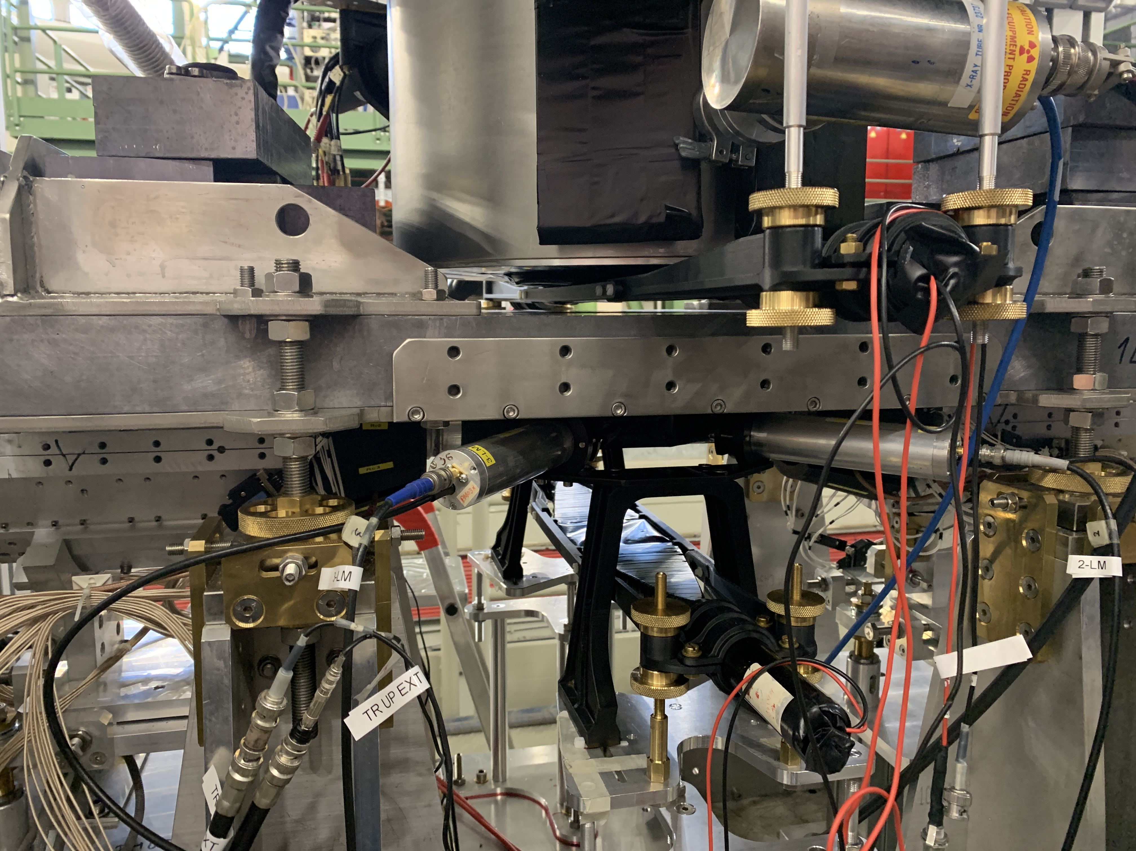
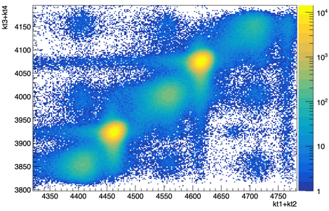



Kaon Trigger
Kaons
Kaon trigger up
$$K^{−}$$
MIPS
e⁻
e⁺
$$K^{+}$$
Kaon trigger down
The ToF is different for Kaons, m(K)~ 500 MeV/c² and light particles
originating from beam-beam and beam-environment interaction (MIPs).
Can efficiently discriminate by ToF Kaons and MIPs!
Catalina Curceanu (A. Scordo)
A new renaissance for kaonic atoms at DAΦNE: future measurements and perspectives

Slide 19
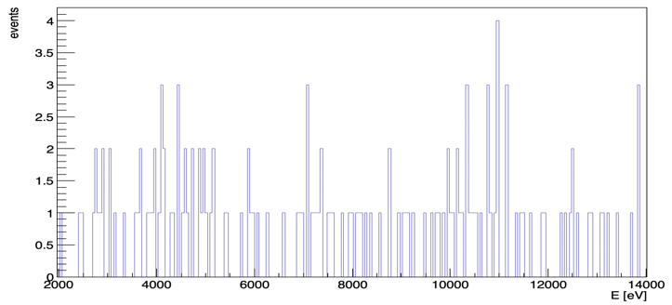
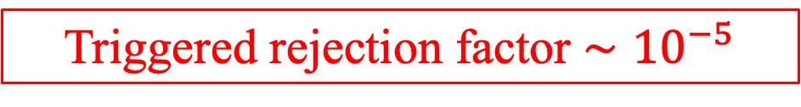
Kaon Trigger
Triggered rejection factor $∼{10}^{−5}$
Catalina Curceanu (A. Scordo)
A new renaissance for kaonic atoms at DAΦNE: future measurements and perspectives

Slide 20
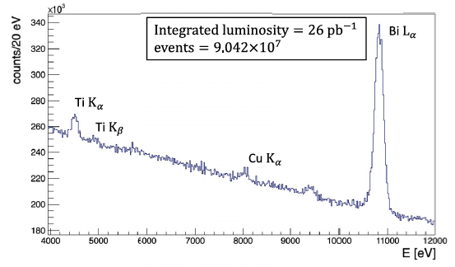
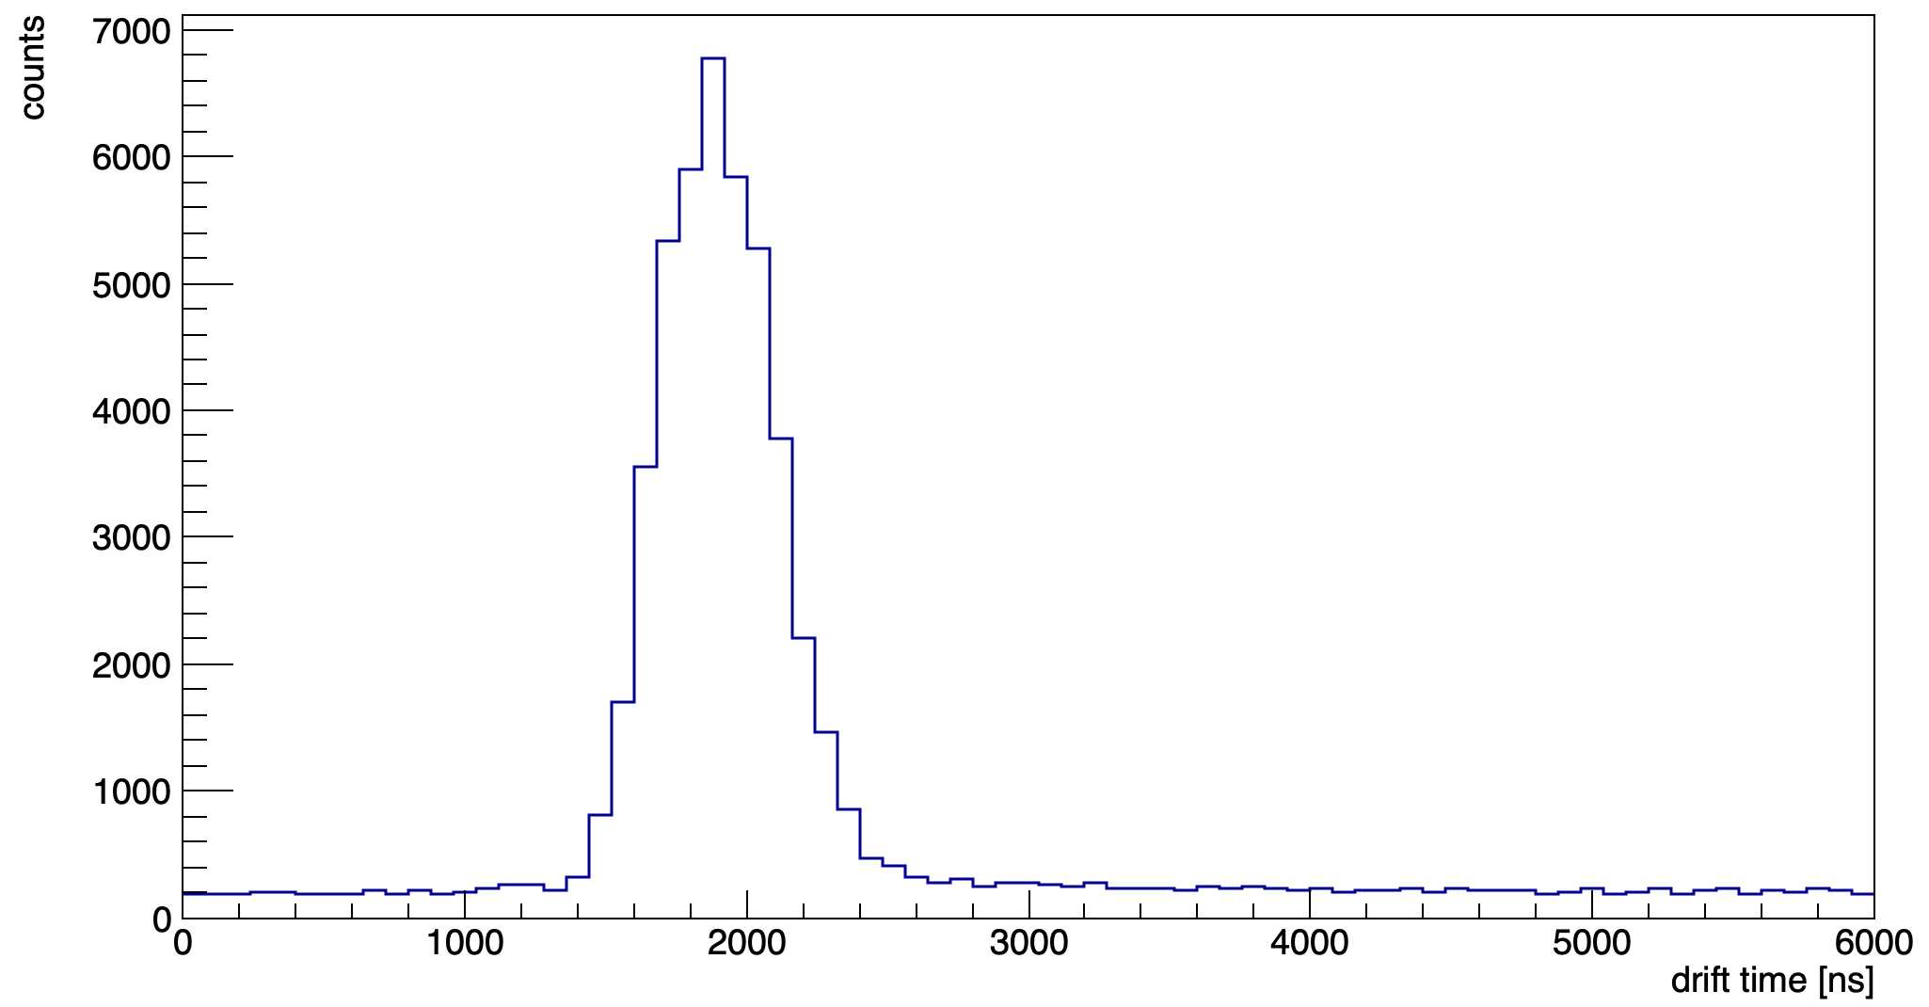

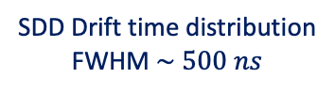
Kaonic ⁴He $3d→2p$ measurement
Kaon Trigger
SIDDHARTINO spectrum before applying the kaon trigger and the drift time rejection
Kaons
MIPS
SDD Drift time distribution
FWHM $\sim 500 ns$
More details in Aleksander Khreptak’s poster:
Calibration of Silicon Drift Detectors for the SIDDHARTA-2 Experiment
Catalina Curceanu (A. Scordo)
A new renaissance for kaonic atoms at DAΦNE: future measurements and perspectives

Slide 21
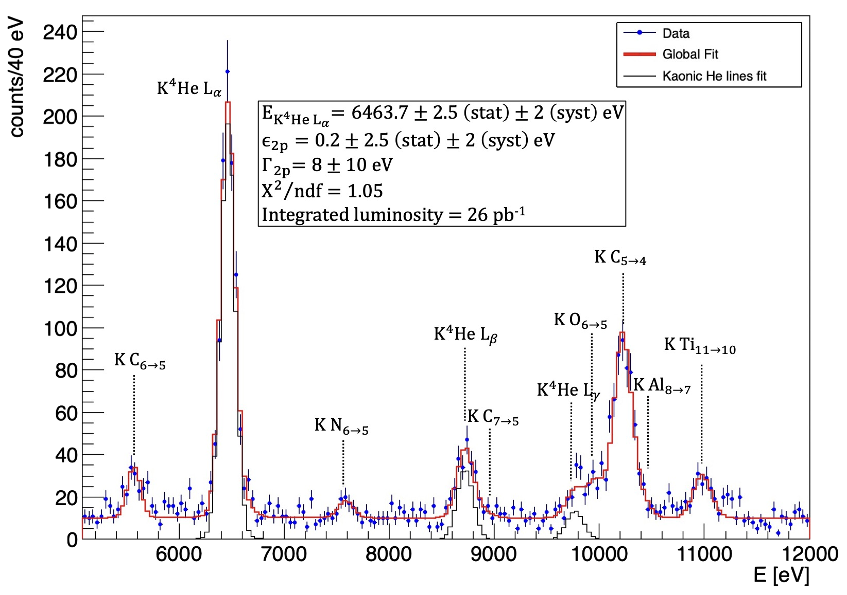
Kaonic ⁴He $3d→2p$ measurement
Sirghi et al 2022 J. Phys. G: Nucl. Part. Phys.
Catalina Curceanu (A. Scordo)
A new renaissance for kaonic atoms at DAΦNE: future measurements and perspectives

Slide 22
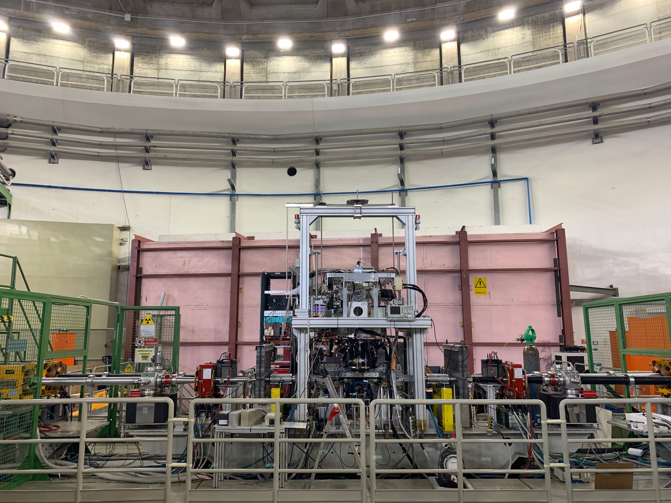
SIDDHARTA-2 setup
Installed on DAFNE autumn 2021
Run: KHe and Kd
7 April – 11 July 2022
Francesco Sgaramella
Kaonic Atoms with SIDDHARTA-2 at the DAFNE Collider

Slide 23
SDD installation
calibration target
SDD installed around the target

Slide 24
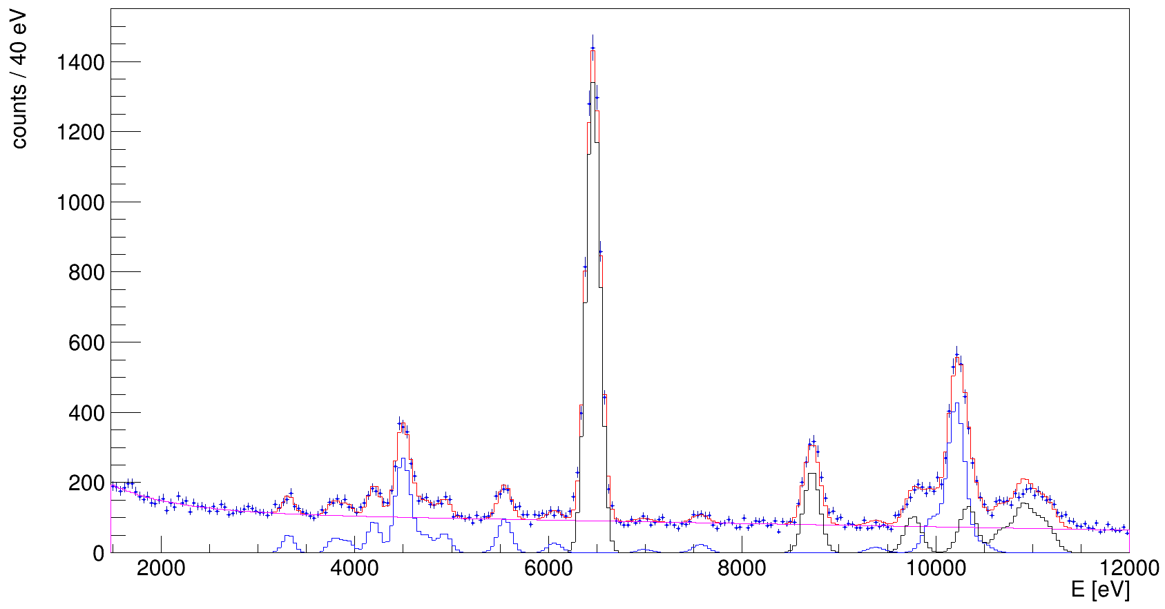
Kaonic ⁴He $3d→2p$ measurement
BONUS: first data with SIDDHARTA-2 full setup with ⁴He target
Total statistics
(SIDDHARTINO + SIDDHARTA-2) → δE (K⁴He_{Lα}) = 1.0 eV
Very preliminary
Catalina Curceanu (A. Scordo)
A new renaissance for kaonic atoms at DAΦNE: future measurements and perspectives

Slide 25

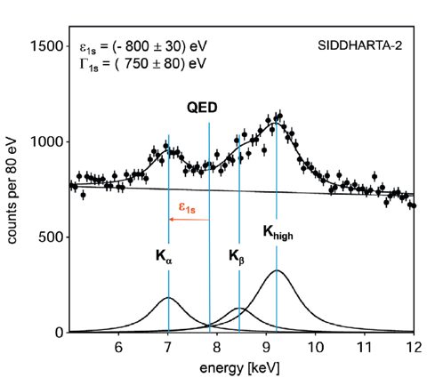
SIDDHARTA-2 K-d measurement
achievable precision
Kaonic deuterium run in (all) 2022
Monte Carlo for an integrated luminosity
of 800 pb⁻¹
to perform the first measurement of the strong interaction induced energy shift and width of the kaonic deuterium ground state
(similar precision as K-p) !
Significant impact in the theory of strong interaction with strangeness
A new renaissance for kaonic atoms at DAΦNE: future measurements and perspectives

Slide 26
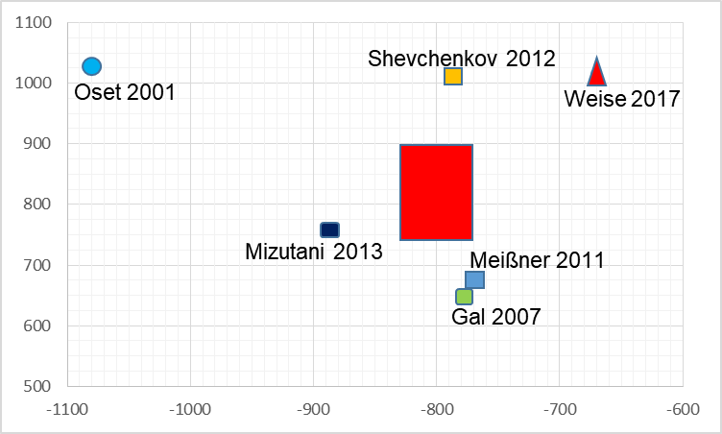
SIDDHARTA-2 K-d measurement
width [eV]
shift [eV]
A new renaissance for kaonic atoms at DAΦNE: future measurements and perspectives

Slide 27
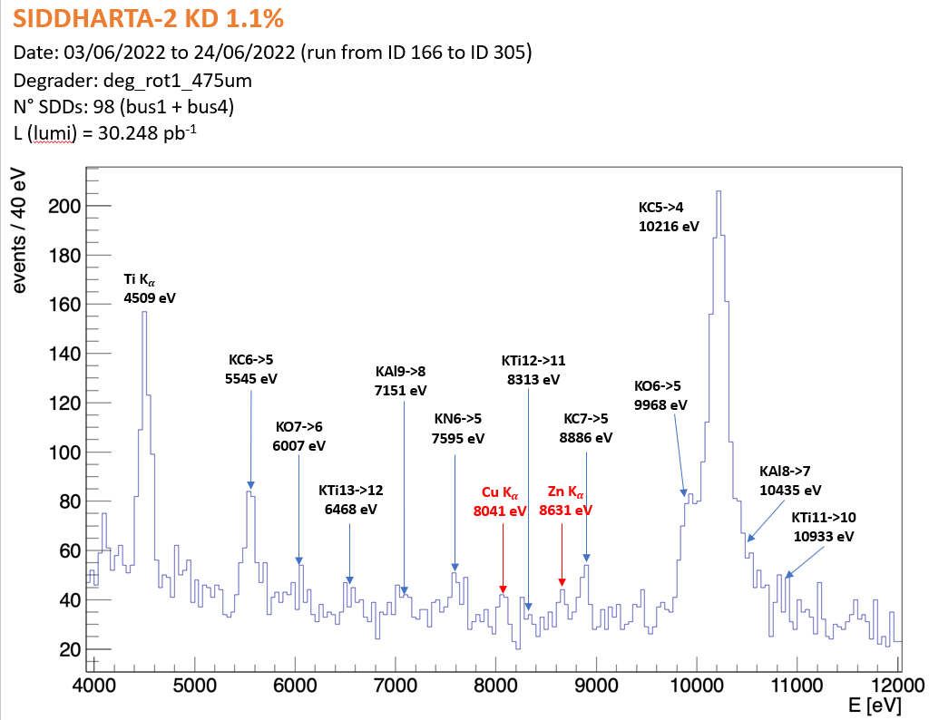
SIDDHARTA-2 K-d measurement
Very preliminary
First spectrum with deuterium target
Catalina Curceanu (A. Scordo)
A new renaissance for kaonic atoms at DAΦNE: future measurements and perspectives

Slide 28
SIDDHARTA-2 strategy and requests
    Setup with all the SDDs (48 SDD arrays) 2022/3 and the kaonic deuterium measurement for a run of 800 pb⁻¹
Action plan for Kd measurement:
First run of test with SIDDHARTA-2 setup as planned
(about 50 pb⁻¹ integrated) - 2022
Second run with optimized shielding, readout electronics and other necessary optimizations; (for other 750 pb⁻¹ integrated) - 2023
Test runs for other kaonic atoms measurements (HPGE…)
Phase 2
SIDDHARTA-2

Slide 29
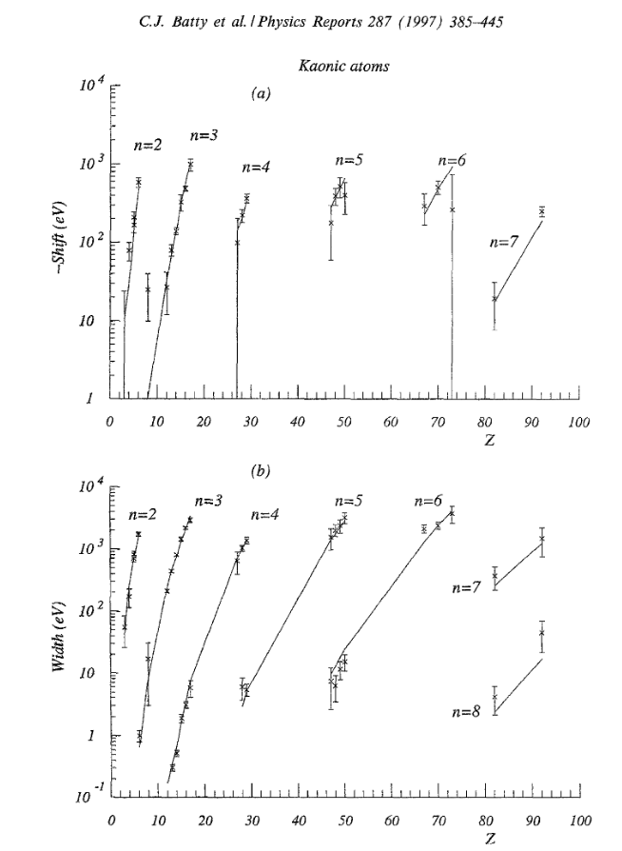
Strangeness precision frontier at DAΦNE: a unique opportunity for measurements of kaonic atoms along the periodic table: will represent a reference in physics with strangeness
Present status: old and very old measurements with low precisison (some even wrong: kaonic helium puzzle)
We propose to do precision measurements along the periodic table at DAΦNE for:
Selected light kaonic atoms
Selected intermediate mass kaonic atoms
Selected heavy kaonic atoms
charting the periodic table

Slide 30
For future:
Physics at the strangeness frontier at DAΦNE studies:
High Precision Kaonic Atoms Measurements on DAΦNE:
The strangeness Mendeleev table
We presented a program for performing unique measurements of kaonic atoms along the periodic table to contributing to understand physics going from the strong interaction (symmetry breaking) to neutron stars, and from Dark Matter to Physics Beyond Standard Model.
A strong international community is putting forward this realistic and feasible programme in particular in terms of the required integrated , that can be delivered within the upcoming 3-5 years, with support from National and European projects.

Slide 31
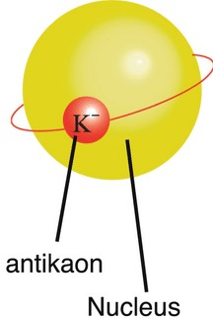
EXtensive Kaonic Atoms research:
from LIthium and Beryllium to Uranium
EXKALIBUR

Slide 33
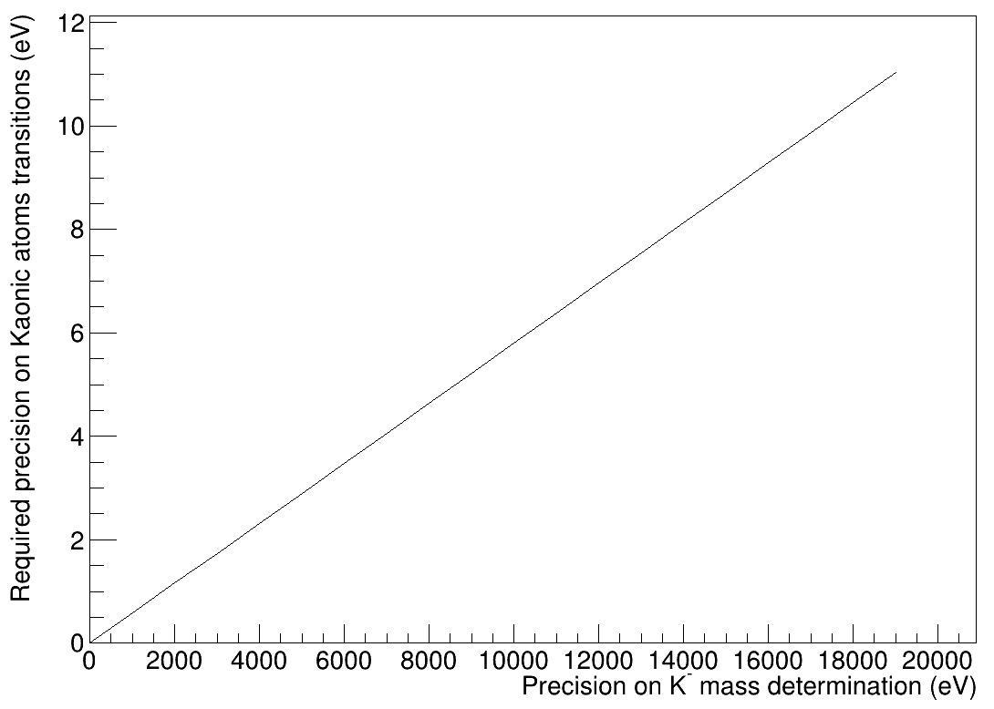
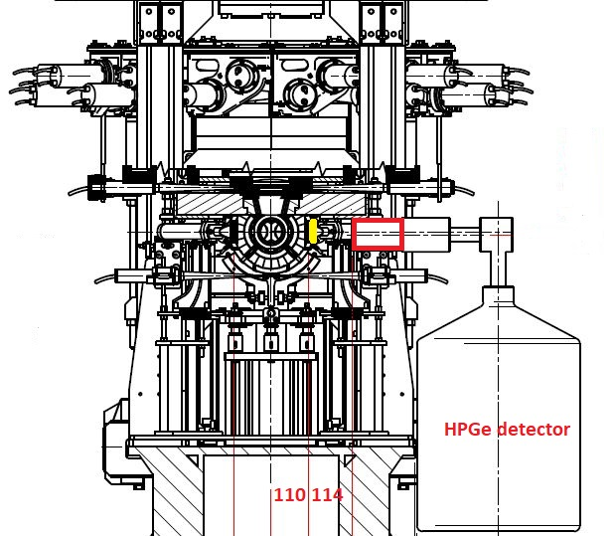
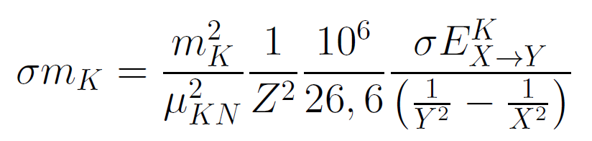
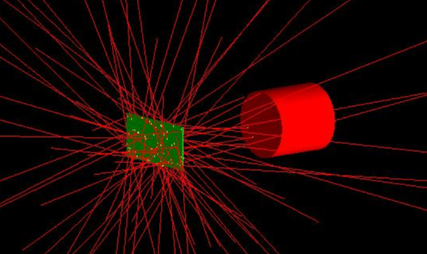
New Kaon Mass measurement with HPGe
Parallel run with SIDDHARTA-2: (already installed)
δE ~ 3 eV needed for δm_{K} = 5 keV
KPb(9→8) : 290 keV
Resolutions (FWHM)
obtained with ⁶⁰Co, ¹³³Ba sources :
0.870 keV @ 81 keV
1.106 keV @ 302.9 keV
1.143 keV @ 356 keV
1.167 keV @ 1330 keV
Pb target just behind
the SIDDHARTA-2 luminometer,
which is used as trigger
HPGe detector available,
Croatian Science Foundation project 8570
Catalina Curceanu (A. Scordo)
A new renaissance for kaonic atoms at DAΦNE: future measurements and perspectives

Slide 34
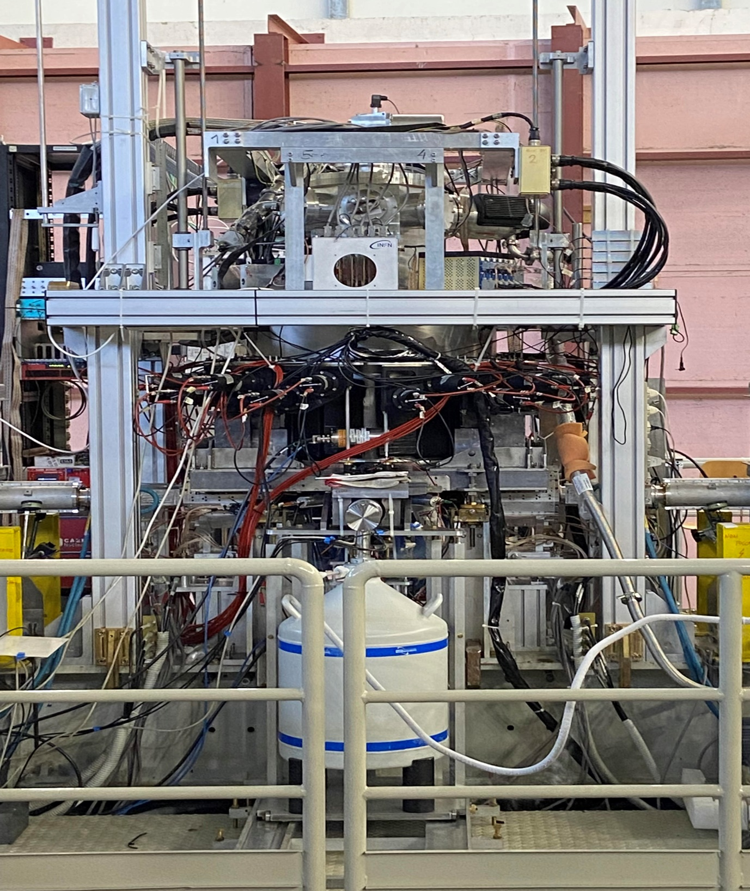
Present status

Slide 35
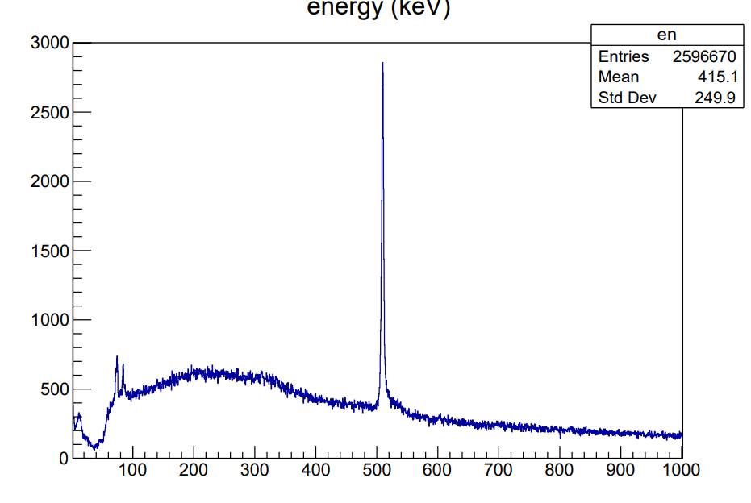
First HPGe spectrum (we plan a technical paper)

Slide 36
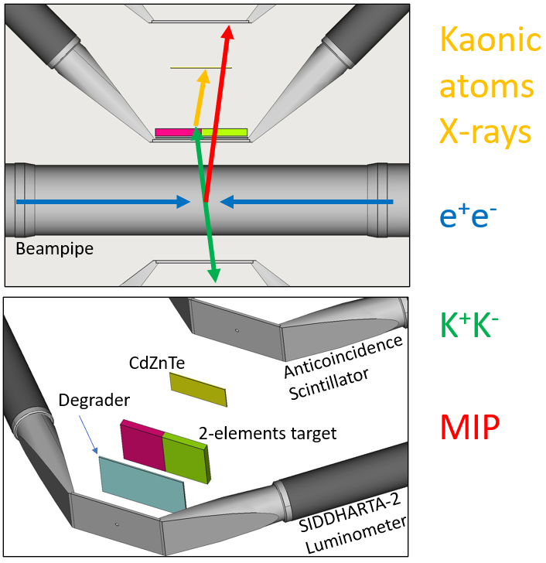
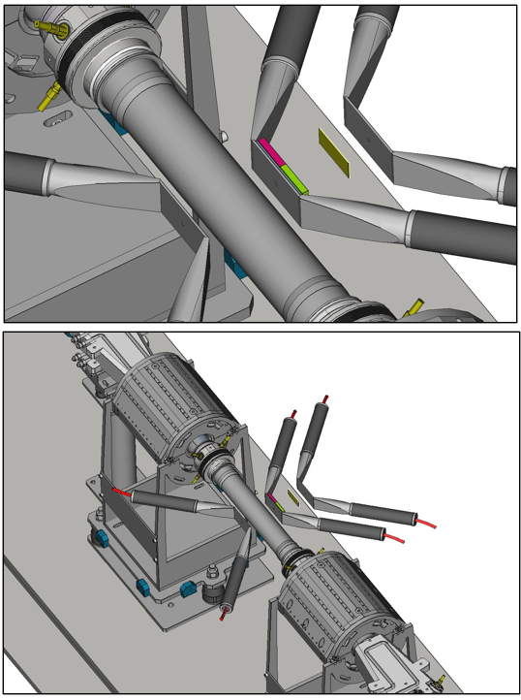
CZT: proposal for new measurements at DAFNE
Catalina Curceanu (A. Scordo)
A new renaissance for kaonic atoms at DAΦNE: future measurements and perspectives

Slide 37
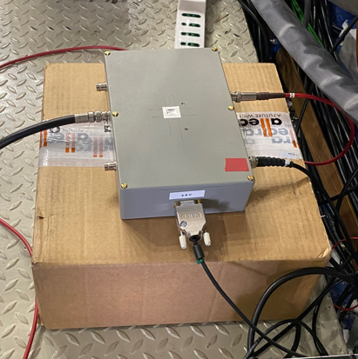
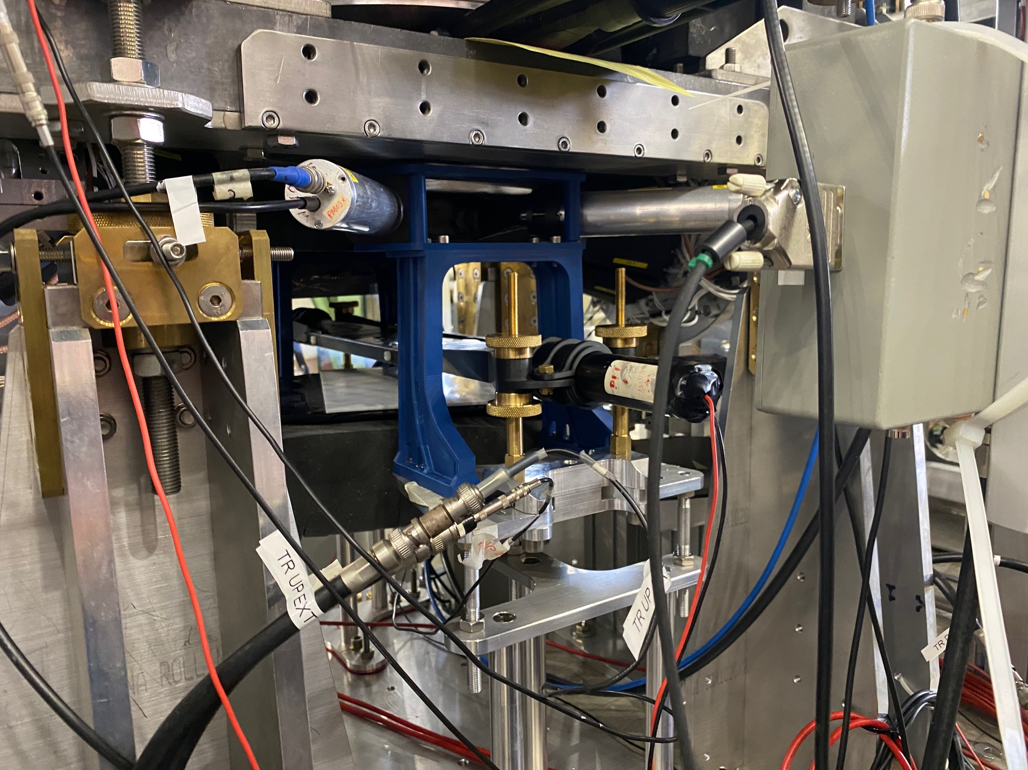
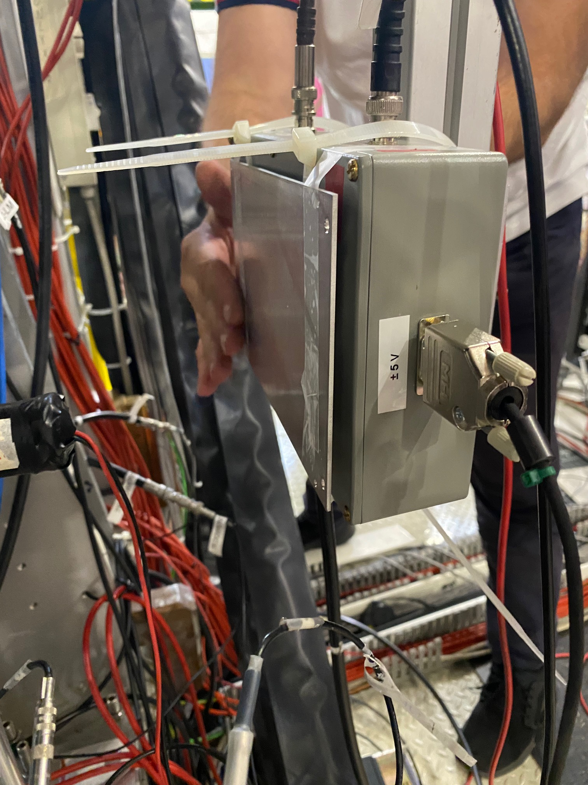
CZT: test prototype mounted in DAFNE (22/06/2022)
1 mm² 5mm thick CZT detector produced by IMEM-Parma
Light-tight box with
Electronics (UniPa)
Entrance window
Goal: background and resolution assessment in machine environment (first time)
Aligned with SIDDHARTA-2 luminometer
Al plate (thickness not optimized)
+
²⁴¹Am source for calibration
Catalina Curceanu (A. Scordo)
A new renaissance for kaonic atoms at DAΦNE: future measurements and perspectives

Slide 38
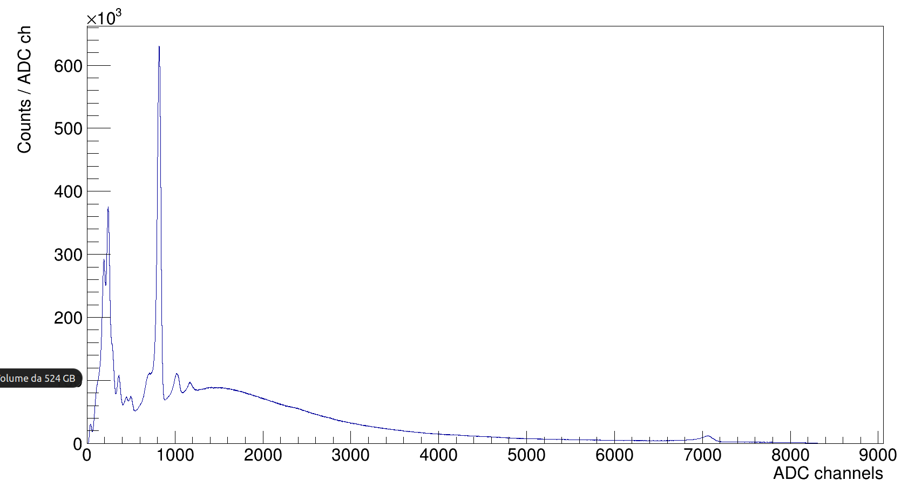
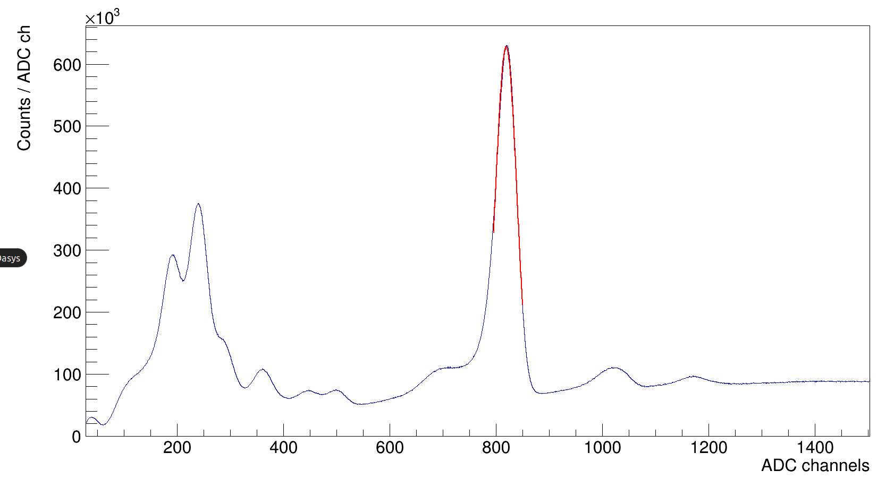
CZT: test prototype mounted in DAFNE (22/06/2022)
Am
FWHM / E = 6 % @ 60 keV
Np peaks
Am
Pb peaks
511 keV peak
(e⁺e⁻ annihilation)
Catalina Curceanu (A. Scordo)
A new renaissance for kaonic atoms at DAΦNE: future measurements and perspectives

Slide 39
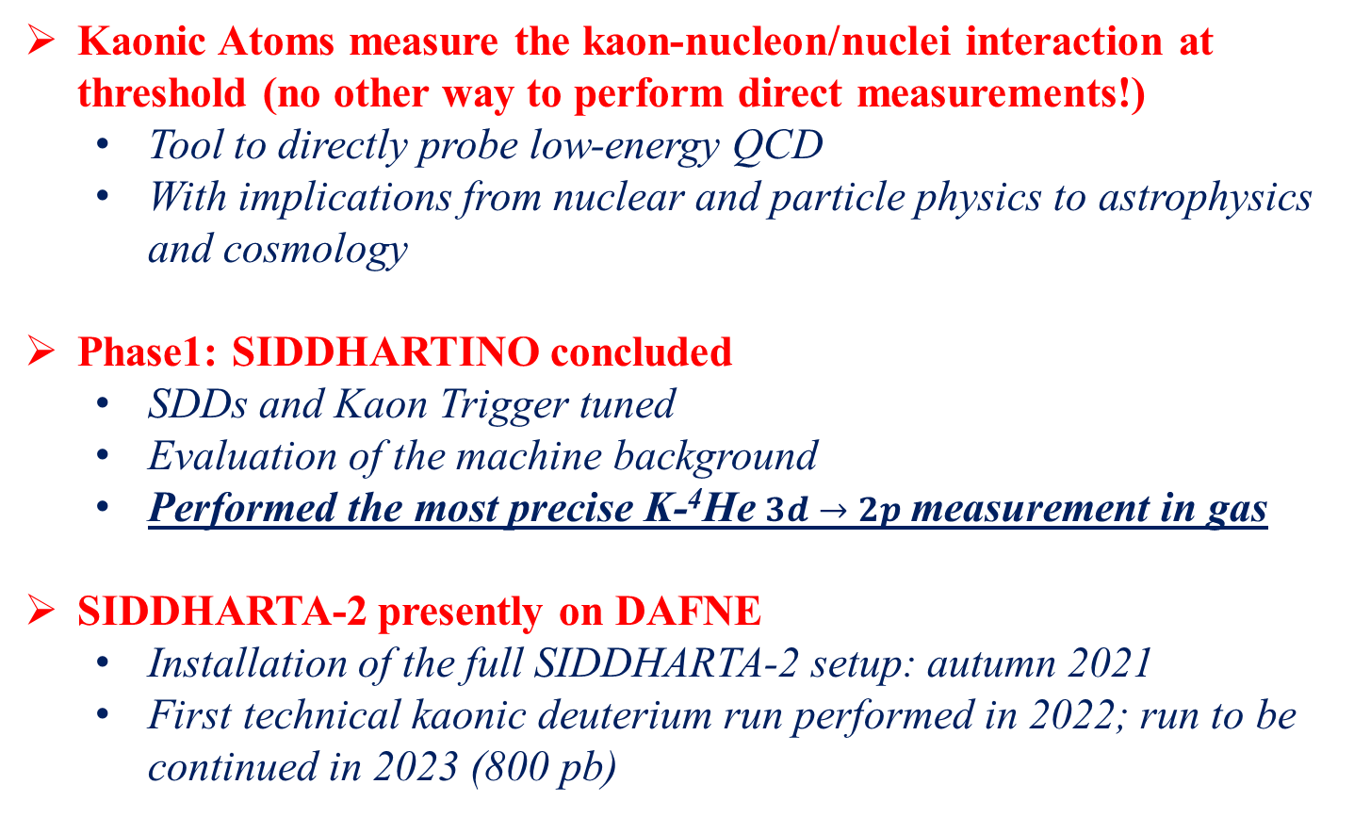
Conclusions
Kaonic Atoms measure the kaon-nucleon/nuclei interaction at threshold (no other way to perform direct measurements!)
  Tool to directly probe low-energy QCD
  With implications from nuclear and particle physics to astrophysics and cosmology
Phase1: SIDDHARTINO concluded
  SDDs and Kaon Trigger tuned
  Evaluation of the machine background
  Performed the most precise K-⁴He $3d→2p$ measurement in gas
SIDDHARTA-2 presently on DAFNE
  Installation of the full SIDDHARTA-2 setup: autumn 2021
  First technical kaonic deuterium run performed in 2022; run to be continued in 2023 (800 pb)
Catalina Curceanu (A. Scordo)
A new renaissance for kaonic atoms at DAΦNE: future measurements and perspectives

Slide 40
Beyond SIDDHARTA-2: EXCALIBUR
JOIN US!
Feasibility studies in parallel with Siddharta-2
Various setups in preparation:
  HPGe
  Crystal spectrometers (VOXES)
  CdZnTe detectors
  SDD 1mm for kaonic atoms measurement
Proposal for Extension of the Scientific Program at DAFNE:
  Kaon mass - precision measurement at a level < 7 keV
  Kaonic helium transitions to the 1s level
  Other light kaonic atoms (K⁻ Bi, Li, B,, K⁻ C,…)
  Heavier kaonic atoms (K⁻ Si, K⁻ Pb…)
  Radiative kaon capture – Λ(1405) study
  Investigate the possibility of the measurement of other types of hadronic exotic atoms (sigmonic hydrogen )
Catalina Curceanu (A. Scordo)
A new renaissance for kaonic atoms at DAΦNE: future measurements and perspectives

Slide 41
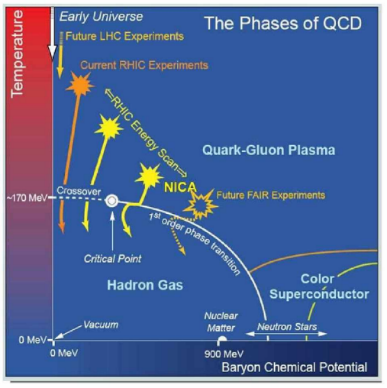
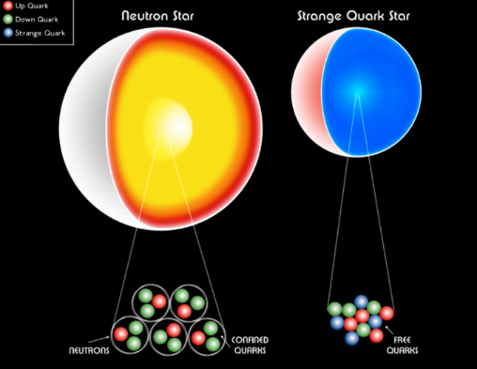
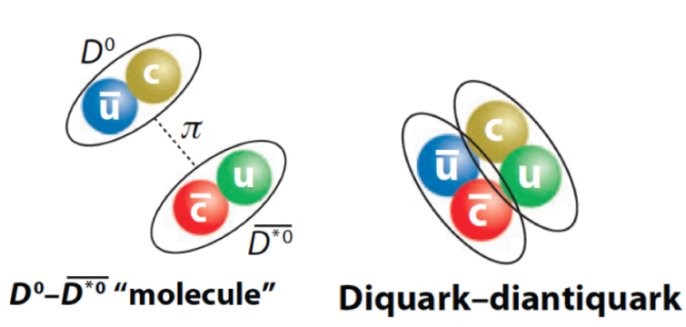
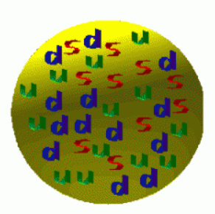
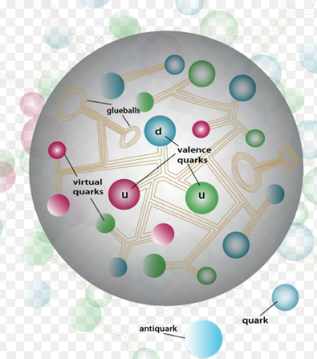
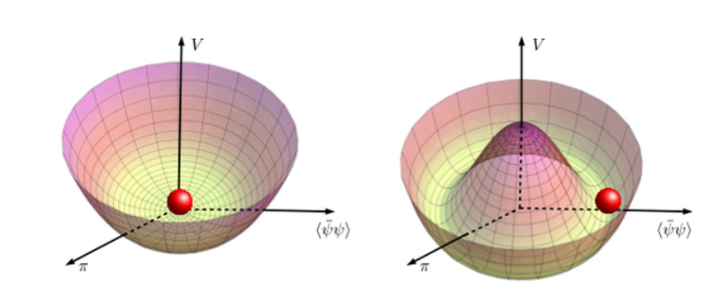

Neutron star EOS
Particles structure
Cold Dense matter
Strangeness Fundamental Physics
Mass generation, visible Universe
QCD
Chiral symm.
Strangelets & Dark Matter

Slide 42


Slide 43

ThanK You

