Slide 1





Biomedical Applications of Radioactive ion Beams: First results of the BARB project at GSI
Marco Durante
www.gsi.de/BARB

Slide 2

Bragg peak in therapy
Durante, Br. J. Cancer 2019

Slide 3
Range uncertainties

Slide 4
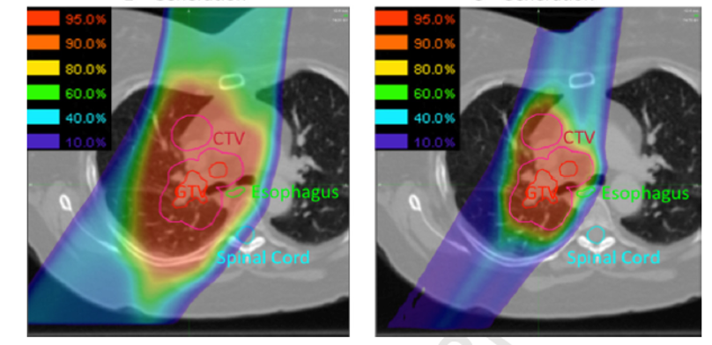
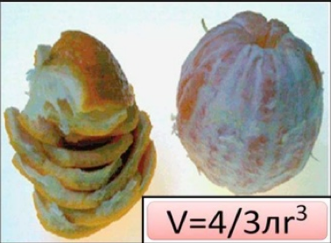
Range uncertainty jeopardizes the Bragg peak precision
Durante & Flanz, Semin. Oncol. 2019
Total margins ∼ 1 cm compared to a proton penumbra ∼ 2 mm
Verellen et al., Nat. Rev. Cancer. 2007

Slide 5
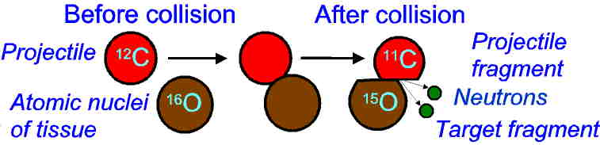
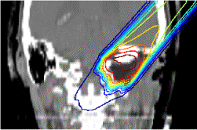
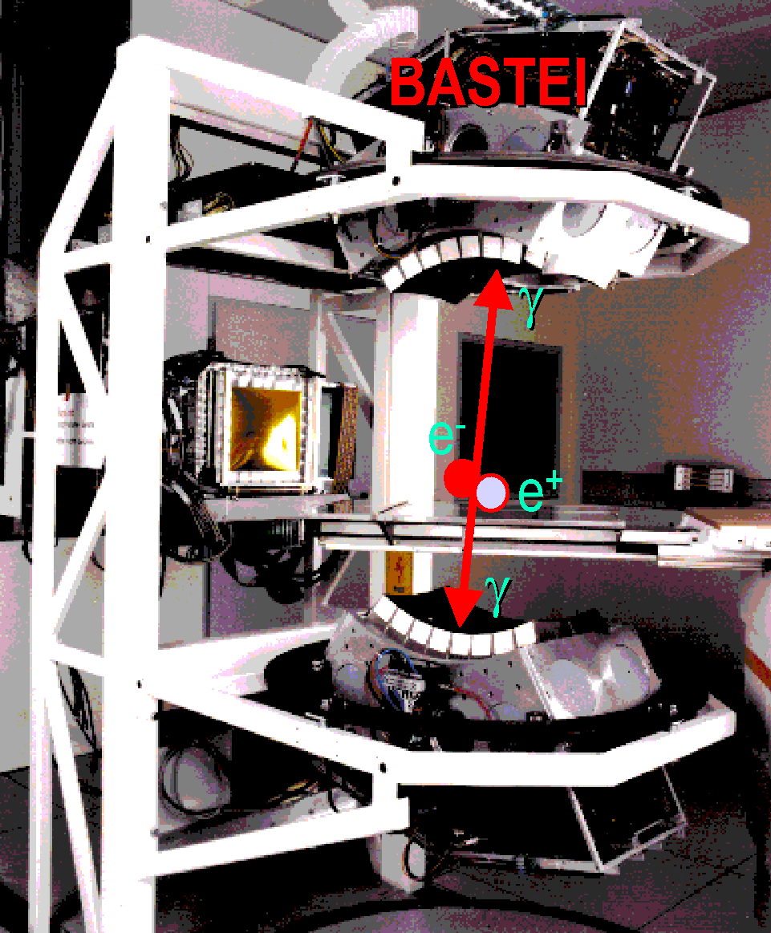
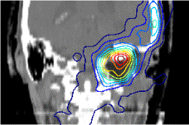
In situ control with PET @GSI
dose plan
Fiedler et al., Phys. Med. Biol. 2010
measured

Slide 6
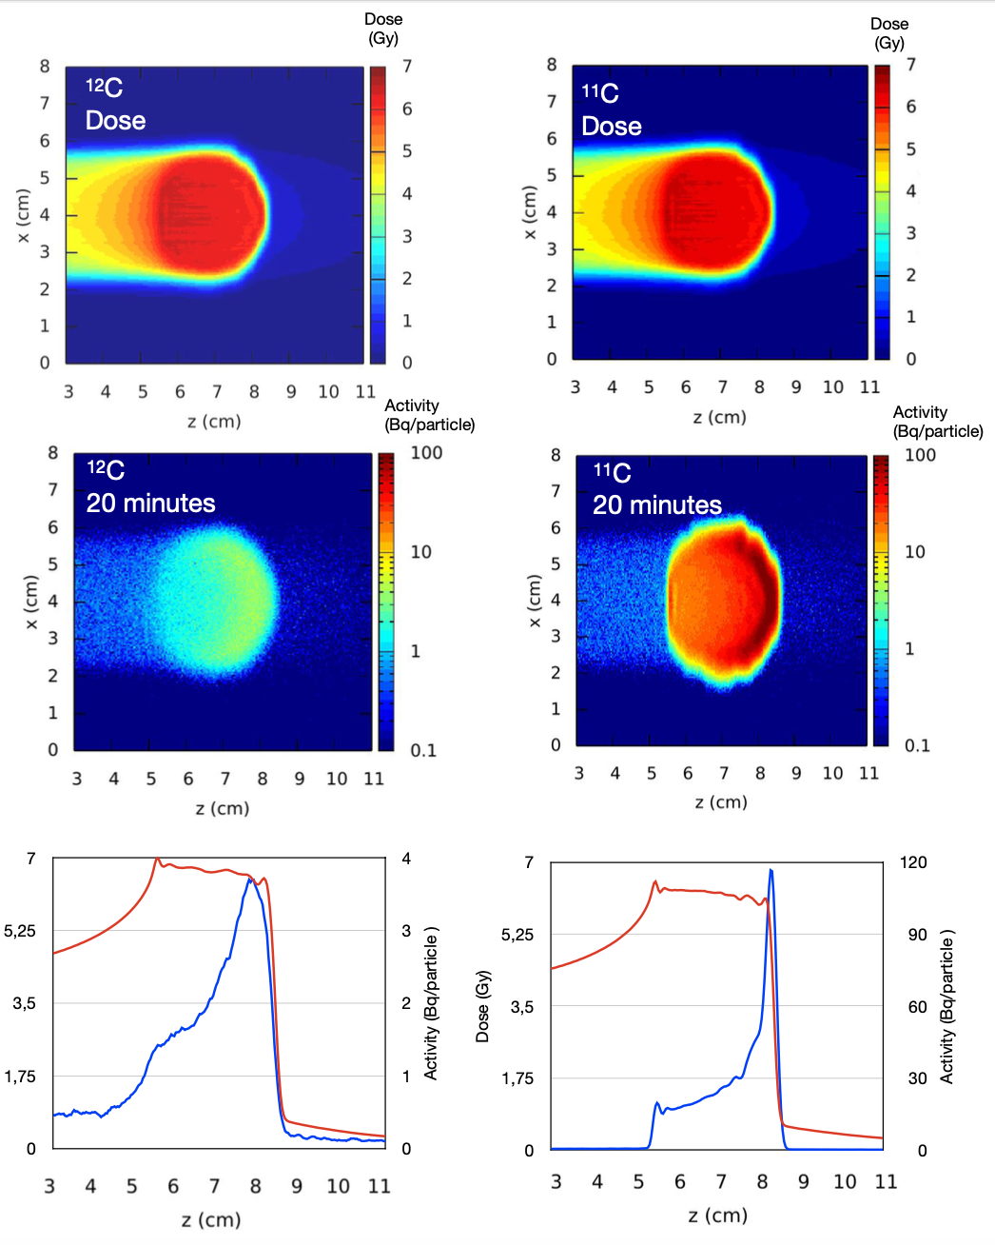

Radioactive Ion Beams (RIB) for simultaneous treatment and range verification
Respect to conventional PET imaging in heavy ion therapy, RIBs show:
Improved count rate (one order of magnitude larger than for stable ions)
Improved correlation between activity and dose
Reduced washout blur thanks to short lived isotopes
Hampered by the low intensities achievable
RIB therapy is now revived thanks to the construction of
therapy compatible high-intensity accelerators.
e.g. FAIR Phase 0 at GSI (Darmstadt, Germany)
Boscolo et al. Front. Oncol. 2020

Slide 7
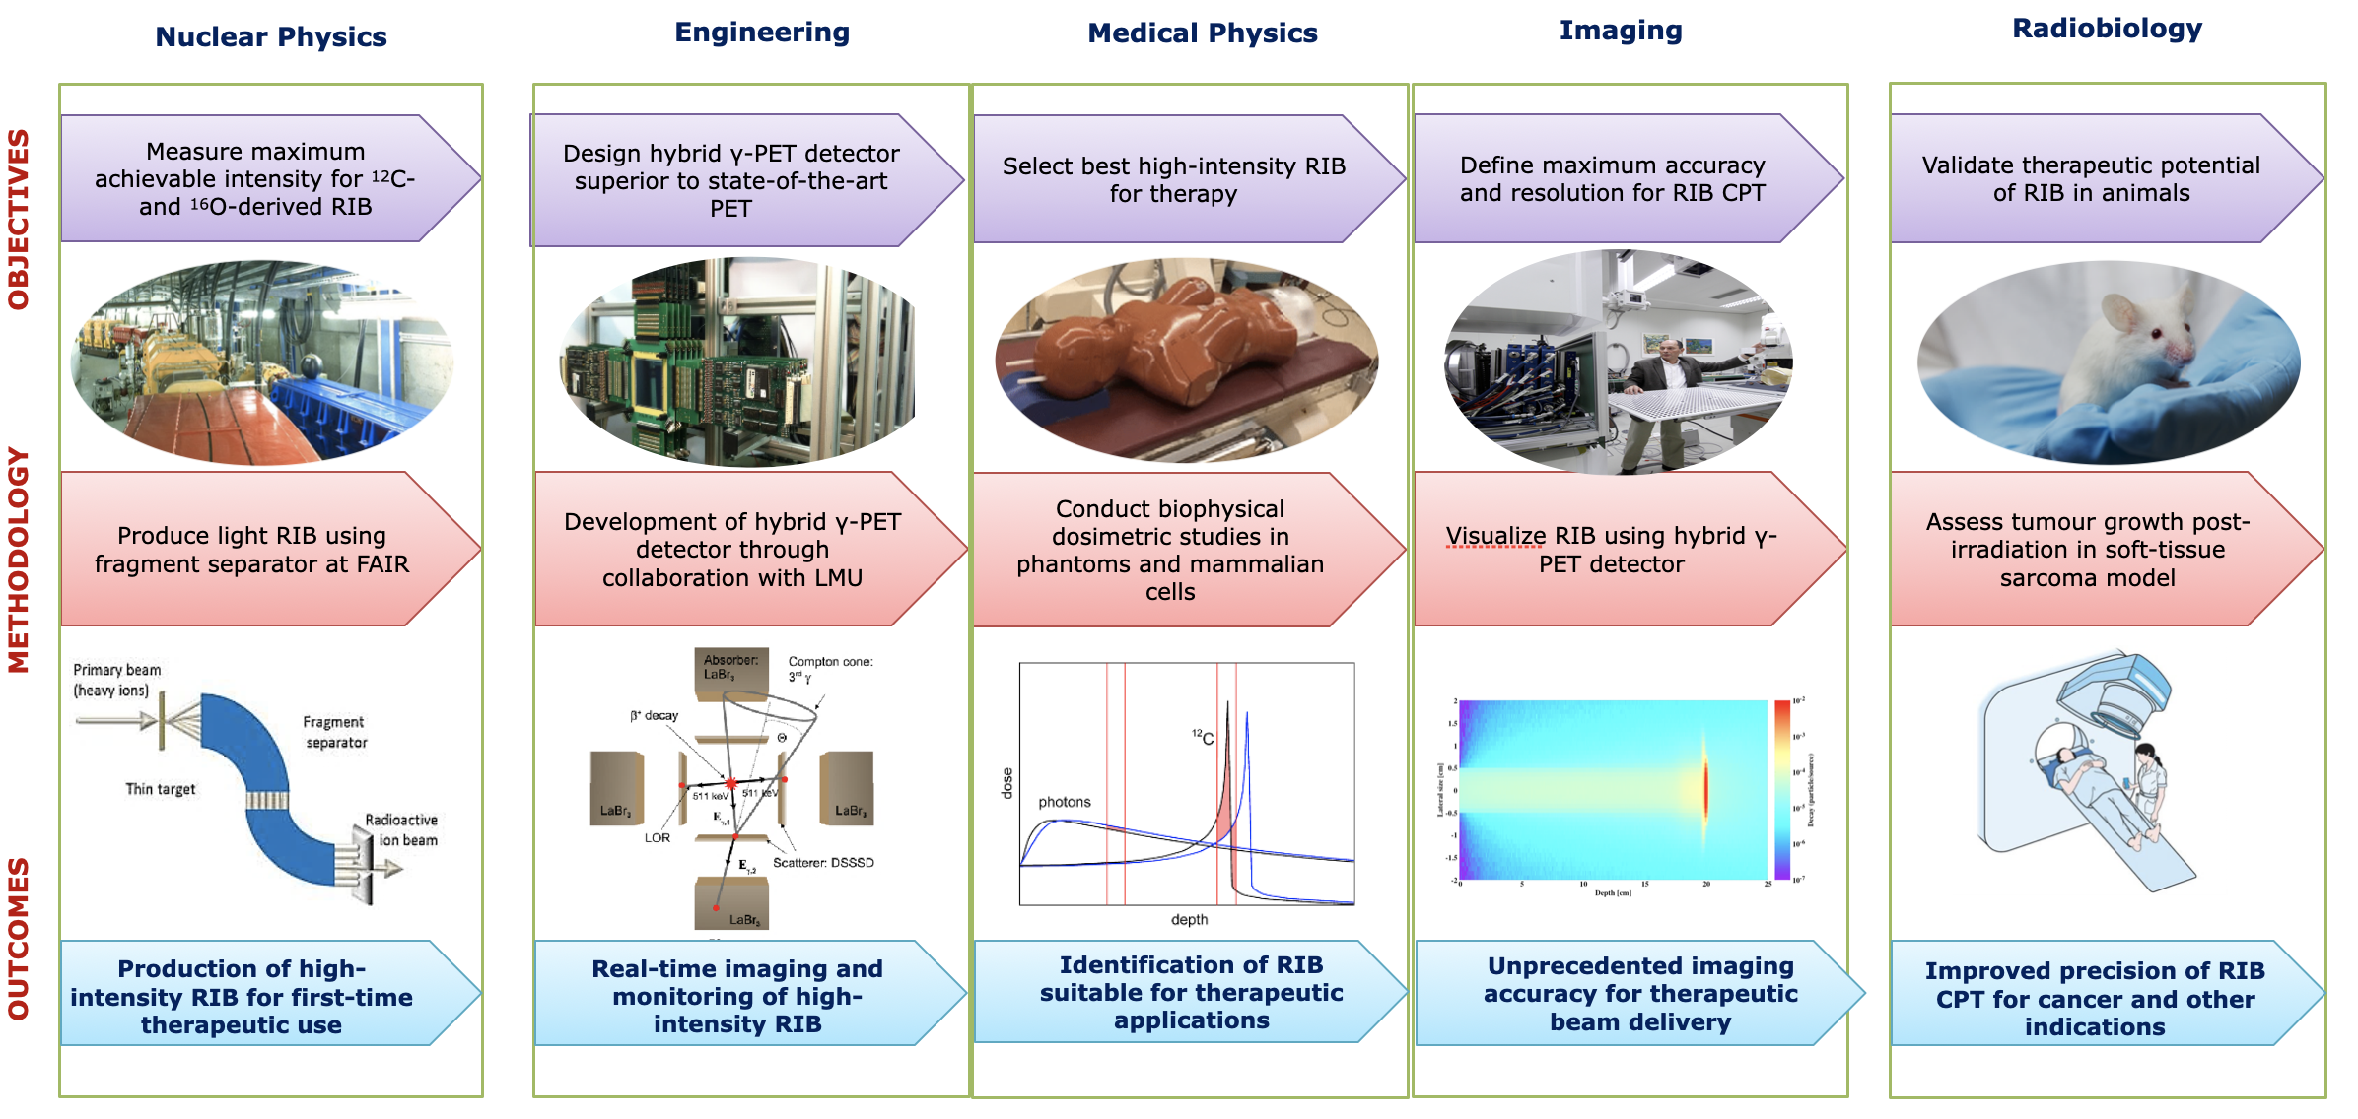
BARB project (www.gsi.de/BARB)

Slide 8
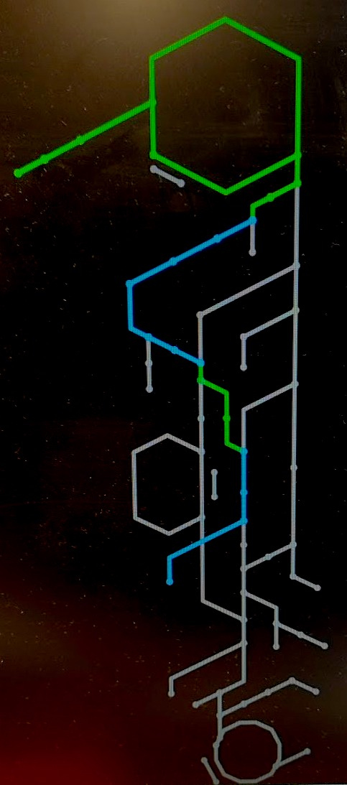
FAIR Phase 0: upgrade of the SIS-18 accelerator at GSI
RIBs at GSI-FAIR
RIBs candidates at FRagment Separator (FRS):
SIS18
Isotope | ¹²C | ¹¹C | ¹⁰C | ¹⁶O | ¹⁵O | ¹⁴O
Half-life, min | stable | 20.4 | 0.32 | stable | 2 | 1.17
Intensities | ~ 10⁶–10⁹ particles per spill
FRS
Commissioning of FRS-CAVE M (medical cave) beam line:
oxygen beams (June 2021):
Transmission FRS-Cave M ¹⁵O: 6%
¹⁵O in Cave M per ¹⁶O in SIS18: 6e-4
Cave M

Slide 9
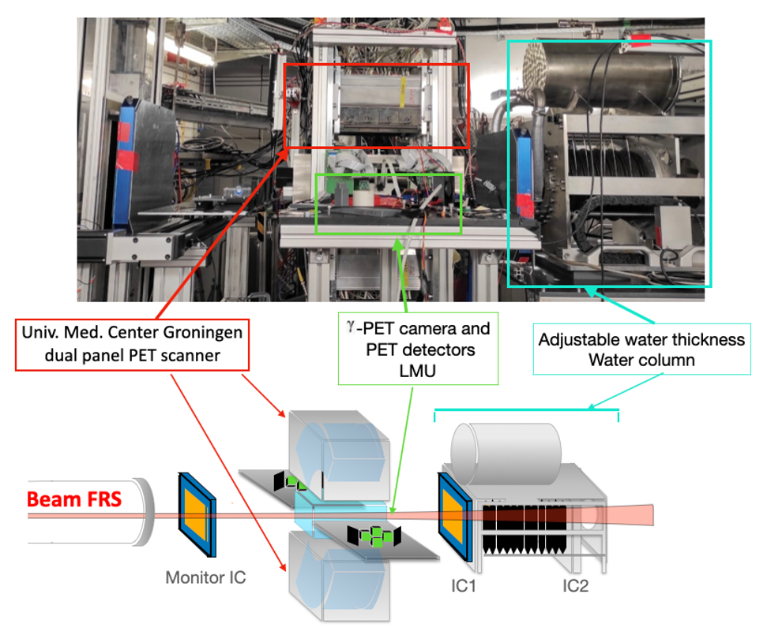
First experiments at FRS and in Cave M
Experimental setup for dosimetry and PET imaging
Isotope | ¹²C | ¹¹C | ¹⁰C | ¹⁶O | ¹⁵O | ¹⁴O
Phantom | PMMA, PE |  |  | PMMA
Energy | ~ 270, 145, 240 MeV/u |  |  | ~ 300,170 MeV/u
Target area
Middle focal pane
Final focal pane
Degrader
PET setup

Slide 10
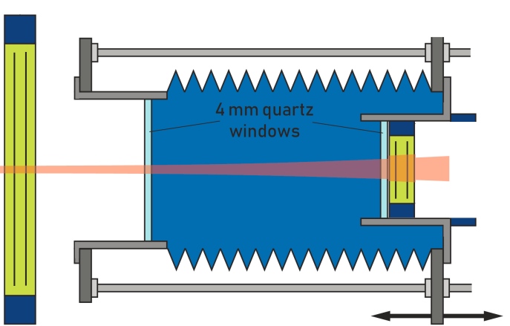
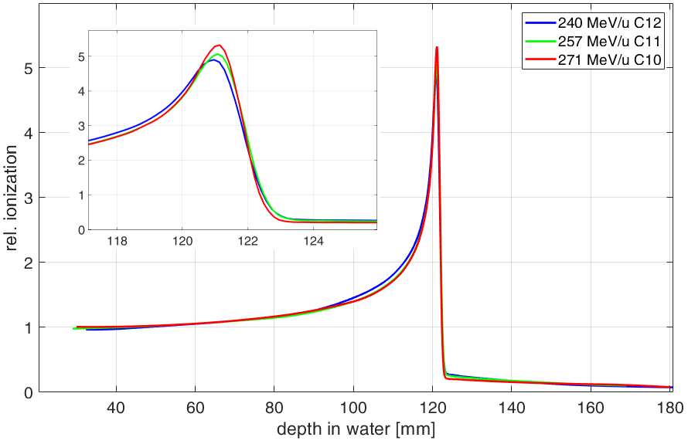
Depth dose profiles measurements
IC1
Reference measurement
Bragg Curves and ranges in water have been measured in all the experiments conditions with a water column.
Beam (FRS)
IC2
measurement position
Monochromaic mode
Achromatic mode
Boscolo et al., Nucl. Instr. Meth. under revision

Slide 11
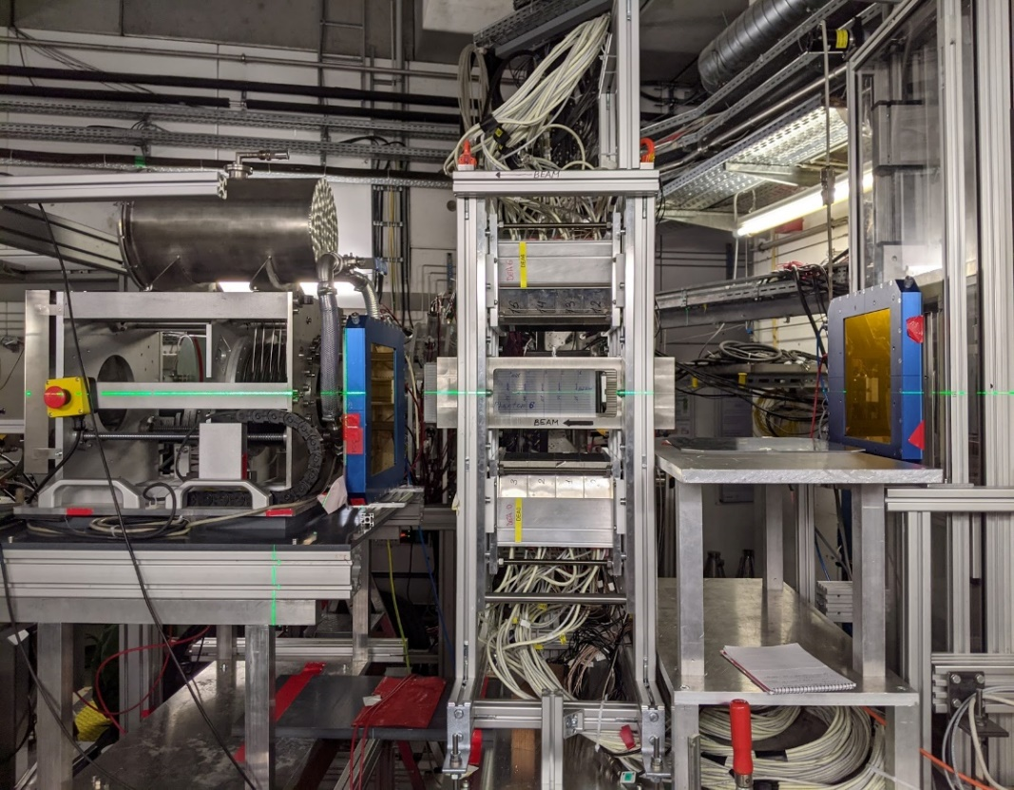
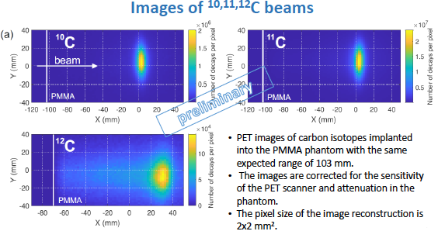

In-beam PET imaging with a SIEMENS scanner
Univ. Med. Center Groningen
dual panel PET scanner
Beam (FRS)
Monitor IC
imaging phantom
FRS: FRagment Separator at GSI, Darmstadt
PET imaging: Dual panel PET scanner. Univ. Med. Center Groningen

Slide 12
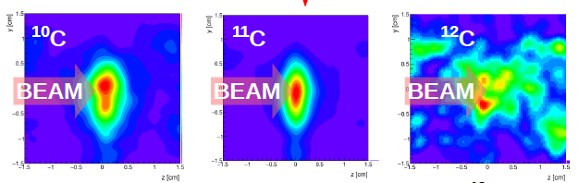
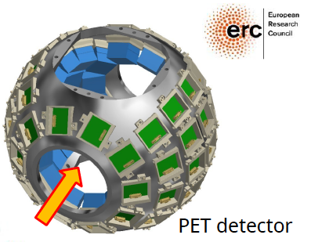

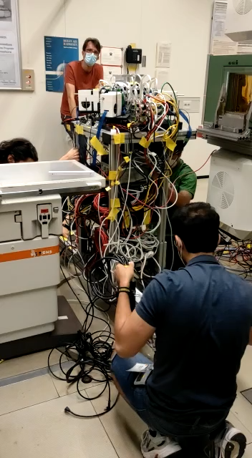
In-beam PET imaging with SIRMIO detector

Slide 13
Planned biological experiments in 2023-2024
In vitro:
Any unexpected difference in RBE?
In vivo:
RIBs for therapy:
can we efficiently kill the tumor with reduced field size?
RIBs as in vivo Tracers:
role of vascular damage in single-fraction high-dose radiotherapy?
Simulation: TRiP98, GSI

Slide 14
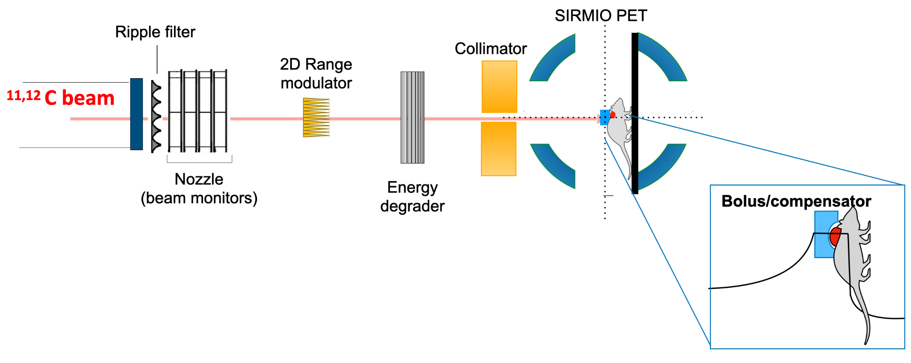
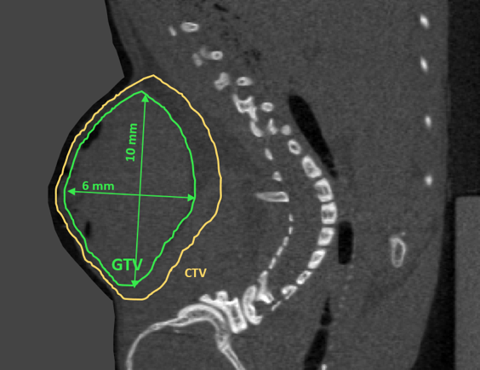
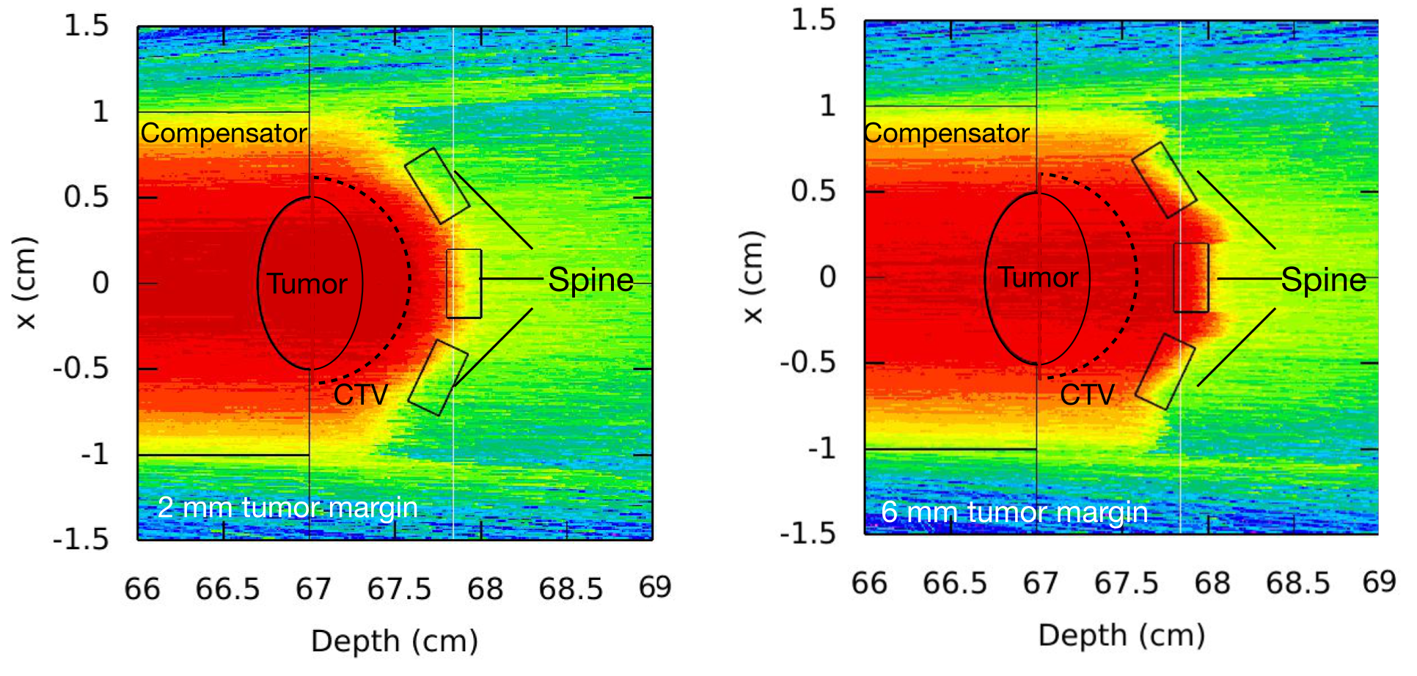
Achieving sub-mm precision in vivo
Boscolo et al. Front. Oncol. 2020

Slide 15

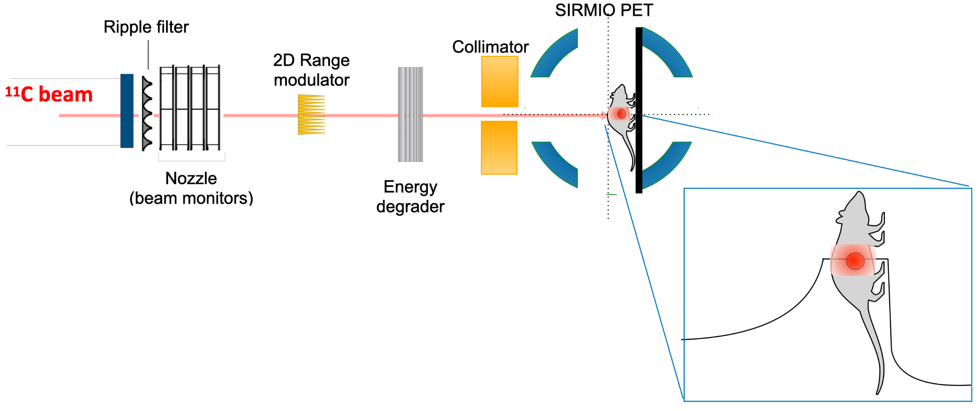
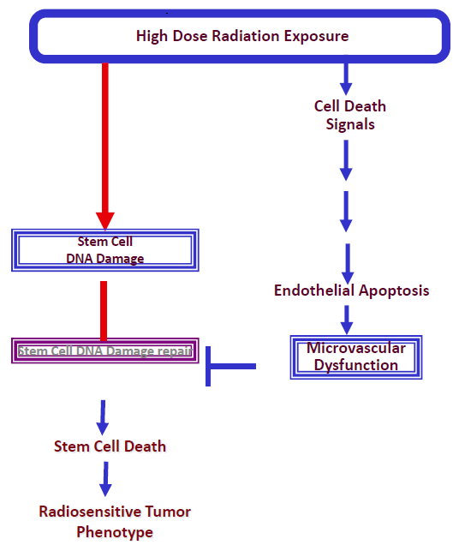
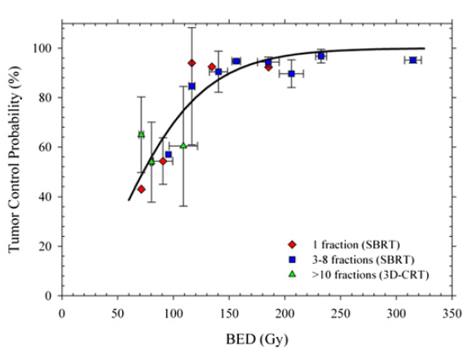
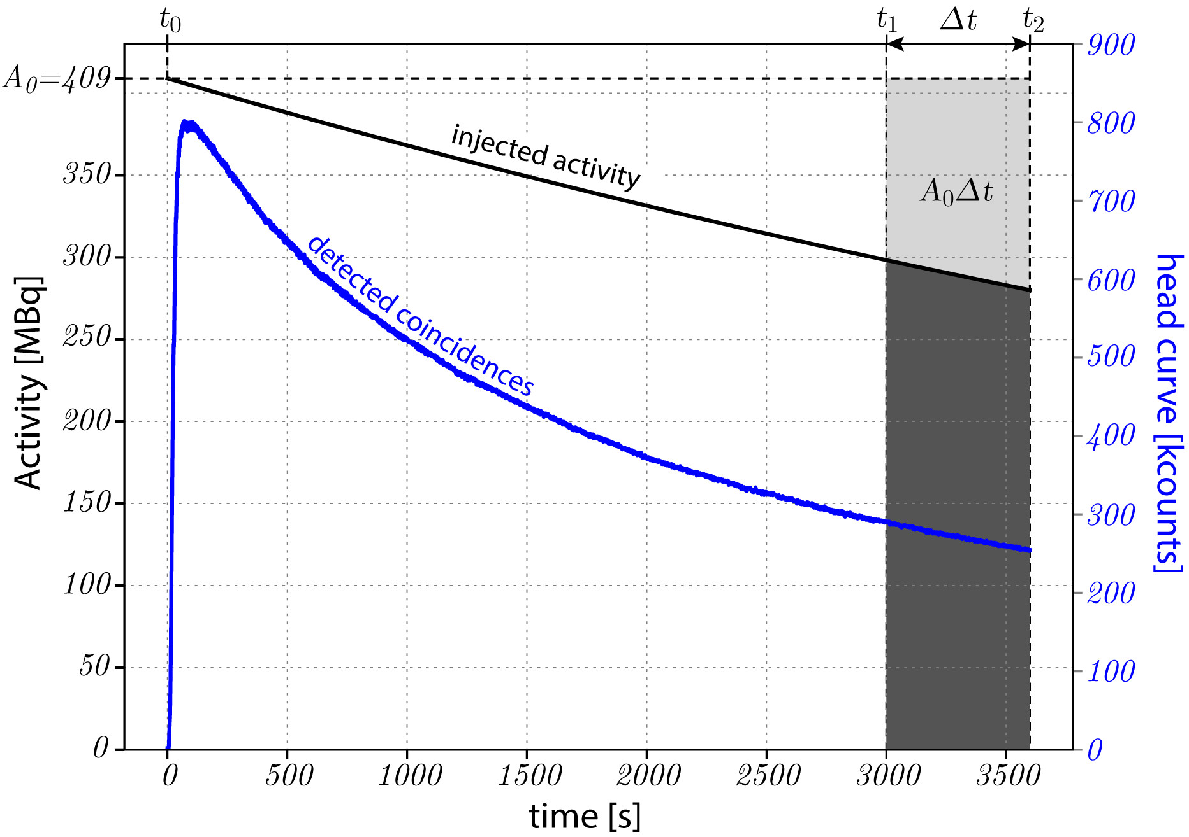
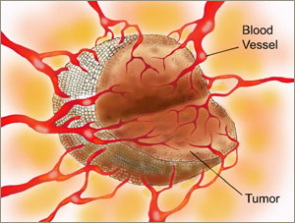
RIB as tracers
Boscolo et al. Front. Oncol. 2020
Kolesnik et al., Science 2008
Brown et al., Int. J. Radiat. Oncol. Biol. Phys. 2013

Slide 16
Conclusions
Radioactive ion beams might be an ideal bullet for image-guided radiotherapy: they are expected to improve the precision treatments and thus widen the therapeutic window
In FAIR-phase-0, RIBs can be produced with clinical intensities
The main objective of BARB is to introduce a new method for image-guided particle therapy, using radioactive ion beams as projectiles for treatment and online imaging.
The ambition is to fully exploit the Bragg peak and improve the precision and image-guidance, giving the opportunity to treat new targets in oncology and non-malignant diseases.
First experimental campaign took place in 2021; biological experiments will follow in 2023-2024 also to exploit RIBs as radioactive tracers

Slide 17


Acknowledgements
…and thank you for the attention!

