Slide 1
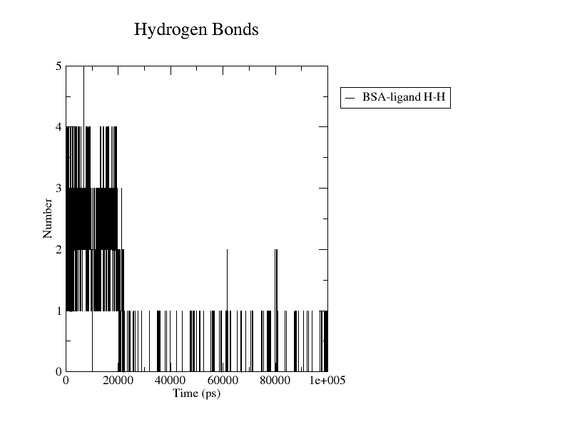
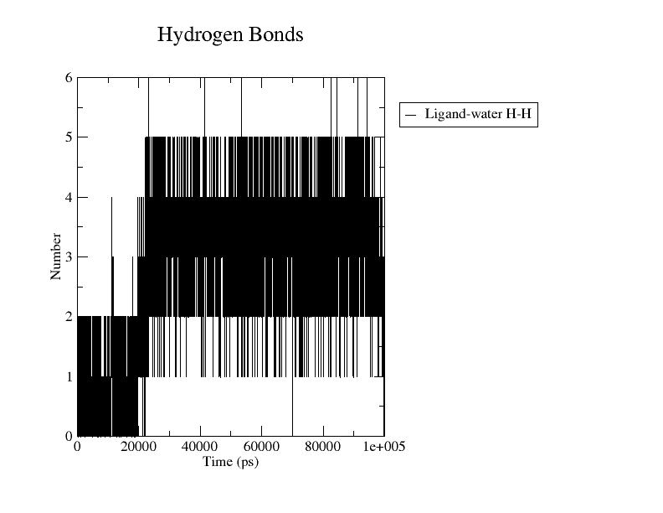
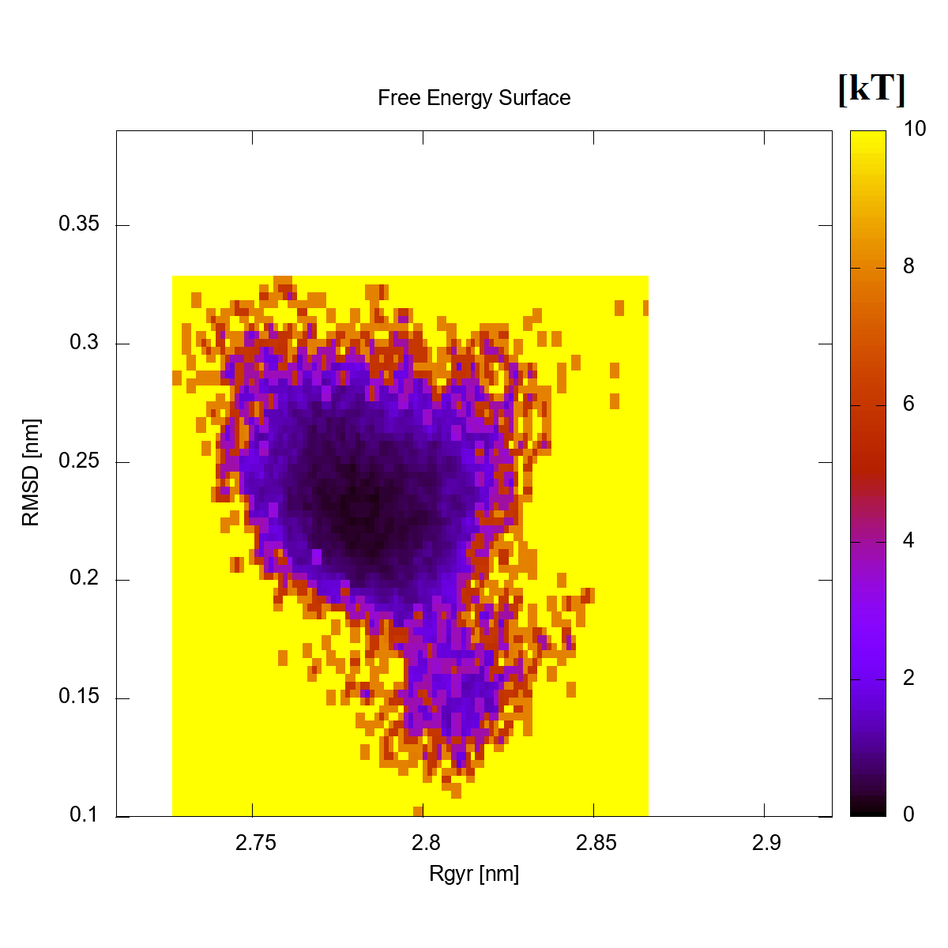
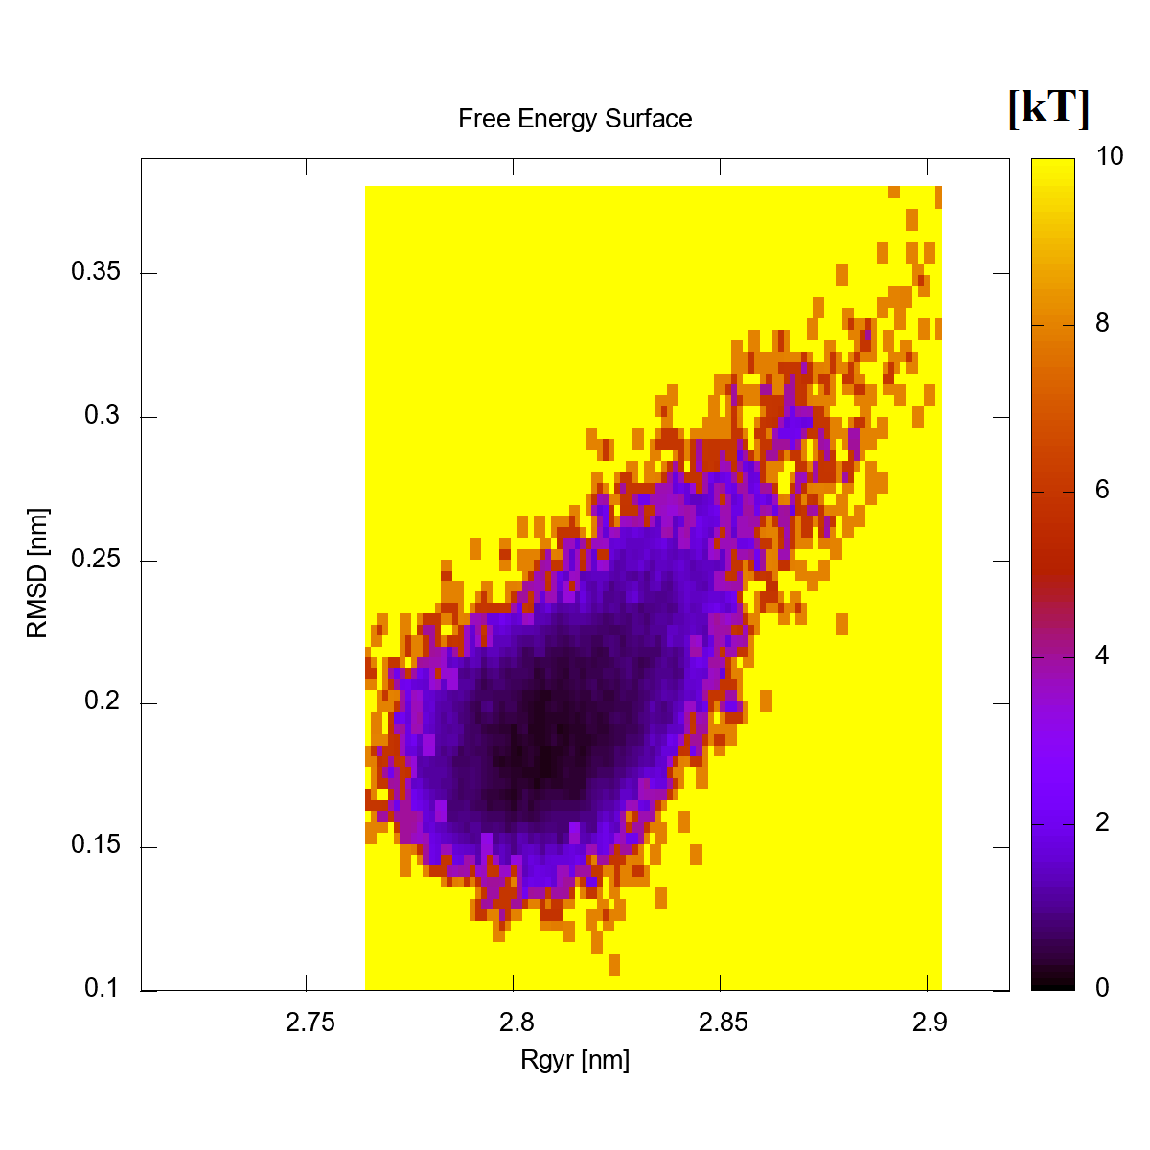
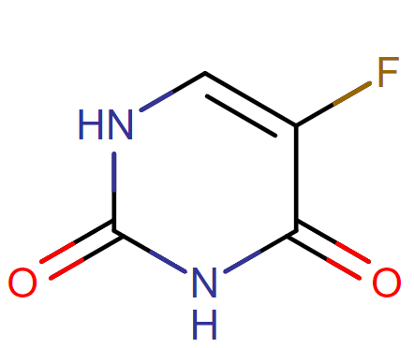
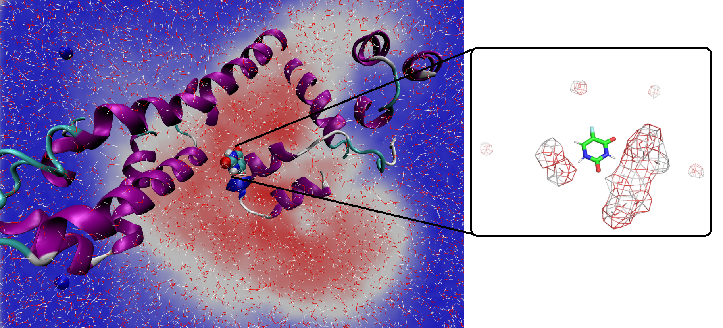
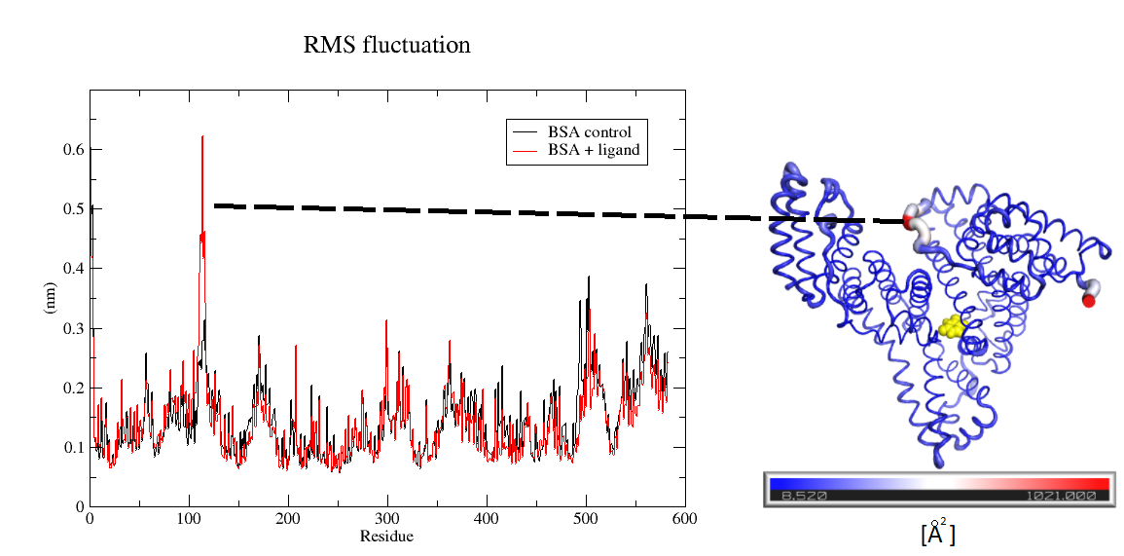
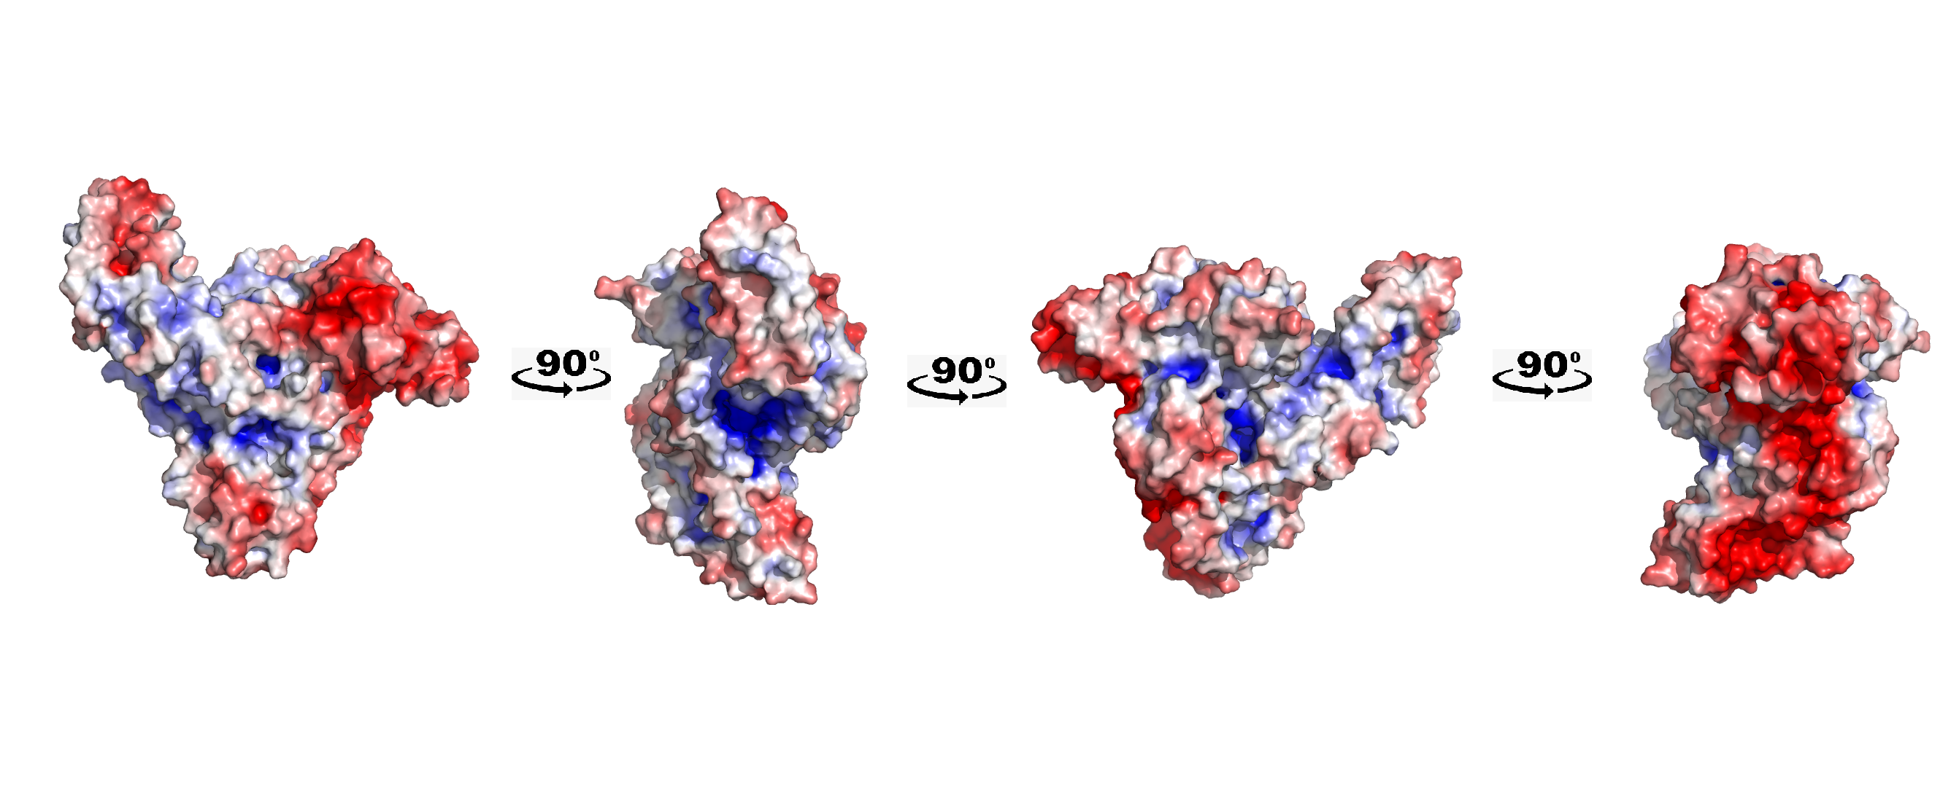
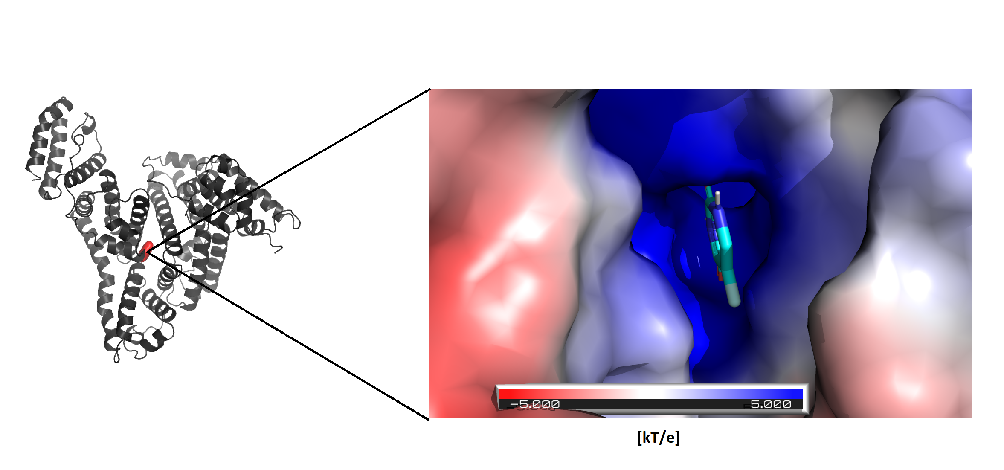
BSA as a biologically active nanocarriers
– computational studies
Kamil Rakowski, Barbara Jachimska
Jerzy Haber Institute of Catalysis and Surface Chemistry, PAS, Niezapominajek 8, 30-239 Krakow, Poland
Human albumin (HSA) is the main plasma protein that ensures the maintenance of proper osmotic blood pressure and is also involved in the transport of metabolites to cells. It exhibits high solubility at pH = 7.4 and the ability to bind molecules, making it possible to use it as a transporter of drugs such as 5-fluorouracil (5-FU) [1]. 5-FU is a drug that causes the incorporation of fluoronucleotides in place of nucleotides that inhibit the thymidylate synthesis of the nucleic acid enzyme. 5-Fluorouracil is used to treat a number of cancers. The biggest problem is its susceptibility to dihydropyrimidine dehydrogenase (DPD), which metabolizes 5FU to the form of dihydrofluorouracil (DHFU) [2] and destroys its therapeutic activity. The crystallographic model of bovine albumin (BSA), which is an equivalent of human albumin (HSA), was selected for the research. Before the docking process, the model was prepared in the Gromacs program. The model was minimized, equilibrated and simulated for 100ns under controlled conditions: T = 298K P = 1Bar, ionic strength I = 0.01M NaCl, CHARMM36 force field, and TIP3P water model. The object was simulated until the conformational changes stabilized, which was monitored via the RMSD function. Finally, the coordinates from the last simulation frame were recorded, and the thus obtained BSA model was used for interaction with 5-FU. Before the docking process, the drug was prepared in the Avogadro program. The 5-fluorouracil ligand was obtained from the DrugBank database. Hydrogens corresponding to a protonation state of pH = 7.4 were added to the drug molecule and minimized in the MMFF94 field using a Conjugate Gradient. The standard protocol of random docking on the whole protein volume was used, the MGLTools tool was used, docked using the rigid Autodock Vin methods. The lowest energy complex was simulated with MD, the drug-free control and the protein/ligand complex were simulated for another 100ns under the same conditions.
Number of hydrogen bonds as a function of simulation time
Free energy landscape of the protein surface
obtained from 100ns simulations
between BSA and 5-FU,
between 5-FU and water
BSA without 5-FU
BSA with 5-FU
Water density profile
3D representation of the BSA carbon chain vibration with the location of the strongest fluctuation in the presence of the 5-FU.
Root-mean-square (RMS) fluctuation
last frame image representing ligand coordinated by solvent clusters inside binding pocket.
water atom density distribution map from 100ns of simulation
compilation of mean square functions of protein chain fluctuations in the presence of the 5-FU and without
BSA electrostatic potential (APBS)
Hydrophobicity of the ligand binding pocket
negative charge – red, positive charge - blue color,
Map of the hydrophobicity of the ligand binding pocket and dominant interactions between BSA and the ligand in the complex with the lowest energy
Specified binding site of 5FU with the lowest energy
Conclusions
BSA has been shown to bind 5-FU at a similar position as HSA in the IB domain. Moreover, it has been established by computational methods that the binding of 5-FU at the center of the protein (IIIA and IIA domains) may be the most common and energetically most beneficial for BSA. Hydrophobic domains inside the ligand-binding pocket have been shown to influence the organization of solvent molecules and the formation of water clusters. The formed clusters constitute the main mechanism that stabilizes the drug inside the canal, which may show promise for its controlled release at elevated temperatures. During the simulation, 5-FU moves into the cavity between domains IIIA and IIA. The binding of 5-FU may affect the mobility of adjacent BSA domains, in particular the IB domain, which is one of the most important pockets for binding substances with therapeutic potential. The presence of the ligand between domains IIIA and IIA resulting in the appearance of strong local chain fluctuations (110-118AA, IB domain).
Acknowledgments: This work was partially supported by project NCN OPUS 2016/23/B/02788
Notes:
1

