Slide 1
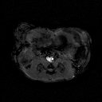
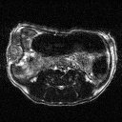
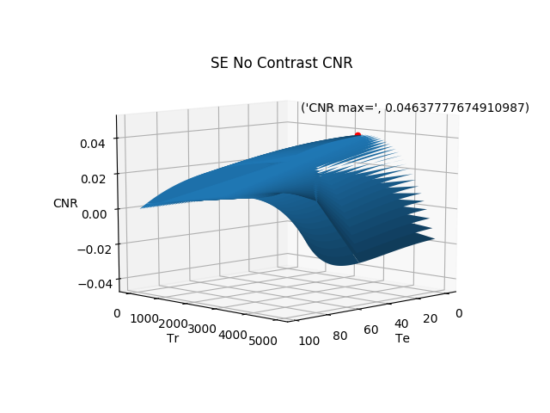
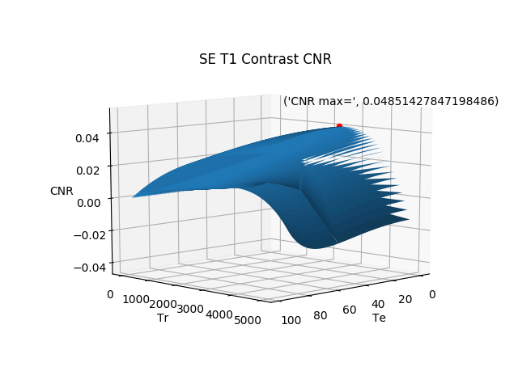
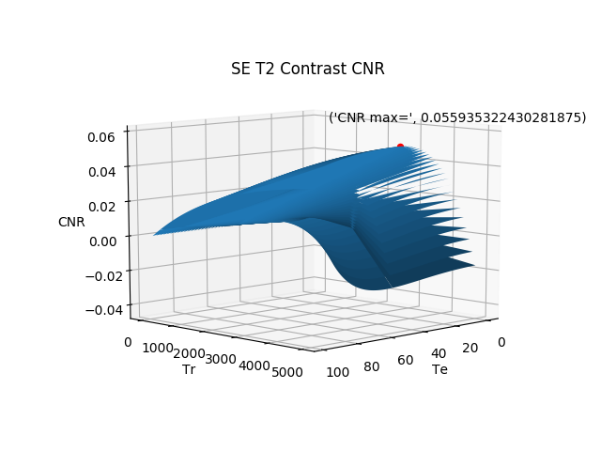
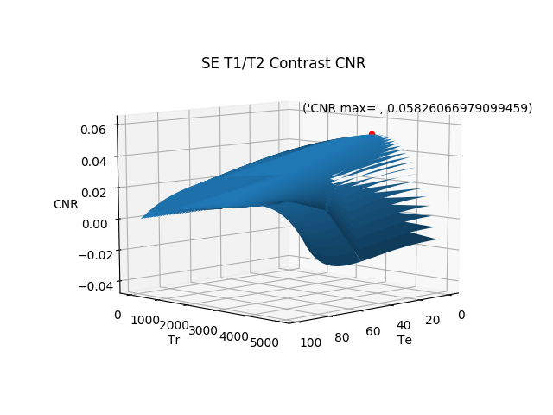
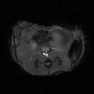
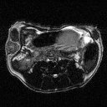
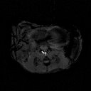
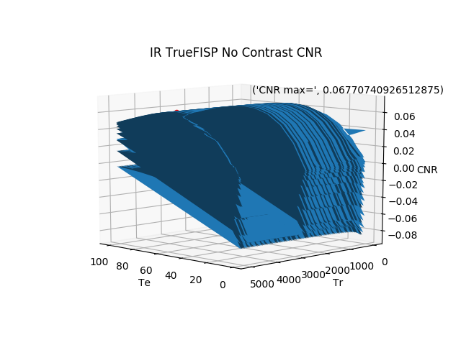
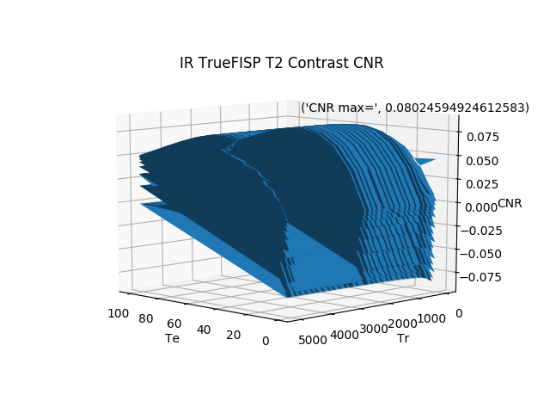
Optimization and Enhancement of CNR in MRI using Core/Shell Contrast Agents
D. MacDonald [1], B. Blasiak [1] [2], B. Tomanek [1] [2] [3]
[1] Institute of Nuclear Physics Polish Academy of Science, Kraków, Poland
[2] University of Alberta, Department of Oncology, Edmonton, Canada
[3] University of Calgary, Health Science Center, Calgary, Canada
Introduction:
Magnetic resonance imaging (MRI) provides the best soft contrast tissue among diagnostic imaging modalities such as CT, PET or X-ray. The contrast provided by MRI is based on the proton density and on interactions of protons with the surrounding molecules of tissues causing so called $T_{1}$ and $T_{2}$ relaxations. MRI techniques utilize these processes for contrast manipulation by producing $T_{1}$ or $T_{2}$ weighted MR images. While MRI contrast may be provided solely by tissues themselves due to differences in their relaxation times, contrast agents shortening $T_{1}$ and $T_{2}$ further improve detection of small pathologies such as early stages breast or brain cancers. Recently $T_{1}$/$T_{2}$ core shell contrast agents have been developed with an expectation that the contrast to noise ratio ($CNR$) would be greater than when compared to no contrast agent, $T_{1} contrast agent, and to T_{2}$ contrast agent. The advantages of some of these core shell contrast agents over core-only contrast agents include lower toxicity, greater dispersibility, greater biocompatibility, easier conjugation with other bioactive molecules, and increased thermal and chemical stability.
Before injection of contrast | After injection of $T_{1}$ contrast | After injection of $T_{2}$ contrast | After injection of $T_{1}$/$T_{2}$ contrast
$$CNR=0.0464$$ | $CNR=0.0485$ | $$CNR=0.0559$$ | $CNR=0.0583$
Images before Injection of T1/T2 Contrast Agent:
-
=
A
B
C
Figure 3: Breast tumor (TNB), from left to right, image A is a $T_{1}$w image pre injection, image B is a $T_{2}$w pre-injection, image C is the subtraction of both images. The red indicates the tumor, blue indicates the tissue.
Images after Injection T1/T2 Contrast Agent:
-
=
Methods:
Optimization:
Assuming a known $T_{1}$ and $T_{2}$ relaxation for tumor and normal tissue, we calculated optimal $T_{E}$ (echo time) and $T_{R}$ (repetition time) for SE and IR TrueFISP to obtain the maximum $CNR$.
Spin Echo (SE):
The optimization was obtained by allowing $T_{E}=\left[20−100\right]ms$ and $T_{R}=\left[100−5100\right]ms$ to find the maximum $CNR$. The signal from the tissues and tumors were calculated as follows for SE:
D
E
F
Table 1, Figure 1: Calculated maximum $CNR$ of a SE pulse sequence before injection of contrast and after injection of $T_{1}, T_{2}$ and ${T_{1}/T}_{2}$ contrast agent based on our data.
Figure 4: Breast tumor (TNB), from left to right, image D is a $T_{1}$w image post injection (NaDyF4/NaGdF4), (injection of what), image E $T_{2}$w post injection and image F is the subtraction of both images. The red indicates the tumor, blue indicates the tissue.
Table 3 below shows the signal acquired from both the tumor and the tissue as well as the $CNR$ for figures 3 and 4.
The results from table 1 and figure 1 shows that the maximum $CNR$ is greatest from the $T_{1}$/$T_{2}$ contrast agent, then from the $T_{2} contrast$agent, then from $T_{1}$ contrast agent and the $lo$west $CNR$ comes from when there is no contrast agent injected.
IR TrueFISP Optimization:
The table and the graphs below the optimal $T_{E}$, $T_{R}$ to generate the highest $CNR$ for a FISP pulse sequence, and is based off of equation 3, 4, and 5:
Before Contrast | $T_{1}$w | $T_{2}$ w | $T_{1}$w-$T_{2}$w
$$CNR$$ | 1576.5 | -221.1 | 233.3
$S_{ti}$=|$M_{0}$(1-$e^{−\frac{Tr}{T_{1ti}}})e^{−\frac{T_{e}}{T_{2ti}}}$|
$S_{tu}$=|$M_{0}$(1-$e^{−\frac{Tr}{T_{1tu}}})e^{−\frac{T_{e}}{T_{2tu}}}$| [1]
Eq 1,2
After $T_{1}$/$T_{2}$ Contrast | $T_{1}$w | $T_{2}$ w | $T_{1}$w-$T_{2}$w
$$CNR$$ | 875 | -1876 | 914
Where $M_{0}=1$, $T_{1}$ is the longitudinal relaxation for both the tumor and the tissue, $T_{2}$ is the transverse relaxation for both the tumor and the tissue.
Before injection of contrast | After injection of $T_{1}$ contrast | After injection of $T_{2}$ contrast | After injection of $T_{1}$/$T_{2}$ contrast
$CNR=0.0677$ | $CNR=0.0685$ | $CNR=0.0803$ | $CNR=0.0811$
$$T_{I}=971$$ | $$T_{I}=861$$ | $$T_{I}=10091$$ | $$T_{I}=10091$$
Table 3. Calculated maximum $CNR$ for the particular $T_{1}$ weighted, $T_{2}$ weighted and $T_{1}$ weighted - $T_{2}$ weighted images, for both pre-injection and post-injection of a 0.25 mL non targeted contrast agent, from figures 1 and 2.
IR TrueFISP:
Optimization for IR TrueFISP pulse sequence was done by ranging $T_{E}=\left[20−100\right]ms$, $T_{R}=\left[100−5000\right]ms$ and $T_{I}=\left[100−10000\right]ms$. Where $T_{I}$ is the inversion time. The Signal in completely balanced IR TrueFISP sequence can be seen below
The results from table 3 shows the $CNR$ for a $T_{1}$w, $T_{2}$w, $T_{1}$w- $T_{2}$w image before and after contrast. Before the intravenous injection of 0.25 mL of non-targeted core shell contrast agent NaDyF4 (20 nm)/NaGdF4 (~ 0.5 nm), the highest $CNR$ was that from the $T_{1}$w image, secondly was the $CNR$ from the subtracted images and lastly the $CNR$ from the $T_{2}$w image. After the intravenous injection of 0.25 mL of non-targeted core shell contrast agent NaDyF4 (20 nm)/NaGdF4 (~ 0.5 nm), the results show that the highest CNR was that from the subtracted image, secondly was the CNR from $T_{1}$w image and lastly the $CNR$ from the $T_{2}$w image.
$S_{ti,tu}$=|(1-2$e^{−\frac{TI}{{T1}_{ti,tu}}}$+$\frac{\left(1−E_{1}\right)\sin{α}}{1−\left(E_{1}−E_{2}\right)\cos{α−E_{1}E_{2}}})e^{−\frac{TE}{{T2}_{ti,tu}}}$|
$E_{1,2}=e^{\frac{−TR}{T_{1,2}}}$ [2]
Eq 3,4
Where $S_{0}=1$ and $α$ is the flip angle.
Conclusions:
The results show that the $CNR$ of a tumor for a $T_{1}$/$T_{2}$ core shell contrast agent is greater than that of no contrast agent, $T_{1}$ contrast agent and a $T_{2}$ contrast agent for both the Spin Echo and IR TrueFISP pulse sequences. To demonstrate the potential of our core/shell contrast agent in vivo MRI we imaged mice with breast tumors before and after intravenous injection of 0.25 mL of non-targeted core shell contrast agent NaDyF4 (20 nm)/NaGdF4 (~ 0.5 nm). Then to further increase the $CNR$, we subtracted a $T_{1}$ weighted image with $T_{2}$ weighted image. Pre injection results show that the best $CNR$ is from the $T_{1}$weighted image, then the next best $CNR$ is from the $T_{1}$w - $T_{2}w$ image and lastly the $T_{2}$w image. Post-injection results show that the best $CNR$ comes from the $T_{1}$ weighted image subtracted by the $T_{2}$ weighted image, and the $CNR$ for the $T_{1}$ weighted image is greater than the $CNR$ for the $T_{2}$ weighted image.
CNR:
The CNR was calculated in the following way:
$$CNR=S_{Tu}−S_{Ti}$$
Eq 5
Table 2, Figure 2: Calculated maximum $CNR$, for the particular $T_{1}$and $T_{2}$ values of a IR TrueFISP pulse sequence before injection of contrast and after injection of $T_{1}, T_{2}$ and ${T_{1}/T}_{2}$ contrast agent based on our data, flip angle alpha=0.261rad (15 deg).
In vivo Image Subtraction
To demonstrate the potential of our core/shell nanoparticles in vivo MRI, we imaged animals with breast tumors after intravenous injection of 0.25 mL of non-targeted core shell contrast agent NaDyF4 (20 nm)/NaGdF4 (~ 0.5 nm), with a $T_{1}$ weighted pulse sequence (SE) and a $T_{2}$ weighted pulse sequence (IR TrueFISP). We then subtracted the $T_{1}$w with the $T_{2}$w image.
The results from table 2 and figure 2 shows that the maximum $CNR$ is greatest from the $T_{1}$/$T_{2}$ contrast agent, then from the $T_{2} contrast$agent, then from $T_{1} contrast agent and the lo$west $CNR$ comes from when there is no contrast agent injected.
Invivo Image Subtraction:
To demonstrate the potential of our core/shell nanoparticles in in vivo MRI, we did a $T_{1}$w and a $T_{2}$w image on animals with breast tumors before and after intravenous injection of 0.25 mL of non-targeted core shell contrast agent NaDyF4 (20 nm)/NaGdF4 (~ 0.5 nm). We then tried to increase the CNR by subtraction the $T_{1}$w image with the $T_{2}$w image. The images can be seen below:
Results:
SE Optimization:
Table 1 and the graphs below show the maximum $CNR$ for a spin echo pulse sequence, using the optimal $T_{E}$ , $T_{R}$. This is based off of equation 1, 2, and 5:
References:
[1] J. P. Hornak, “The basics of MRI,” CHAPTER-10. [Online]. Available: https://www.cis.rit.edu/htbooks/mri/chap-10/chap-10.htm. [Accessed: 08-Oct-2021].
[2] Huang, T., Huang, I., Chen, C., Scheffler, K., Chung, H. and Cheng, H., 2002. [online] Mriquestions.com. Available at: <http://mriquestions.com/uploads/3/4/5/7/34572113/are_truefisp_images_t2t1-weighted.pdf> [Accessed 8 October 2021].

