Slide 1
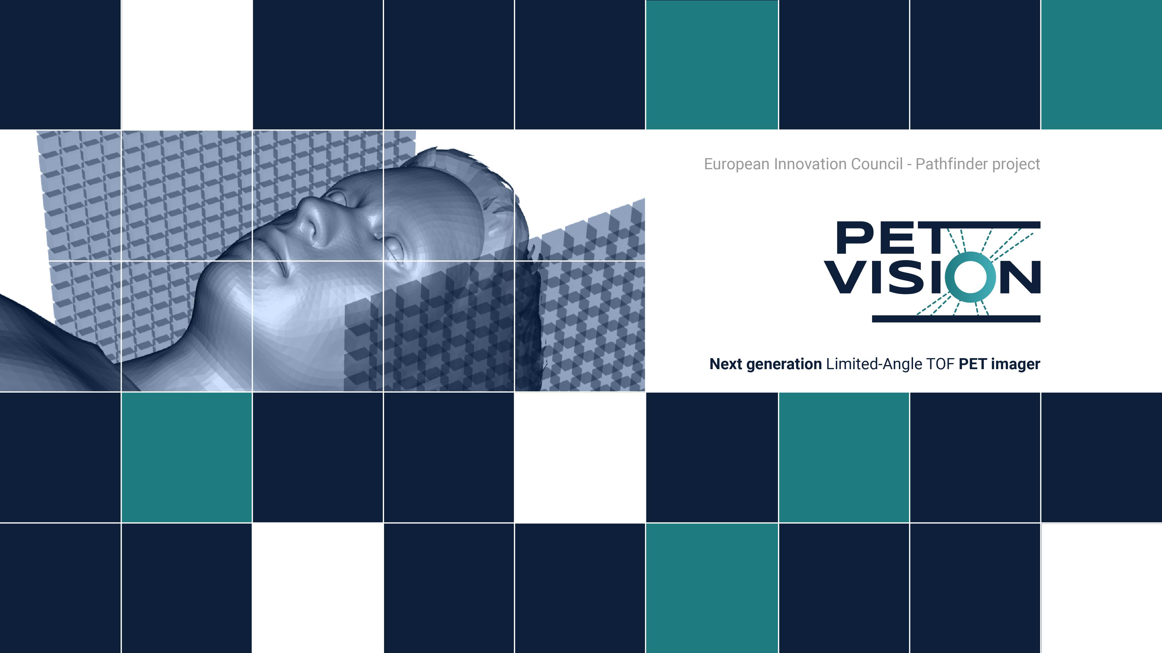



Flexible, Mobile and Modular PET Imaging
Gašper Razdevšek
6th Jagiellonian Symposium on Advances in Particle Physics and Medicine, Kraków July 5-10 2026

Slide 2
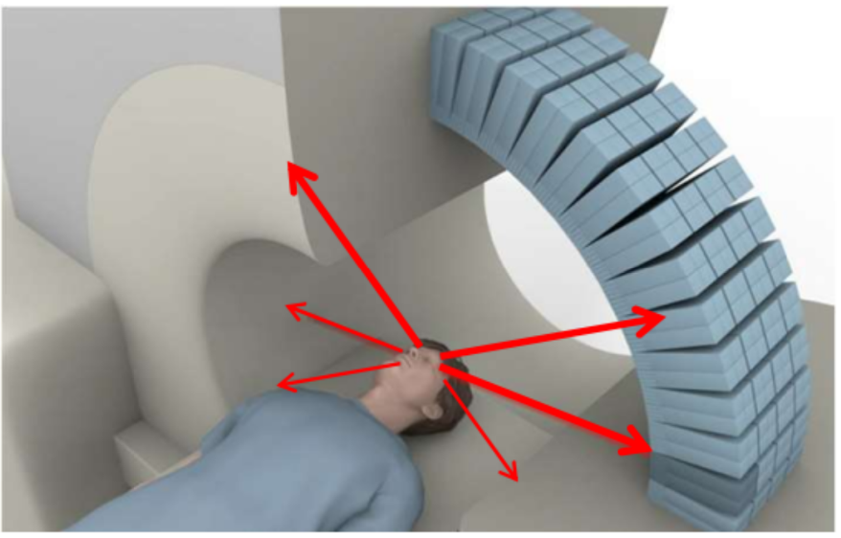
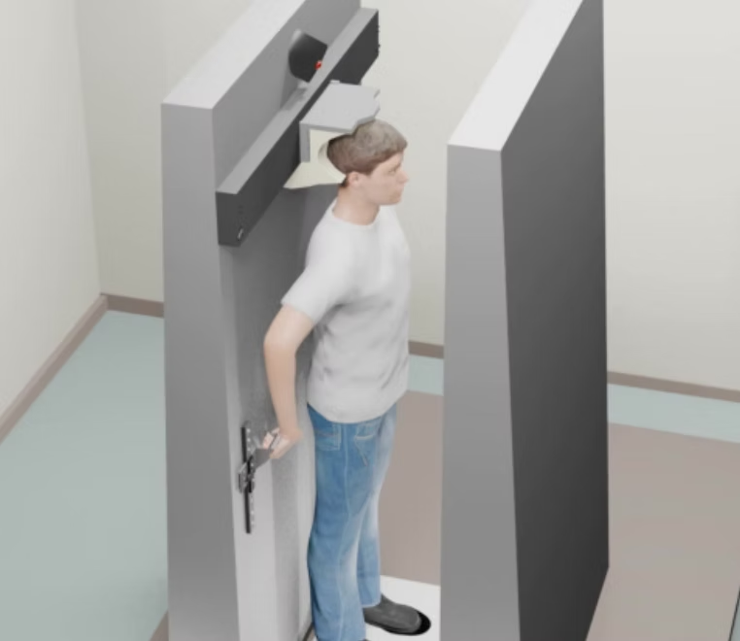
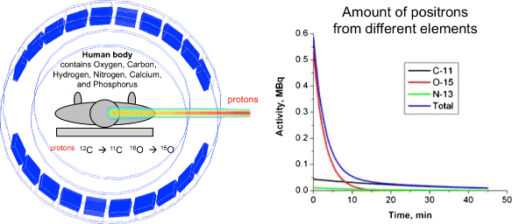
PET scanners
Full-ring PET is the clinical standard.
Ring systems are not ideal for every clinical or research scenario.
Can we make the geometry more flexible without sacrificing image quality?
The Walk-Through PET (https://www.wt-pet.org/)
Vandenberghe et al., EJNMMI Physics 3, 3 (2016), doi:10.1186/s40658-016-0138-3

Slide 3
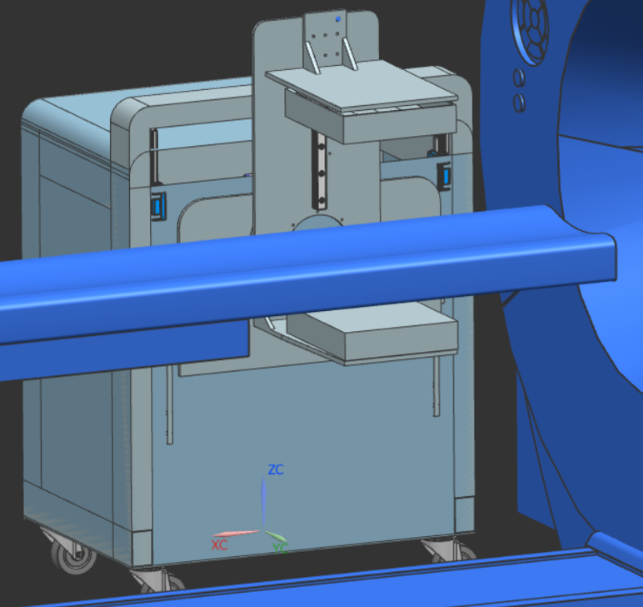
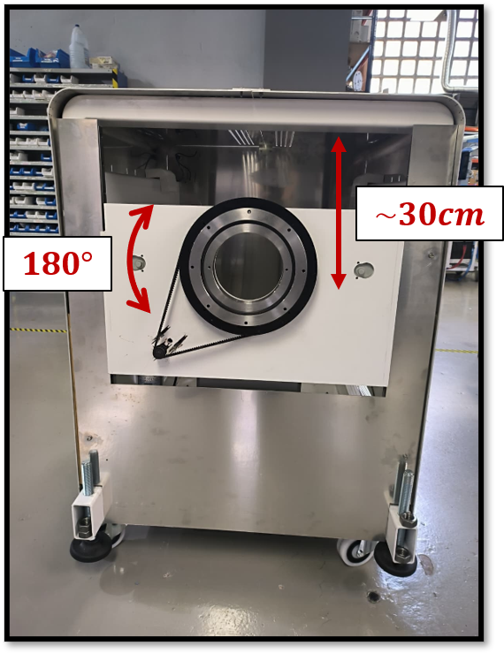








PetVision project
Develop a flexible, modular and cost-effective PET scanner based on two opposing planar detector panels with excellent TOF resolution.

Slide 4
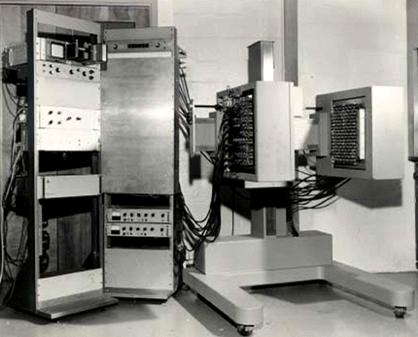
Panel detectors
Two-panel PET: back to the past? Not with excellent TOF resolution.
The PC-I, completed in 1969, used two planar arrays of crystals and was one of the first PET imaging devices.
PetVision aims for artifact-free open-geometry imaging without rotating the panels.

Slide 5

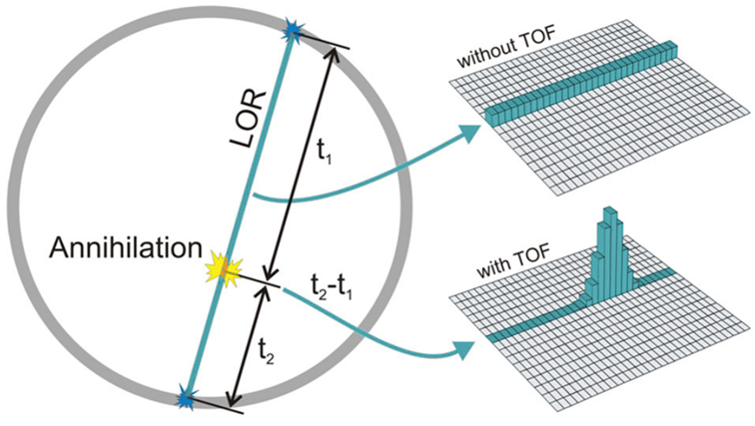
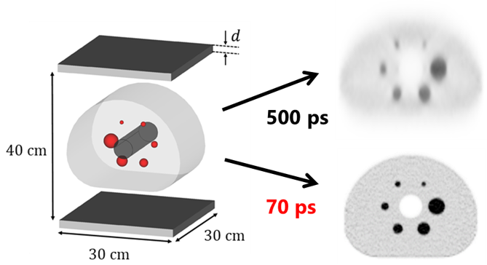
Time-of-flight (TOF) information
Improves localization of the annihilation event, reduces noise correlations, and increases image signal-to-noise ratio (SNR) → sensitivity amplifier
TOF also enables reduced angular sampling → open-PET geometry

Slide 6
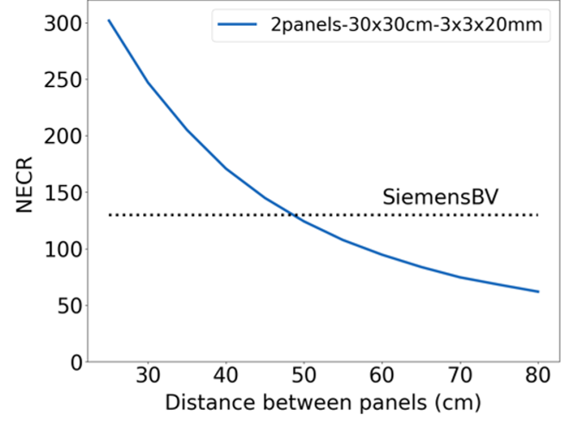
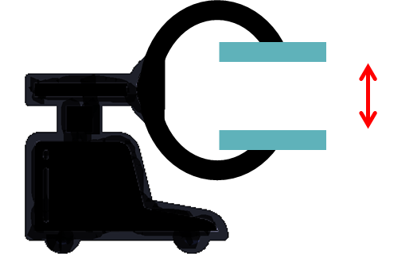


Advantages of panel detectors
Flexibility → adjustable FOV and sensitivity
Mobility → portable or bedside PET imaging
Modularity → multi-organ/total-body PET scanner
Accessibility → reduced manufacturing cost and complexity
Razdevšek G, et al. Flexible and modular PET: Evaluating the potential of TOF-DOI panel detectors. Med Phys. 2025; 52: 2845–2860. https://doi.org/10.1002/mp.17741

Slide 7
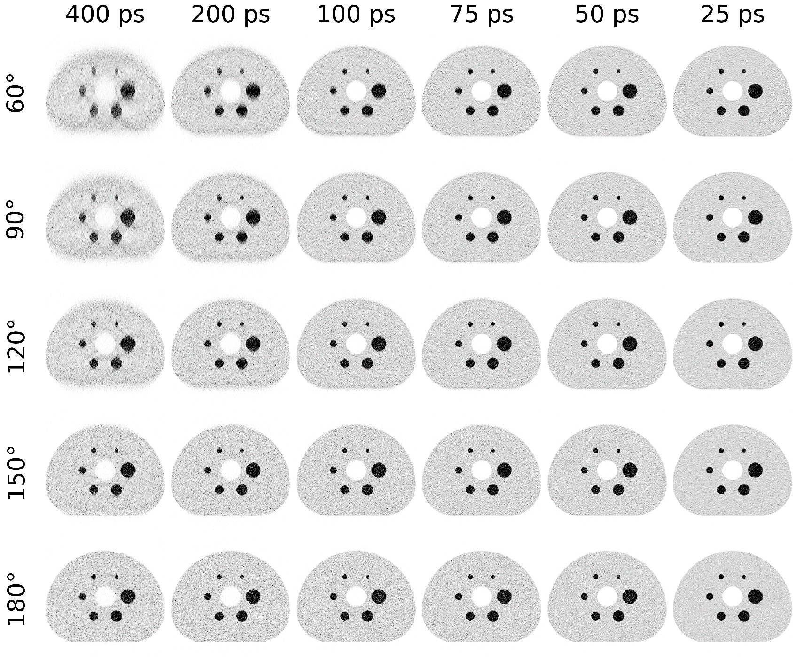
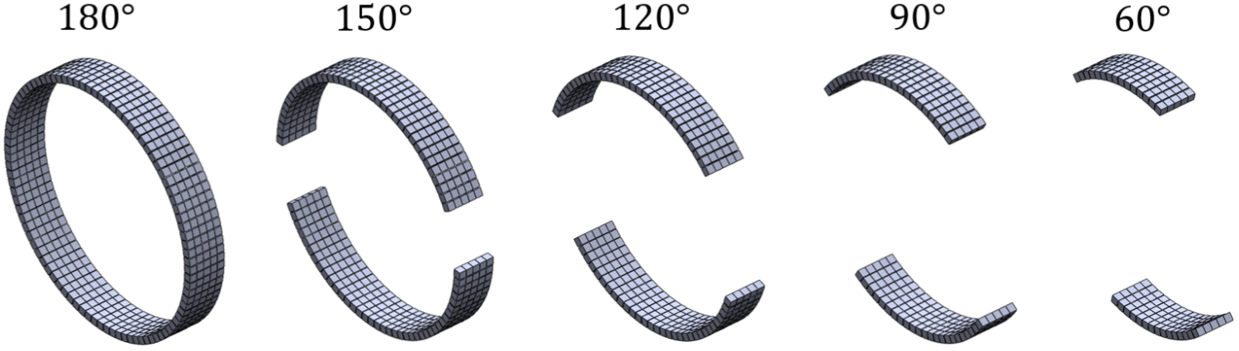
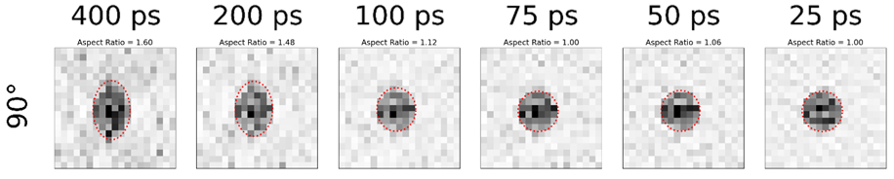
TOF Requirements for Artifact-Free Open-Geometry PET
TOF ≤ 100 ps → the key to unlocking the full potential of open-geometry PET imaging

Slide 8
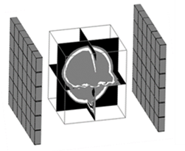
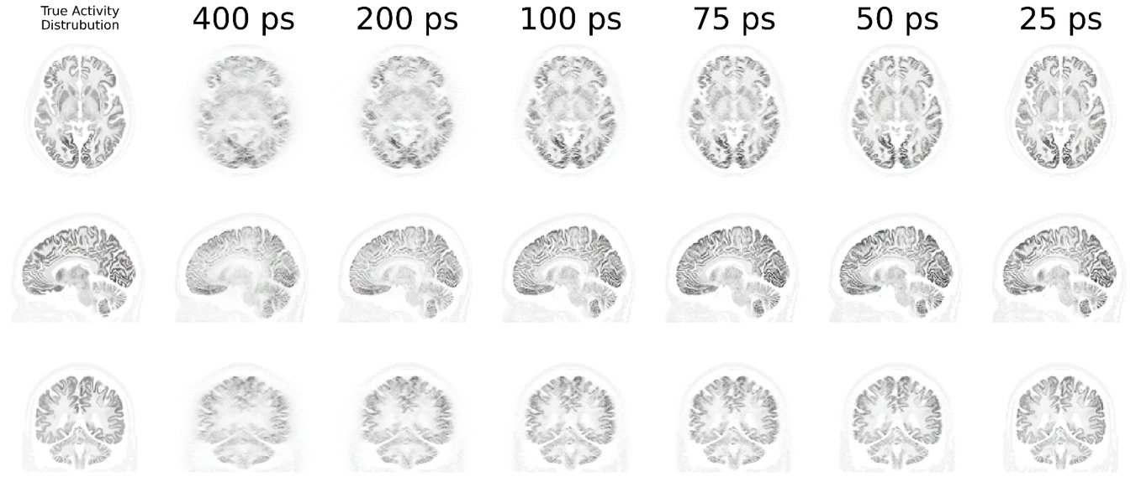
2-Panel System: Monte Carlo simulation
2 panels: 30 x 30 cm, panel separation: 30 cm (90° angular coverage)
High-resolution brain phantom [18F]FDG, 100 M true events

Slide 9
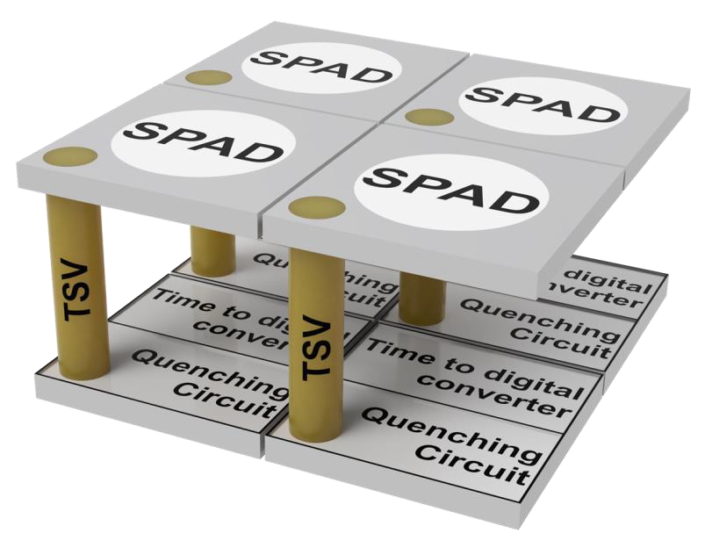
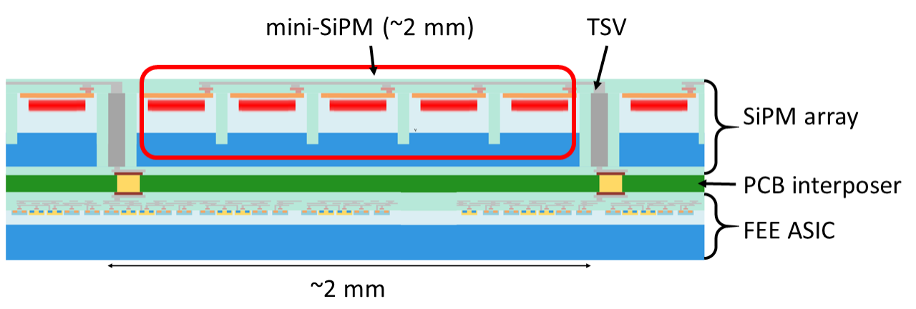
How do we plan to achieve sub-100 ps TOF resolution?
Shorter crystals → 10 mm (3×3×10 mm + 100 ps ≈ 3×3×20 mm + 200 ps)
High-PDE SiPMs → Sensor based on NUV-HD-MT + TSV technology
Fast ASICs → PoETIC, a highly configurable pixelated ASIC for fast-timing applications based on FastIC
Minimized-capacitance interconnects → 2.5D integration
Current detector
Improved detector
Thinner scintillator
SiPM Improved PDE and timing
Fast ASIC
2.5D integration
Integrated Photon detector module
Gamma ray
mini SiPM
(~3mm)
TSV
Scintillation
array
Gamma ray
SiPM array
Light sensors
Scintillation array
Light sensors
PCB interposer
Front end electronics
Front end electronics
FEE ASIC
Time, energy, position
Time, energy, position
~3mm

Slide 10
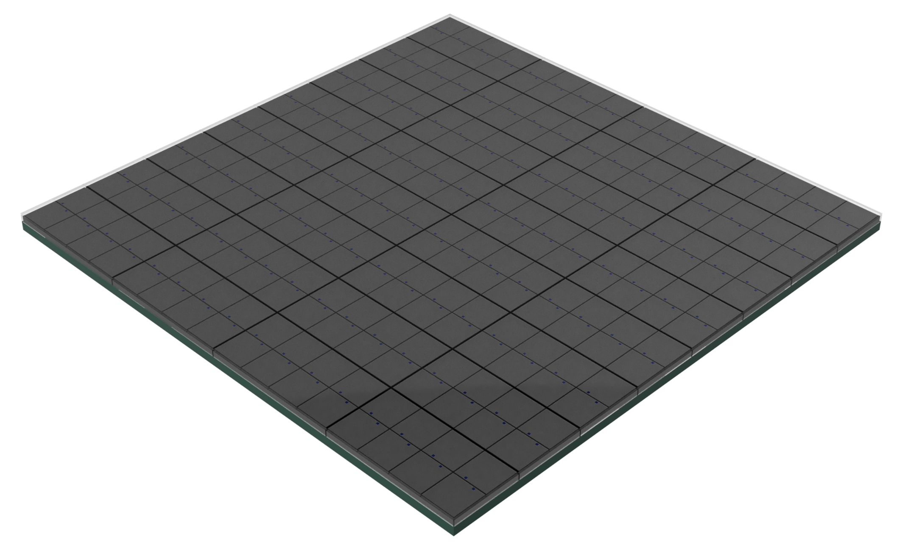
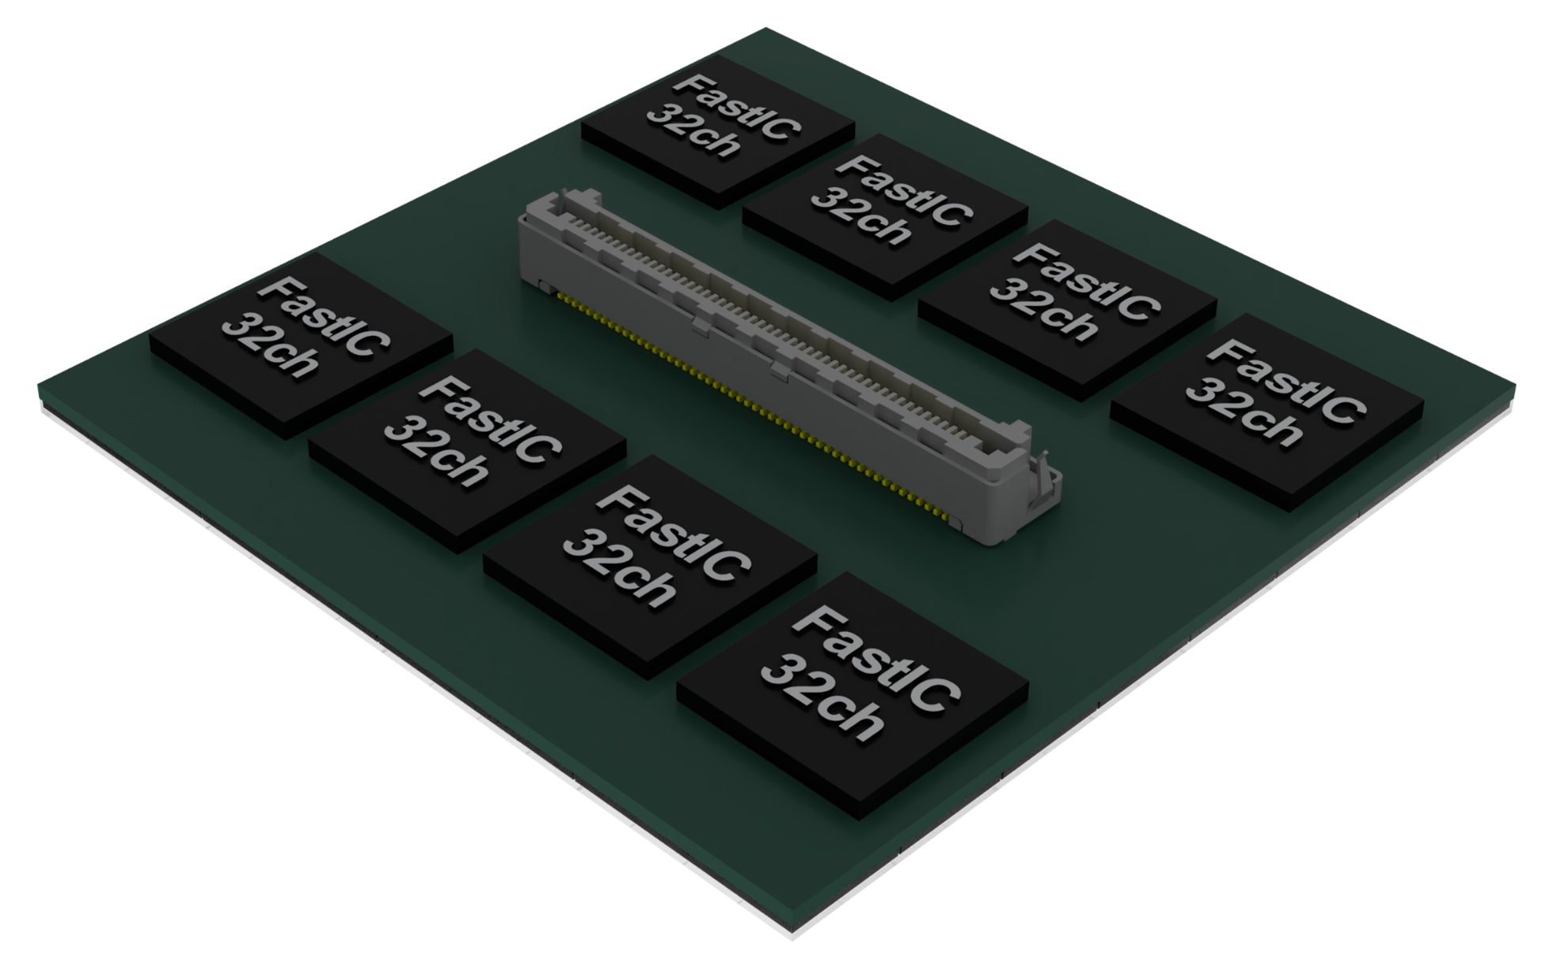

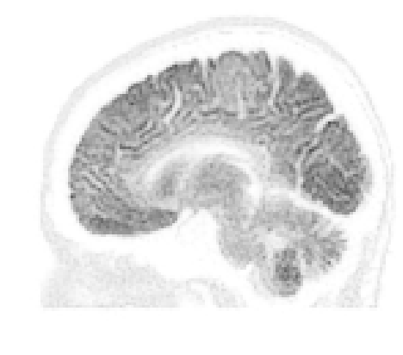
Timeline
2026
3x3 mm² Photo Sensor with improved performance
PoETIC ASIC and integration into a digital module
Integration of the prototype:
2 panels 30x30 cm²
Validation in two hospitals
Further developments & exploitation
PetVision
Year 2
Year 3
Year 4
Year 5
Year 6-7
Further funding

Slide 11
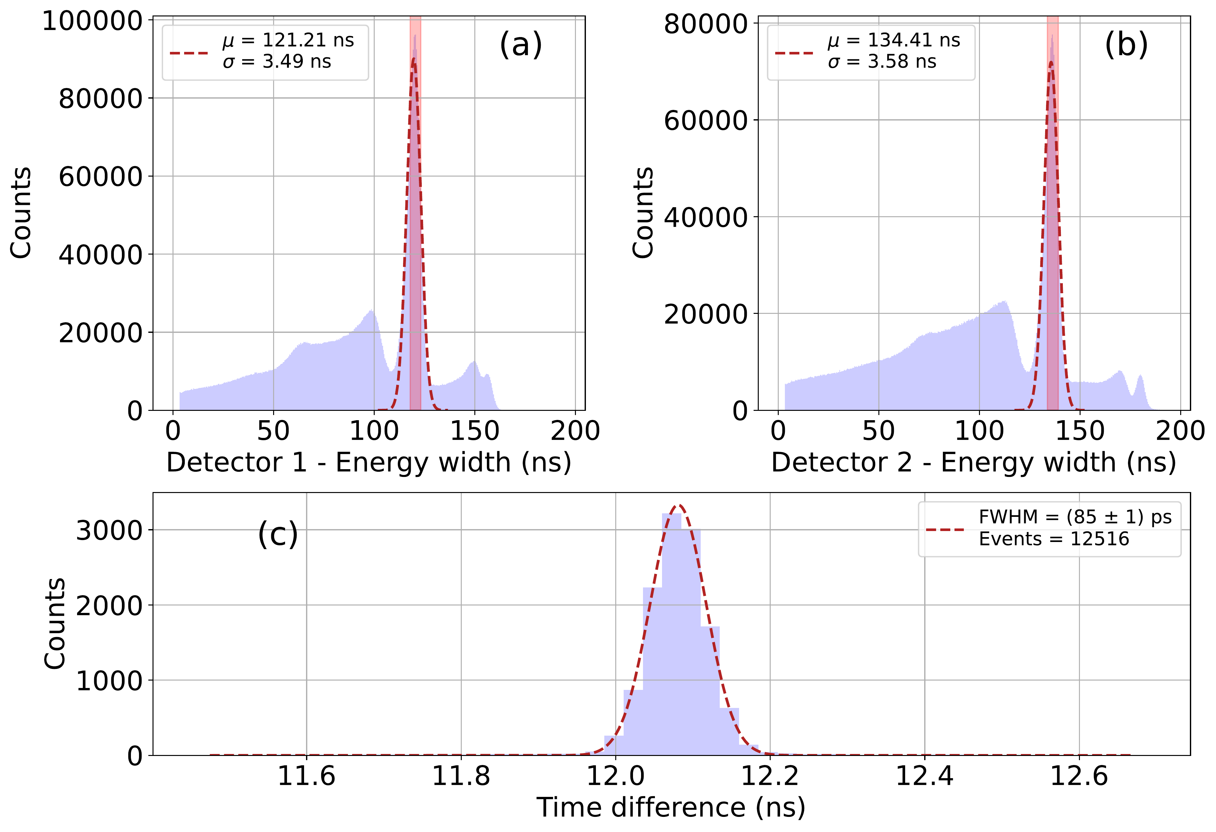
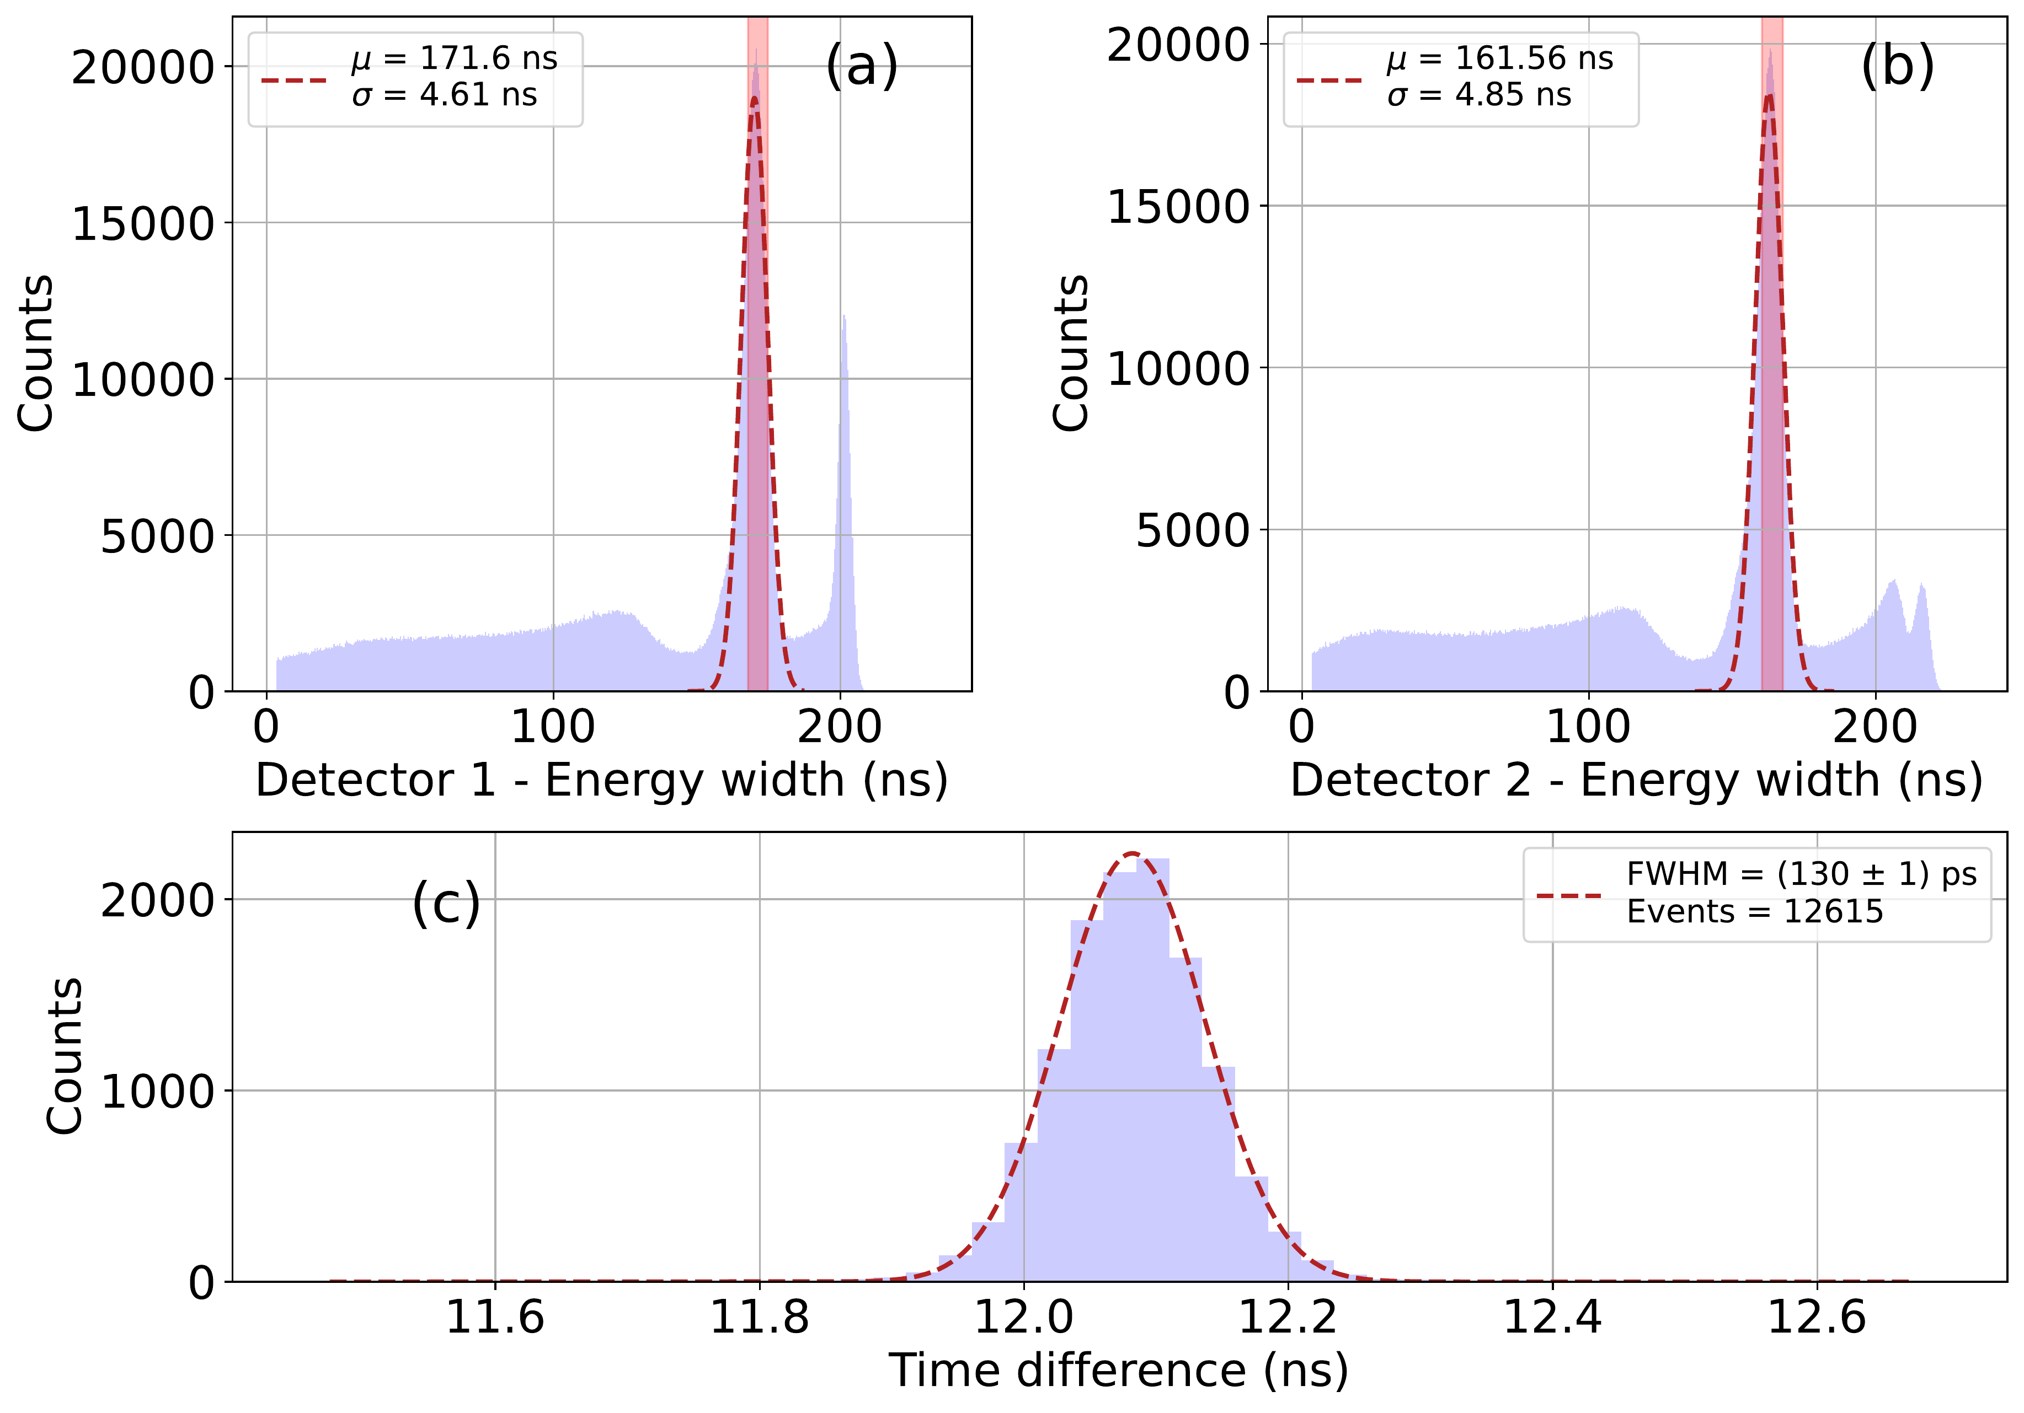
Proof of principle: FastIC+ CTR performance
Results with FastIC+ (the predecessor of the final chip) and without 2.5D integration
SiPM: FBK NUV-HD-MT LFv2 M0 3x3 mm² 50 µm SPAD
Over-Voltage: ~10 V
Crystal: Fast-LGSO (Oxide Corporation) – 2x2x3 mm³
SiPM: FBK NUV-HD-MT LF 4x4 M0 mm² 40 µm SPAD
Over-Voltage: ~10 V
Crystal: LYSO:CeCa (Taiwan Applied Crystals) – 2.8x2.8x20 mm³
CTR = (85 ± 1) ps
CTR = (130 ± 1) ps

Slide 12


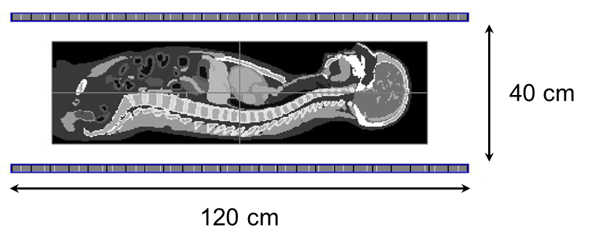
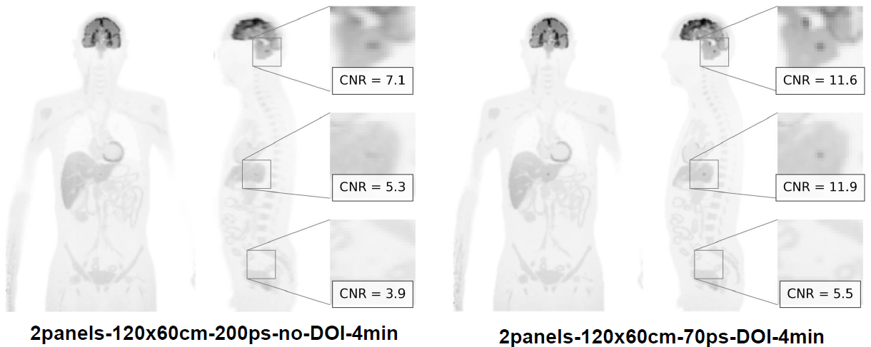

Beyond PetVision
FastSight project: panel detectors with depth-of-interaction (DOI) capability from dual-sided readout of longer crystals (20 mm)
Long axial FOV PET imaging
R01 EB036642
FBK, I3M, JSI, ICCUB

Slide 13
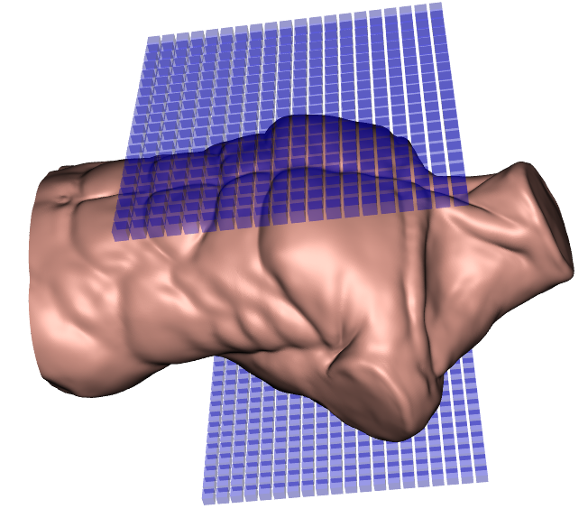
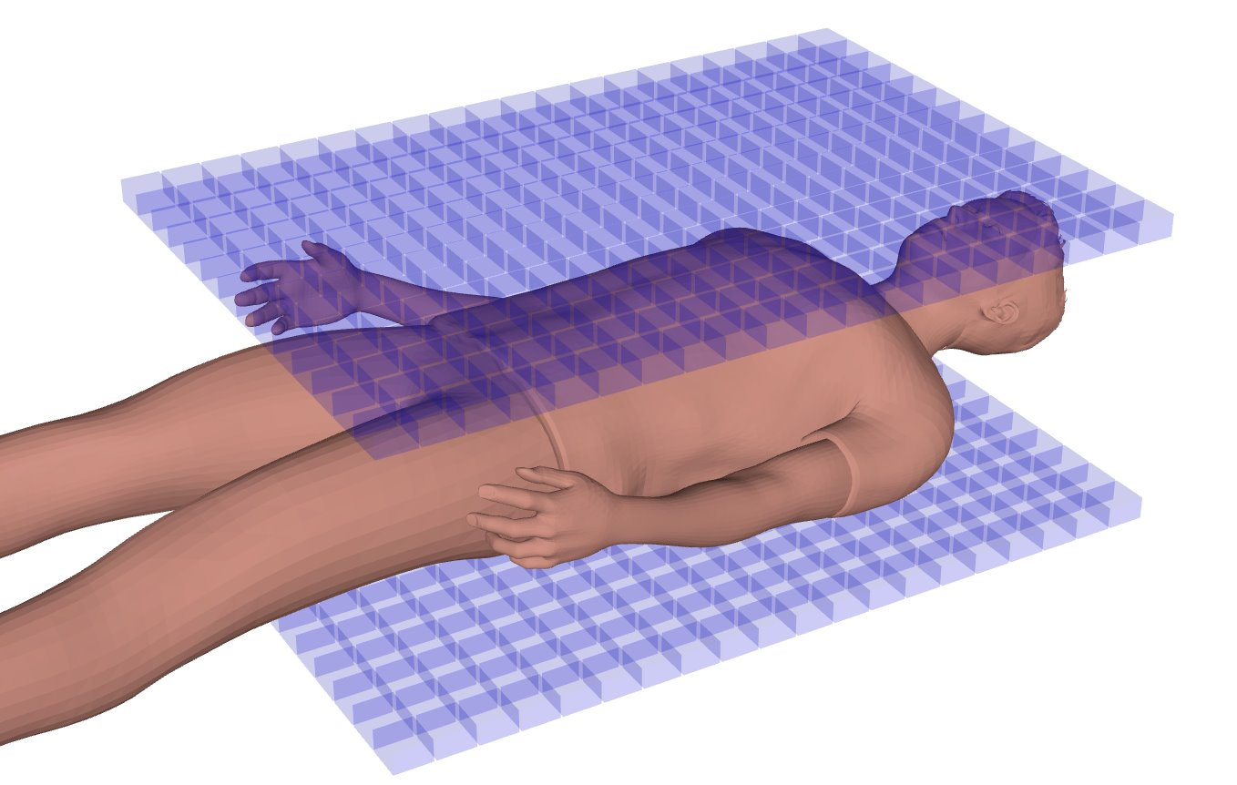
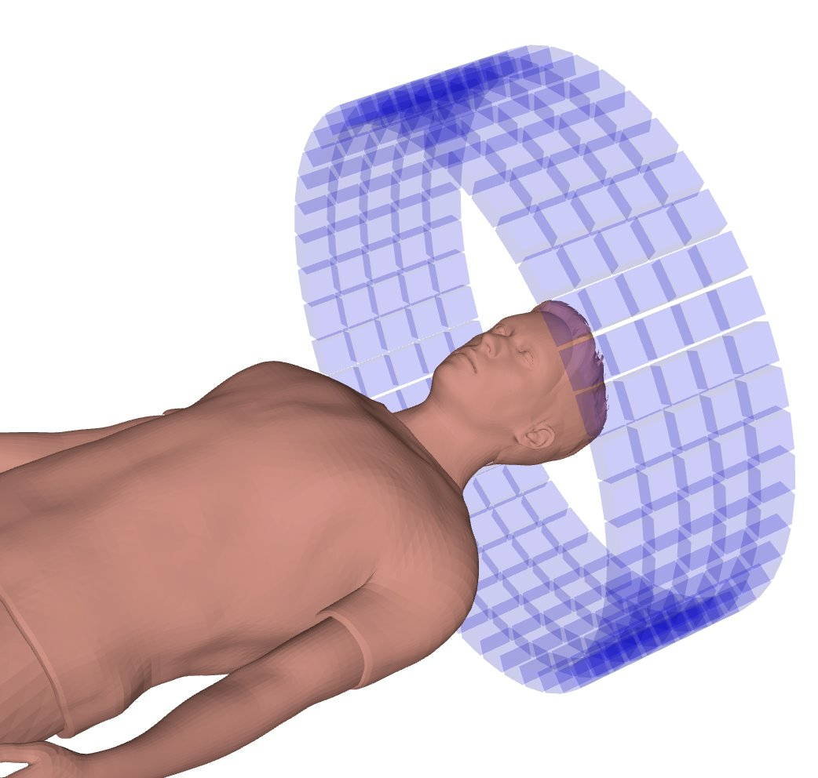
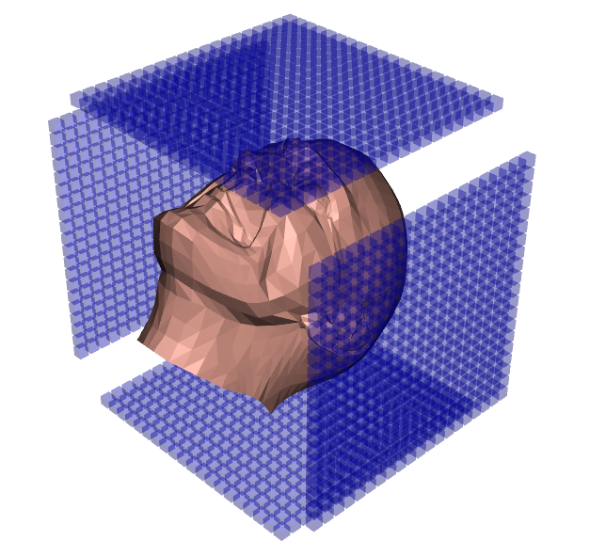
Summary
TOF ≤ 100 ps is the key that unlocks open-geometry PET.
TOF-enabled open geometry allows us to design the next generation of flexible, mobile, and modular PET scanners.
Modular panel-based limited angle PET scanner​
Traditional Full ring PET scanner
Very fast TOF PET
< 100 ps

Slide 14


Thank you to all PetVision collaborators
G. Razdevšek¹, R. Pestotnik¹, D. Gascon², A. Gola³, J. Benlloch⁵, J. Alamo⁶, R. Ballabriga⁷, J. Barbera⁶, Y. Chemli⁴, R. Dolenec^{8, 1}, J. Fernández-Tenllado², S. Gómez^{9, 2}, S. Korpar^{10,1}, P. Križan^{8,1}, S. Majewski¹¹, R. Manera², T. Marin⁴, A. Mariscal², J. Mauricio², D. Mazzanti², G. Pavon⁶, N. Pavon⁵, M. Penna³, A. Sanuy², A. Seljak¹, A. Studen^{8,1}, D. Žontar¹ , G. ElFakhri⁴
¹ Jožef Stefan Institute, Experimental Physics Department, Ljubljana, Slovenia, ² University of Barcelona, Dept. Física Quàntica i Astrofísica, Institut de Ciències Del Cosmos, Barcelona, Spain, ³ Fondazione Bruno Kessler, Trento, Italy, ⁴ Yale School of Medicine, New Haven, United States of America, ⁵ The Institute of Instrumentation for Molecular Imaging, Valencia, Spain, ⁶ Oncovision, Valencia, Spain, ⁷ European Organisation for Nuclear Research - CERN, Geneva, Switzerland, ⁸ University of Ljubljana, Faculty of Mathematics and Physics, Ljubljana, Slovenia, ⁹ Polytechnic University of Catalonia, Barcelona, Spain, ¹⁰ University of Maribor, Faculty of Chemistry and Chemical Engineering, Maribor, Slovenia, ¹¹ University of California Davis, Dept. of Biomedical Engineering, Davis, California, USA
This project has received funding from the European Union’s Horizon Europe research and innovation programme under grant agreement No 101099896

Slide 15
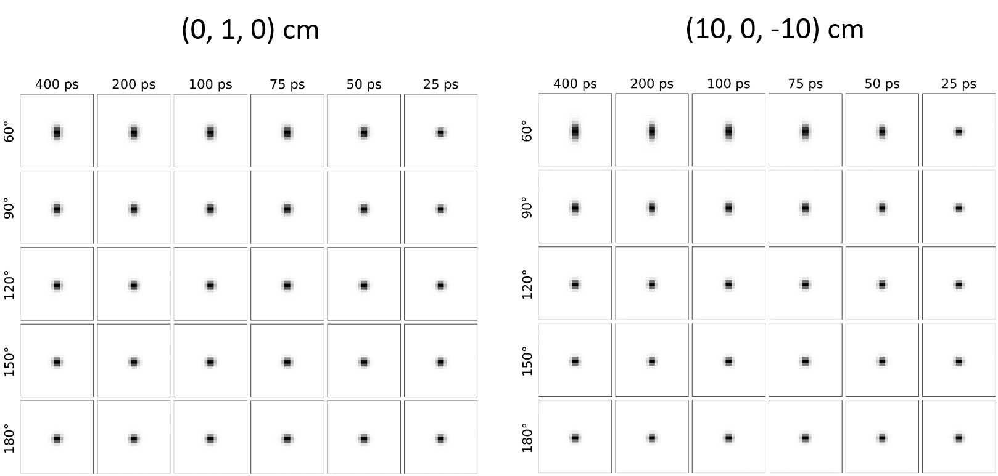
Spatial Resolution
Point sources (NEMA standard)
Voxel size: 0.75 mm

Slide 16
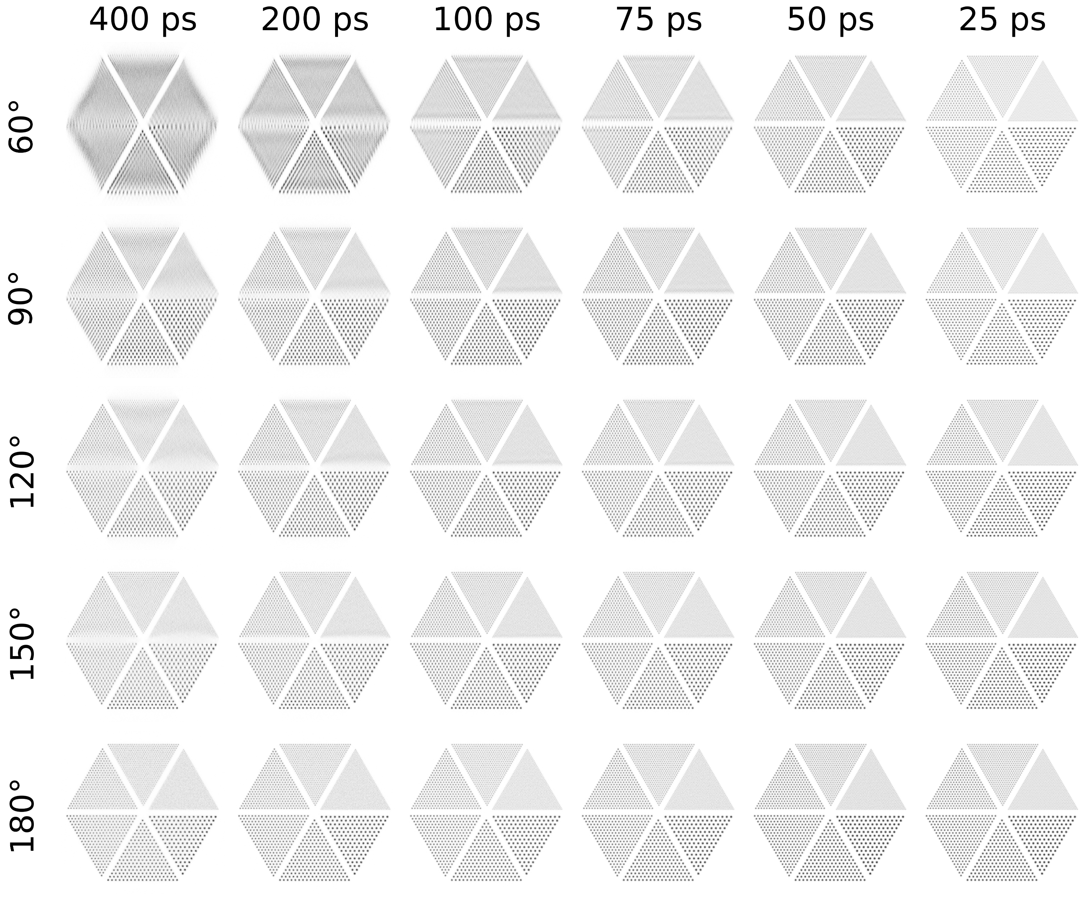
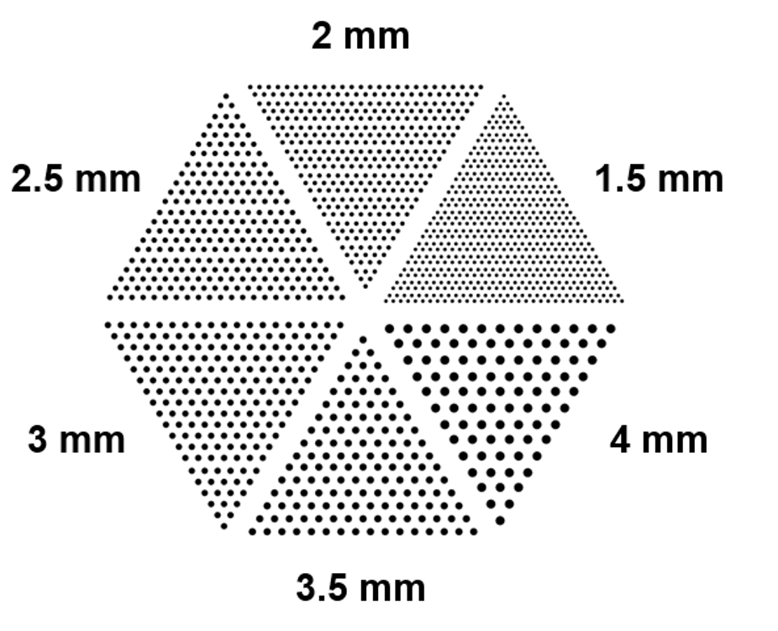
Spatial Resolution

Slide 17
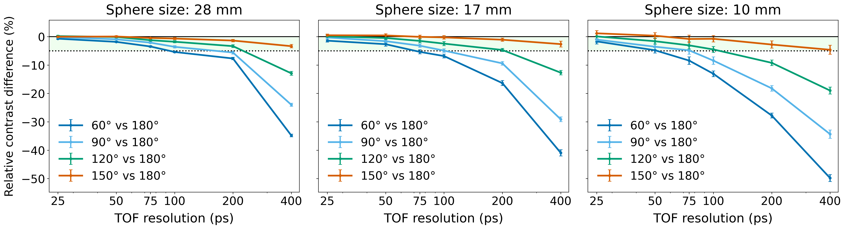
NEMA image quality phantom

Slide 18
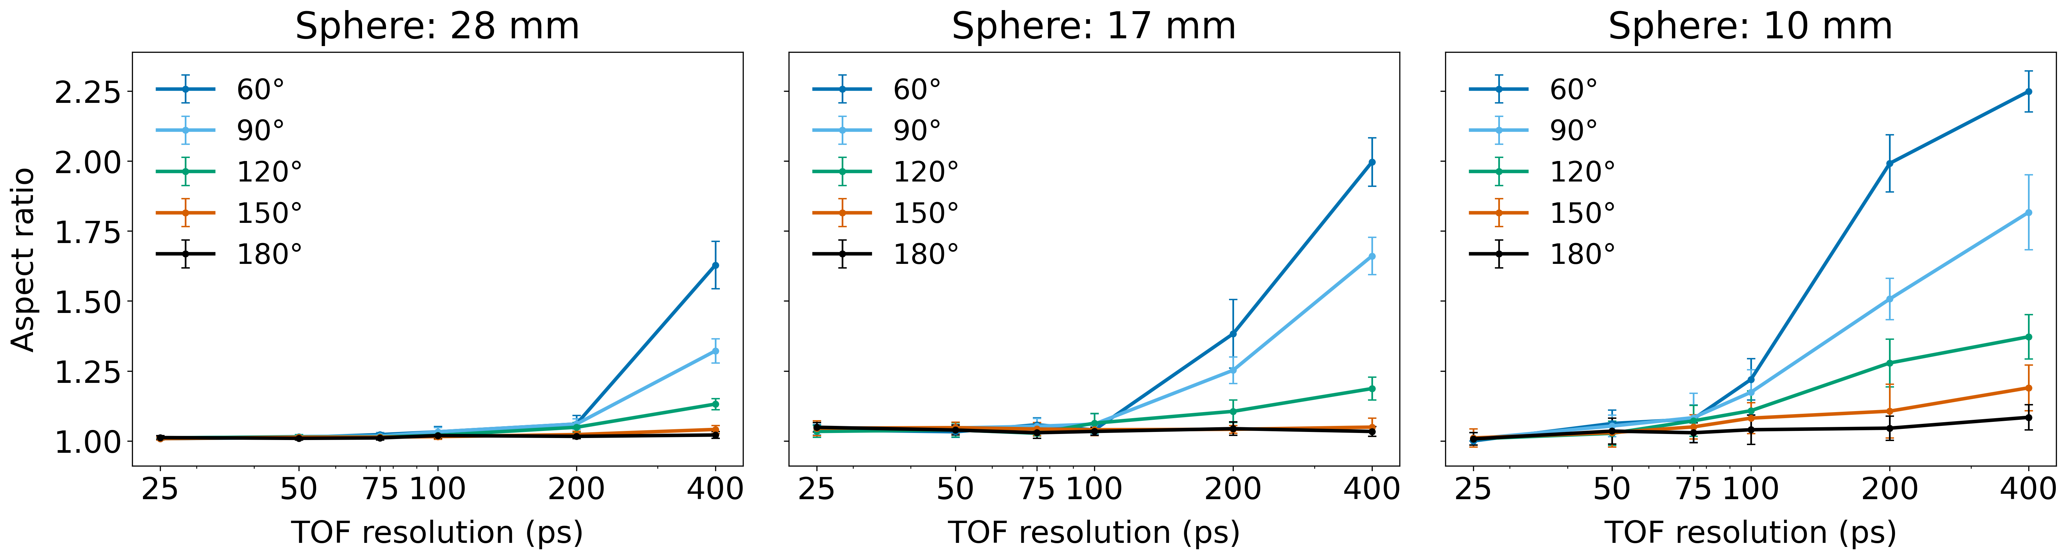
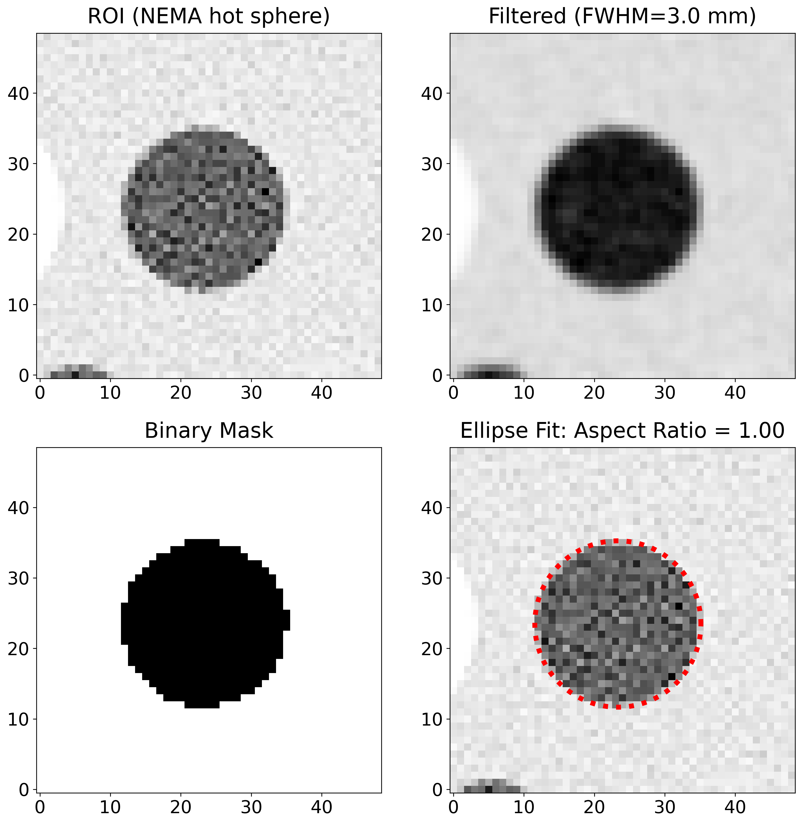
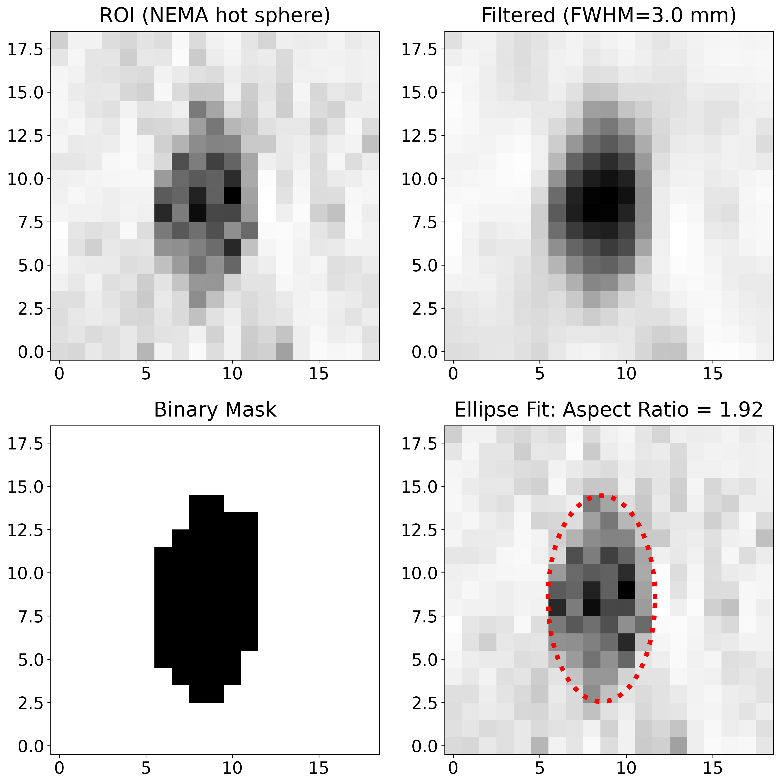
Ellipse fitting to reconstructed hot spheres

Slide 19
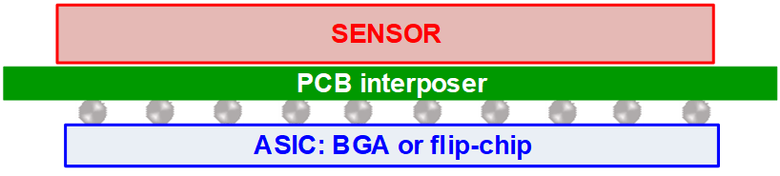
Next generation ASICs based on FastIC family
PoETIC - Highly configurable pixelated ASIC for Fast Timing applications based on FastIC
Collaboration between the University of Barcelona and CERN
Time Over Threshold
Low power (~10 mW/ch),
25 ps bin TDC integration
Packaged or direct 2.5D integration

