Slide 1
Apparatus neutron sources at IFJ PAN for basic research and applications
A. Kulińska,
J. Dankowski, D. Dworak, A. Kurowski, Ł. Marciniak, U. Wiącek and W. Królas
The Institute of Nuclear Physics Polish Academy of Sciences (IFJ PAN)

Slide 2
Outline
Department of Radiation Transport Physics at IFJ PAN –research activities
The Jan A. Czubek Laboratory of Apparatus Neutron Sources
  Fast neutron generator 14 MeV (IGN-14)
    Technical data
  Nanosecond sources of fast neutrons (plasma focus PF-24, PF-4)
    Main parameters
    Diagnostic systems: Electric diagnostics, Neutron pinhole camera, VUV/SXR 4-frame pinhole camera
Experiments and results
  IGN-14: thermal test of CVD detectors
  Plasma Focus PF-24 device: Neutron emission, evaluation of the Lee Model code
  Computer modelling of the radiation field
  Monte Carlo modeling for detection of non fissile and fissile materials
Summary and plans
2nd Workshop on Neutrons in Medicine and Homeland Security

Slide 3
Department of Radiation Transport Physics
The activities cover physics of the neutron and other nuclear radiation interaction with different mediums in theoretical, experimental and computational aspects; fundamental plasma and nuclear fusion research; computer modeling of the nuclear radiation generated during fusion.
Research on interaction of nuclear radiation with different medium
Neutron and plasma diagnostics in big thermonuclear devices: tokamak, stellarator
  - neutron activation method; plasma tomography (JET, WEST); high resolution neutron spectrometer (HRNS) – ITER
Construction concept of the neutron accelerator source DONES
(Demo Oriented Neutron Source)
Computer modelling of the radiation field
The Jan A. Czubek Laboratory of Apparatus Neutron Sources
Fast neutron generator 14 MeV (IGN-14)
Plasma Focus devices – the PF-24 and PF-4

Slide 4
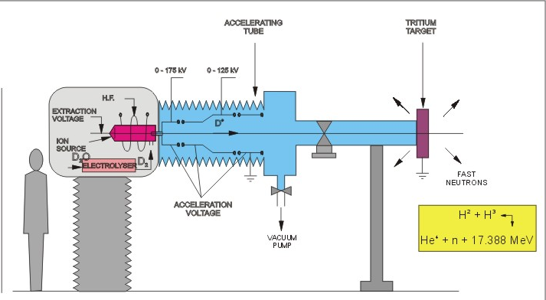
The Jan A. Czubek Laboratory of Apparatus Neutron Sources
Technical data
Continuous regime:
- neutron yield: 5x10⁸ n/s
ion current:~50 µA
(up to 100 µA)
Pulse regime:
- duration: 25-1000 μs (step 1)
repetition 0.3-100 ms (step 0.1)
neutron yield during the pulse: 5x10⁹ n/s
target :
T/Ti, max. activity 200 GBq
H.F. ion source: 50 MHz
14 MeV Fast neutron generator (IGN-14)
Monitors:
³He detectors
BF₃ detector in paraffin, scintillation fast neutron probe

Slide 5
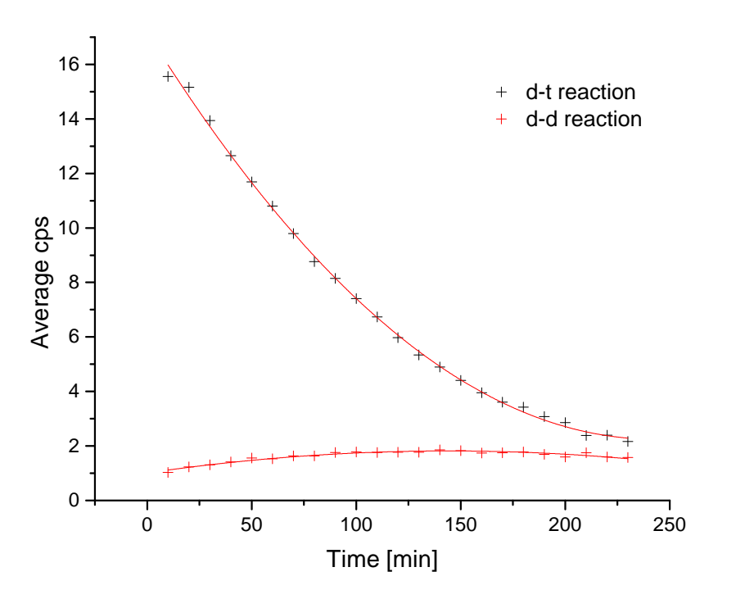
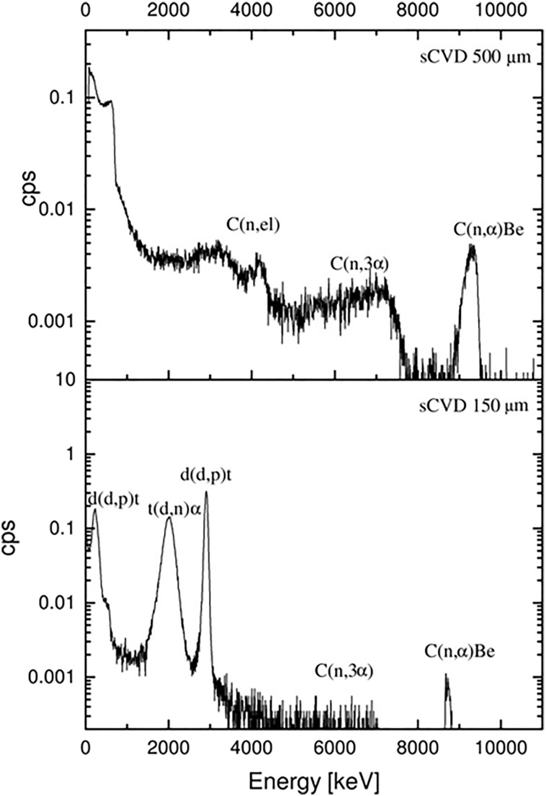
IGN-14 fast neutron generator
Jan Dankowski, Arkadiusz Kurowski
Energy spectrum of DD and DT reaction products
recorded by diamond detector.
Time-dependence efficiency of T/Ti target
CVD diamond detector
14 MeV neutrons peak
- 500, 150 μm diamond
- 1.5 mg/cm² Al foil
DD and DT reaction products
D-T reaction (T/Ti target bombarded ~100 keV deuteron beam)
²D + ³T → n (14.1 MeV) + ⁴He (3.5 MeV)
After some time of the generator operation the target contains deuterium implanted from the bombarding ion beam:
²D + ²D → ³He (0.82 MeV) + n (2.45 MeV)
²D + ²D → ³T (1.01 MeV) + p (3.02 MeV)

Slide 6
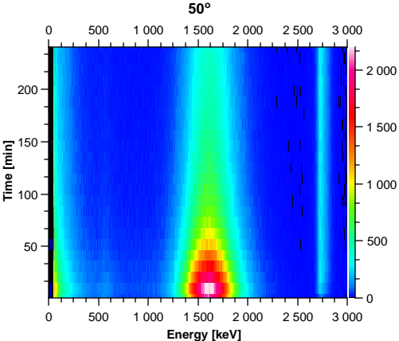
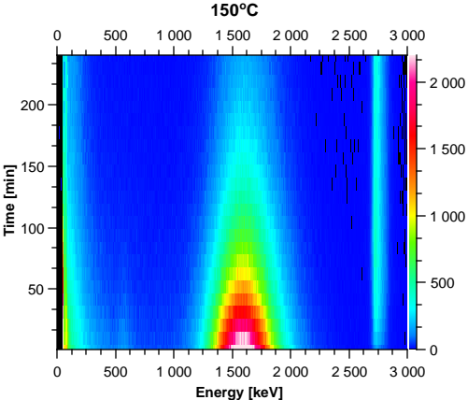
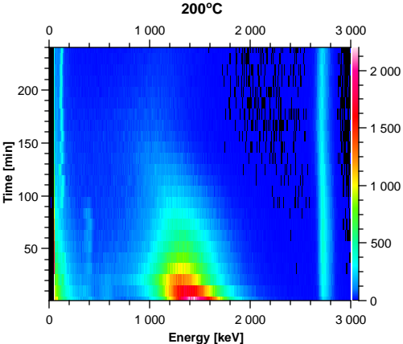
IGN-14 fast neutron generator
Response of the CVD diamond detector for spectrometric measurement of DD and DT products
detectors heated to 250 °C (ITER baking temperature)
Spectrometric measurements at 28, 50, 100, 150, 200 and 250ºC
Heating scenario: 2 hours measurement for each temperature
Spectrometric capabilities of CVDD did not deteriorate during the test up to 200ºC
Position and area of the proton peak does not change
Alpha peak moved to lower energy channels for 200&250ºC

Slide 7
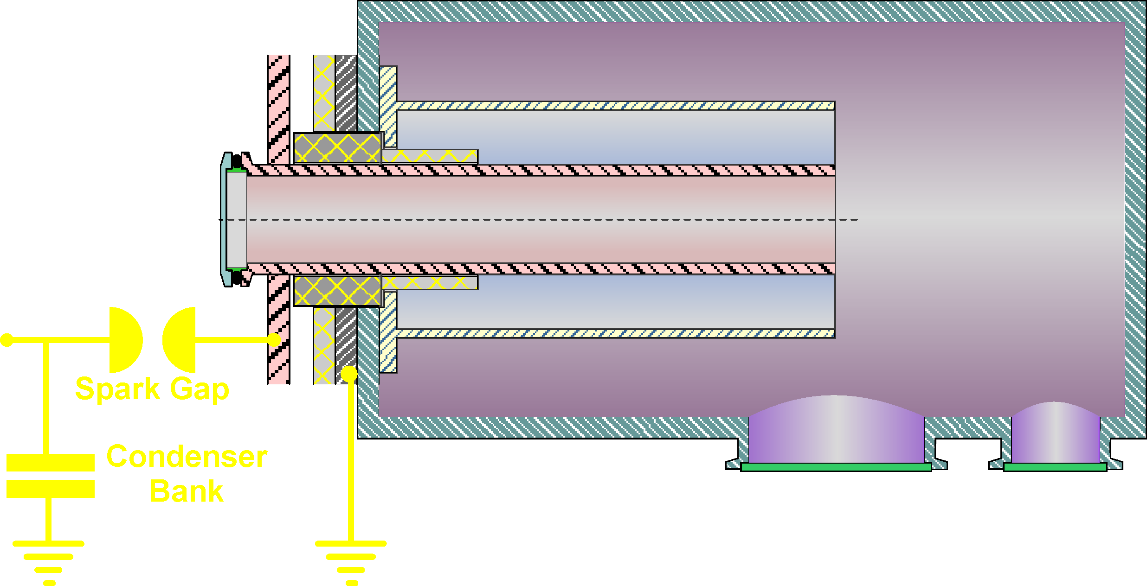


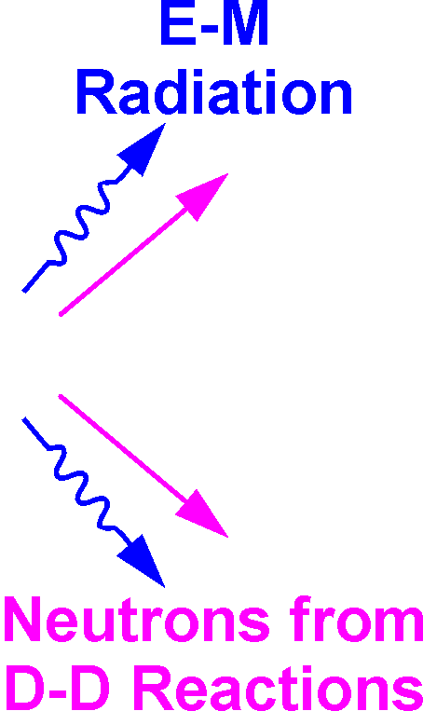
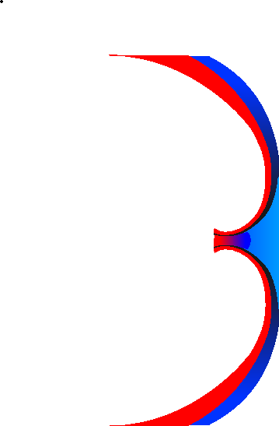



The Plasma Focus device
Plasma focus (dense plasma focus) – device in which plasma is generated by electric breakdown along the insulator in the gas between the cylindrical electrodes. The plasma sheath is accelerated and compressed at the and of the electrodes, creating a dense and hot plasma column (pinch).
General principle of PF operation::
Charging of the capacitors bank
Release of energy from charged capacitors.
Energy transmission to the collector.
Transmission of energy from the collector to the central electrode located in the experimental chamber.
Discharge: an electric breakdown over the surface of insulator in working gas.
Creating a plasma pinch - if the working gas is deuterium then it is a nanosecond source of fast neutron
Trigger pulse
v_{z}
Electron Beams
v_{z}

Slide 8
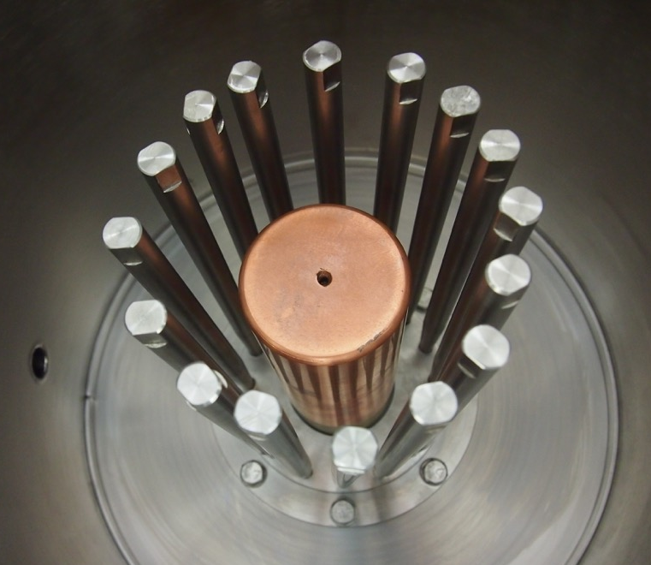
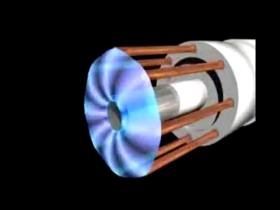
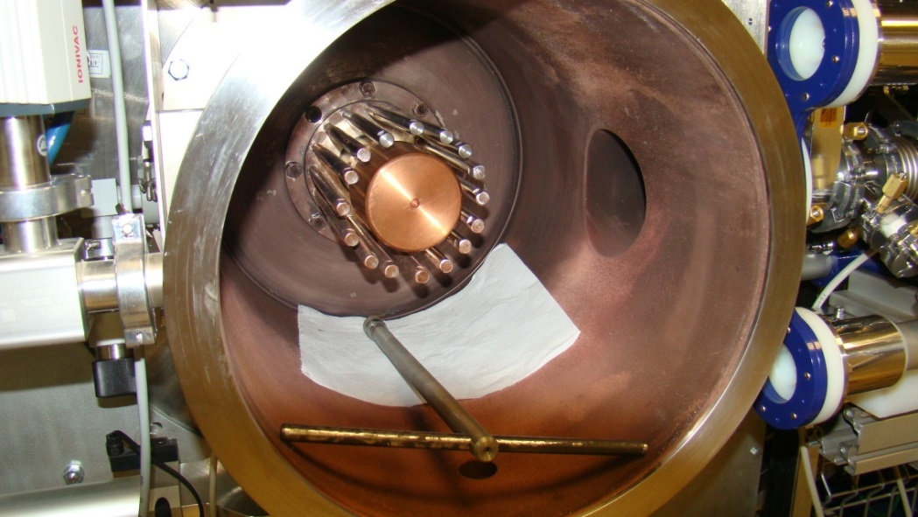
The PF-24 device – experimental chamber
Electrodes geometry:
Anode (Cu oxygen free)
r_{a} = 3.1 cm lub 4.0 cm,
l_{a} = 17.0 cm,
Cathode (16 rods; stainless steel)
r_{k} = 5.5 cm,
l_{k} = 17.0 cm
Ceramic insulator l_{i} = 6.0 cm

Slide 9
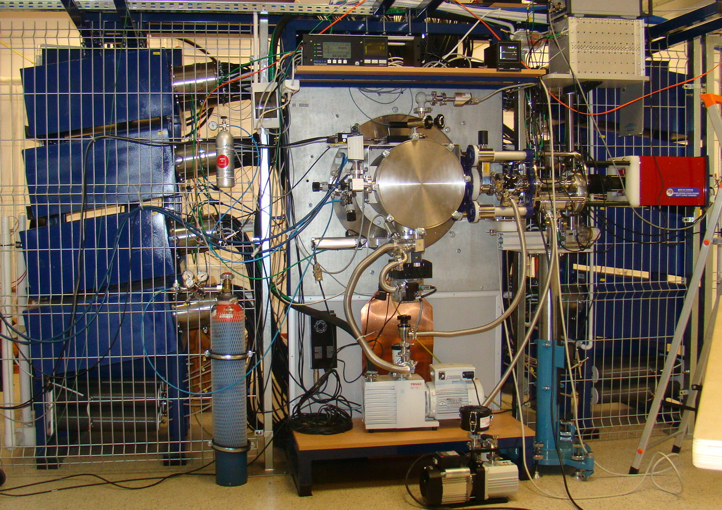
The Plasma Focus PF-24 device
Beryllium activation counter
Transmission cables
Electric probes output
Condensers
Spark gaps
VUV/SXR plasma imaging system
Collector area
Experimental chamber

Slide 10
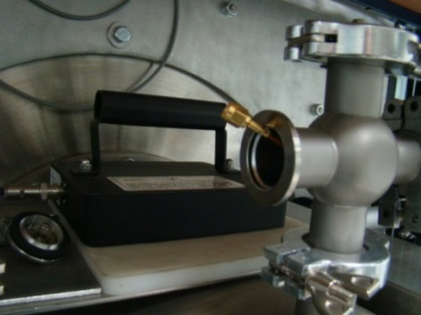
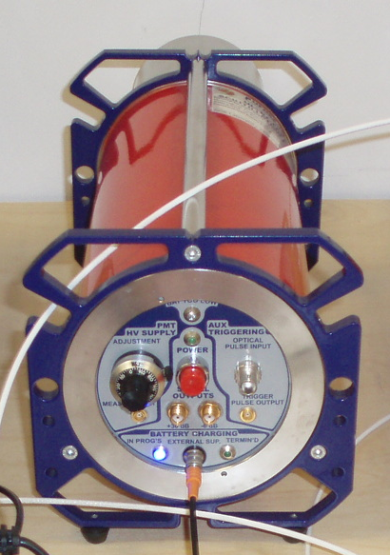
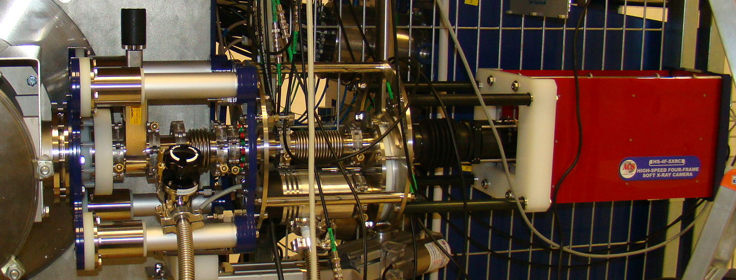
The PF-24 device – technical parameters and diagnostics system
Bank parameters:
Operating parameters:
Bank capacitance C₀ = 116 μF
Nominal inductance L₀ = 8.5 nH
Inter. Resistance R₀ = 3.1 mΩ
Bank Energy E₀ = 15 kJ – 93 kJ
Charging voltage U₀ = 16 kV – 40 kV
Quarter period T_{1/4}~1.8 μs
Electric diagnostic systems:
Rogowski coil – I(t)
Magnetic probe – dI/dt
Resistive voltage divider– U(t)
Neutron and HXR Detectors
Beryllium activation counter – Y_{n}
ultrafast scintillation neutron probe - ToF
Plasma imaging system
Neutron pinhole camera
VUV/SXR 4-frame pinhole camera

Slide 11
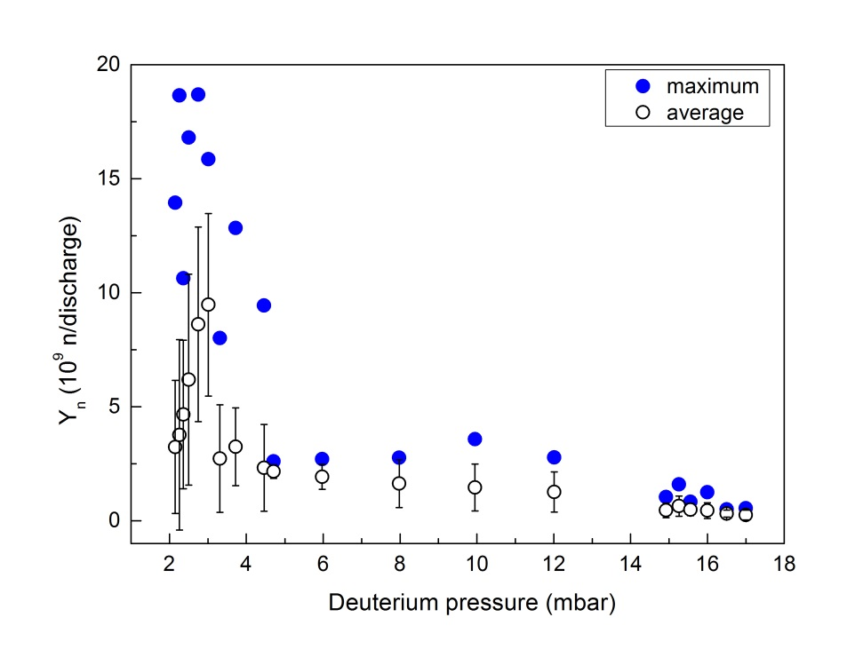
The PF-24 – neutron emission from D₂
Agnieszka Kulińska, Łukasz Marciniak, Marek Scholz
Basic research on the neutron production and emission from the D₂ plasma pinch
U₀ = 17 kV; E₀ = 16.8 kJ
516 discharges
D₂ pressure 2.0-17.0 mbar
Y_{n} between 10⁸-10¹⁰ n/dis
Maximum Y_{n} = 1.9x10¹⁰ n/dis
Median Y_{n} = 1.8x10⁹ n/dis
Optimum D₂ pressure 2.20-3.20 mbar

Slide 12
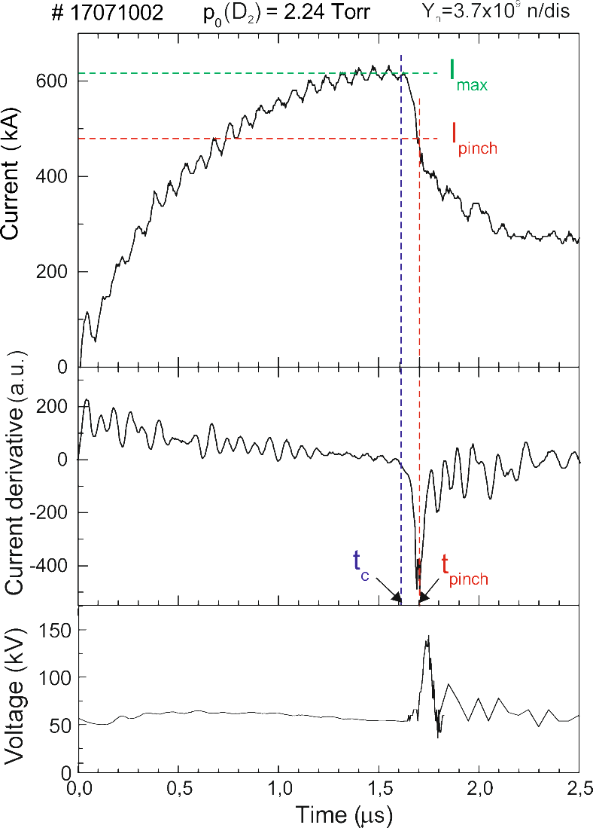
The PF-24 – electric diagnostics
Important plasma parameters:
I_{max} – maximum discharge current
I_{pinch}– pinch current (at min. of dI/dt)
t_{c} – time of magnetic piston acceleration along anode
t_{pinch} – time to plasma pinch generation
v_{z} = l_{a}/t_{c} – average speed of magnetic piston along anode (axial direction)
v_{r} = r_{a}/(t_{pinch} - t_{c}) – average speed of magnetic piston towards center of anode (radial direction)
Neutron emission
Y_{n} – total neutron yield

Slide 13
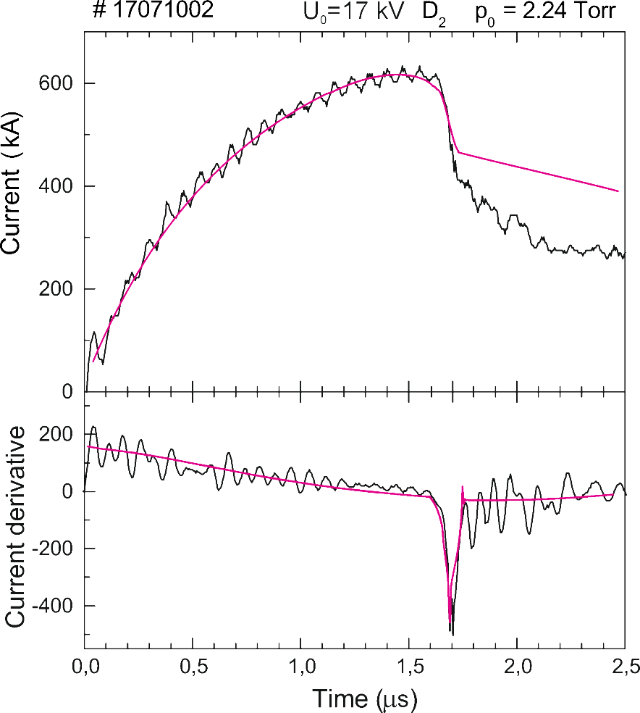
Modeling of discharges in plasma-focus –
the 5-phase Lee model code
    Snow-plough and elongated slug description of CS+shock movement
    Coupled differential equations describing CS+shock movement and RLC circuit equation
    Energy, mass, momentum and charge consistent.
Input parameters
U₀ = 17 kV C₀ = 116.12 µF
b = 4.9 cm; a = 3.1 cm; z₀ = 17 cm
p₀ = 2.98 mbar
MW1 = 4; A1 = 1; At-1 mol2 = 2
L₀ = 20 nH
R₀ = 6.0 mΩ
pure D₂
f_{m} = 0.115
f_{c} = 0.7
f_{mr} = 0.3
f_{cr} = 0.9
Output parameters:
exp calc
I_{max} (kA) 615(±16) 622
I_{pinch} (kA) 480(±56) 540
t_{c} (μs) 1.61(±0.03) 1.58
v_{z} (cm/ μs) 10.6(±0.2) 10.8
Y_{n}^{meas} = 37.2(±0.8)x10⁸ n/dis
Y_{n}^{calc} = 12.7x10⁸ n/dis

Slide 14
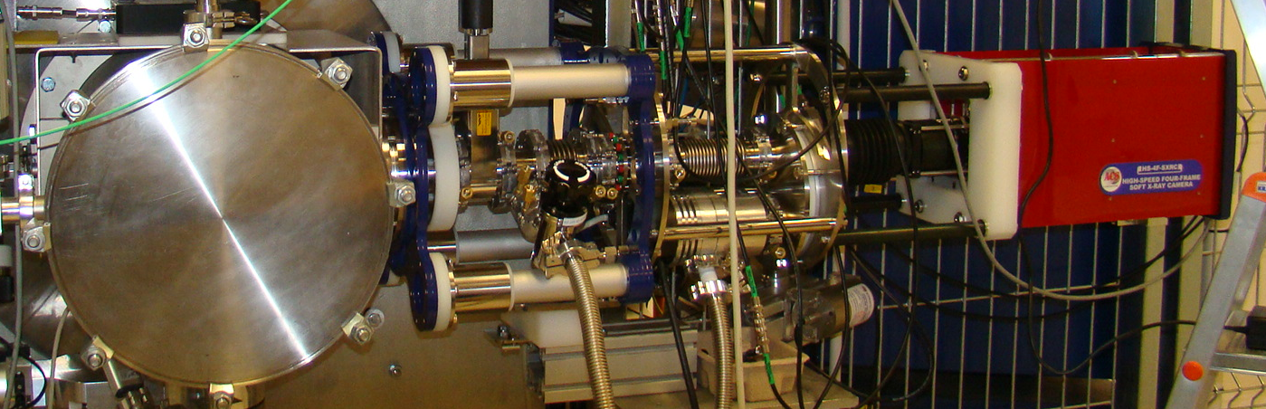
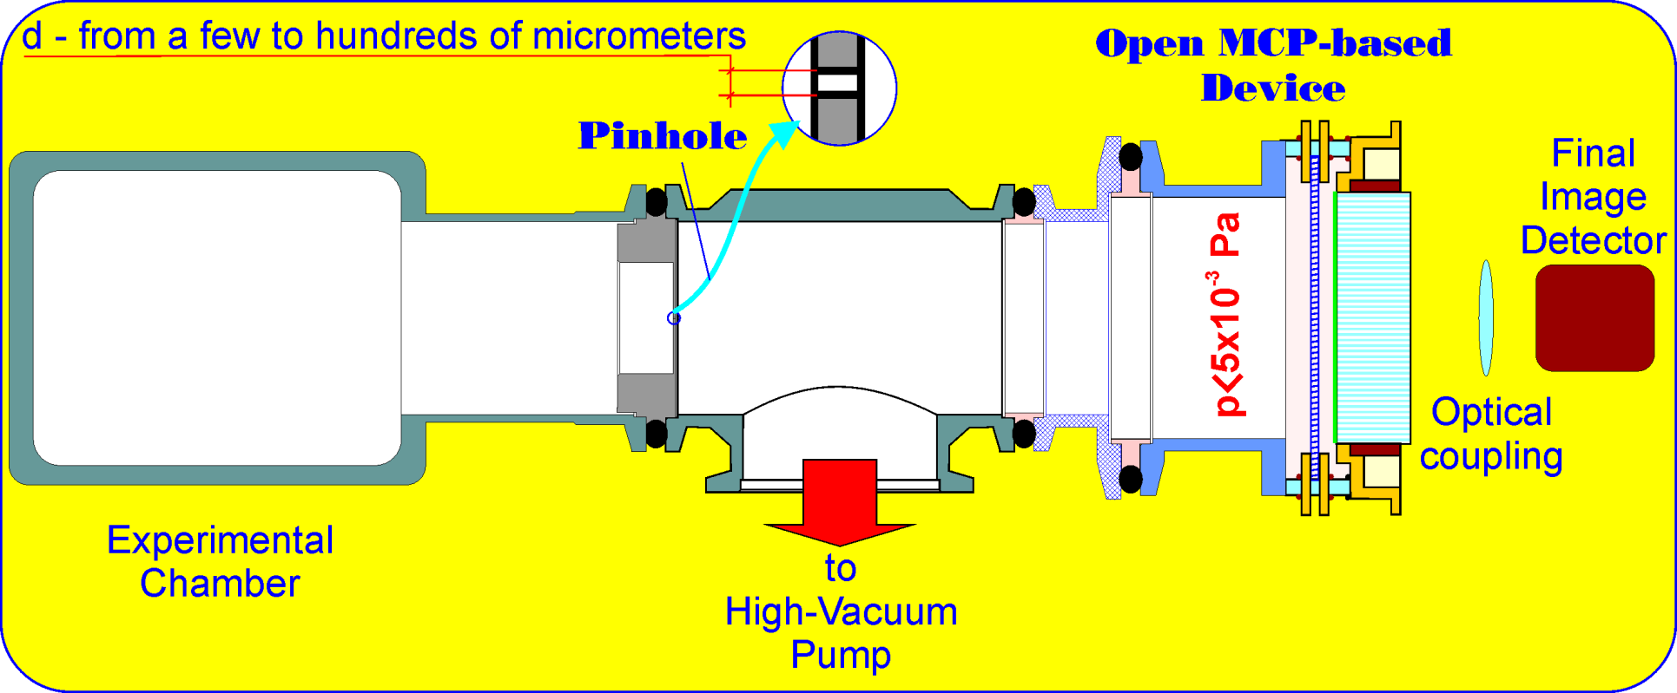
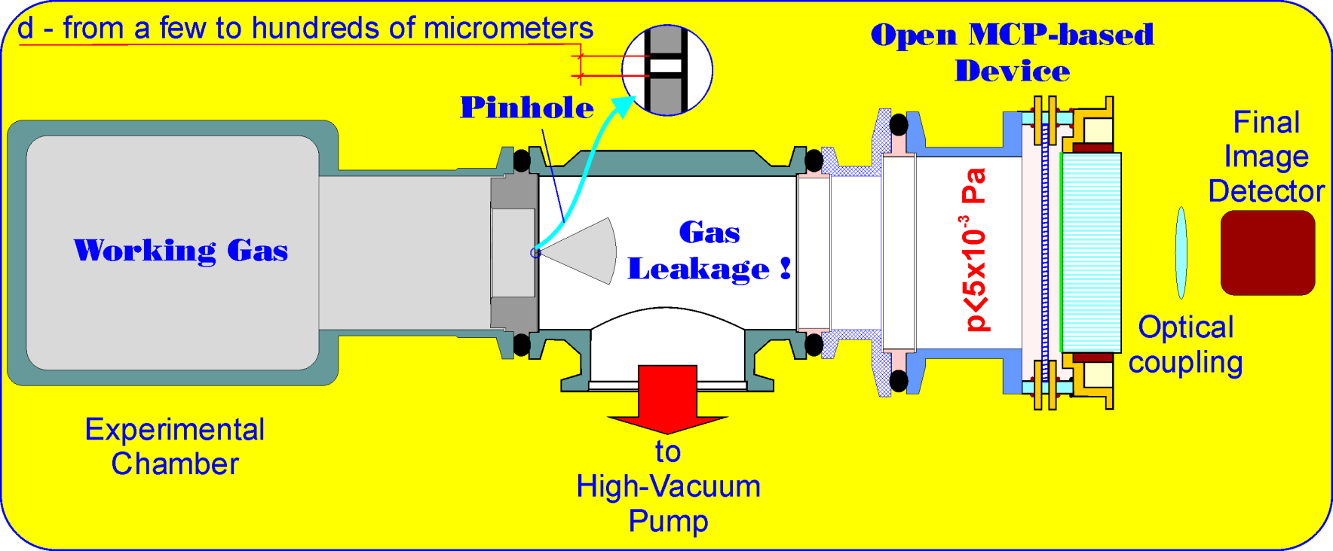
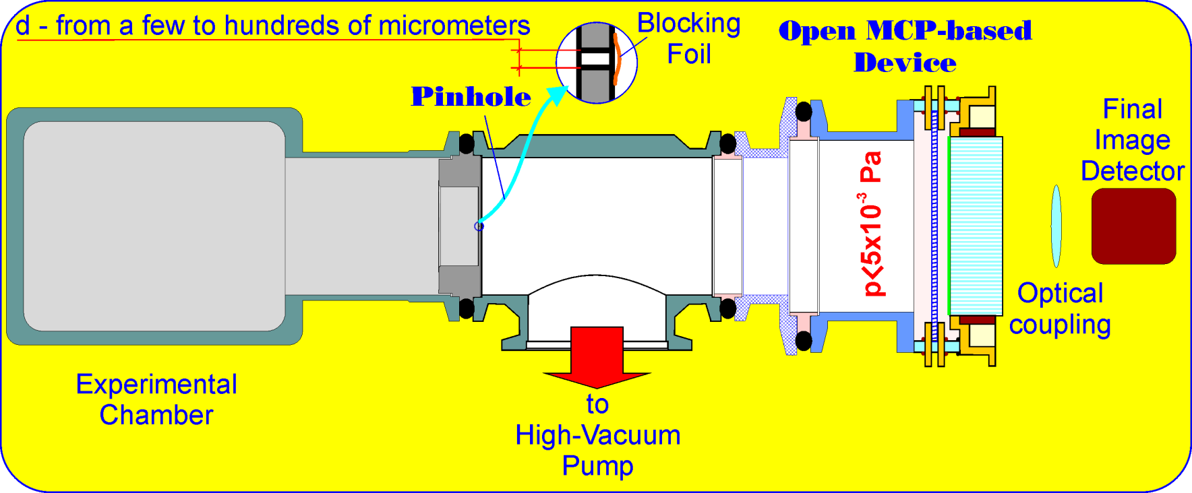
The PF-24 diagnostics – VUV/SXR pinhole camera

Slide 15
Plasma imaging – radiative compression phenomenon
Time of registration: 1.0 ns
Pinhole diameter: 70 μm
The plasma radiative compression phenomenon –
the plasma density and emission of X-ray radiation should increase significantly, whereas the volume
of plasma and temperature should decrease significantly.
Number of pixels: 2048 x 2048
Pixel size: 43 μm
Spatial resolution: 215 μm
discharge number: #17101303
pressure: 2.97 mbar D₂
total neutron yield: 12.9x10⁸ n/discharge
time between frames: 4.7 ns
triggering time: 16 ns after dI/dt dip
blocking foils: no
thickness of blocking foils:
#19082218
2.04 mbar D₂ + Ne
2.8x10⁸ n/discharge
14.0 ns
20 ns before dI/dt dip
yes, Be, #1 and #4
7 μm
#19082204
1.57 mbar D₂ + Ne
2.5x10⁸ n/discharge
14.0 ns
at dI/dt dip
yes, Be, #1 and #4
7 μm

Slide 16
The PF-24 – research topics
Basic research:
Neutron emission from discharges in D₂ and D₂ + Ar, Ne
Plasma parameters determination,
The 5-phase Lee model code – comparison of measured and computed results,
Evaluation of the theoretical calculations carried out using the Lee model code.
Radiative compression phenomenon
…
Test of new diagnostic systems

Slide 17
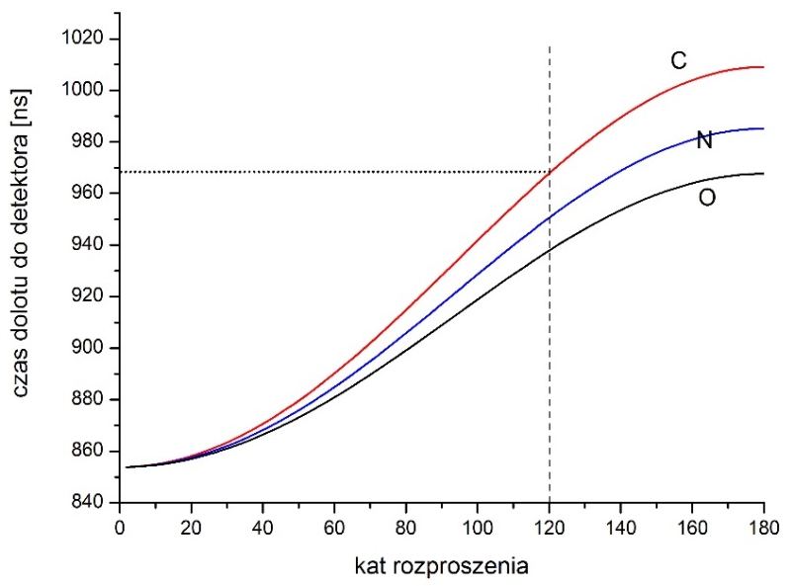
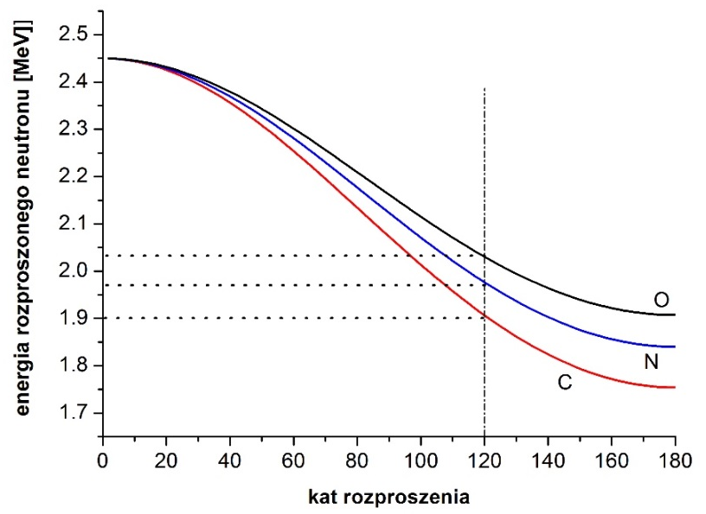
Detection of hidden materials by a single nanosecond neutron pulses –
Monte Carlo simulation of the detection process
Urszula Wiącek, Dominik Dworak, Krzysztof Drozdowicz,
Ryszard Miklaszewski (IPPLM, Warszawa), Vladimir Gribkov (Moscow, Russia)
Geometry of incident and scattered neutron beams
NINIS - Nanosecond Impulse Neutron Investigation System
is a method dedicated for detection of hidden objects (explosives and other illicit materials).
Energy of scattered neutrons as a function of the scattering angle and the mass of scattering nucleus
The method is based on recording of Time-of-Flight signals of neutrons elastically and non-elastically scattered by the object under investigation.

Slide 18
Detection of explosives and other illicit materials by a single nanosecond neutron pulses
Geometry of the system for Monte Carlo modelling of neutron scattering
To distinguish between different substances scattering angle should be as large as possible (except the case of hydrogen). In practice, only the angles on the order of 150° – 170° allows to get a proper separation of signals.
The neutron source pulse duration should be as short as possible:
  The best option – delta Dirac,
  Acceptable in practice - 2-3 ns
For realistic neutron source
- pulse duration ~10 ns – too long
  - distance „object-detector” ~20 m,
  - distance „neutron-object” >50 cm (to avoid geometrical spread of scattering angles)

Slide 19
Monte Carlo modeling for detection of fissile materials
E= 2.5 MeV
Uranium 10%
Uranium 50%
Uranium 90%
Thorium
Aluminum
By using short pulses of the 2.45 MeV neutrons one can detect presence of fissile materials by checking existence of neutrons with energies higher then 2.45 MeV as well as recording long and well pronounced tail of low energy neutrons.
  Result seems to be very promising - fission neutrons can be distinguished .

Slide 20
Summary and plans
Spectrometric capabilities of CVD detector test up to 250°C
          CVD detector testing in the fast neutron field & Temp
Plasma parameters determination in gas mixture D₂ + Ar/Ne/Kr
– comparison of measured and computed results
Evaluation of the theoretical calculations carried out using the Lee model code
Radiative compression phenomenon
          Tracking detectors for ion beam
          Development of plasma imaging system
  Triggering system
  Calibration of BCF-12 detectors
Neutron free plasma (p+B reaction)

Slide 21
Department of Radiation Transport Physics
dr. hab. Wojciech Królas
dr. Hab. Jakub Bielecki
dr. Jan Dankowski
Prof. Krzysztof Drozdowicz
msc. Dominik Dworak
msc. Andrzej Igielski
dr. Axel Jardin
dr hab. Agnieszka Kulińska
dr. Arkadiusz Kurowski
prof. Marek Scholz
dr. Grzegorz Tracz
dr. Urszula Wiącek
prof. Urszula Woźnicka
dr. Anna Wójcik-Gargula
Technicians:
Władysław Janik
Maciej Turzański
PhD students:
Łukasz Marciniak
Krzysztof Król

Slide 23
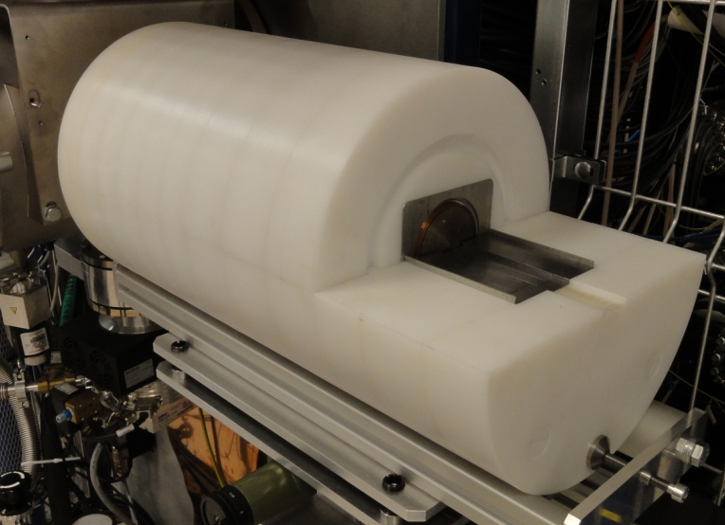
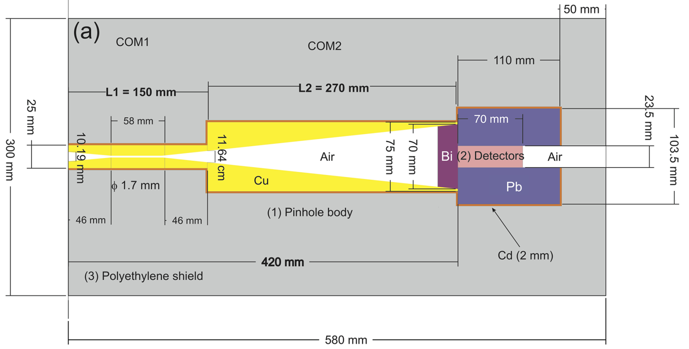
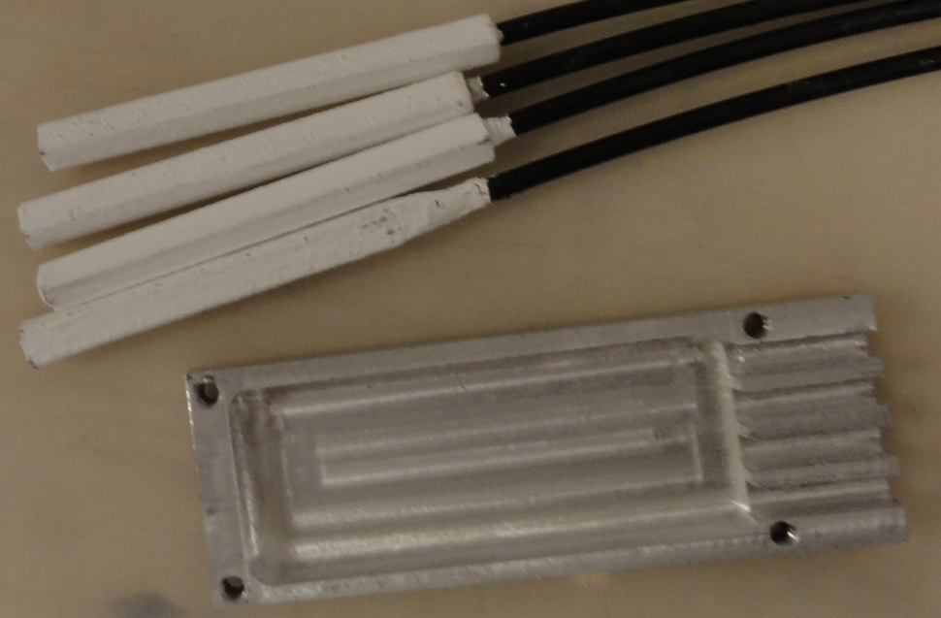
The PF-24 diagnostics – neutron pinhole camera
Neutron pinhole camera:
four BCF-12 small area scintillation detectors (5mmx5mmx60mm)
Magnification: 1 : 1
spatial resolution: 5 mm
Temporal resolution: a few nanoseconds
Distance PF-24 source – pinhole camera: min 640 mm

Slide 24
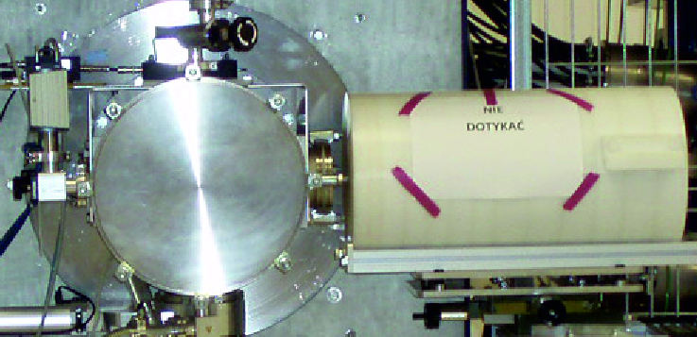
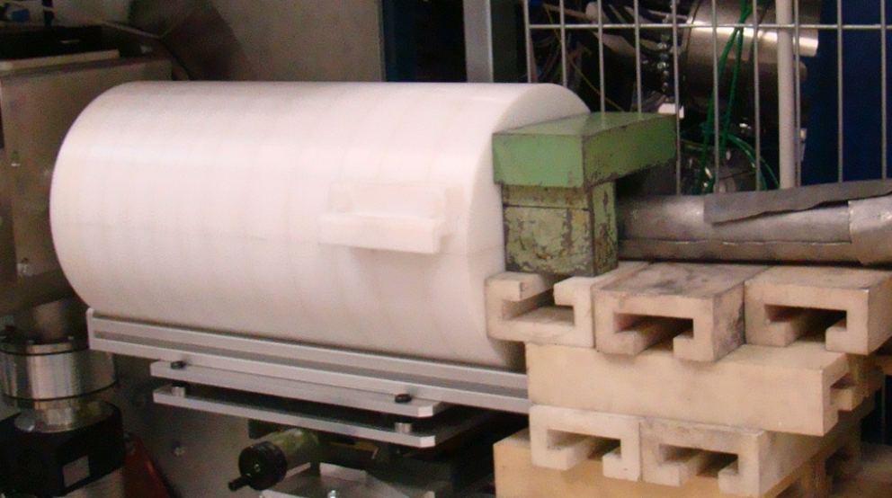
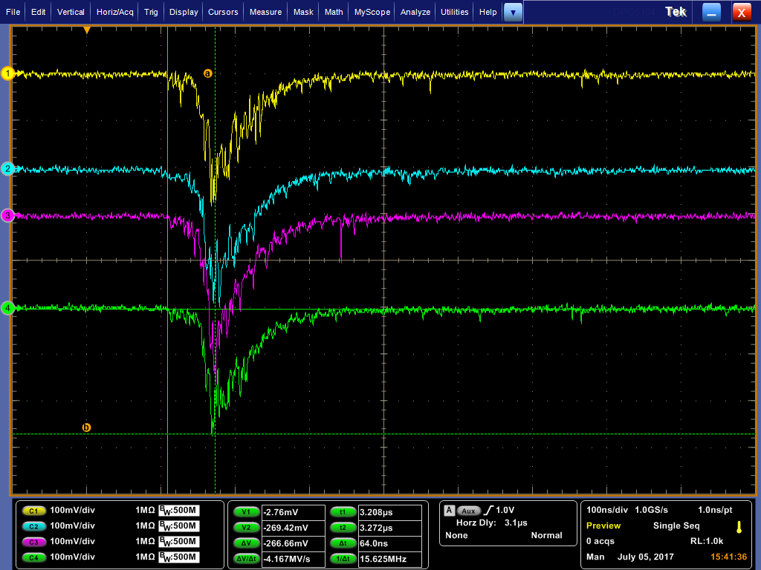
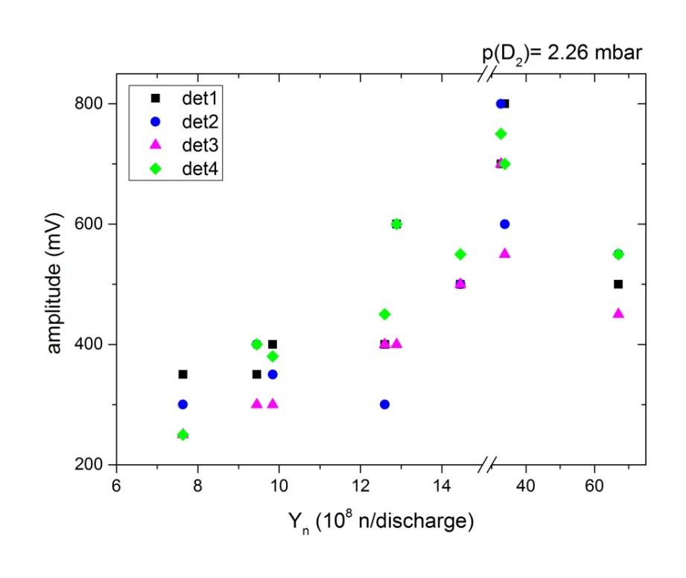
Neutron pinhole camera – BCF-12 detectors tests

Slide 25
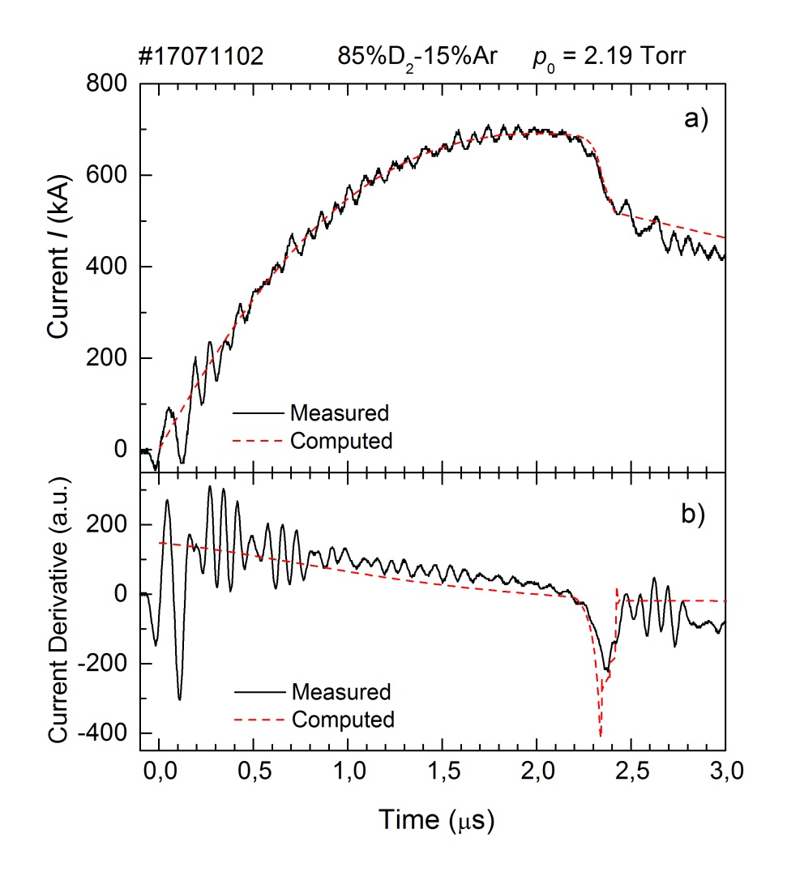
The 5-phase Lee model code – gas mixture
D₂ = 2.48 mbar; Ar = 0.44 mbar
Input parameters
U₀ = 17 kV C₀ = 116.12 µF
b = 4.9 cm; a = 3.1 cm; z₀ = 17 cm
p₀ = 2.92 mbar
MW1 = 4; A1 = 1; At-1 mol2 = 2
MW2 = 40; A2 = 18; At-1 mol2 = 1
L₀ = 23 nH
R₀ = 7.5 mΩ
f_{m} = 0.068
f_{c} = 0.5
f_{mr} = 0.08
f_{cr} = 0.46
Y_{n}^{meas} = 2.09(±0.05)x10⁸ n/dis
Y_{n}^{calc} = 2.1x10⁸ n/dis

Slide 26
References:
U. Wiącek, K. Drozdowicz, V. Gribkov, R. Miklaszewski; MCNP Simulations of Fast Neutron Scattering by Various Elements and their Compounds in View of Elaboration of a Single Shot Inspection System Proc. of IAEA Technical Meeting Padova, 13- 17.11.2006, “Combined devices for humanitarian demining and explosive detection”, IAEA, Vienna (2007), STI/PUB/1300;
U. Wiącek, K. Drozdowicz, B. Gabańska, V. Gribkov, R. Miklaszewski; Monte Carlo simulations of scattering and detection of pulsed neutrons from a plasma-focus source for detection of hidden illicit materials, Acta Technica, 54 (2009) 87;
V.A. Gribkov, S.V. Latyshev, R. Miklaszewski, M. Chernyshova, K. Drozdowicz, U. Wiącek, A.V..Dubrovsky, B.D. Lemeshko; Powerfull Nanosecond Single – Shot Technique for Detection of Illicit Materials and Explosives Proc. Of the Int. Topical Meeting on Nuclear Research Applications and Utilization of Accelerators, International Atomic Energy Agency, Vienna, Austria, 4-8 May 2009, 2009/5/4 SM/EN-19
K. Drozdowicz, U. Wiącek, B. Gabańska, R. Miklaszewski, V. Gribkov; Monte Carlo modeling of scattering of fast neutrons (emitted from a plasma-focus source) on hidden explosives and common use objects (in Polish), Proc. of the 40th General Meet. of Polish Physicists, Kraków, Poland, 6-11 September (2009), p. 46;
V.A. Gribkov, S.V. Latyshev, R. A. Miklaszewski, M. Chernyshova, K. Drozdowicz, U. Wiącek, K. Tomaszewski, B. D. Lemeshko; A dense plasma focuse-based neutron source a single-shot detection of illicit materials and explosives by nanosecond neutron pulse, Physica Scripta, 81 (2010) 035502 12, doi: 10.1088/0031-8949/81/03/035502;
U. Wiącek, K. Drozdowicz, B. Gabańska, V. Gribkov, R. Miklaszewski; Monte Carlo modeling of fast neutron scattering by various compounds in view of elaboration of a single shot inspection system, Proc. of the Int. Topical Meet. on Nuclear Research Applications and Utilization of Accelerators, IAEA, Vienna, Austria, 4-8 May 2009, STI/PUB/1433 (2010) SM/EN-P10;
U. Wiącek, R. Miklaszewski, V. A. Gribkov, B. Gabańska; Method for detection of hidden explosives and other illicit materials with use of nanosecond neutron pulses from plasma focus device – Monte Carlo modeling of the system, Proc. of the NUTECH-2011 Int. Conf. On Development and Applications of Nuclear Technologies, Kraków, Poland, 11- 14 September 2011, p. 160;
R. Miklaszewski, U. Wiącek, D. Dworak, K. Drozdowicz, V. Gribkov; Detection of explosives and other illicit materials by a single nanosecond neutron pulses - Monte Carlo simulation of the detection process, J. Inst. 7 (2012) JINST C07006 doi: 10.1088/1748-0221/7/07/C07005;
V. Gribkov, R.A. Miklaszewski, M. Chernyshova, M. Scholz, R. Prokopovicz, K. Tomaszewski, K. Drozdowicz, U. Wiącek, B. Gabańska, D. Dworak, K. Pytel, A. Zawadka, A single-shot nanosecond neutron pulsed technique for the detection of fissile materials, J Inst 7 (2012 ) JINST C07005, doi:10.1088/1748-0221/7/07/C07005;

Slide 27
Department of Radiation Transport
Research on interaction of nuclear radiation with different medium.
  activation studies of real ITER materials – WPJET-3 ACT – JET
  MCNP modelling for geophysics
Construction concept of the neutron accelerator source DONES (Demo Oriented Neutron Source)
Neutron and plasma diagnostics in big thermonuclear devices: tokamak, stellarator.
- neutron activation method (delayed neutrons emitted by fissionable materials) –W7-X
- computer modelling of the radiation field
- plasma tomography – JET, WEST
- high resolution neutron spectrometer (HRNS) – ITER
- diamond detectors

