Slide 1


Techniques for data processing in real-time using FPGAs
www.fpgafais.com
Dr Grzegorz Korcyl
Department of Information Technologies
Jagiellonian University, Cracow
2nd Workshop on Neutrons in Medicine and Homeland Security,
12-13 September 2019, Kraków

Slide 2
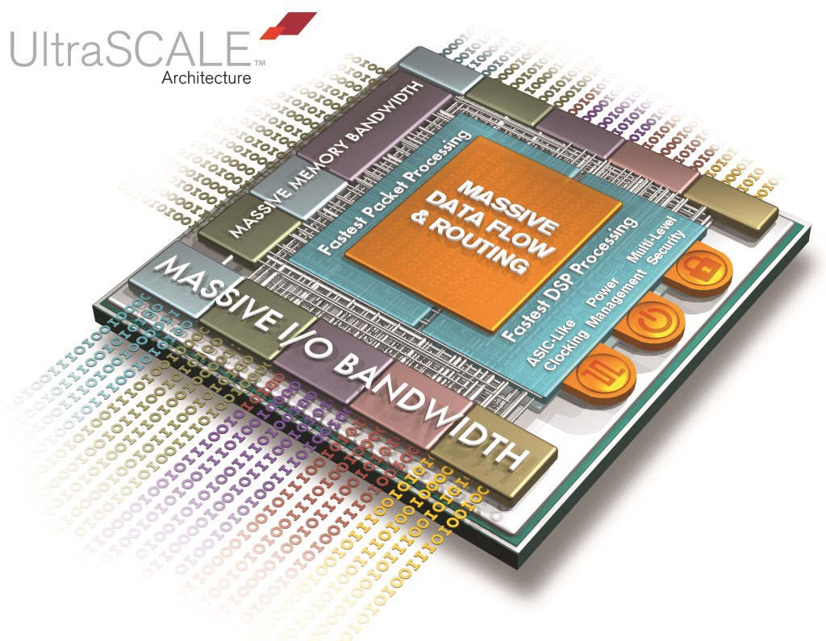
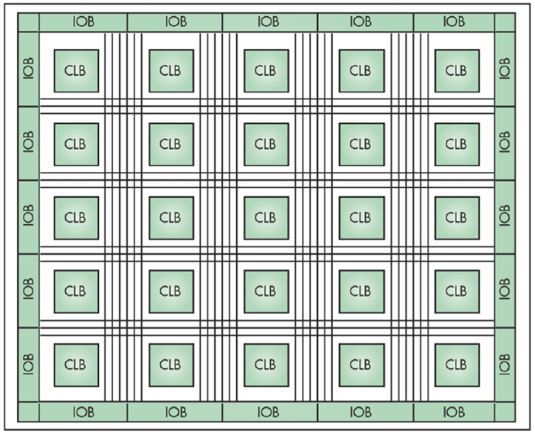
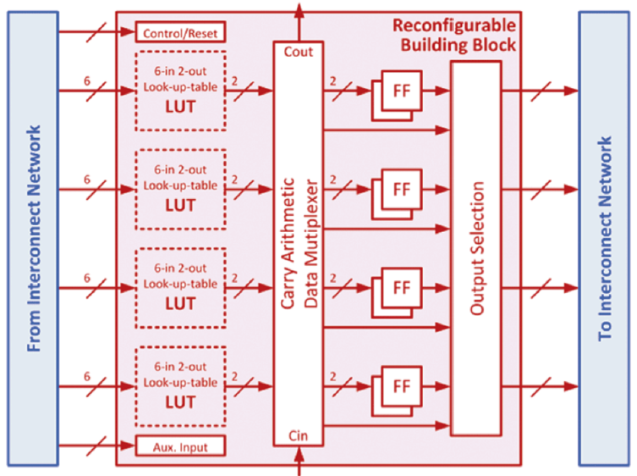
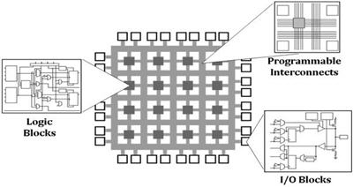
What are FPGAs
Field Programmable Gate Arrays
  Reconfigurable devices for processing digital data streams
  Adaptable computing resources
  No predefined architecture
  Massive parallelism
  Streamlined processing
www.electronicdesign.com

Slide 3
CPU vs GPU vs FPGA
Instr 11
Instr 1
Instr 12
Instr 1 Data 1
Data 1
Clock cycle
Instr 21
Instr 13
Data 1
Data N
Clock cycle
Instr 2
Data 2
Instr 22
Instr 1M
Instr 2
Data 2
Instr 31
Instr 3
Data 3
Clock cycle
Instr 23
Data 3
Data M
Instr 32
Instr 2M
Instr 4
Data 4
Data N
Instr 33
Instr NM
CPU
  Single Instruction Single Data per core
  Multiple cores
  High clock freq.
  Operating system
GPU
  Single Instruction Multiple Data
  High clock freq.
  Memory access
  Accelerates CPU
FPGA
  Massive parallelism
  Streamlined processing
  Low clock freq.
  Instant memory access
  Standalone platforms

Slide 4
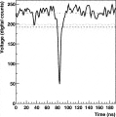
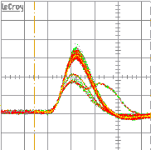


Processing pipeline

Slide 5
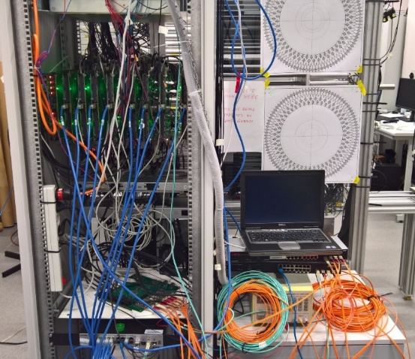
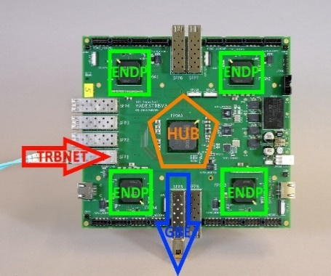
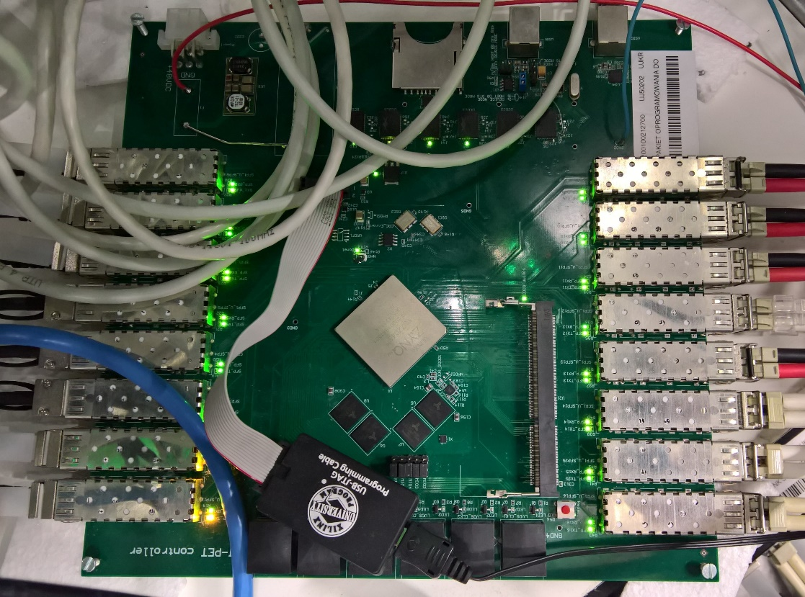
JPET Readout System
Entirely based on FPGAs
  Front End boards
    Analogue signal discrimination
  Digitizers / Data collectors
    TRBv3 boards
    TDC in FPGA
  Data processing and visualization
    Controller board
    Event by event processing
Traxler, M.; Korcyl, G.; Bayer, E.; Maier, L.; Michel, J.; Palka, M.
„A compact system for high precision time measurements (<14 ps RMS)
and integrated acquisition for a large number of channels”,
JINST 10.1088/1748-0221/6/12/C12004

Slide 6
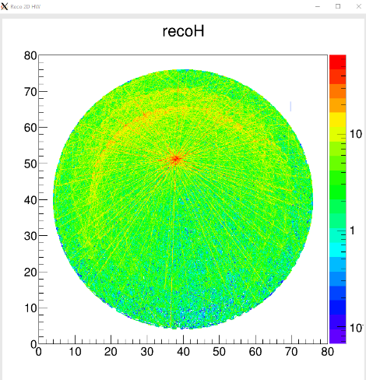
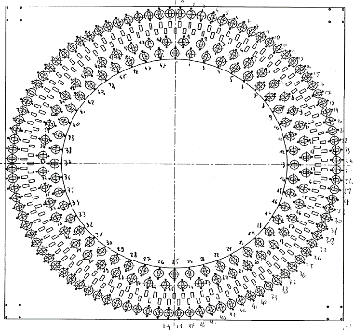
JPET processing pipeline
Data processing steps
  Data units reception and assembly
  Extraction of timing data
  Application of detector geometry
  Application of calibration parameters
  Search for time coincidences
  Filtration
  Construction of histogram and visualization
Hit1: ch 1, 115 ns, TOT 5 ns
Hit2: ch 2, 116 ns, TOT 7 ns
…

Slide 7
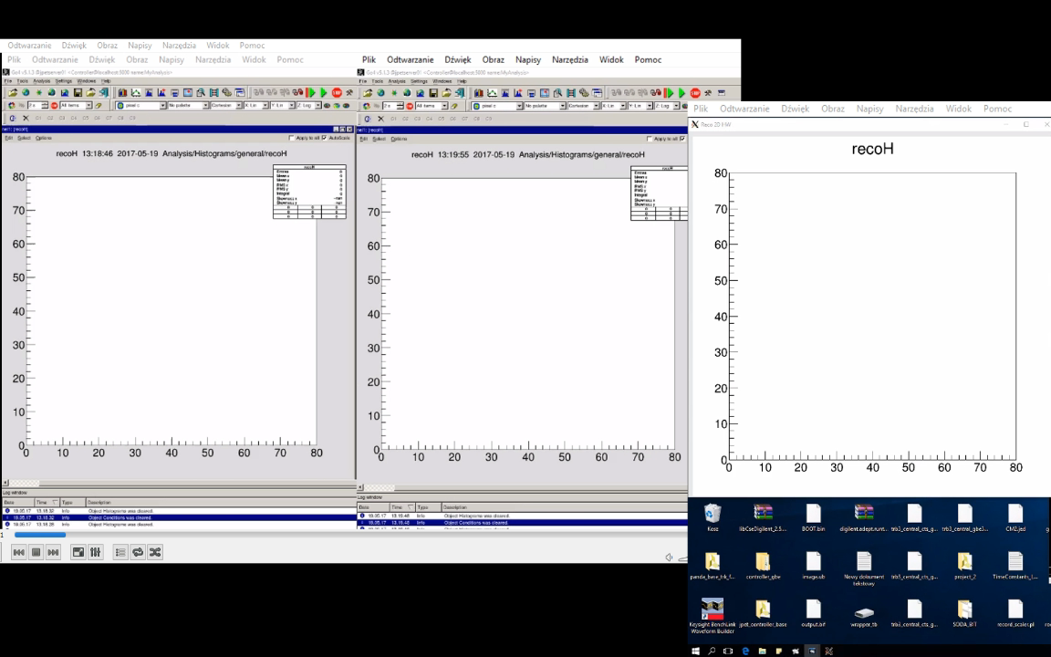
JPET processing pipeline
CPU vs FPGA

Slide 8
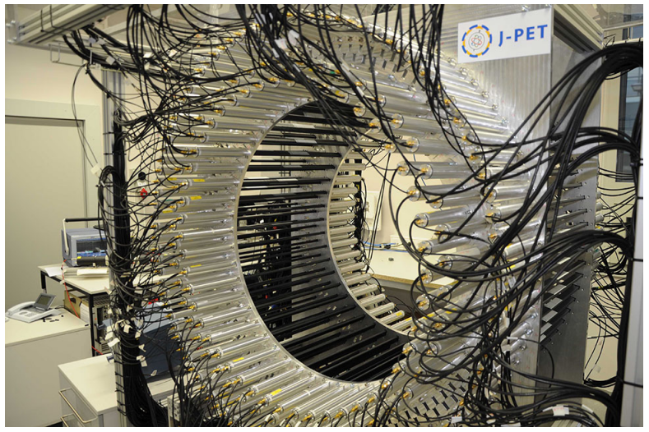
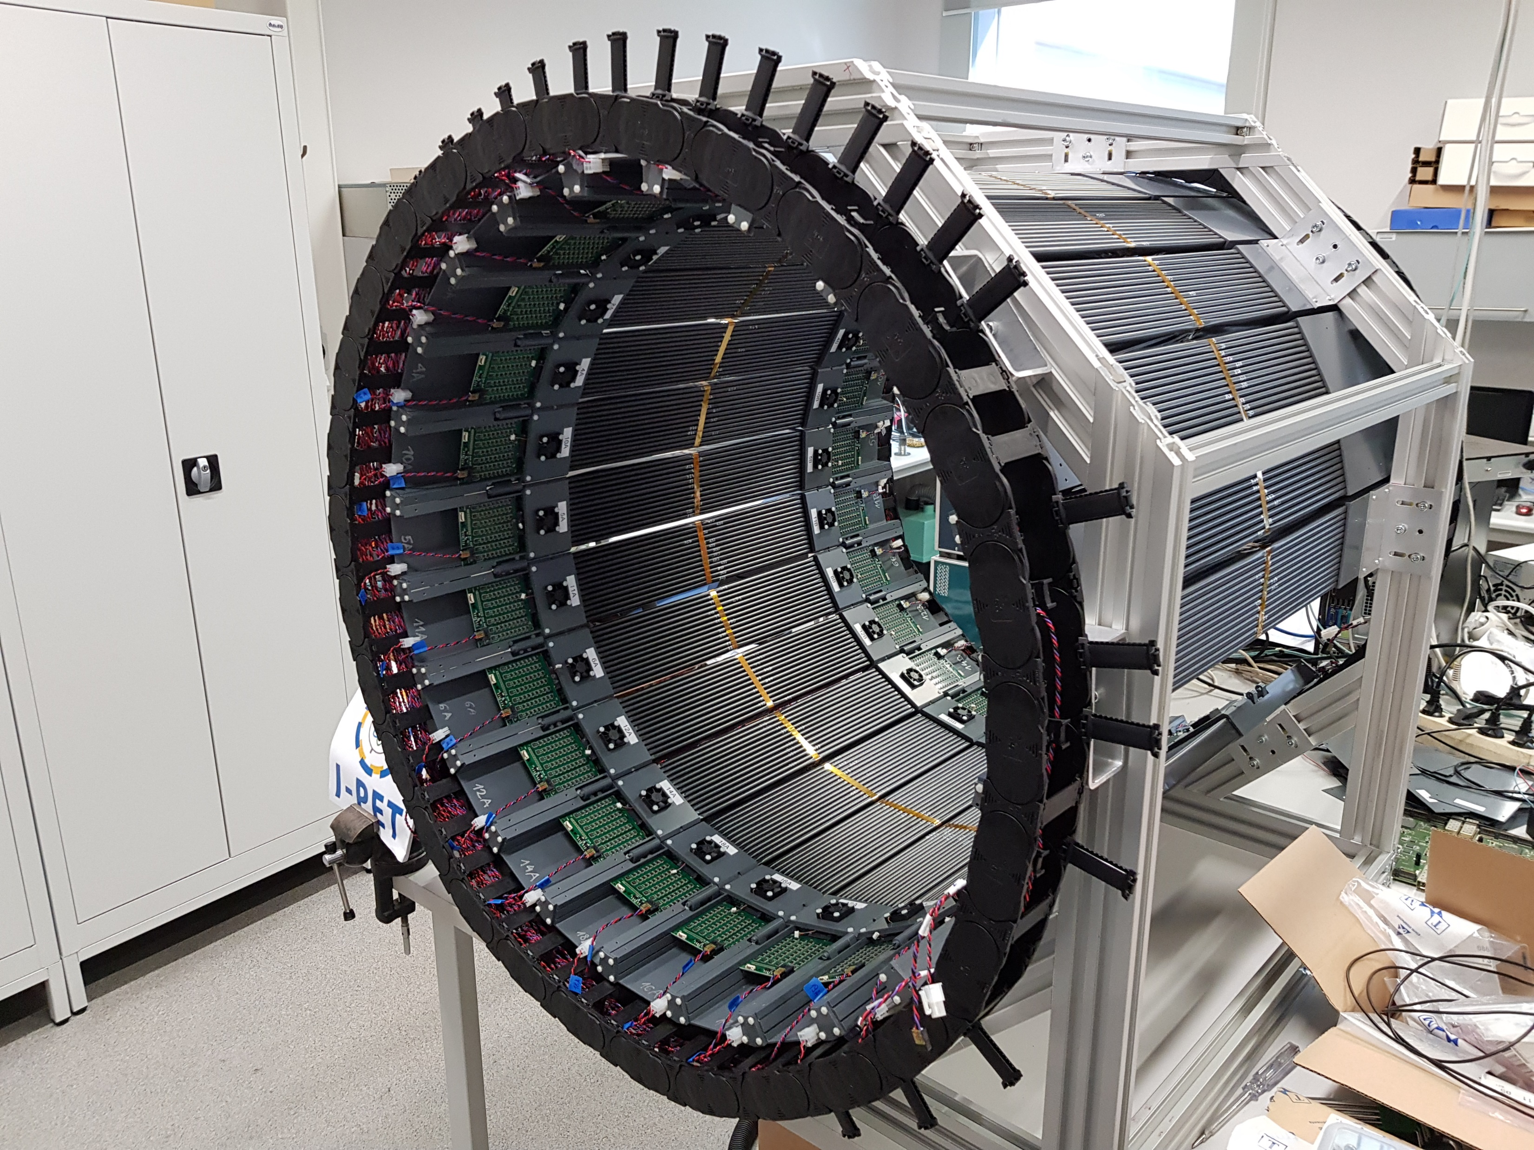
Modular JPET readout
 | JPET | Modular JPET
Scintillators | 192 | 312 | 1.6x
Analog channels | 1536 | 4992 | 2.9x
Digitizers | 32 | 48 | 6x
Logic [k cells] | 350 | 5400 | 15.4x
Memory [Mb] | 19 | 272 | 14.3x
DSP | 900 | 3972 | 4.4x
ARM cores | 2 | 4 + 2x RT + 1x GPU | >2x

Slide 9
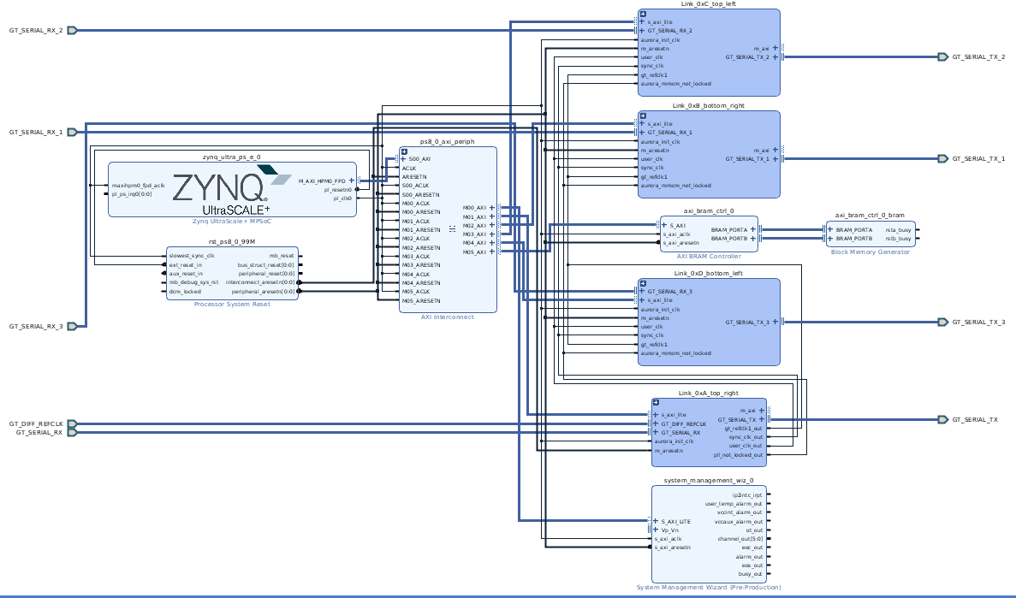



Novel development techniques
Reduce HDL logic development to minimum
  Time consuming, requiring experience, error-prone process
Block designs
  Library of ready to use, configurable components (IPCores)
High Level Synthesis
  Component development in C/C++/OpenCL
  Compilation into HDL IPCore
Algorithmic/data processing components in HLS
Hardware interfacing in HDL
Build entire systems without HDL

Slide 10
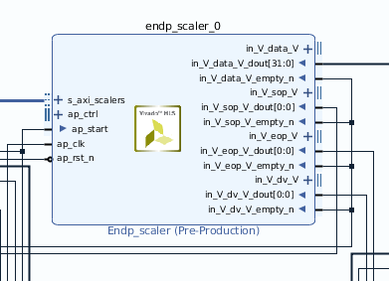
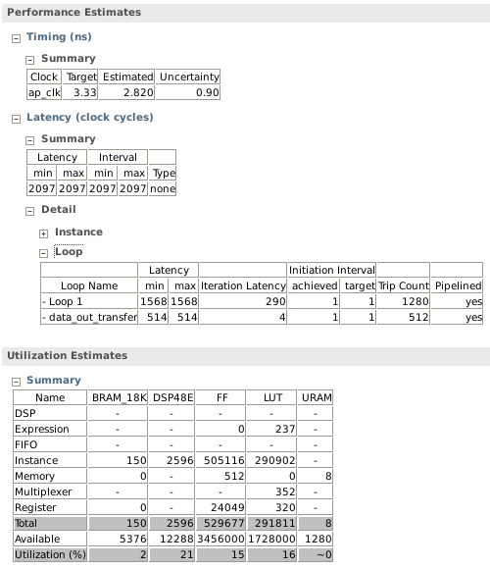
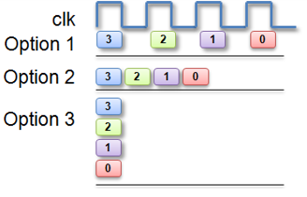
Development in HLS
Single function – single component
  Function arguments become component interface
  Function body translated into logic
  Results analysis with a set of reports
    Timings, resources
  Compilation process controlled with a set of #pragmas

Slide 11
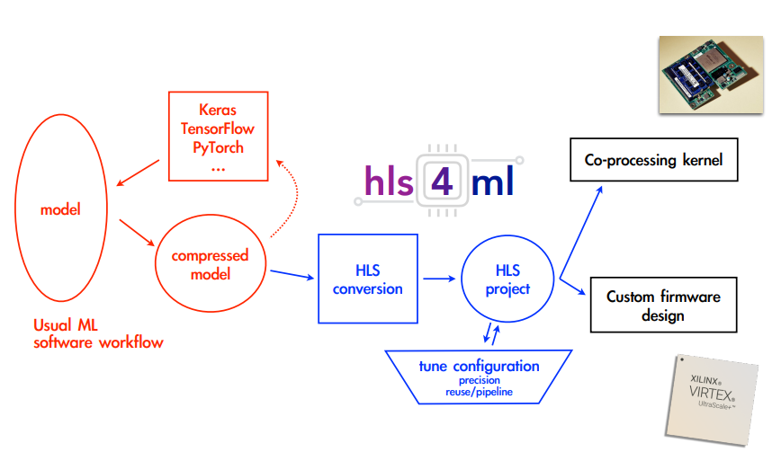
HLS Example
Entire flow for Neural Network implementation on FPGA with a single HDL module
Advantages: fixed latency, level of parallelism, data types
Used for L1 trigger at ATLAS CERN
Python
C++
Bitstream
hls4ml

Slide 12
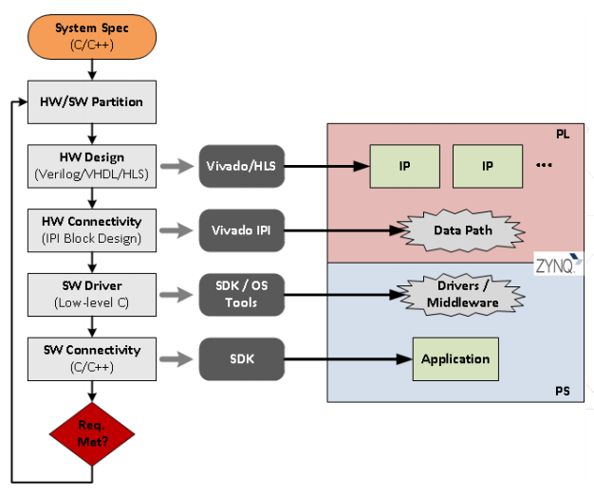
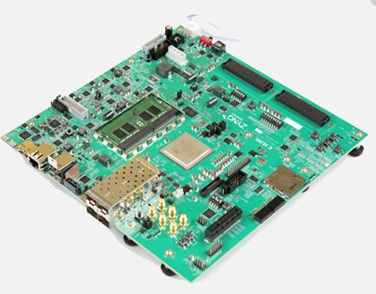
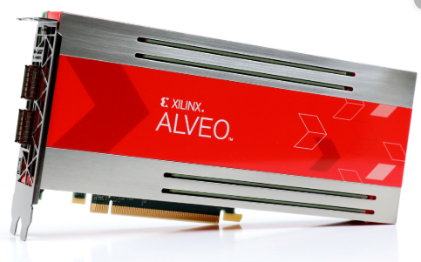
Software Defined environment
Large selection of hardware platforms on market
  Standalone boards – System-on-Chip devices – SDSoC
  Accelerator boards – PCIe enabled - SDAccel
Development environment
  Entire project in C/C++
  Host <–> Kernel architecture
  Main function – starting point on the host
  Kernel – hardware accelerated function
  Encapsulates all other tools and compilers

Slide 13
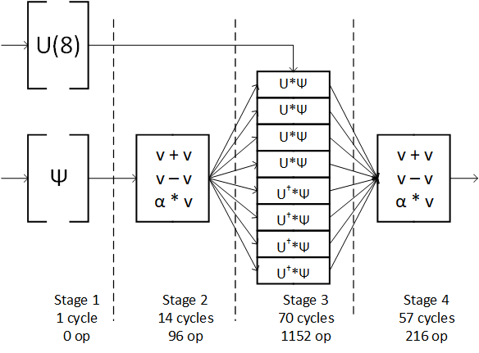
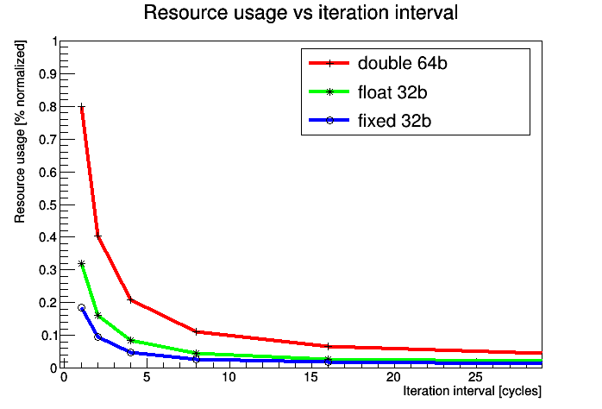
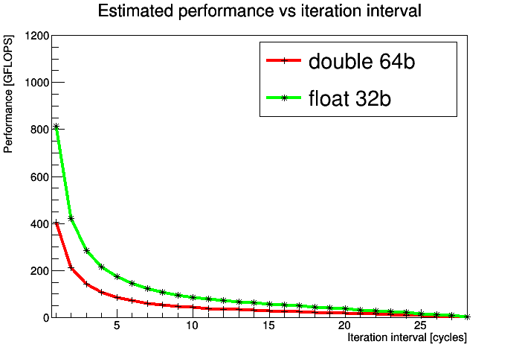
SDx Example
Conjugate Gradient as HPC benchmark
  Host prepares data and streams to the accelerated kernel
  1464 floating point numerical operations per single iteration
  Kernel implemented with II=1, latency 150 at 300 MHz
  2x faster than Intel Xeon Phi 64-core, 1.7 GHz
  Not a single HDL line written
80%
812 GFLOP
30%
406 GFLOP
II=1
II=1

Slide 14
Summary
FPGAs are no longer reserved for experienced engineers
Ready to use platforms and new development tools accelerate project timeline
  High Level Synthesis
FPGA resources capable to cope with complex problems
  Numerical algorithm
  Image processing
  Artificial Intelligence
All that in real-time and fixed latency

Slide 16
Acceleration on FPGAs
Delegate computational intensive functions from HOSTs to KERNELs in Programmable Logic
  Profit from:
    Pipelined processing
    Natural parallelism
    Distributed internal memory, direct DDR connection
    Embedded network transceivers
    Deterministic latency
    Low power consumption
  Bottleneck - data delivery
Architectures:
  Classic FPGA
    Host: x86 CPU
    Interconnect: from host DDR memory through PCIe to DDR on FPGA platform
  System-on-Chip
    Host: ARM cores embedded within FPGA package
    Interconnect: DMA transfers with shared DDR memory
Host
func1
api
api
func3
Interconnect
WR
RD
FPGA
func2
Cloud providers (FPGA as service):
  MS Azure - 2017
  Amazon AWS – Sep. 2017
  Huawei – June 2018
  Aliyun – Sep. 2018
  Nimbix – Oct. 2018
  Cyfronet Kraków - 2013

Slide 17
Kernel implementation
Conjugate Gradient solver as a benchmark for HPC systems
  Accelerate sparse matrix-vector multiplication
    Low level of data dependency
    High level of parallelization
    Large problem sizes
Host initiates the algorithm, reads input data from storage
Prepares dataset for the kernel
Transfers data and calls the kernel
Retrieves results and evaluates next iteration
Kernel development
  High-Level Synthesis
    Engine to generate RTL from C/C++, OpenCL sources
    Wide range of #pragmas and OpenCL attributes to control RTL production
    Frameworks to import Tensorflow/Keras to HLS
    Detailed reports describing compilation results
System development
  Define data transfer infrastructure between Host and Kernel
  Compile and generate executable files

Slide 18
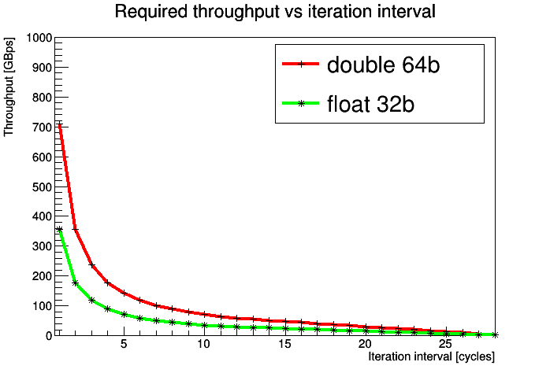
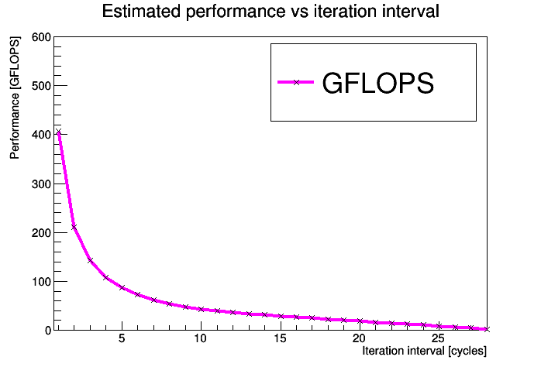
Kernel details
High-level synthesis optimizations
  Balance between: Latency / Iteration Interval / Resources
  Ensure full pipeline
    Accept new data set considering maximum throughput from memory
  Loop unrolling for parallelization
  Internal memory management
    Ensure entire required data set is available at a given clock cycle
  Data type selection
    Custom bit-width data types
Kernel summary:
  1464 FLOP per iteration
  296 variables required to start the iteration
  Compiled for Xilinx U250 with 300MHz clock

Slide 19
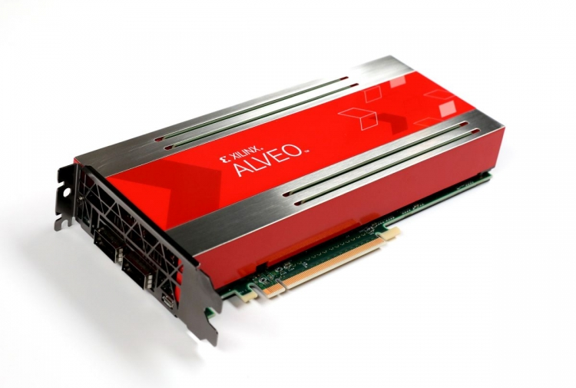
External memory
Store data in DDR connected to the FPGA
  Large capacity
    Many data sets stored for pipelined iterations
  Limited bandwidth and additional latency
Implemented on Xilinx Alveo platform
  Initial data preparation on x86 host
  Data transfer over PCIe
  DDR 64GB capacity – problem size 49152*8*8*8 (double)
  4x DDR 512b wide @ 300MHz = 77GBps
  Single kernel instance exceeds memory bandwidth
limit
www.xilinx.com
II=5
II=9
8%
12%
86
48
77 GBps

Slide 20
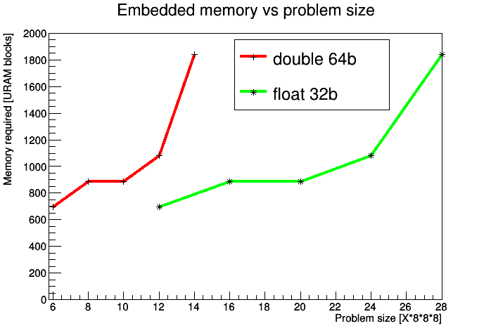
Embedded memory
Use embedded, distributed memory resources
  Small capacity – frequent in/out data transfers
  Very high bandwidth
  Single-chip, standalone, low-power solution
Simulated for Xilinx Alveo platform
  54 MB memory – problem size 12*8*8*8 (double)
  32 TBps bandwidth
  Kernel with iteration interval 1 achieveable
limit
80%
1280 URAMs
812 GFLOP
30%
406 GFLOP
12*8*8*8
24*8*8*8
II=1
II=1

Slide 21
Conclusions and future prospects
FPGAs are versatile platforms suitable for HPC applications
  Software only development (FPGA architecture understanding helpful)
  Commercially available platforms
  Reprogrammable within ms – self adapting platforms, power savings
  Single-clock-cycle Conjugate Gradient kernel developed and measured with two data delivery methods:
    External memory: 48 GFLOPs (double), 86 GFLOPs (float)
    Embedded memory: 406 GFLOPs (double), 812 GFLOPs (float)
  Current state-of-art CPU implementations:
    Intel Broadwell 6 cores: 47 GFLOPs (double), 95 GFLOPs (float)
    Intel KNL 64 cores: 220 GFLOPs (double), 345 GFLOPs (float)
Possible improvements
  External memory
    FPGA with integrated HBM: 8GB capacity, bandwidth up to 460 GBps (Xilinx Alveo U280 available Q3 2019)
  Embedded memory
    Employ integrated high-speed serial transceivers to deliver data directly to the kernel instances
      Up to 120x 32.75Gbps links (aggregated 480 GBps bandwidth on XCVU9P)
S. Durr, „Three Dirac operators on two architectures
with one piece of code and no hassle”,
LATTICE2018, arXiv:1808.05506v2, Nov. 2018
This work was in part supported by Deutsche Forschungsgemeinschaft under Grant No. SFB/TRR 55 and by the
polish NCN grant No. UMO-2016/21/B/ ST2/01492, by the Foundation for Polish Science grant no. TEAM/2017-
4/39 and by the Polish Ministry for Science and Higher Education grant no. 7150/E-338/M/2018.
The project could be realized thanks to the support from Xilinx University Project and their donations.

