Slide 1
DAIMON – current status
Jacek Bełdowski

Slide 2
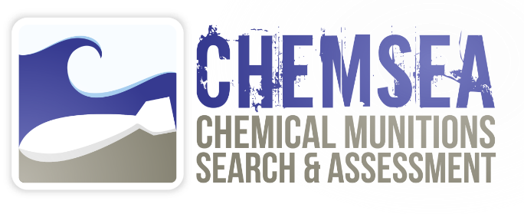


Situation of Baltic Sea dumped munitions

Slide 3
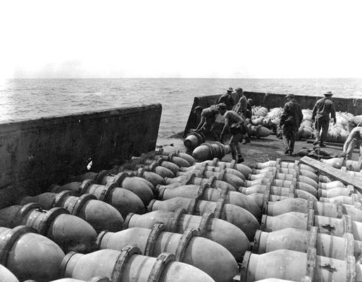
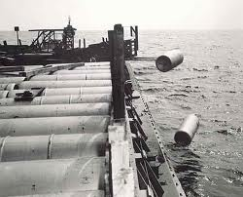
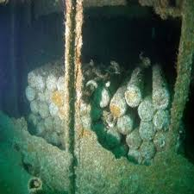
Chemical munitions sunk at sea
40 000 tonnes sunk in Baltic proper, 150 000 tonnes in Skagerrak
Natural processes plus enhancing human pressure put environment at risk
Notes:
3
3
3

Slide 4
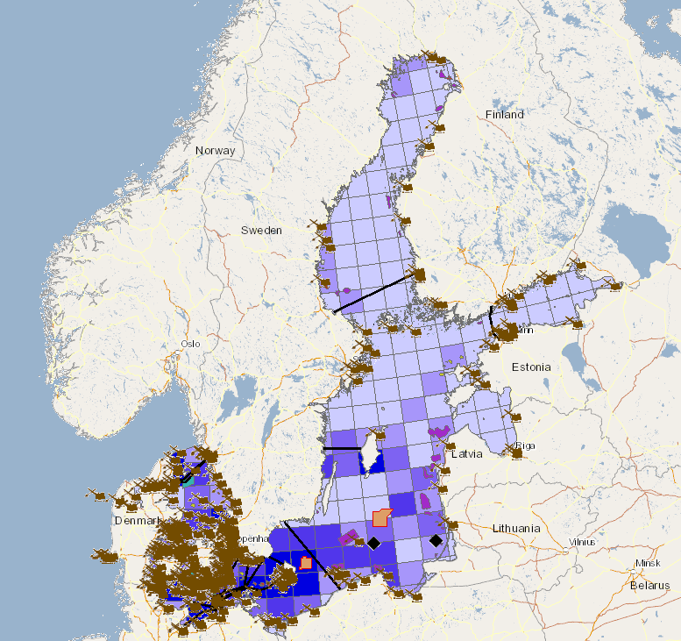
Legend:
CWA Dumps
Dredge sites
Offshore wind farms
(planned)
Bottom Trawling intensity
Pipelines and Cables
Notes:
Figure 4 Baltic Sea underwater activities

Slide 5
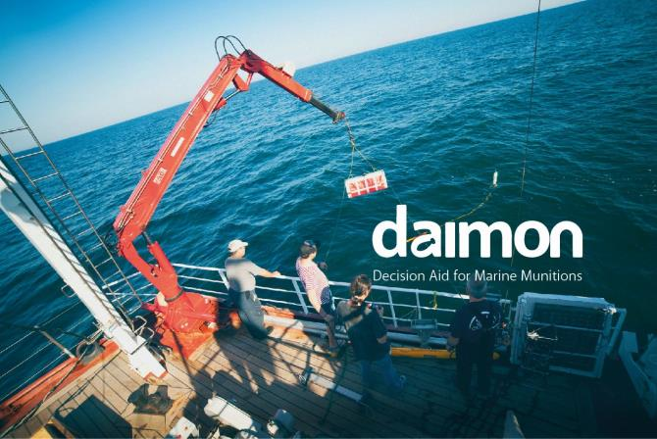

Decision Aid for Marine Munitions
Notes:
Dumped munitions are a growing concern in the Baltic Sea area. They include chemical munitions dumped after Second World War, and a number of conventional munitions sunk on the sea floor during both world wars. We know, that those munitions are toxic, that they are a hazard for fishermen and offshore activities, but there is no easy solution to this problem. Removing them all would be very costly, while leaving them in place is a potential danger for ecosystem and humans. Some countries and public opinion are requiring action, but how to prioritize the remediation activities? Are they really needed? Will remediation affect the ecosystem?
To answer those questions, Decision Aid for Munition Management (DAIMON) programme was formulated.

Slide 6
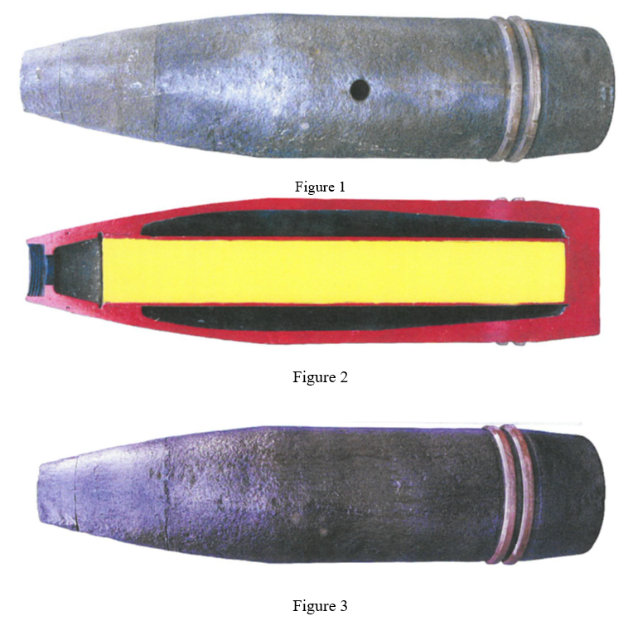
Munition Status
Identification
Corrosion
Threat
Leakage

Slide 7
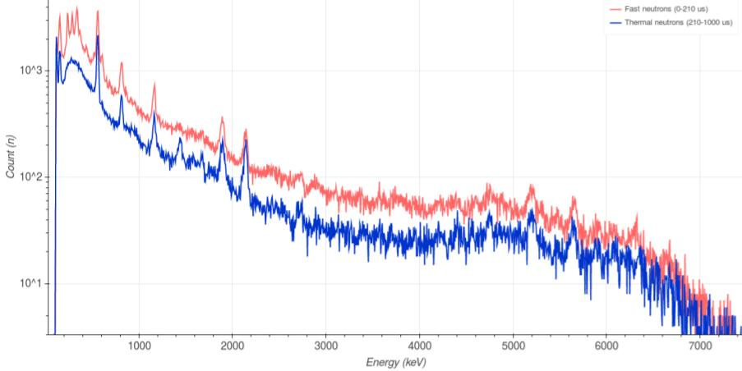
Elemental Analysis System (EAS)
EAS determines the elemental composition of an individual munition in seabed by exciting the object with neutrons and by measuring and analyzing the resulting spectrum.
EAS can be used to identify and differentiate CWA munitions, from distance. Additionally, information about munition’s corrosion level and leak risk are objectively estimated. This information is essential for fact based decision making.
Seabed surveys regarding infrastructure construction
Monitoring of dumped munitions’ status and leak risk
Scheduling and planning of cleanup and salvage operations
Mustard Gas Surrogate spectrum as measured with EAS

Slide 8
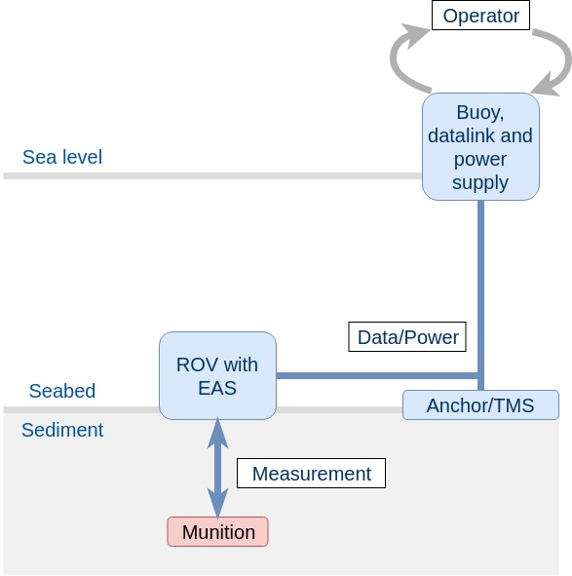
Operational Description
ROV with EAS operates within a radius of one km around the anchorage. Through satellite datalink, the ROV is operated remotely from anywhere on the Globe. A ship is only needed for transportation during delivery and recovery.
EAS can identify munitions within 1 m distance in a time frame of minutes to hours, depending on the measurement conditions.
Fast, accurate, cost effective and safe identification for individual munitions, without physical contact.

Slide 9
Corrosion

Slide 10
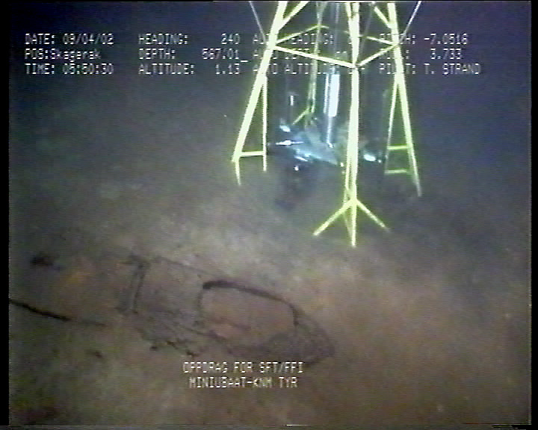
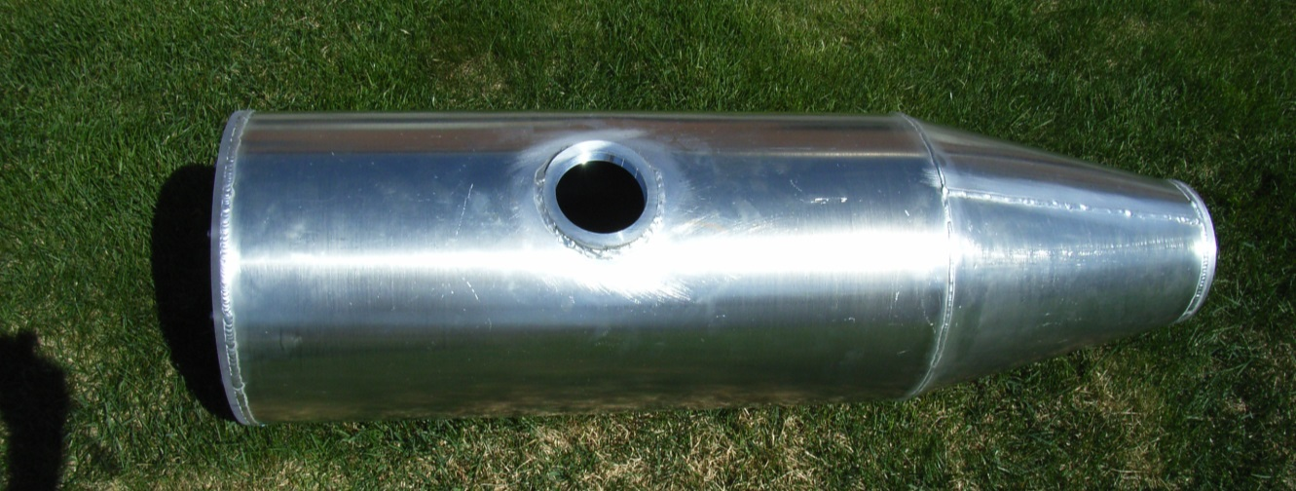
Leakage
© FFI: 2002
© FFI: 1989

Slide 11
Impact on Environment
Release
Contamination
Biota
Leakage rate
Transport Modelling
Map of potentially contaminated areas

Slide 12
Modelling release
Corrosion:
X-ray Energy Dispersive Spectroscopy
Release:
High Resolution Model, NEMO
© FFI: 2002

Slide 14
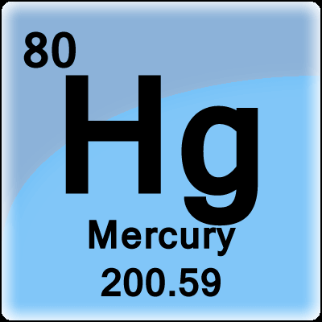
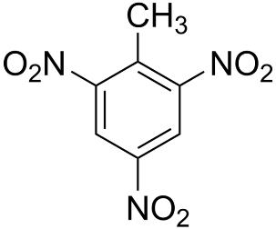
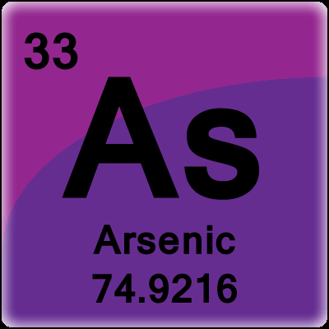
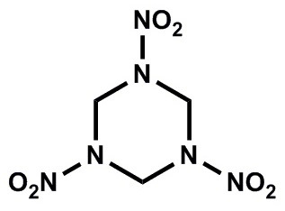
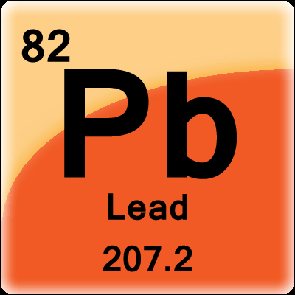
Pollution of sediments and water
Metals
Chemical Warfare Agents
Explosives

Slide 15
CHEMSEA
Degradation Products

Slide 16
Detection

Slide 17
Overal concentrations

Slide 18
Object-by-object – drastic drop

Slide 19
Enrichment, range
Large sources predominantly local
Sharp gradients
May depend on corrosion
Range not directly depend on concentration
Target number
Target number

Slide 20
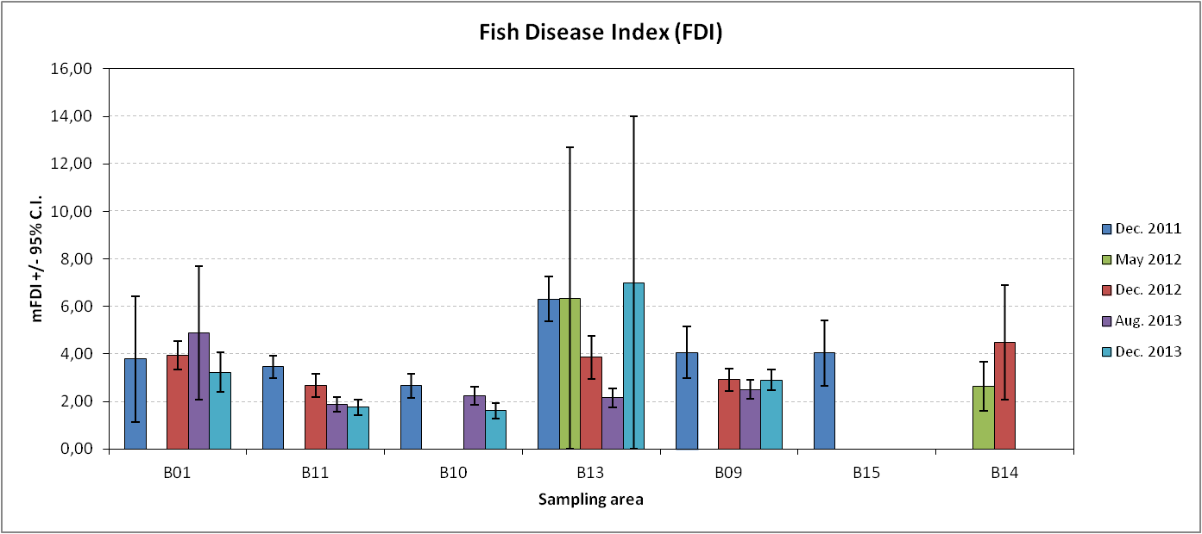
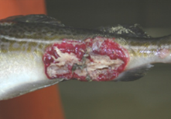
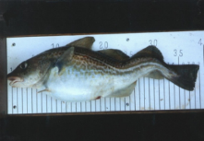
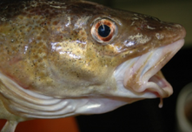
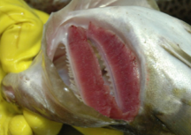
Impact on biota
Bornholm

Slide 21
Toxicity

Slide 22
Biota Impact

Slide 23
Fish results

Slide 24
Food web impact

Slide 25
Remediation options
Costs
Environmental impact
Legal considerations
Decision support tool

Slide 26
DSS

Slide 27






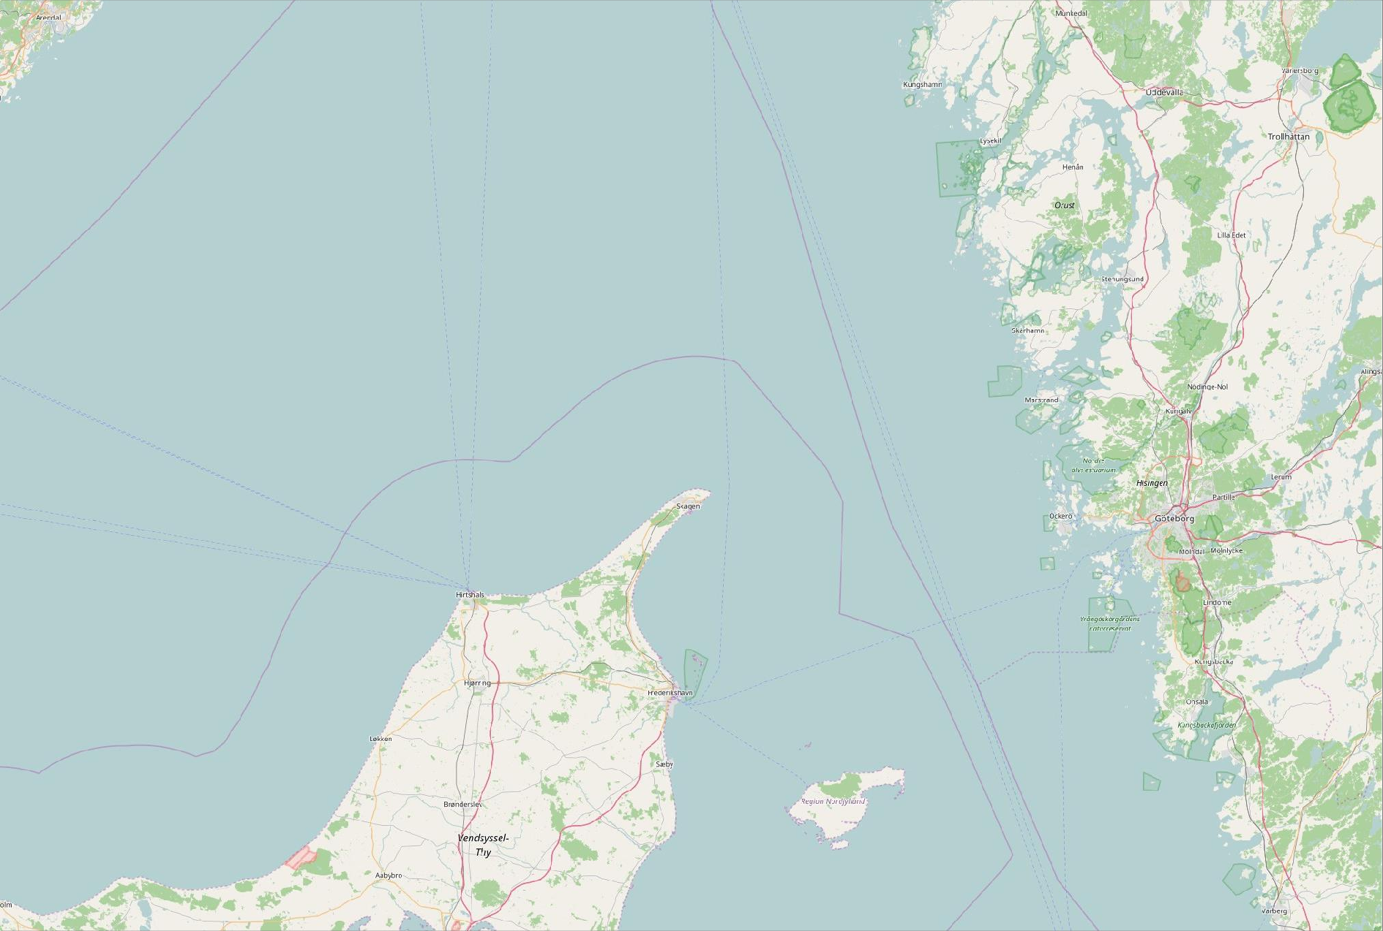









DAIMON
Chem. WF
Munition
New Source
…
Enter data about a new detection of warfare agents
Chem. WF
Munition
Date of detection:
16 / 11 / 2018
Place of detection:
GPS Coordinates
What munition was detected:
Sea mine
fired lost
Land mine
dumped
unkown
Enter new munition type
How was the munition detected:
On sea ground
adrift
fishernet
Washed up at the coast other
State of corrosion: 4
Leaks: 0
Calculated ecological hazardousness: Level of confidence:
(low)
(low)
(heigh) (heigh)
+ -
Private map
Cancel
Save data set and classify munition

Slide 28
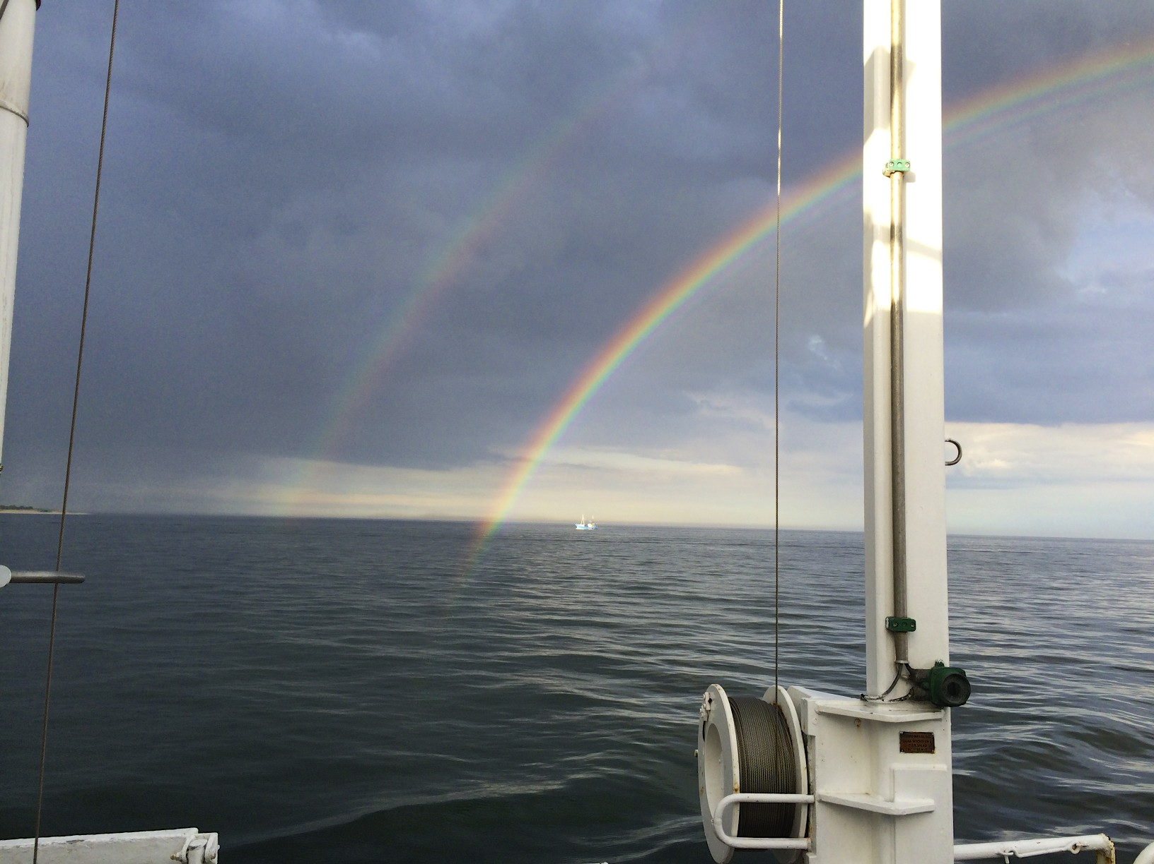
Thank You for attention
1) 'The research work was fund by the European Union (European Regional Development Fund) under the Interreg Baltic Sea Region Programme 2014-2020, project #R013 DAIMON'
2) 'The research work was financed by the Ministry of Science and Higher Education from the 216-2019 science funding allocated for the implementation of international co-financed project'

