Slide 1
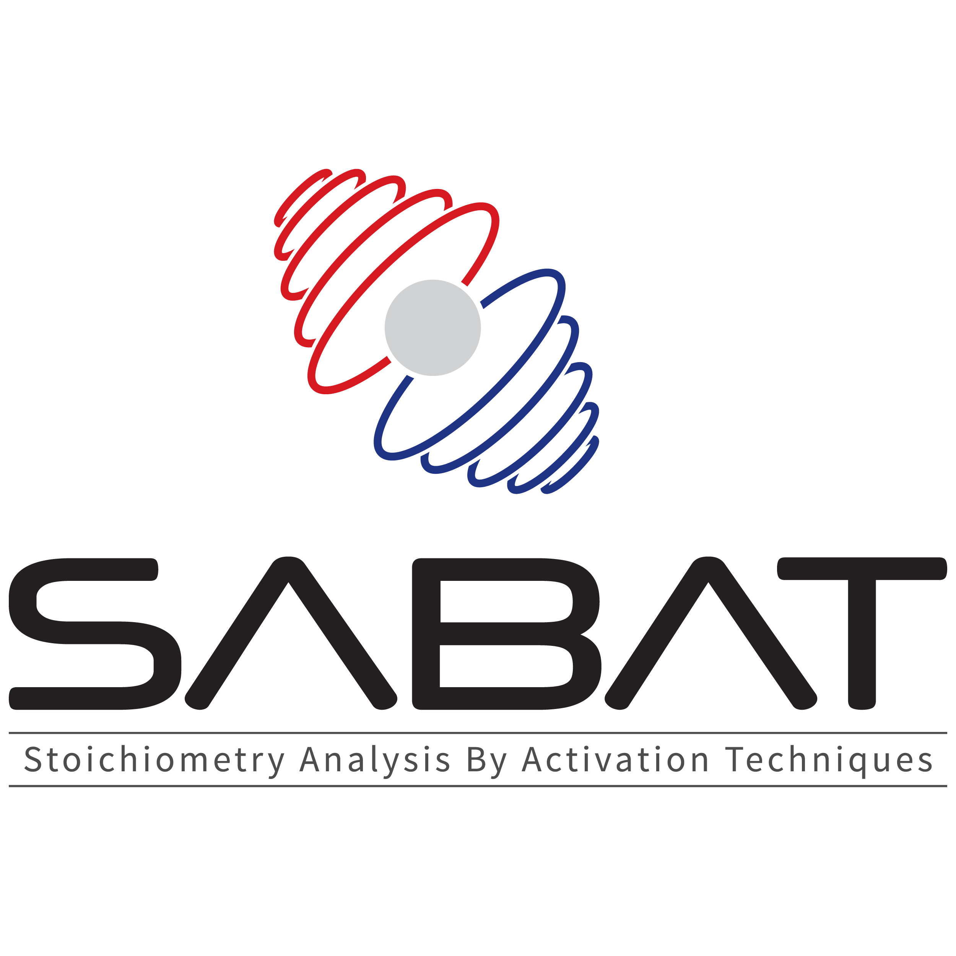


Underwater threats detection with neutrons: the SABAT project
Michał Silarski
Jagiellonian University
2nd Workshop on neutrons in medicine and homeland security, 12-13.09.2019, Kraków

Slide 2
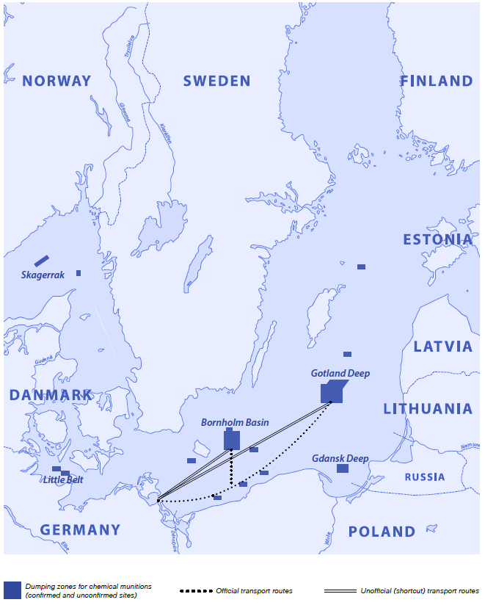
Motivation
Unknown amount of sunken chemical weapons is scattered across the Baltic Sea… and not only!

Slide 3
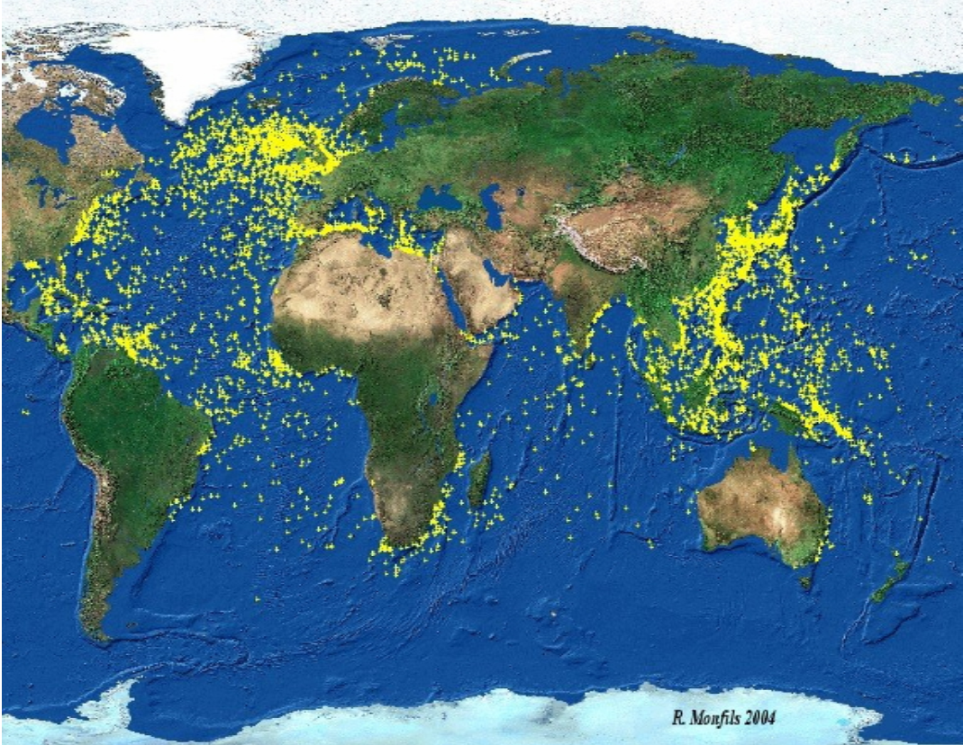
V. Valkovic et al. 'Surveyor': An Underwater System for Threat Material Detection. International Atomic Energy Agency (IAEA): IAEA (2010).

Slide 4
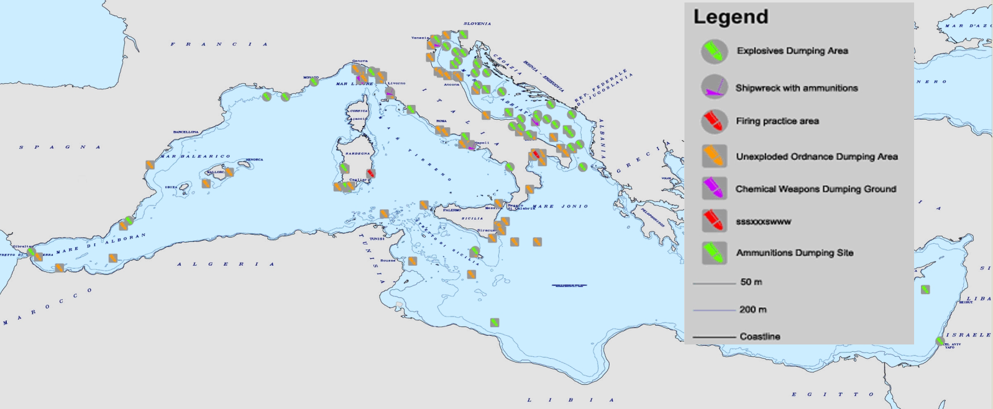
V. Valkovic et al. 'Surveyor': An Underwater System for Threat Material Detection. International Atomic Energy Agency (IAEA): IAEA (2010).

Slide 5
Introduction
Menace to merchant navy
Serious threat for people and environment
(„Fake amber” on the coast, mustard gas „fished” out the sea)
Clearing the sea bottom due to the construction of Nord Stream gas pipeline : 100 million euro

Slide 6
Introduction
Menace to merchant navy
Serious threat for people and environment
(„Fake amber” on the coast, mustard gas „fished” out the sea)
Clearing the sea bottom due to the construction of Nord Stream:
100 million euro
Detection methods for underwater hazardous materials: sonars / robots
  Recognition of shapes and density of objects ("chemically blind" methods)
  They usually require confirmation by a qualified sapper

Slide 7
Introduction
Menace to merchant navy
Serious threat for people and environment
(„Fake amber” on the coast, mustard gas „fished” out the sea)
Clearing the sea bottom due to the construction of Nord Stream:
100 million euro
Detection methods for underwater hazardous materials: sonars / robots
  Recognition of shapes and density of objects ("chemically blind" methods)
  They usually require confirmation by a qualified sapper
  Expensive, inefficient and slow
Possible alternative/improvment: Neutron Activation Techniques

Slide 8

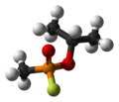
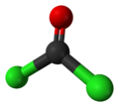


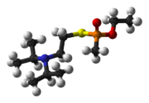
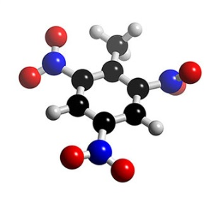
Introduction
Main agents to deal with:
Mustard gas (C₄H₈Cl₂S)
    Sarin (C₄H₁₀FO₂P)
Fosgen (COCl₂)
    Soman (C₇H₁₆FO₂P)
Tabun (C₅H₁₁N₂O₂P)
  VX (C₁₁H₂₆NO₂PS)
    TNT (C₇H₅N₃O₆)
High economic and environmental costs have been preventing so far any activities aiming at extraction of these hazardous substances.

Slide 9
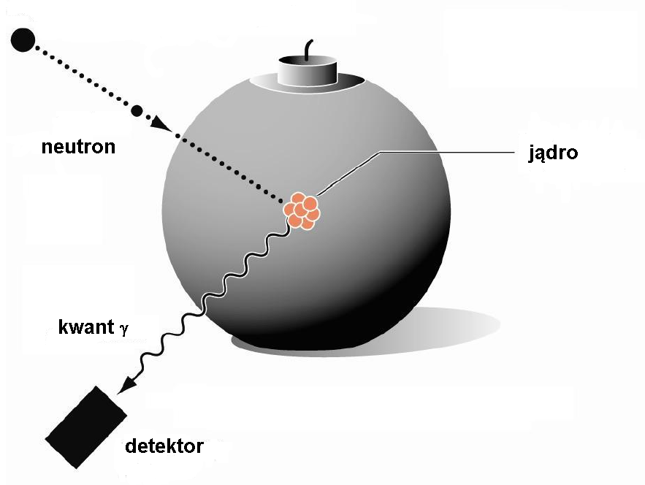
Neutron Activation Techniques
Novel methods of nondestructive chemical threat detection based on neutron activation:
D+T → α + n
n + nucleus → nucleus + γ + n
Thermal neutron capture
(sources, D+Dgenerators)
Neutron inelastic scattering
(D+D/D+T generator)
neutron
nucleus
γ quantum
Excited nuclei emit gamma quanta of energy characteristic of the element
detector
Relative content of elements ⇔ Stoichiometry
Identification

Slide 10
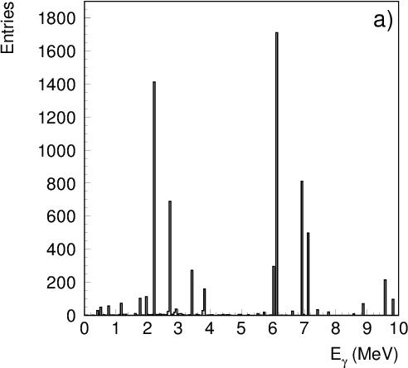
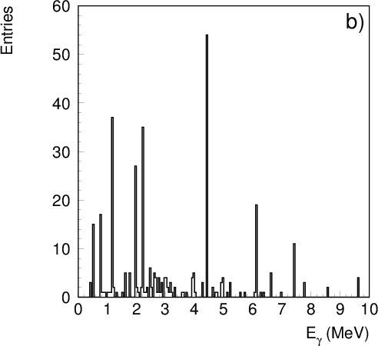
Neutron Activation Techniques
Signature:
gamma quanta of the following nuclei: C (4.44 MeV),
O (6.13 MeV), N (10.83 MeV), Cl (1.17 MeV, 7.79 MeV),
S (2.32 MeV), P (1.27 MeV), F (0.11 MeV, 0.197 MeV)
H₂O
High penetration allows detection of explosives/ which are hidden in vehicles, buried, etc.
Drawbacks:
Small cross sections for some of the elements
Decreased mobility due to detector cooling
High neutron flux needed
Insensitivity to the structure of molecule
High neutron attenuation in water
High background from oxygen and hydrogen
C₄H₈Cl₂S

Slide 11
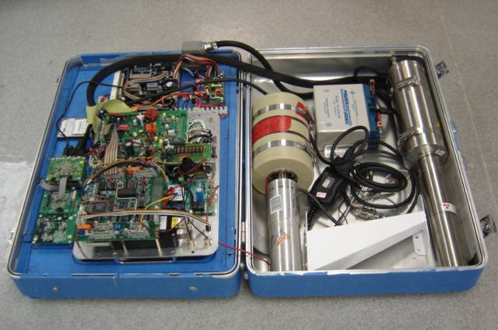
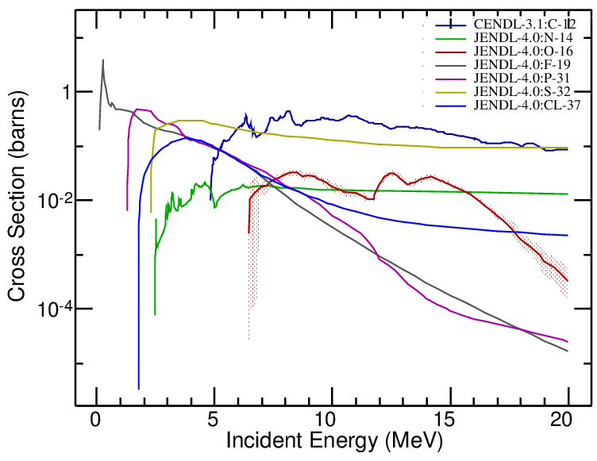
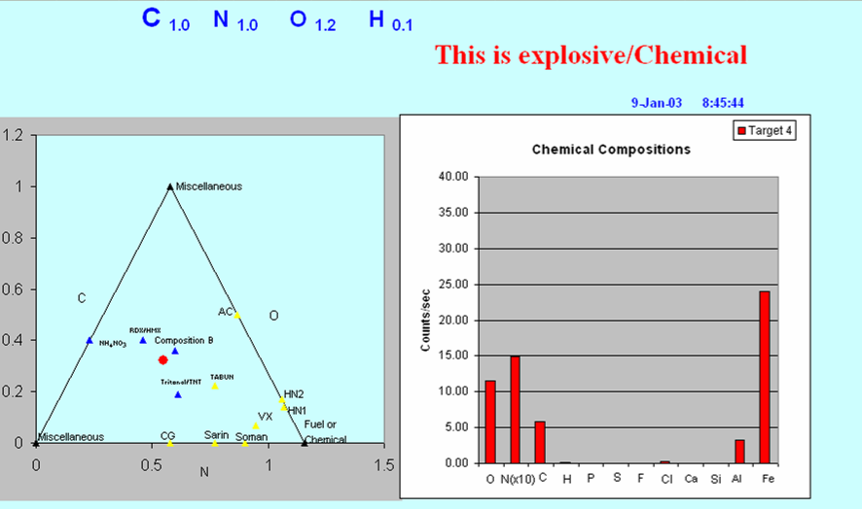
Neutron Activation Techniques
http://www.calseco.com/
γ quanta detection
Data analysis
http://www.calseco.com/
http://www.calseco.com/
Comparison with database of known substances & identification

Slide 12
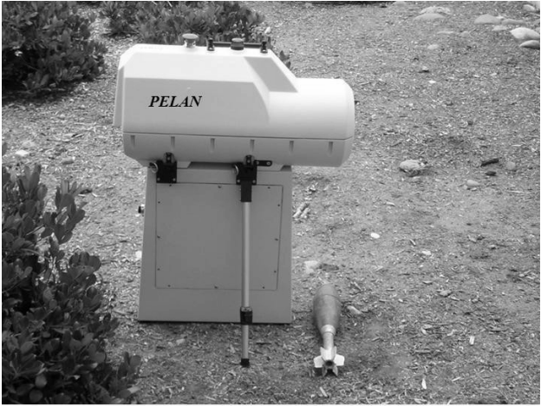
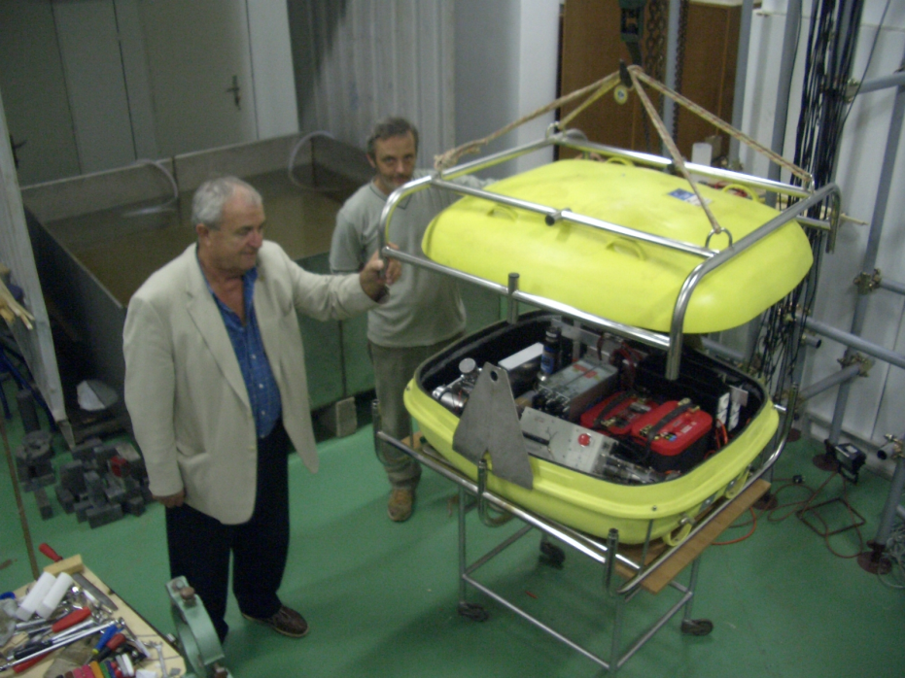
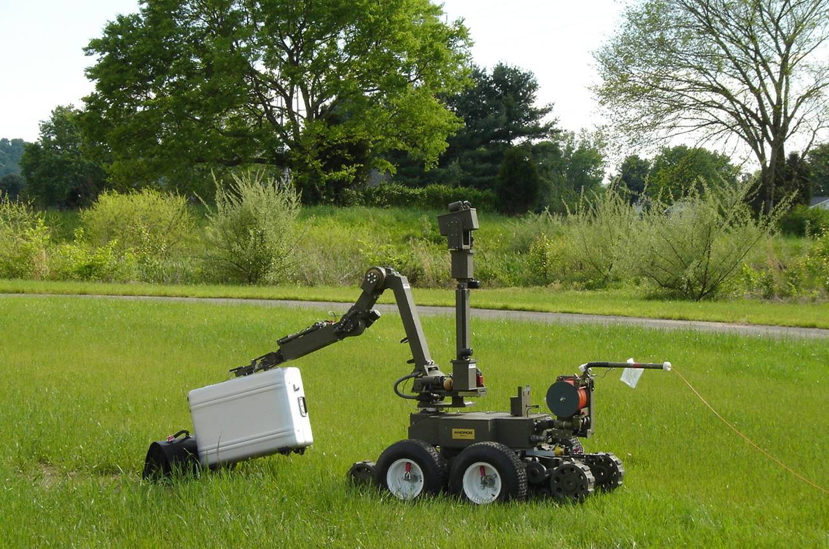
Practical applications
V. Valkovic et al. 'Surveyor': An Underwater System for Threat Material Detection. International Atomic Energy Agency (IAEA): IAEA (2010).

Slide 13
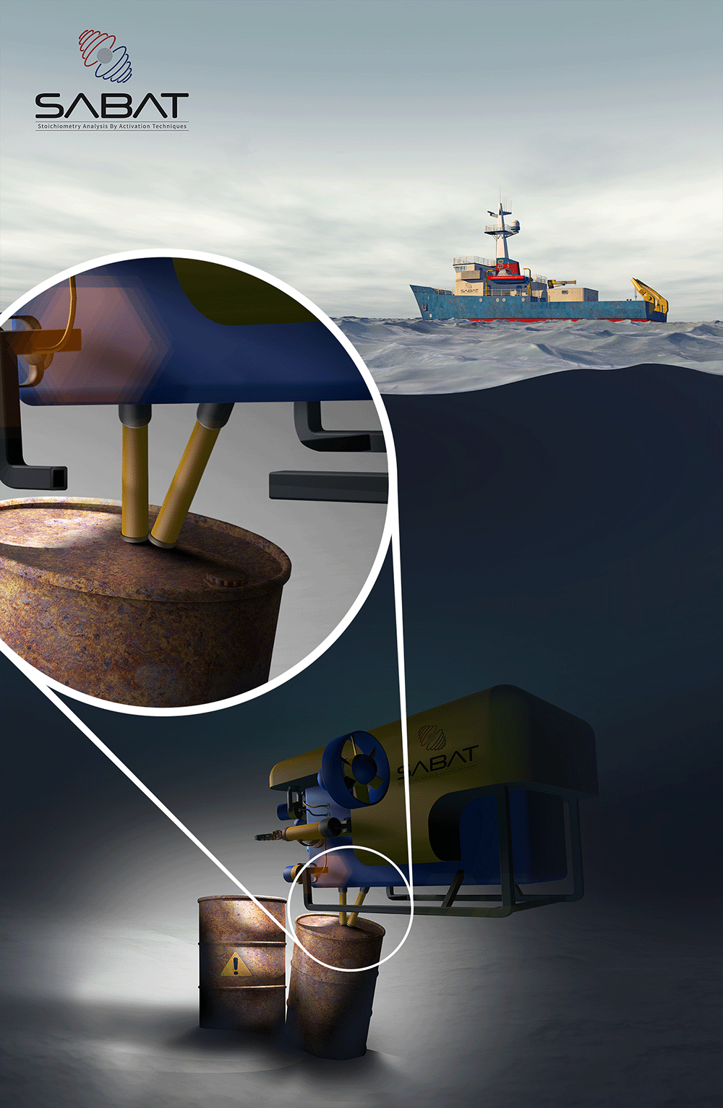
The SABAT project (Stochiometry Analysis By Activation Techniques)
The 14.1 MeV neutron generator with α particle detection
Neutron and γ quanta attenuation in water minimized by guides filled with air or some other gas
Pulsed generator & correlated α particles detection ⇔ tomographical picture of the chemical composition
Changeable position, length and orientation of guides
Position sensitive detector (scintillator)
(M. Silarski, P. Moskal, Patent PL 223751; EP 15738491.8;US 15/509,013)

Slide 14






SABAT
Laboratory work
Data analysis
Monte Carlo simulations
Project management
dr Sushil Sharma
dr Paweł Sibczyński
dr Michał Silarski
dr Szymon Niedźwiecki
prof. Pawel Moskal
dr Sylwia Orzechowska
dr Michał Silarski

Slide 15
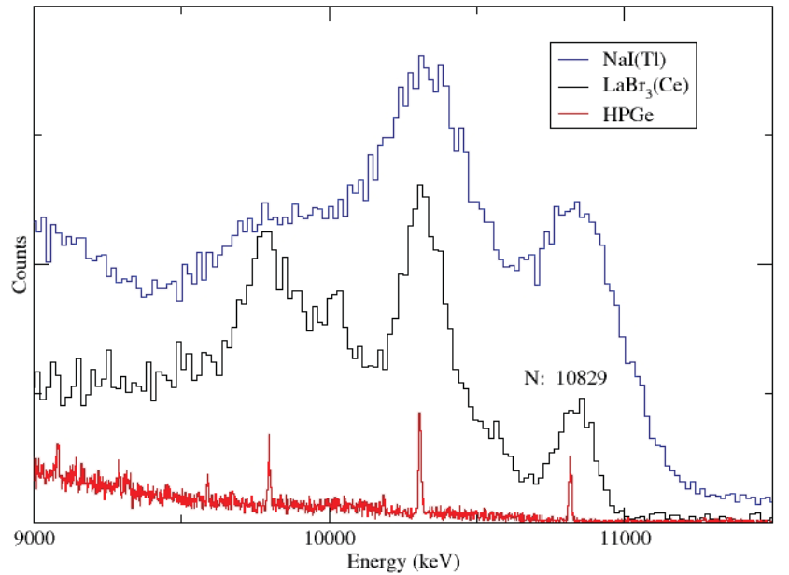
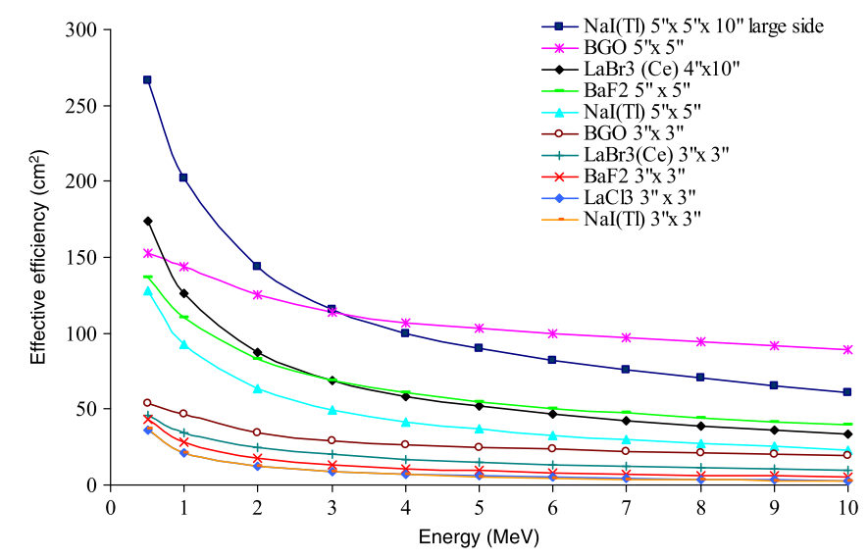
The SABAT project (Stochiometry Analysis By Activation Techniques)
Mobility and compactness requires substitution of semiconductor detectors
Natural candidates: inorganic scintillators:
 | BGO | NaI:Tl | LaCl₃:Ce | LaBr₃Ce
Average Z | 28 | 32 | 28 | 41
Density [g/cm³] | 7.1 | 3.7 | 3.9 | 5.3
Energy resolution (@662 keV) [%] | 12 | 7 | 3.3 | 2.8
IEEE Nuclear Science Symposium,San Diego, CA,10/29/2006,11/04/2006
C. Elon et al..NIMA 619 (2010) 234–239

Slide 16
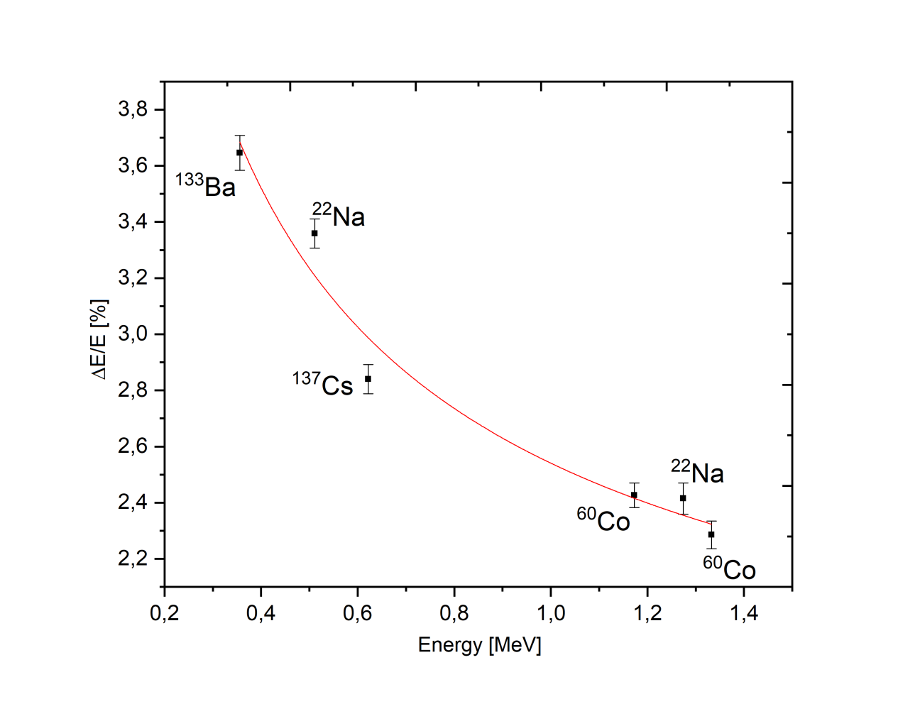
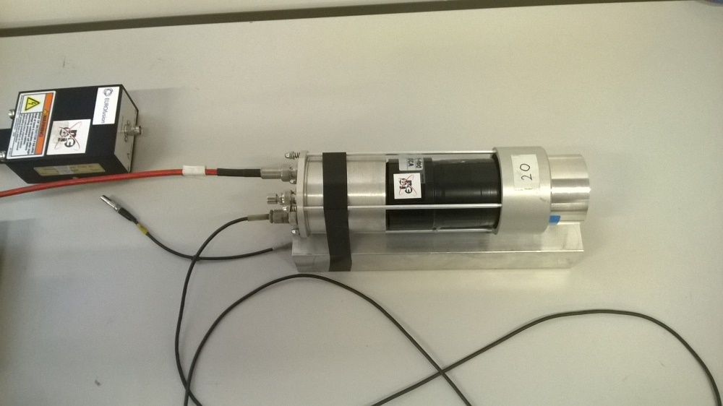
The SABAT project (Stochiometry Analysis By Activation Techniques)
The best material for our purpose:
LaBr₃:Ce:Sr
PREMILINARY
The final goal: position/direction sensitive detector red out by SiMPs

Slide 17
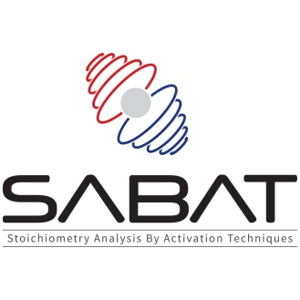
Summary
Neutron Activation Techniques constitute promising improvement of the underwater threats detection
Design of the prototype of such device was started in the Institute of Physics of the Jagiellonian University
The SABAT project was founded by NCBR in January 2017 (LIDER/17/0046/L-7/15/NCBR/2016)
Construction of the first (laboratory) prototype scheldued for 2019
Collaboration in integration of the whole system with an underwater drone is very welcome.
Neutron transport
Monte Carlo simulations
Radiation detectors development
Materials studies
with Neutron Activation Analysis
Monitoring system for Boron-Neutron Capture Therapy

Slide 18
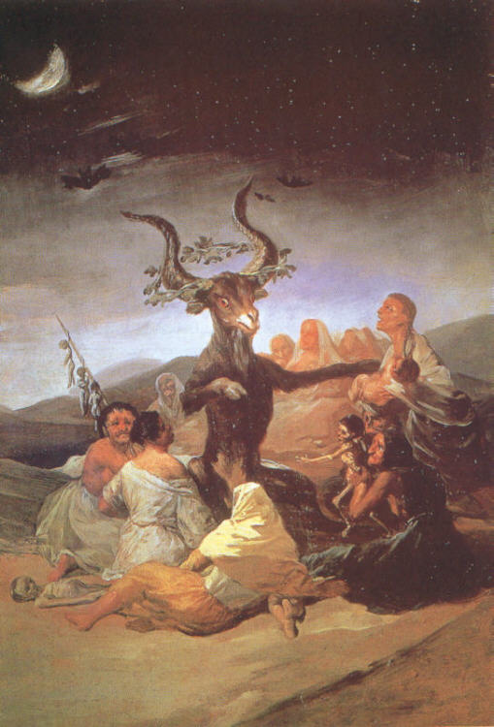
Thank You for attention
Goya, Witches sabbath

