Slide 1



Ortho-Positronium Detection with a
High-Resolution PET Scanner
Firas Abouzahr
University of Texas at Austin
Department of Physics
July 5th, 2024

Slide 2

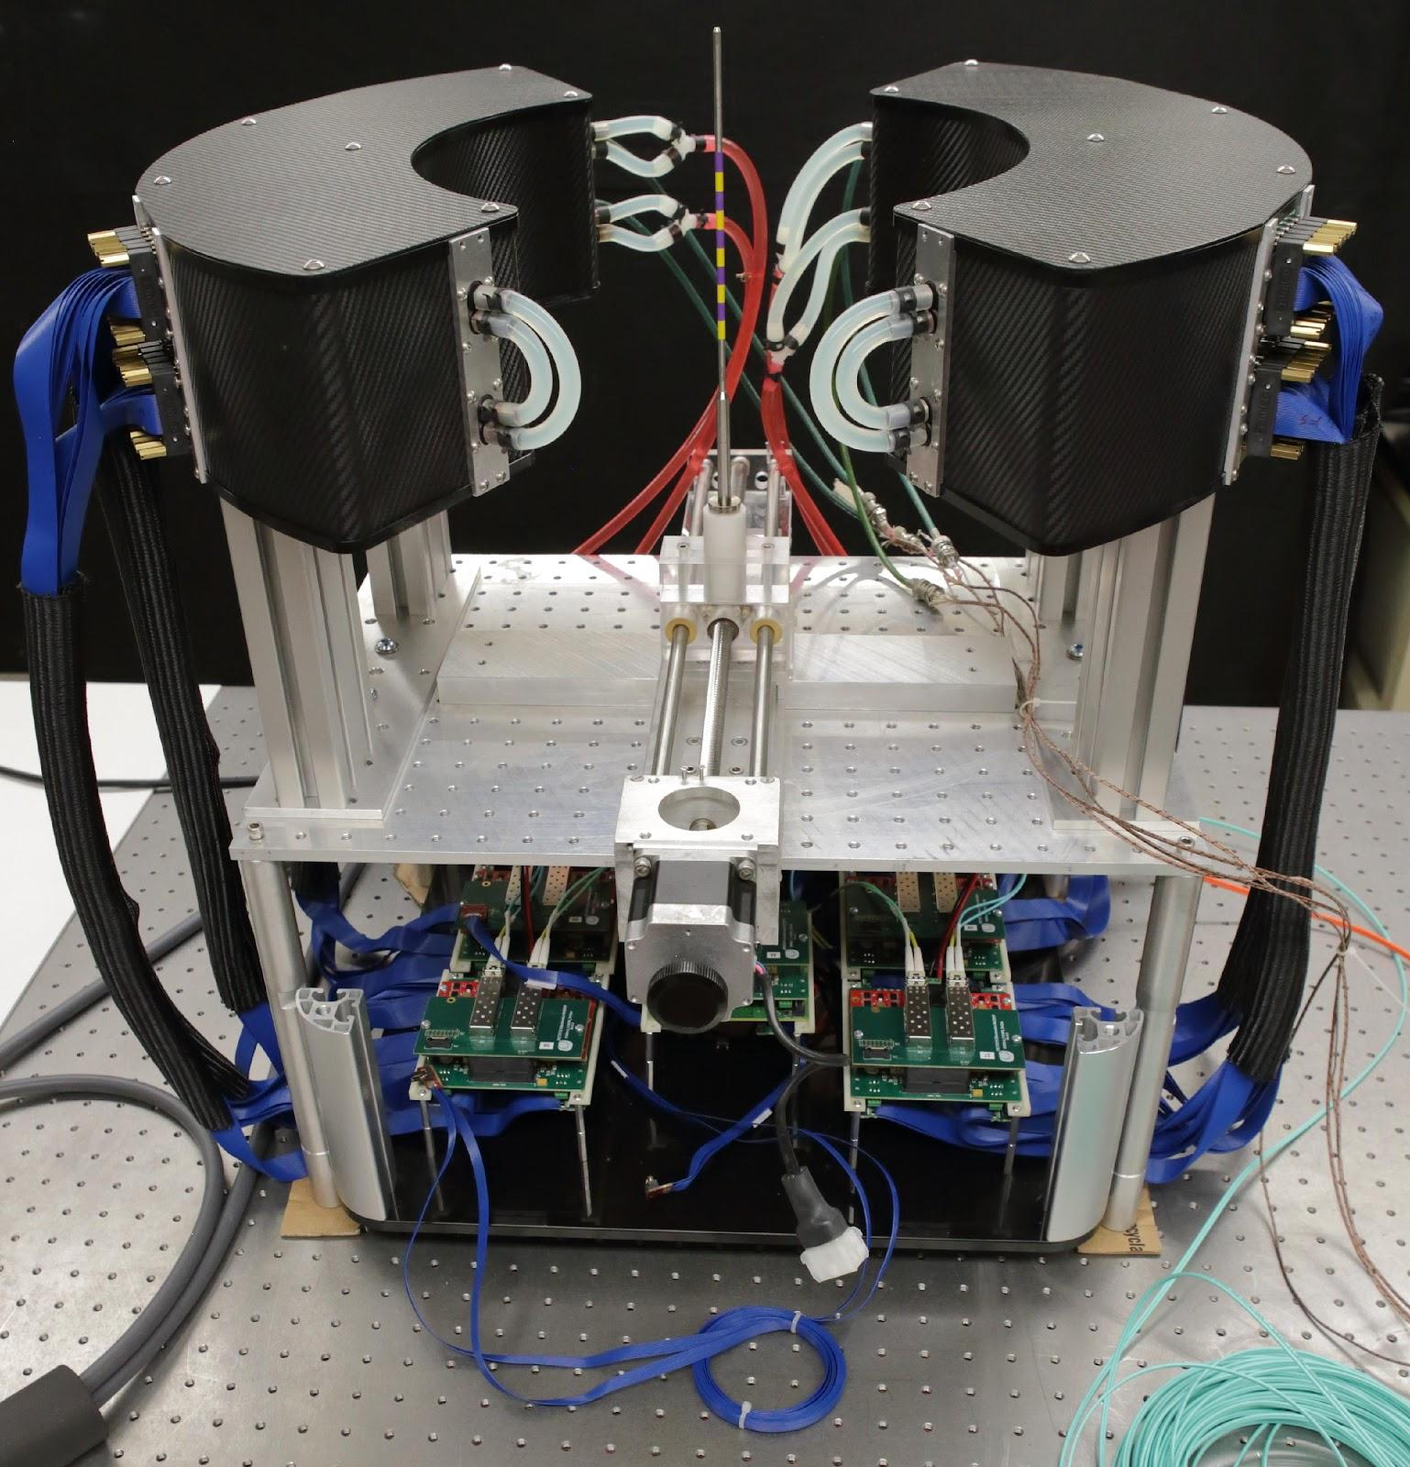
Time-of-Flight PET for Proton Therapy (TPPT)
3 x 3 x 15 mm³ LYSO (Lu_{1.8}Y_{0.2}SiO₅:Ce) Crystals
Hamamatsu S14161-3050HS-08 silicon photomultiplier (SiPM) [1]
One-to-one coupling between scintillator and SiPM pixels
6144 total detector channels → 3072 per crescent.
SiPM channel readout and DAQ provided by PETSys Electronics [2]

Slide 3
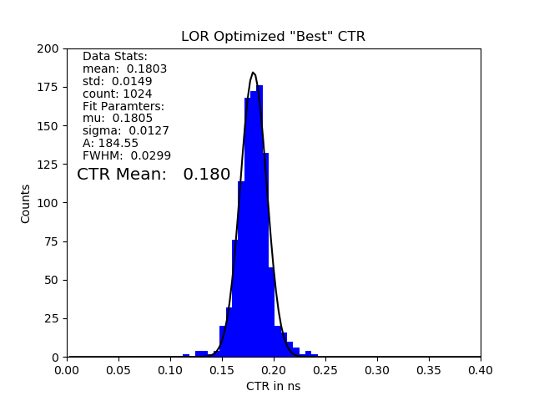
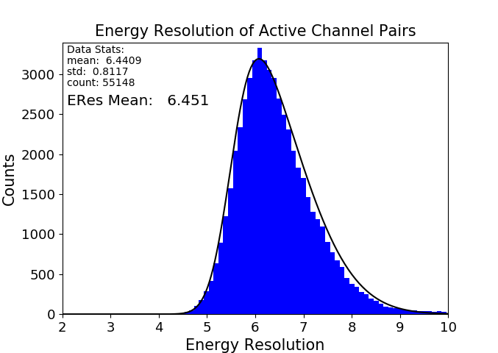
TPPT Research PET Scanner Metrics
CTR = 180 ps
Eres = 6.5%
Optimized timing resolution < 200 ps
~6.5% energy resolution at 0.511 MeV
Initial measurements yield ~2 mm spatial resolution.

Slide 4
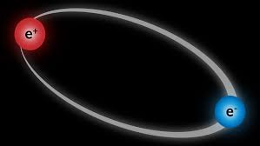




Ortho-Positronium (o-Ps): Why Three Photons?
Coupled spins of ground-level fermion-antifermion state:
S = |$S_{e^{+}}+S_{e^{−}}$| , … , |$S_{e^{+}}−S_{e^{−}}$| = |½ +½ |, … , |½ - ½ | = 0,1
e⁻
e⁺
Spin-1
(Ortho-Positronium)
In the basis of $\text{|}\left.S m_{s}\right\rangle$ for Spin-1, we get a triplet state (o-Ps):
$$\left\{\begin{aligned}\text{|}\left.1 −1\right\rangle \\ \text{|}\left.1 0\right\rangle \\ \text{|}\left.1 1\right\rangle \end{aligned}\right.$$
The Charge Conjugation (C) operator acting on a on photon:
C |$\left.\text{γ}\right\rangle$ = -1 |$\left.\text{γ}\right\rangle$
C |n$\left.\text{γ}\right\rangle$ = (-1)^{n} |$\left.\text{n}\text{γ}\right\rangle$
C operating on a fermion-antifermion bound state:
C|$\left.Q\right\rangle$ = (-1)^{L+S} |$\left.Q\right\rangle$
C|$\left.oPs\right\rangle$ = (-1)⁰⁺¹ |$\left.oPs\right\rangle$ = -1 |$\left.oPs\right\rangle$
e⁻
e⁺
Spin-0
(Para-Positronium)
C symmetry in EM interactions demands n be odd (n≠1) for o-Ps → n𝛾.
3𝛾 (n = 3) occurs with highest probability. 0.5% - 1.5% of total events.

Slide 5
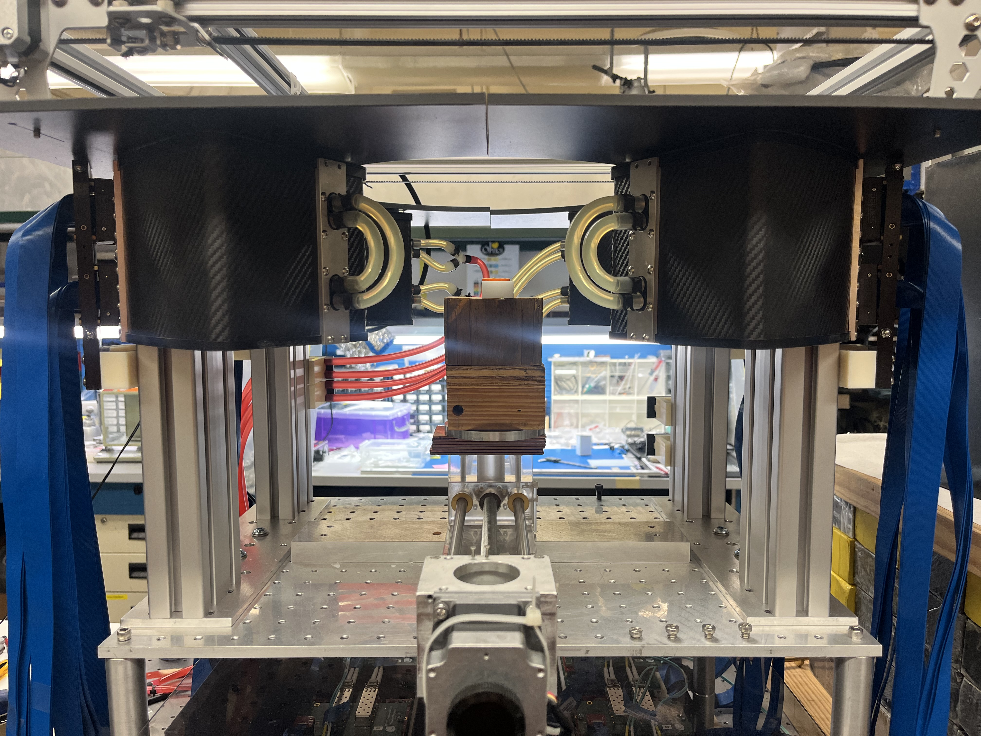
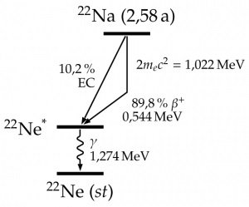
Experimental Setup
Figure taken from https://physicsopenlab.org/2016/05/22/webcam-particle-detector-measurements/
Experimental setup:
Na-22 Button source placed in isocenter of PET scanner.
Only 30-minute data acquisition!
PMMA case acts as medium for Ps formation.
Source placed horizontally to maximize formation area.
Data processed into triple coincidences to search for o-Ps → 3𝛾
Na-22 (~4.5 µCi)
3.2 mm
e+
e-
26 mm

Slide 6
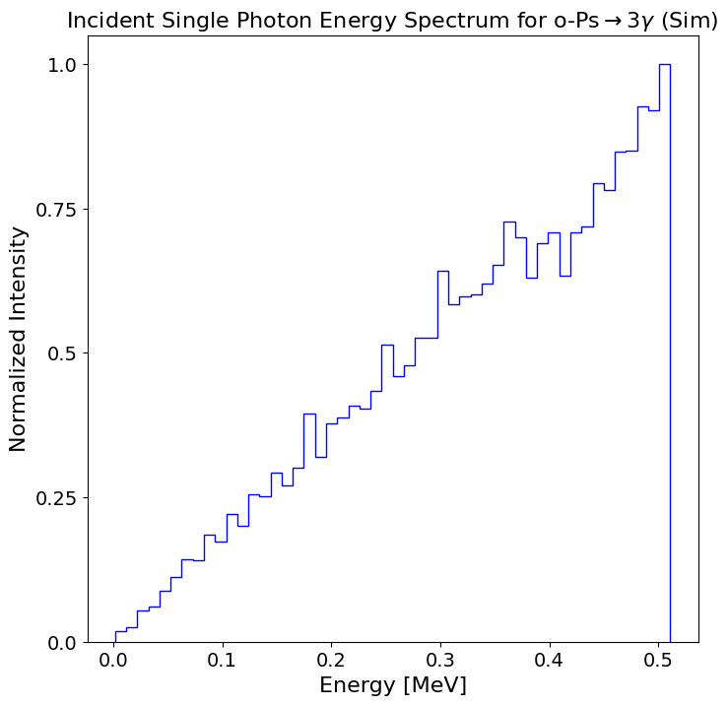
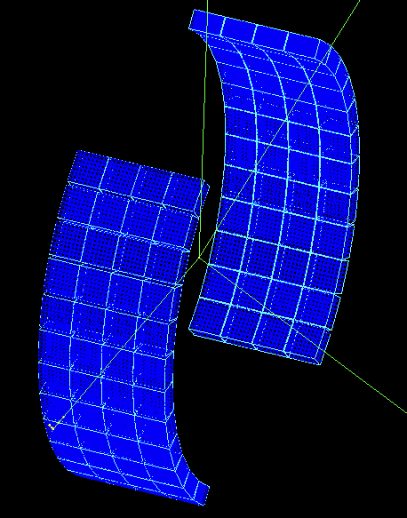
Geant4 Simulations
o-Ps single photon energy spectrum as predicted by nrQED
TPPT research PET scanner in GEANT4

Slide 7
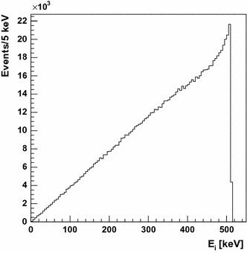
Geant4 Simulations
o-Ps single photon energy spectrum as predicted by non-relativistic quantum electrodynamics [3].
Figure taken from D. Kaminska et al (2016) [4]

Slide 8
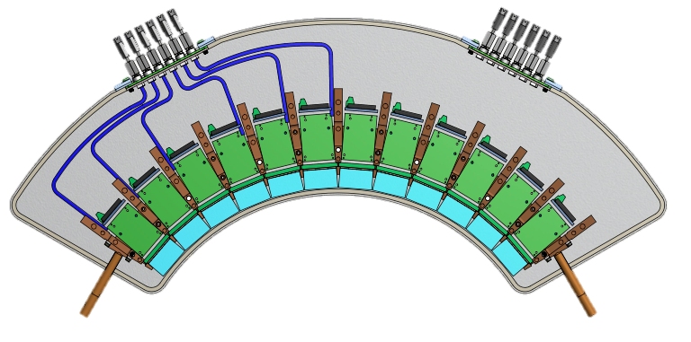
Triple Coincident Events
1. True event: o-Ps→3𝛾 and all three photons interact. *
* Also, o-Ps events where a photon misses but scattering adds a third signal.
Annihilation Gammas
Scattered Gammas
Prompt Gammas

Slide 9
Triple Coincident Events
1. True event: o-Ps→3𝛾 and all three photons interact. *
2. False event: Back-to-back photons interact + a Compton Scatter
* Also, o-Ps events where a photon misses but scattering adds a third signal.
Annihilation Gammas
Scattered Gammas
Prompt Gammas

Slide 10
Triple Coincident Events
1. True event: o-Ps→3𝛾 and all three photons interact. *
2. False event: Back-to-back photons interact + a Compton Scatter
3. False event: Two photons interact (either back-to-back or from o-Ps) + contribution by Prompt gamma.
* Also, o-Ps events where a photon misses but scattering adds a third signal.
Annihilation Gammas
Scattered Gammas
Prompt Gammas

Slide 11
Triple Coincident Events
1. True event: o-Ps→3𝛾 and all three photons interact. *
2. False event: Back-to-back photons interact + a Compton Scatter
3. False event: Two photons interact (either back-to-back or from o-Ps) + contribution by Prompt gamma.
4. False Event: Coincidence window allows for photons from different events to be counted as coincident.
* Also, o-Ps events where a photon misses but scattering adds a third signal.
Annihilation Gammas
Scattered Gammas
Prompt Gammas

Slide 12
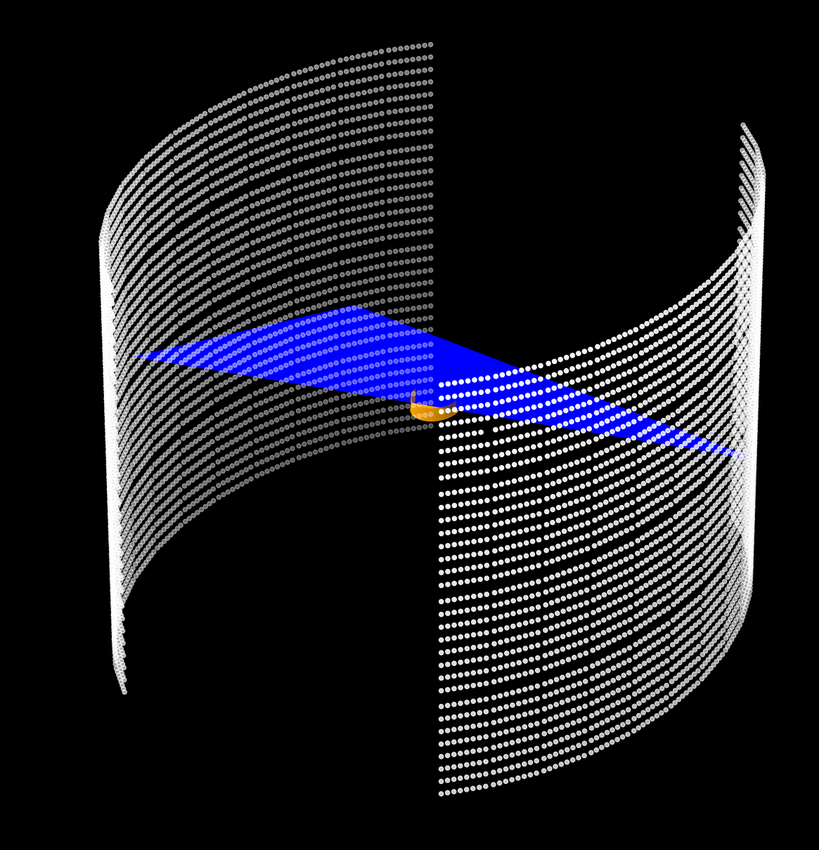
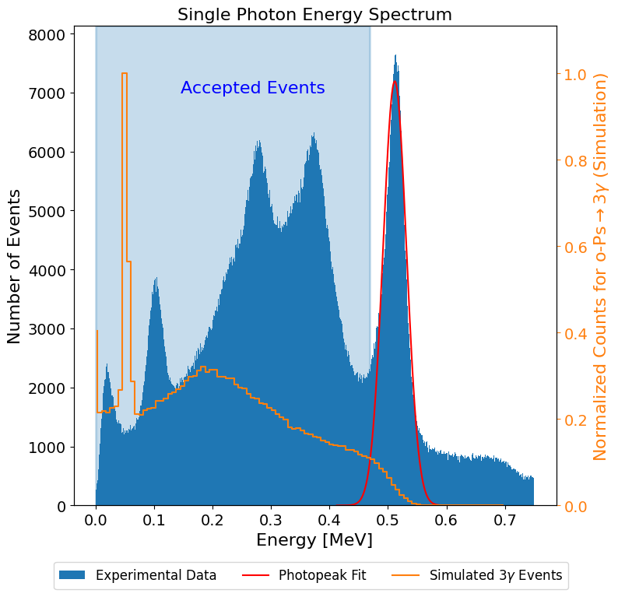
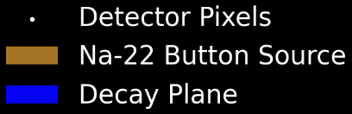

Filtering Techniques
Energy
1.5σ cut below on the photopeak
1.022 MeV cut
2. Decay Plane Cut
4. Time-of-Flight
3. Momentum Conservation
Θ₂₃
Θ₁₂
∆T
Θ₁₃

Slide 13
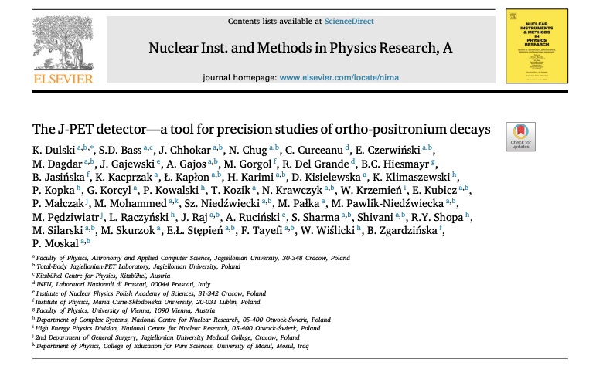
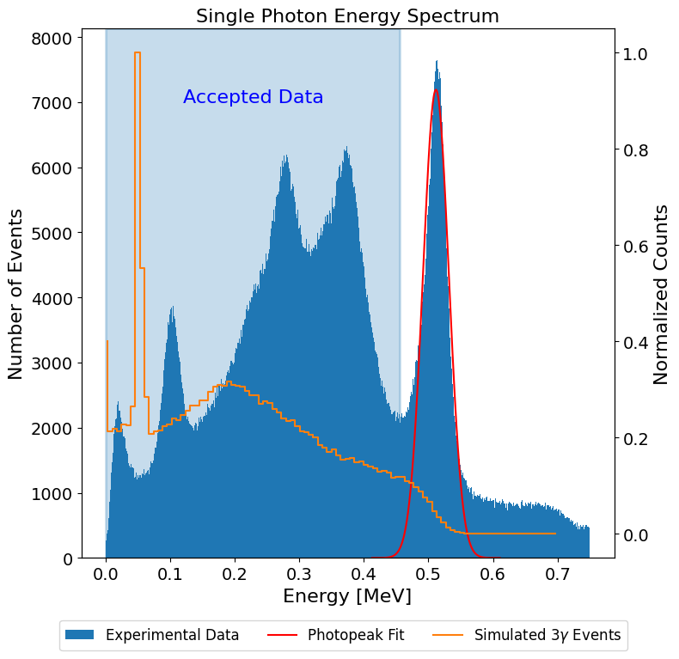
Filtering Techniques
Energy
1.5σ cut below on the photopeak
1.022 MeV cut
2. Decay Plane Cut
4. Time-of-Flight
3. Momentum Conservation
Θ₂₃
Θ₁₂
Filtering techniques inspired by the pioneering work of J-PET [5]
∆T
Θ₁₃

Slide 14
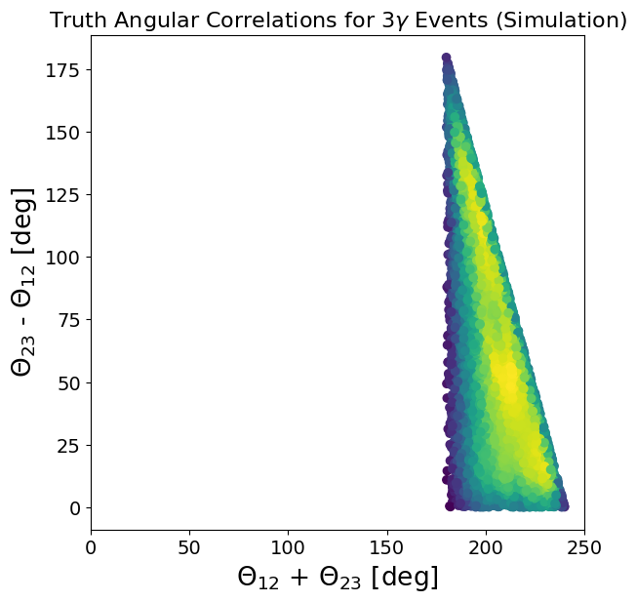
Momentum Conservation
Define Θ₁₂ < Θ₂₃ < Θ₁₃ between momentum vectors:
If Θ₁₂ + Θ₂₃ < 180˚ then Θ₁₃ > 180˚.
If Θ₁₂ + Θ₂₃ > 180˚ then Θ₁₃ < 180˚.
Θ₂₃
Θ₁₂
Momentum not conserved
❌
Θ₁₃
Θ₂₃
Θ₁₂
Momentum conserved
✅
Θ₁₃

Slide 15
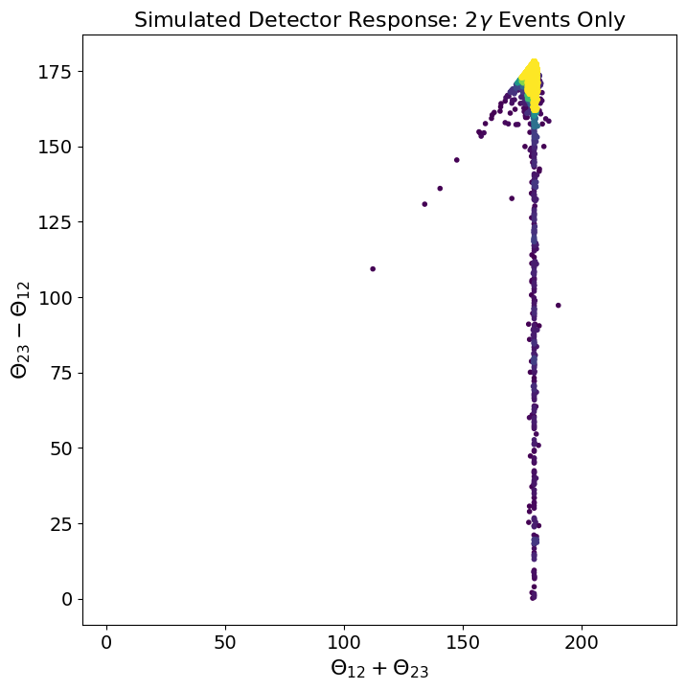
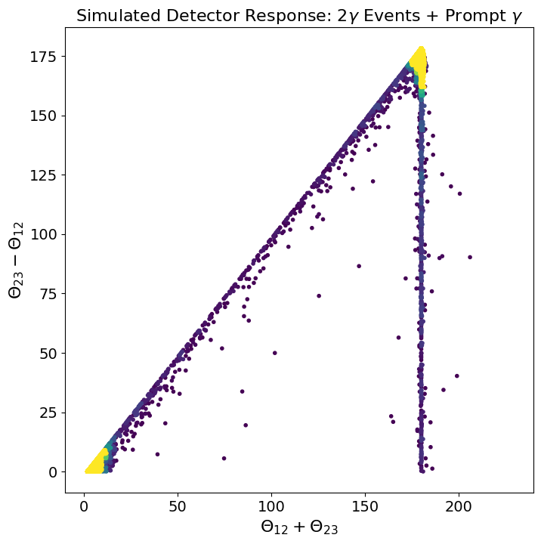
Momentum Reconstruction in Geant4: 2𝛾 Events
Event Diagnosis:
Prompt gamma acts as third signal in triple coincidence
Event Diagnosis:
Event Diagnosis:
Back-to-back gamma deposition + Compton Scattering.
Event Diagnosis:
Event Diagnosis:

Slide 16
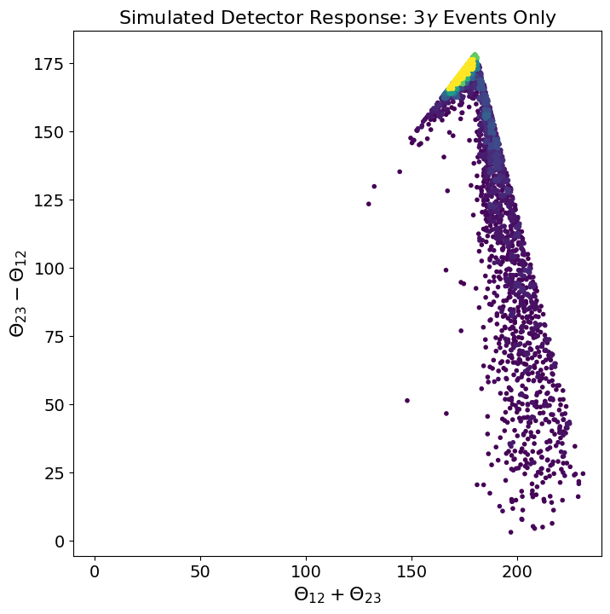
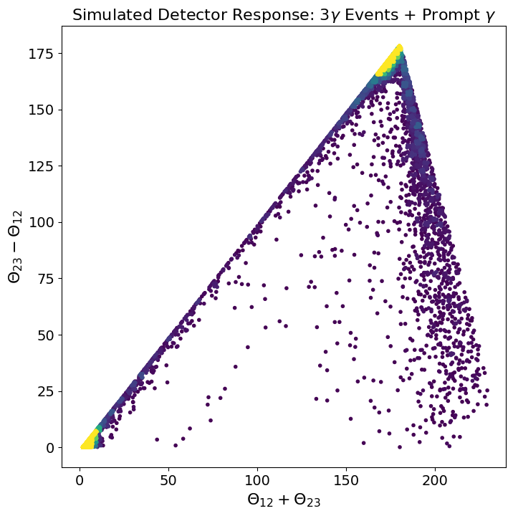
Momentum Reconstruction in Geant4: 3𝛾 Events
Event Diagnosis:
Prompt gamma acts as third signal in triple coincidence
Event Diagnosis:
Event Diagnosis:
Two of three photons interact + Compton Scattering.
Geometric constraint of crescent geometry.
Event Diagnosis:
Event Diagnosis:

Slide 17
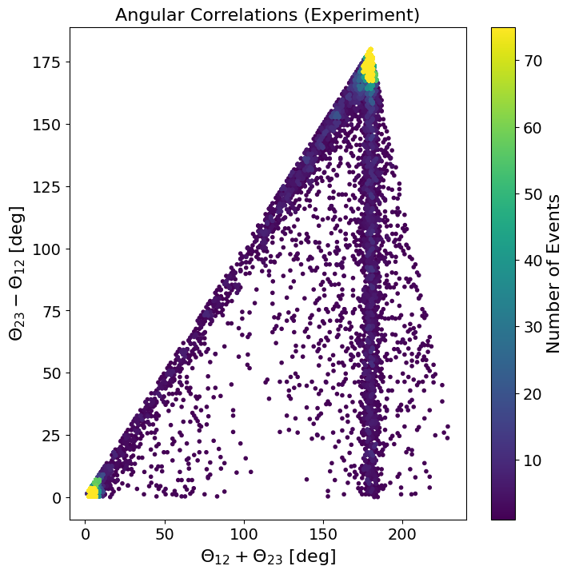
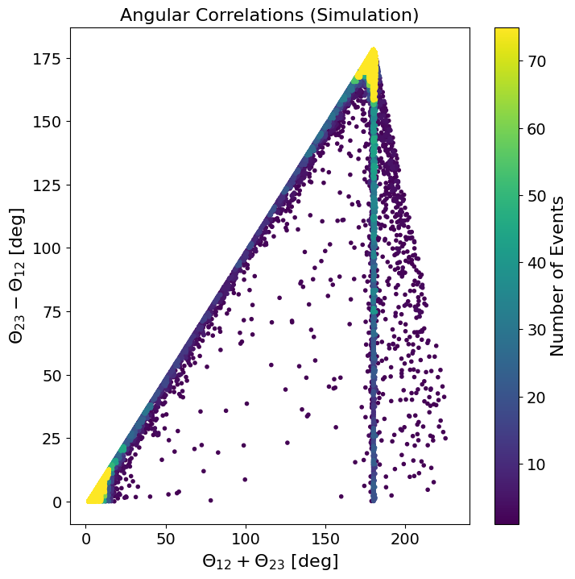
Momentum Reconstruction
Assumed f_{3𝛾} = 0.5%
Observations in experimental data:
Broadening of the back-to-back gamma line at 180˚
Additional ”noise” across the entire spectrum.
Potential o-Ps→3𝛾 candidate region (Θ₁₂ + Θ₂₃ ≥ 186˚)

Slide 18
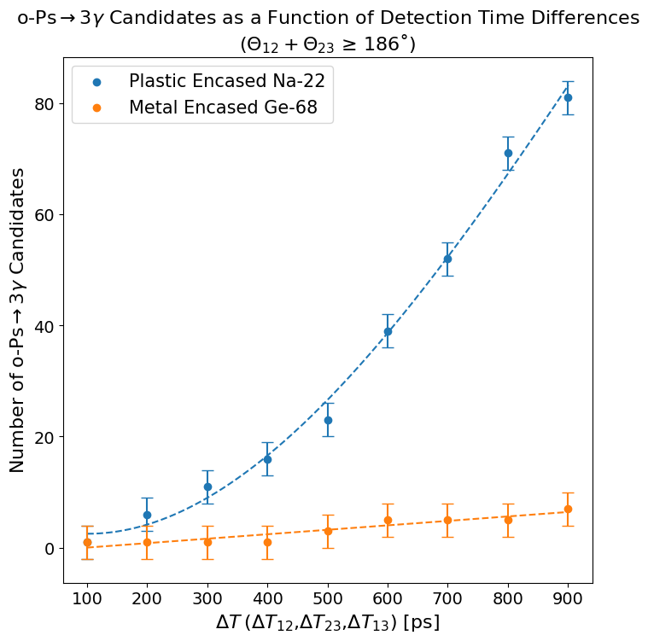
Time-of-Flight + Control Study
Monte Carlo result does not tell the whole story… it does not *yet* account for timing.
True triple coincident photons should be detected in very close temporal proximity.

Slide 19
Time-of-Flight + Control Study
Monte Carlo result does not tell the whole story… it does not *yet* account for timing.
True triple coincident photons should be detected in very close temporal proximity.
The number of potential o-Ps→3𝛾 candidates changes as we vary the required detection time window.
As a control study, the same filtering pipeline was applied to data acquired from a steel encased Ge-68.
Within metals we expect to observe few 3𝛾 events.
We see an evident quenching effect in the metal, further validating the observation of o-Ps→3𝛾 events in our plastic casing.

Slide 20
Conclusion & Next Steps
We have seen strong evidence of o-Ps→3𝛾 events from Ps formation in the plastic of a Na-22 button source using our research PET scanner. ~ with a non-optimized experiment.
The result follows from guidance by Geant4 simulations & employing four techniques to remove false triples:
  Energy – photopeak and 1.022 MeV cuts
  Decay plane cut
  Timing
  Conservation of Momenta
A control study done with metal encased Ge-68 illustrates the expected quenching of 3𝛾 events compared to the plastic Na-22 study.
Next steps:
Optimize experimental setup to boost f_{3𝛾} (aerogels).
Lifetime measurements.
Positronium in conventional and FLASH proton therapy.

Slide 21
Dziękuję za uwagę
Acknowledgements
University of Texas at Austin
Department of Physics
UTKL Group :
Prof. Karol Lang (P.I)
John Cesar Ph.D.
Marek Proga
Michael Gajda
Alex Kuo
Aryan Ojha
Laboratory of Instrumentation and Experimental Particle Physics
University of Coimbra, Portugal
Andrey Morozov Ph.D.

Slide 22
References
[1] Hamamatsu silicon photo-multipliers(SiPM), or mult-pixel photon counters(MPPC). Hamamatsu Photonics K. K, Hamamatsu City, Japan.
[2] PETSys Electronics S.A., Taguspark, Ed. Tecnologia I, 24 and 26, 2740-257, Portugal.
[3] Ore, A., & Powell, J. L. (1949). Three-photon annihilation of an electron-positron pair. Physical Review, 75(11), 1696.
[4] Kamińska, D., Gajos, A., Czerwiński, E., Alfs, D., Bednarski, T., Białas, P., ... & Moskal, P. (2016). A feasibility study of ortho-positronium decays measurement with the J-PET scanner based on plastic scintillators. The European Physical Journal C, 76, 1-14.
[5] Dulski, K., Bass, S. D., Chhokar, J., Chug, N., Curceanu, C., Czerwiński, E., ... & Moskal, P. (2021). The J-PET detector—a tool for precision studies of ortho-positronium decays. Nuclear Instruments and Methods in Physics Research Section A: Accelerators, Spectrometers, Detectors and Associated Equipment, 1008, 165452.

Slide 23
Back-up Slides

Slide 24
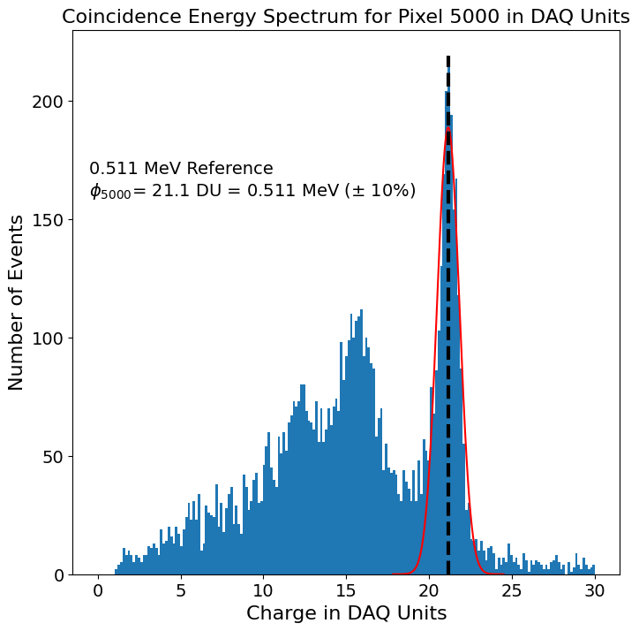
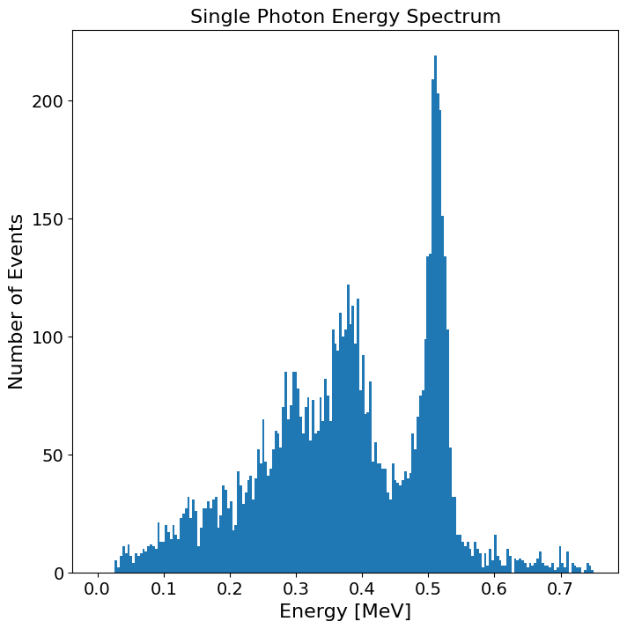
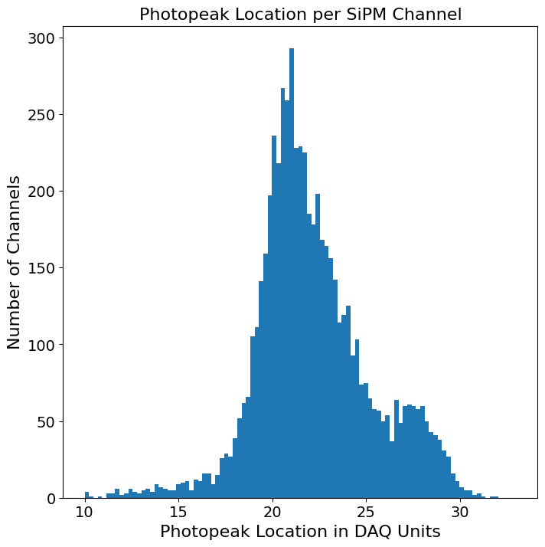
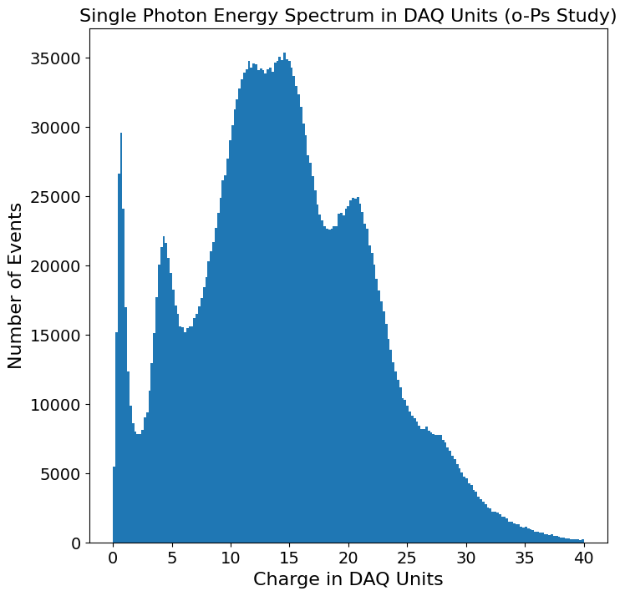
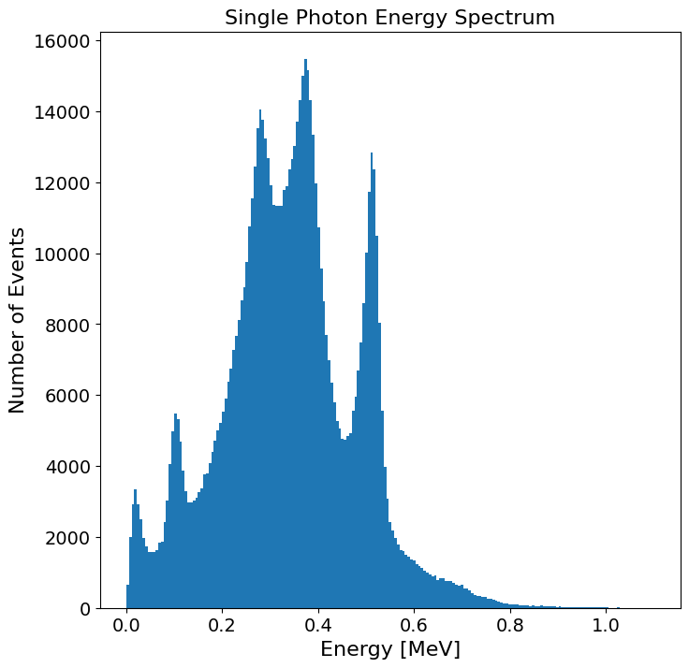


Photopeak Normalization and Alignment
Fix title
SiPM channels are not yet energy calibrated.
First order energy approximation from DAQ Unit.
DAQ units are sufficient for double coincidences… but known energy values are needed in triple events.
$$E_{MeV}= \frac{E_{DAQ}}{∅_{5000}} ∙0.511 MeV$$
$$E_{MeV}=0.511 MeV\bigcup_{i=1}^{N=6144}{\frac{E_{i,DAQ}}{∅_{i}}}$$

Slide 25
Energy Cut
Two Energy Cuts:
Filter out triple coincidences that do not meet E_{total} = 1.022 ± 0.1 MeV
1.5σ cut below the photopeak to remove known back-to-back & prompt gamma depositions.
Prompt
Gammas

Slide 26
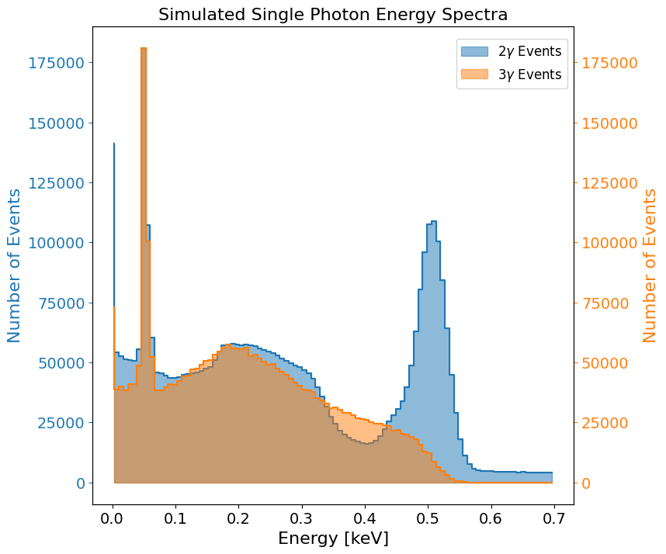
Simulated Energy Spectra

