Slide 1
Positron emission tomography imaging using polarization-correlated annihilation quanta – an experimental study
Ana Marija Kožuljević¹, Tomislav Bokulić¹, Darko Grošev², Zdenka Kuncic³, Siddharth Parashari¹, Luka Pavelić⁴, Marijan Žuvić² and Mihael Makek¹
5th Jagiellonian Symposium on Advances in Particle Physics and Medicine
June 29 – July 7, 2024
¹ Department of Physics, Faculty of Science, University of Zagreb, Zagreb, Croatia
² Department of Nuclear Medicine and Radiation Protection, University Hospital Centre Zagreb, Zagreb, Croatia
³ School of Physics, The University of Sydney, Sydney, NSW, Australia
⁴ Institute for Medical Research and Occupational Health, Zagreb, Croatia

Slide 2
Motivation
Two gammas from positronium annihilation have:
511 keV energy
opposite momenta
orthogonal polarizations

Slide 3
Motivation
Two gammas from positronium annihilation have:
511 keV energy
opposite momenta
orthogonal polarizations
Implemented in PET
YES
YES
NO

Slide 4
Motivation
Two gammas from positronium annihilation have:
511 keV energy
opposite momenta
orthogonal polarizations
Implemented in PET
YES
YES
NO
Polarization correlations could be used as an additional handle to reduce background in PET
Improved image quality
*McNamara A et al. (2014) Phys. Med. Biol., 59: 7587; Toghyani M et al. (2016) Phys. Med. Biol., 61: 5803; Watts DP et al. (2021) Nat. Commun., 12: 2646;
Kim D et al. (2023) JINST, 18(07):P07007

Slide 5
Azimuthal correlations of annihilation quanta
Double Klein-Nishina differential cross section:​

Slide 6
Azimuthal correlations of annihilation quanta
Double Klein-Nishina differential cross section:​
Maximum at |φ₁-φ₂|=90°

Slide 7
Azimuthal correlations of annihilation quanta
Double Klein-Nishina differential cross section:​
Maximum at |φ₁-φ₂|=90°
Polarimetric modulation factor:

Slide 8
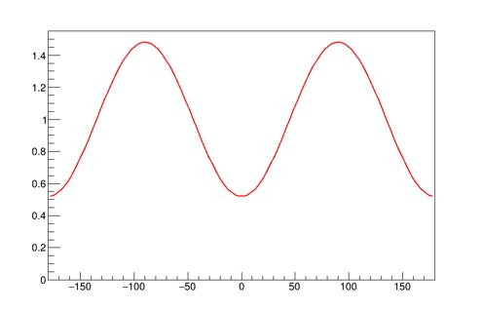
Azimuthal correlations of annihilation quanta
Double Klein-Nishina differential cross section:​
Maximum at |φ₁-φ₂|=90°
Polarimetric modulation factor:
a.u.
Max for Θ₁= Θ₂= ~82°:
μ = 0.48
Background events will lack such correlation!
Δφ [°]
Δφ [°]
Double K-N function with polarimetric modulation factor 0.48

Slide 9
Laboratory setup
Pixelated Compton polarimeters in one layer
Video made by Ena Piškorić

Slide 10
Laboratory setup
Pixelated Compton polarimeters in one layer
Scintillating crystals
GaGG:Ce
8.1% ± 0.5% at 511 keV
Silicon Photomultiplier (SiPM)
(Hamamatsu Photonics, Japan, model S13361-0808AE), 1:1 coupling
ToFPET2 ASIC read-out system
Parashari et al., Nucl. Instrum. Methods Phys. Res. A (2022) 167186

Slide 11
Data selection
2 pixels fired per module
EVENT
1 pixel fired per module with 511±3σ keV deposited energy
Selection of events with photoelectric interaction

Slide 12
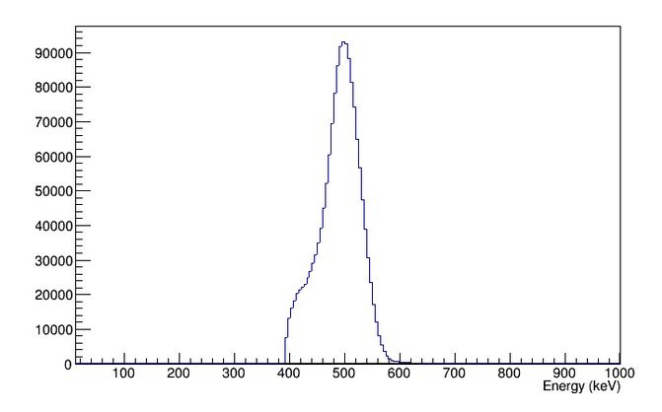
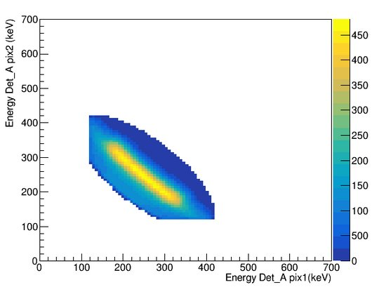
Data selection
Counts
Selection of events with two pixels fired with sum of deposited energies 511±3σ keV
a
b
2 pixels fired per module
elliptical cut with sum of deposited energies 511±3σ keV
EVENT
Selection of Compton events with two pixels fired with sum of deposited energies 511±3σ keV
Compton scattering events
1 pixel fired per module with 511±3σ keV deposited energy
First pixel -
lower energy deposition!
Selection of events with photoelectric interaction
True for ~55% of the events
(A. M. Kožuljević et al., Condensed Matter (2021), 6, 43)

Slide 13
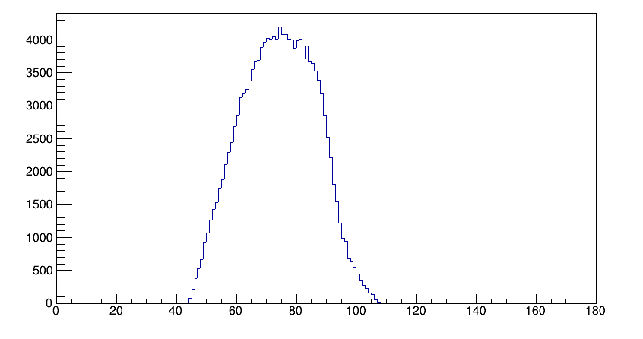
Data selection
Counts
Distribution of the selected events' Compton scattering angles Θ
θ [° ]
2 pixels fired per module
elliptical cut with sum of deposited energies 511±3σ keV
Θ angle reconstruction
EVENT
Compton scattering events
1 pixel fired per module with 511±3σ keV deposited energy
Selection of events with photoelectric interaction

Slide 14
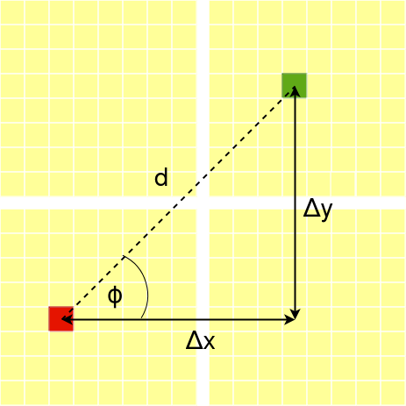
Data selection
Counts
Distribution of the selected events' Compton scattering angles Θ
θ [° ]
2 pixels fired per module
elliptical cut with sum of deposited energies 511±3σ keV
Θ angle reconstruction
ϕ angle reconstruction
EVENT
Compton scattering events
1 pixel fired per module with 511±3σ keV deposited energy
Selection of events with photoelectric interaction

Slide 15
Data selection
Counts
Selection of events with correlations in polarizations
θ [° ]
2 pixels fired per module
elliptical cut with sum of deposited energies 511±3σ keV
Θ angle reconstruction
ϕ angle reconstruction
EVENT
Azimuthal angle difference: ϕ ₁- ϕ ₂
Compton scattering events
1 pixel fired per module with 511±3σ keV deposited energy
Selection of events with photoelectric interaction

Slide 16
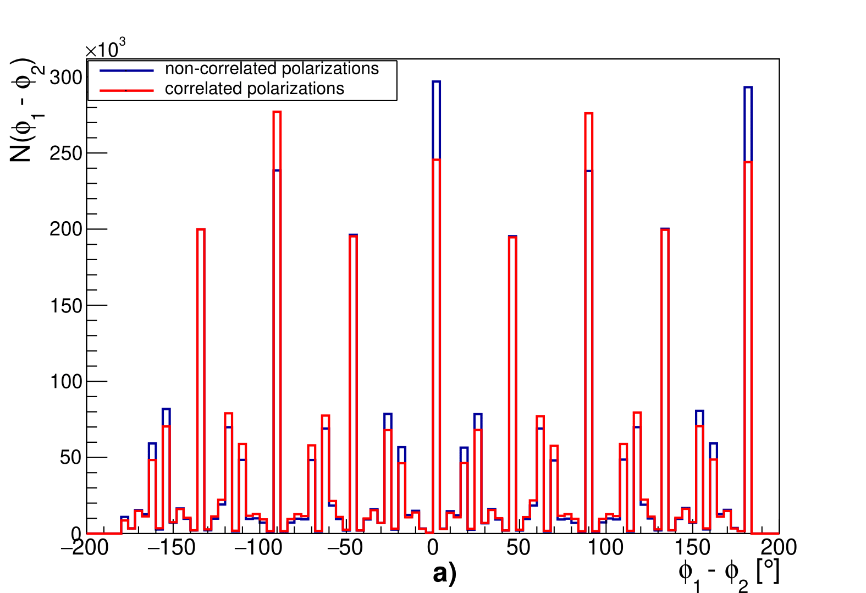
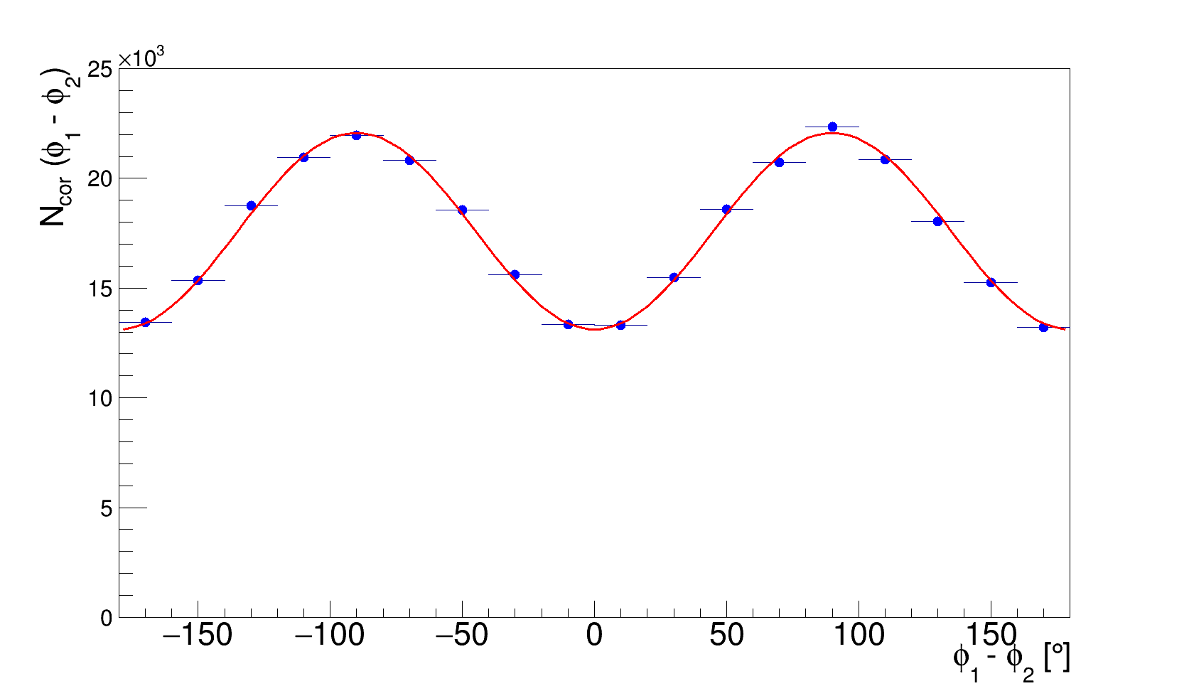
Polarization correlations - reconstruction
After the acceptance correction
Acceptance correction:
A. M. Kožuljević et al., Condensed Matter (2021), 6, 43
GAGG:Ce 2.9 mm
Distribution of the azimuthal angle differences
after both gammas undergo Compton scattering
(from measurements)
Blue – measured data
Red – Klein-Nishina fit function
An example of N(ϕ₁- ϕ₂ ) distribution for correlated gamma photons in GAGG detector module for Θ= 82°, compared to the simulated distribution for non-correlated photons.

Slide 17
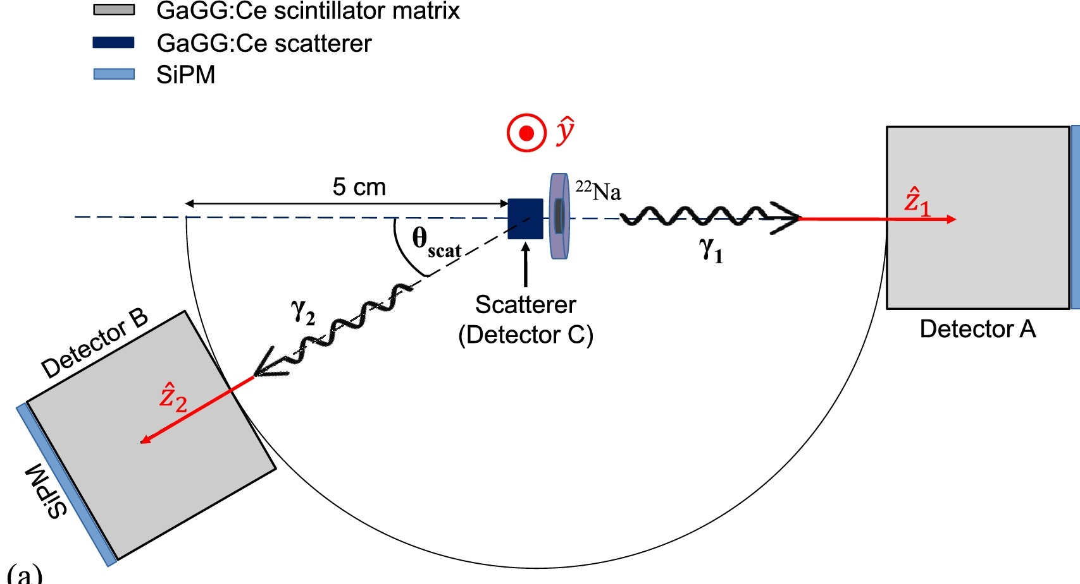
Polarization correlations - addendum
Parashari et al. (2024) Physics Letters B, 852:138628
Experimental setup for measuring polarization correlations after one of the annihilation photons undergoes previous scatter

Slide 18
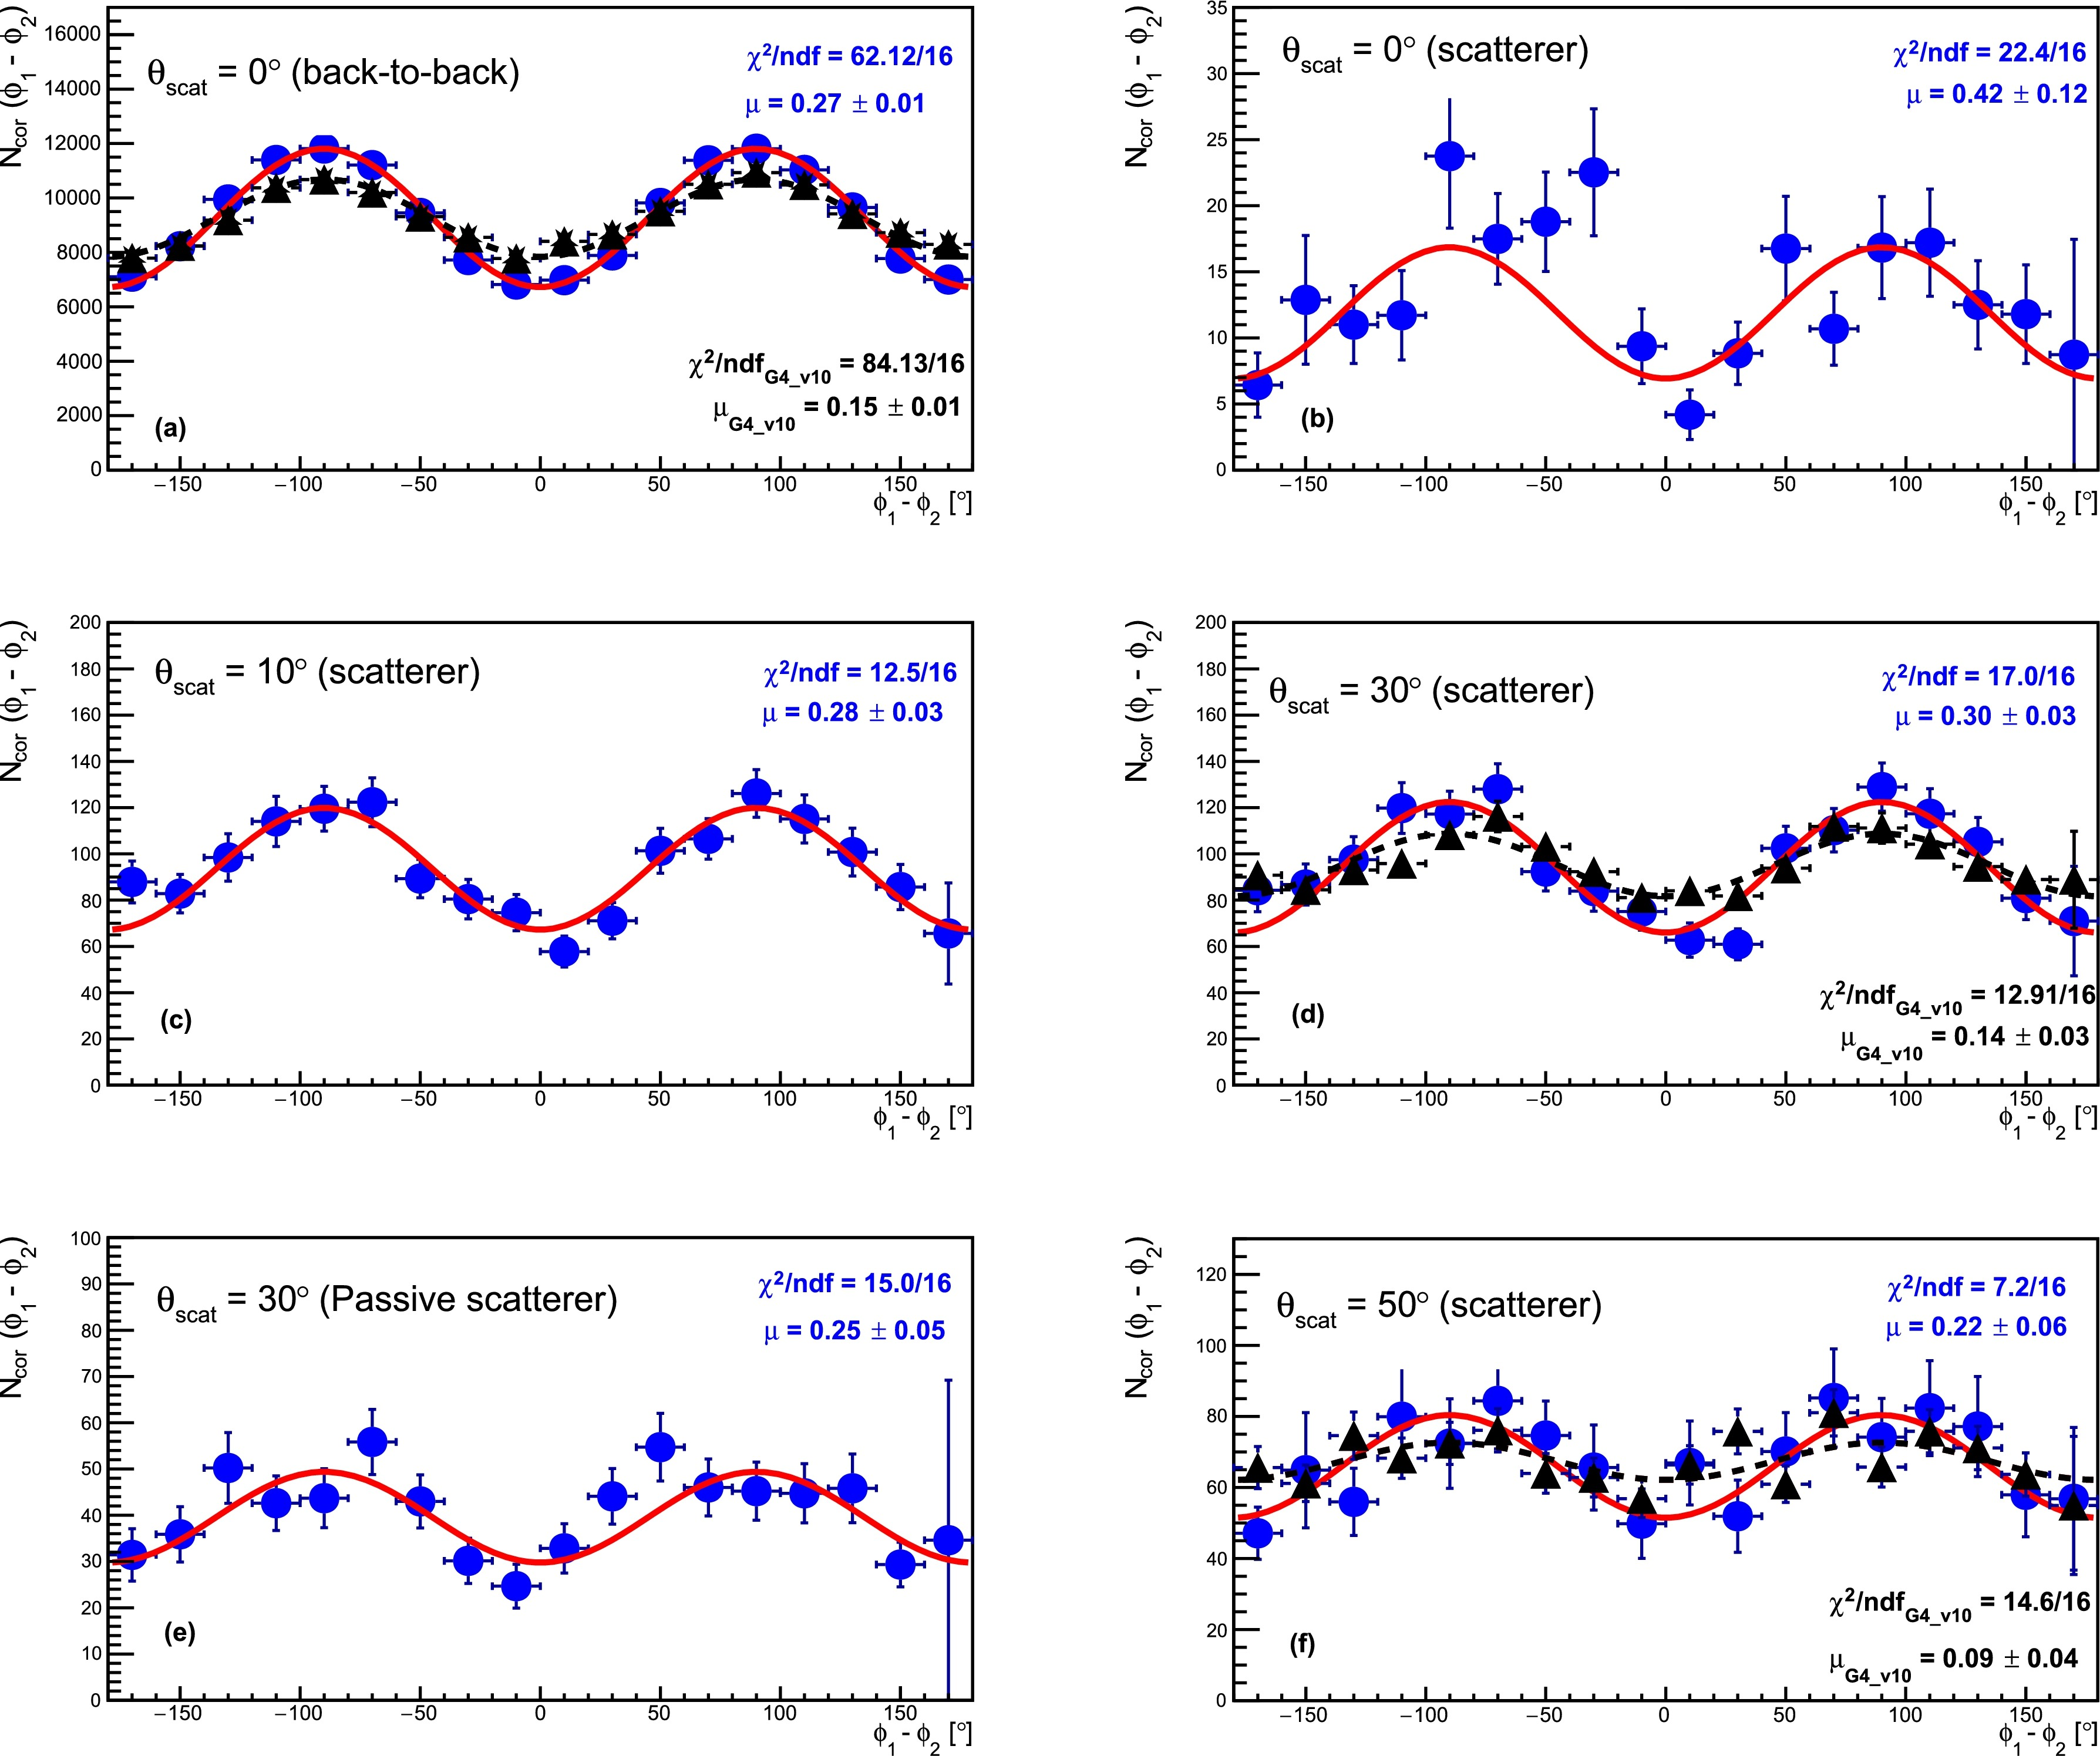
Polarization correlations - addendum
Parashari et al. (2024) Physics Letters B, 852:138628
Experimental setup for measuring polarization correlations after one of the annihilation photons undergoes previous scatter
Polarization correlations observed even after the scatter of one of the annihilation gammas
Azimuthal angle difference distributions observed for different Compton scattering angles of the scattered annihilation photons

Slide 19
Polarization correlations - addendum
Parashari et al. (2024) Physics Letters B, 852:138628
Experimental setup for measuring polarization correlations after one of the annihilation photons undergoes previous scatter
Polarization correlations observed even after the scatter of one of the annihilation gammas
Limits the ability of the method to reduce background by eliminating scatter coincidences
The method is still applicable for random and multiple coincidences
Azimuthal angle difference distributions observed for different Compton scattering angles of the scattered annihilation photons

Slide 20
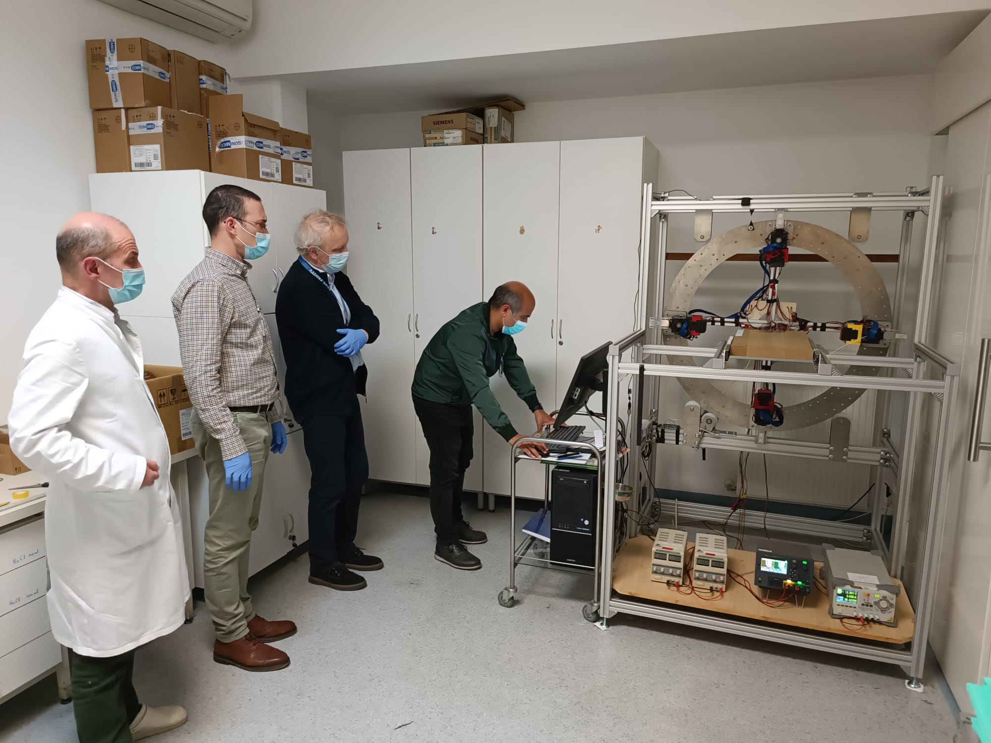
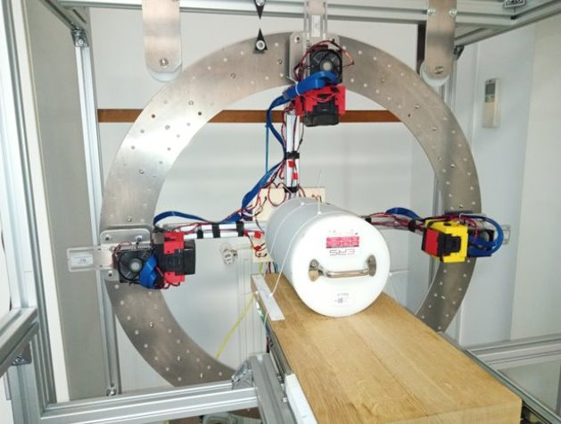
The PET Demonstrator
Four super-modules of segmented scintillators
16 x 16 pixels in each module
Diameter range: 420 – 700 mm​
Precise rotation around the scanner axis​

Slide 21
Preliminary results
Two Ge-68 line sources in aluminum encapsulation
Epoxy phantom, 3 cm in diameter
Data acquired with 3.2 mm matrix pitch GaGG:Ce modules
Activity (each source): | 45.5 MBq
Distance between the sources: | ~ 2 cm
Diameter: | 430 mm
Number of positions (angle): | 12 (15 deg)
Time of acquisition (per position): | ~ 2.3 h

Slide 22
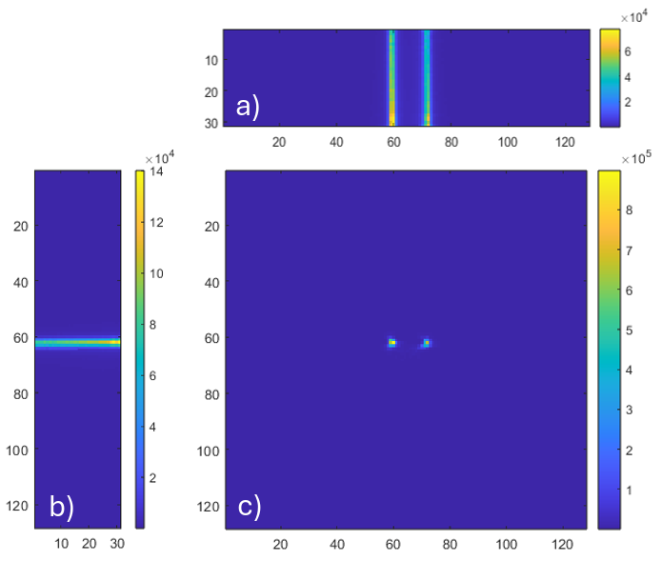
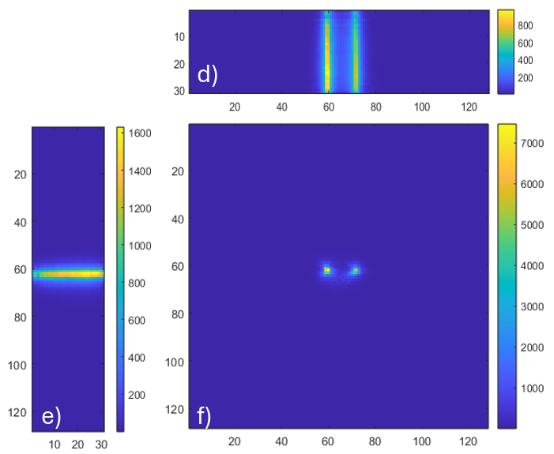
Extended sources (2 Ge-68 sources in stainless steel, 45.5 MBq each)
RAW IMAGES!
OMEGA software (MATLAB), OSEM - NO CORRECTIONS!
Preliminary results
128x128 pixels; FOV: 20x20 cm², 31 slices; OSEM: 10 iterations, 6 subsets
Images reconstructed from events which are selected
as the ones with polarization correlations where
Θ∈[72,90], |Δϕ|∈[70, 110]
Images reconstructed from events which are selected as the single-pixel (PE) events
a & d - coronal view
b & e – sagittal view
c & f - axial view

Slide 23
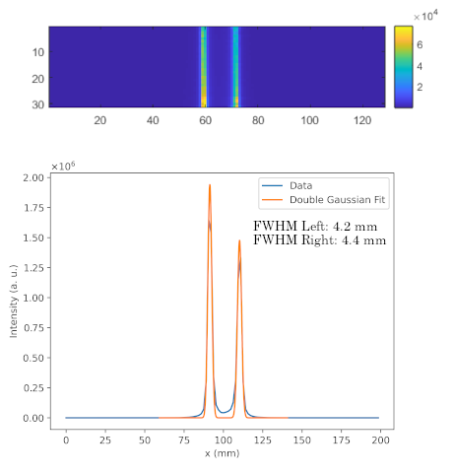
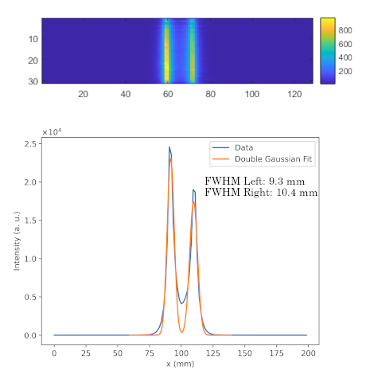
Study of the spatial resolution of the novel PET device
Preliminary results
Image profile from single-pixel (PE) events
Image profile from events with polarization correlations where Θ∈[72,90], |Δϕ|∈[70, 110]

Slide 24
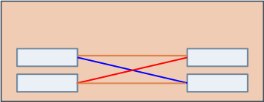
Study of the spatial resolution of the novel PET device
Preliminary results
LOR ambiguity
Image profile from single-pixel (PE) events
Image profile from events with polarization correlations where Θ∈[72,90], |Δϕ|∈[70, 110]

Slide 25
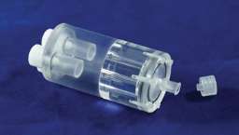
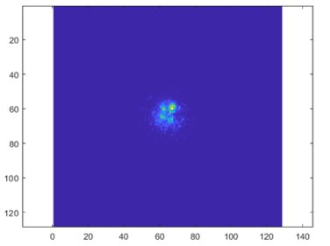
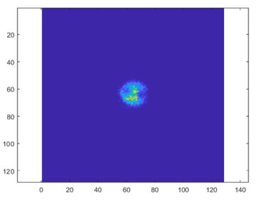
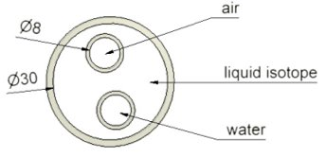
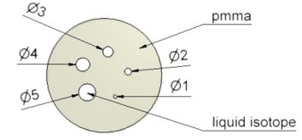
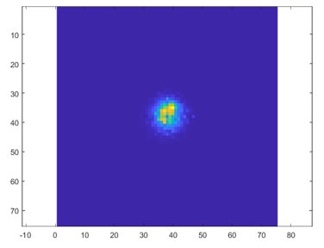
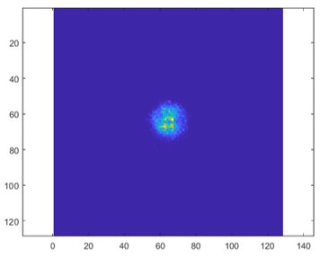
NEMA NU-4 Small Animal Phantom
Preliminary results
b) and d)
a) and c)
a)
b)
a) and b): Photoelectric events
128x128 pixels
FOV: 200
c) and d): Polarization correlated events
75x75 pixels
FOV: 195
Initial activity: ~ 400 MBq Ga-68
Number of positions: 12 (15 deg)
Total acquisition length: ~ 1h
3.2 mm detector matrix pitch
c)
d)

Slide 26
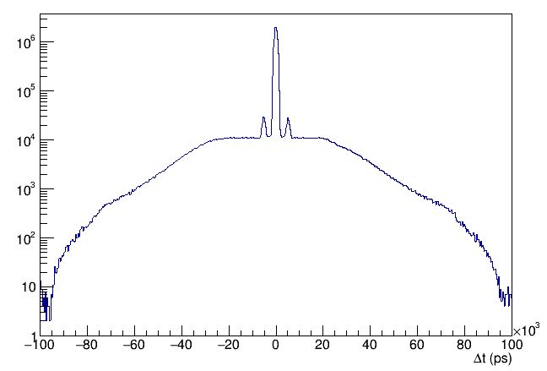
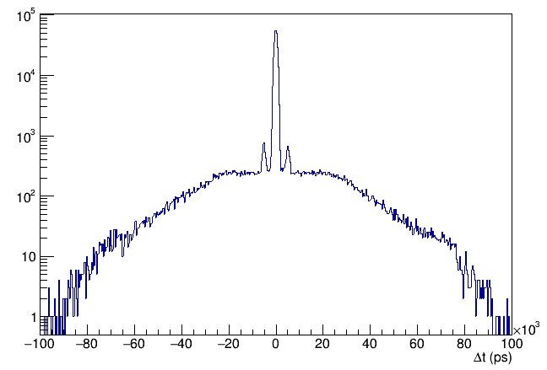
Signal to random background ratio (from coincidence time spectra)
Counts
u.
Counts
u.
Counts
Counts
Coincidence time spectrum from single-pixel (PE) events
Coincidence time spectrum from events with polarization correlations where Θ∈[72,90], |Δϕ|∈[70, 110]
Gaussian fit to the peak

Slide 27
Signal to random background ratio (from coincidence time spectra)
Counts
Counts
Counts
Counts
Coincidence time spectrum from single-pixel (PE) events
Coincidence time spectrum from events with polarization correlations where Θ∈[72,90], |Δϕ|∈[70, 110]
Total signal (|Δt| < mean ± 3σ)
SBR = (A_{tot}-A_{BG})/A_{BG}​
Background signal
(Left: Δt < mean - 15σ and Δt > mean - 21σ,
Right: Δt > mean + 15σ and Δt < mean + 21σ)

Slide 28
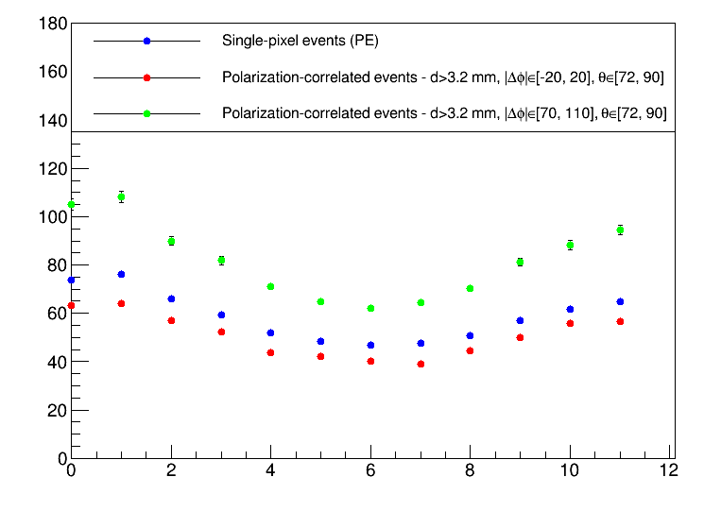
Signal to random background ratio (from coincidence time spectra)
Preliminary results for 2 line Ge-68 sources in a phantom, 430 mm diameter, total activity ~90 MBq
u.
u.
Selection of events with polarization correlations where Θ∈[72,90], |Δϕ|∈[70, 110]
SBR
Selection of events with polarization correlations where Θ∈[72,90], |Δϕ|∈[-20, 20]
Position #
SBR vs. Data-acquisition position on the ring for 2 line Ge-68 sources with phantom at 430 mm diameter. Comparison between single-pixel events, and events with polarization correlations at selected |Δϕ|.

Slide 29
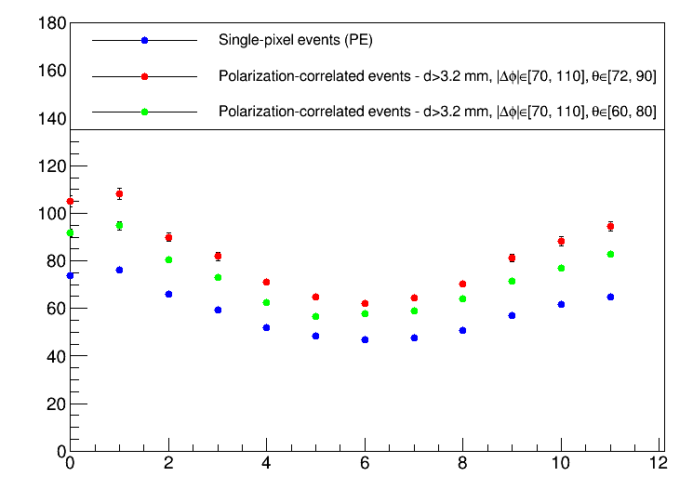
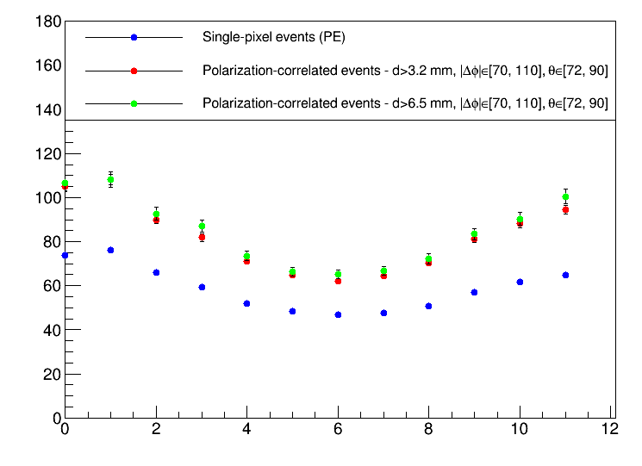
Signal to random background ratio (from coincidence time spectra)
Preliminary results for 2 line Ge-68 sources in a phantom, 430 mm diameter, total activity ~90 MBq
u.
u.
SBR
SBR
Position #
Position #
SBR vs. Data-acquisition position on the ring for 2 line Ge-68 sources with phantom at 430 mm diameter. Comparison between single-pixel events, and events with polarization correlations at selected Θ.
SBR vs. Data-acquisition position on the ring for 2 line Ge-68 sources with phantom at 430 mm diameter. Comparison between single-pixel events, and events with polarization correlations at selected pixel distances d.

Slide 30
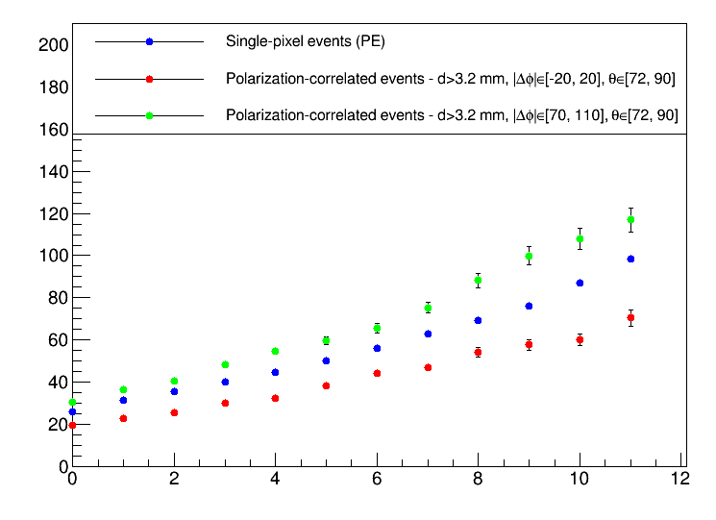
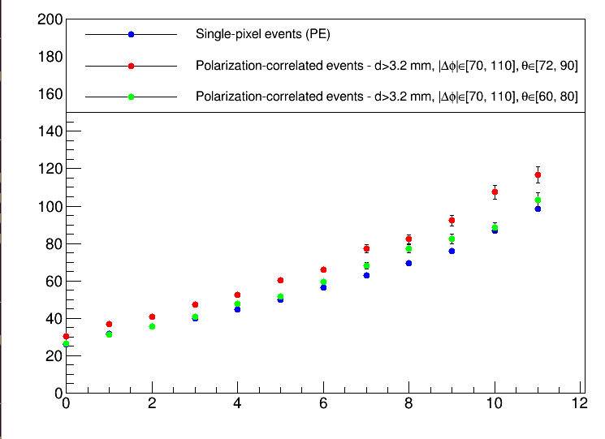
Signal to random background ratio (from coincidence time spectra)
Preliminary results for NEMA phantom filled with Ga-68, 430 mm diameter
Initial activity ~400 MBq, final activity ~200 MBq
u.
u.
SBR
SBR
SBR
Position #
Position #
Position #
SBR vs. Data-acquisition position on the ring for NEMA phantom at 430 mm diameter. Comparison between single-pixel events, and events with polarization correlations at selected |Δϕ|.
SBR vs. Data-acquisition position on the ring for NEMA phantom at 430 mm diameter. Comparison between single-pixel events, and events with polarization correlations at selected Θ.

Slide 31
Conclusions
It is possible to measure polarization correlations of the annihilation quanta using single-layer Compton polarimeters.
We have demonstrated that image reconstruction solely from polarization correlated annihilation quanta is possible.
Limiting factor: LOR ambiguity
Signal to random background ratio from coincidence time spectra of correlated events selected for Θ∈[72,90], |Δϕ|∈[70, 110] exhibits higher values when compared to events with PE and other choices of Θ and |Δϕ|.

Slide 32
Thank you!
This work was supported by the “Research Cooperability” Program of the Croatian Science Foundation funded by the European Union from the European Social Fund under the Operational Program Efficient Human Resources 2014–2020,
Grant number PZS-2019-02-5829.

Slide 33
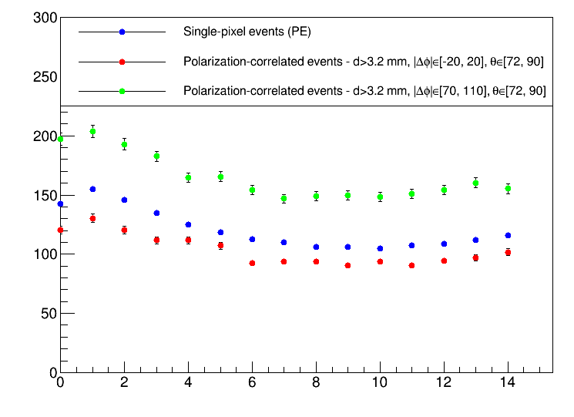
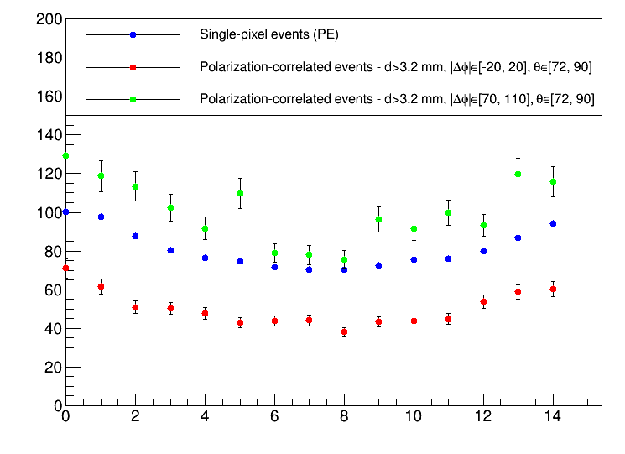
Signal to random background ratio (from coincidence time spectra)
Preliminary results for 2 line Ge-68 sources in a phantom, 620 mm diameter
u.
u.
SBR
SBR
Position #
Position #
SBR vs. Data-acquisition position on the ring for 2 line Ge-68 sources (no phantom) at 620 mm diameter. Comparison between single-pixel events, and events with polarization correlations at selected |Δϕ|.
SBR vs. Data-acquisition position on the ring for 2 line Ge-68 sources with phantom at 620 mm diameter. Comparison between single-pixel events, and events with polarization correlations at selected |Δϕ|.

