Slide 1
Evolution of the data acquisition and processing system in J-PET
Grzegorz Korcyl
Department of Information Technologies
2023

Slide 2

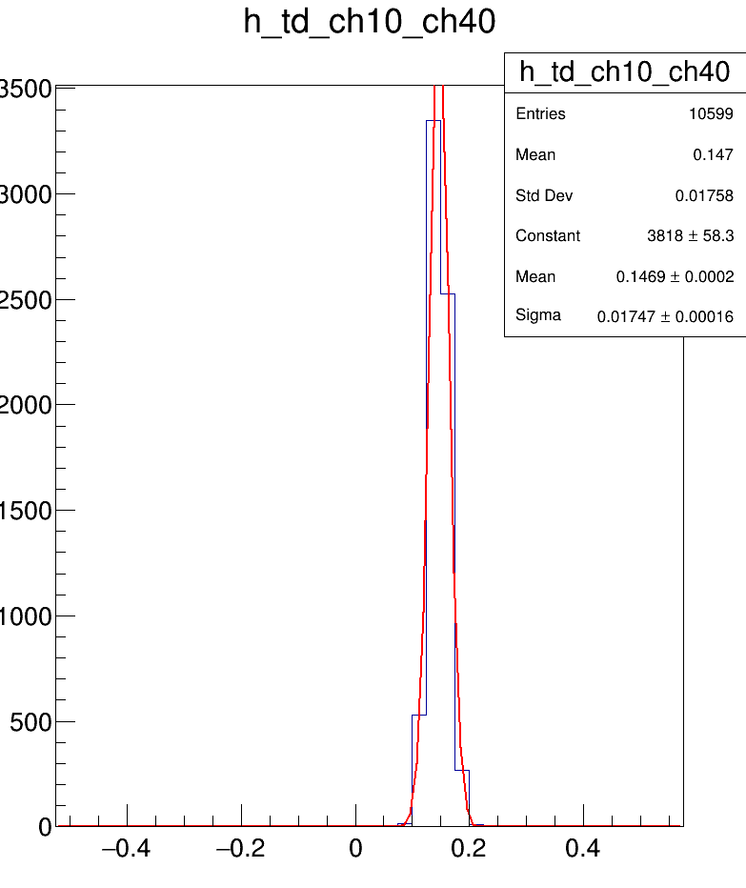
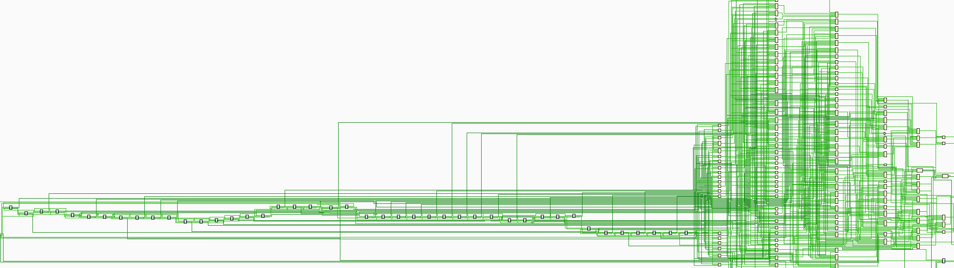
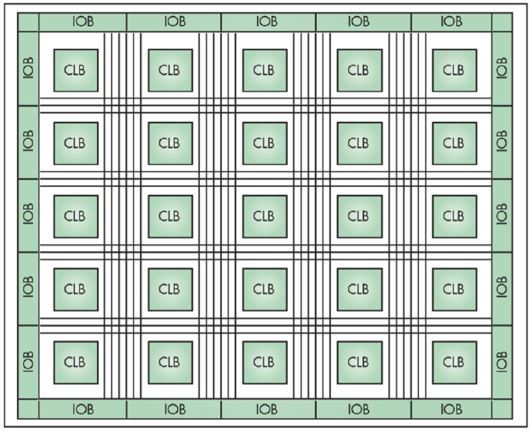
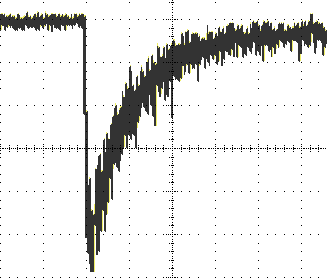
The key concepts
Field-Programmable Gate Arrays in the center of the system
  Reduction of the analog part
    Analog signal discrimination and digitization with FPGA
  Migration of functionalities into flexible FPGAs
    Time-Digital-Converter implemented using FPGA resources
    Data already in the chip - faster readout, less deadtime, less overhead
  Less prone to costly mistakes and long hardware production cycles
Decoder
Delay chain
Test pulses
Time difference
Sigma 17ps
Threshold level
+
-
www.electronicdesign.com
000000000000000000000111110000000000000000000
Time-Over-Threshold

Slide 3
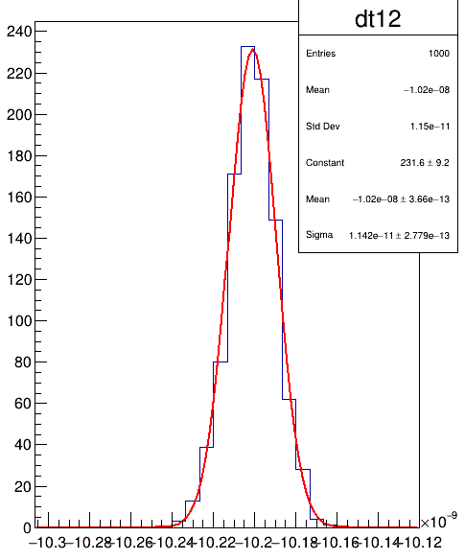

The key concepts
Korcyl G.: A system for acquisition of tomographic measurement data
Patent Application No. US 20160209522A1, 2016
Continuous readout
  No hardware trigger
    Simplified circuits
    Less deadtime
    Higher throughput
  No hardware pre-selection
    Simplified logic
    No artificial bias and artifacts
    More context for deeper offline analysis
    High level of the background
    High data rates
  Requires precise time synchronization
    Common synchronization pulse on dedicated TDC channel
    Common clock distribution
System Master
Concentrators
Sync pulses
Time difference
11 ps
(scope)
TDC
TDC

Slide 4
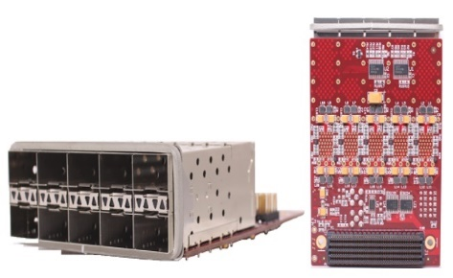

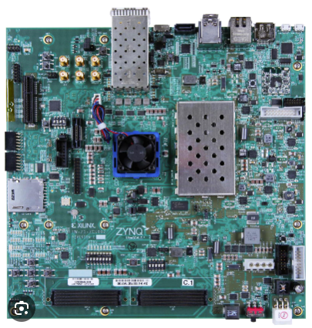
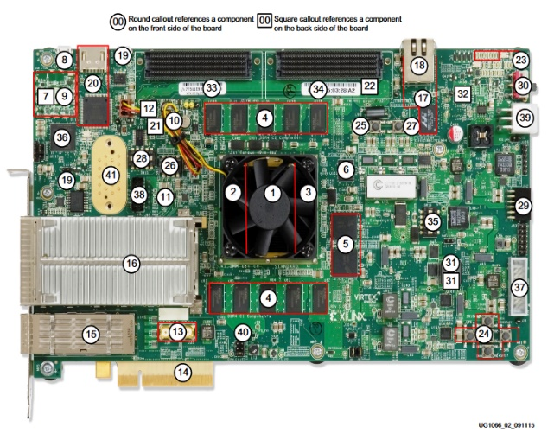

The key concepts
Apply verified standards and solutions
  Do not reinvent the wheel
  Avoid common mistakes
  Reduce development time and costs
  Custom hardware on Front-End level only
  Commercially available platforms on other levels
  Standardized interfaces and protocols in Firmware
  Industry supported IPs

Slide 5
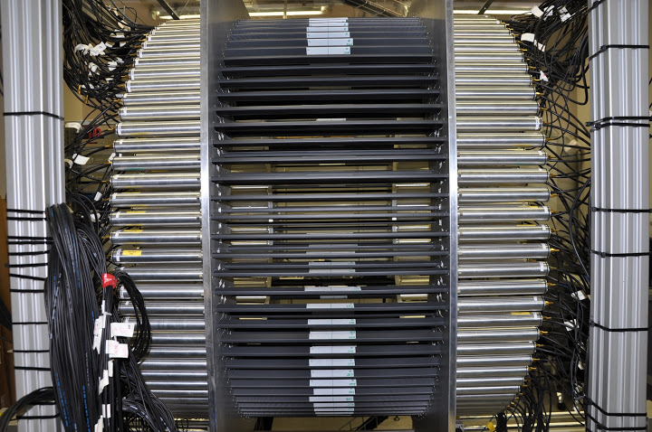
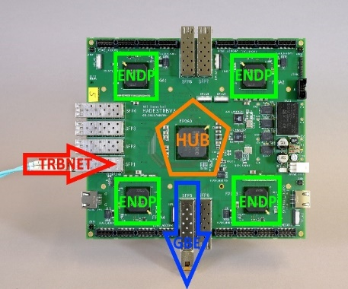
The first J-PET system
System based on TRB platform in 2015
  Experience from medium-scale HEP experiments
    Jagiellonian University as part of the developers team
  Versatile platform for complete systems
    Over 30 hardware components
    Complete software packages for control/monitoring, data handling
    Verified by dozens of users in multiple experiments
TRBv3
  Lattice ECP3 FPGA as board controller
  4x Lattice ECP3 FPGA as configurable peripherals with add-on cards
  Inter-board communication with optical links and custom protocol
  Synchronization with dedicated LVDS lines
  Gigabit Ethernet data output
Traxler, M.; Korcyl, G.; Bayer, E.; Maier, L.; Michel, J.; Palka, M.
„A compact system for high precision time measurements (<14 ps RMS)
and integrated acquisition for a large number of channels”,
JINST 10.1088/1748-0221/6/12/C12004

Slide 6
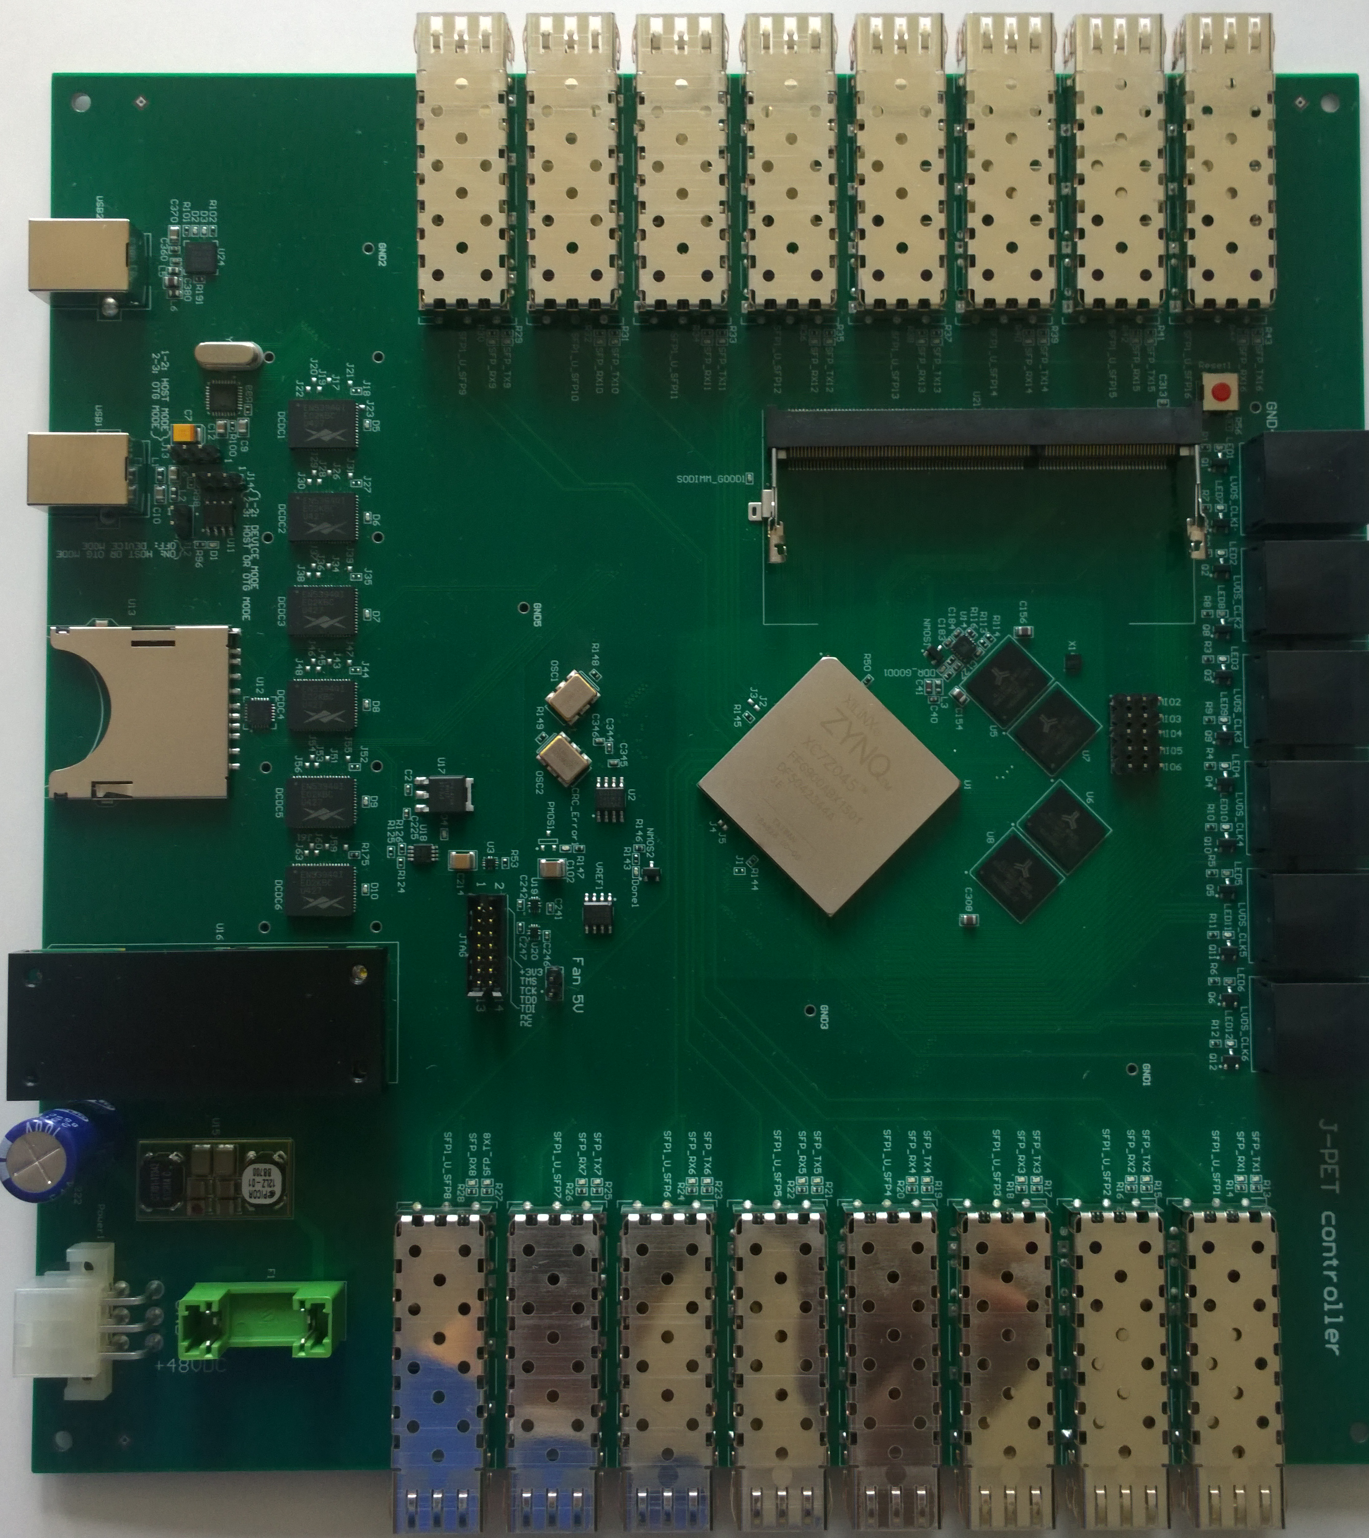
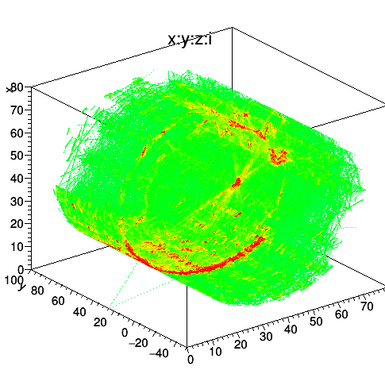
The first J-PET system
System extended with a dedicated processing board in 2017
  Xilinx Zynq045, 8x Ethernet inputs, 8x Ethernet outputs
  Man-in-the-middle card
    Online data processing (coincidences, calibrations, LOR, ROR calculation)
    Produces live visualizations
    Preserves original, raw data streams
    Selectable operation mode
Conclusions
  Minimalistic FEE and signal digitization and time measurement in FPGA are satisfactory
  Fast protocols and large throughput required for continuous readout
  Spare logic resources required for potential pre-processing
  TRBv3 was designed in 2011 on Lattice FPGAs, modern hardware required

Slide 7
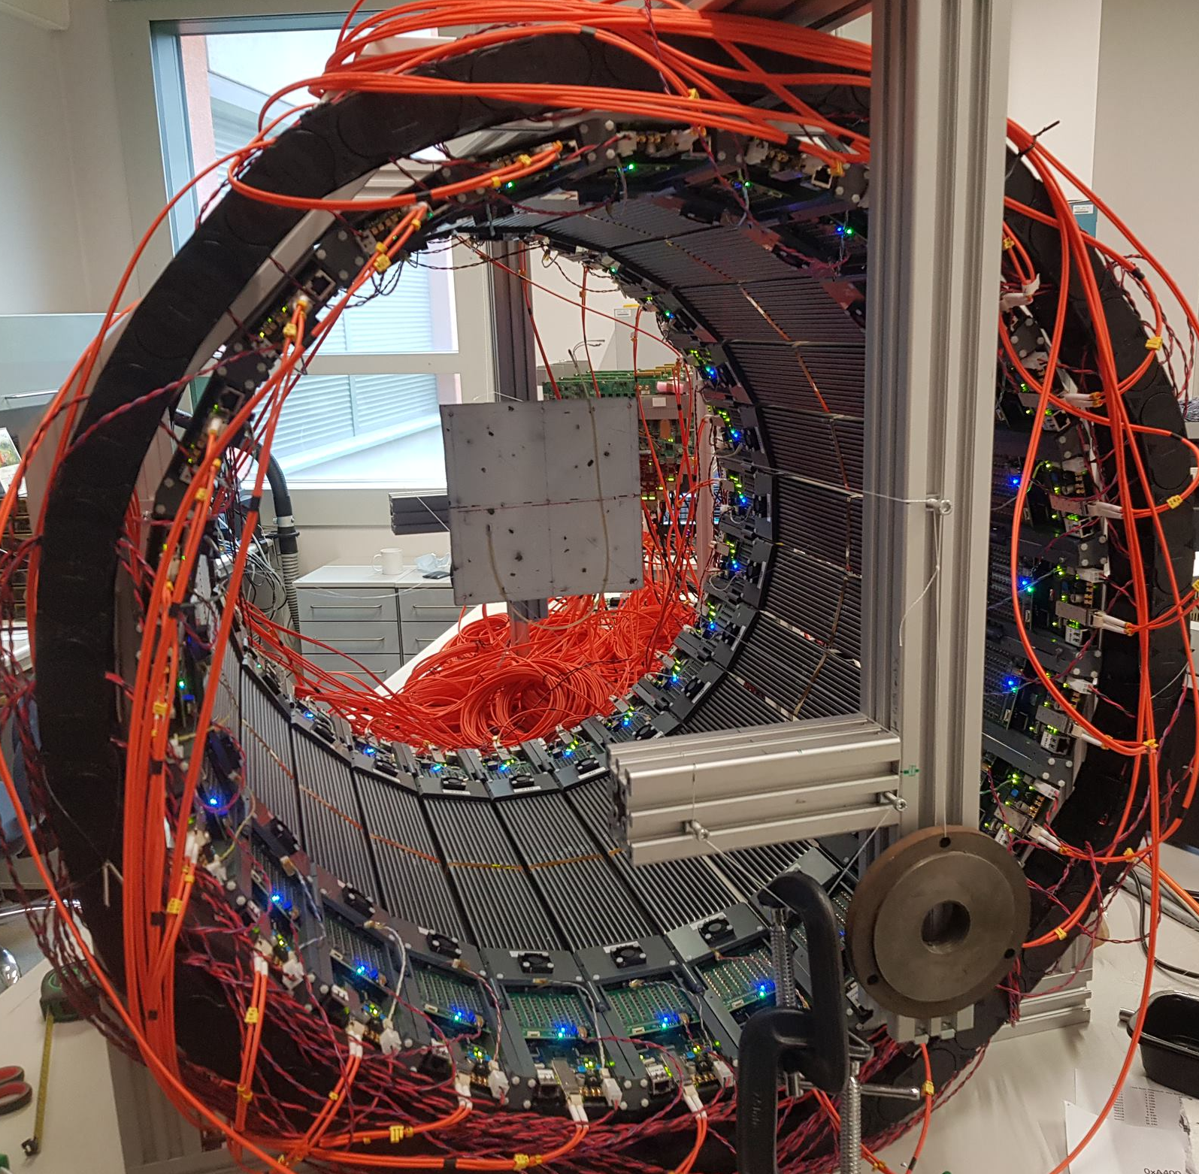
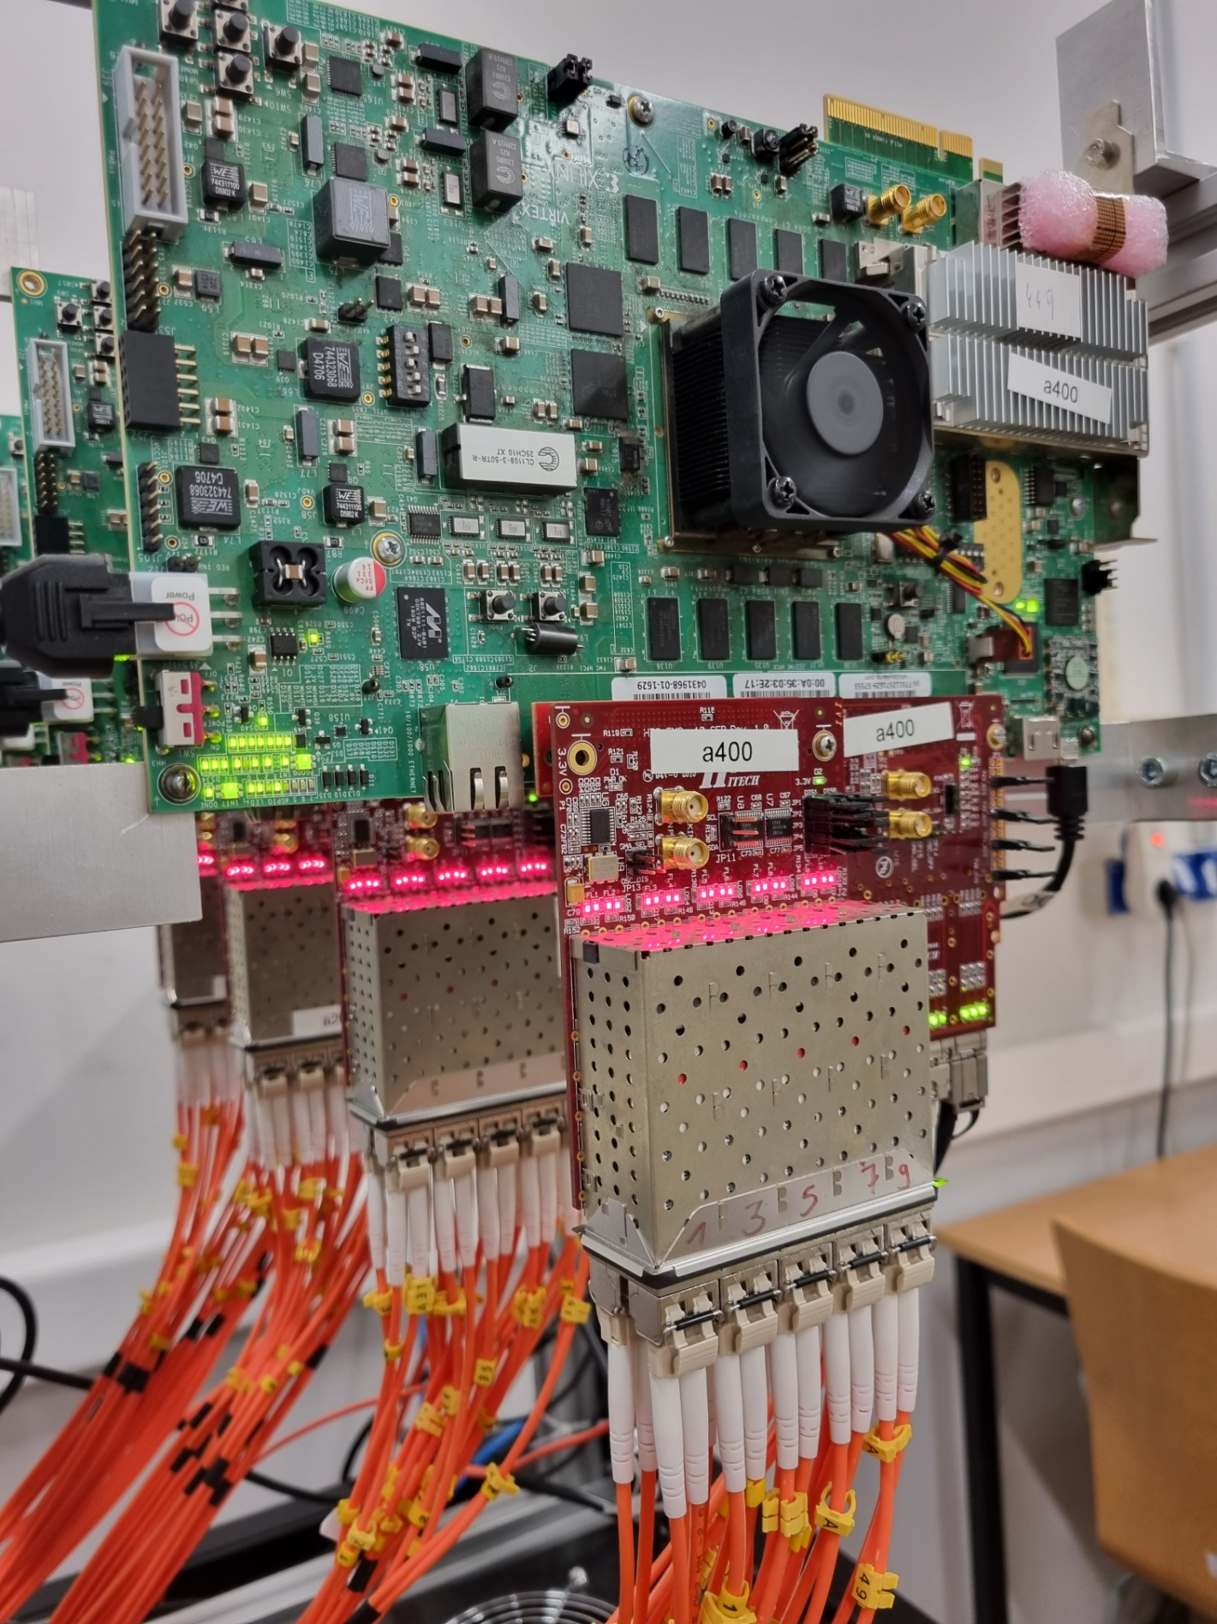
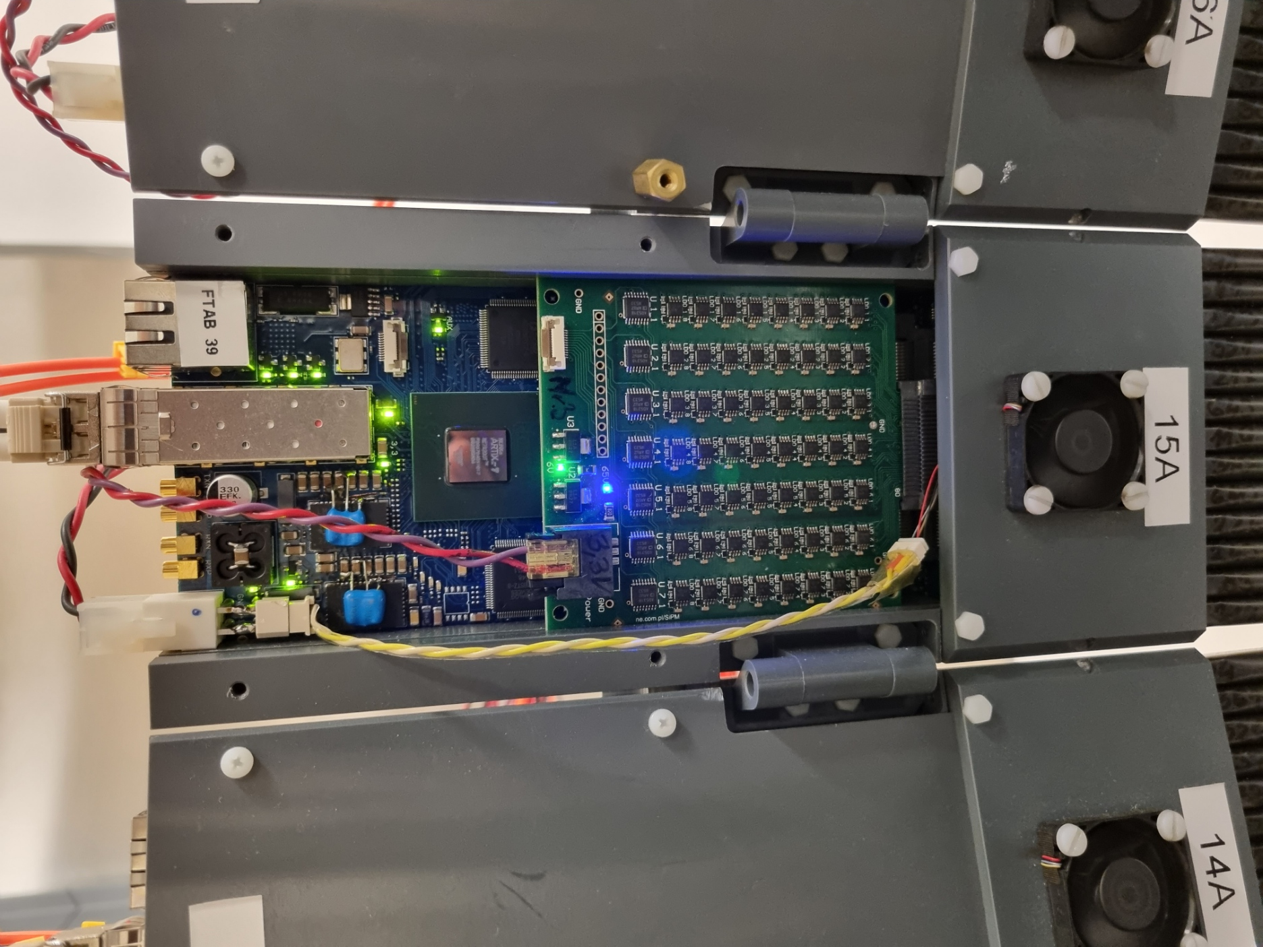
The second generation
New prototype based on silicon photomultipliers – high channel density
Xilinx/AMD introduced efficient hardware families and dev. tools
FEE – digitization platform redesigned
  Artix200 as TDC and system Endpoint
Xilinx commercial boards:
  Virtex Ultrascale VCU108 as data concentrator
  Zynq Ultrascale+ MPSoC ZCU102 as system controller
3x more analog channels – 15x more logic resources
Design and development by M. Pałka

Slide 8
The second generation
Clock and sync pulse receiver
Buffered data transmitter
Endpoint 1
Endpoint N
…
Efficient communication is the key
  Downstream:
    Precise time synchronization – synchronous links, clock distribution
    Control/monitoring messages
  Upstream:
    Measurement data transport to the nearest Ethernet Gateway
  Native Xilinx Aurora protocol
    5 Gbps default link speed
    Enhanced with synchronous mode
    Easily reusable on variety of hardware platforms
    Easily integrable with native AXI logic interfaces
Clock and sync pulse receiver
Clock and sync pulse distributor
Control/monitoring forwarder
Data collector
10G Ethernet gateway
downstream
Concentrator
Concentrator
upstream
Master
Source of the master clock
Sync pulse generation
Control/monitoring gateway

Slide 9
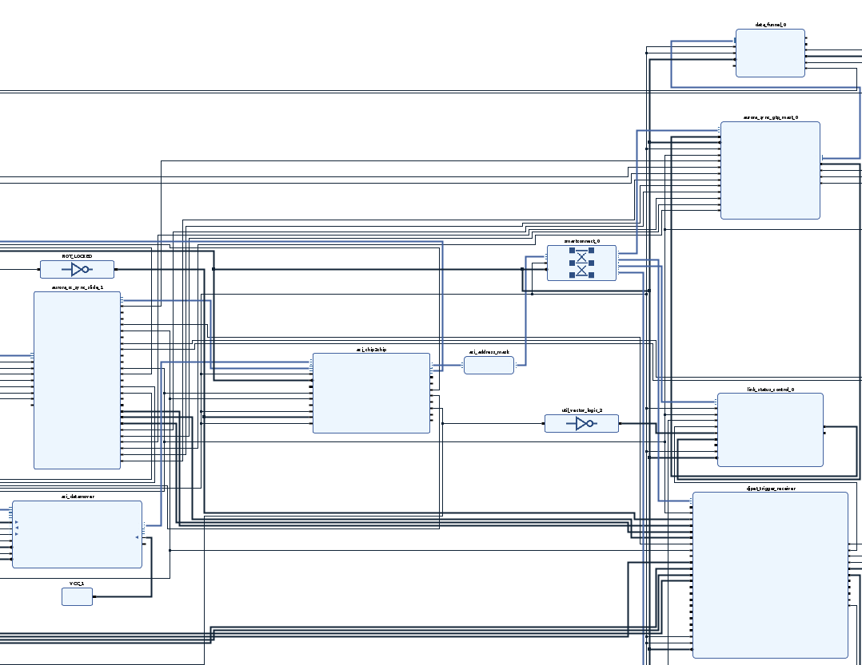
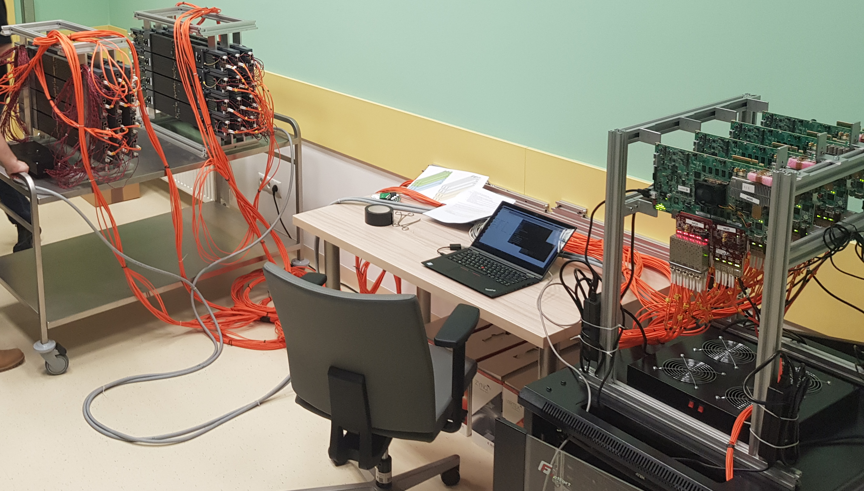
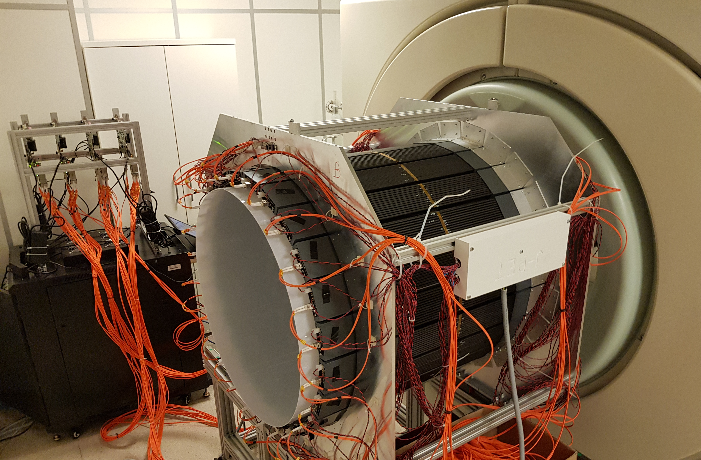
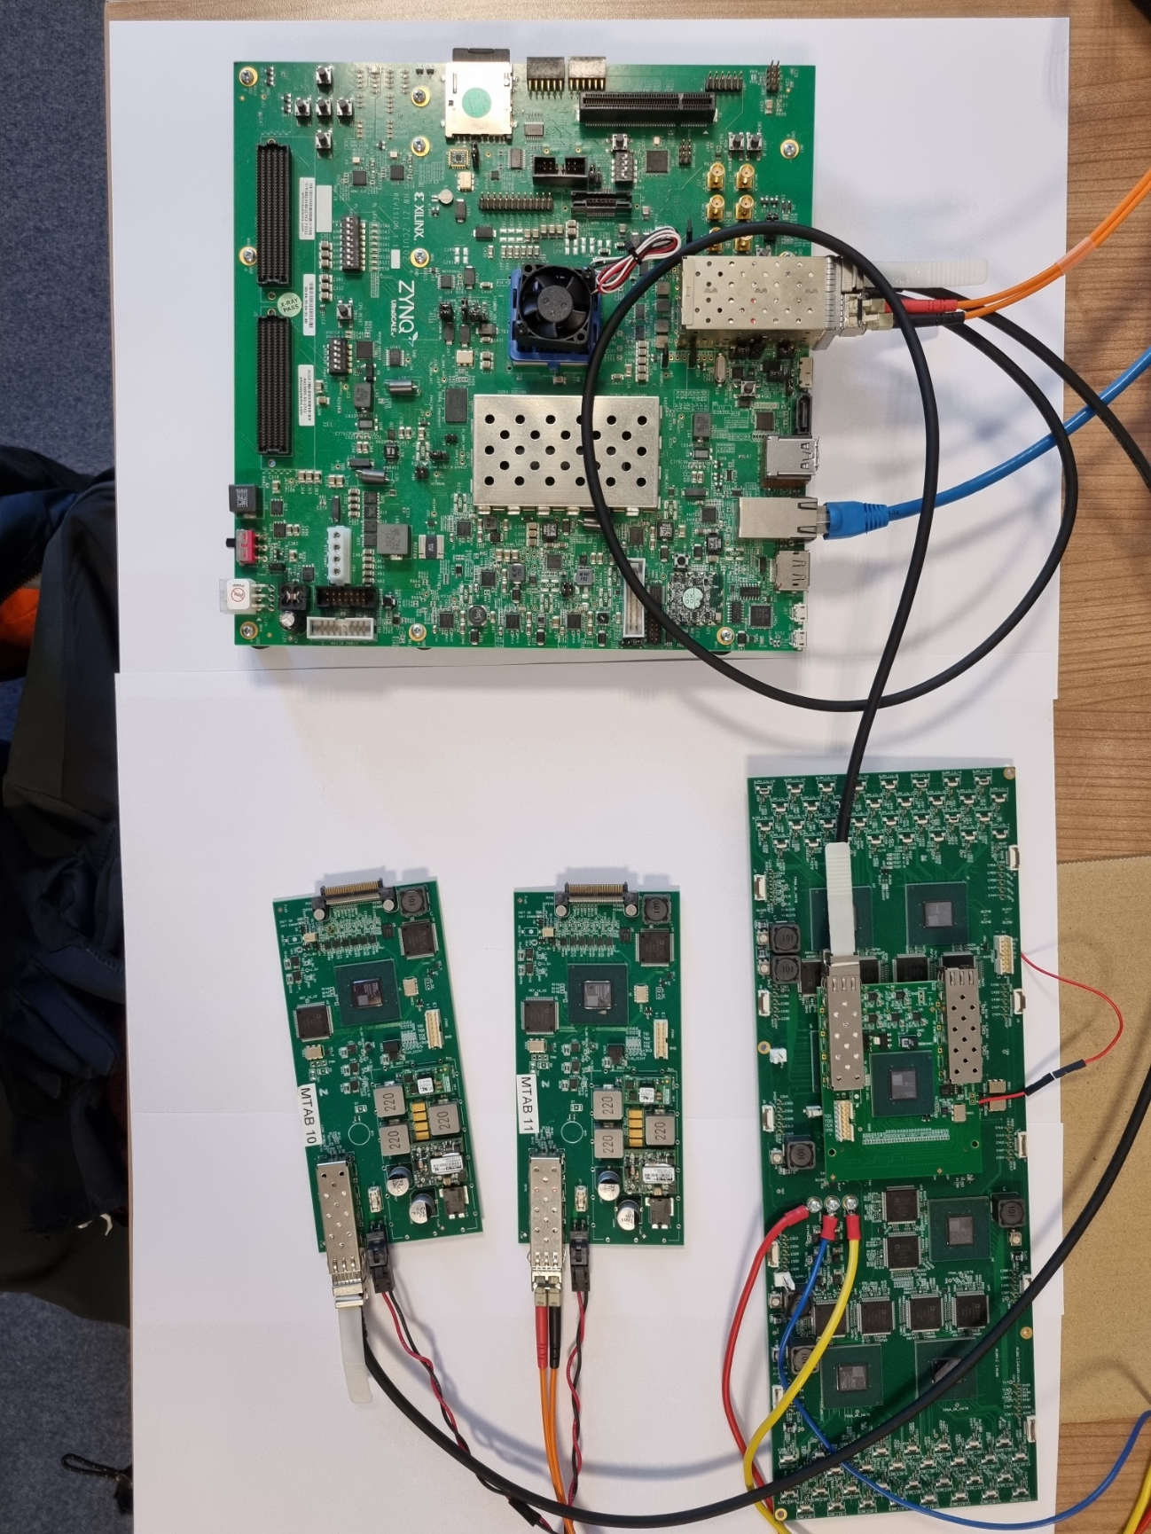
The second generation
Data collector
Sync transceiver
Sync receiver
Link status monitor
Function within the system is defined by:
  Hardware capabilities
  Collection of logic function blocks
    Sync. Transmitter/Receiver for GTP, GTX, GTH, GTY
    Sync. decoders
    Data collectors, forwarders
    Time-Digit Converters
    Control/monitoring
Flexible setup construction
  Small test setups: one master and one endpoint
  Full-scale modular J-PET
    One master (ZCU102)
    4x Data Concentrators (VCU108)
    48x Endpoints (MTAB, FTAB)
Complemented with an easy to use
Python software package
Sync decoder
CCB IFJ PAN, Kraków 2021
Lab setup, Kraków 2023
Hospital Banacha, Warsaw 2022

Slide 10
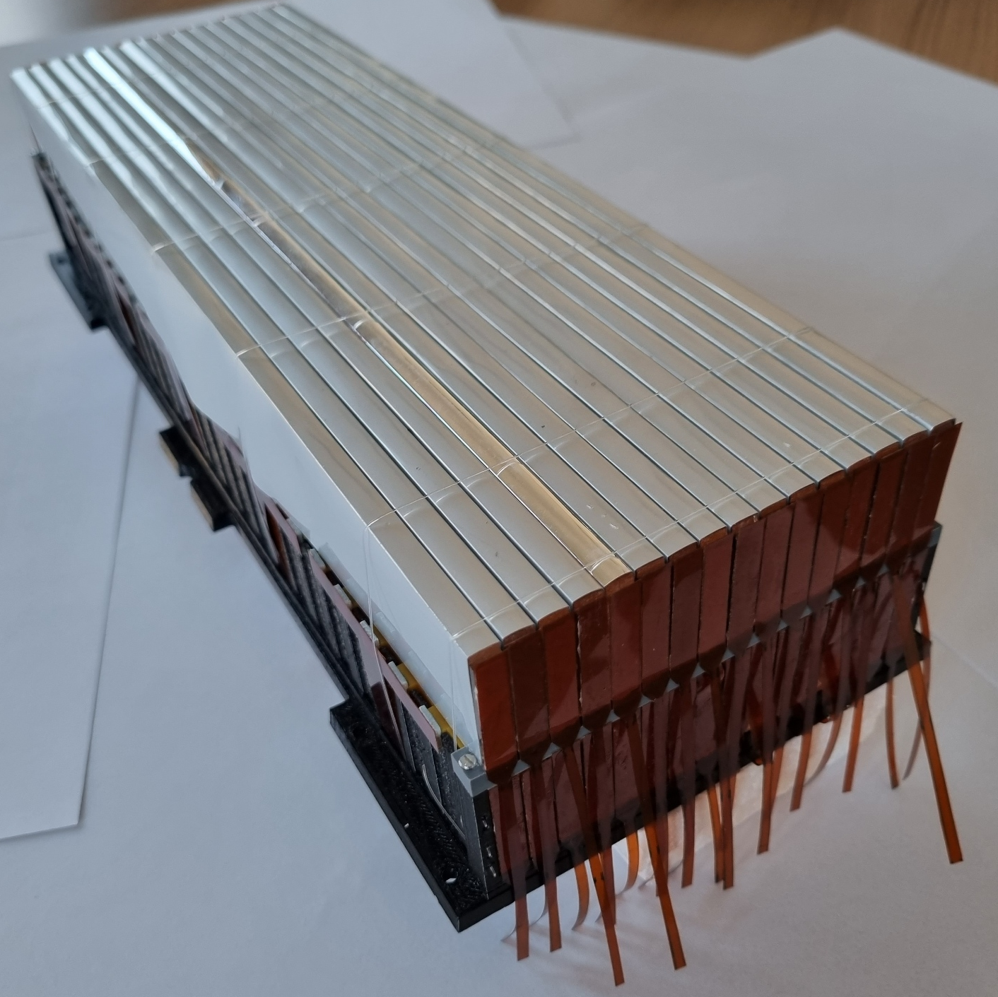
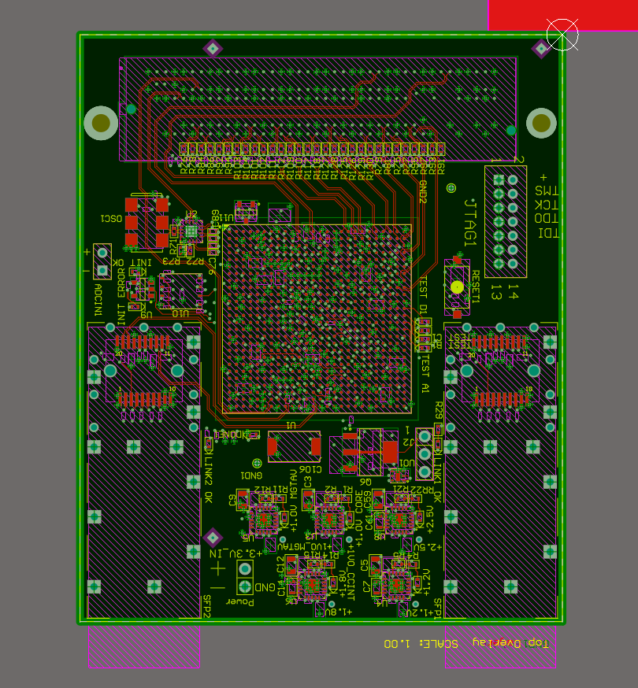
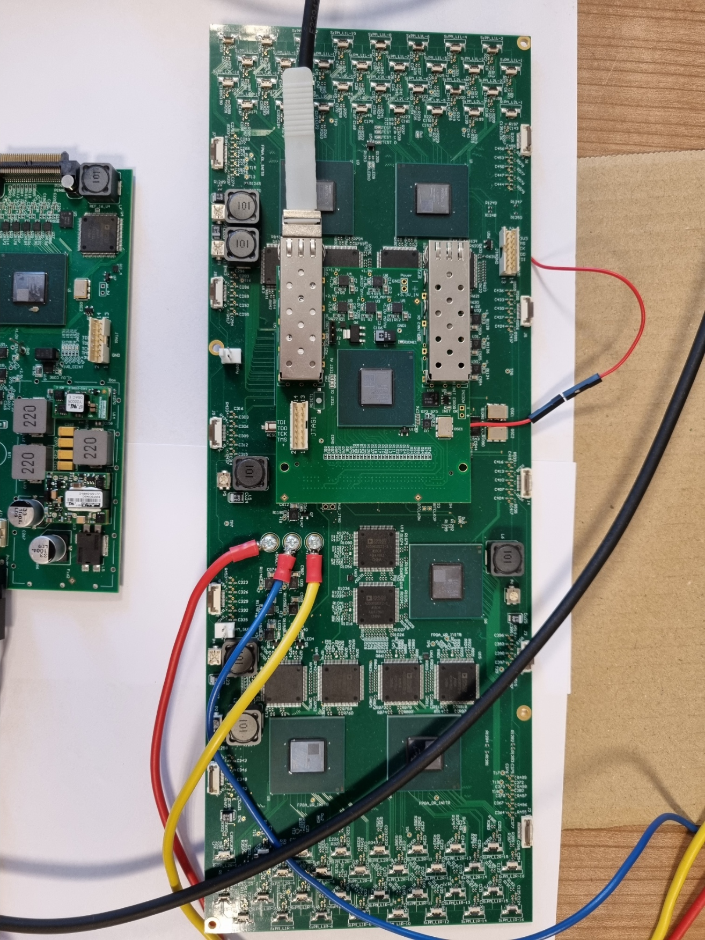
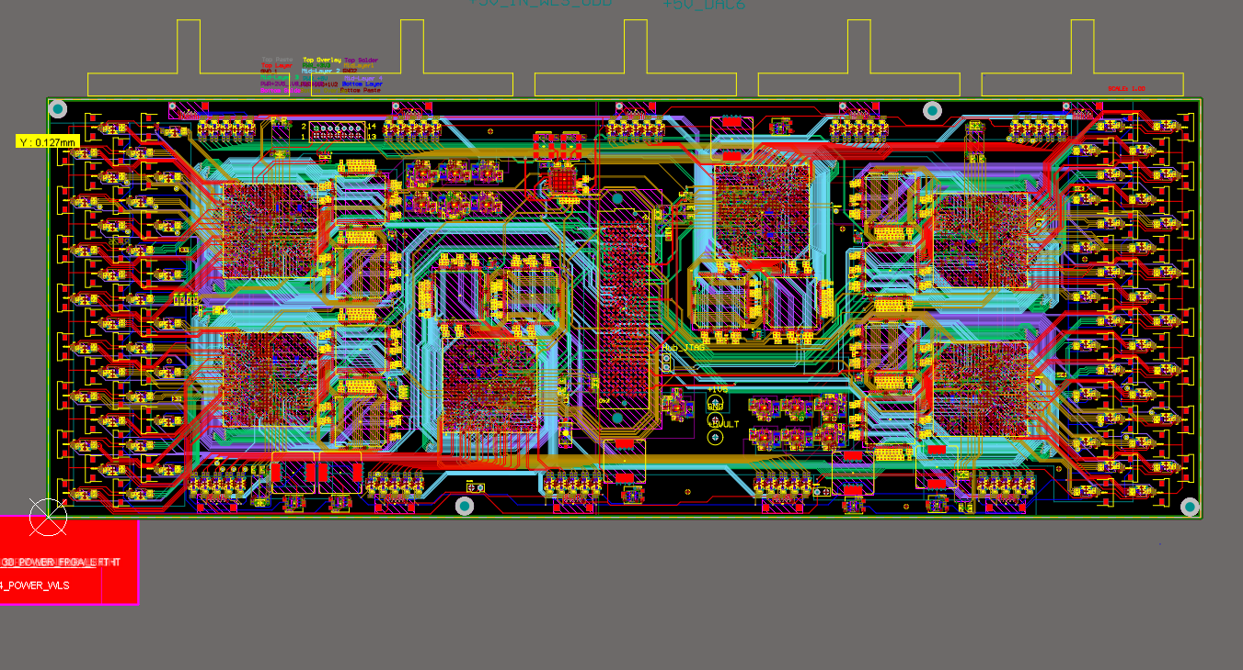
Total-Body DAQ module
Design and development – M. Kajetanowicz
Compact with high channel density
  Single board for an entire module
  TDC section:
    356x TDC channels on 6x Artix200 FPGA (Endpoints)
    10x DACs for threshold setting and SiPM tuning
    Analog signal amplifiers
  HUB section:
    1x Artix200 FPGA as Concentrator
    2x general purpose optical links
  Data from the entire module in a single FPGA
    Complex online pre-processing capability
Design and development – M. Kajetanowicz

Slide 11
Summary The DAQ group:
Over 10 years of electronics, firmware and software design, development and implementation
A versatile and flexible DAQ system for recent and future J-PET projects
  Based on stable and verified components (HW, standards, protocols)
  Functional backbone (time sync, data collection, control/monitoring)
  Precise time measurement in distributed setups
  Exchangeable Endpoints for future upgrades or adaptations
  Expandable with data pre-processing logic cores
Actual members:
  Marcin Kajetanowicz
  Piotr Kapusta
  Wojciech Migdał
  Szymon Niedźwiecki
  Grzegorz Korcyl
Former members:
  Paweł Strzempek
  Tomasz Bednarski
  Marek Pałka
  Karol Farbaniec
  Maciej Bakalarek

