Slide 1




The start of the Belle II experiment at the SuperKEKB e⁺e⁻ factory
Bostjan Golob
University of Ljubljana/
Jozef Stefan Institute
also with
Introduction
B-Factories
Belle II
Luminosity
Performance
Measurements
University
of Ljubljana
“Jozef Stefan”
Institute
3rd Jagiellonian Symposium on
Fundamental and Applied
Subatomic Physics
Krakow
23 - 28 June 2019

Slide 2
Introduction
Setting the scene
electromagnetic
weak
strong
gravitational
The Standard Model (SM) of basic interactions in Nature -
- one of the experimentally best verified physics theories...
...at the current level of experimental precision and energies reached
Several severe shortcomings, for example
degree of CP asymmetry between particles and anti-particles;
responsible for matter dominated Universe,
tested in subatomic world;
10 orders of magnitude too low to explain the matter / anti-matter
asymmetry of Universe
search for physics phenomena beyond SM,
new particles, and new interactions often addressed as
New Physics (NP)

Slide 3
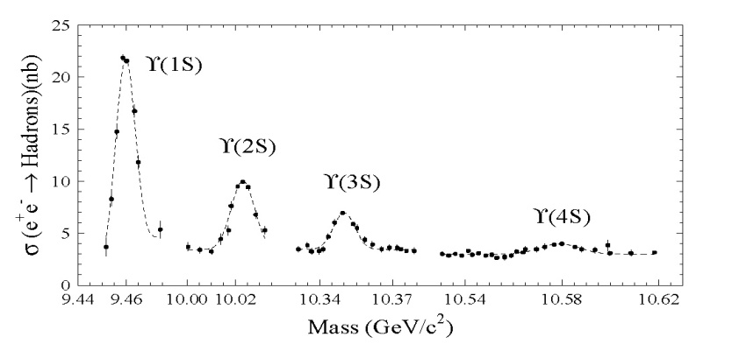
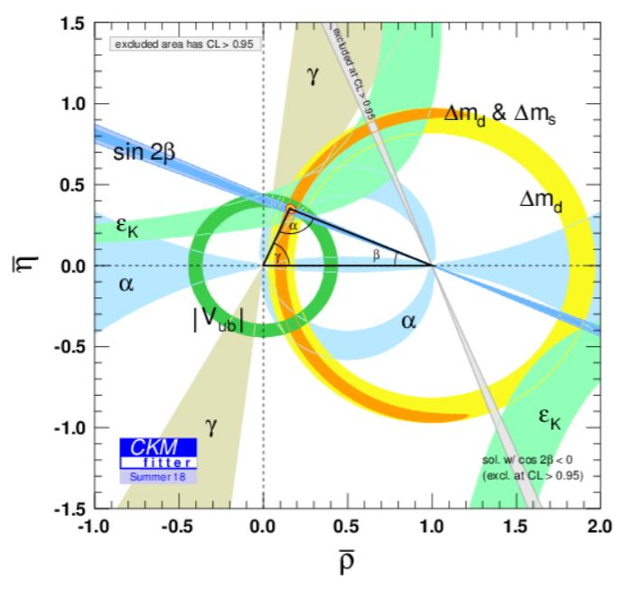
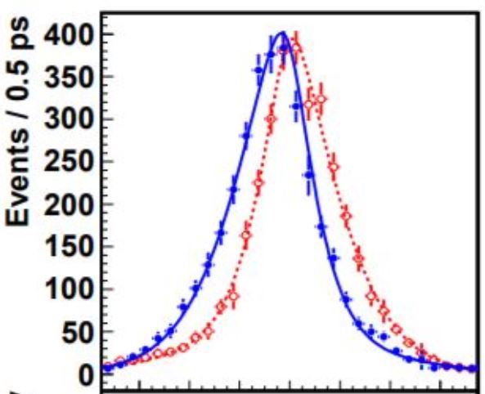

B Factories
TEST of Kobayashi-Maskawa
Mechanism
B-Factories, e⁺e⁻:
BaBar (SLAC)/Belle (KEK)1999 – 2010
L_{max}=2.1 ⋅10³⁴ cm⁻²s⁻¹
Belle: N(BB) ≈770 ⋅10⁶
sin2φ₁ from B →J/ψ K_{S}
B⁰→
J/ψK_{S}
B⁰→
J/ψK_{S}
√s=10.58 GeV
e⁻
e⁺
2008: M. Kobayashi, T. Maskawa
Υ(4S)
n.b.: only to Δm_{d}
32 measurements
contribute!
B
-6 -4 -2 0 2 4 6
Δt [ps]
Υ(4S)
Δz ~ cβγτ_{B}
~ 200μm
B
I. Adachi et al. (Belle Coll.), Phys. Rev. Lett. 108, 171802 (2012)
p(e⁻)=7 GeV p(e⁺)=4 GeV
βγ≠0

Slide 4
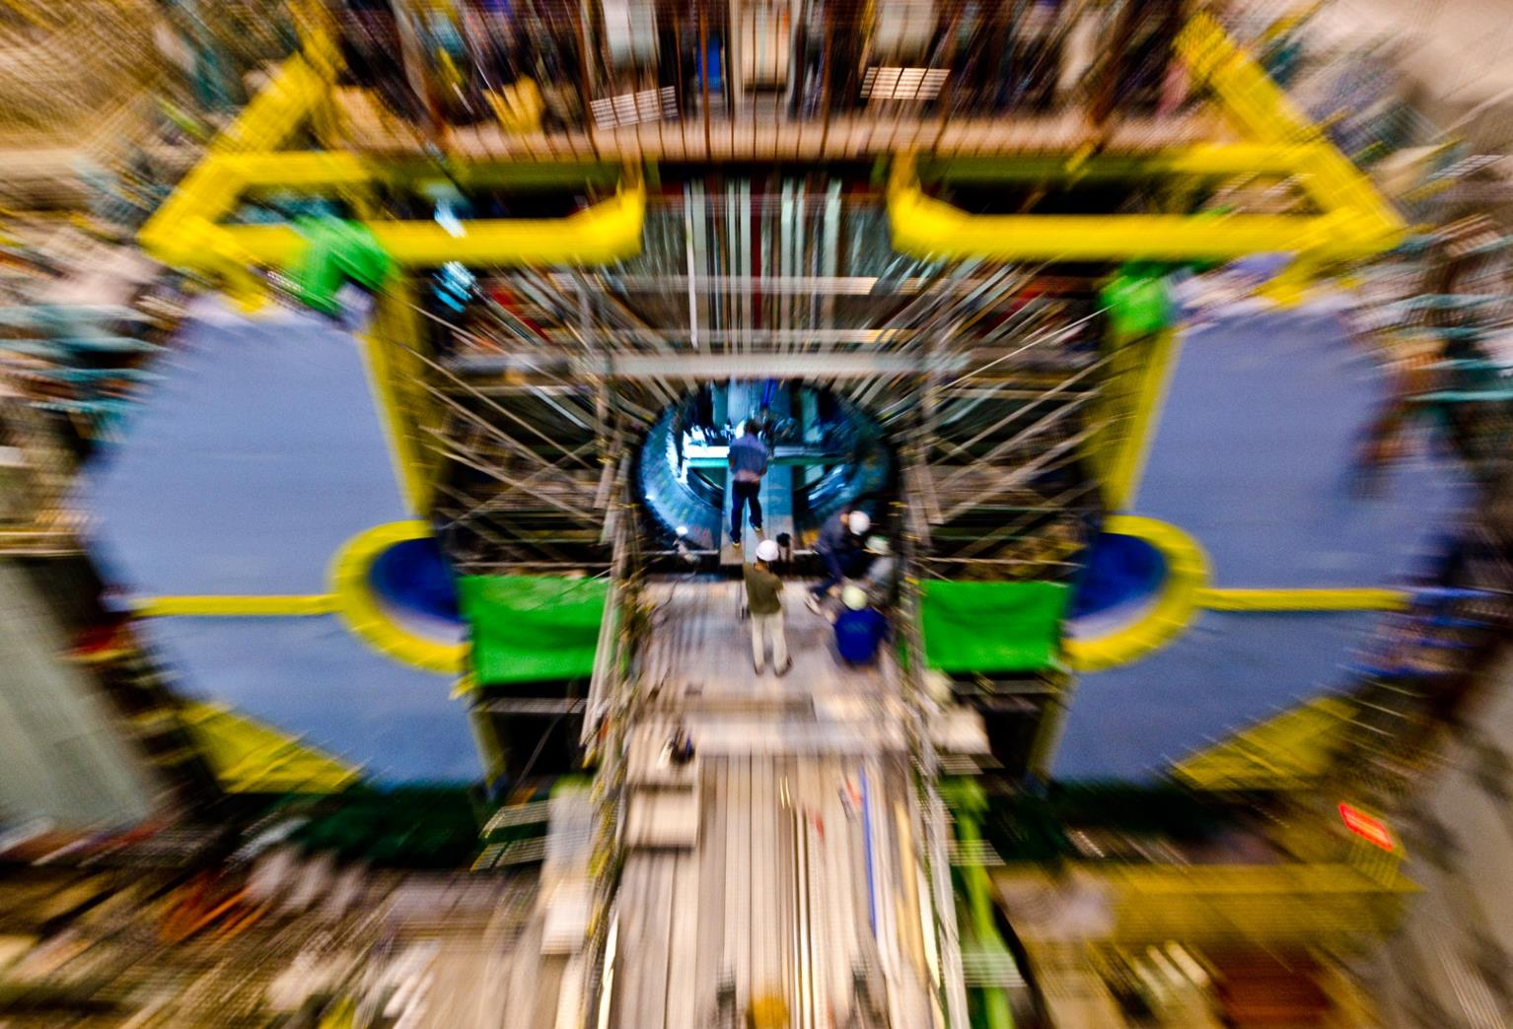
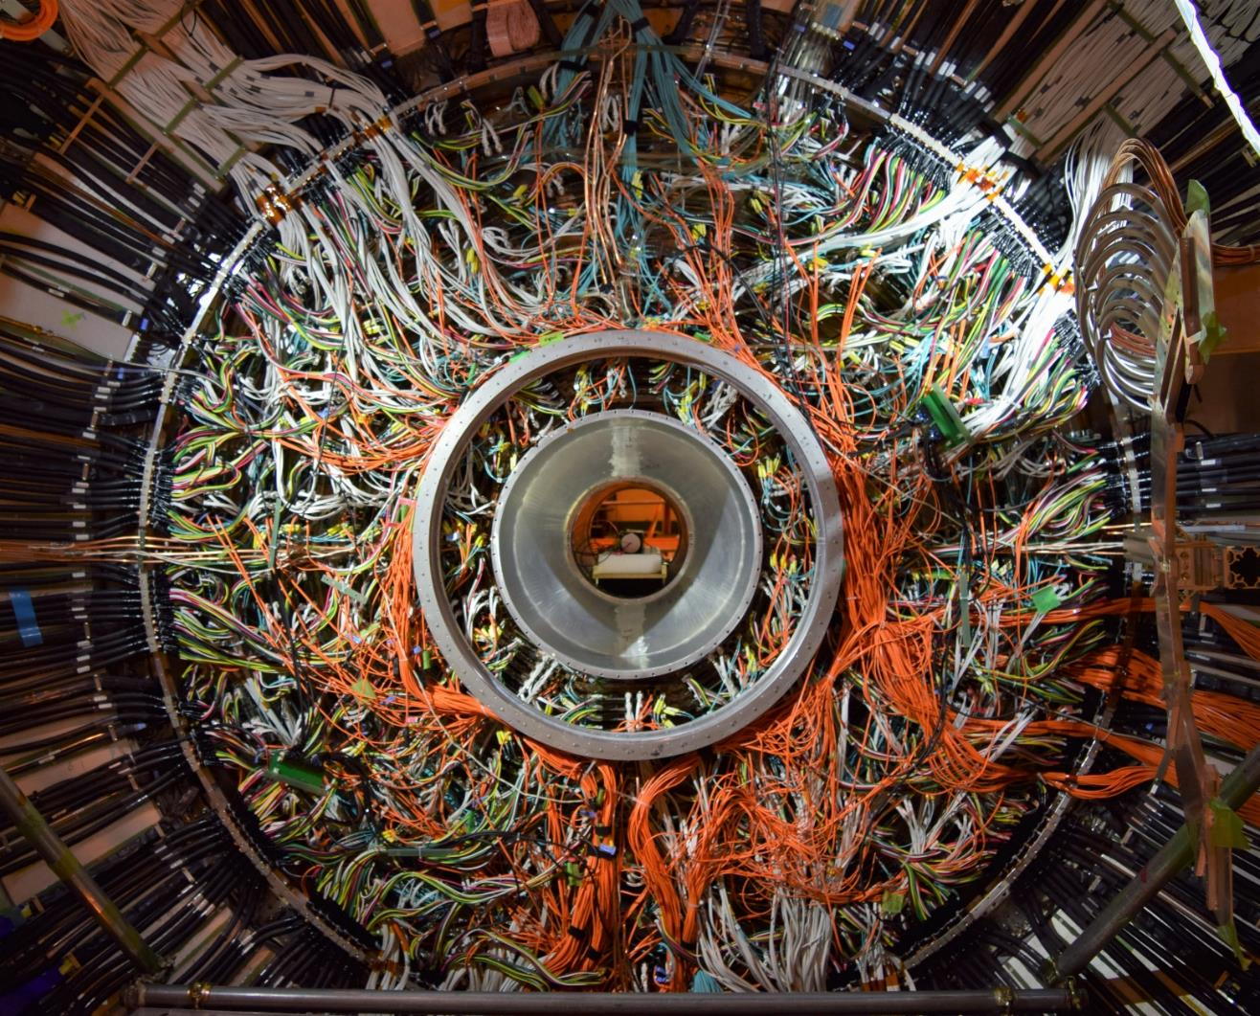
Belle II
Super B-Factory:
SuperKEKB & Belle II (KEK) 2018 →
Access B decays with ε_{rec} Br >~10⁻⁹
(e.g.
ε_{rec} Br(B →η‘K_{S}) ~ 1 ⋅10⁻⁶
ε_{rec} Br(B →X_{d}γ) ~ 1 ⋅10⁻⁷
ε_{rec} Br(B →X_{u}τν) ~ 4 ⋅10⁻⁸
ε_{rec} Br(B →K⁽*⁾νν) ~ 7 ⋅10⁻⁹
)
L=2 ⋅10³⁴ cm⁻²s⁻¹
→
L=8 ⋅10³⁵ cm⁻²s⁻¹
N(BB) ≈ 50 ⋅ N _{Belle}(BB)
explore possible deviatons from
SM prediction
appearing in some rare decays

Slide 5
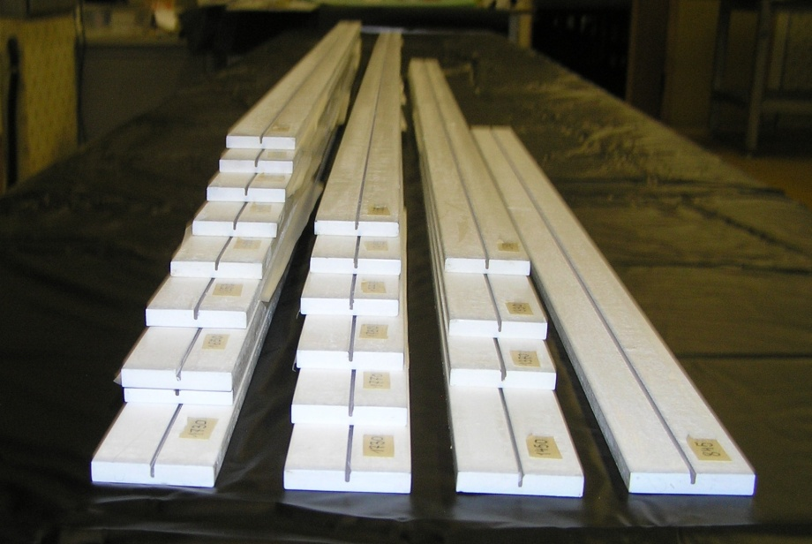
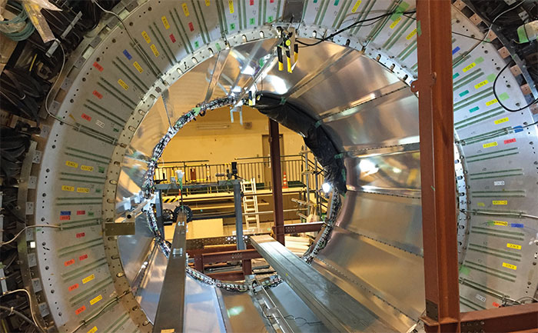
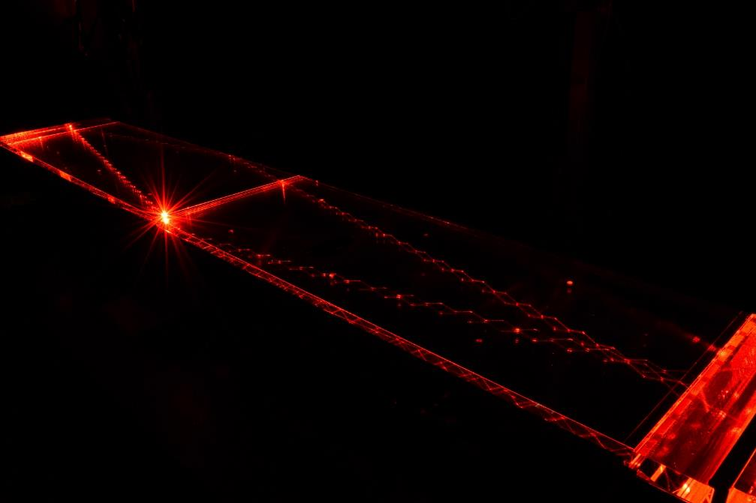
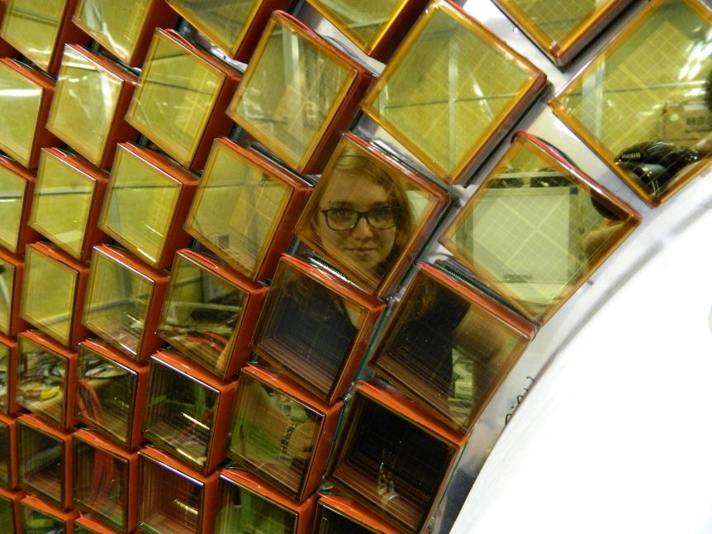
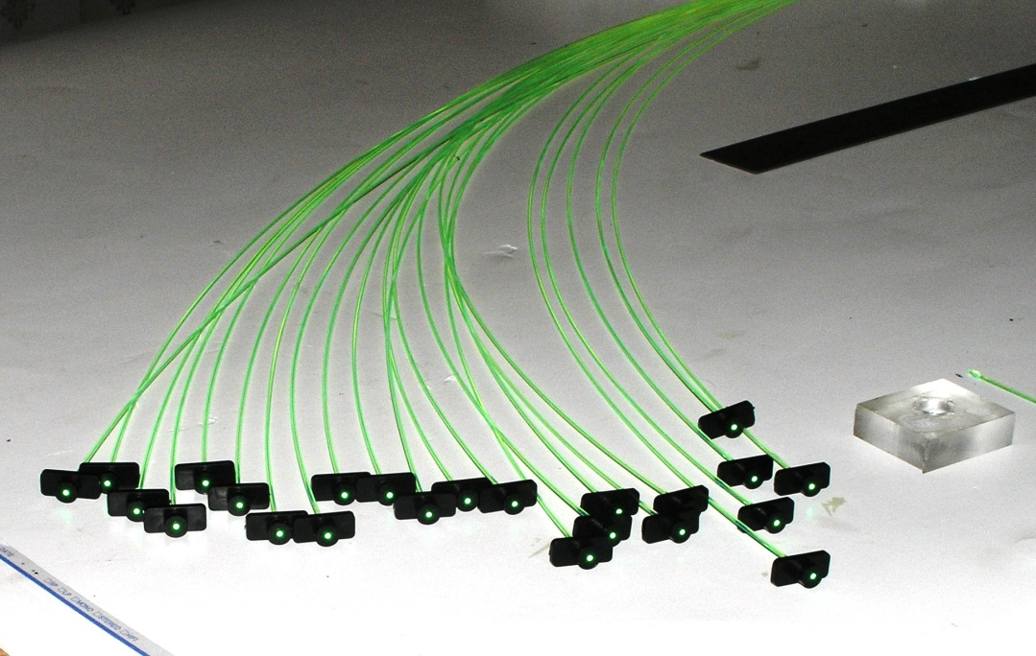
Belle II
Detector Belle II
KL and muon detector:
Resistive Plate Counter (barrel outer layers)
Scintillator + WLSF + MPPC (end-caps , inner 2 barrel layers)
EM Calorimeter:
CsI(Tl), waveform sampling (barrel)
Pure CsI + waveform sampling (end-caps)
Particle Identification
Time-of-Propagation counter (barrel)
Prox. focusing Aerogel RICH (fwd)
electrons (7GeV)
Beryllium beam pipe
2cm diameter
Vertex Detector
2 layers DEPFET + 4 layers DSSD
positrons (4GeV)
Central Drift Chamber
He(50%):C2H6(50%), small cells, long lever arm, fast electronics

Slide 6
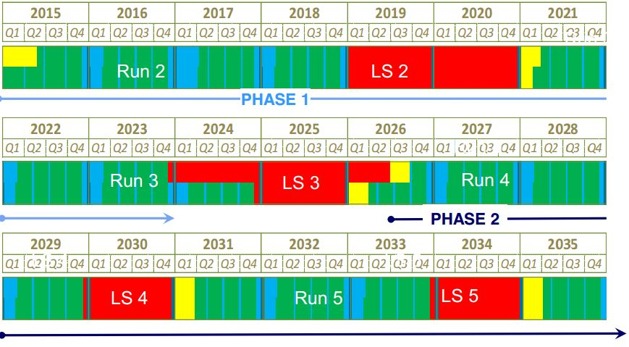
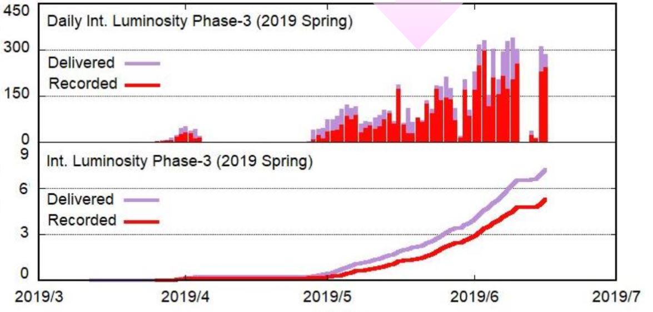
Luminosity
Luminosity plans
end
^{07/19}
start
^{03/19}
start
^{10/19}
end ?
^{07/19}
Phase 1
Phase 2
Phase 3 →
Phase 1:
w/o QCS
w/o Belle 2
Phase 2:
w/ QCS
w/ Belle 2
(no VXD)
Phase 3:
full Belle 2
daily ∫L dt [pb⁻¹]
QCS, Belle 2
VXD
~ 50 ab⁻¹
LHCb LS2
∫L dt [fb⁻¹]
LHCb LS3
HL LHC
current issues:
fire (4/2019, not related to SuperKEKB,~2 weeks recovery)
injection bkg (reduced with machine and collimators tuning)
storage backgrounds (mainly beam-gas, vacuum scrubbing, additional pumps)
Plan:
reach KEKB luminosity in June 2020
> 100 fb⁻¹ by end of 2020 spring run

Slide 7
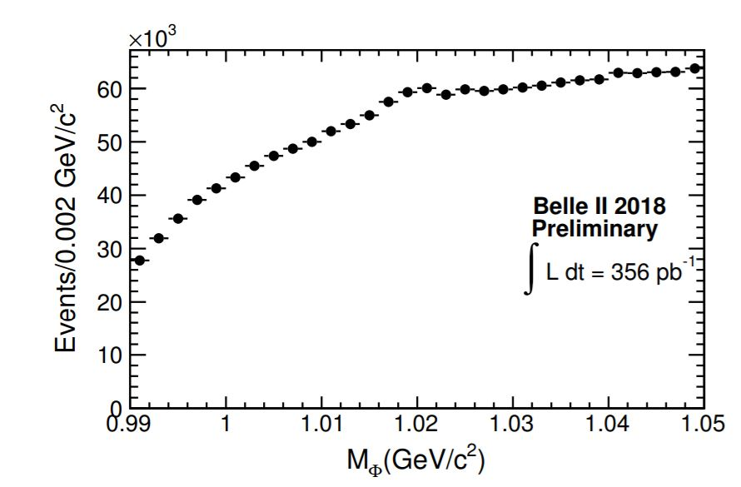
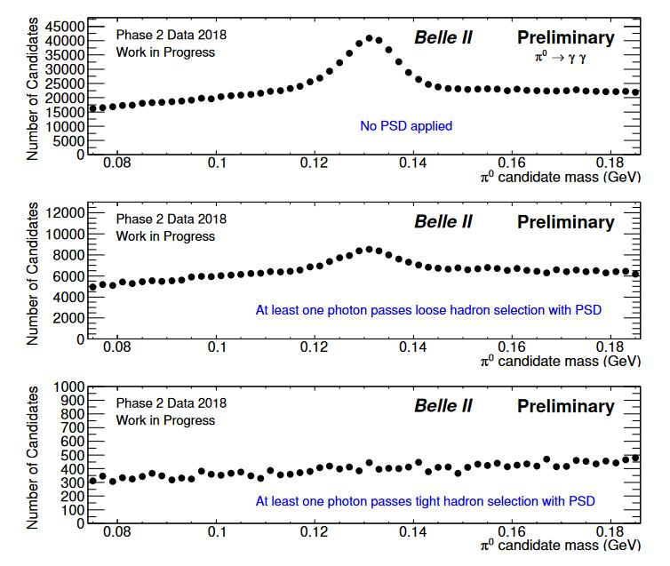
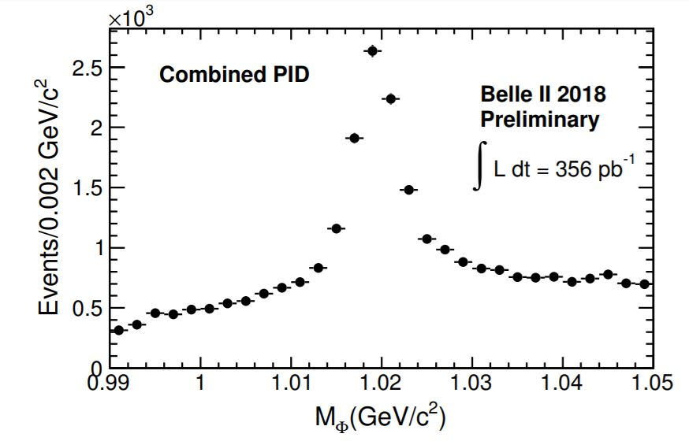
Performance
Physics performance
A. Sangal et all. (Belle II Coll.), BELLE2-NOTE-PL-2018-035
S. Longo, J.M. Roney et all. (Belle II Coll.), BELLE2-NOTE-PL-2018-027
π⁰ → γγ
φ →K⁺K⁻
no requirement on γ
at least one γ passing loose PSD
at least one γ passing tight PSD
hadron veto in ECL using
Pulse Shape Discrimination
combined pid
(TOP, CDC, ARICH)

Slide 8
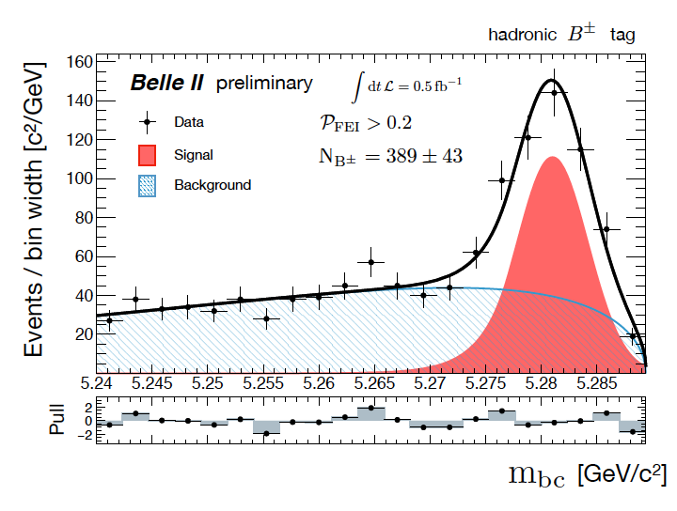
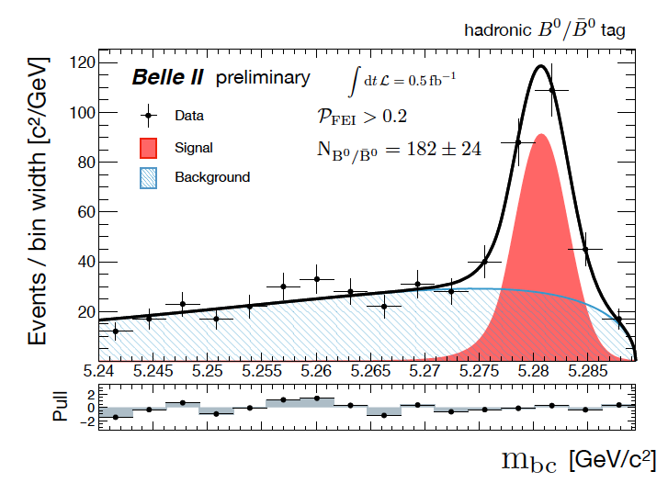
Performance
Full Event Interpretation
only a single BB pair produced @ Υ(4S)
FEI performed using MVA
ε_{tag} ~ 0.2%-0.3% @ P~50%-60%
recontruction of final
states with undetected particles
B_{tag}
detected
hadrons
e⁻
e⁺
ν
B_{sig}
K⁻
D⁽*⁾
l
π ⁺
B⁺
B⁰
W. Sutcliffe, F. Bernlochner, B2NOTE-2018-031-1

Slide 9
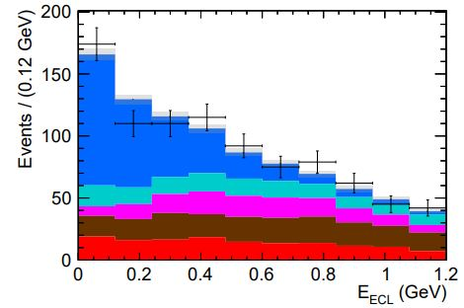
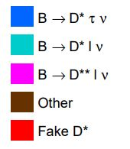
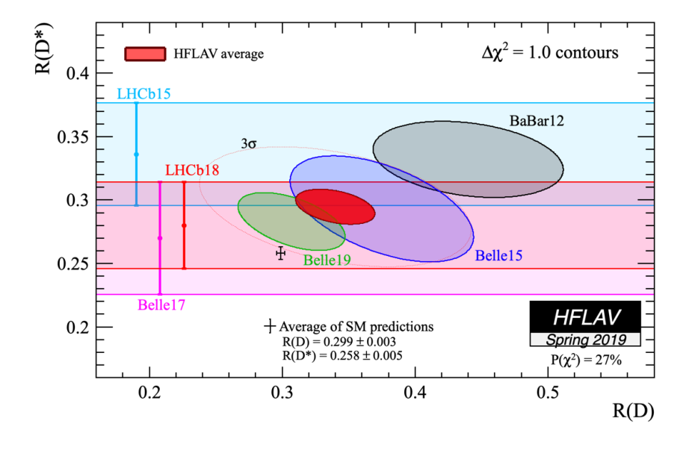
Measurements
Lepton Flavor Universality
B →D⁽*⁾ l ν
u
B⁻
D⁽*⁾⁰
τ ⁻, l = e⁻, μ⁻
b
c
D*⁺ l ⁻
N_{sig}=376 ±36
W ⁻
ν
R(D*)_{SM} = 0.252 ±0.003
S.Fajfer et al.,
Phys.Rev.D85(2012) 094025
R(D)_{SM}= 0.300 ±0.008
H. Na et al.,
Phys.Rev.D 92, 054410 (2015)
A. Abdesselam et al. (Belle Coll.),
arXiv:1904.08794
R(D)= 0.307 ±0.037 ±0.016
R(D*) = 0.283 ±0.018 ±0.014
Belle II
(50 ab⁻¹)
SM
WA
E. Kou, P. Urquijo eds., The Belle II Physics Book
to be published in Prog. Theor. Exp. Phys.

Slide 10
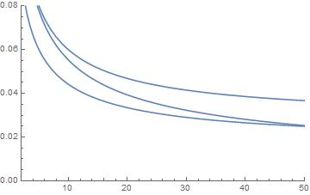
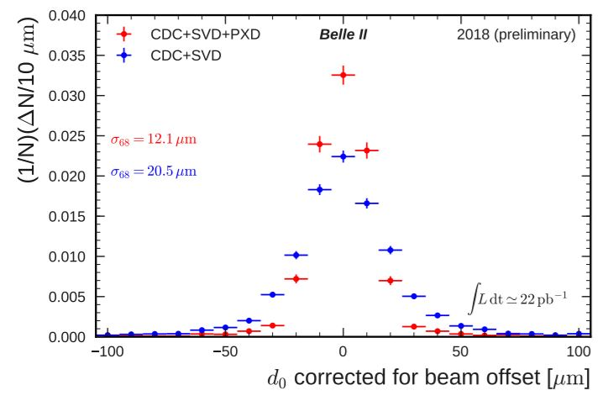
Measurements
CPV in b →sqq
some uncertainties cancel in ΔS
vtx reconstr. improved with better tracking;
ε_{rec} Br(B →η‘K_{S}) ~ 1 ⋅10⁻⁶
41 new phases in MSSM;
b →sqq B → J/ψ K_{s}
σ(sin2φ₁^{eff})
E. Kou, P. Urquijo eds., The Belle II Physics Book
to be published in Prog. Theor. Exp. Phys.
ΔS=sin2φ₁^{eff} - sin2φ₁
⊗
σ~12 μm
ω(π⁺π⁻π⁰)K_{s}
φ(K⁺K⁻)K_{s}
Belle: σ~30 μm
η‘(γγππ)K_{s}
⊗
⊗
σ(sin2φ₁) from B → J/ψ K_{s}
⊗ current th. uncertainty
∫L dt [ab⁻¹]
N. Braun et all. (Belle II Coll.), BELLE2-NOTE-PH-2018-040
M. Beneke, PLB620,143 (2005)

Slide 11
Summary
Belle & BaBar: confirmed CKM mechanism
SuperKEKB: start of data taking in 2018
luminosity gradually increasing
Belle II: ~900 members (~45% from Europe), 26 countries
detector operating as expected
search for NP
Lepton Flavor Violation
Lepton Flavor Universality
new sources of CPV
light dark matter
:
Physics (far) beyond current
theoretical understanding (SM)
Severe constraints on possible
beyond SM theories

Slide 12
Suplementary Material

Slide 13
Standard Model
Setting the scene
The Standard Model (SM) of basic interactions in Nature -
- one of the experimentally best verified physics theories...
...at the current level of experimental precision and energies reached
Several severe shortcomings
for example
(too) large number of free (to be measured, unexplained) parameters
degree of CP asymmetry between particles and anti-particles,
10 orders of magnitude too low to explain the matter / anti-matter
asymmetry of Universe
Dark Matter (25% of Universe) completely unknown
search for physics phenomena beyond SM,
new particles, and new interactions often addressed as
New Physics (NP)

Slide 14

CKM
TEST of Cabibbo-Kobayashi-Maskawa
V_{CKM} must be unitary ⇒
unitary triangle
various B meson processes ⇒
sides & angles of unitary triangle
W ⁻
q_{d}
V_{quqd}
q_{u}
u
B⁻
D⁽*⁾⁰
b
c
l ⁻, q_{d}
V_{cb}
W ⁻
V_{quqd}
ν, q_{u}
n.b.: only to Δm_{d}
32 measurements
contribute!

Slide 15
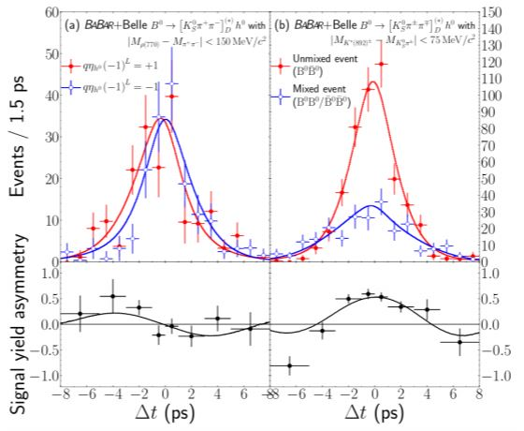
CKM
TEST of Cabibbo-Kobayashi-Maskawa
joint analysis of Belle & BaBar data
1.24 ⋅10⁹ BB pairs
B⁰ → D⁰(K_{S}π⁺π ⁻) h⁰
h⁰=π⁰,η,ω
enables determination of cos2β
(not only sin2β as in B⁰ → J/ψK_{S} )
m_{π+π-}~
ρ(770)
m_{Ksπ}~
K*(892)
cos2β =0.91± 0.22 ± 0.09 ± 0.07 (model)
B_{tag}=B⁰
B_{tag}=B⁰
B⁰ → J/ψK_{S}
(b → ccs)
Belle: σ_{S}~0.03
Belle II: σ_{S} ~ 0.004

Slide 16
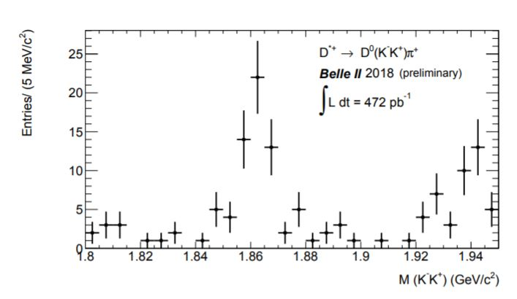
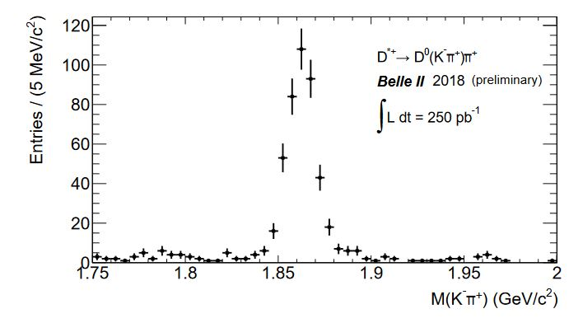
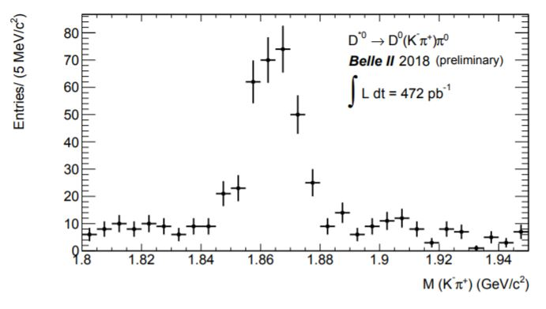
Performance
Physics performance
A. Sangal et al., BELLE2-NOTE-PL-2018-031
V. Bhardwaj et al., BELLE2-NOTE-PL-2018-012
D*⁺ → D⁰(K⁻K⁺)π⁺
D*⁺ → D⁰(K⁻π⁺)π⁺
V. Bhardwaj et al., BELLE2-NOTE-PL-2018-022
Combined PID (TOP, ARICH, CDC)
D*⁰ → D⁰(K⁻π⁺)π⁰

Slide 17
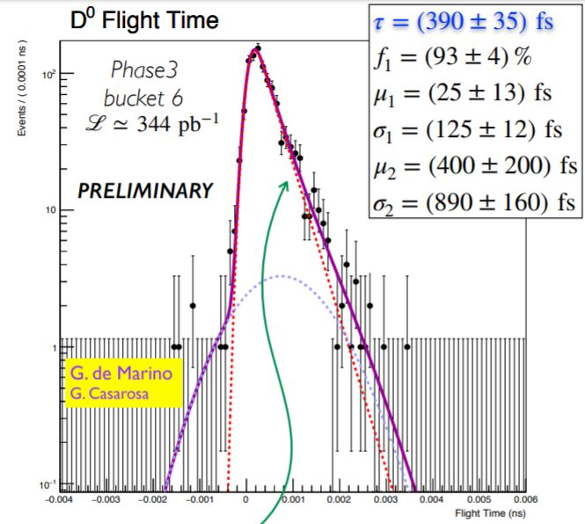
Performance
Physics performance
testing analysis tools from low
to high level
vertexing
(SVD, PXD)
unapproved

Slide 18
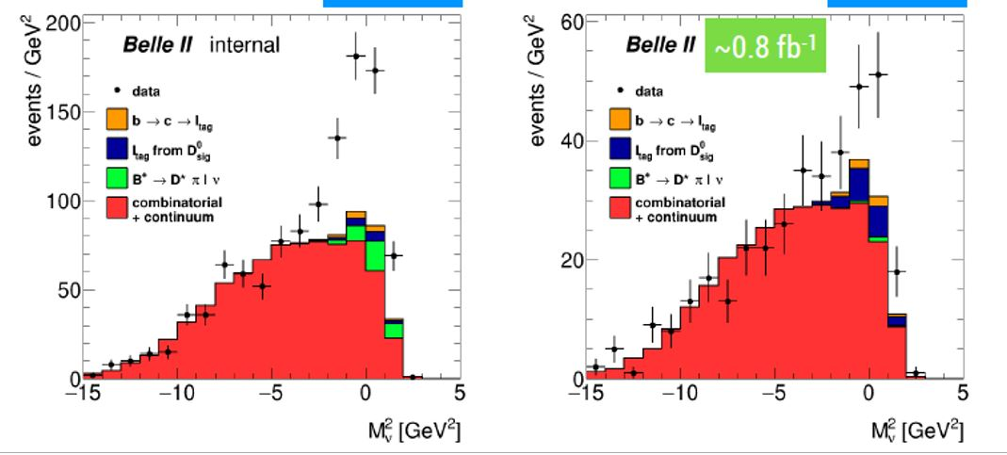
Performance
Physics performance
testing analysis tools from low
to high level
V. Bhardwaj et al., BELLE2-NOTE-PL-2018-012
Combined PID
(TOP, ARICH, CDC)
D*⁺ → D⁰(K⁻π⁺)π⁺
A. Gaz et al., BELLE2-NOTE-PH-2019-004
B →D* l ν
D* partial reconstruction
N_{sig}=
282 ± 25
unapproved
N_{sig}=
51 ± 15
l
B
ν
B
D*
π ⁺
opposite sign leptons
(no mixing)
Leptons
(ECL, KLM)
l
same sign leptons
(mixing)

Slide 19
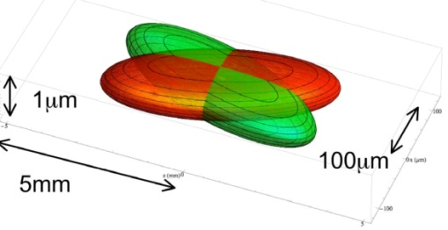
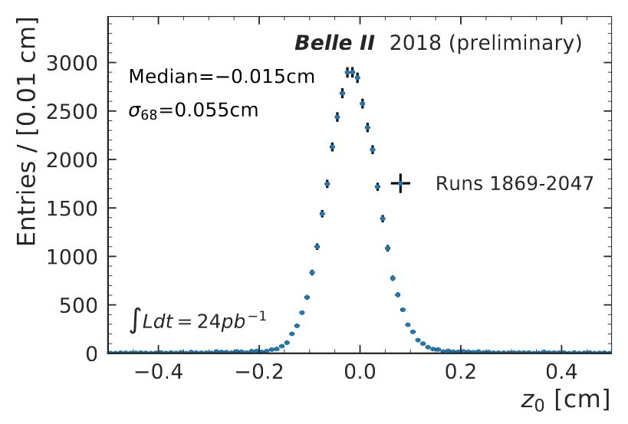
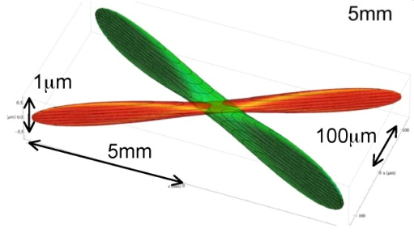
Accelerator
Phase 2: accelerator and detector comissioning, physics collissions
validation of Nano beam scheme
March – July 2018
KEKB:
σ_{x}~100μm,σ_{y}~2μm
Belle: σ ~ 1 cm
SuperKEKB:
z₀ of single tracks
from primary vtx
N. Braun et al., BELLE2-NOTE-PL-2018-008
σ_{x}~10μm,σ_{y}~60nm

Slide 20
LFU
TESTS of LFU
in B decays;
H_{L,T} : form factors parametrizing
unknown QCD effects
cancelation of some theoretical and syst. uncertainties
u
B⁻
D⁽*⁾⁰
b
c
W ⁻
l = e⁻,
μ⁻,τ ⁻
ν
R(D*)_{SM} = 0.252 ±0.003
S.Fajfer et al., Phys.Rev.D85(2012) 094025
R(D)_{SM}= 0.300 ±0.008
H. Na et al., Phys.Rev.D 92, 054410 (2015)

Slide 21
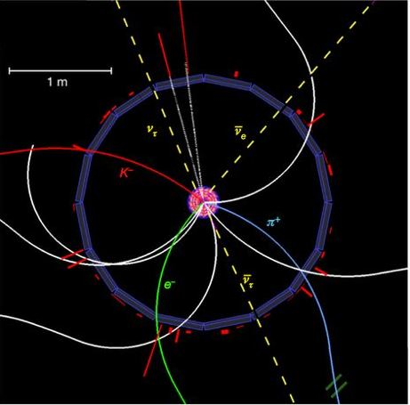
LFU
TESTS of LFU
Br(B →D l ν) ~ 2%
problem?
B_{tag} reconstruction
e⁺e⁻ → Υ(4S) → B_{tag} B_{sig}
h from B_{sig}→hX ;
no extra energy in calorim.;
signal E_{ECL}~0;
B_{tag} reconstruction
NeuroBayes, neural network
ε_{rec} ~0,5%
B⁻
D⁽*⁾⁰
neutrinos!
(B →D τ (→ eν_{e}ν_{τ} )ν_{τ} )
l =e⁻,μ⁻,τ ⁻
e⁺
ν
ν
B_{tag} B_{sig}
e⁻

Slide 22
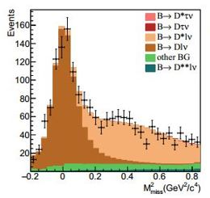
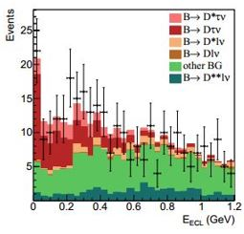

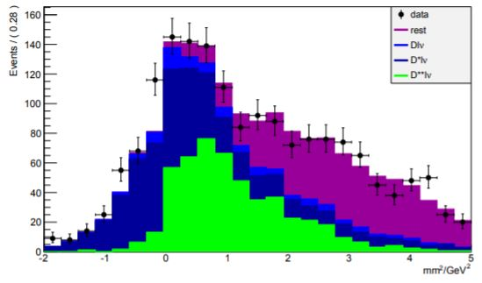
LFU
example of measurement
B_{tag}
detected
hadrons
Belle, PRD92, 072014 (2015), 700 fb⁻¹
e⁻
e⁺
ν
B_{sig}
K⁻
D⁽*⁾
l
π ⁺
single ν ⇒ M_{miss}²=M_{ν}²≈ 0
N_{sig} ~ 3800 D* l ν
N_{sig} ~ 3150 D l ν
N_{sig}=503 D* τ ν
N_{sig}=320 D τ ν
systematic checks:
bkg‘s from B → D** (→ D* π ) l ν ;
select D* π l ν decays
checks of distributions
D** l ν
R(D)= 0.375 ±0.064 ±0.026
R(D*) = 0.293 ±0.038 ±0.015

Slide 23
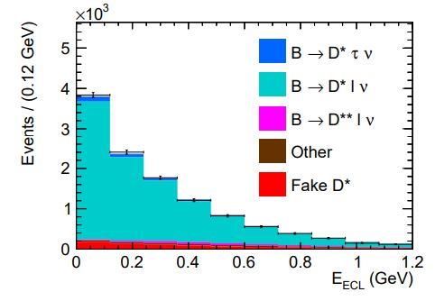

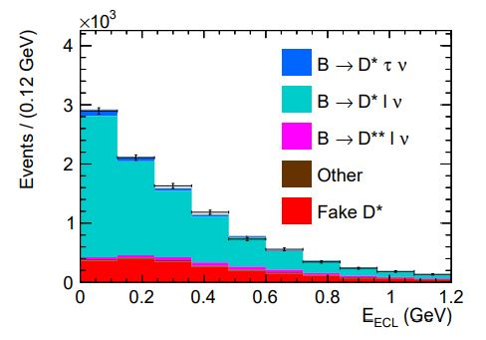
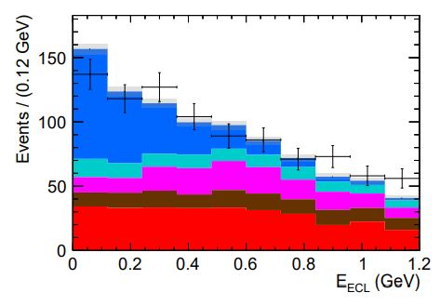
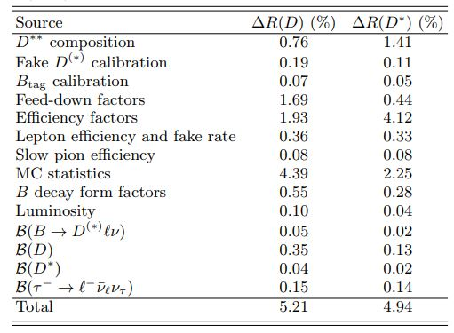
LFU
Belle Semileptonic tagging
D*⁺ l →
D*⁰ l →
A. Abdesselam et al. (Belle Coll.),
arXiv:1904.08794
full NN range signal NN range
NN: signal/normalization
E_{ECL}: signal+normaliz. / bkg.
fit: D⁽*⁾τν, D⁽*⁾ l ν, feed down from D⁽*⁾ l (τ)ν,
D** l (τ)ν, other bkg., shape from MC

Slide 24
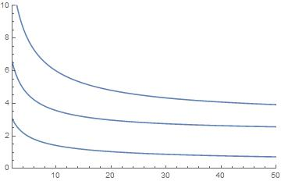
LFU
Lepton Flavor Universality
B →D⁽*⁾ l ν
u
B⁻
D⁽*⁾⁰
τ ⁻, l = e⁻, μ⁻
b
c
D*⁺ l ⁻
N_{sig}=376 ±36
W ⁻
ν
R(D*)_{SM} = 0.252 ±0.003
S.Fajfer et al.,
Phys.Rev.D85(2012) 094025
R(D)_{SM}= 0.300 ±0.008
H. Na et al.,
Phys.Rev.D 92, 054410 (2015)
A. Abdesselam et al. (Belle Coll.),
arXiv:1904.08794
R(D)= 0.307 ±0.037 ±0.016
R(D*) = 0.283 ±0.018 ±0.014
6.0%
σ(R_{D})/R_{D} [%]
3.6%
σ(R_{D*})/R_{D*} [%]
0.14
σ(P_{τ}) [x10]
∫L dt
[ab⁻¹]
E. Kou, P. Urquijo eds., The Belle II Physics Book
to be published in Prog. Theor. Exp. Phys.

Slide 25
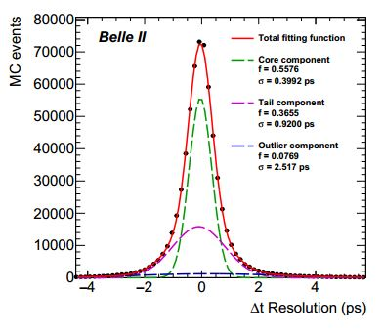
CPV in b →sqq
CPV in b →sqq
some uncertainties cancel in ΔS
(vtx reconstr., flavor tag, likelihood fit) ;
better K_{S} eff. with vtx hits - larger vtx radius,
30%);
vtx reconstr. improved with better tracking;
41 new phases in MSSM;
b →sqq B → J/ψ K_{s}
σ(sin2φ₁^{eff})
E. Kou, P. Urquijo eds., The Belle II Physics Book
to be published in Prog. Theor. Exp. Phys.
ΔS=sin2φ₁^{eff} - sin2φ₁
⊗
vtx resol.
B→φ(K⁺K⁻)K_{s}
2.1 ps
iptube, K_{s}
→ 0.75 ps
ω(π⁺π⁻π⁰)K_{s}
φ(K⁺K⁻)K_{s}
η‘(γγππ)K_{s}
(B→η‘(γγππ)K_{s}
B→ω(π⁺π⁻π⁰)K_{s}
→ 1.25 ps)
⊗
⊗
σ(sin2φ₁) from B → J/ψ K_{s}
⊗ current th. uncertainty
∫L dt [ab⁻¹]
M. Beneke, PLB620,143 (2005)

Slide 26
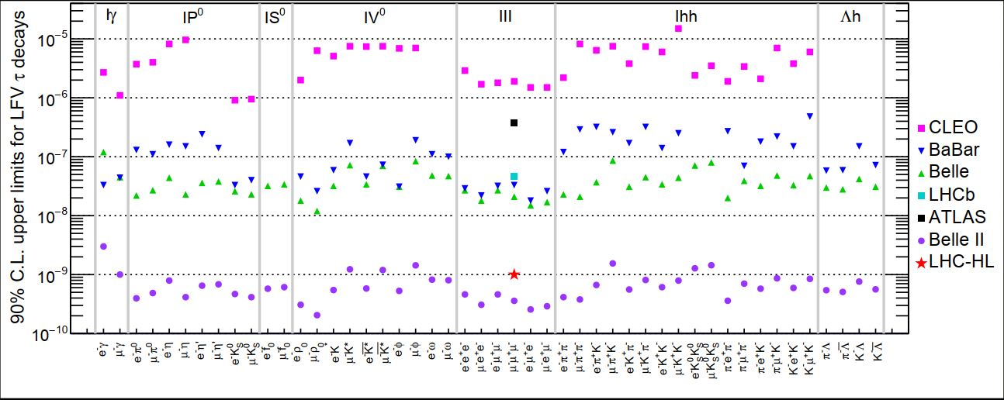
τ leptons
τ Lepton Flavor Violation
A.Lusiani, EPPSU2019, may 2019
CLEO
Belle/BaBar
Belle II/HL-LHC
τ → μγ at e⁺e⁻ → τ⁺τ⁻
backgrounds from e⁺e⁻ → μ⁺μ⁻γ and τ → μνν + noise γ
Br^{UL} ∝1/√L
τ → 3μ at e⁺e⁻ → τ⁺τ⁻
almost background free
Br^{UL} ∝1/L

Slide 27
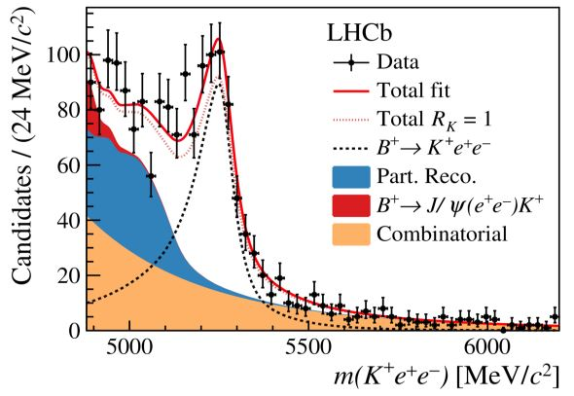
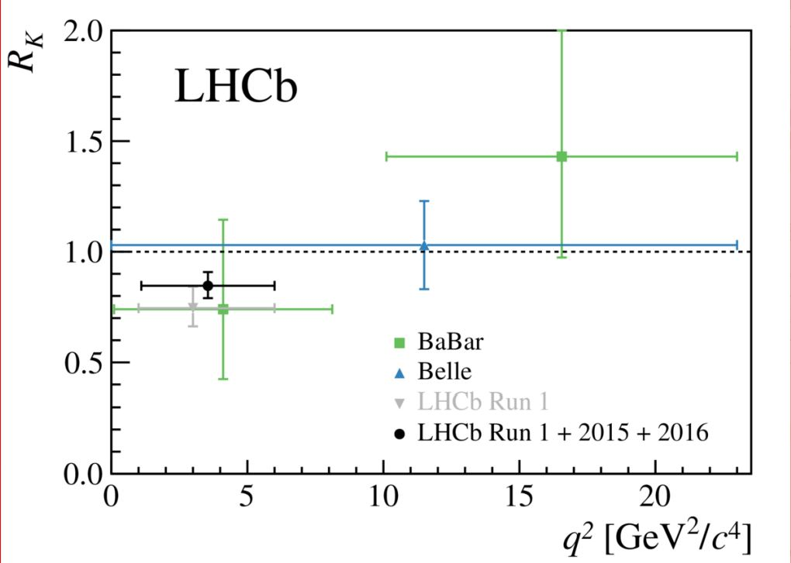
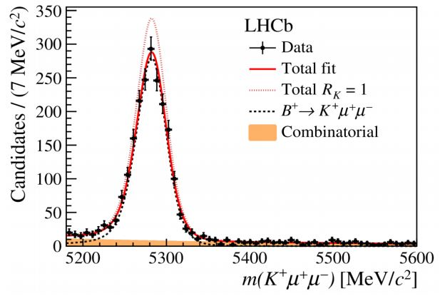
B → K⁽*⁾l⁺ l ⁻
B → K⁽*⁾l⁺ l ⁻
R(K⁽*⁾)= B(B → K⁽*⁾ μ⁺μ⁻) / B(B → K⁽*⁾ e⁺e⁻ )
l ⁻
θ _{l}
K
B
K*
θ_{K*}
LHCb Coll., LHCb-Paper-2019-009
π
l ⁺
K⁺ e⁺e⁻
R_{K}=1
K⁺ μ⁺μ⁻
q²=m²(l ⁺ l ⁻)

Slide 28
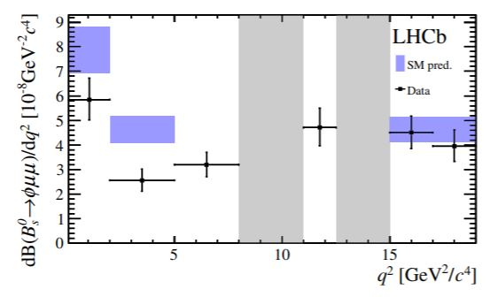
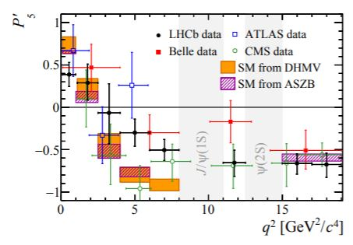
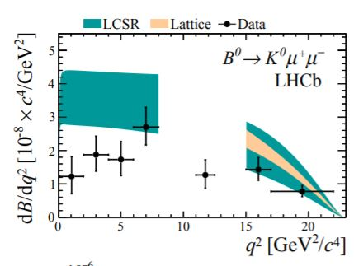
B → K*μ⁺ μ ⁻
angular distrib.
B → K*μ⁺ μ ⁻
P₅‘: one of ang. distr.
variables w/ reduced th.
uncertainty
LHCb Coll., JHEP09 179 (2015)
several b → sμμ
processes
B_{s} → φμ⁺ μ ⁻
B⁰ → K⁰μ⁺ μ ⁻
LHCb Coll., JHEP 06 133 (2014)
LHCb Coll., JHEP02 104 (2016)
NP
Belle Coll., PRL118 111801 (2017)
Atlas Coll., JHEP10 047 (2018)
CMS Coll., PLB781 517 (2018)
new data from LHCb / Belle II
being recorded as we speak

Slide 29
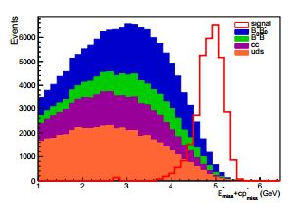
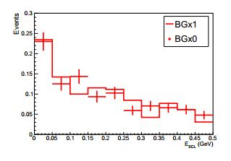


B → K⁽*⁾νν
B → K⁽*⁾νν
FEI, had. Tag;
⁴p*_{miss} = ⁴p*(Υ(4S)) -- ⁴p*(B_{tag}) – ⁴p*(K*)
E*_{miss}+ p*_{miss} isolates signal;
influence of beam bkg. on FEI
not crucial;
ε_{rec} (K* → Kπ) ~ 5 ⋅10⁻⁴
sig,
arb.
norm.
bkg
signal MC
selection
BB MC
σ(Br(B → K*⁰νν))
Br(B → K*⁰νν)
BKGx1
BKGx0
E_{ECL}
E_{ECL}
+
18% (combined semil. + had. tag)
σ(F_{L}(K*⁰))
similar for K*⁺ and K⁺
∫L dt [ab⁻¹]

Slide 30

B → K⁽*⁾νν B_{(s)} → νν
B → K⁽*⁾νν
C_{l,r}^{NP} allowed 68% C.R.
from Br(B → K*νν), Br(B → Kνν)
& F_{L}(B → K*νν) @ 50 ab⁻¹
(C_{l,r}^{NP} ∈ Real, ν flavor independent)
σ(C_{l,r}^{NP}) ~ 0.1 – 0.2
B_{(s)} → νν
Br( B→ νν) < 1.5 ⋅10⁻⁶ @ 50 ab⁻¹
Br( B_{s}→ νν) < 1.1 ⋅10⁻⁵ @ 5 ab⁻¹ (Υ(5S))
Br(B → K*νν)
F_{L}(B → K*νν)
Belle, BaBar
excluded
Br(B → Kνν)

Slide 31


DM
Dark sector, e⁺e⁻ → μ⁺μ⁻ Z‘, Z‘→ invis.
identified by μ⁺μ⁻ recoil mass;
expected UL on g‘ (Z ‘ coupling to
μ and τ)
expected UL with Phase II data
value for (g-2)μ discrepancy
explanation
M. Bertemes et al. (Belle II Coll.), BELLE2-NOTE-PH-2019-002

Slide 32


DM
Dark sector, e⁺e⁻ → γ a, a→ γγ
for low m_{a} two merged γ‘s, same as
e⁺e⁻ → γγ, trigger not to veto or prescale
M. de Nuccio, T. Ferber et al. (Belle II Coll.), BELLE2-NOTE-PH-2019-005

