Slide 1
Revisiting the charged kaon mass
Damir Bosnar
with M.Makek and P. Žugec
Department of Physics, University of Zagreb, Zagreb, Croatia
C. Curceanu et al. Laboratori Nazionali di Frascati
J. Zmeskal et al. Stefan Meyer Institute, Vienna
and SIDDHARTA-2
Croatian Science Foundation
Project 8570
Motivation and previous measurements of the charged kaon mass
Preparations for measurements at DAɸNE LNF during SIDDHARTA-2 run:
hardware and simulations
3rd Jagiellonian Symposium on Fundamental and Applided Subatomic Physics, Krakow, 24-28 June 2019

Slide 2
Motivation
The accuracy of the determination of the charged kaon mass (m_{K}=493.677±0.013 MeV, 26 p.p.m.) is much less than the accuracy of the charged pion mass (m_{π}=139. 57061±0.00023 MeV, 1.6 p.p.m.), PDG2018.
Serious disagreement between the two precise measurements
->Large scaling factor: S=2.4 (m_{K}=493.677±0.005 MeV)
Kaon mass has large influence on the K⁻N scattering lengths and through them on the kaon-nucleon sigma terms and eventually degree of chiral symmetry breaking.

Slide 3
Measurements of kaon mass, history
Q value K⁻->π⁺+π⁻+π⁻
W.H. Barkas, Annu. Rev. Nuclear Sci. 15 (1965) 67 m_{K}=493.75+0.16 MeV
Range measurements in emulsions
(A. Barbaro-Galtieri et al., Revs. Mod. Phys. 42 (1970) 87, m_{K}=493.7+0.3 MeV;
L.M. Barkov et al. Nucl. Phys. B148 (1979) 53 (ɸ->K+K-) m_{K}=493.670+0.029 MeV
Energies of X-ray transitions in kaonic atoms, m_{K}=493.679 ± 0.013 MeV
all with energetic kaons (PDG2018)

Slide 4
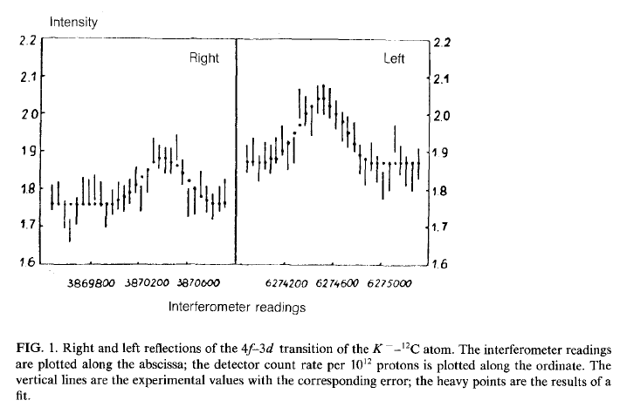
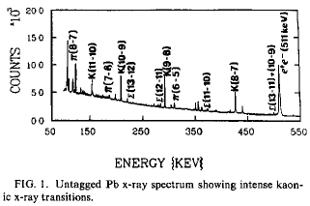
PDG 2018:
The main disagreement is between the two most recent and precise measurements (x-ray energies from kaonic atoms):
m_{K}=493.696±0.007 MeV
A.S. Denisov et al. JEPT Lett. 54 (1991)558
K⁻ ¹²C, crystal diffraction spectrometer
(6.3 eV at 22.1 keV), 4f-3d
m_{K}=493.636±0.011 MeV
K.P. Gall et al. Phys. Rev. Lett. 60 (1988)186
K⁻ Pb, K⁻ W; HPGe detector (1 keV), K⁻Pb (9 -> 8),
K⁻Pb (11 -> 10), K⁻W (9 -> 8), K⁻W (11 -> 10),
PDG2018
m_{K}=493.679 ± 0.013 MeV
Average m_{K}=493.679 ± 0.006 MeV S=2.4

Slide 5
Previous measurements, motivation
PDG2018:
PDG18 conclusion:
” While we suspect that the GALL 88 K− Pb (9 ->8) measurements could be the problem, we are unable to find clear grounds for rejecting it. Therefore, we retain their measurement in the average and accept the large scale factor until further information can be obtained from new measurements and/or from reanalysis of GALL 88 and CHENG 75 data”.
It is sufficient that the new measurement has the same precision (10 keV) as the 2 previously mentioned measurements, which differ by 60 keV (PLB535 (2002)52):
-if the new result agrees with Denisov (and results from Gall are disregarded) the precision would be 5 keV (10 p.p.m)
-it the new results agrees with Gall, the precision would be 7 keV (14 p.p.m.)
-> substantial improvement in the precision

Slide 6
Principles of measurements in kaonic atoms
Measure X-ray energies in kaonic atoms for transitions not influenced by strong interactions.
In order to determine the kaon mass, the experimental energies have to be compared with the calculated energies obtained with a certain K-mass value (corrections: vacuum polarization, electron screening, non-circular trasitions)
Measurements with HPGe detectors and with crystal diffraction spectrometer, TES, …

Slide 7
Kaonic atom formation
X-ray energies in kaonic atoms
Kaon cascade -> X-rays
Kaon absorption
K⁻
1) Kaon capture
Interesting X-rays from the
the transitions in the middle
of spectrum:
No influence from strong
interaction
avoid electron screening
of nuclei
^{e-}
X-ray
2) Kaon cascade
3) Kaon absorption

Slide 8
Measurement at DAɸNE with HPGe
-> Our aim is to do measurements with HPGe detector(s) during SIDDHARTA-2 run at DAɸNE - using the available space at the SIDDHARTA-2 interaction region and with different solid targets.
All previous measurements have used energetic kaons and a thick degrader to slow them down was necessary.
Advantage: DAɸNE is producing low momenta kaon pairs – no need for degrader. No secondary particles in the beam.
Disadvantage: High background from the beam close to the interaction point (unknown!).
Background originating from the kaons absorbed in nuclei.

Slide 9
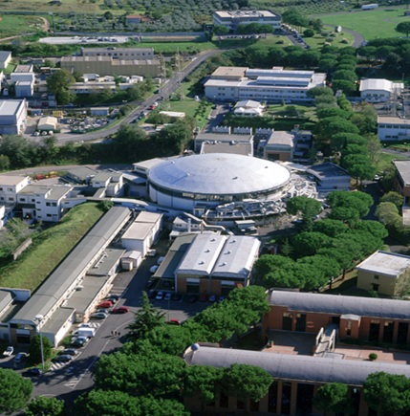
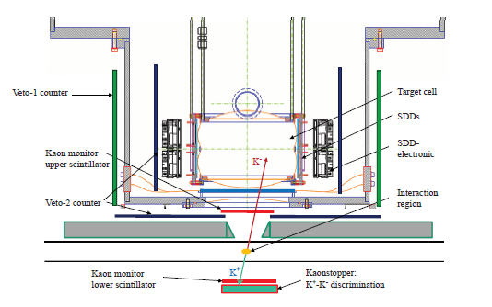
SIDDHARTA-2 at DAɸNE Silicon Drift Detector for Hadronic Atom Research by Timing Application
e+e-- -> ɸ -> K⁺K⁻, E_{K} ≈ 16 MeV
-> Our aim is to do measurements with HPGe detector(s) during SIDDHARTA-2 run at DAɸNE - using the available space at the SIDDHARTA-2 interaction region and with different solid targets.
2019/2020 SIDDHARTA-2 run: X-ray transitions in gaseous targets: deuterium, helium, …
e+
e-
Advantage: DAɸNE is producing low momenta kaon pairs – no need for degrader. No secondary particles in the beam.
Disadvantage: High electromagnatic background from the beam close to the interaction point (unknown!).
Background originating from the kaons absorbed in nuclei.

Slide 10
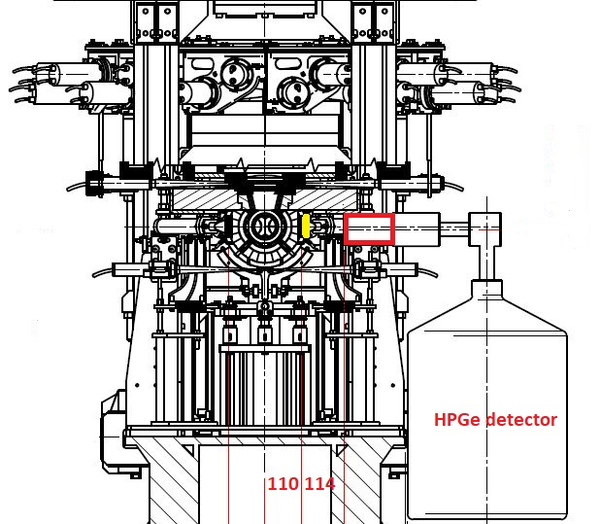
Measurement at DAɸNE with HPGe during SIDDHARTA-2 run
HPGe detector system is
independent of SIDDHARTA-2
Signal from the luminometer
(80x40x2 mm³) as a trigger
for HPGe detector.
Interaction point
Positions of the target
and the HPGe detector
is restricted by
SIDDHARTA-2 setup
-> Hardware preparations
-> Simulations (GEANT4)
Figure: Cesidio Capoccia

Slide 11
Preparation of the measurement at DAɸNE with HPGe
Our aim is to do measurements with HPGe detector(s) during SIDDHARTA-2 run - using the available space at the SIDDHARTA-2 interaction region with different solid targets (Pb, W, …).
-> Hardware preparation
-> Simulations: to determine position and size of the target, degrader,
and position of the detector, estimate duration of measurement.

Slide 12
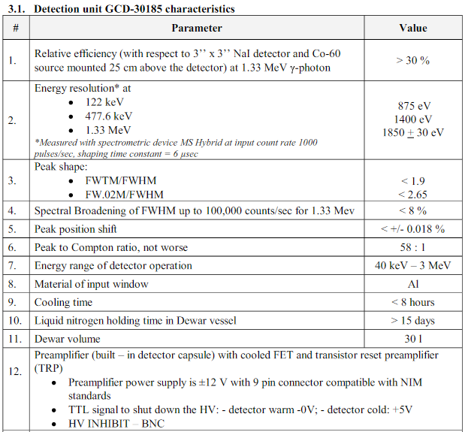
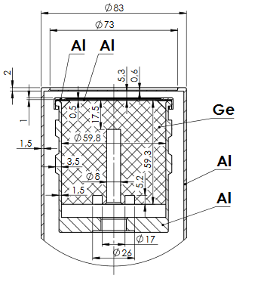
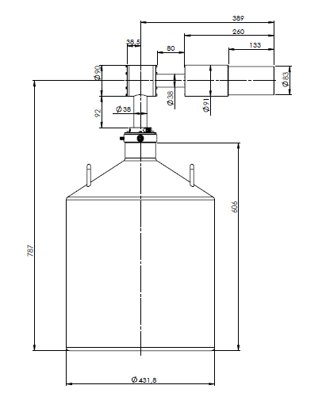
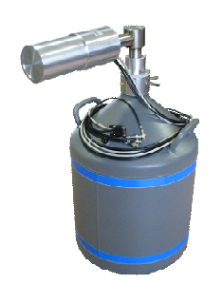
Measurement at DAɸNE with HPGe during SIDDHARTA-2
BSI HPGe detector with
transistor reset preamplifier (TRP).
HPGe active detector diameter 60 mm, height 60 mm.
Analog electronics and fast pulse digitizer.

Slide 13
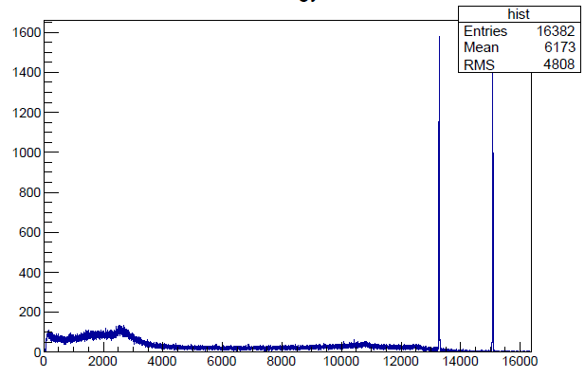
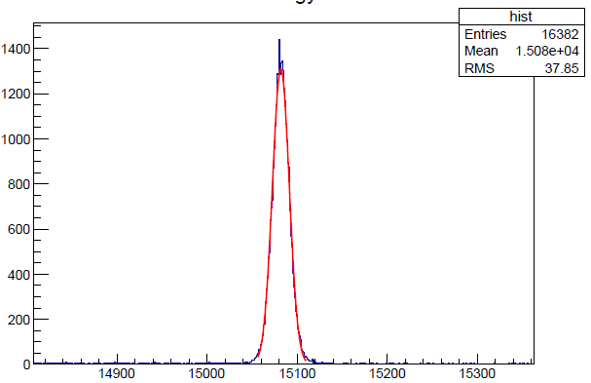
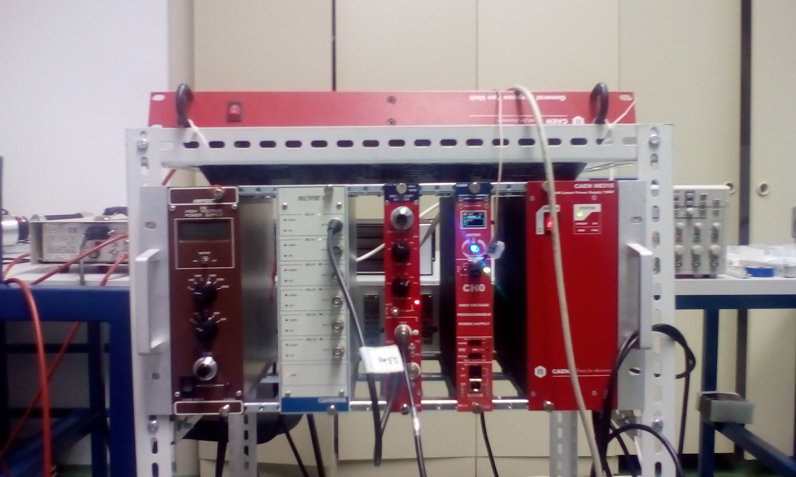
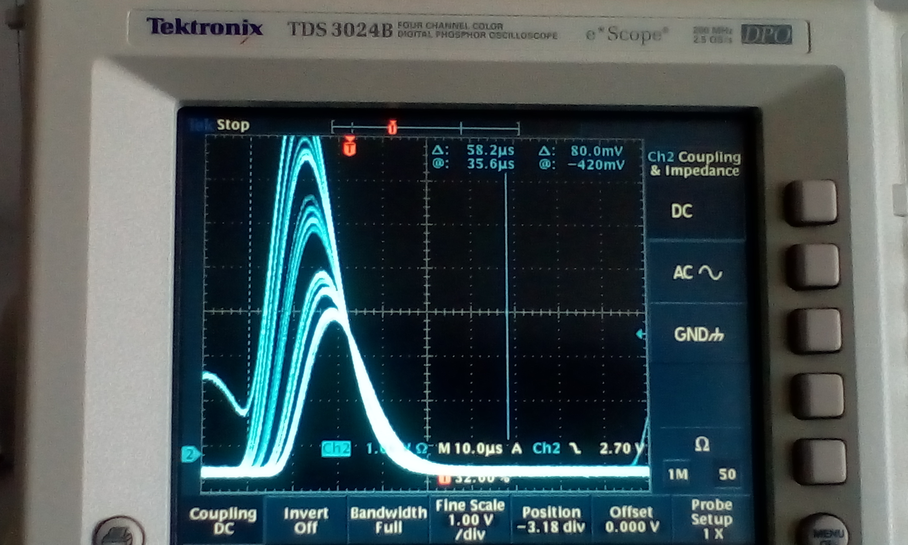
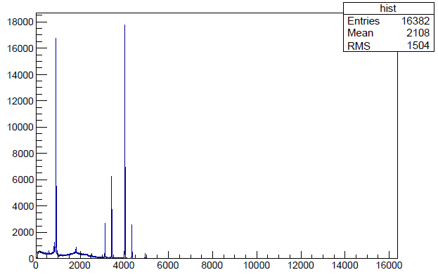
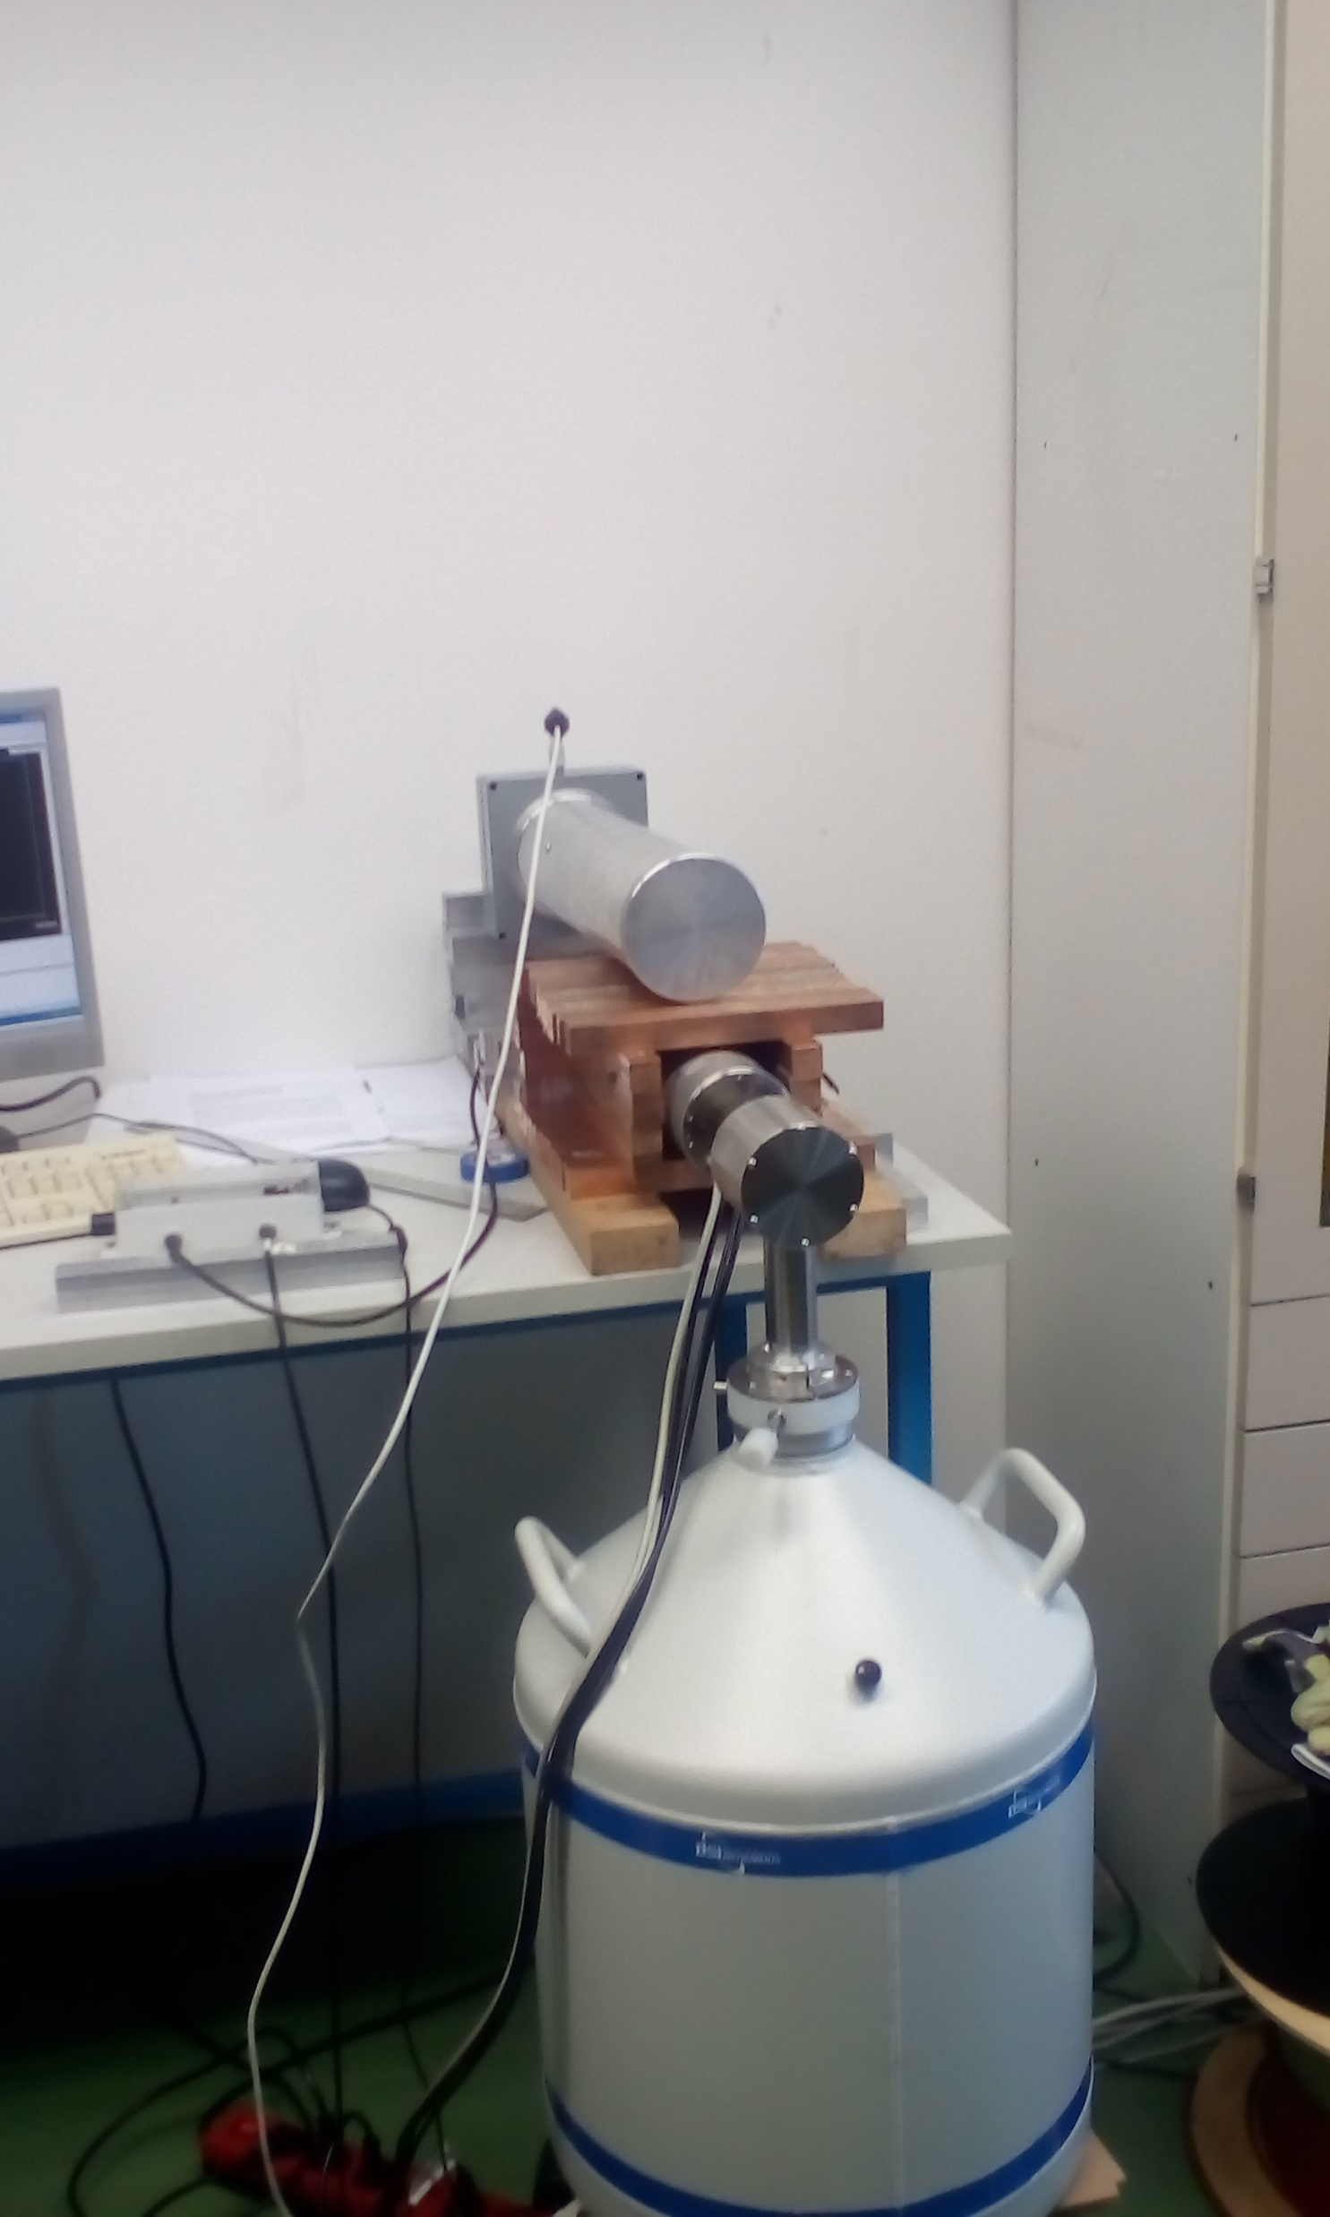
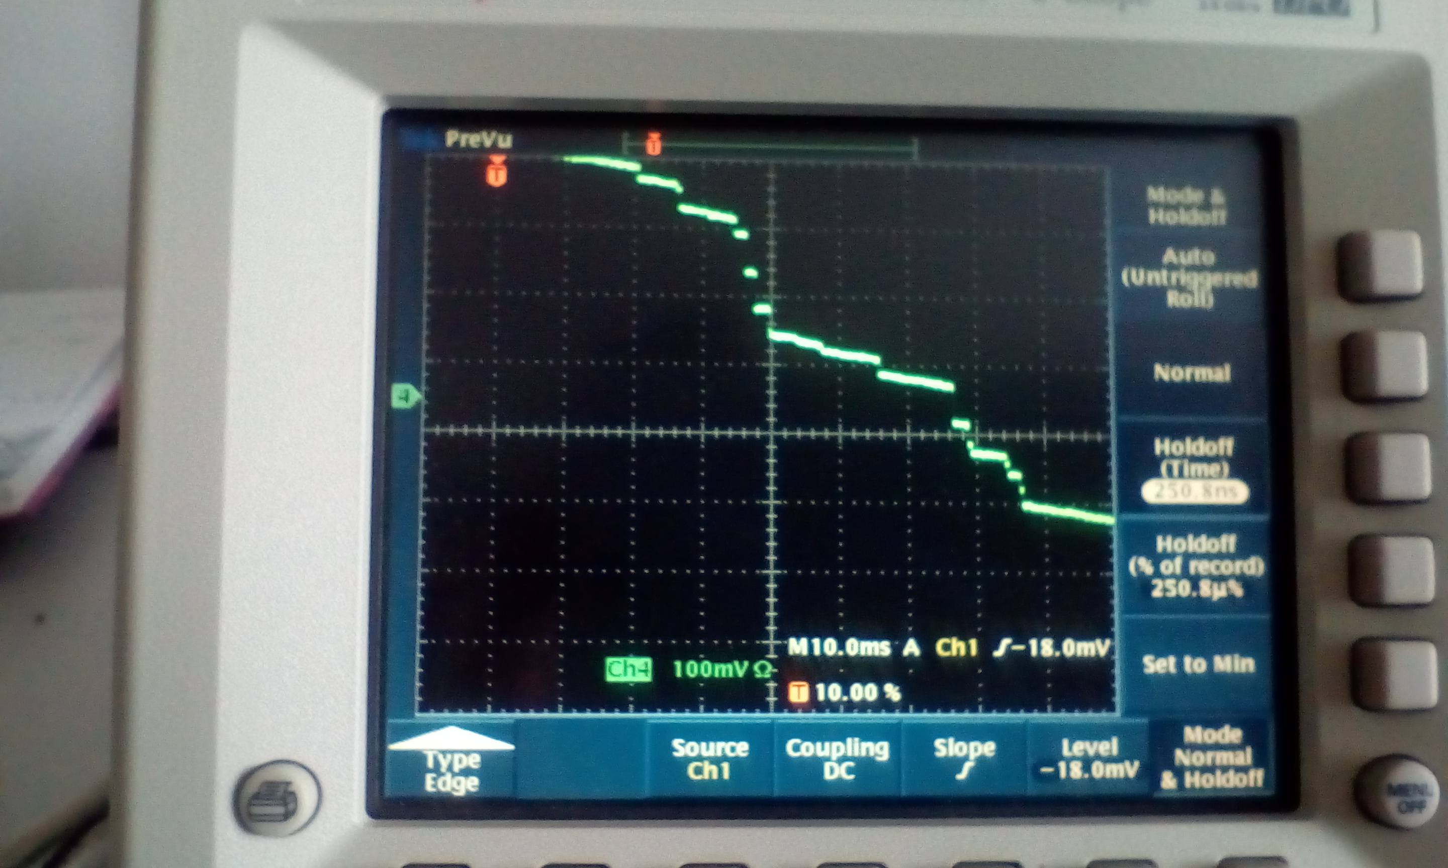
Laboratory tests of HPGe (BSI - TRP preamp) & analog electronics
Signal from spectroscopy amplifier
Signal from preamp of HPGe with TRP
Pb lines
Stability tests
⁶⁰Co, ¹³³Ba spectra,
resolutions: 0.870 keV at 81 keV
1.06 keV at 302.9 keV
1.11KeV 1.43 keV at 356 keV
1.67 keV at 1330 keV
CAEN spectroscopy amplifier N968, Canberra
Multiport II, Canberra Genius DAQ + analysis

Slide 14
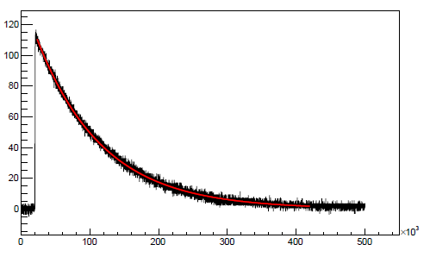
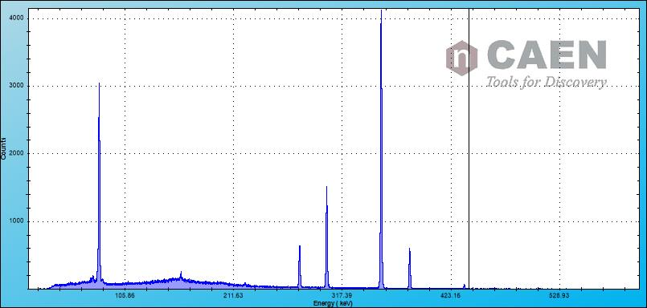
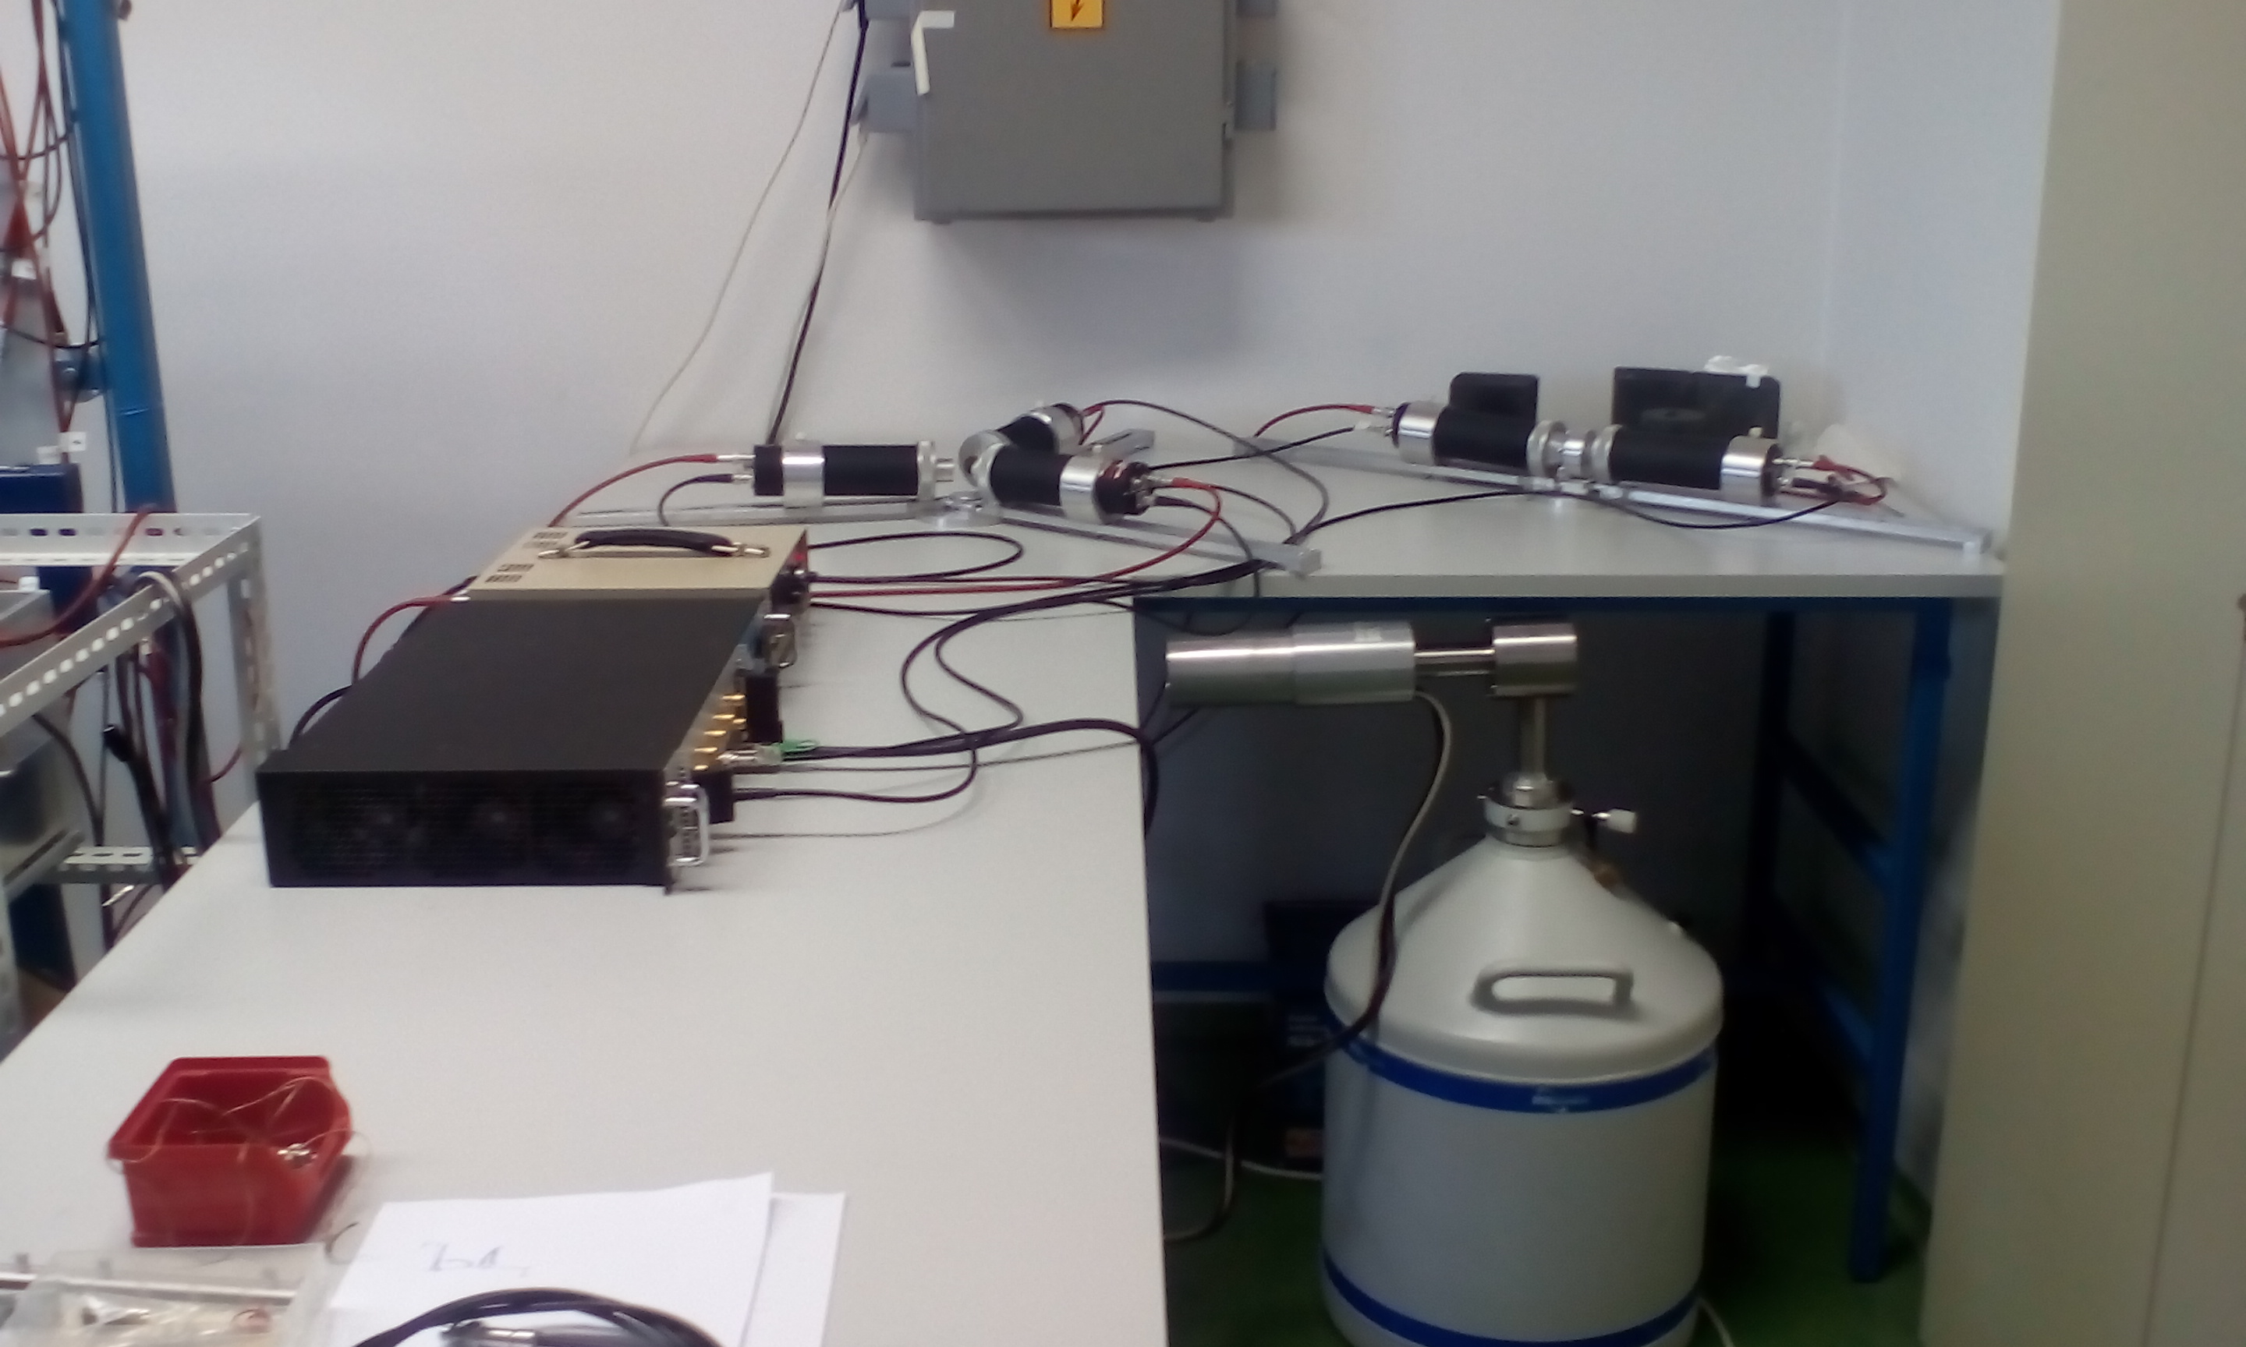
Laboratory tests of HPGe (BSI - TRP preamp) & fast pulse digitizer, CAEN DT5781 4 ch, 14 bit,
CAEN DT5781 4 ch, 14 bit, 10ns sampling time
Signal from spectroscopy amplifier ~20 μs (shaping time 6 μs),
restriction on the rate.
Digital Pulse Processing for Pulse Height Analysis firmware , based on
V.T. Jordanov et al. Nucl. Instr. Meth. A 353
(1994) 337
Coincidences
Signal from HPGe with RC preamp
Signal from preamp of HPGe with TRP
Tests: ¹³³Ba
Setup ready for
measurements!
Possible rates up to 150 kHz

Slide 15
Measurement at DAɸNE with HPGe during SIDDHARTA-2 run
Signal from the luminometer
(80x40x2 mm³) as a trigger
for HPGe detector.
The position of luminometer
110 mm from the interaction point (+30 mm) .
Targets (Pb, W) just behind
the luminometer,
80mm x 40mm x 0.6mm
no degrader
min. 100 mm from the HPGe
Positions of the detector and
the target (size)
are being determined by
GEANT4 simulations.
Efficinency
Background (kaon absorption)
Figure: Cesidio Capoccia

Slide 16
Simulations – GEANT4
To estimate the thickness and size of the target, setup configuration and HPGe efficiency
To estimate background – from the beam (?) and from the kaon absorption and to determine optimal position of the detector and target (+ target size) and shielding .
To estimate required time for the measurements.
Not all parameters are known: beam background !? – test measurements with the beam are required.

Slide 17
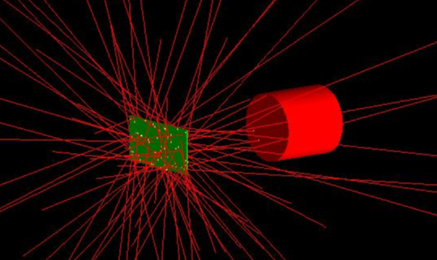
Simulations – HPGe efficiency
HPGe 150 mm from Pb sheet
E(keV) (transition) | efficiency ( d=0.6 mm) | efficiency (d=0.2 mm)
90.9 (13->12) | 0.19 % | 0.47 %
116.9 (12->11) | 0.32 % | 0.61 %
153.9 (11->10) | 0.50 % | 0.71%
291.6 ( 9 -> 8) | 0.72% | 0.77%
426.2 ( 8 -> 7) | 0.74 % | 0.75 %
Pb 80mm x 40mm x X.Ymm
0.6 mm Pb sufficient to stop K-, no degrader

Slide 18
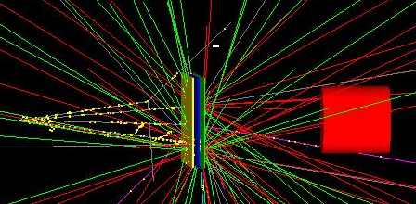
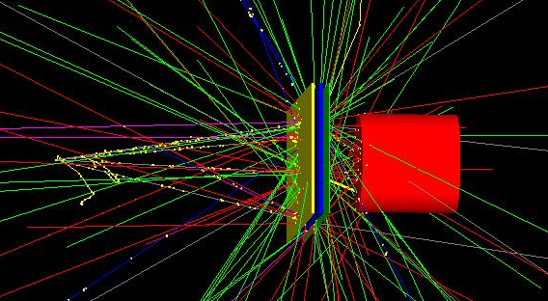
Simulations – kaon absorption background
Pb 80mm x 40mm x 0.6mm
0.6 mm Pb sufficient to stop K-, no degrader
HPGe min. 114 mm from luminometer
interaction point is 110 mm from luminometer

Slide 19
Simulations – HPGe efficiency
E_{x}=291.6 keV (Pb 9->8)
d (mm) | efficiency (d=06mm) | efficiency (d=0.2 mm)
110 | 1.21 % | 1.31 %
150 | 0.72% | 0.77 %
200 | 0.42 % | 0.45 %
300 | 0.20% | 0.21 %
400 | 0.11% | 0.12 %
Pb 80mm x 40mm x 0.6mm
0.6 mm , no degrader
HPGe minimal distance approx 110mm from the target

Slide 20
Estimation of the requested number of X-rays in the peak (Pb, 9->8 transition,291 keV)
precision(trans.)$=\frac{σ}{\sqrt{N}}$
FWHM(302.9 keV)=1.106 keV
N≈10.000 X-rays in the peak (291.6 kEV)
to reach the precision of previous
measurements.
Calculation: A. Scordo
d (mm) | efficiency (d=06mm) | efficiency (d=0.2 mm)
110 | 1.21 % | 1.31 %
150 | 0.72% | 0.77 %
200 | 0.42 % | 0.45 %
300 | 0.20% | 0.21 %
400 | 0.11% | 0.12 %

Slide 21
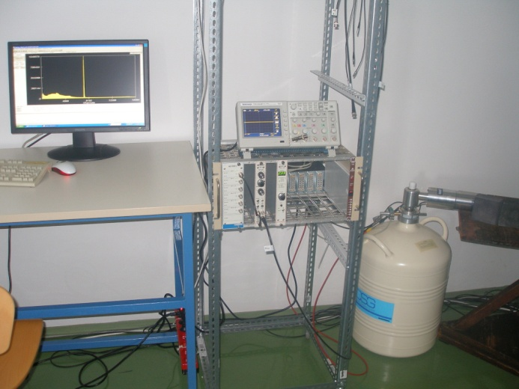
Second HPGe detector
Additional HPGe detector
with RC preamplifier (DSG)

Slide 22
Summary and outlook
HPGe detector with TRP (BSI) ready for the measurements with analog electronics and fast pulse digitizer.
(and DSG HPGe detector, with RC amplifier)
Test measurements / measurements in parallel with SIDDHARTA-2 2019/2020 run.
If the beam background is not to high, measurements with the required precision are entirely feasible!

Slide 23
Thank you for your attention !

Slide 24
Backup slides

Slide 25
Estimation of the requested number of X-rays in the peak (Pb, 9->8 transition,291 keV)
precision(trans.)$=\frac{σ}{\sqrt{N}}$
FWHM(302.9 keV)=1.106 keV
N≈10.000 X-rays in the peak (291.6 kEV)
to reach the precision of previous
measurements.
Calculation: A. Scordo
d (mm) | efficiency (d=06mm) | efficiency (d=0.2 mm)
110 | 1.21 % | 1.31 %
150 | 0.72% | 0.77 %
200 | 0.42 % | 0.45 %
300 | 0.20% | 0.21 %
400 | 0.11% | 0.12 %
d (mm) | N_x rays (d=06mm) | N_x rays detected/day
110 | 1.21 % | 4.181
150 | 0.72% | 2.488
200 | 0.42 % | 1.451
300 | 0.20% | 691
400 | 0.11% | 380

