Slide 1
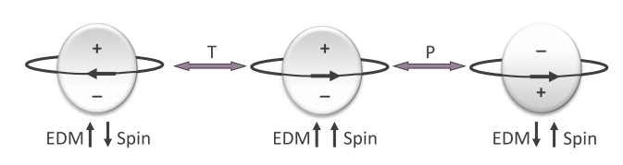
Static and oscillating electric dipole moments
Experiments at the Precision Frontier
Hans ströher I 3rd jagiellonian symposium on fundamental and applied subatomic physics

Slide 2
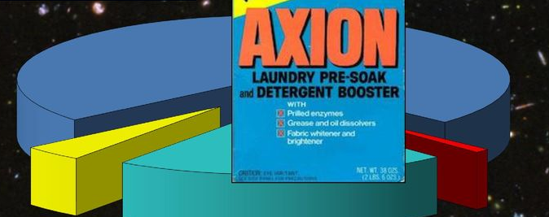

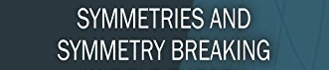
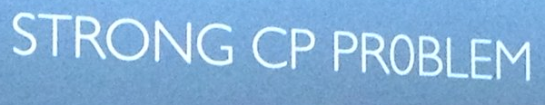
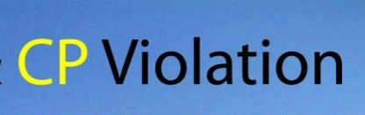
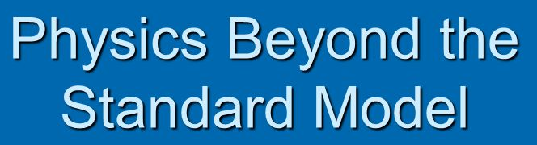
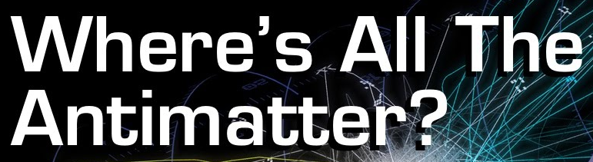
EDM science case: great!

Slide 3
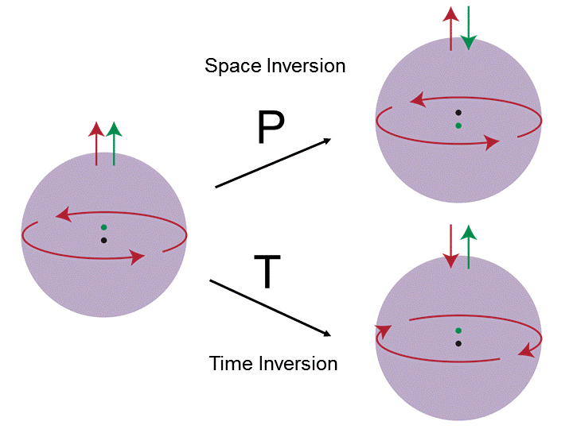
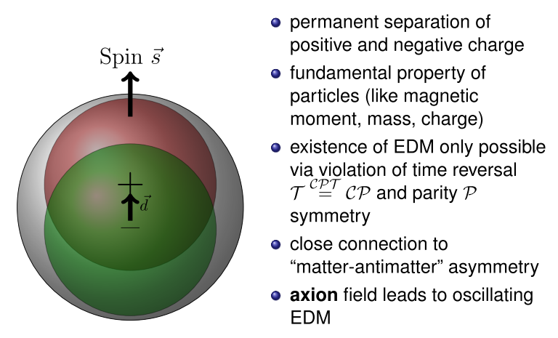

Introduction, science case
EDM: a permanent separation of positive and negative charge
(vector along spin direction)
Fundamental property of particles (like mass, charge, magnetic
moment)
Existence of EDM only possible if violation of time reversal
and parity symmetry; note:
Close connection to matter-antimatter asymmetry of Universe
Sensitive to new physics beyond the Standard Model
Dark Matter: Axion field (coupling to gluons); oscillating EDM
Why no CP-V in Strong Interactions?
(Strong CP Problem)
R. Peccei and H. Quinn postulated a new kind
of symmetry: Peccei-Quinn (PQ) symmetry
F. Wilczek and S. Weinberg: PQ symmetry
implies existence of a new particle
(Wilczek:”axion”)
Axions are DM candidates

Slide 4
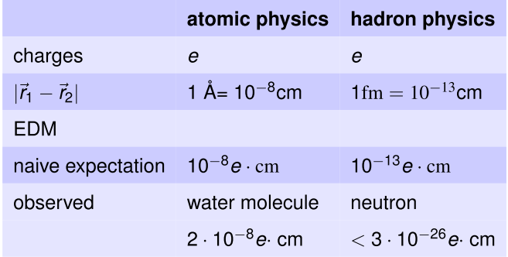
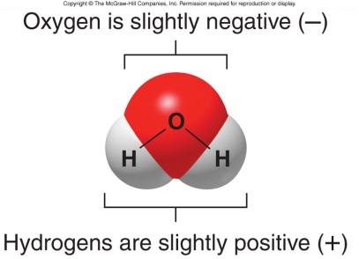
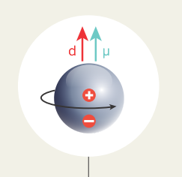
Introduction, science case
Why particle EDMs are special:
ok
?
(no) degenerate
ground state
w/ different parity

Slide 5
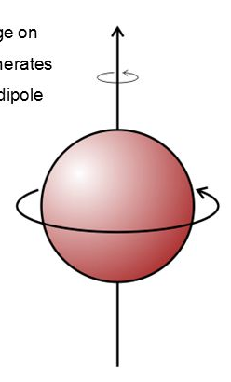
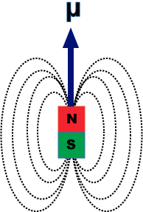
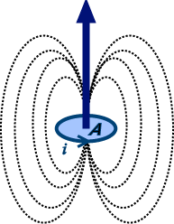
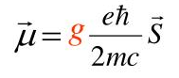
Introduction, science case
Challenges for particle EDMs:
(i) Smallness of EDM effect (ii) Magnetic moment
Naive expectation:
- P-violation (~ G_{F} f_{π}²): 10⁻⁷
- T/CP-violation: 10⁻³
→ suppression factor > 10⁻¹⁰
corresponds to 10⁻¹⁴ e cm
p
„Spin“

Slide 6
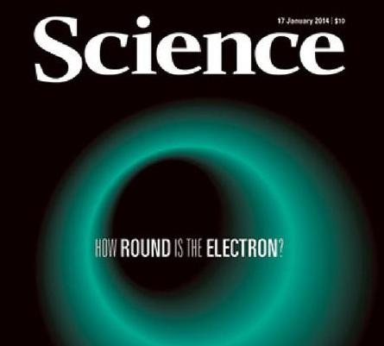
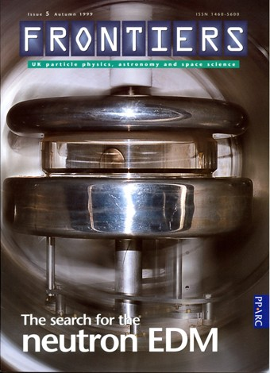
EDM searches: various systems

Slide 7


Experimental effort
Free particles: neutron, proton, deuteron, light nuclei
Λ, Ξ, Ω
μ, τ
Atoms: ¹²⁹Xe, ¹⁹⁹Hg (→ n,p), ²²⁵Ra (diamagnetic)
²⁰⁵Tl (→ e), Cs (→ e), Rb, ²¹⁰Fr (radioactive) (paramagnetic)
Molecules: YbF (→ e), ThO (→ e), BaF, PbF, RaF, PbO, WC
HfF+ (→ e), ThF⁺
Condensed states: YbOH, YbOCH3, Gd₃Ga₅O₁₂, Gd₃Fe₂Fe₃O₁₂ (polyatomic)
Eu_{0.5}Ba_{0.5}TiO₃ (ceramics)
solid He
liquid Xe

Slide 8

Status: no particle EDM discovered yet

Slide 9
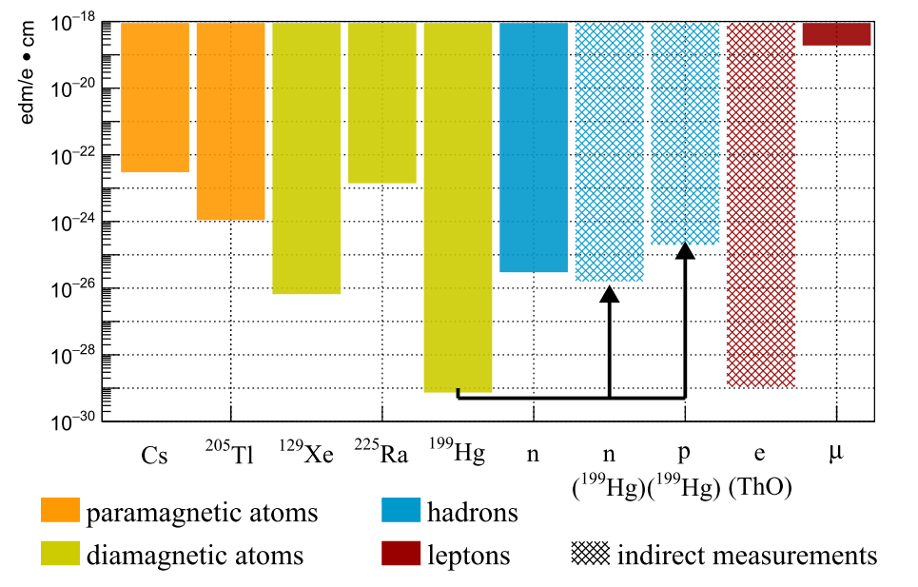
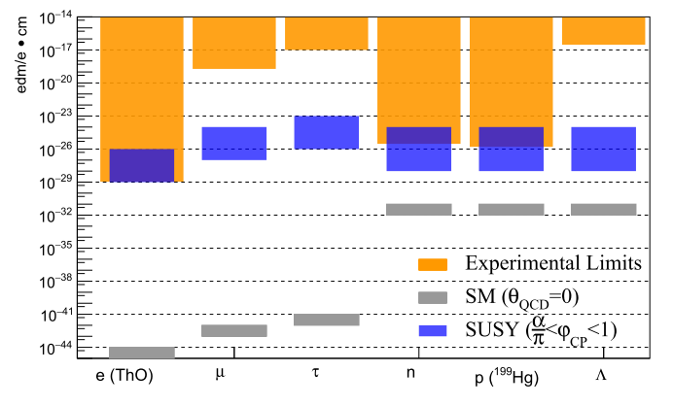
Status – upper limits, overview
„Gap“ to SM prediction

Slide 10
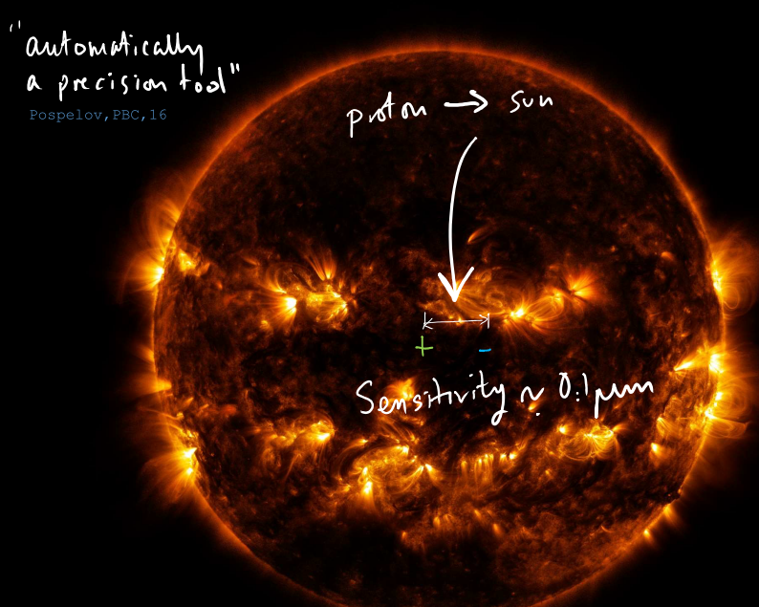
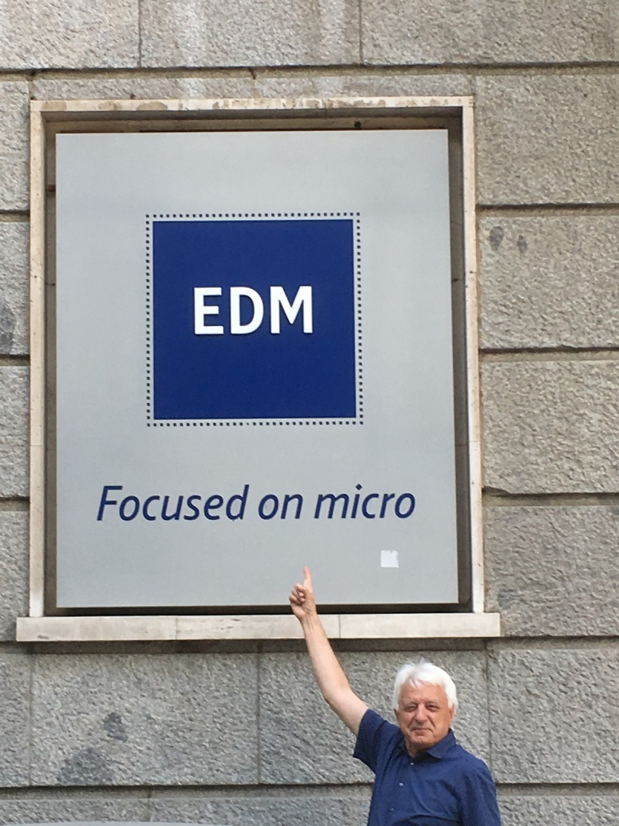
Status – exceptional precision required

Slide 11
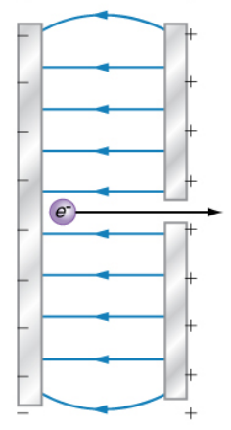
EDM NKOTB: charged hadrons
E
storage
ring

Slide 12
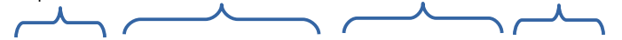
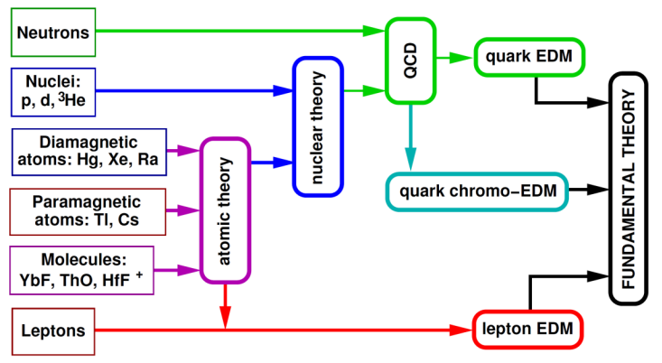
EDM searches for charged particles
Exp. input Theoretical Backgd. EDM sources Theory
New: charged particles
(proton, deuteron …)
Potentially highest
sensitivity
Identification of source
requires neutron and
proton (and maybe also
deuteron …)
Nucleons
(p, n)
Nuclei
(d, ³He)

Slide 13
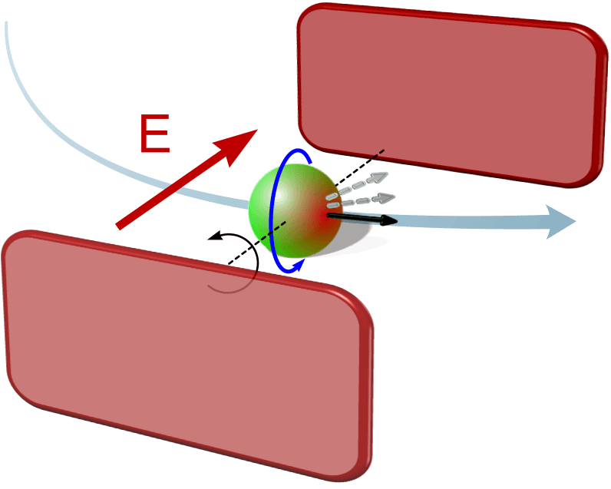
EDM measurement principle (d x E )

Slide 14
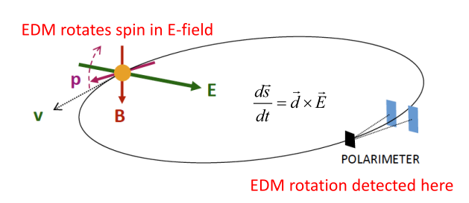
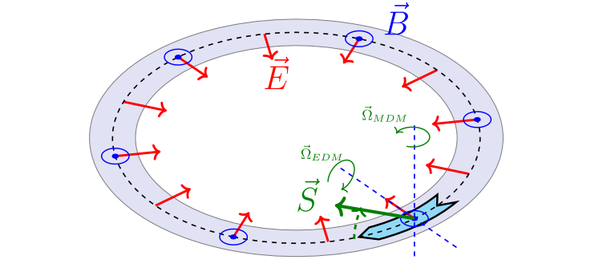
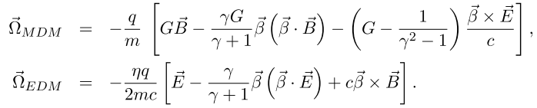
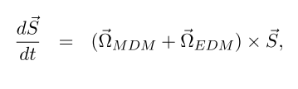

Polarized beam in Storage ring
Longitudinally polarized beam in
storage ring
Radial electric field interacting with
EDM (torque)
Observable: slow rotation of spin
direction (→ polarimetry)
But: MDM precession
Thomas-BMT eq.:
Ideal situation: Ω_{MDM} = 0 → B = 0, magic momentum:

Slide 15
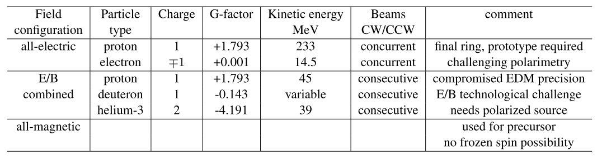


Polarized beam in Storage ring
General Possibilities:
COSY
polarized proton, deuteron beams
beam manipulation equipment
long-standing experience of IKP
→ ideal R&D, test machine
→ proof-of principle measurement

Slide 16

srEDM: highest sensitivity

Slide 17
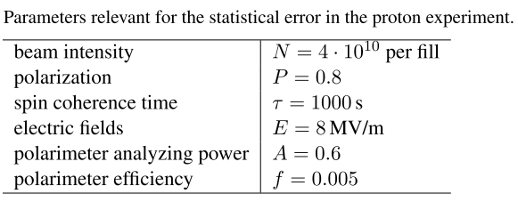
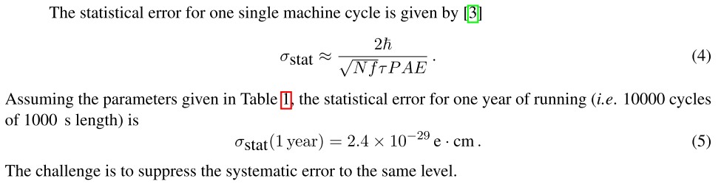
Statistical sensitivity
Statistical sensitivity (one cycle):
10.000 cycles (w/ parameters of table):
Challenge:
Identify and suppress all systematic errors to the same level!

Slide 18
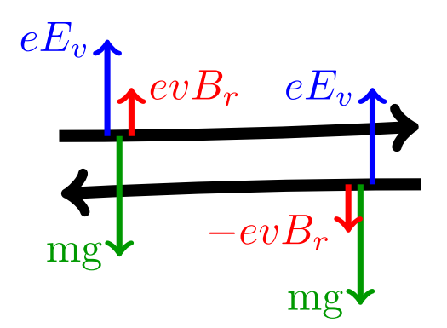
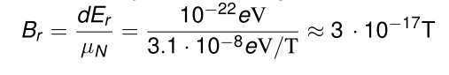
Systematics
Major source: radial magnetic field B_{r}
→ mimics EDM, if μ B_{r} ~ d E_{r}
Order of magnitude estimate:
assume d = 10⁻²⁹ e cm, E_{r} = 10 MV/m
Corresponding magnetic field B_{r}:
!
Potential solution:
Use two beams running clockwise and counter-clockwise
→ Separation of the two beams is sensitive to B_{r}

Slide 19

EDM strategy: staged approach

Slide 20
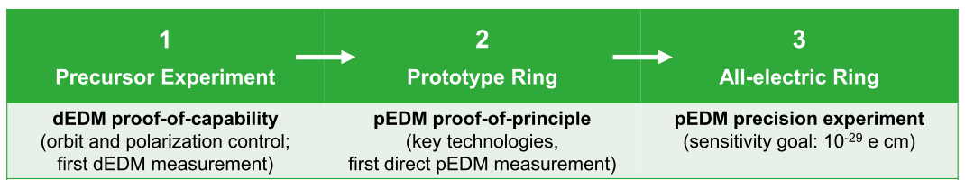
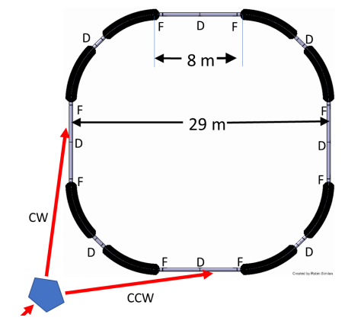
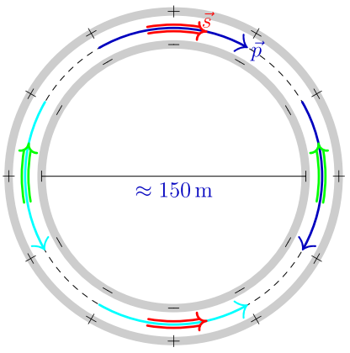
Stages towards the EDM ring
p
COSY

Slide 21
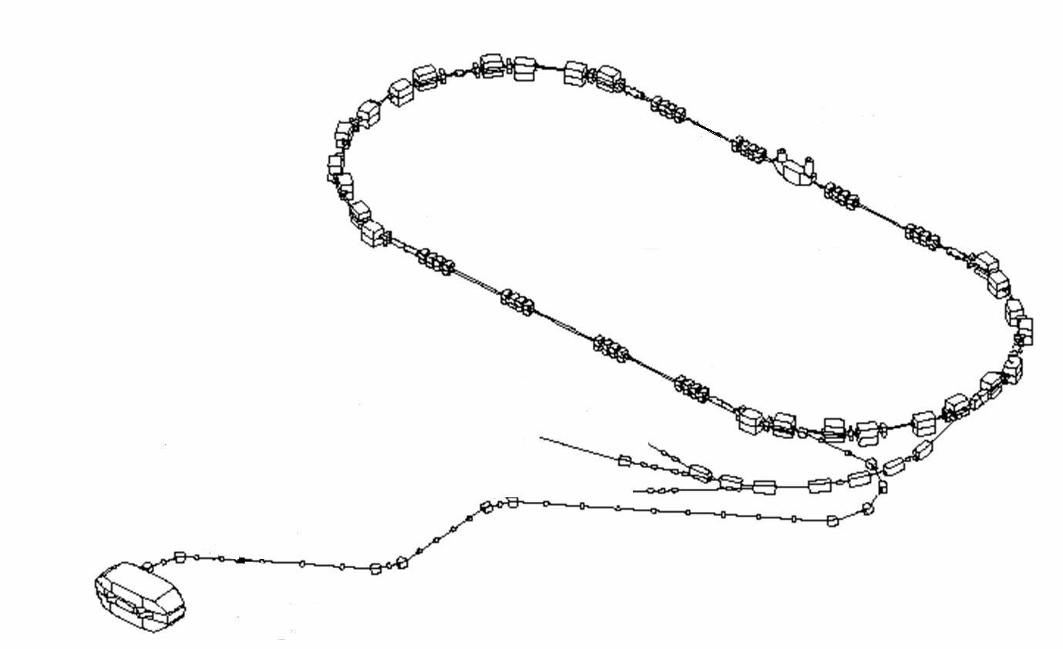
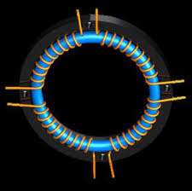
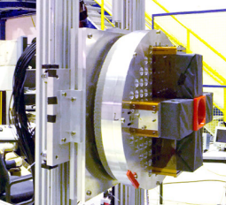
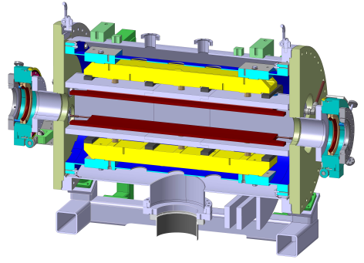
Stage-0 and -1: use of cosy
Precise determination of spin tune
  PR ST-AB (2014), PRL (2015)
  → ν_{s} ~ 10⁻¹⁰ in 100s
Long spin coherence time
PRL (2016) → τ > 1000s
Phase-lock of spin precession
PRL (2017) → |δS| < 12°
Polarimeter development
Beam instrumentation
RF-Wien filter → Precursor Expt.
COSY is world-wide unique to perform these measurements

Slide 22
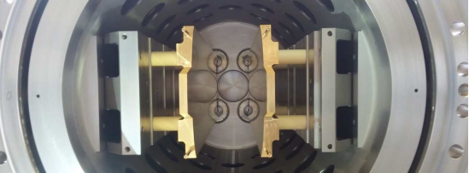
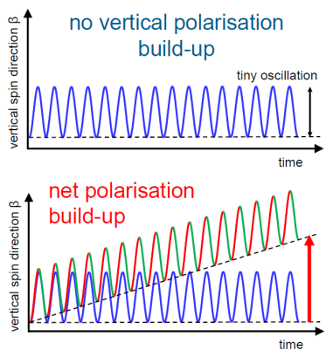
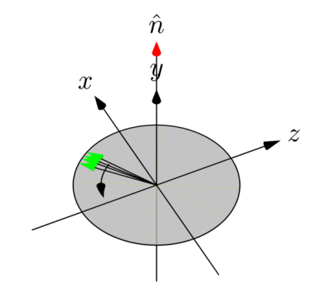
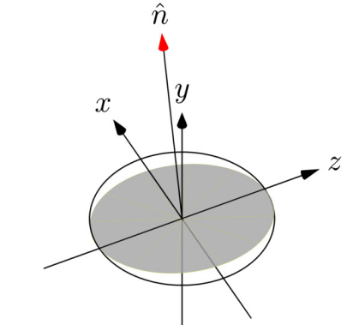
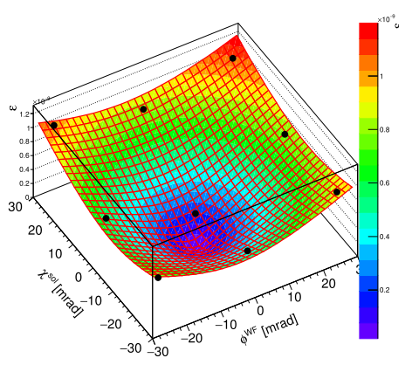
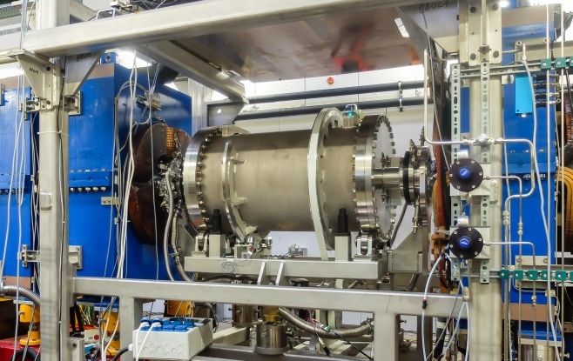
Stage-1: precursor exp. At cosy
COSY (magnetic storage
ring) → spin precession;
use of deuteron beams
Problem: no EDM effect
→RF Wien Filter:
RF-fields such that
forward-backward
effect does not cancel
Sensitivity to EDM
Wien Filter
RF Wien Filter
invariant spin axis:
d = 0 d > 0
COSY
Exptl. data (Dec.2018)
?
First-ever deuteron EDM measurement
Statistical sensitivity 10⁻⁽²³⁻²⁴⁾ e cm; systematics: imperfections, alignment, … → limit: ~ 10⁻¹⁹ e cm
systematics: imperfections, alignment, … → limit: ~ 10⁻¹⁹ e cm

Slide 23
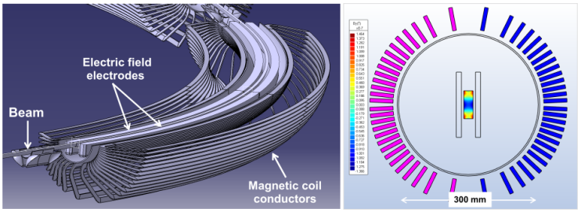
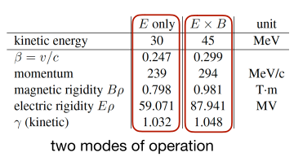
Stage-2: prototype ring
30 MeV all-electric p ring
Storage time
CW/CCW operation
Spin coherence time
Polarimetry
Phase space cooling
μ_{p} effects
Option: add B-field, 45 MeV
pEDM measurement
→ Possible host: COSY
Inevitable next step

Slide 24
Stage-3: precision edm ring
p
All-electric deflection
Magic momentum (p = 0.7007 GeV/c)
Simultaneous CW/CCW beams
Phase-space cooled beams
Long spin coherence time (> 1000 s)
Non-destructive precision polarimetry
Optimum orbit control
Optimum shielding of external fields
Control of residual (intentional) B_{r} field
„Holy Grail“ of storage rings (largest ever conceived)

Slide 25



Goals and timeline
Step 1:
Precursor
Now
5 yrs
10 yrs
Step 2:
Prototype
Step 3:
Final ring
p
Submission to ESPP Update; CERN Yellow Report (2019)

Slide 26



Oscillating EDMs

Slide 27


Oscillating EDM - motivation
QCD Lagrangian: explicitly CP-violating (θ _{QCD} –parameter – should be ~ 1)
Experiments: strong interaction very well CP preserving: θ _{QCD} < 10⁻¹⁰ („Strong CP problem“)
Solution: a new symmetry („Peccei-Quinn“):
→ relaxes θ _{QCD} to zero
→ predicts a light neutral pseudoscalar particle: axion
→ axion-like particles (ALPs) (e.g. penitude in SUSY)
→ coupling to SM suppressed („invisible axion“)
→ acquires a small mass from mixing with the pion
Cold axions produced in early universe may be dark matter today
Axion DM detectable (wide constrained parameter space) → „industry“ of axion searches
→ interaction of coherently oscillating axion DM field with gluons: oscillating EDMs

Slide 28




Oscillating EDM – principle
Static EDM: accumulation
in „frozen spin“ condition
Oscillating EDM:
spin precesses, but oEDM flip
→ right frequency: accumulation
frequency (axion mass) not
known → resonance scan
Phase unknown
static EDM (see above)
now: oscillating EDM
p = 979 MeV/c
f = 120 kHz
Axion (DM) / oEDM: additional science case for CPEDM
Oscillating EDM easier to detect (resonance)
Proof-of-principle possible at COSY

Slide 29


Electric dipole moments
  Unique possibility to search for microscopic T-reversal violation
  → new: charged particles in storage rings
Stage-1 (Ongoing): precursor experiment at COSY (RF Wien filter)
Stage-2 (Next milestone): prototype ring (design study under preparation)
Stage-3 (Long-term vision): precision storage ring (CW/CCW, magic momentum)
  Additional science option: Axion Dark Matter search via oscillating EDM

Slide 30

Hans Ströher
Institut für Kernphysik
Forschungszentrum Jülich GmbH
52425 Jülich, Germany
h.stroeher@fz-juelich.de
+49 2461 61 4408

