Slide 1
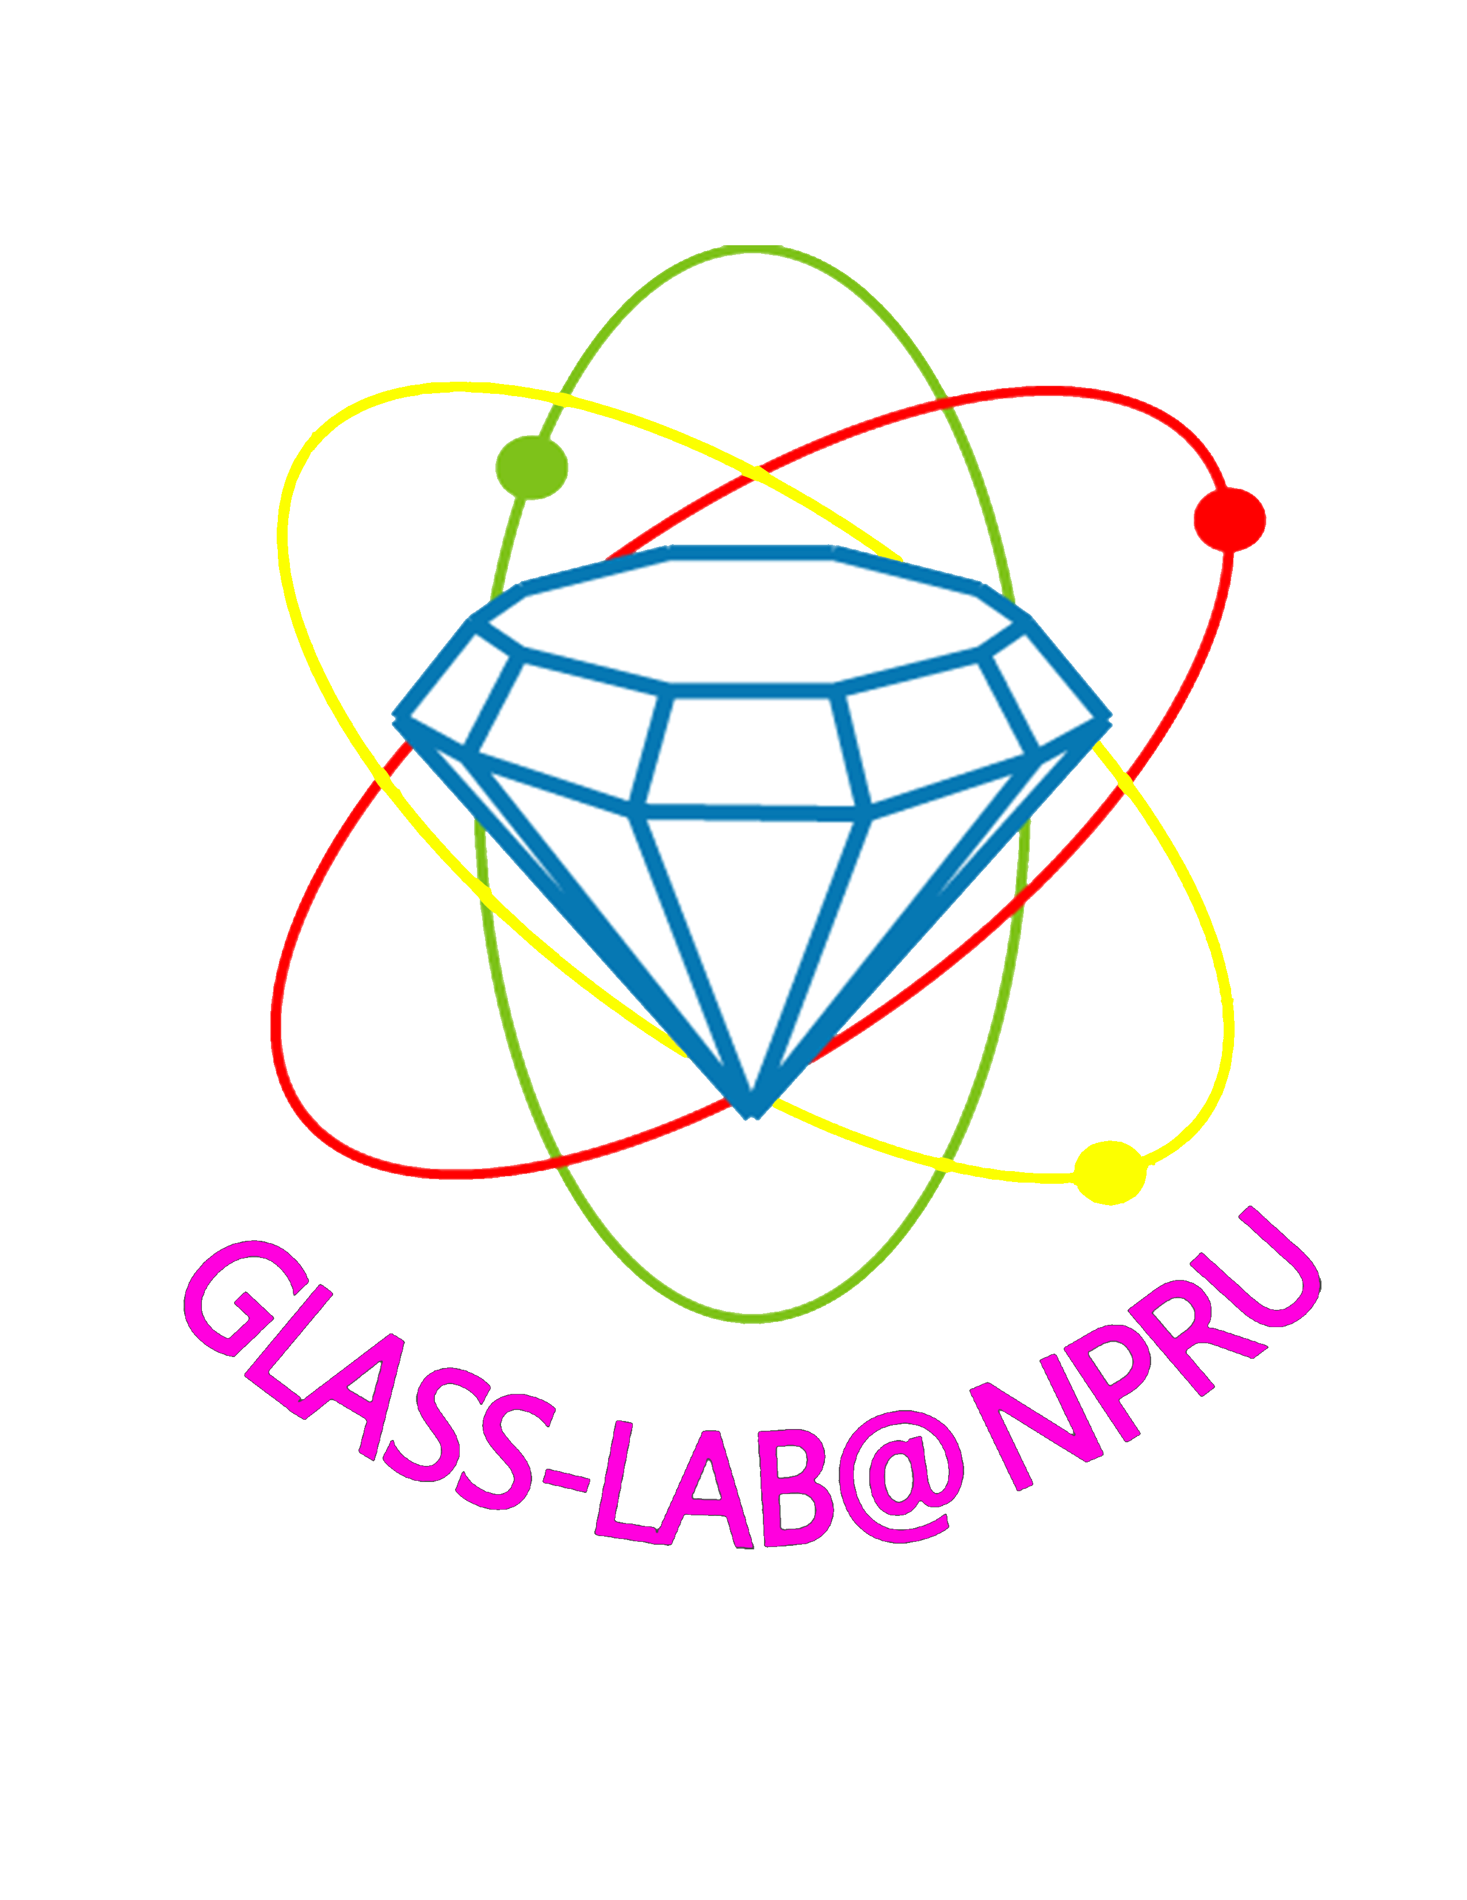

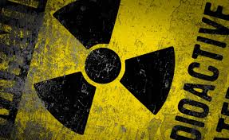
Luminescence behaviors of Sm³⁺ doped high density tungsten gadolinium borate scintillating glass
Jakrapong Kaewkhao
Center of Excellence in Glass Technology and Materials Science (CEGM)
Nakhon Pathom Rajabhat University, Nakhon Pathom, Thailand

Slide 2
Topic
GlassLab@NPRU
Application of Radiation Detection Materials
Concept of Glass
Luminescence from Ln3+
Glass Preparation
Result and Discussion
XRD, Density, Molar Volume
Transmission Spectra
Excitation and Emission (Photo, X-rays and Protron induced luminescence)
Temperature dependence (down to 10 K)
Decay time (PL and X-rays excitation)

Slide 3
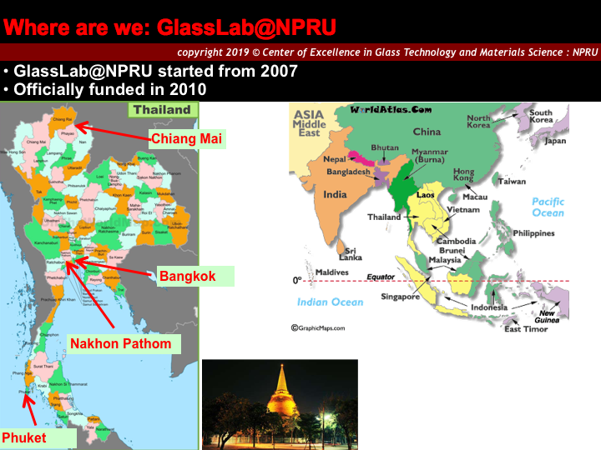

Slide 4
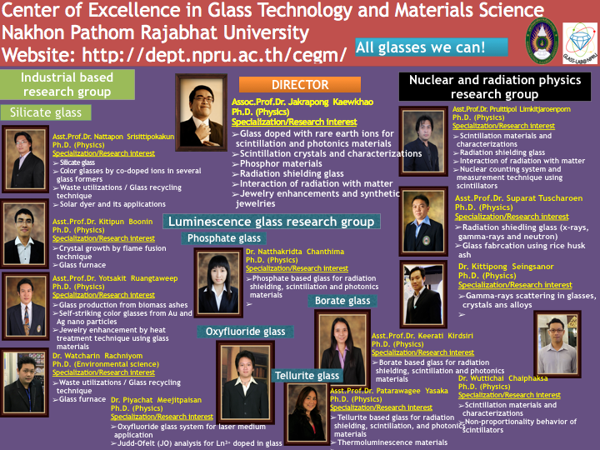

Slide 5
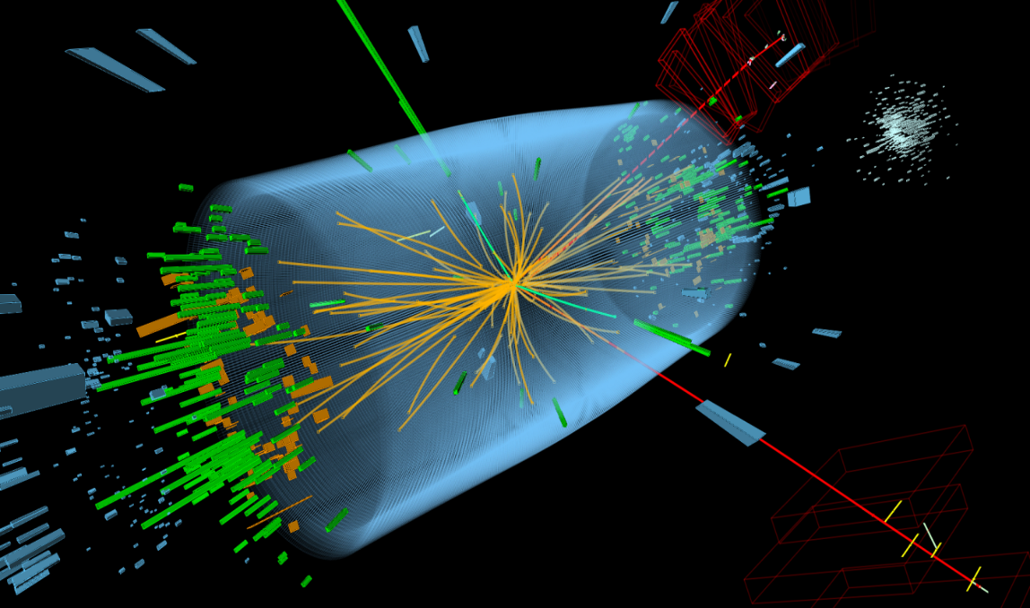
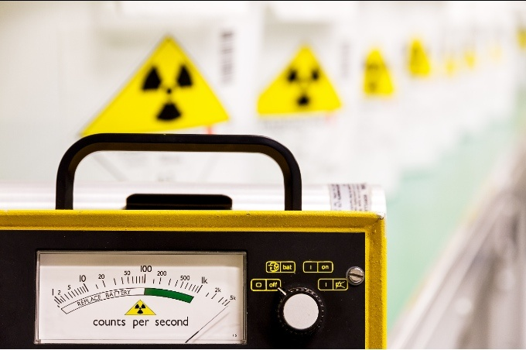
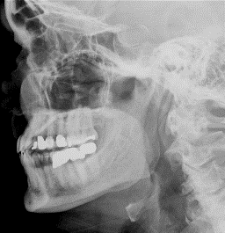
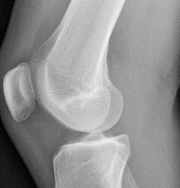
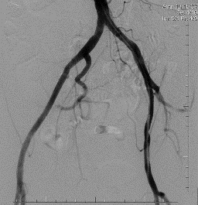
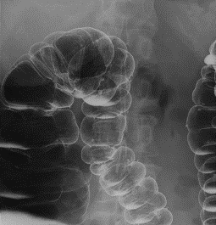
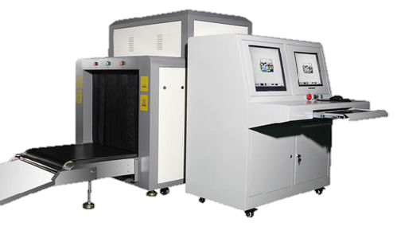
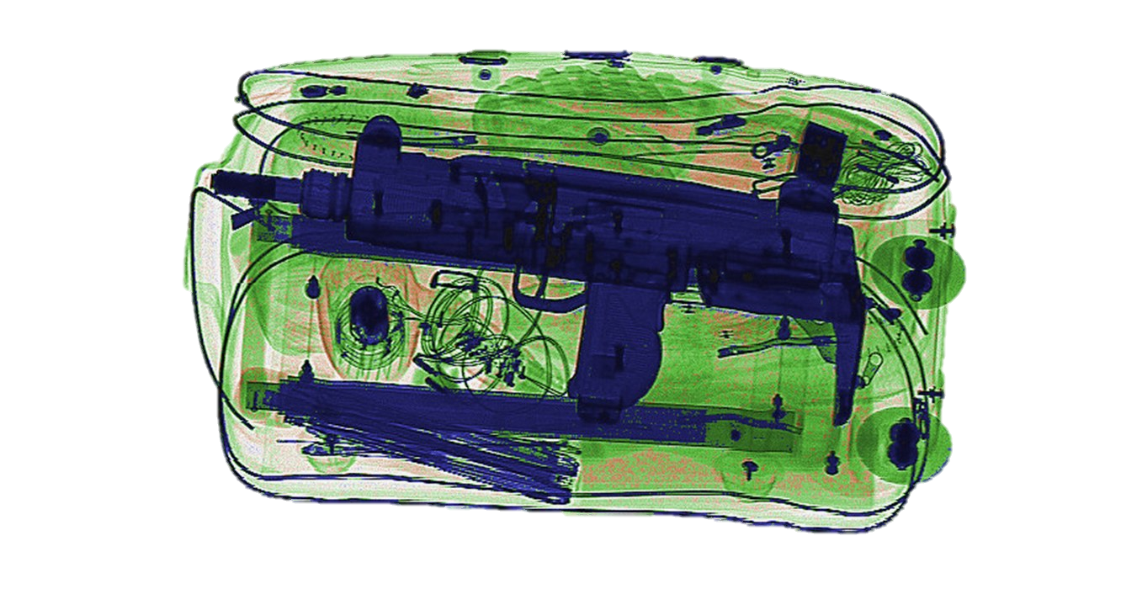
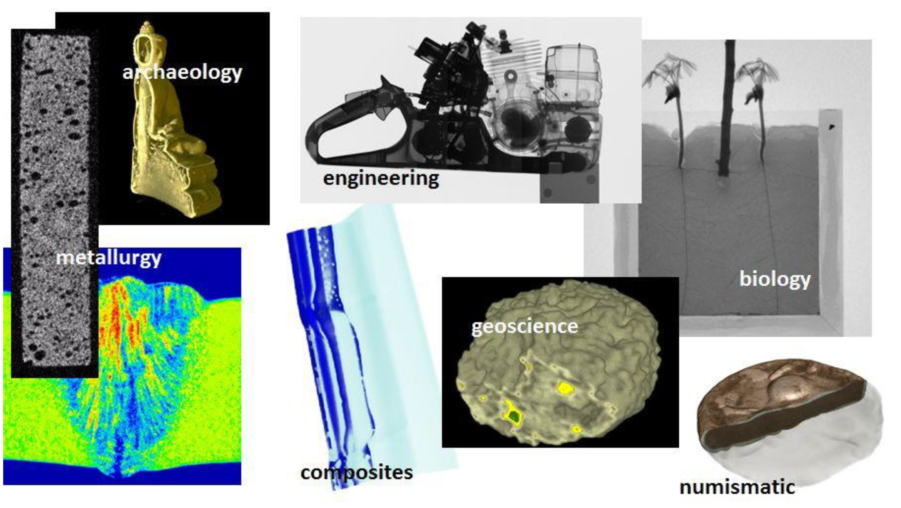
Radiation Detecting Material Application
X-ray imaging
High Energy / Nuclear Physics
Radiation Monitoring
Neutron Imaging
Homeland Security
2

Slide 6
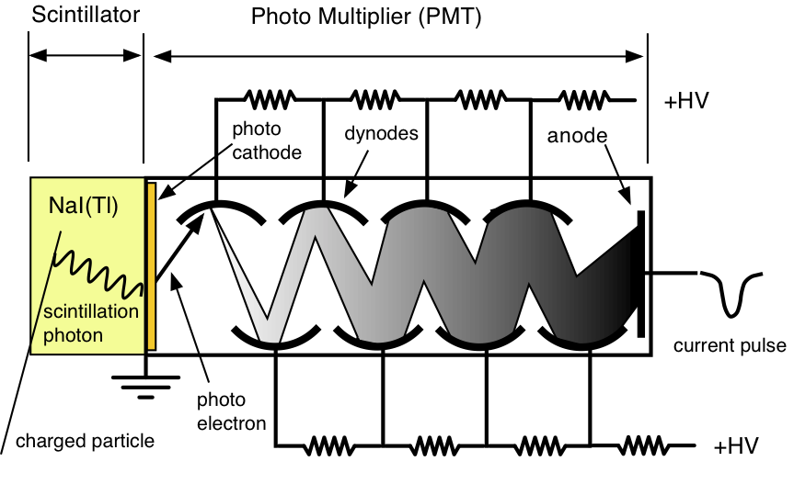
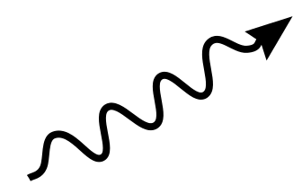
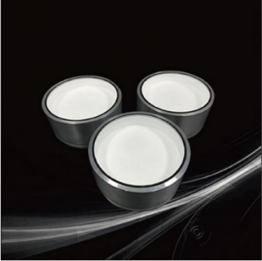
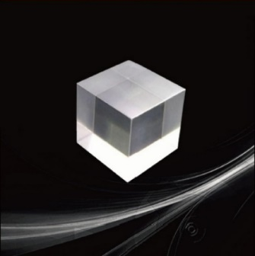
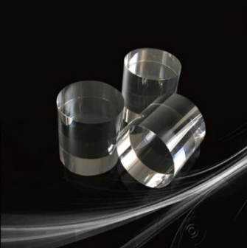
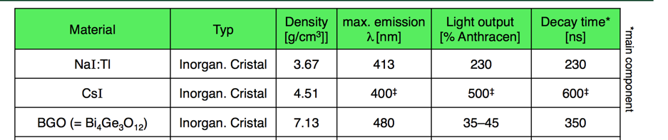
Radiation detection (bulk) material
Scintillation crystal
Radiation
NaI:Tl
CsI:Tl
BGO
3

Slide 7
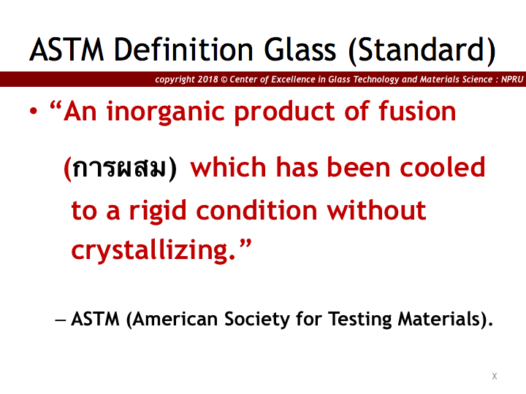

Slide 8
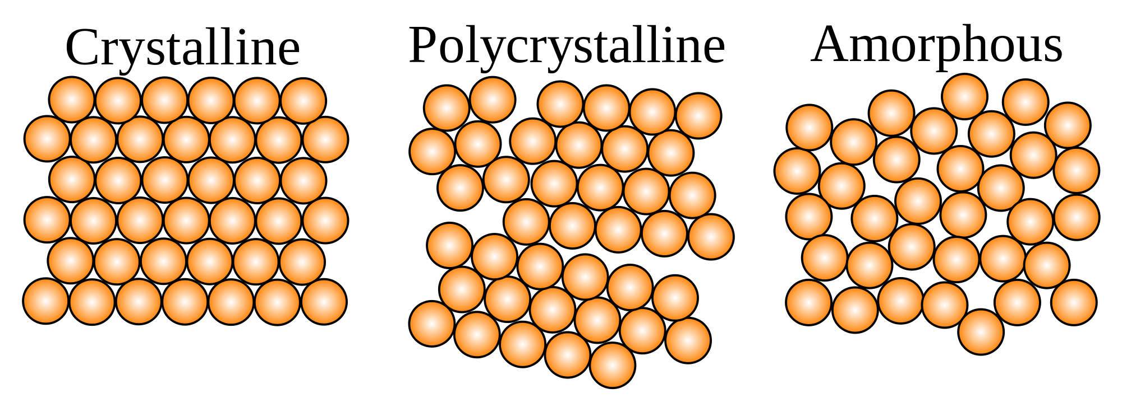
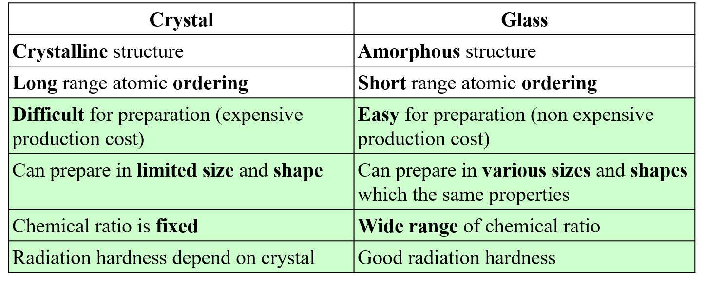
Single crystal and Glass
4

Slide 9
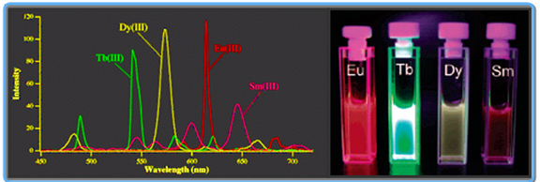
Luminescence properties of Ln³⁺
Ln³⁺
5s & 5p
Excitation factor
4f
Photon
Photon
Electric current
Chemical reaction
Neutron
etc (not heat directly)
Intense emission
Stable in difference host
4f-4f transition
Ln³⁺ | Emission (nm) | τ
Sm³⁺ | ~600 | ms
Dy³⁺ | ~483 and ~575 | ms
Eu³⁺ | ~613 | ms
Nd³⁺ | ~1050 , λ/2 to Green | μs
Tb³⁺ | ~544 | ms
Ce³⁺ | ~350 | ns
5

Slide 10
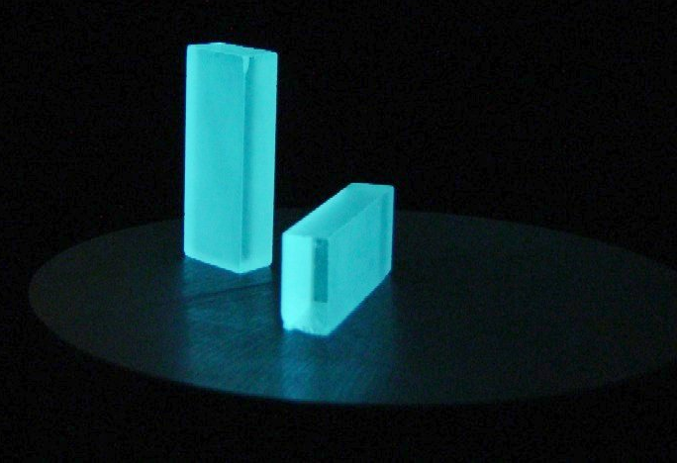
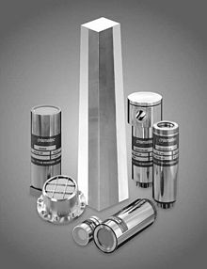
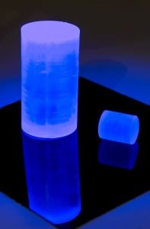
Glass for X-ray/neutron detection
The necessary properties of X-ray / neutron detection material
Good transparent (Borate glass)
Good interaction with X-ray (W & Gd) and neutron (B & Gd)
Good energy transfer from host to luminescence center (Gd3+)
Strong emission (Sm3+)
High density (W)
6

Slide 11
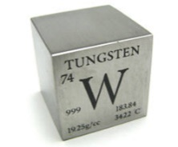
Composition of Glass
Gd
W
B
Tungsten
Tungsten are important due to increase density and decrease phonon in the glass.
Gd³⁺ as sensitizer
Good for capturing the neutron,
X-ray and γ- ray
Transfer energy to Ln³⁺
Sm
Borate
Borate compound is a suitable host glass with high transparency, high thermal stability, low melting point and good solubility of lanthanide ions.
¹⁰B can interact to thermal neutron with high capture cross-section
Sm³⁺ as luminescence center
Strong orange emission
Decay time in ms
42.5WO₃ ˗ 27.5Gd₂O₃ ˗ (30-x)B₂O₃ ˗ xSm₂O₃ Glass
Where x is 0.0, 0.1, 0.5, 1.0 and 2.0 mol%
Carel W.E. van Eijk, Inorganic scintillators for thermal neutron detection, Radiation Measurements 38 (2004) 337 – 342.
Gang Ho Lee, Yongmin Chang, Tae-Jeong, 2 - Properties and possible application areas, Ultrasmall Lanthanide Oxide Nanoparticles for Biomedical Imaging and Therapy (2014) 15–28.
Y. Taki, K. Shinozaki, T. Honma, V. Dimitrov, T. Komatsu, Journal of Solid State Chemistry 220 (2014) 191–197.
N. Wantana, S. Kaewjaeng, S. Kothan, H.J. Kim, J. Kaewkhao, Journal of Luminescence 181 (2017) 382–386.
N. Wantana, E. Kaewnuam, Y. Ruangtaweep, D. Valiev, S. Stepanov, K. Yamanoi, H.J. Kim, J. Kaewkhao, Radiation Physics and Chemistry 164 (2019) 108350.
7

Slide 12
Objective
- To prepare high density glass and study their luminescence behaviors for radiation detection materials application

Slide 13
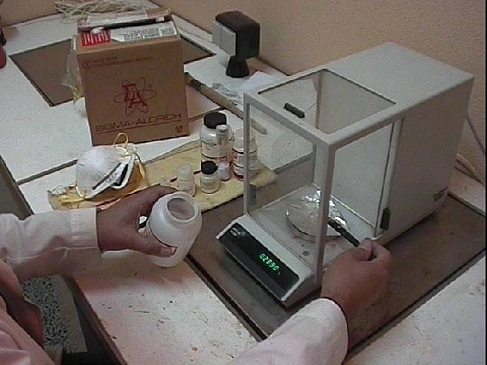
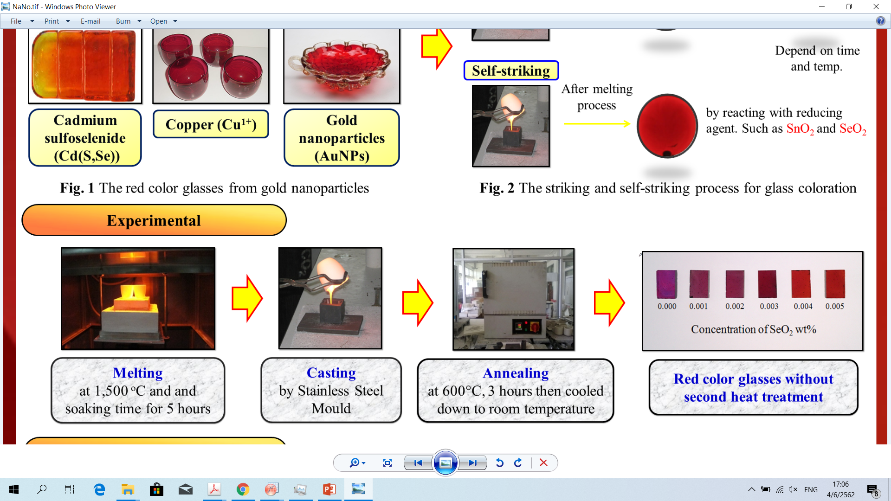
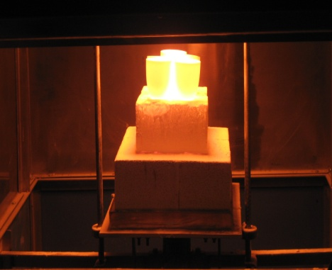
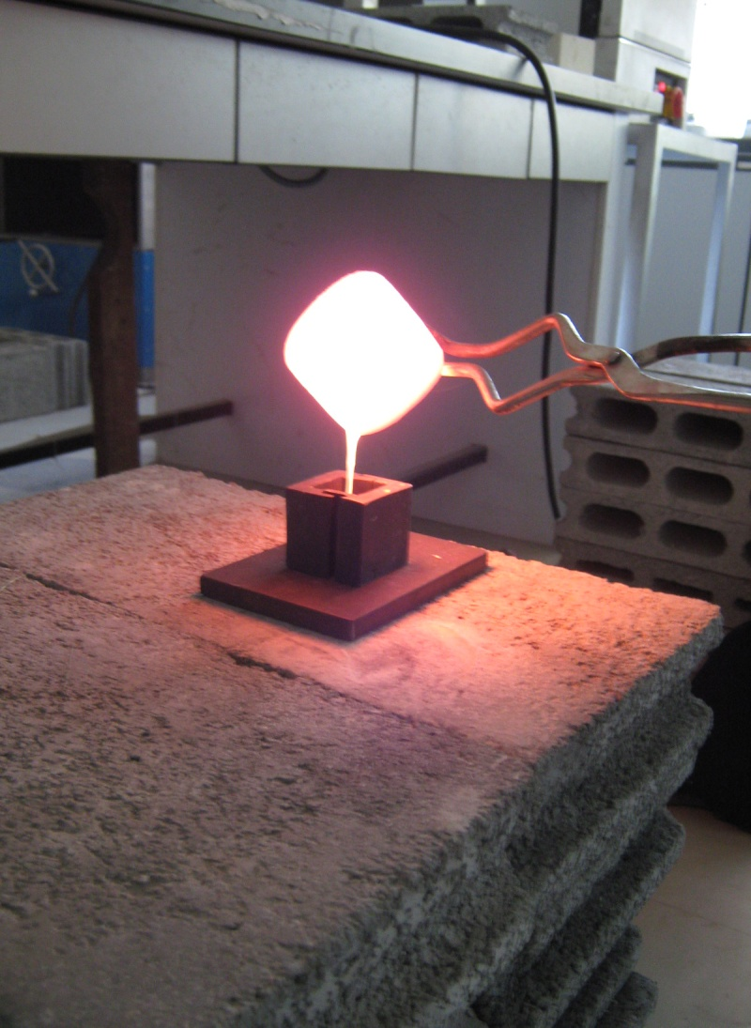
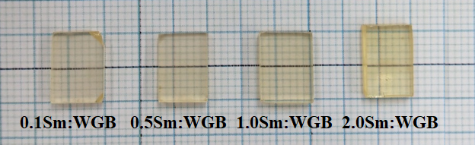
Glass Preparation
42.5WO₃ ˗ 27.5Gd₂O₃ ˗ (30-x)B₂O₃ ˗ xSm₂O₃ Glass
Where x is 0.0, 0.1, 0.5, 1.0 and 2.0 mol%
1200 ̊C
500 ̊C
Weight
Melt
Anneal
Poured into preheat stainless steel mould
Put alumina crucible in Electric Furnace
8

Slide 14
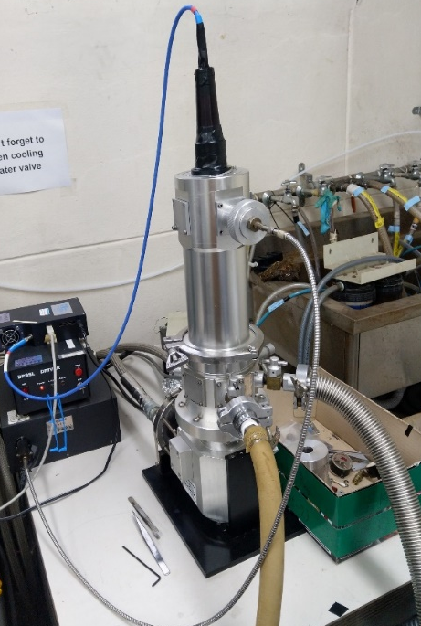
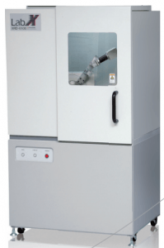
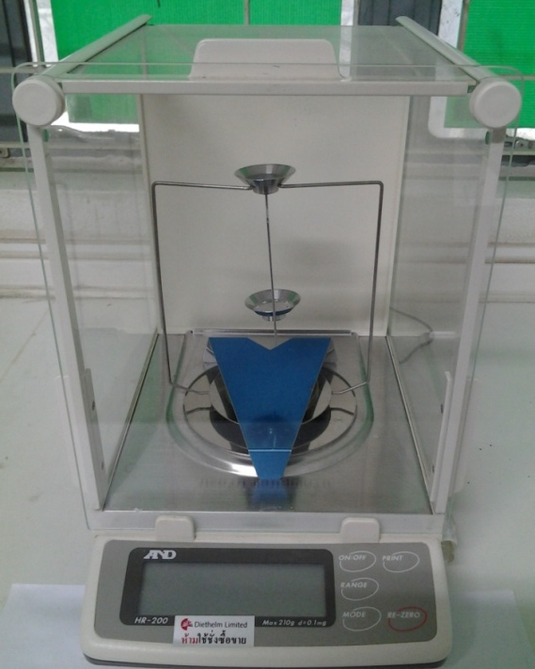
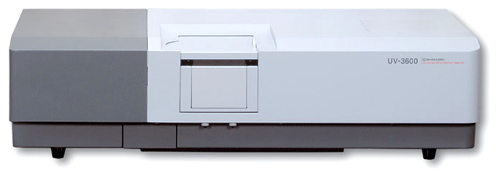
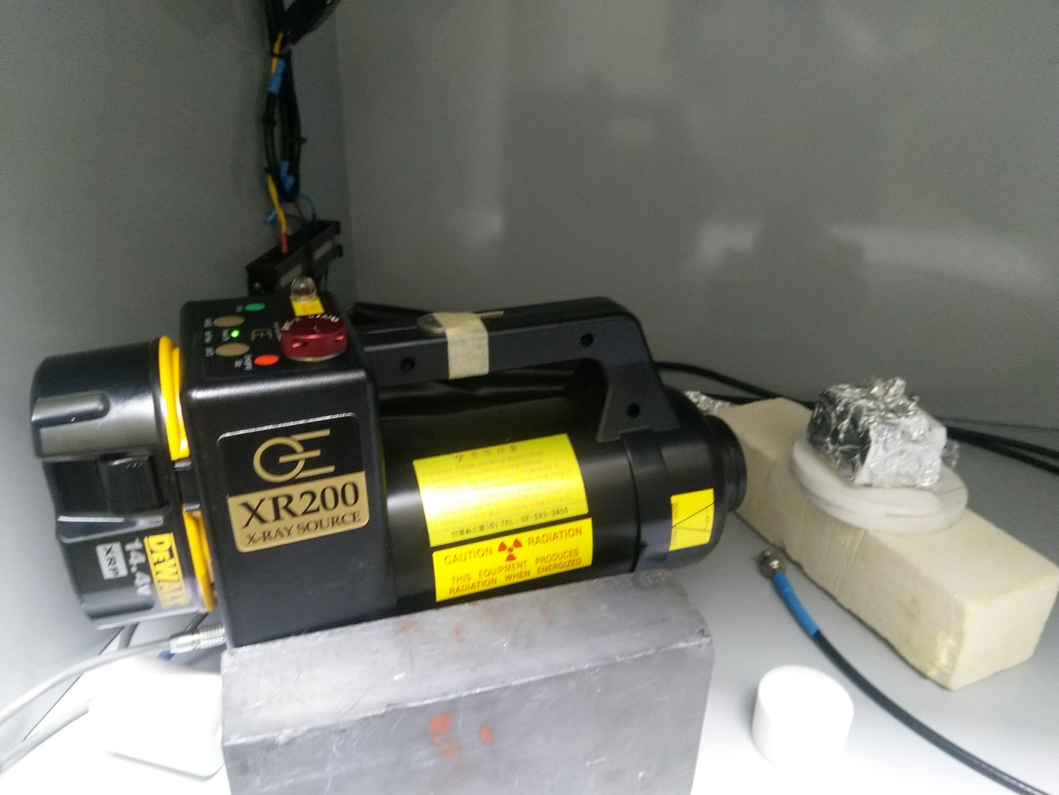
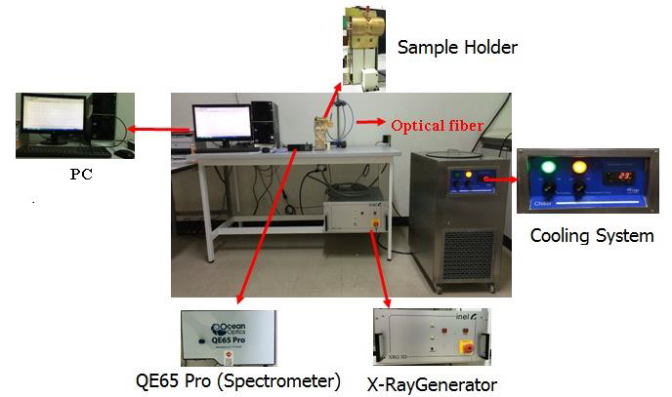
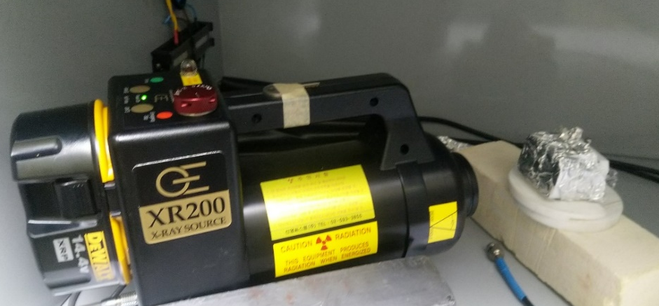
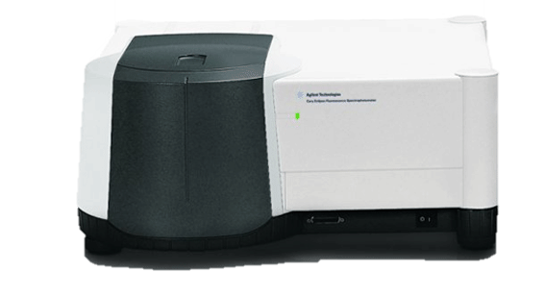
Analytical instrument
Temperature-dependent Luminescence
XRD
ρ; Archimedes principle
Absorption spectra
UV-3600 Shimadzu Spectrophotometer
(XRD) (Shimadzu XRD-6100)
4-digit sensitive microbalance A&D HR-200
X-Rays Induced Optical Luminescence (Raidolumenescence; RL)
X-ray source was operated
at 50 kV and 30 mA
Pulse X-ray decay curve
Photoluminescence (PL)
Pulse x-ray 20 ns
Cary Eclipse Fluorescence Spectrophotometer
9

Slide 15
XRD, Density & Molar Volume
The XRD pattern confirms the weak of crystalline phase that indicates
the amorphous nature of the glass system.
Molar volume
Density
36.647 – 36.360 cm³/mol
5.986 – 6.180 g/cm³
(a)
(b)
Fig. (a) XRD pattern of 2.0Sm:WGB glass and (b) density and molar volume of Sm:WGB glasses.
10

Slide 16
Transmission Spectra
Journal of Luminescence 181 (2017) 382–386, Applied Physics B 98 (2010) 417–421.
Glass samples absorbed photon in VIS and NIR region
Fig. (a) The transmission of the Sm:WGB glasses.
11

Slide 17
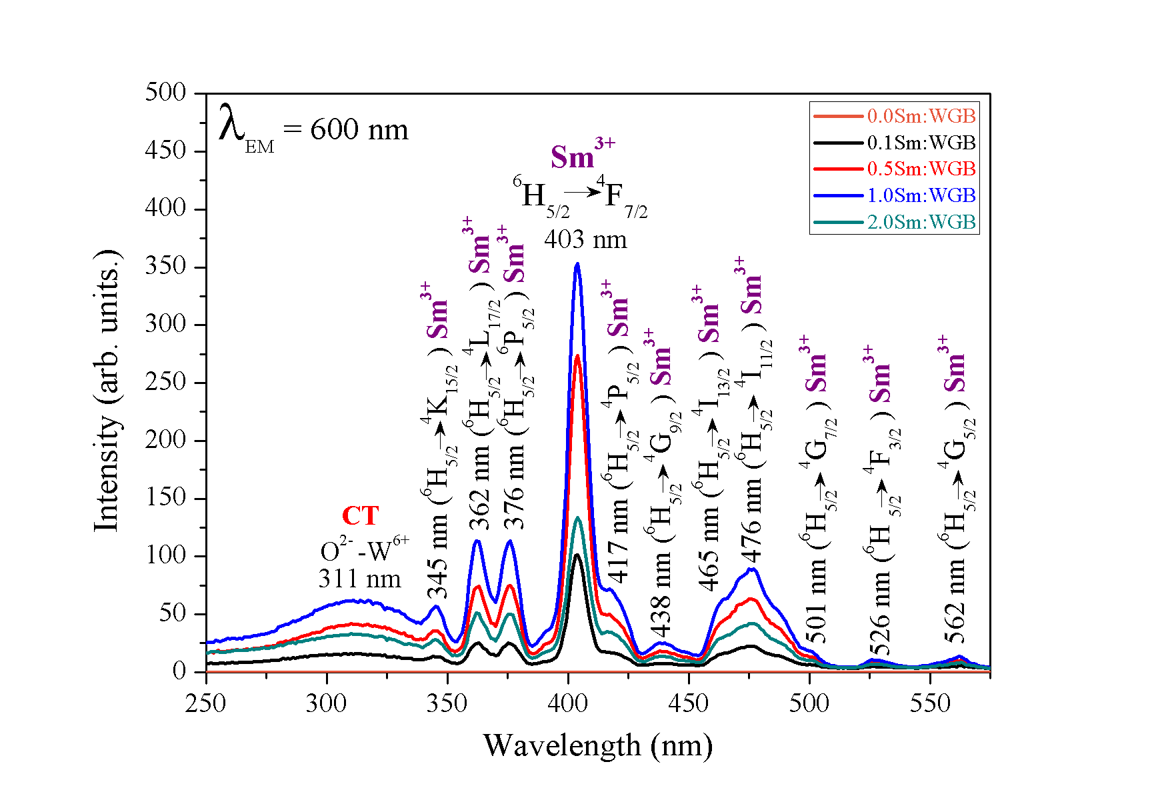
Excitation Spectra
11

Slide 18
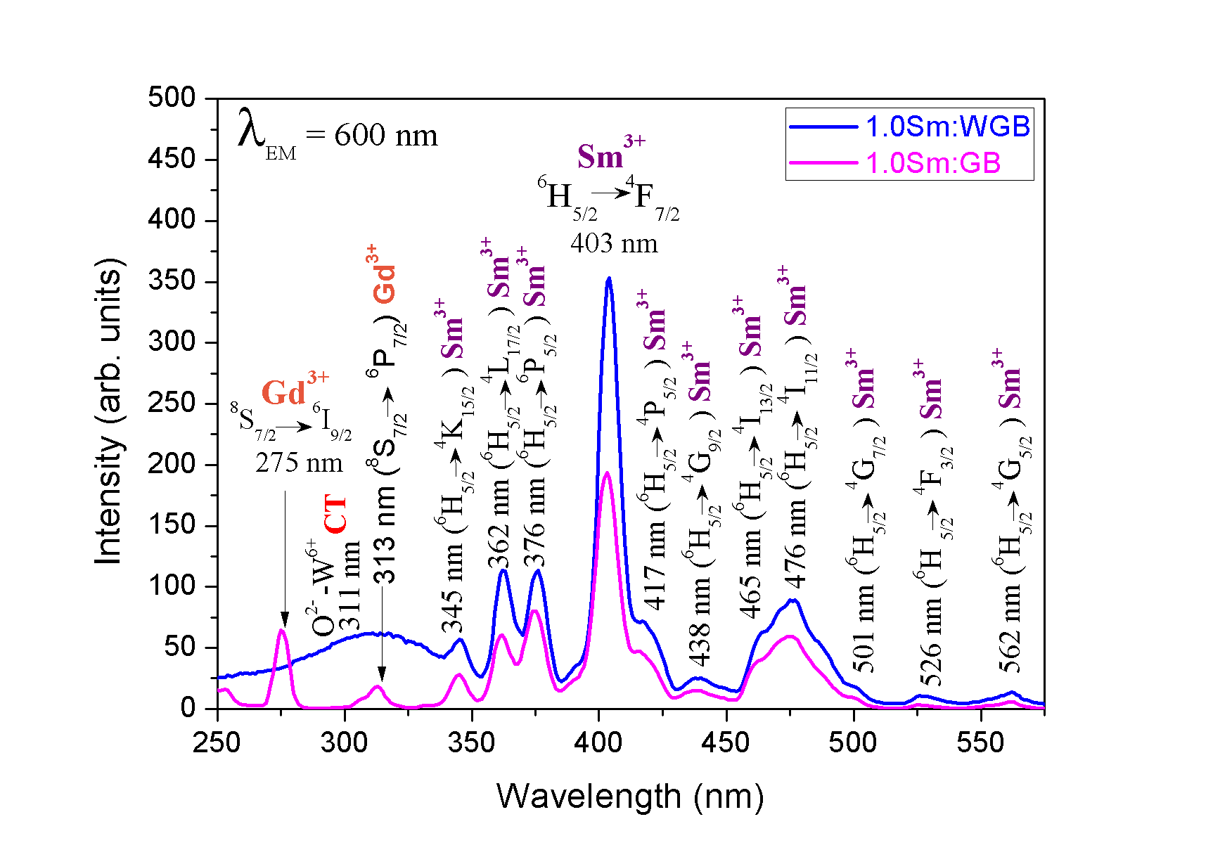
Excitation Spectra (with/without WO3)
With WO3
42.5WO₃ ˗ 27.5Gd₂O₃ ˗ (29-x)B₂O₃ ˗ 1Sm₂O₃ Glass
Without WO3
70Gd₂O₃ ˗ (29-x)B₂O₃ ˗ 1Sm₂O₃ Glass
11

Slide 19
Photoluminescent spectra (with WO3, Vary Sm2O3 concentration)
Journal of Luminescence 181 (2017) 382–386, Applied Physics B 98 (2010) 417–421.
Glass show the strongest emission with 600 nm
Intensity of emission is highest at
1.00 mol% Sm₂O₃ doped glass
Concentration quenching effect
Under 275 nm excitation
Under 311 nm excitation
Under 403 nm excitation
12

Slide 20
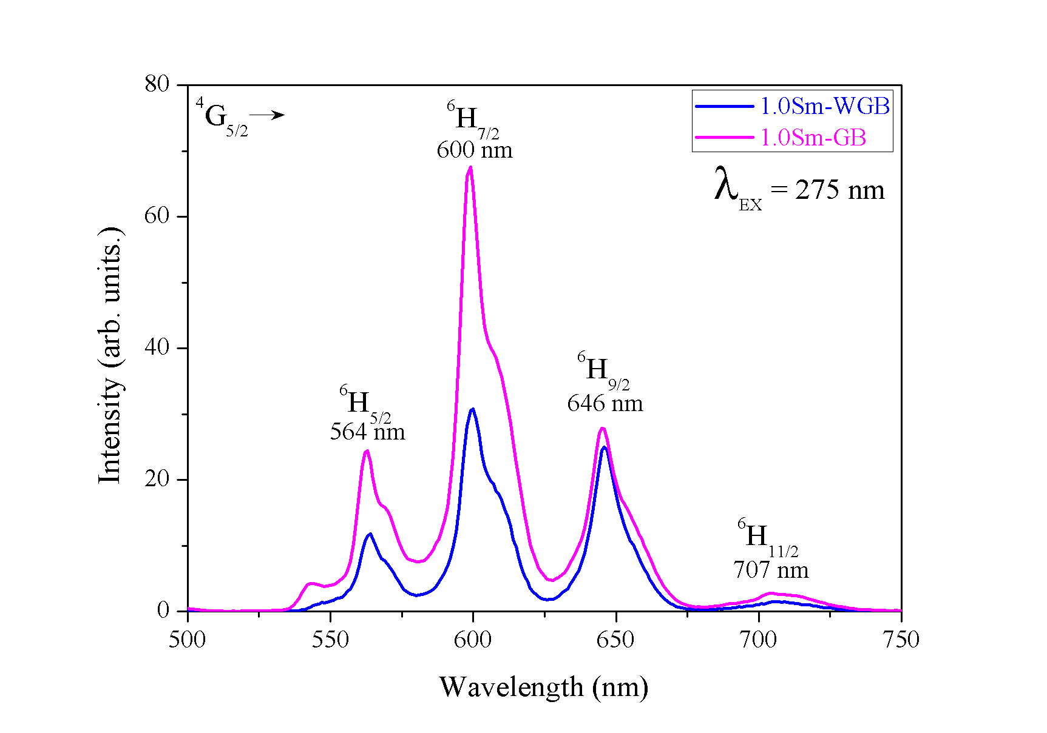
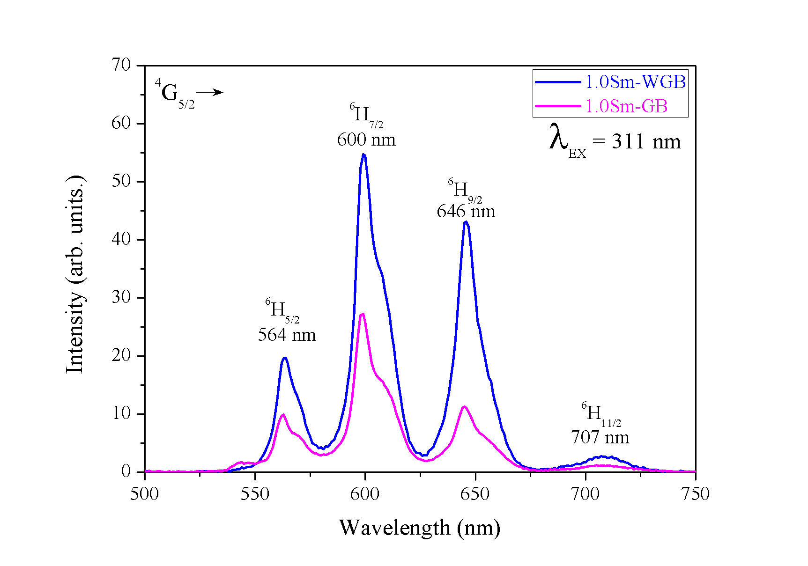
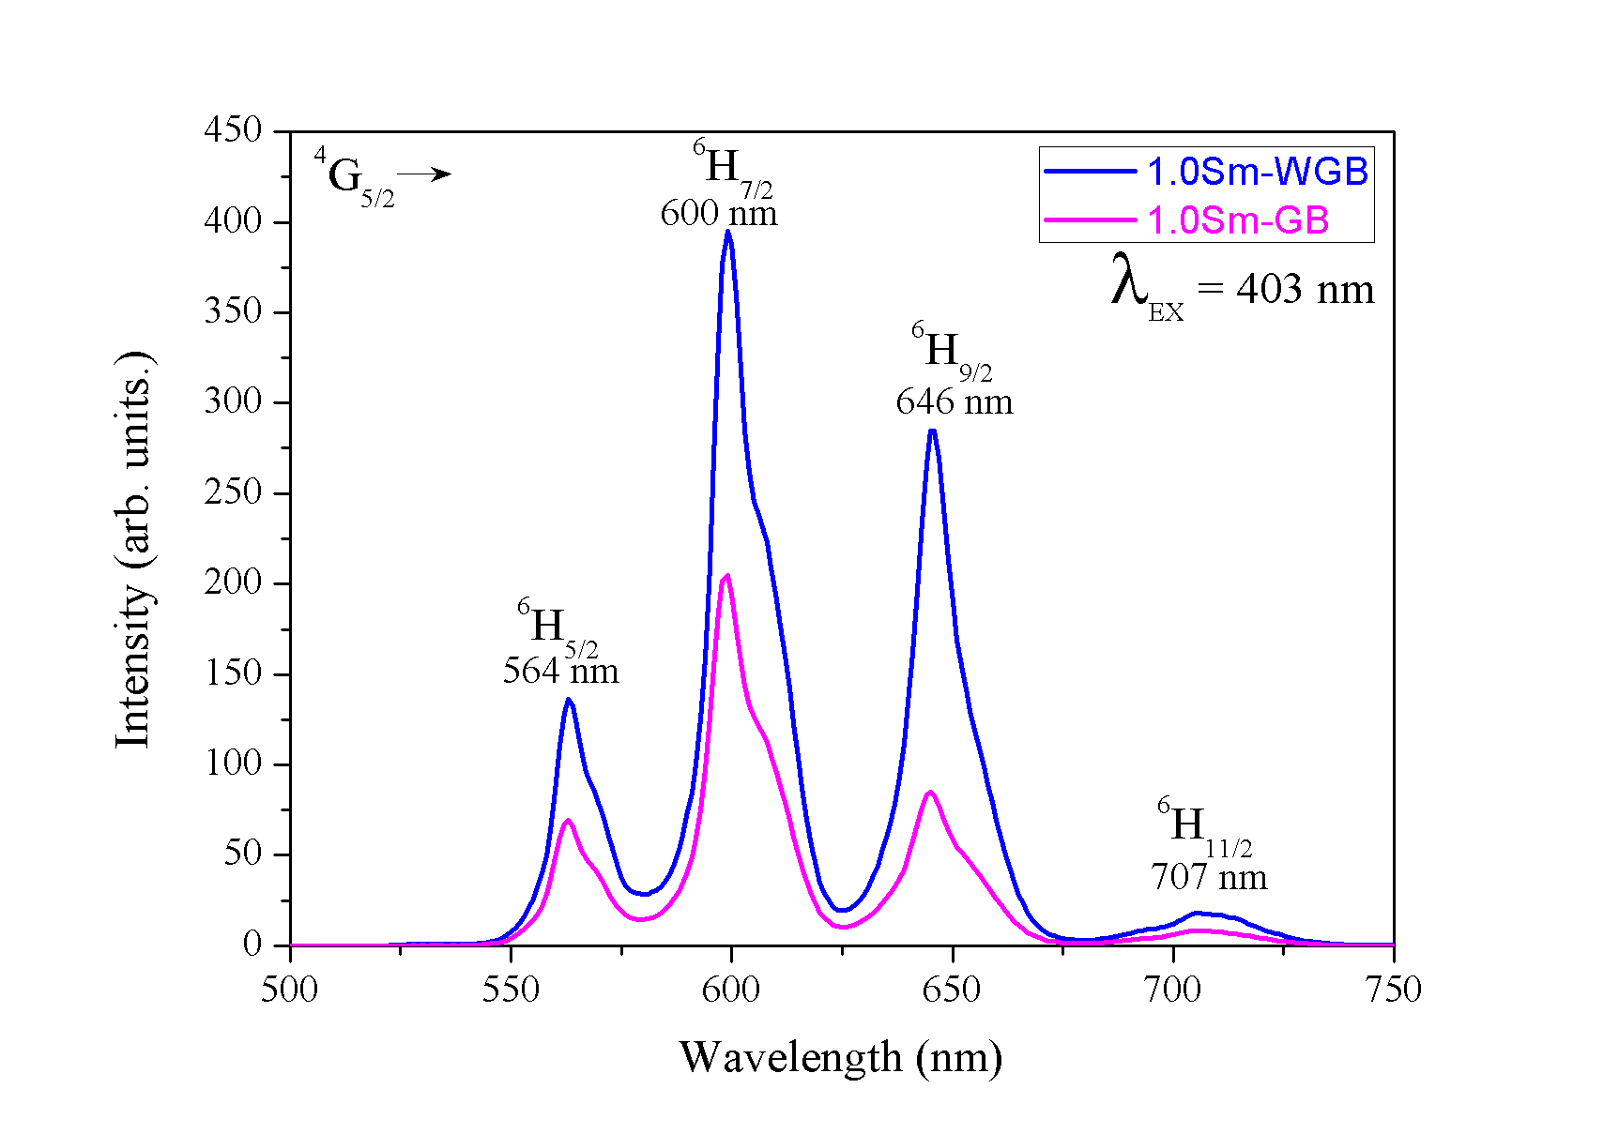
Photoluminescent spectra (with/without WO3)
Journal of Luminescence 181 (2017) 382–386, Applied Physics B 98 (2010) 417–421.
Under 275 nm excitation
Under 311 nm excitation
Under 403 nm excitation
12

Slide 21
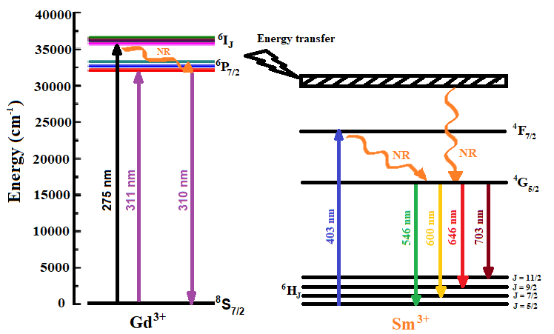
The emission intensity & Energy diagram
Journal of Luminescence 181 (2017) 382–386, Applied Physics B 98 (2010) 417–421.
(a) (b)
Fig. (a) The emission intensity of 600 nm under all three wavelengths excitation as a function of Sm₂O₃ concentration and
(b) Energy levels diagram of Gd³⁺ and Sm³⁺ ions in the WGB glasses for PL emission spectra.
13

Slide 22
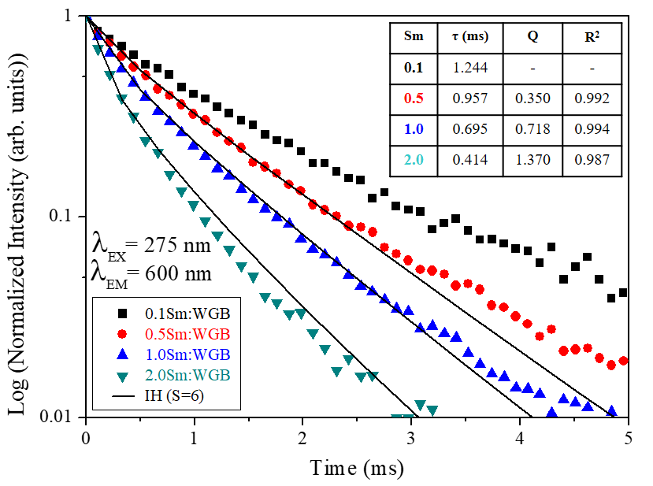
Decay curve
Journal of Luminescence 181 (2017) 382–386, Applied Physics B 98 (2010) 417–421.
Table. Lifetime (τ) and energy transfer parameter (Q)
and R-squared (R²) of the Sm:WGB glasses
Glass | τ (ms) | Q | R²
0.1Sm:WGB | 1.244 | - | -
0.5Sm:WGB | 0.957 | 0.350 | 0.992
1.0Sm:WGB | 0.695 | 0.718 | 0.994
2.0Sm:WGB | 0.414 | 1.370 | 0.987
The energy transfer parameter (Q) that relates to the probability of energy transfer between Sm³⁺ ions.
Fig. Decay curves of the Sm:WGB glasses for 600 nm emission under 275 nm excitation
14

Slide 23
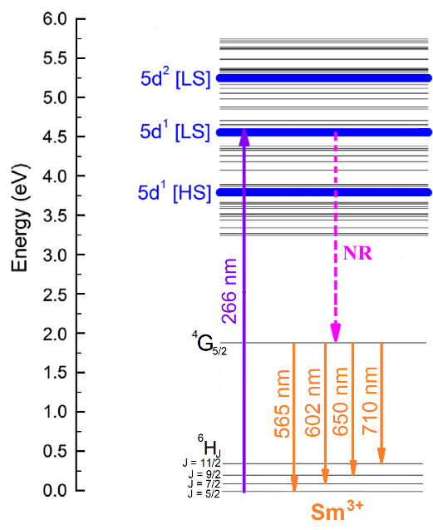
Temperature dependent luminescence
Journal of Luminescence 181 (2017) 382–386, Applied Physics B 98 (2010) 417–421.
The emission intensity at 10 K is higher than the intensity at 300 K around 3.76 times
(a) (b)
Fig. (a) the temperature dependent luminescence spectra and (b) Energy diagram of temperature dependent luminescence in the 1.0Sm:WGB glass
15

Slide 24
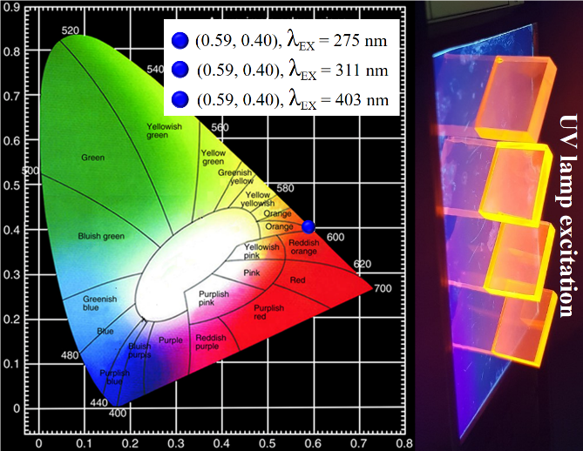
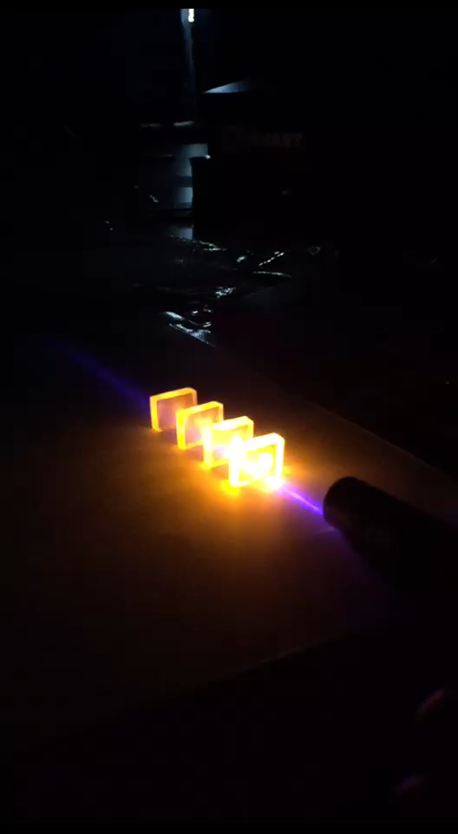

CIE 1931 Chromaticity
Under laser excitation
(405 nm)
Under UV lamp excitation
16

Slide 25

X-rays induced optical luminescence
Journal of Luminescence 181 (2017) 382–386
The obtained fast (τ₁) and slow (τ₂) luminescence decay time of glass is
0.020, and 0.268 ms, respectively.
(a) (b)
Fig. (a) RL spectra of the Sm:WGB glasses (b) RL decay curve of the 1.0Sm:WGB glass.
17

Slide 26

Proton Luminescence
Journal of Luminescence 181 (2017) 382–386,
1.0Sm:WGB glass
Emitted photons with 4 wavelengths via similar transitions in the RL spectra.
Glass show the strongest emission with 650 nm (⁴G_{5/2} →⁶H_{9/2})
Fig. protonluminescence spectrum of the 1.0Sm:WGB glass.
18

Slide 27
Conclusion
Scintillating Sm:WGB glass are very heavy, having densities up to 6.18 g/cm³.
For photoluminescence, energy transfer from Gd³⁺ to Sm³⁺ resulted to the strongest emission around 600 nm of Sm³⁺ (⁴G_{5/2} →⁶H_{7/2}).
For the X-ray induced optical and proton luminescence, the emission spectra were nearly identical to those of the PL, but strongest intensity at 650 nm (⁴G_{5/2} →⁶H_{9/2}) wavelength. (PL is strongest at 600 nm peak)
The optimum concentration of Sm₂O₃ for WO₃-Gd₂O₃˗B₂O₃ glass is 1.0 mol% which performed the highest emission intensity in these two types of luminescence spectra.
The emission intensity of glass increased 3.7 times, with temperature down to 10 K)
The decay time under pulse X-ray excitation is 0.268 ms that is in the same order of photoluminescence decay time.
These glasses perform a potential for applications in the high energy / nuclear physics, radiation monitoring and homeland security.
19

Slide 28


Acknowledgements
The Royal Golden Jubilee (RGJ) Ph.D. Program (Grant No. PHD/0100/2559)
Prof. HongJoo Him, Department of Physics, Kyungpook National University, Daegu, Republic of Korea
20

Slide 29
Thank you for your attention

