Slide 1



Indian Institute of Technology Bombay
Mumbai, India
Nuclear shapes and symmetries seen through measurement of short lifetimes
Pragya Das
3rd JAGIELLONIAN SYMPOSIUM IN KRAKOW (POLAND), June 24-28, 2019

Slide 2

Map of India
New Delhi
Mumbai

Slide 3

Tata Institute of Fundamental Research (TIFR)
Mumbai-400005, India
14 MV Heavy ion accelerator (Pelletron)
Heaviest beam delivered so far ¹²⁷I
Arabian Sea

Slide 4

Inter University Accelerator Center (IUAC), New Delhi, India
14 MV Heavy ion accelerator (Pelletron)

Slide 5
Research group
Prof. (Mrs.) Pragya Das, IIT Bombay
Mr. Himanshu Kumar Singh, IIT Bombay
Mr. Bhushan Bhujang, IIT Bombay
Mr. Virendra Kumar Pasi, IIT Bombay
Mr. Umakant Lamani, IIT Bombay
Mr. Satyajit Ghosh, IIT Bombay
Dr. Bhushan Kanaglekar, R. C. University, Belagavi (earlier IIT Bombay)
Dr. S. Muralithar, IUAC, New Delhi
Dr. R. P. Singh, IUAC, New Delhi
Prof. R. Palit, TIFR, Mumbai

Slide 6
Plan of the talk
Nuclear shapes: spherical, axially symmetric and triaxial.
Triaxial nuclei (in mass region 130): Observed phenomena
(i) Signature splitting and inversion,
  (ii) Chirality.
  Our study: Lifetime measurement using
  Doppler shift attenuation method (DSAM)
  (i) ¹²⁶I: ⁷Li beam (50 MeV) on ¹²⁴Sn target,
  (ii) ¹²⁹Cs: ¹¹B beam (70 MeV) on ¹²⁴Sn target
  (iii) ¹³⁰La: ¹⁹F beam (94 MeV) on ¹¹⁶Cd target
  Understanding symmetries through reduced transition probabilities
  Theoretical tool: Particle rotor model
          Summary and future plan
June 25, 2019

Slide 7
Nuclear shapes and symmetries
Rotational symmetry
No collective rotation possible
Single particle excitations
Spherical
Rotational symmetry broken
a = b < c or a = b > c
Signature symmetry exist
Collective rotation possible about axis perpendicular to symmetry axis
K is good quantum number.
Axial Prolate
Axial Oblate
Rotational symmetry broken
Collective rotation possible with two different signatures causing Signature splitting and inversion.
K is not a good quantum number.
Rotational freedom
Suitable for Chiral symmetry
Triaxial
June 25, 2019

Slide 8
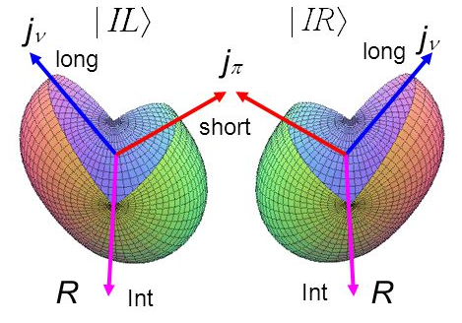
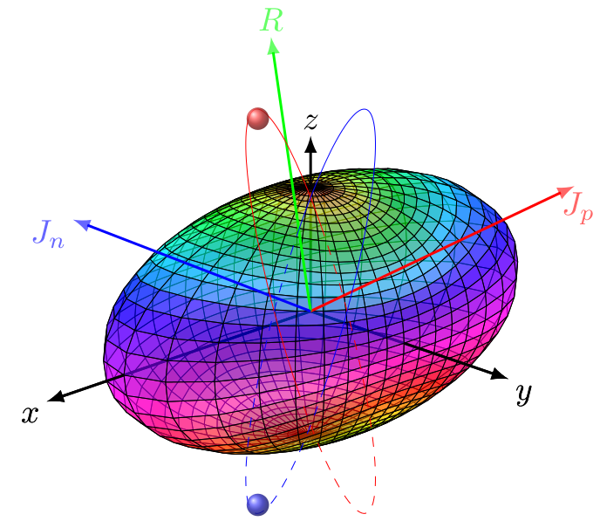
Triaxial nuclei: freedom of rotation
Odd-odd Nuclei
Rotational freedom encourage the nuclei move to any axis.
Triaxial deformation with three distinct orientation of angular momenta for proton, neutron and rotation.
Leads to the formation of Chiral nuclei.
June 25, 2019

Slide 9
Axially symmetric shape ⇒ Symmetry in rotation by angle π
conserved quantum number Signature (α)
For nuclear state of spin I
I = α mod 2
Even-even or odd-odd nuclei
α = 0 for I = 0, 2, 4, 6………
α = 1 for I = 1, 3, 5, 7………
Even-odd or odd-even nuclei
α = +1/2 for I = 1/2, 5/2, 9/2,.……
α = -1/2 for I = 3/2, 7/2, 11/2,……
June 25, 2019

Slide 10
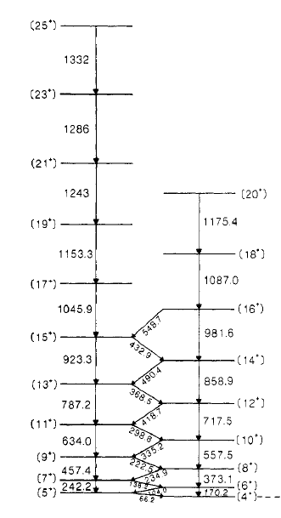
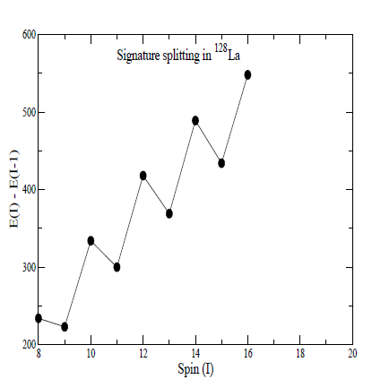
Triaxial shape
¹²⁸ La
α = 1
Signature splitting
α = 0
Godfrey et al., J. Phys. G: Nucl. Part. Phys. 15, 487 (1989)
June 25, 2019

Slide 11
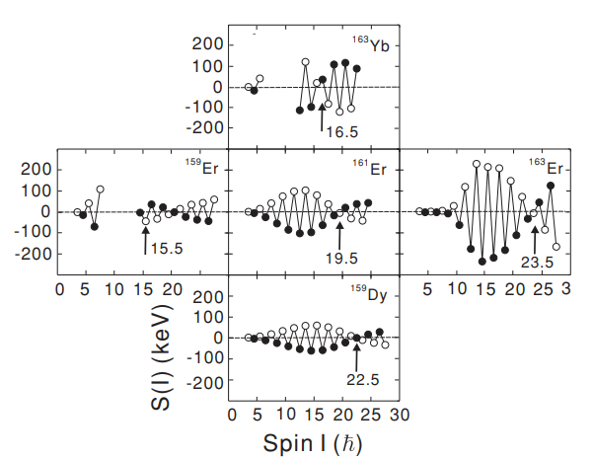
Signature inversion
L Chen et al., Phys. Rev. C 83, 034318 (2011)
Mass near 160
Signature inversion shown as arrow (↑)
Possible causes?
S(I) ≡ ΔE ≡ [E(I) - E(I-1)] - {E(I+1)-E(I)+E(I-1)-E(I-2)}/2
June 25, 2019

Slide 12
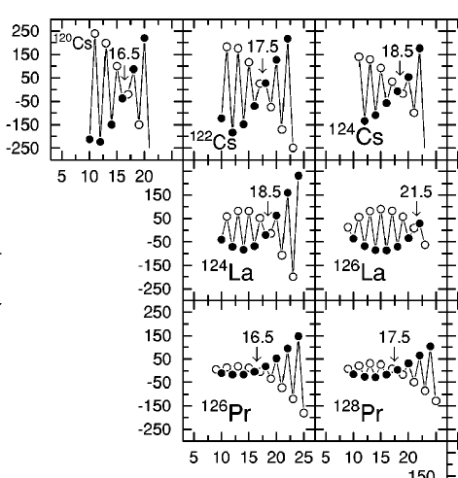

Odd-odd nuclei in mass region 130
Hartley et al., Phys. Rev. C65, 044329 (2002)
Possible cause of signature inversion
↓
Change in the rotational axis of triaxial nuclei
OR
Change in shape
ΔΕ
πh_{11/2} ⊗ νh_{11/2}
Spin
June 25, 2019

Slide 13
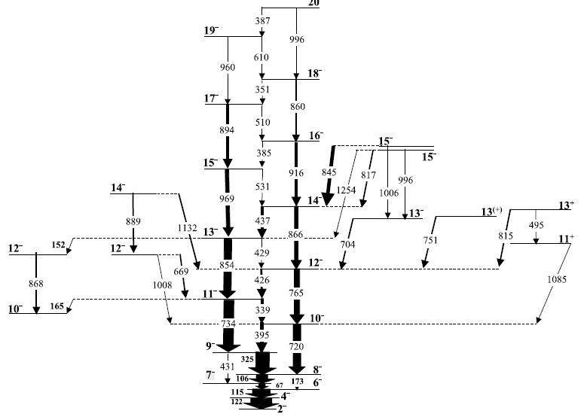
Case of ¹²⁶I: Change in axis or shape?
¹²⁴Sn(⁷Li, 5n)¹²⁶I at E_{beam} = 50 MeV
Yrast band
B. Kanagalekar et al., Phys. Rev. C88, 054306 (2013)
June 25, 2019

Slide 14
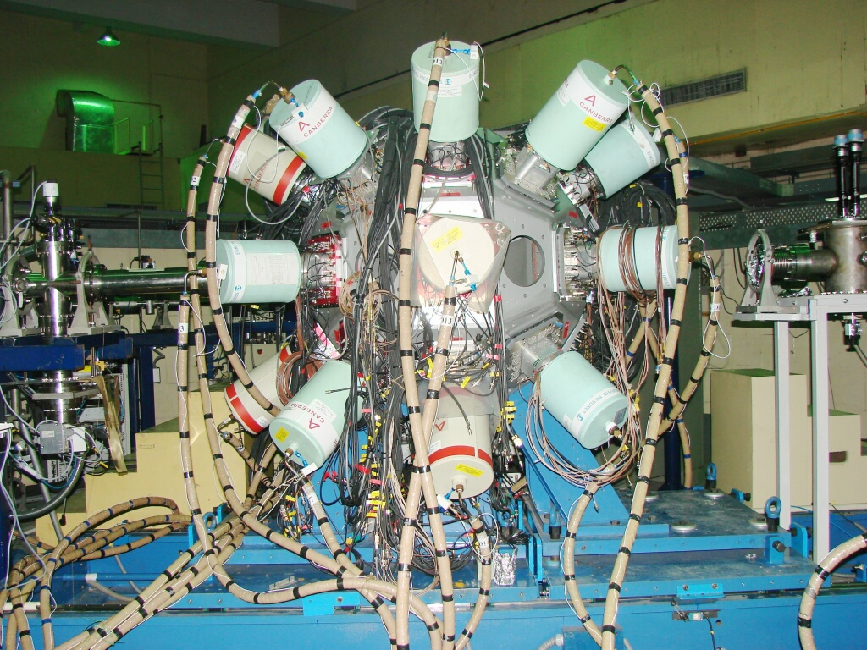
Clover detector setup
at Inter University Accelerator Center, New Delhi, India
June 25, 2019

Slide 15
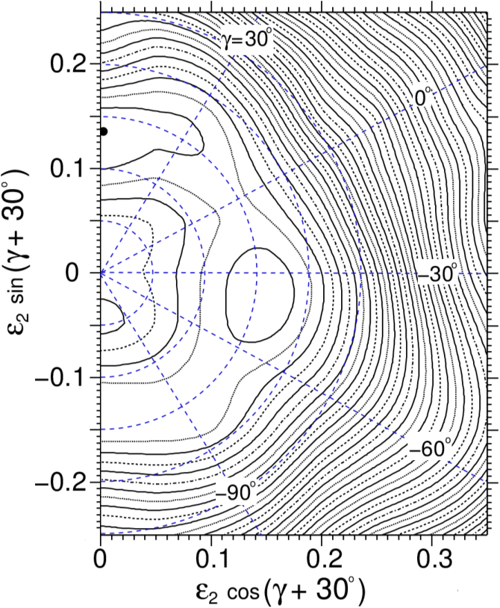
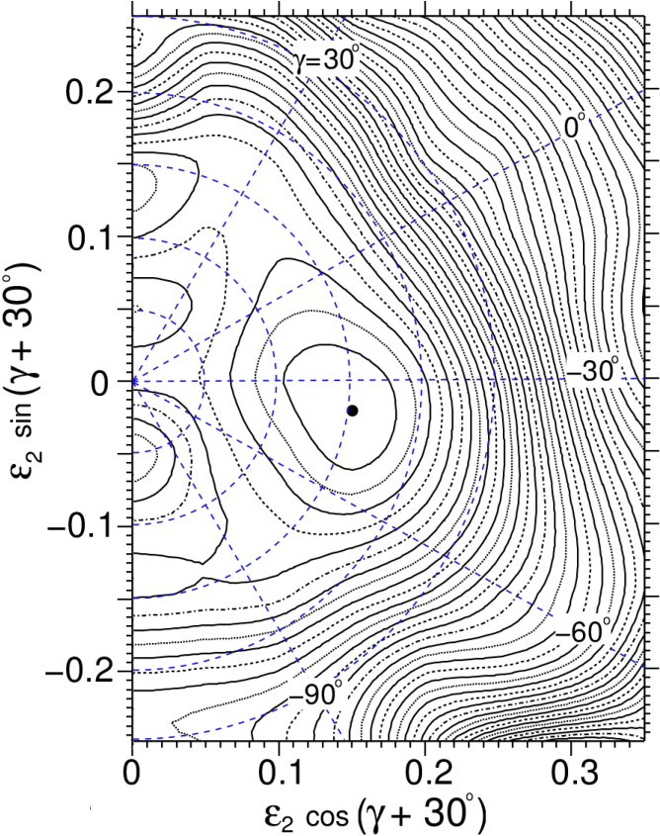
Theoretical prediction: TRS calculation
Low spin: γ ≈ +45⁰
High spin: γ ≈ -45⁰
June 25, 2019

Slide 16
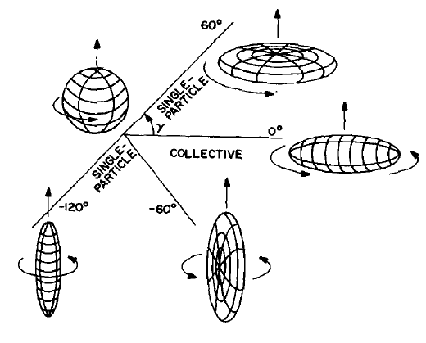
Nuclear deformation parameters
  Nuclear deformation R₀ : Radius of sphere
  Y_{λμ} : Spherical harmonics
  λ = 2 Quadrupole deformation
  λ = 3 Octupole deformation
Lund convention
Quadrupole deformation
β
Deformation parameters
β ≡ Measure of axial deformation
γ ≡ Degree of triaxiality
ε₂ ≡ 0.95β
June 25, 2019

Slide 17
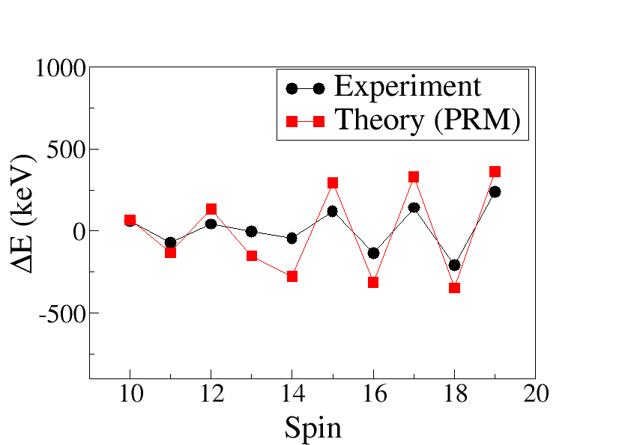
Theoretical prediction: PRM calculation
Low spin: β = 0.15, γ = +45°
High spin (above inversion):
β = 0.15, γ =−45°
Difference of ∼ 200 keV
The predicted particle configuration near bandhead:
π d_{5/2}⊗ ν h_{11/2} (dominant) mixed with π g_{7/2}⊗ ν h_{11/2}
signature inversion possibly due to change in axis of rotation
From shortest to intermediate axis.
June 25, 2019

Slide 18
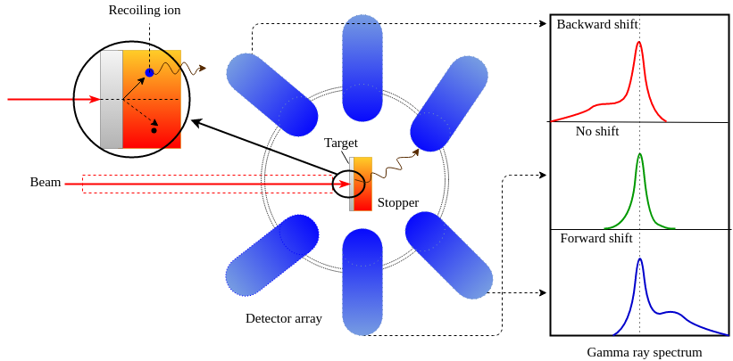
Short lifetimes: lineshape analysis via DSAM
The stopping power from Lindhard and Northcliff table.
The time dependent velocity profile convoluted with the detector response and its orientation via Monte-Carlo simulations.
The lineshape profile fitted by the “Lineshape program*” with a chi-square minimization subroutine “Simplex”.
Parabolic error analysis done by Minos subroutine.
For small value of
*J. C. wells and N. R. Johnson, ORNL Report, 6689, 44 (1991).
June 25, 2019

Slide 19
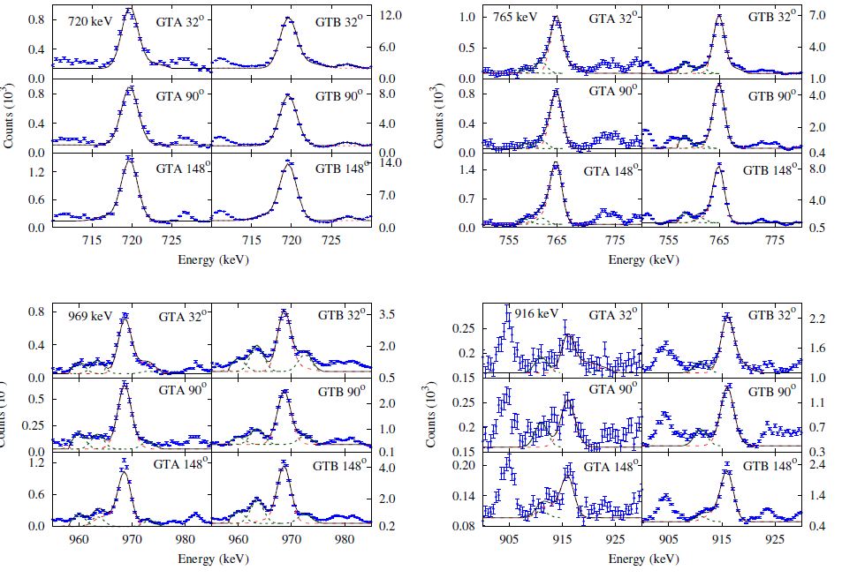
¹²⁶I: Yrast band

Slide 20
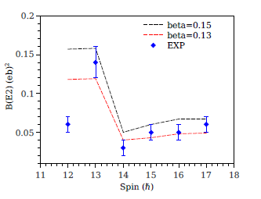


Derived experimental values
June 25, 2019

Slide 21
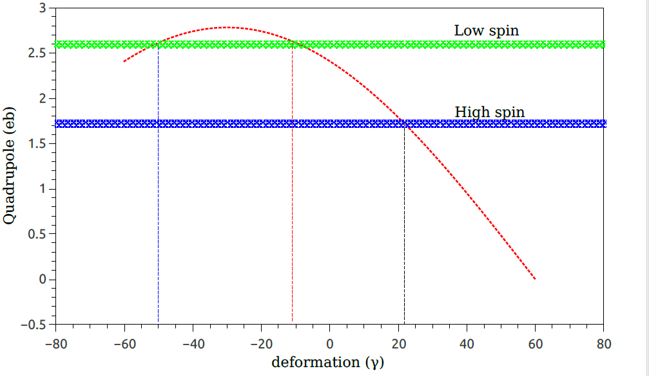
Evaluated deformation parameters
γ in Lund convention
γ calculated using
theoretical formula
The γ found to be
γ ≈ -10 (low spin)
γ ≈ +23 (high spin)
Unphysical
PRM results
June 25, 2019

Slide 22
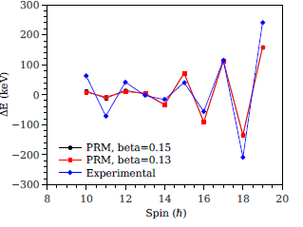
PRM calculation with new γ values
γ ≈ -10 (low spin)
γ ≈ +23 (high spin)
The predicted particle configuration near bandhead
π d_{5/2}⊗ ν h_{11/2} (dominant) mixed with π g_{7/2}⊗ ν h_{11/2}
Concluding remark: signature inversion due to shape change
June 25, 2019

Slide 23

Chiral symmetry (handedness) in nature
Left side of the picture cannot be produced by right side picture by just rotation

Slide 24
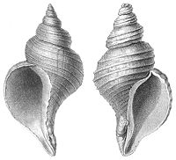
More example of Chiral partners
Seashell

Slide 25
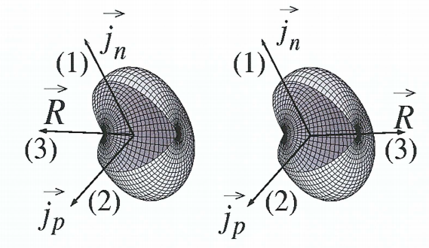
Chiral geometry in the nuclei
Angular momentum coupling of
a valence proton particle (j_{p}),
valence neutron hole (j_{n}) with
collective rotation vector (R)
in mutually perpendicular.
[ I. Hamamoto, Int. J. Mod. Phys. E 20, 373 2011) ]
The chiral operator is defined as χ = T R_{y}(π), where T is time reversal operator.
June 25, 2019

Slide 26
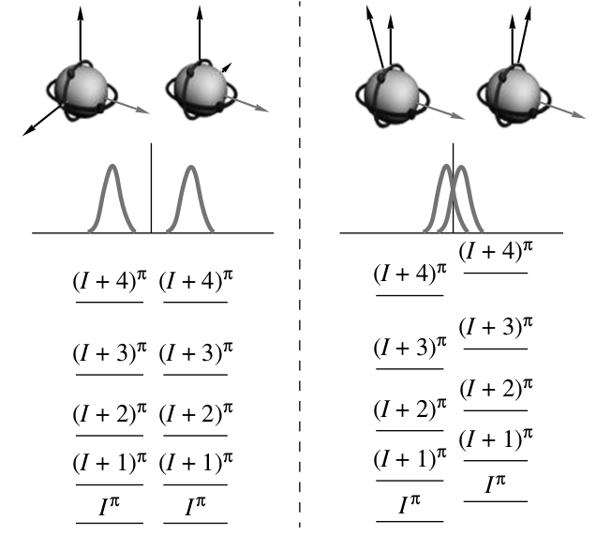
Chiral symmetry breaking
[ A. A. Pasternak, Phys. Atom. Nucl. 73, 8 (2010) ]
Good symmetry :
Perfect degeneracy
separate
wave function
Weak symmetry
broking :
energy band uplift
overlapping of
wave function
June 25, 2019

Slide 27
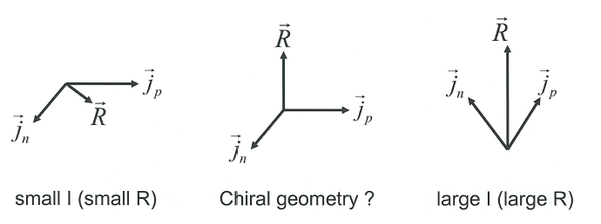
Emergence and disappearance of Chiral bands !
Chiral behavior exist only within a range of angular momentum (I )?
Energetically favoured configurations
S. Fraundorf, Nucl. Phys. A 752 (2005)
June 25, 2019

Slide 28
Selection rules based on EM transition probabilities
transition probabilities (B(E2) and B(M1))
∝ thickness of arrow
Theoretical Results
Similar B(E2) and B(M1) for intra-band
transitions.
B(M1) for intra- and inter-band transitions
alternate between low and high.
I. Hamamoto, Int. J. Mod. Phys. E 20, 373 2011)
A. A. Pasternak, Phys. Atom. Nucl. 73, 8 (2010)
June 25, 2019

Slide 29
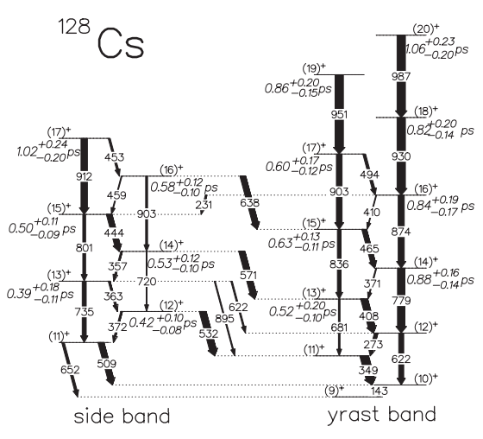
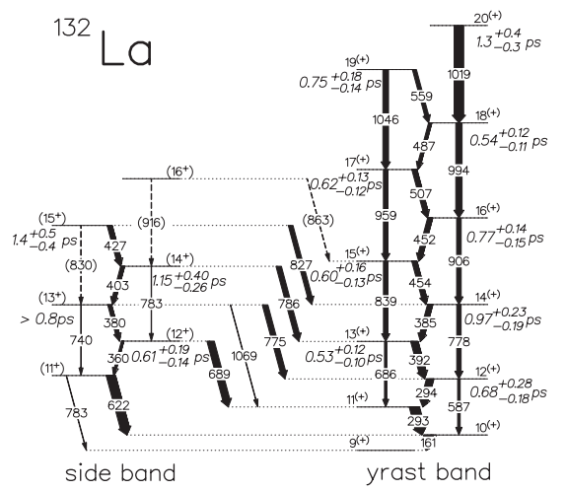
Case of ¹²⁸Cs and ¹³²La
June 25, 2019

Slide 30
Case of ¹²⁸Cs and ¹³²La
E. Grodner et al., Phys. Rev. Lett. 97, 172501 (2006)
June 25, 2019

Slide 31
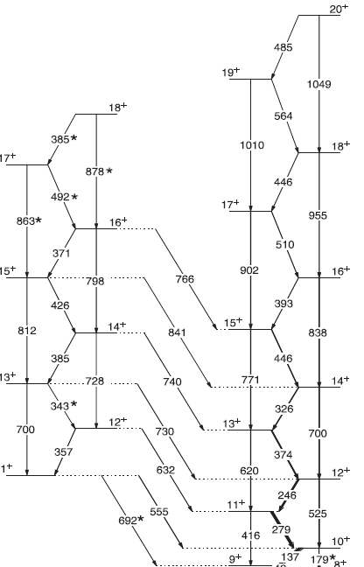
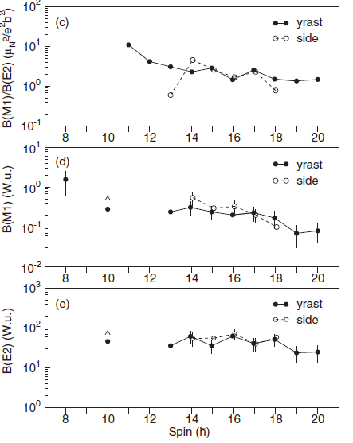
¹³⁰La (Chiral or not?)
particle configuration
π h_{11/2}⊗ ν h⁻¹_{11/2}
PRC 98, 054305 (2018)
June 25, 2019

Slide 32
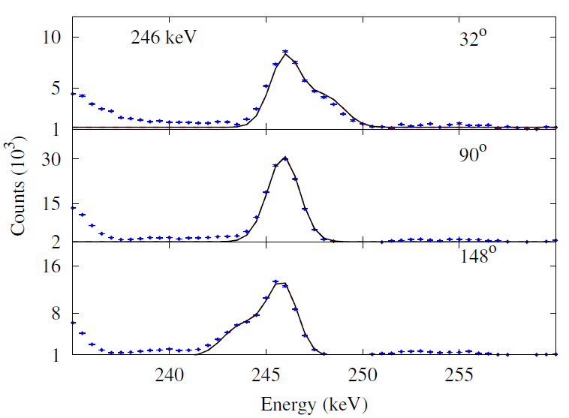
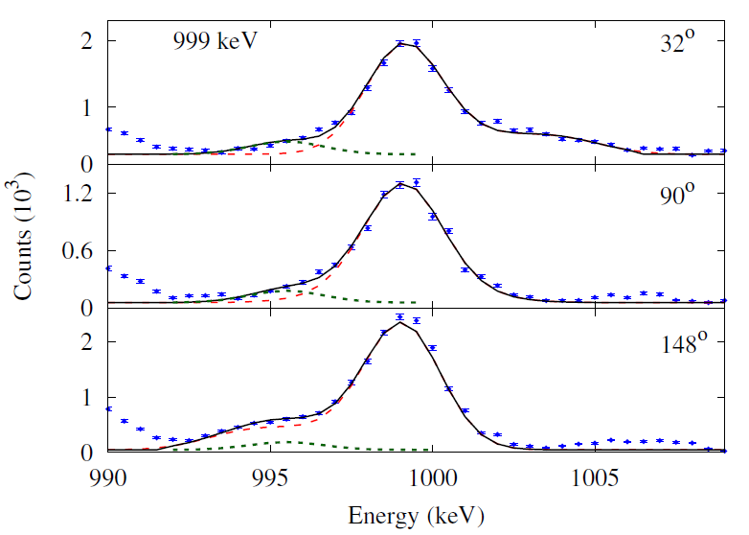
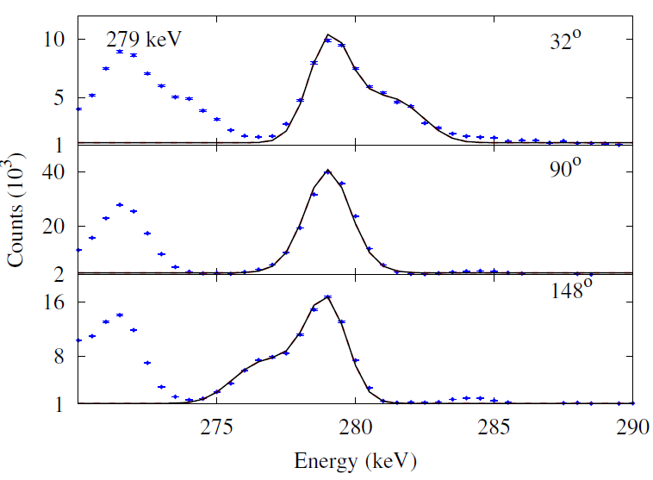
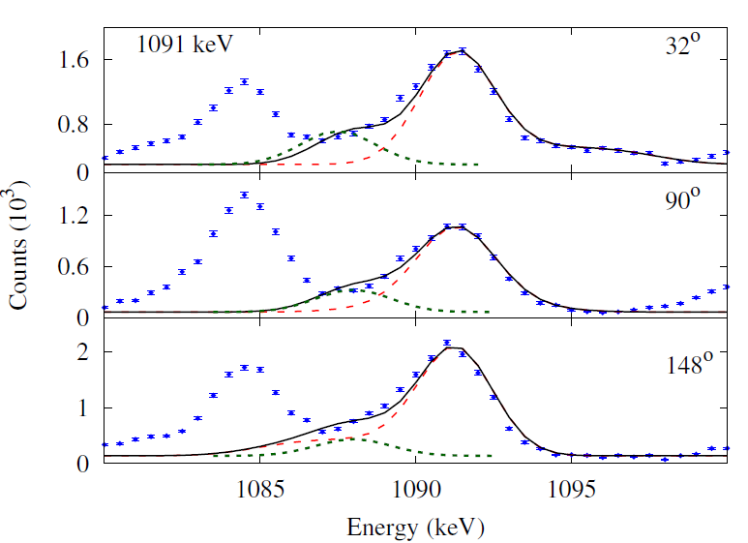
¹³⁰La
Our lineshape analysis
¹²⁶I

Slide 33
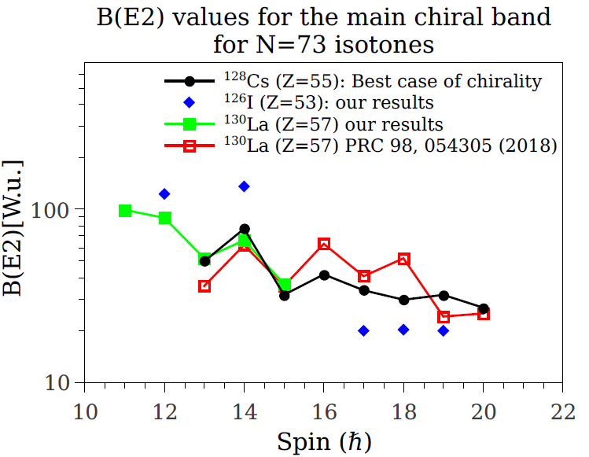
Preliminary results
June 25, 2019

Slide 34
Summary
  Signature inversion in ¹²⁶I is due to shape change from negative γ deformation to positive based on our lifetime results.
  Originally, both ¹²⁸Cs and ¹³²La were observed with Chirality based on identical looking energy levels of main and partner bands.
  For ¹³²La, reduced transition probability selection rule was not followed; hence discarded to be Chiral [E. Grodner et al., Phys. Rev. Lett. 97, 172501 (2006)]
      Question remains what kind of symmetry it posses!
  ¹³⁰La shows a typical energy pattern of a Chiral nucleus (in literature).
  Also, small staggering in reduced transition probabbilities.
  Recent publication: M. Ionescu-Bujor et al. PRC 98, 054305 (2018).
  Our lifetime (DSAM) data analysis for ¹³⁰La is in preliminary stage.
  Clear lineshapes are observed for transitions belonging to the bands of interest.
  Lifetime experiment planned for ¹²⁸La: ¹⁹F beam (85-92 MeV) on ¹¹⁴Cd target.

Slide 35


