Slide 1
Investigation of the Effect of Axial Ring Splitting for Cost Reduction of Total Body PET Scanners
N. Efthimiou (Univ. of Hull, UK),
S. J. Archibald (Univ. of Hull, UK) and
S. Vandenberghe (Univ. of Ghent, BG)

Slide 2
Instead of an introduction …
Prof. S. Cherry presented the benefits of the Total body PET scanner.
Higher sensitivity, real time pharmacokinetics, pediatric imaging
Ass. Prof. S. Surti gave an update on the PENN-PET project
Modular geometry, current at 700 mm moving to longer geometries.
Delayed studies
Ms. M. Stockhoff presented the benefits of monolithic detectors in total body PET scanner PET2020.
Each J-PET module has effective length of 50 cm

Slide 3
Challenges
Large data streams
Prof. S. Cherry, dr. S. Niedźwiecki
Cost
Prof. S. Cherry, M. Stockhoff

Slide 4
Goals
Investigation of the benefits using the split ring geometry.
Lower cost
Use of open source STIR for reconstruction of long axial FOV scanners
Processing of large amounts of data

Slide 5
Simulations
GATE Monte Carlo simulation toolkit
Adapted NEMA protocol
The cylindrical phantom was extended to 1.5 m
XCAT Anthropomorphic phantom
Normal FDG biodistribution (140 MBq)
Acquisition of 10 sec in all cases

Slide 6
Image reconstruction
OSEM - 12 subsets
2 full iterations (no post-filtering)
Projection data reconstruction
No Time-Of-Flight
No axial compression
No views mashing
No scattered or random photons were considered
Maximum acceptance angle ~27deg (Segment num range ≤(-167, 167)
Reconstruction performed on cluster, with OpenMP (32 cores)
No GPU

Slide 7
1. Split rings geometry

Slide 8
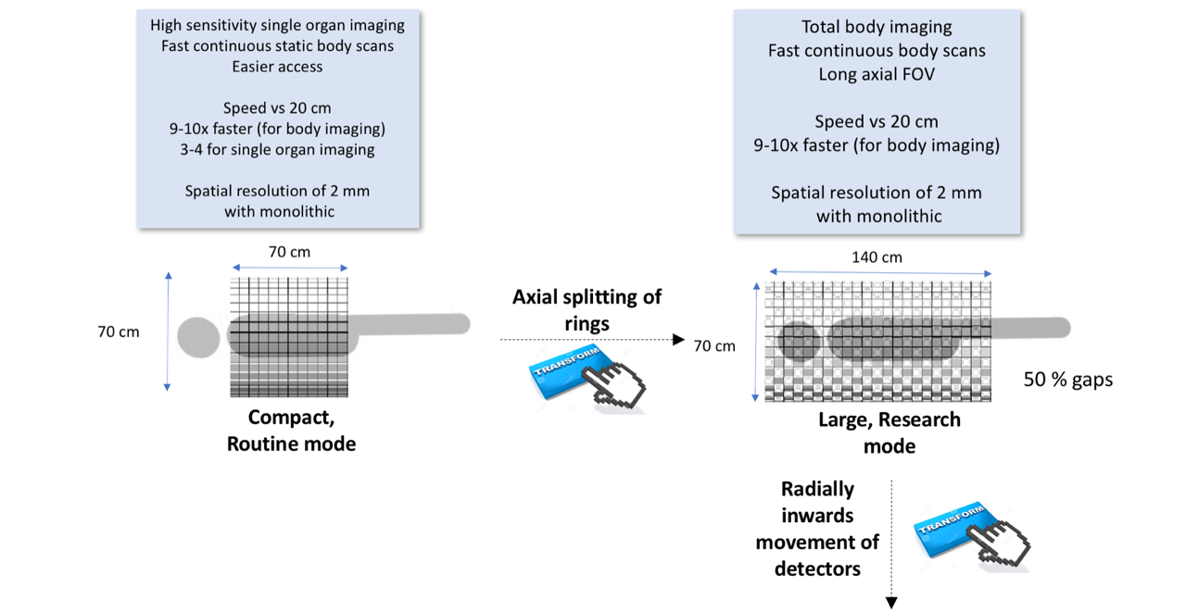
Stefaan Vandenberghe, UGhent

Slide 9
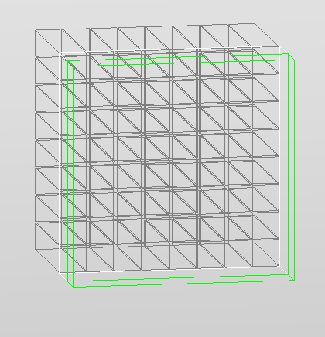
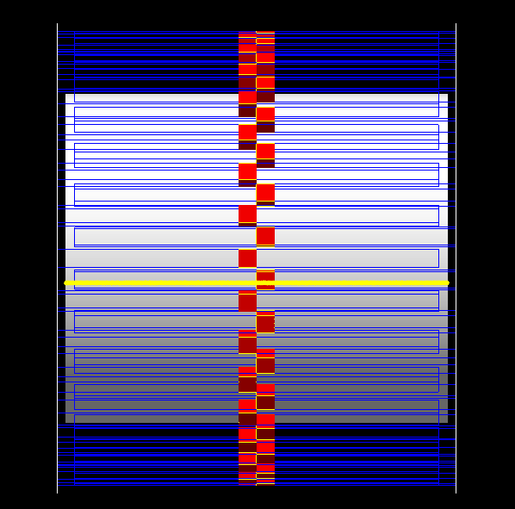
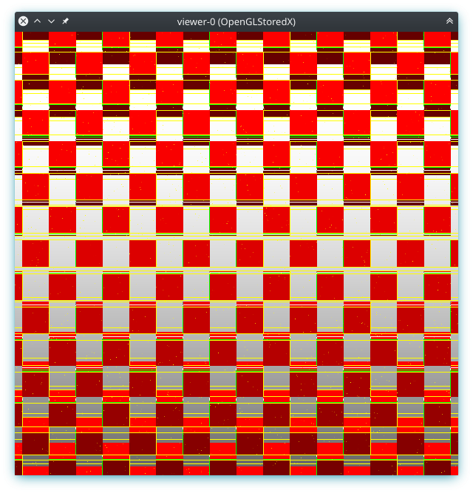
Implementation of split rings in GATE
Each detector block had 8x8 LYSO crystals (4.07 mm)
In GATE the shift or Rsectos (± 16.5 mm) was used.
Then the ring was repeated 10 times

Slide 10
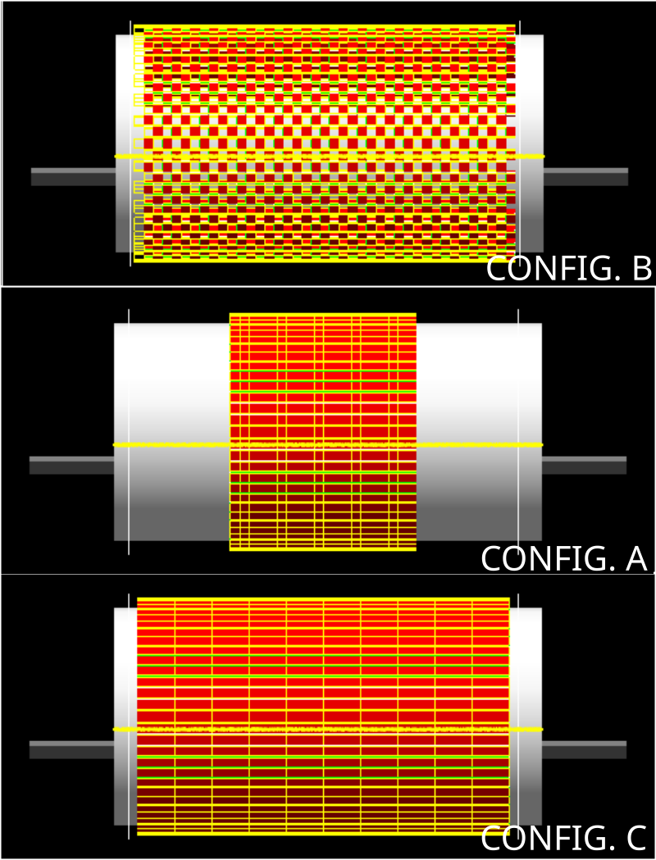
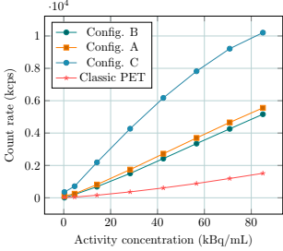
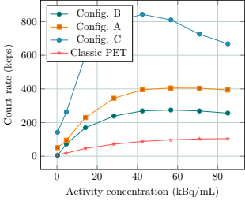
Counting performance
Prompts NECR

Slide 11
2. PENN-PET based modifications

Slide 12
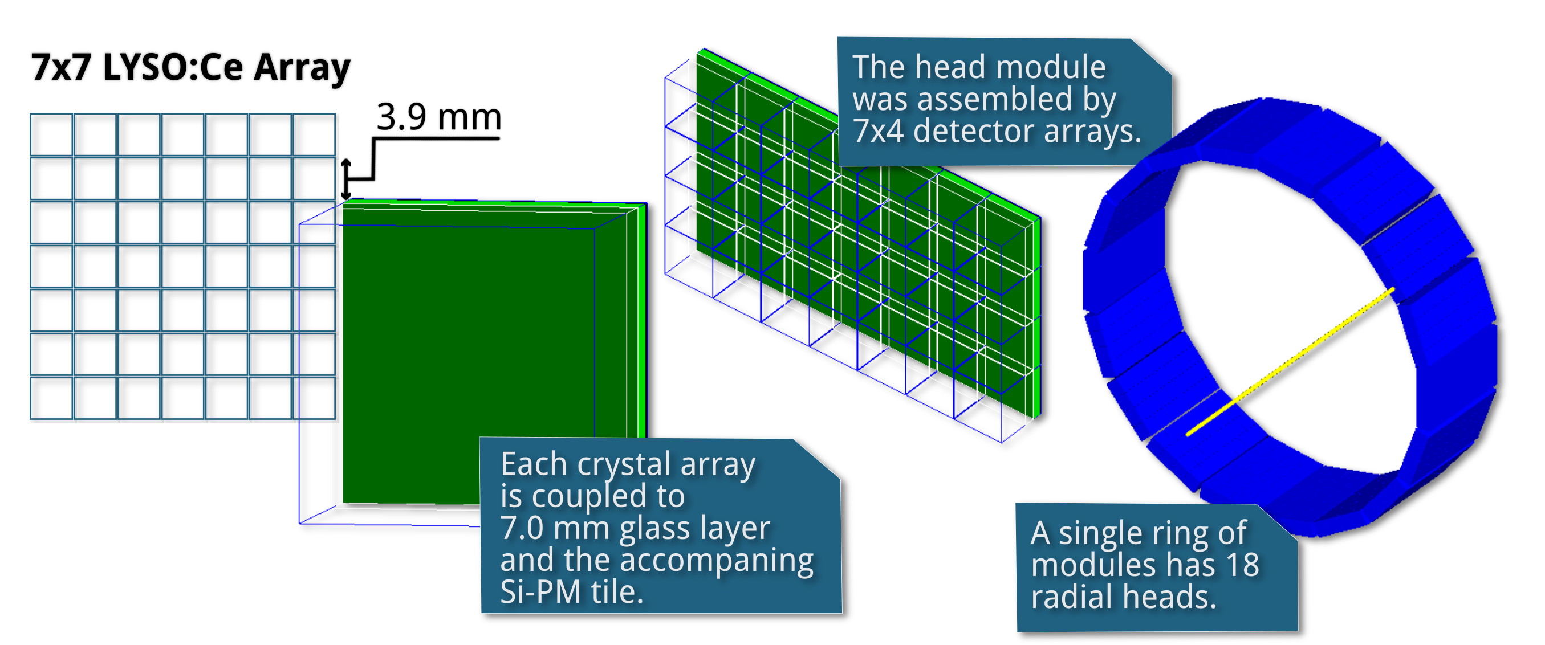
PENN-PET based geometry
* I. Rauschet al., “Performance Evaluation of the Vereos PET/CTSystem According to the NEMA NU2-2012 Standard,”J. Nucl. Med.,vol. 60, no. 4, pp. 561–567, Apr. 2019.DOI: 10.2967/jnumed.118.215541

Slide 13
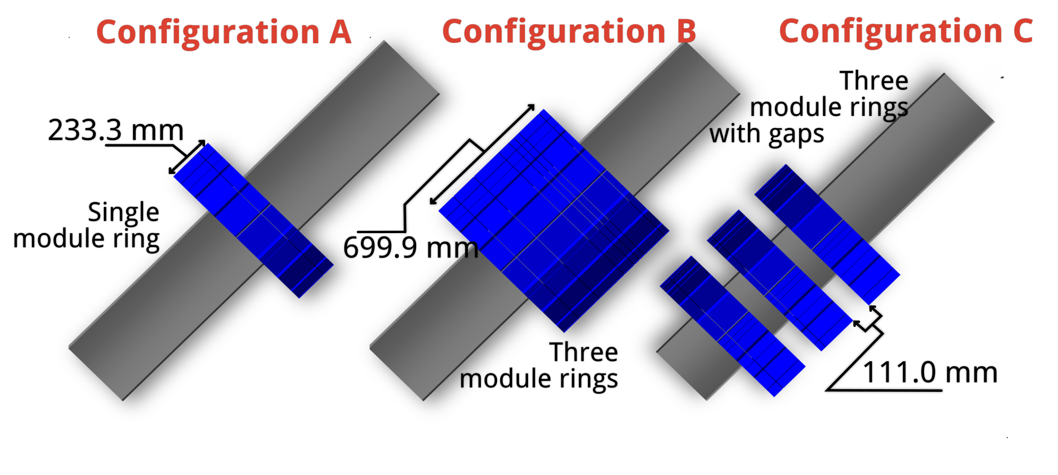

Slide 14
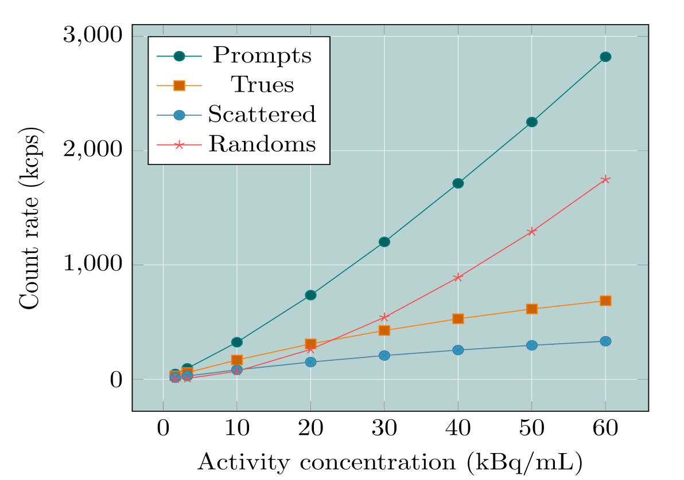
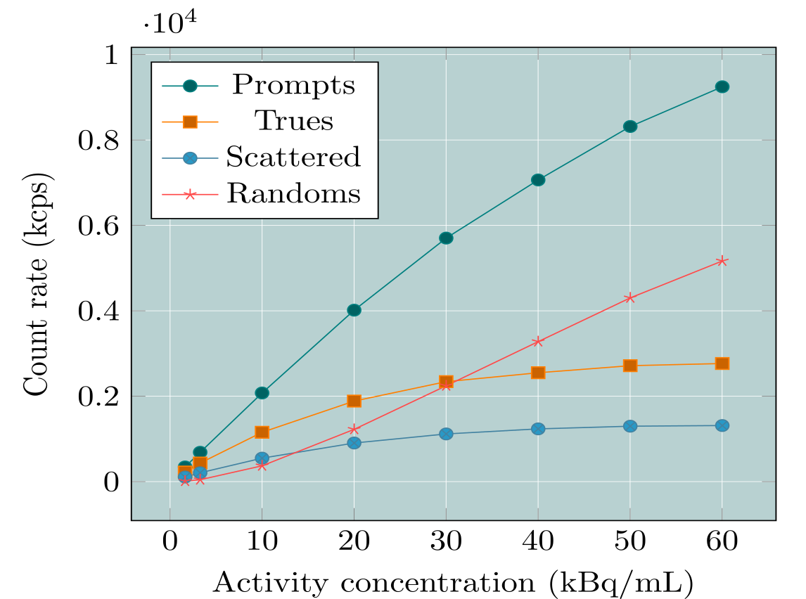
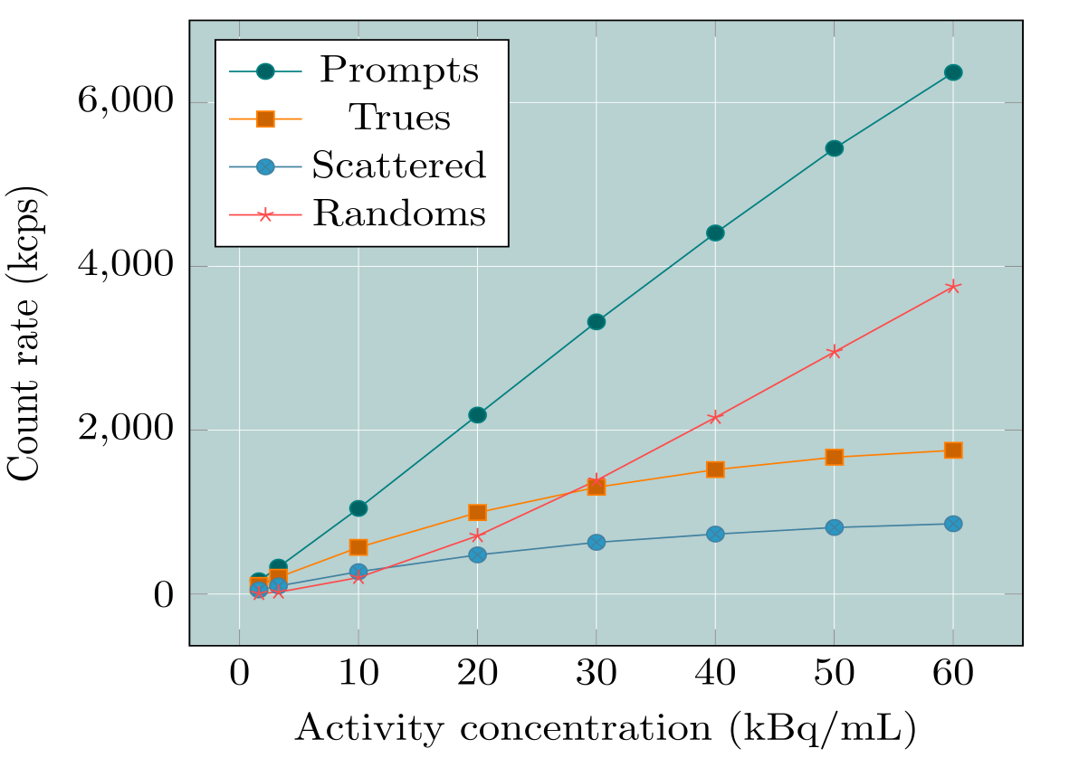
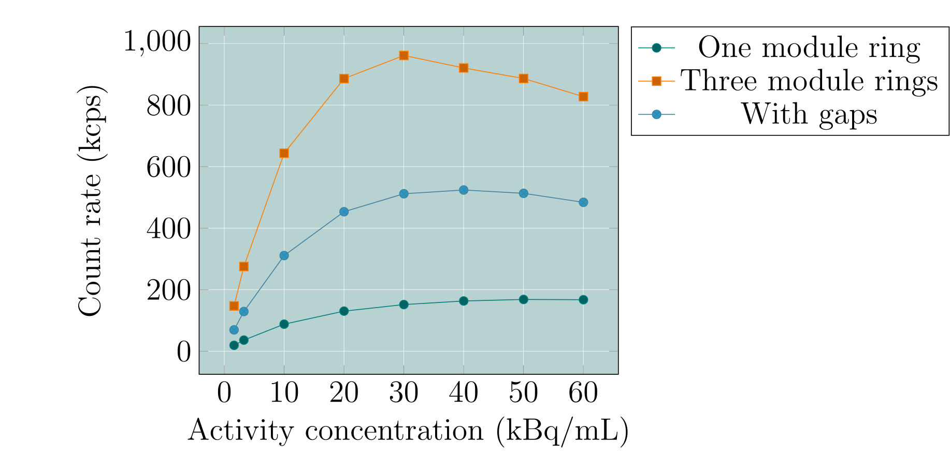
Performace
~7 mm radial spatial
Resolution
~8 mm axial resolution

Slide 15
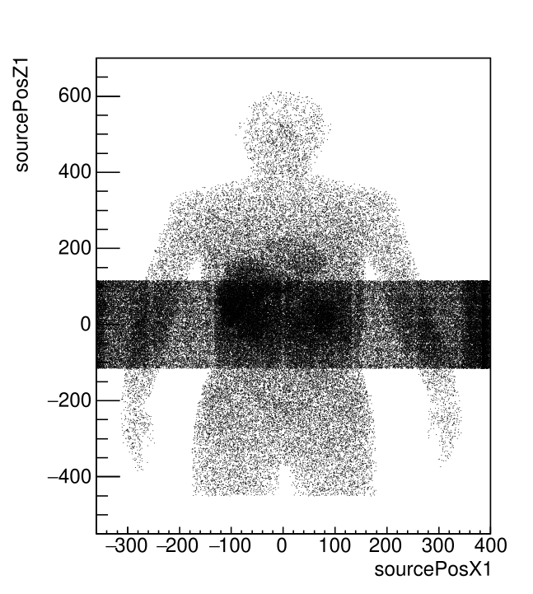
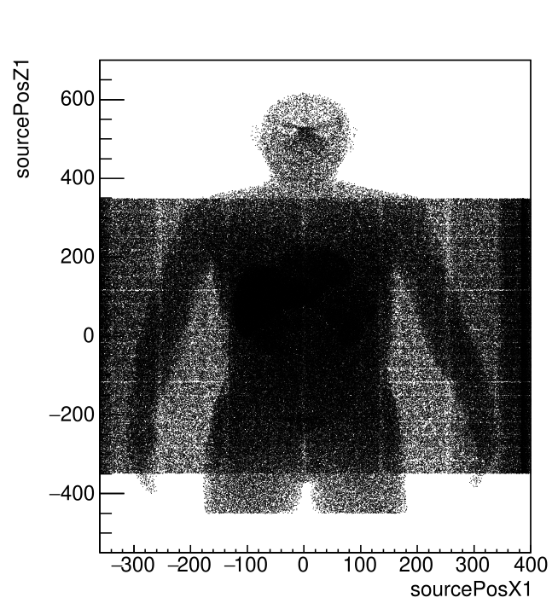
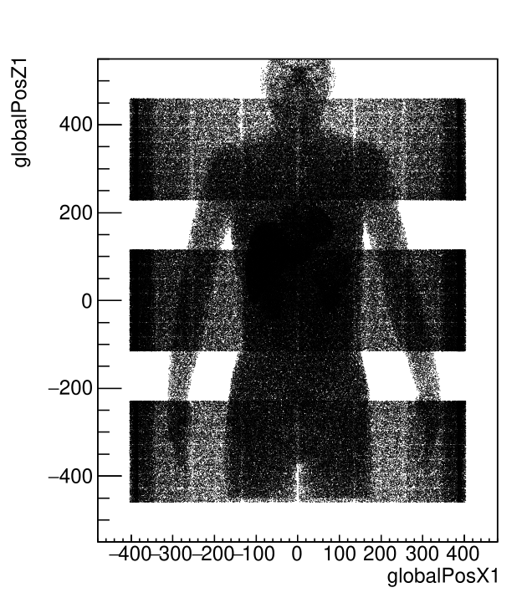
Num. Det. Rings: 1
Num. Of rings: 56
Full iteration: ~0.5 h
Data min: 0
Data max: 6
Data sum: 1.85165e+07
Num Det. Rings: 3
Num. Of rings: 168
Full iteration: ~1.1 h
Data min: 0
Data max: 6
Data sum: 9.54506e+07
Num. Det. Rings: 3
Num. Of rings: 224
Full iteration: ~7. h
Data min: 0
Data max: 7
Data sum: 7.76138e+07
https://github.com/UCL/STIR

Slide 16
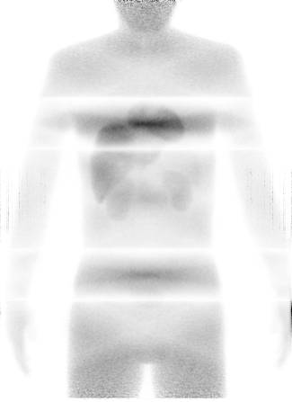
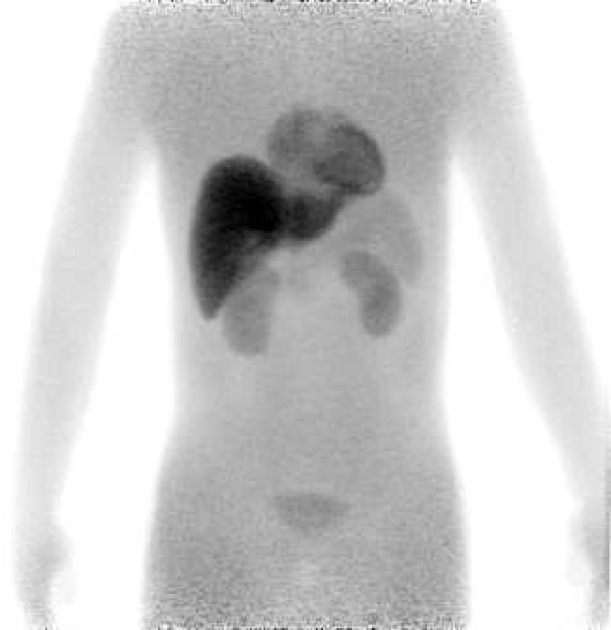
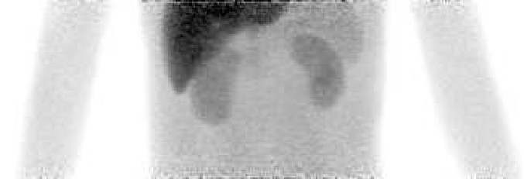

Slide 17
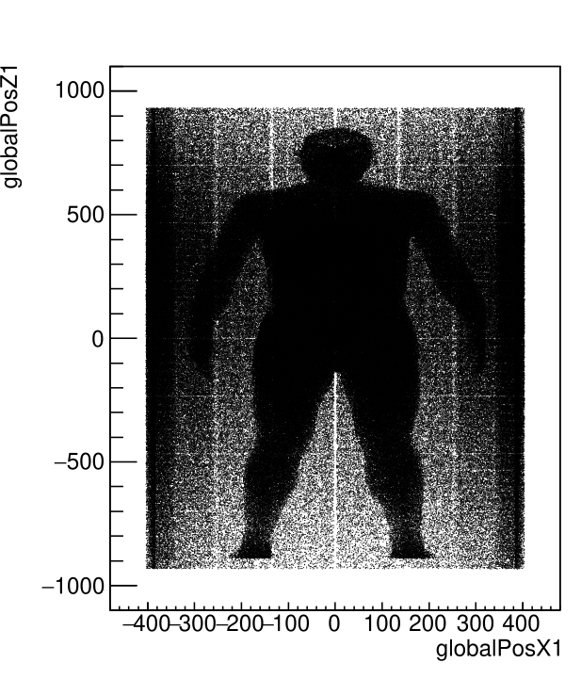
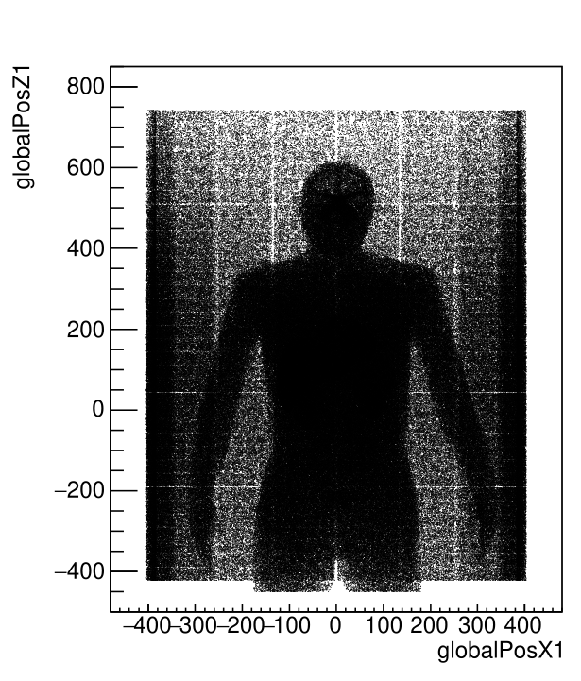
Going longer …
Num. Det. Rings: 5
Num. Of rings: 280
Full iteration: 3.5 h
Data min: 0
Data max: 6
Data sum: 1.30175e+08
Num. Det. Rings: 8
Num. Of rings: 448
Full iteration: 8 h
Data min: 0
Data max: 5
Data sum: 1.30998e+08

Slide 18
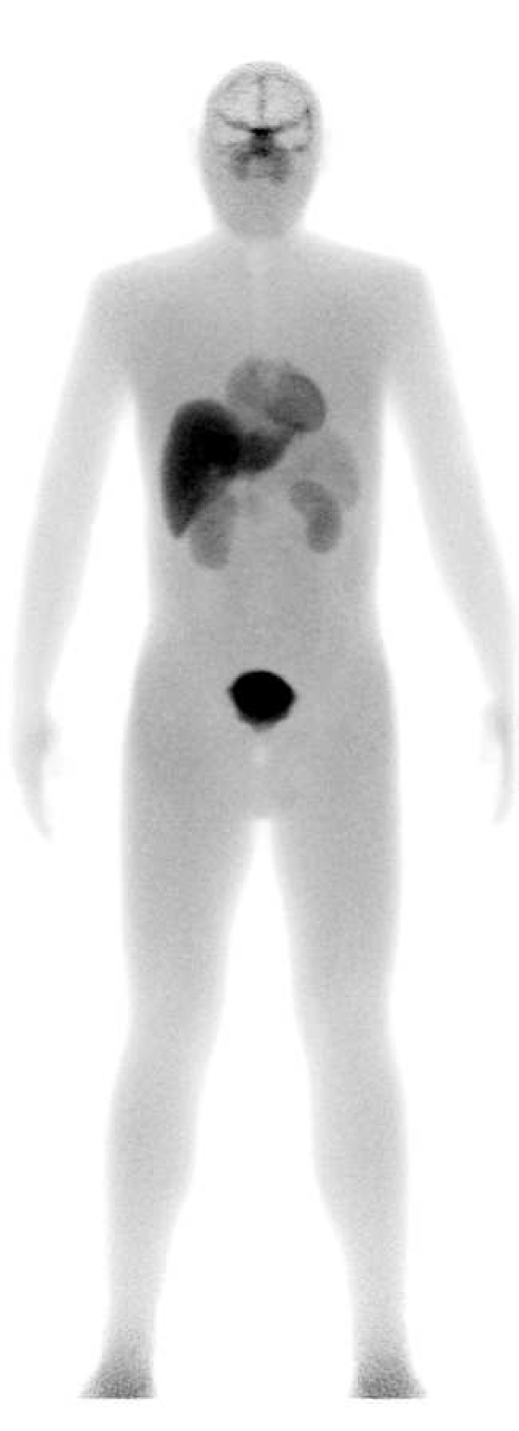
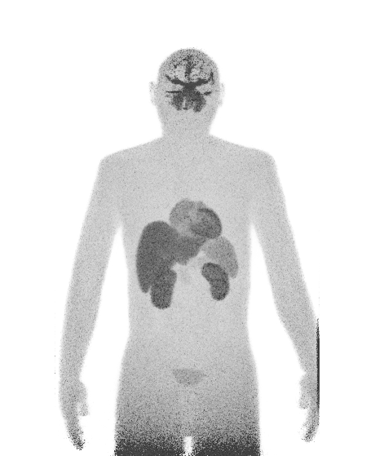
I would like to thank:
Dr. Assem Allam, Fatima Allam and the Allam Family.
Prof. S.J. Archibald
UCL:
Prof. K. Thielemans
UoLeeds:
P. Wadhwa
M. Oloniyo
dr. C. Tsoumpas

