Slide 1





The Future of Charged Particle Therapy after Solving the Uncertainty Problems
Reinhard W. Schulte, MD, MS, Loma Linda University

Slide 2
Funding and Collaborators
Funded by grants from
  NIH: R01 grant from NIBIB, , P20 grant from NCI with UCSF and LBNL
  Binational Science Foundation (image reconstruction and fast computing)
  DOD, Department of Radiation Medicine, LLU
Collaborators
  Academia: Researchers at UC Santa Cruz, Baylor University, UCSF, CSUSB, Haifa University, LBNL, LMU, IFJ PAN
  Business: Integrated Sensors, IBA, Cosylab, Raysearch

Slide 3
Outline
Motivation for and status of proton and ion therapy
Unsolved problems (R.E.S.I.D.U.E)
  Range (uncertainty)
  RBE (uncertainty)
  Clinical evidence (lack thereof)
Hypothesis: Once a) and b) are solved, c) will be solved as well is particle therapy is also cost effective
Suggested solutions
  Range (uncertainty)
  RBE (uncertainty)
The future of particle therapy (after solving its major issues)
  Clinical trials – adding new evidence
  Integration of particles into personalized treatment schemes

Slide 4
Prologue
Despite many advances, modern radiation therapy, which is mostly performed with external photon beam radiation therapy and supported by advanced treatment planning and image-guidance techniques and enhanced with chemo- or biologically targeted therapy, there are still too many patients dying from loss of local control or suffering from late effects, second cancers, and loss of quality of life.
Overall, radiation therapy needs to become more conformal, more effective against radioresistant/hypoxic cells, and more personalized, i.e., tailored to the individual patient, and more tumor specific.
With particle therapy using protons and ions, we may solve some or most of these problems, but it has a set of its own challenges, which I will talk about today.

Slide 5
Seven Major Challenges to Overcome in Particle Therapy- “RESIDUE”:
Radiobiology to address uncertainty in optimal fraction sizes and doses and RBE (biological)
Exchange of technology, funding and infrastructure between academic centers, health care payers, industry and funding agencies (operational)
Size/weight of accelerators & gantries (engineering/physics)
Integration of technology to advance key areas from beam acceleration and delivery, through treatment planning and image guidance (engineering/physics)
Define the patient population to be studied; that is, “who really needs ion beam therapy” (clinical)
Uncertainties of dose and range at the end of the Bragg peak (physics)
Evidence of clinical cost-effectiveness (societal)

Slide 6
The Problem with Cost
With current patient numbers per facility (based on regional referral), multi-room (>2) facilities are not cost-effective, except for a few high-volume cancer centers
A four-room facility with 2 or 3 gantries costs in excess of $100M USD
A single-room facility, currently at ~40M USD, can be cost-effective but the cost per treatment is still more than 2-times higher than that of a comparable photon treatment
Insurance companies, especially in the U.S., often refuse to cover the treatment due to lack of clinical evidence

Slide 7
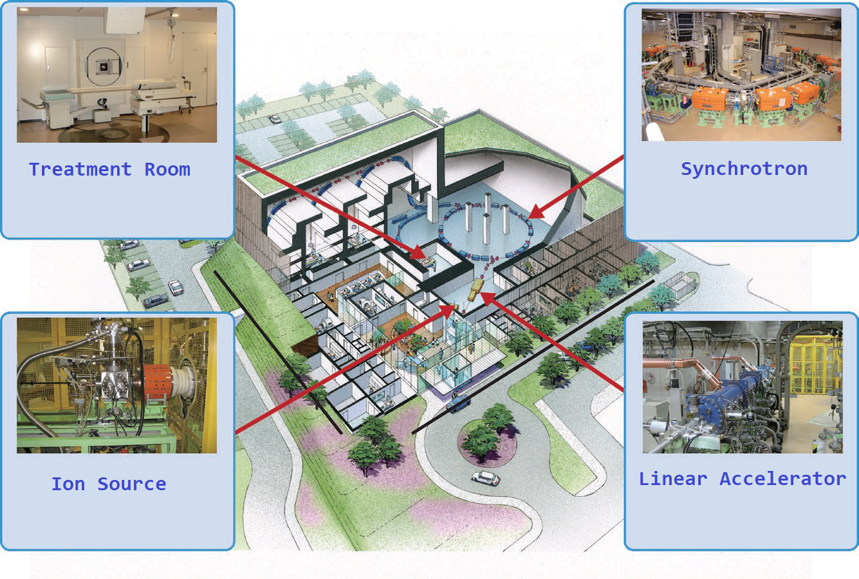
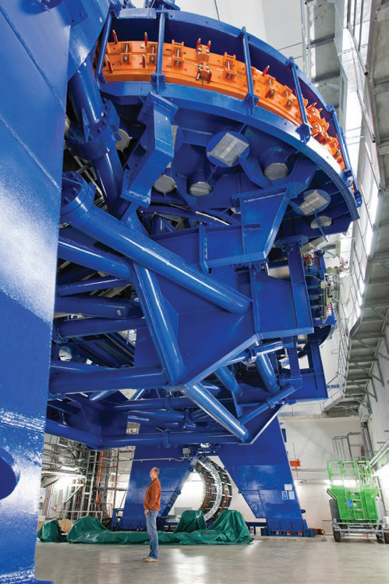
The Problem with Size
Gunma Medical Heavy Ion Medical Center facility, Japan
Ion therapy gantry at HIT

Slide 8
The Problem with Range and Suggested Solution

Slide 9
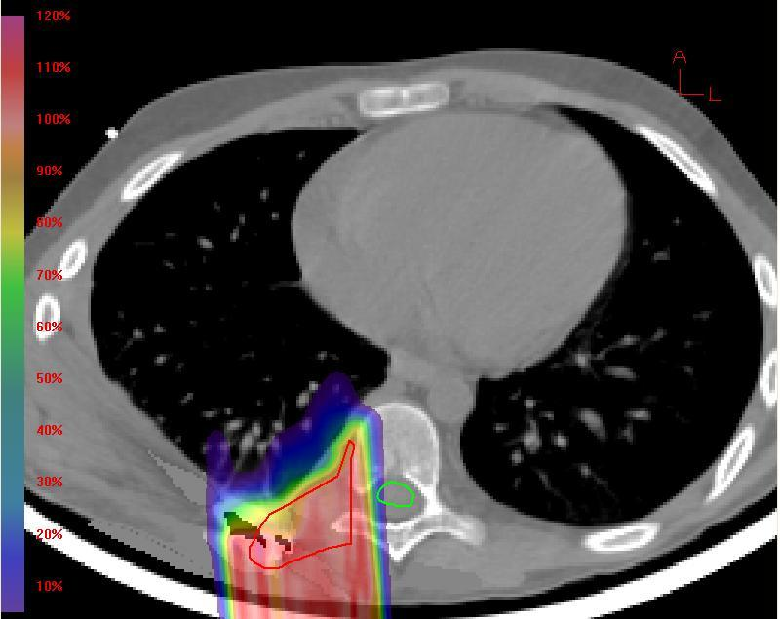
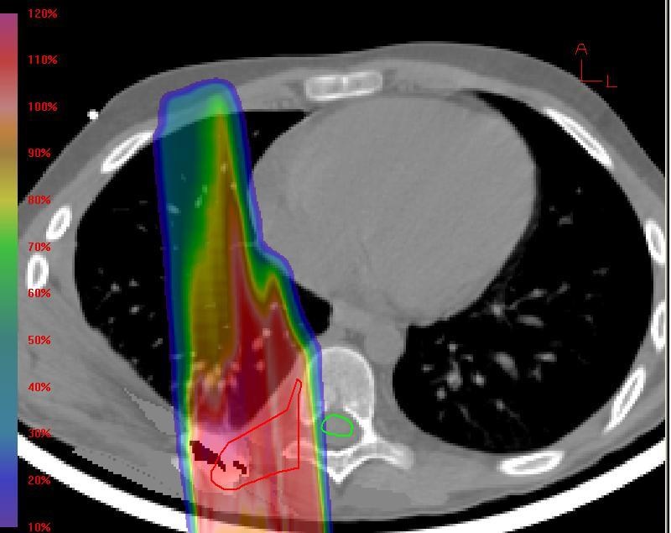
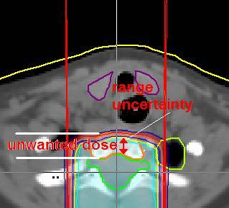
Range Uncertainties lead to Larger distal & proximal Field Margins
Range uncertainties are masked by expanding the distal margins of the planning target volume (PTV) to 3-5% of the nominal proton beam range
For example, range uncertainties force us fully expose vertebral bodies of children treated with CSI
Range uncertainties at soft-tissue lung interfaces cause unwanted dose in lung and heart
There are many other examples where range uncertainties interfere with treatment planning goals

Slide 10
General Outline of a Complete Problem Solution
A complete solution must address the all causes of range uncertainties.
Range errors in treatment planning: We may replace current x-ray planning CT with an imaging modality that is free from high-density artifacts and HU-to-RSP conversion errors.
Interfraction range errors: We replace pre-treatment x-ray imaging (radiographs or CBCT) that would allow to detect pretreatment range (3D) or WET (2D) errors with very low doses (μGy)
Intrafraction range errors: We should have a method that can detect range errors during treatment with <2 mm accuracy.
Ideally all this could be done with the same low-dose imaging modality
pCT, pRad

Slide 11
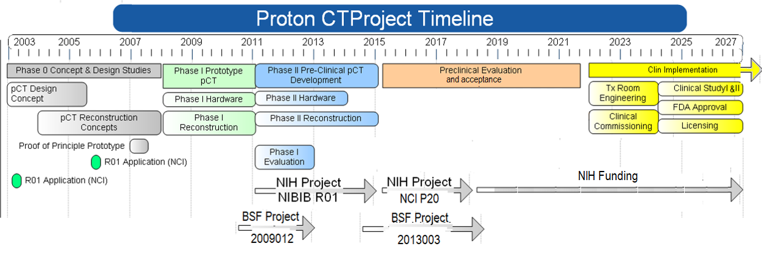
Addressing Proton Range Uncertainty with Proton CT:
The pCT Collaboration Project

Slide 12
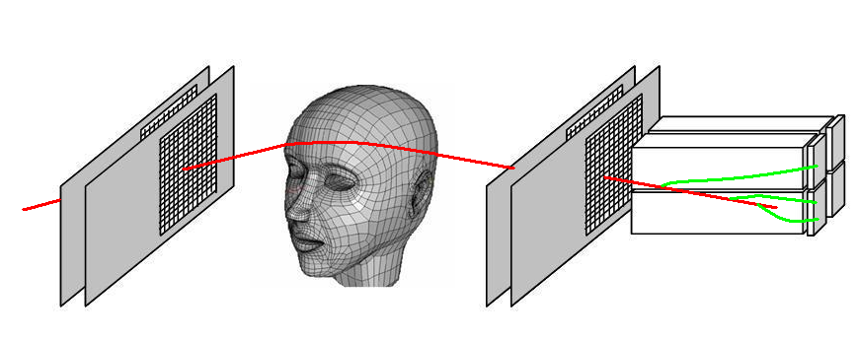
Proton CT/PRad Scanner: Design Principle
Protons of sufficient energy can penetrate the human body
Protons can be tracked on the entry and exit side using modern particle detectors
Residual energy detector to measure energy loss of individual protons
Detector can be mounted on the Gantry (or rotate with it), but rotating the patient in a vertical chair appears a more straightforward solution
Low intensity proton beam
Tracking of individual protons
Original design of a pCT Scanner rotating with the proton gantry (R. Schulte et al. IEEE TNS, 2004)

Slide 13
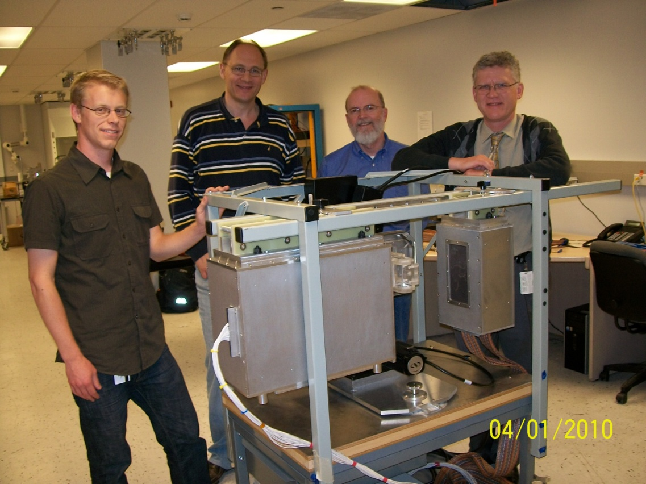
Phase I pCT Scanner at LLU
The Phase I pCT scanner (mounted on rails) with a horizontal axis rotational stage was completed in 2010 and tested in 2011
It was a slow scanner taking more than 1 hour to acquire a complete phantom scan (15 cm acrylic sphere) on a proton synchrotron
The active area was too small to capture an adult head phantom

Slide 14
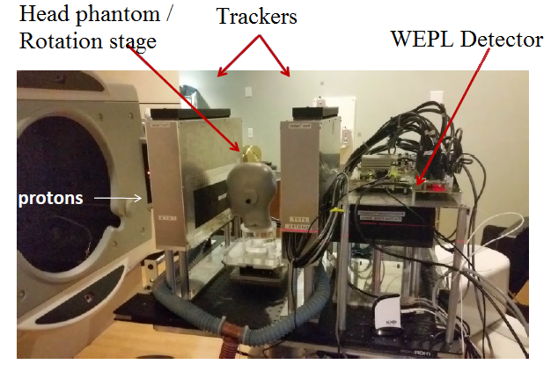
Proton CT Imaging System Developed with NIH Funding
The experimental Phase II proton CT scanner is a compact proton imaging system that can be mounted on any horizontal proton beam line for testing
The system is currently at the Northwestern Medicine Chicago Proton Therapy Center, a facility operating a 235 MeV cyclotron
The scanner area is 36 cm x 9 cm allowing to image standard QA and head phantoms
I single continuous scan of high quality takes about 6 minutes at proton rates of ~1 million protons/sec (0.1% of therapeutic beam intensity)
The proton CT Phase II experimental scanner at the Chicago Proton Treatment Center horizontal uniform scanning beam line

Slide 15
Towards Clinical Implementation
We have started to study experimental pCT with realistic head phantoms, in particular one that contains Ti dental implants.
pCT and x-ray CT plans were generated and imported into a clinical MC-based treatment planning system (RayStation). The pCT images did not require “to-RSP” conversion but human tissues were selected according to RSP intervals and their densities adjusted to match the measured RSP, thus conserving it.
Radiochromic films were exposed to both x-ray and pCT-generated SFUD plans passing through the implants. X-ray CT images with artifacts were corrected using a standard clinical procedure.
Planned and film-measured dose distributions were compared using a gamma index analysis.

Slide 16
Proton CT Planning Workflow

Slide 17
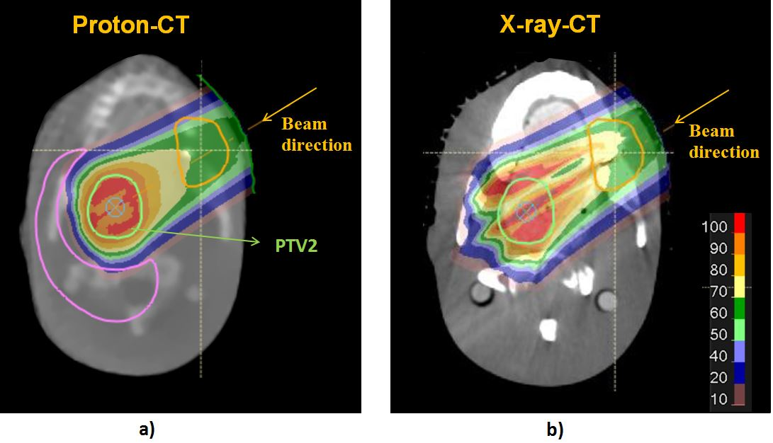
PTV2 – Implants at the entrance region of the Bragg curve
Identical targets were drawn on proton-based CT (a) and X-ray CT scans (b).

Slide 18
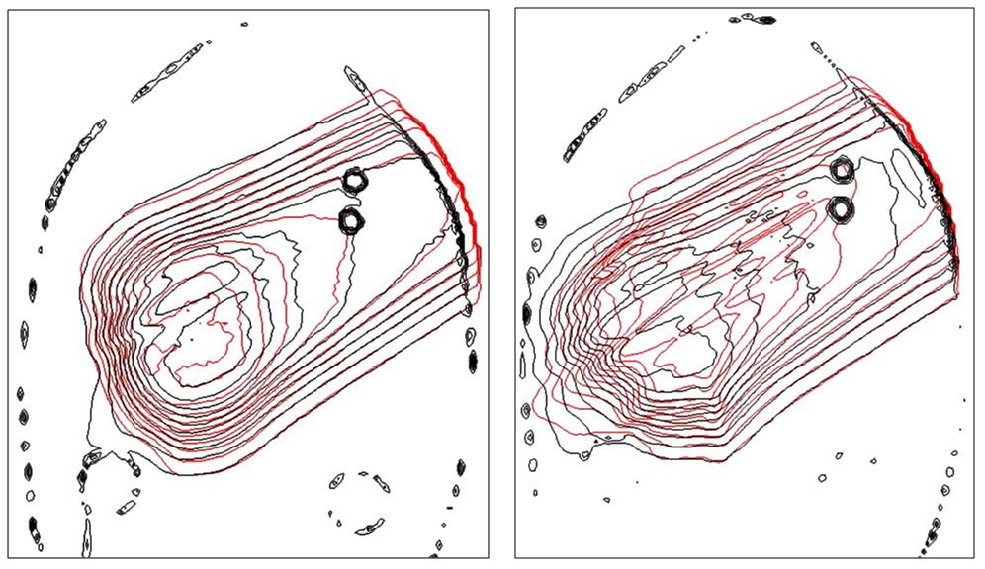
Proton CT
X-ray CT
Planned
Measured
Gamma index analysis (3%,3mm) for the PTV2 that contained the implants at the entrance region of the SOBP .
Isodose% | 30 | 50 | 70 | 90 | >90
X-ray CT | 81.4 | 68.8 | 34.2 | 42.0 | 42.4
pCT | 95.8 | 90.4 | 93.6 | 82.0 | 85.2

Slide 19
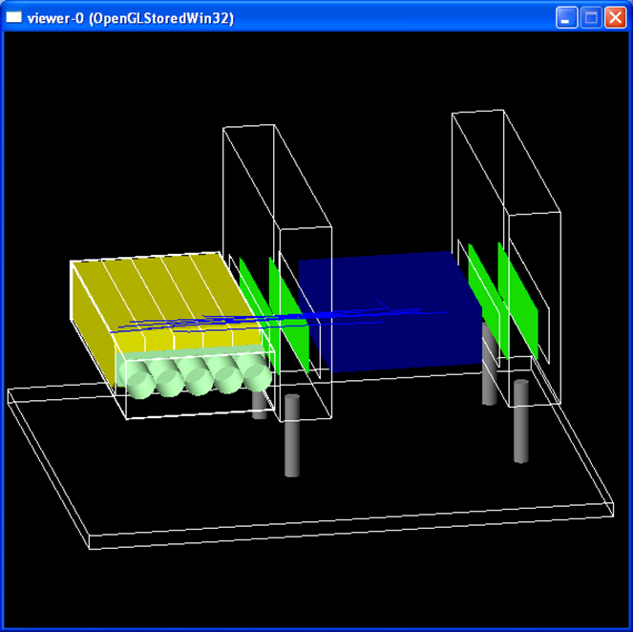
Getting pCT/pRad Experience (Clinical and Research) in the Virtual Environment
We have developed pCT MC simulation platforms for the original Geant4 tool kit and also for Topas (Tool for particle simulation).
Academic users can get access to (GitHub) and run these tools free of charge on the University of Baylor Kodiak server/computer cluster.
Medical physicists, dosimetrists, and radiation oncologists can simulate their own patients by importing a patient model generated from the planning CT and generate pCT/pRad output for planning and verification testing.
Researchers can generate their own phantom data and try new reconstruction techniques or modify the scanner technology.

Slide 20
The Problem with Biological Effectiveness and Suggested Solution

Slide 21
Absorbed Dose times RBE - A Flawed Concept
The increased relative biological effectiveness (RBE) of protons and heavier ions in tumors and also in normal tissues creates additional uncertainties in particle range (further extension), effect uniformity in the target, and dose-volume constraints in normal tissues
Currently, dose prescription and definition of dose constraints are performed in terms of RBE weighted dose. The RBE is uncertain in itself, as it depends on dose and beam quality as well as on normal tissue- or tumor-specific radiobiological factors that may be subject to change (e.g., hypoxia)
At present, three mechanistic RBE models are employed in carbon ion therapy: (a) the mixed-beam model, (b) the Microdosimetric Kinetic Model (MKM), and (c) the local effect model. With Japanese centers using the (a) and (b) and European centers using (c).

Slide 22
Suggested Solution: Treatment Planning based on Ionization Detail in Nanometer Volumes
Details of the pattern of ionization deposition (ID) along ion tracks are certainly important to the biological effect, such that knowledge of the ID, in particular the absolute and frequency of “large” ionization clusters in a defined DNA sensitive volume may improve individual patient treatment plans
ID calculation relies on time-consuming track structure simulation
However, our initial work (developed with P20 grant funding) has shown that practical methods can be employed to incorporate pre-calculated ID into the treatment plan to increase uniformity in ID across the target volume, which may result in a more uniform biological effect with an increased therapeutic ratio
Constraints for large ion cluster frequencies imposed on normal tissues can be derived from MC simulations of photon plans and serve also as limit for ion therapy plans
Thus an RBE independent ID-based treatment planning algorithm can be used for optimizing biologically weighted treatment plans

Slide 23
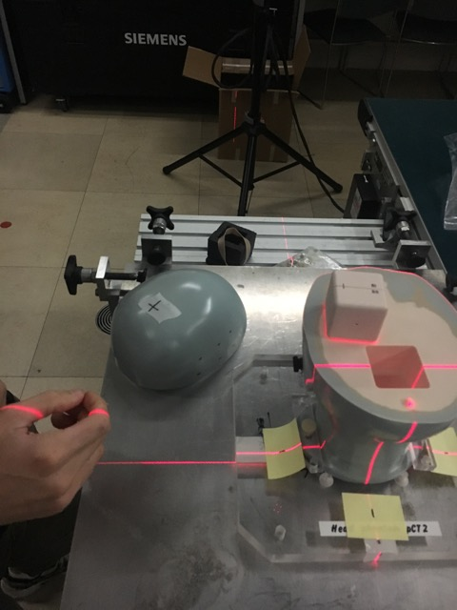
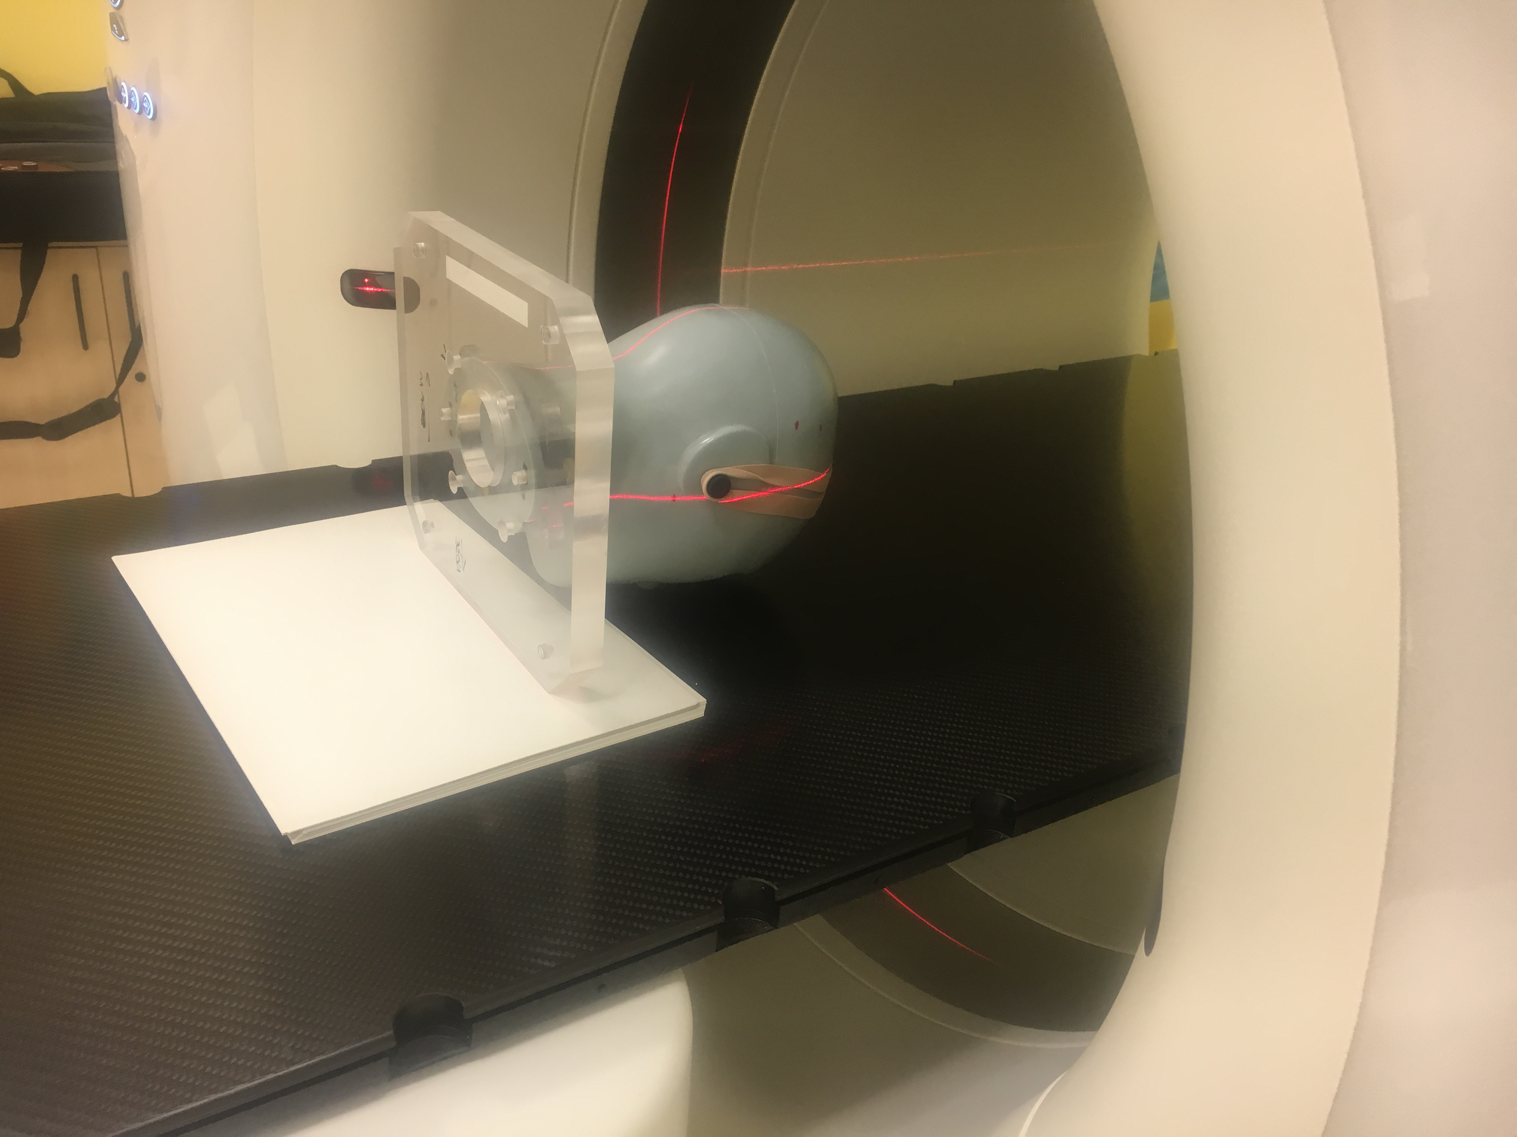
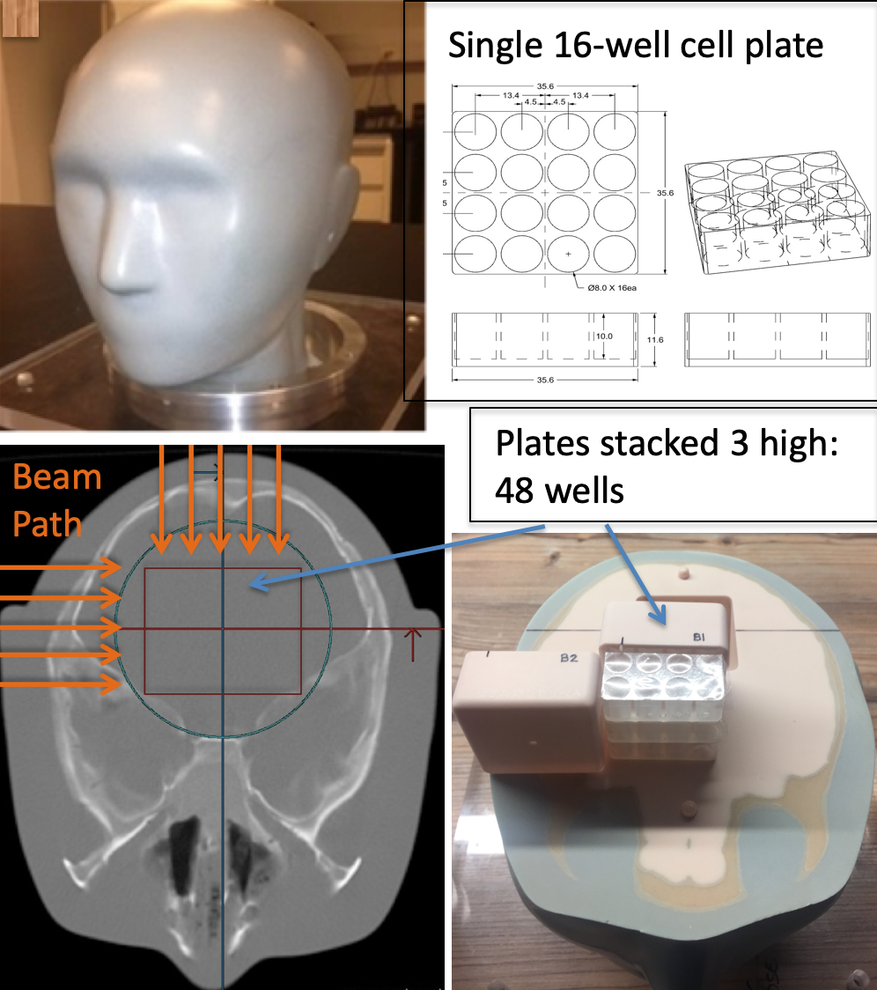
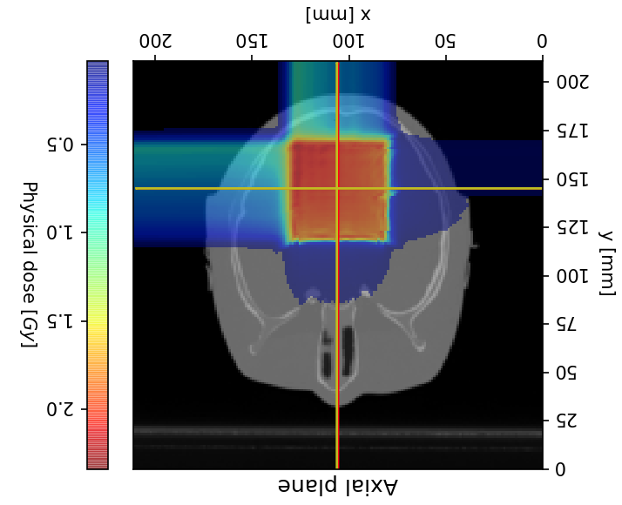
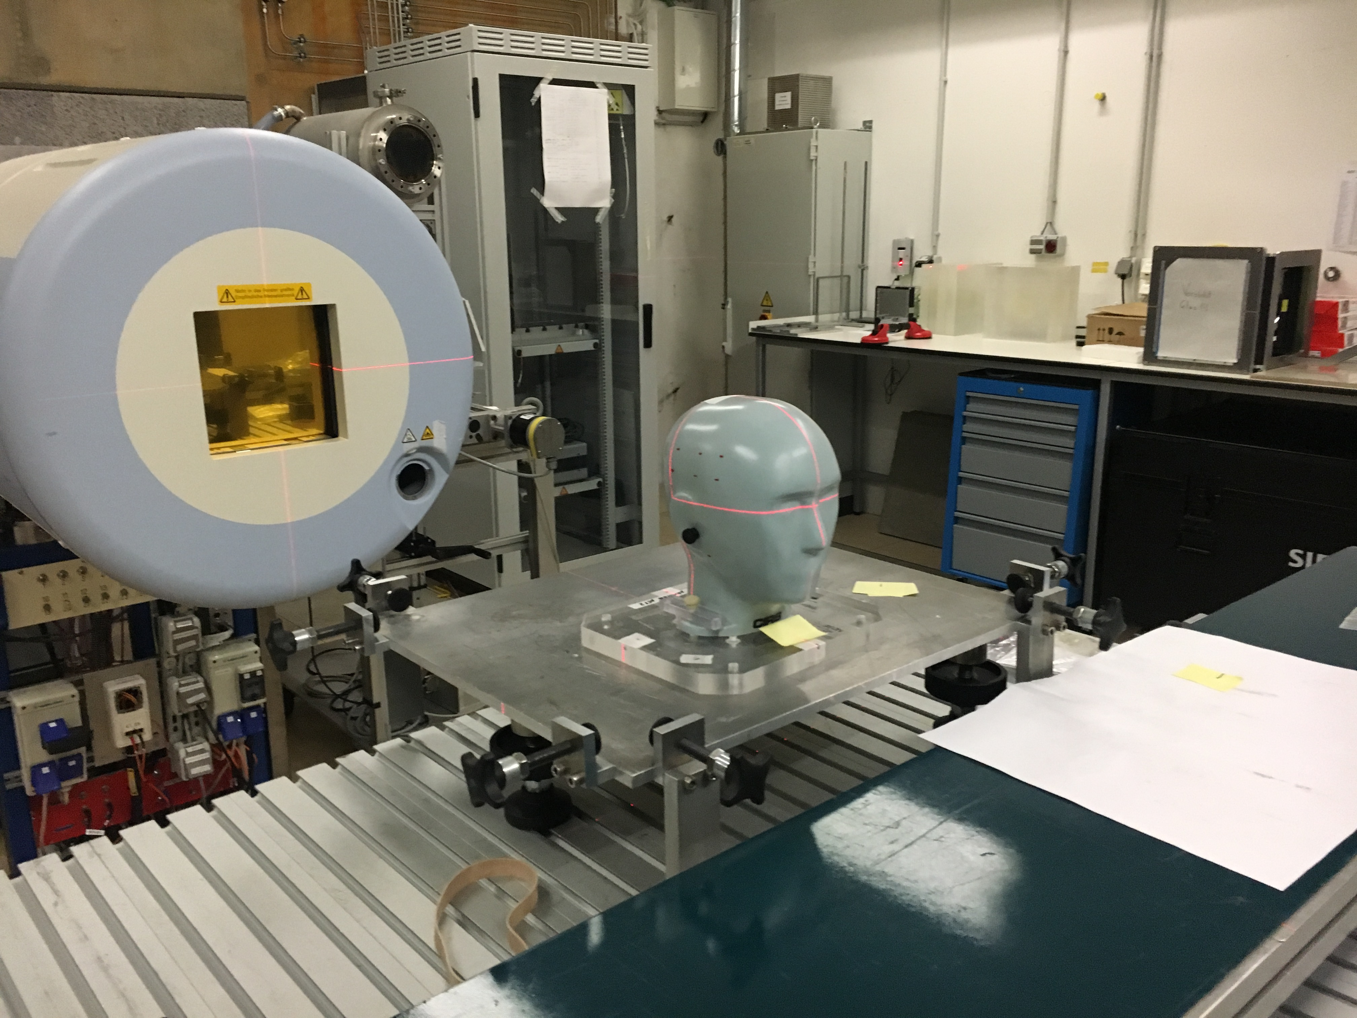
First experiment at HIT
Place cells in cube: Primary human clival chordoma cell line UMChor1
SCAN
POSITION
PLAN
TREAT

Slide 24
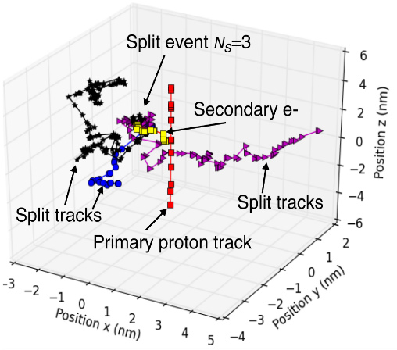
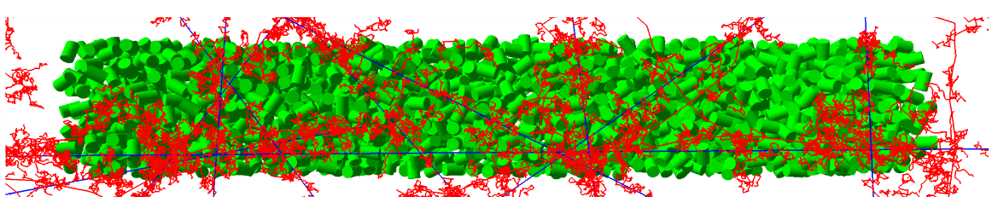
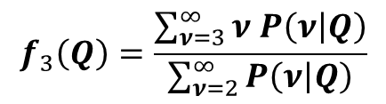
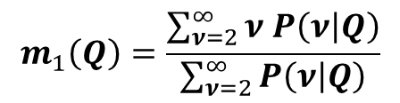
Pre-calculated ID
Track-structure simulation with TOPAS-nBio/Geant4-DNA
161 nm
30.4 nm
2.3 nm
3.4 nm
Flagged particle splitting
$$m_{1}\left(Q\right)=\frac{\sum_{ν=2}^{∞}{ν P\left(ν | Q\right)}}{\sum_{ν=2}^{∞}{P\left(ν | Q\right)}}$$
Ramos-Méndez et. Al. Phys. Med. Biol. 62(15), 5908-25, 2017
Energy dependent m₁ or f₃
$$f_{3}\left(Q\right)=\frac{\sum_{ν=3}^{∞}{ν P\left(ν | Q\right)}}{\sum_{ν=2}^{∞}{P\left(ν | Q\right)}}$$
Ramos-Méndez et al, Phys Med Biol 63:235015-28, 2018
Bueno et. Al. Phys. Med. Biol. 60(21), 8583, 2015
Alexander et. Al. Eur. Phys. J D. 69(216), 2015
Conditional ICSD for light ions with 1 MeV/u.

Slide 25
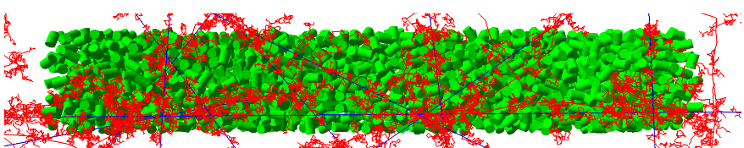

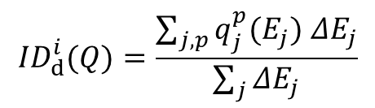
Pre-calculated ID for voxel-based ID estimation
Macroscopic approach and verification with track structure simulations
Condensed-history simulation
In a voxel i:
Interpolated
M₂ or f₃ at energy E_{j}
$${ID}_{d}^{i}(Q)$$
$${ID}_{d}^{i}(Q)=\frac{\sum_{j,p}{q_{j}^{p}(E_{j}){ ΔE}_{j}}}{\sum_{j}{{ΔE}_{j}}}$$
i
Proton SOBP
(10.6 cm range,
2 cm modulation)
or Carbon beam
(26 cm range)
water
Energy deposited at event j
Phase spaces
Track-structure simulation
(Geant4-DNA/TOPAS-nBIO)
Similar approach was used in Alexander et. Al. Phys. Med. Biol. 60(13), 9145, (2015) for cellular-size simulations.
Shrunken
phase space at slice position i
Ramos-Méndez et al, Phys Med Biol 63:235015-28, 2018

Slide 26
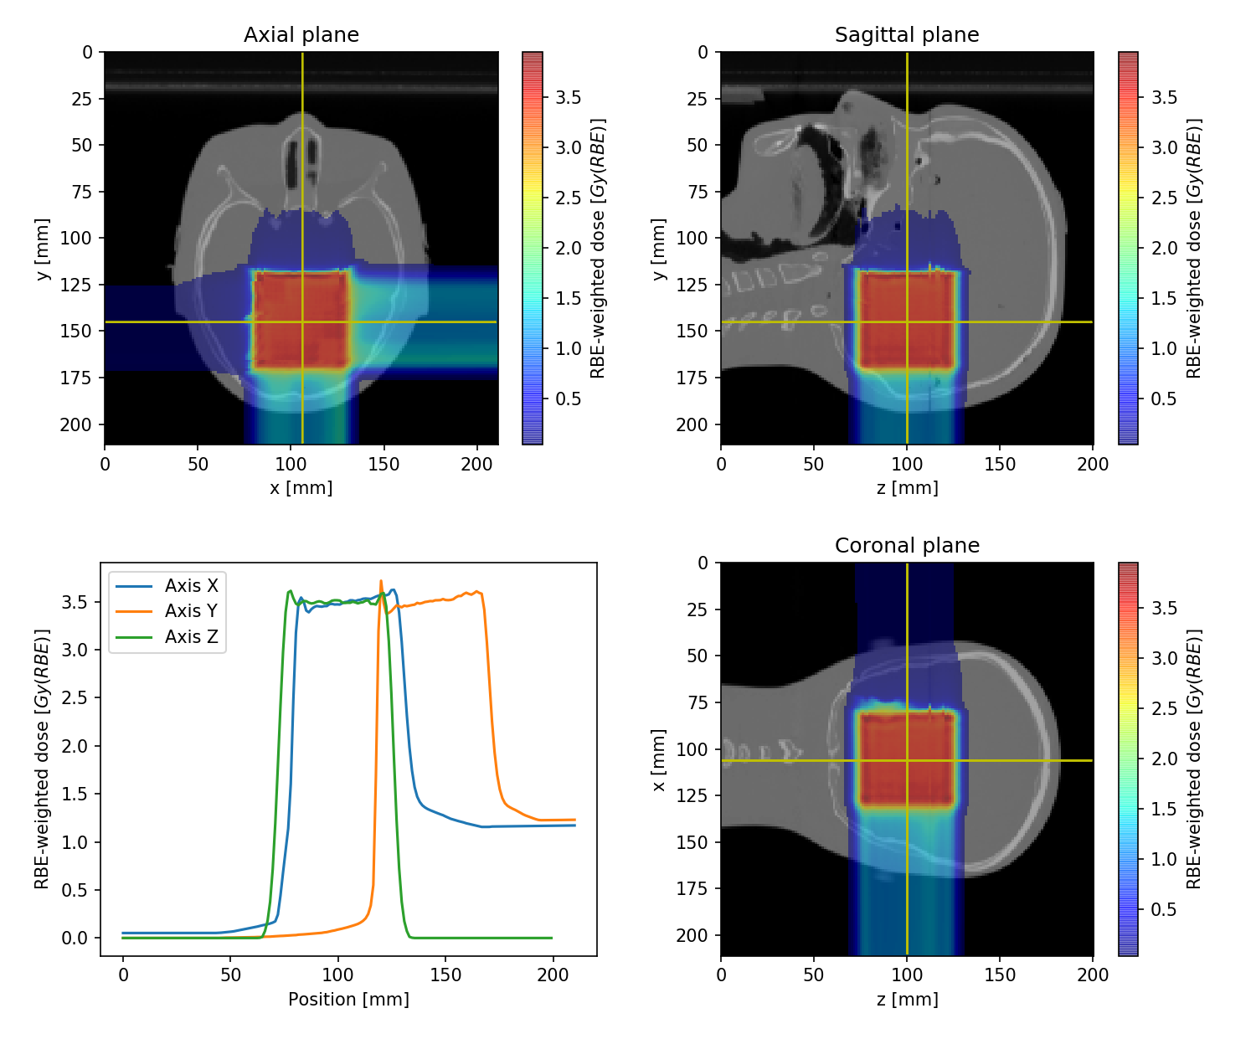
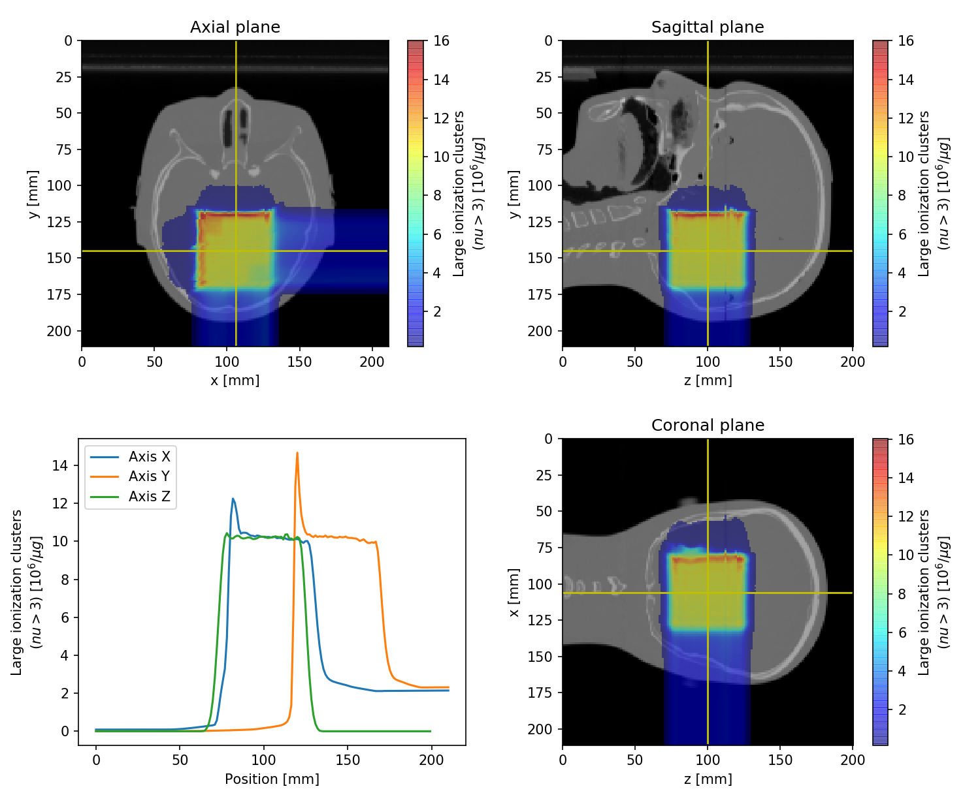
Treatment plans: Uniform ID
12C PA: 100.1 - 222.3 MeV/u 12C RL: 88.8 - 196.2 MeV/u
Simultaneous optimization of LEM and ID using (MatRad from DKFZ)
Burigo et al, Phys Med Biol 64:015015-27, 2019

Slide 27
The future of particle therapy (after solving its major issues)

Slide 28
Once the main issues are resolved, what can we do?
Only when range uncertainties are reduce to values compatible with photon therapy and we have implemented pretreatment verification protocols, we can have similar PTV margins in photon and proton/ion therapy trials, making them comparable in terms of late effects
Only when biological treatment plan optimization is harmonized between CIRT centers, we can proceed with multi-institutional carbon ion trials
Evidence should be created with common tumors, such as prostate and lung cancer; the first is preferred because range & dosimetry errors due to motion issues are harder to resolve

Slide 29
Major Steps in the U.S. towards Ion Therapy
Design and completion of clinical trials at existing centers
Design and construction of new compact facilities for research & clinical trials
Center for Medicare & Medicaid Services reimbursement
FDA approval for new equipment
Broad insurance coverage requires level 1 evidence, obtained with 1st step

Slide 30
SBRT with Heavy Ion vs. Proton vs. Photon (SHIPP) Radiotherapy and Short-term Adjuvant Androgen Deprivation Therapy for Unfavorable Intermediate Localized Prostate Cancer: A Phase II Randomized Trial
Background: Ultrashort hypofractionation to treat patients is of great interest.
Objectives: This study will assess feasibility in terms of quality assurance and fundability, compare quality of life, safety and clinical endpoints of photon and protons with that of carbon ion therapy in a prospective phase II trial :
  1) Feasibility: QA: the same-accuracy (PTV margins) across international sites using appropriate image guidance.
  2) Feasibility: fundable model for financial coverage in the U.S.
  3) QOL endpoints: Detectable changes in health-related quality of life measured by urinary domain at 1-year of the Expanded Prostate Cancer Index Composite (EPIC-50)
  4) Safety: rate of acute and late GI and GU toxicity for each arm at 1, 2, and 5 years; An acceptable percentage of 1% will be deemed to have an acceptable adverse event profile.
  5) Clinical endpoints: Biochemical failure (PSA endpoint), Local Control, Cause-Specific Survival, Overall Survival

Slide 31
SBRT with Heavy Ion vs. Proton vs. Photon (SHIPP) (continued)
Design: Randomized phase II study of unfavorable intermediate risk prostate cancer, not blinded
Eligibility: Unfavorable intermediate risk prostate cancer + adjuvant short term hormone therapy and negative 68Ga-PSMA PET/CT (pelvic lymph nodes).
45 International Sites: 45 total sites and 159 patients: 30 sites with photon therapy (53 patients); 10 sites with proton therapy (53 patiens); 5 sites with carbon ion therapy (53 patients).
Intervention(s): Carbon ions with 4 fractions vs. SBRT photon therapy 4 or 5 fractions vs. hypofractionated proton therapy 4 or 5 fractions but no whole pelvis RT

Slide 32
Summary and Outlook
Particle therapy with protons and ions is not fully developed to exploit its potential
The main remaining issues are range and biological uncertainty
Solutions are available and should be explored and compared
Once these issues are resolved we can move on with international randomized trials in a common cancer site, e.g. localized prostate cancer

