Slide 1


Synthesis and characterization of the plastic scintillators for the total-body J-PET scanner
Łukasz Kapłon
Faculty of Physics, Astronomy and Applied Computer Science
Jagiellonian University
28.06.2019

Slide 2
Outline
Chemistry of plastic scintillators
Optical properties measurement:
- light yield
- emission spectra
- decay time
Technical attenuation length of long plastic scintillator strips

Slide 3
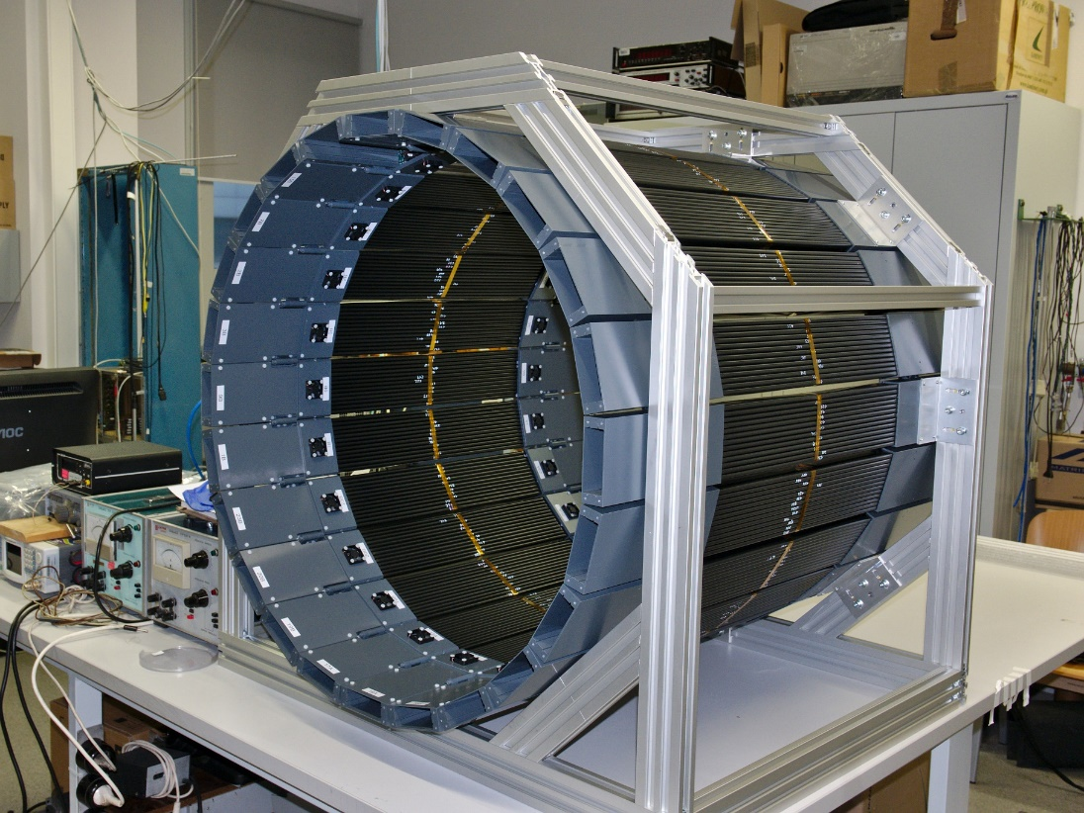
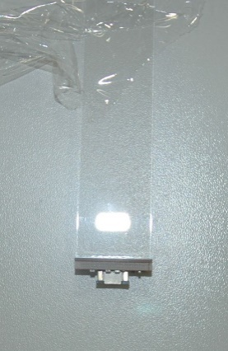
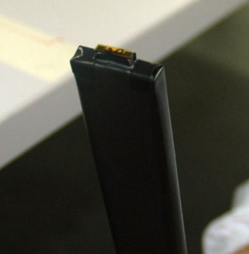
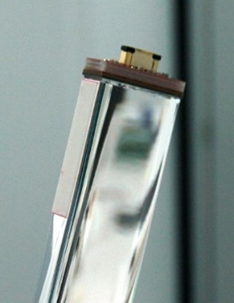
Motivation
Develop plastic scintillators with high light transparency for J-PET construction.
Measure properties of commercial scintillators
and choose the best for prototypes building.

Slide 4
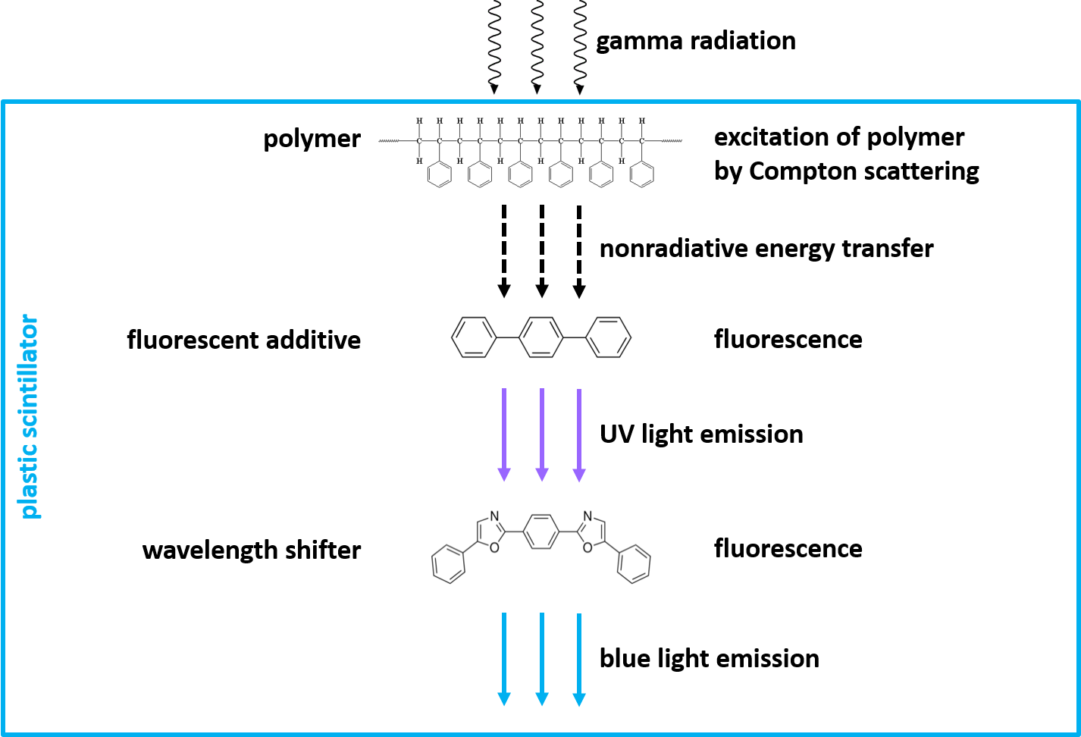
Scintillation Principles: light emission mechanism

Slide 5
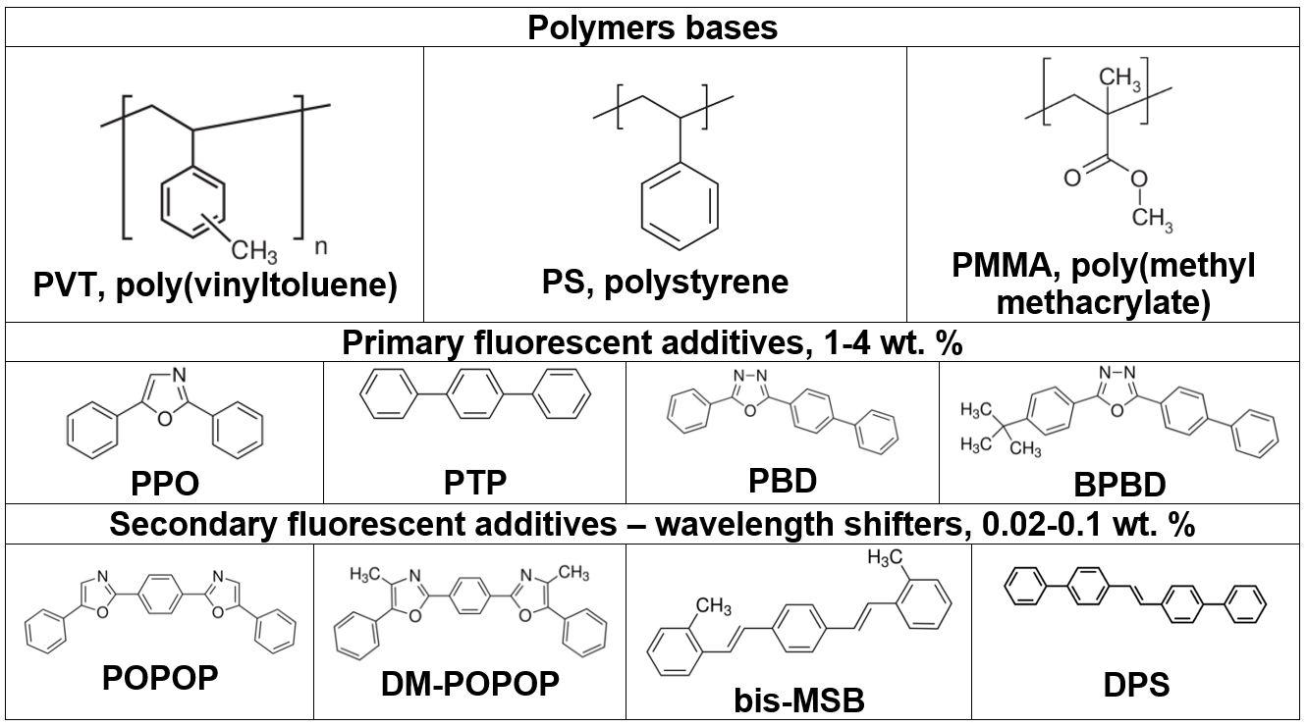
Scintillation Principles: chemical components

Slide 6
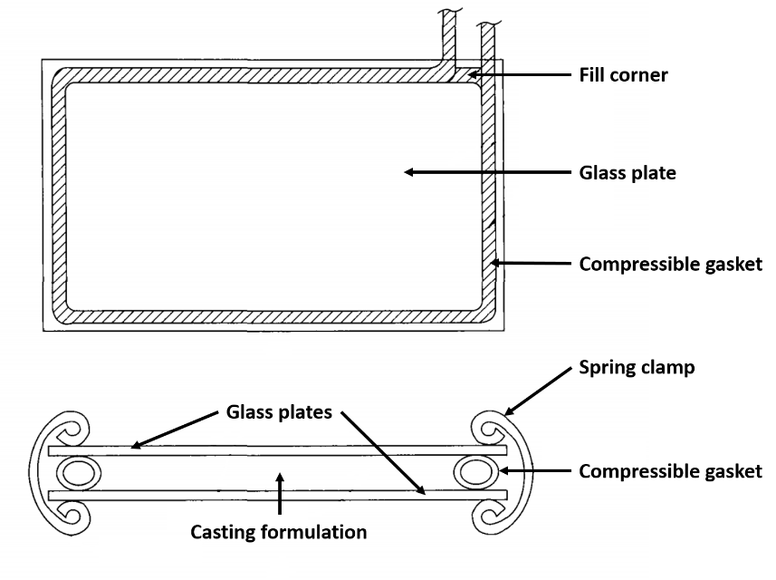
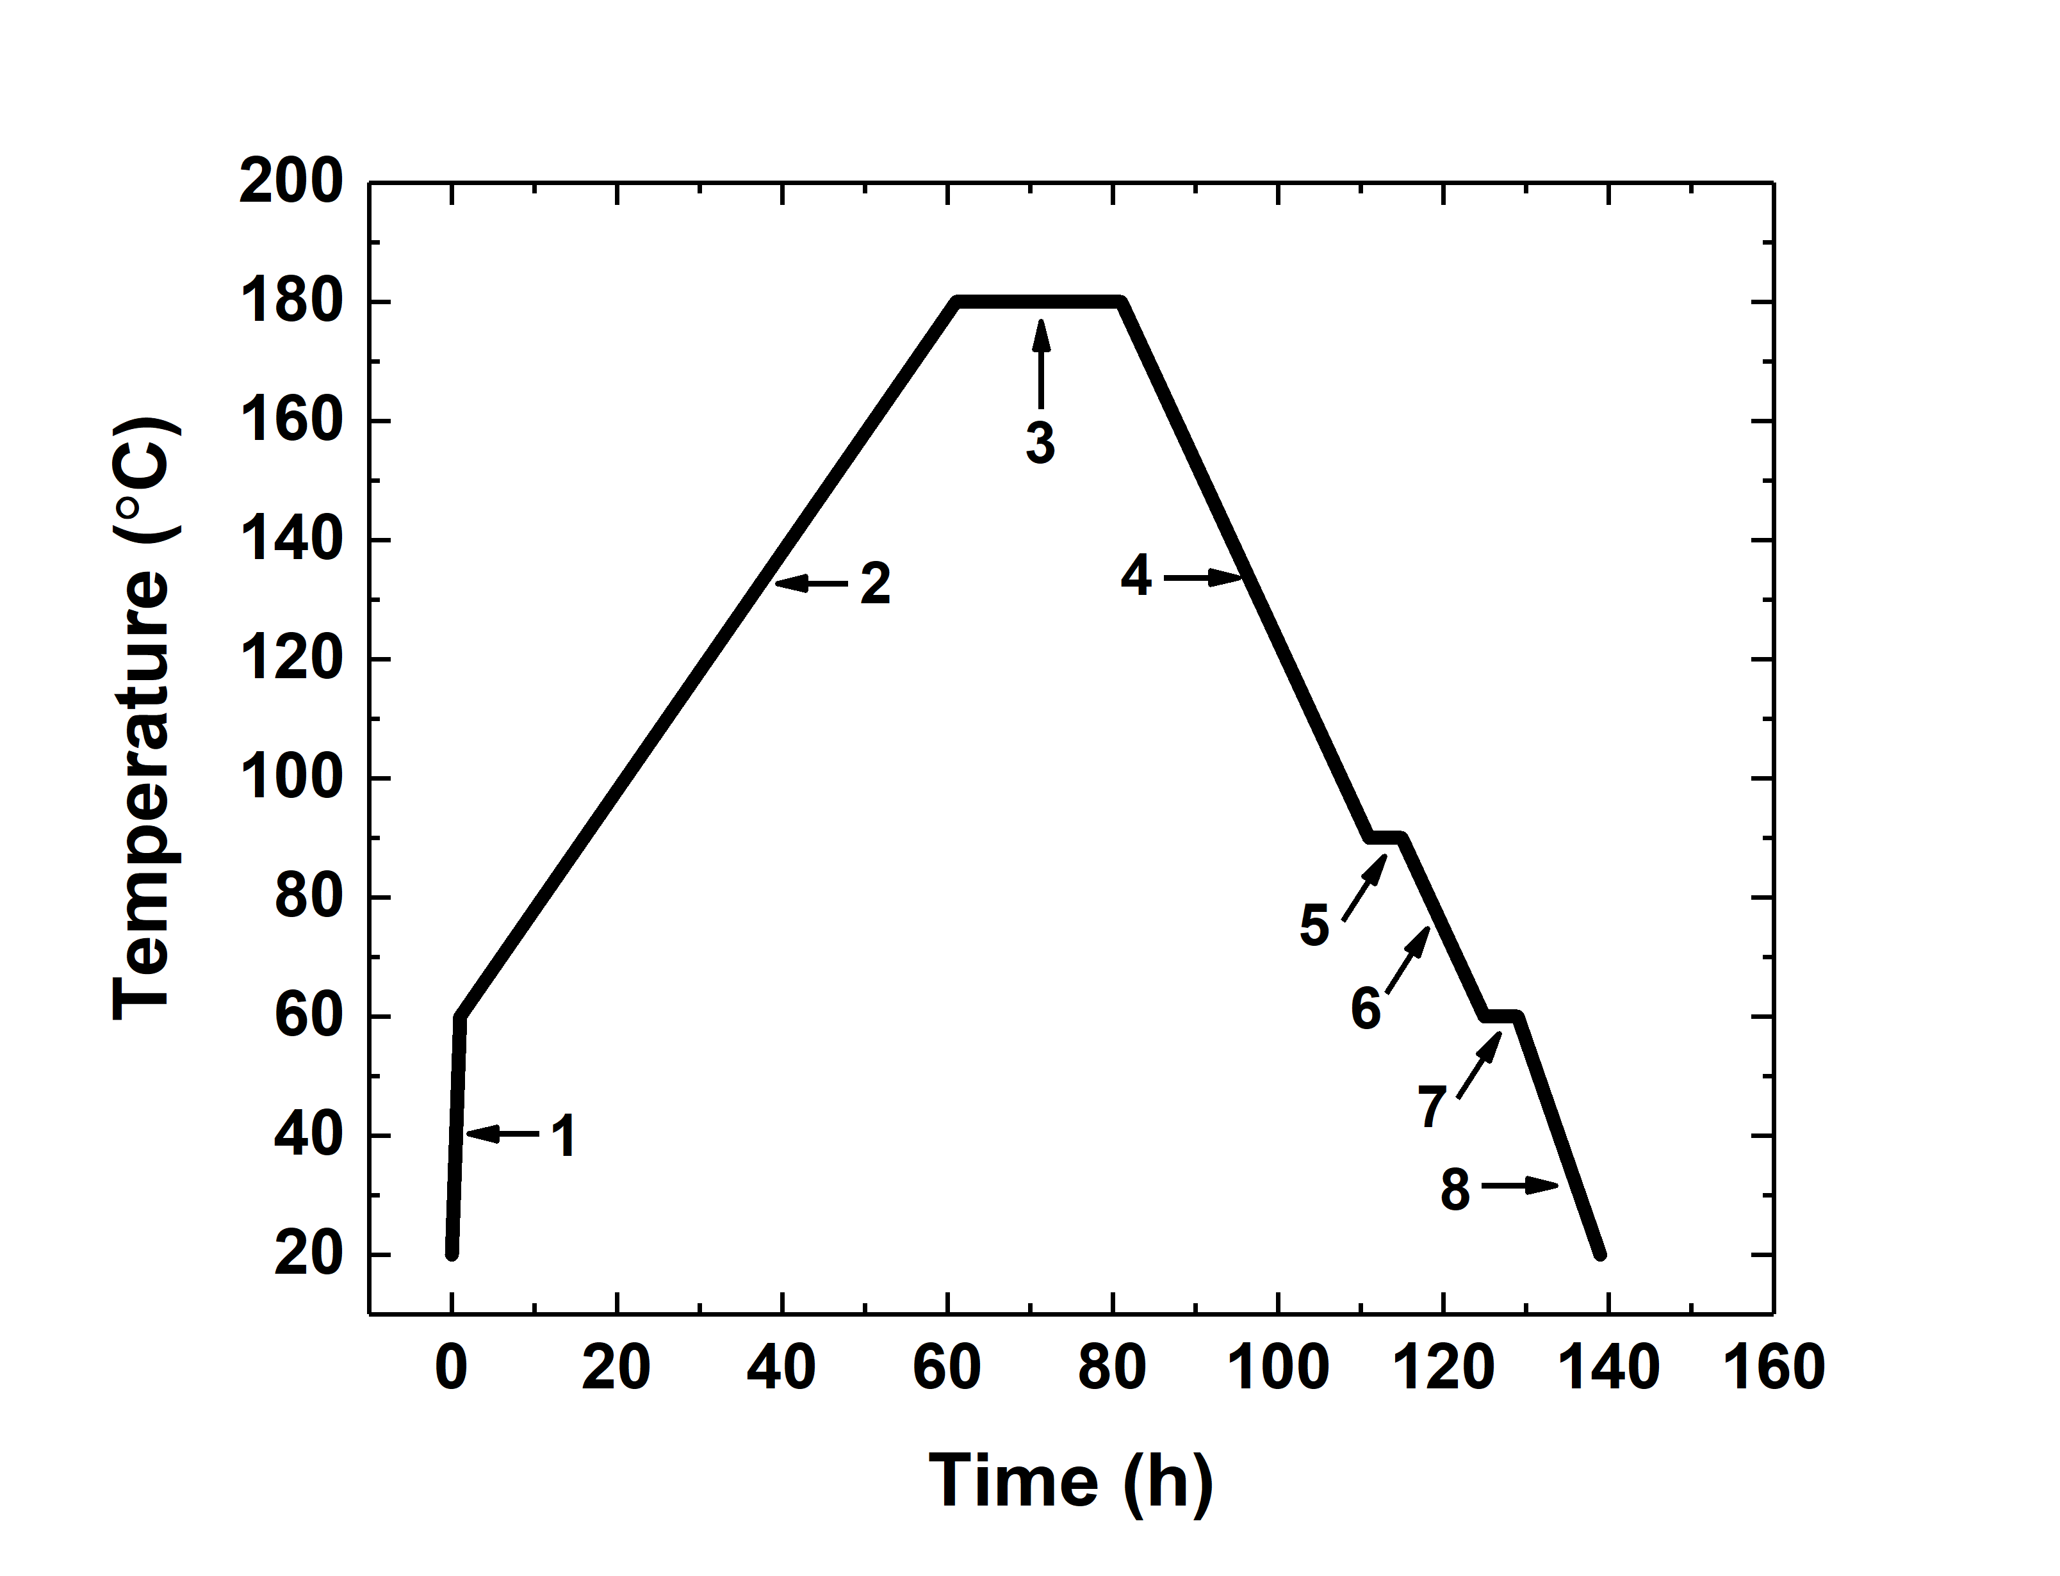
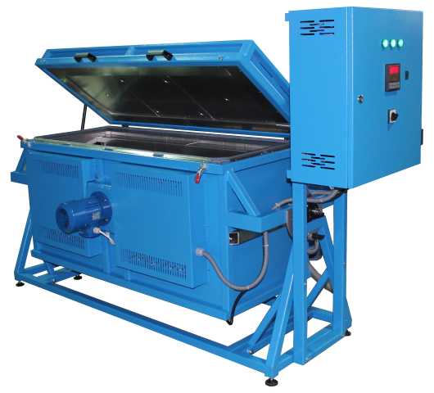
Scintillation Principles: cell casting polymerization
1. fast heating from room temperature 20 °C to 60 °C in 1 hour, 40 °C/h,
2. slow heating from 60 °C to 180 °C in 60 hours, 2 °C/h,
3. polymerization in 180 °C during 20 hours,
4. cooling from 180 °C to 90 °C in 30 hours, 3 °C/h,
5. first annealing in 90 °C for 4 hours,
6. cooling from 90 °C to 60 °C in 10 hours, 3 °C/h,
7. second annealing in 60 °C for 4 hours,
8. cooling from 60 °C to 20 °C room temperature in 10 hours, 4 °C/h.

Slide 7
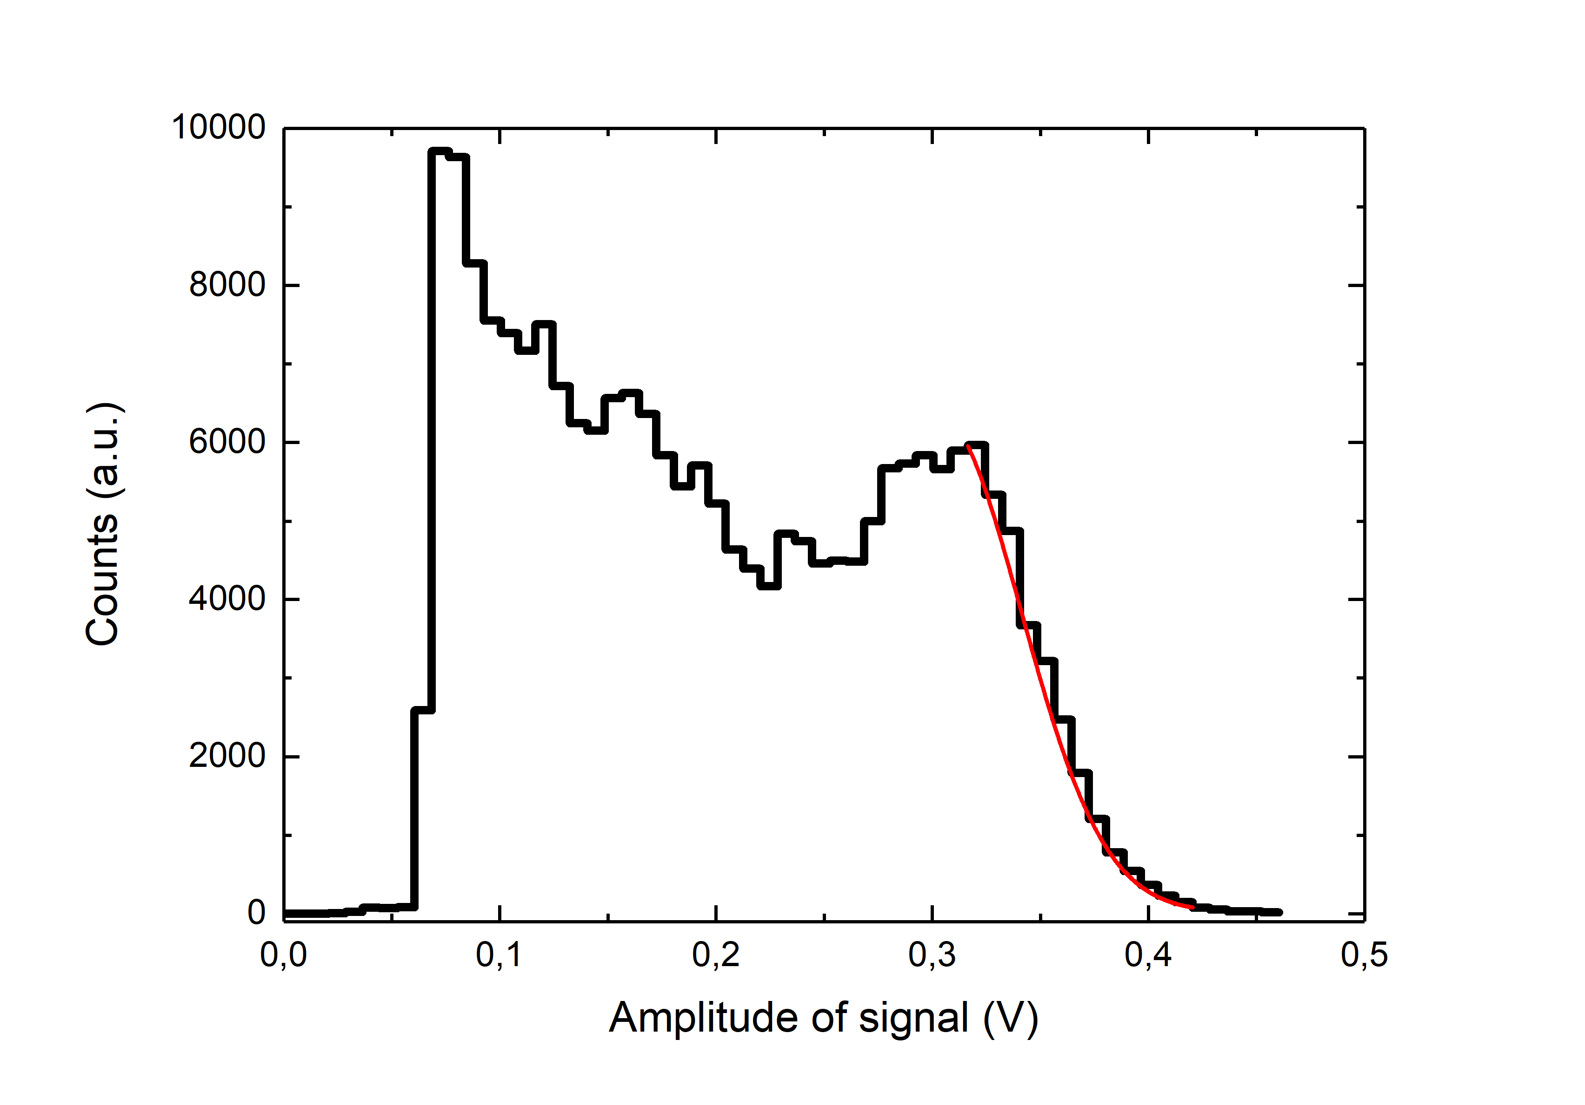
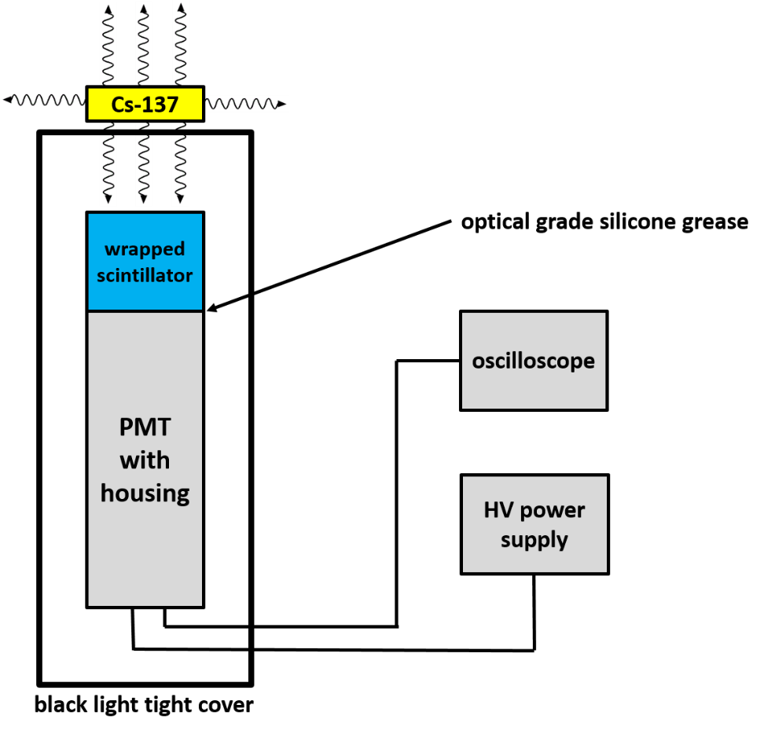
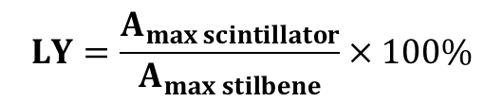
Scintillation Principles: light yield of scintillators
Light yield (LY) is a conversion efficiency of radioactive energy deposited in scintillator into light and is expressed in light photons
generated per megaelectronvolt of deposited energy (photons/MeV) by radiation quanta or particle. Comparing light yield of produced plastic
scintillators to light yield of anthracene or stilbene crystal scintillators is known as relative light yield.
A_{max}
$$LY=\frac{A_{max scintillator}}{A_{max stilbene}}×100\%$$
A_{max scintillator} – middle of Compton edge for sample
A_{max stilbene} – middle of Compton edge for sdandard

Slide 8
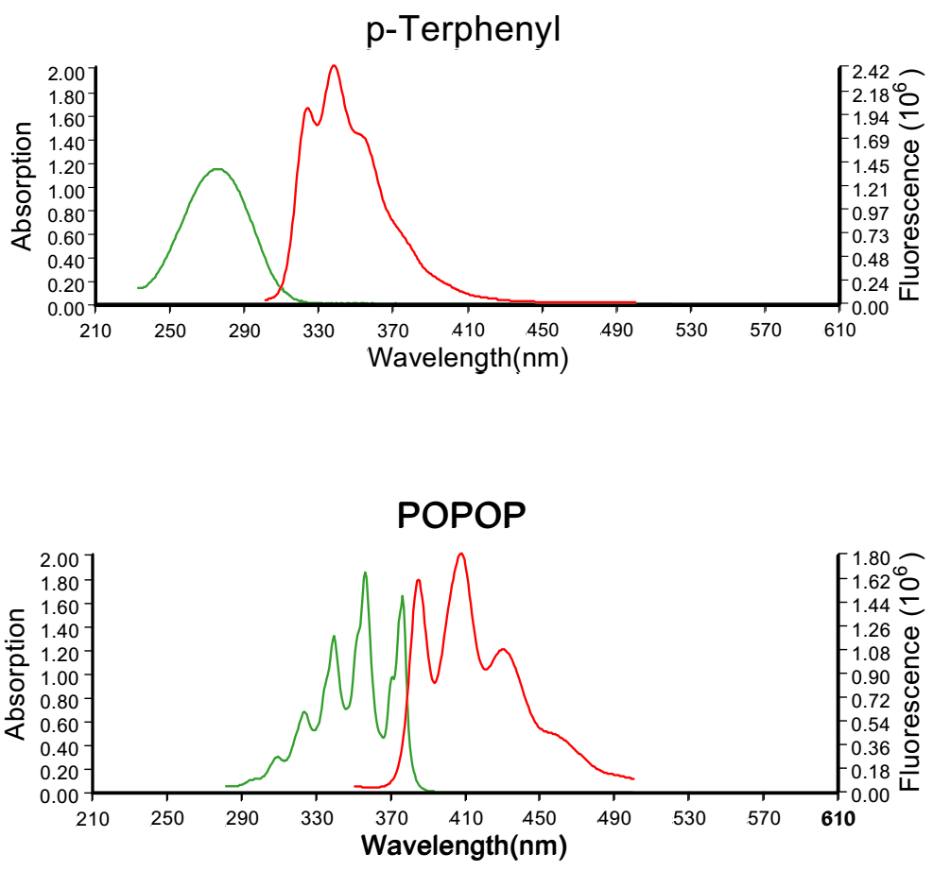
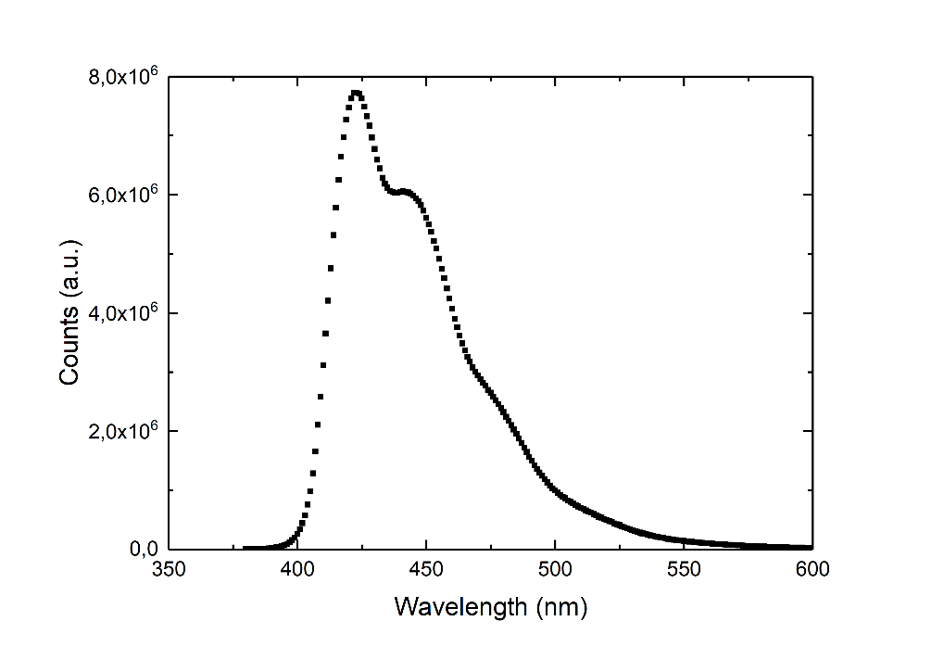

Scintillation Principles: emission and absorption spectra
1-4 wt. %
p-Terphenyl + POPOP
~0.05 wt. %
Absorption (green) and emission (red) spectra of two fluorescent substances commonly used in plastic scintillators
Emission spectrum of plastic scintillator with p-Terphenyl and POPOP
p-Terphenyl emission spectrum overlaps with
POPOP absorption spectrum

Slide 9
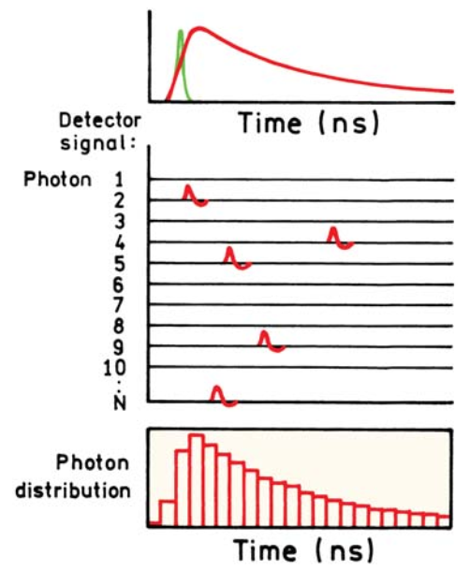
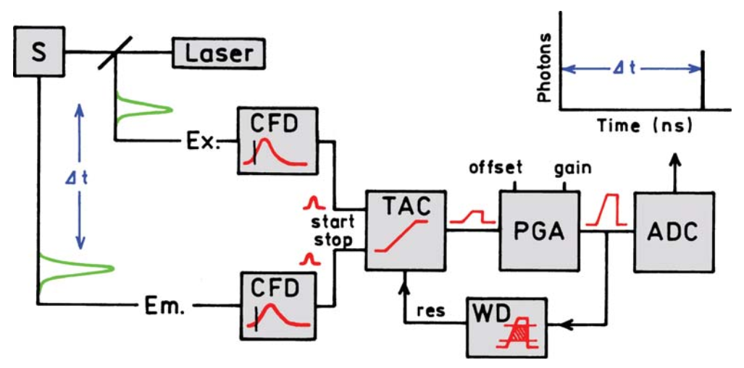
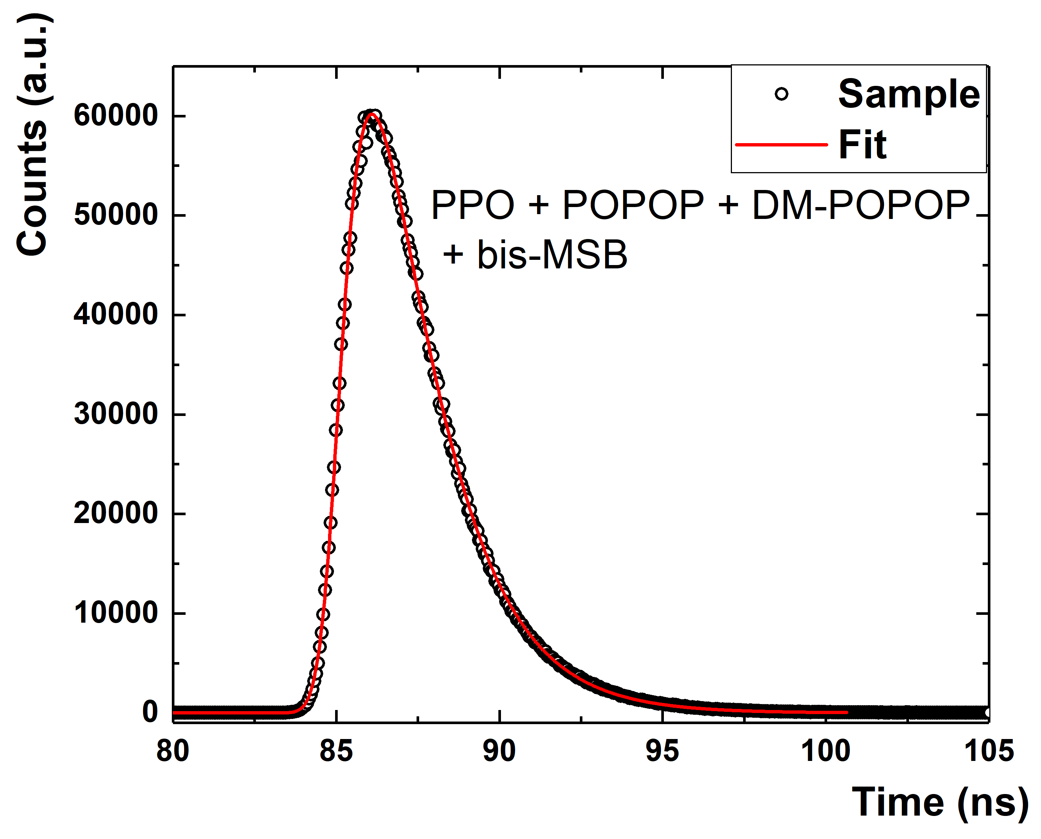

Scintillation Principles: light pulse properties
Decay time can be defined as time over which the light signal from scintillator decreases to 1/e of its maximum value.
To measure decay time of plastic scintillators time-correlated single photon counting (TCSPC) was used.
$$f\left(t\right)=K\int_{θ}^{t}{\left(e^{−\frac{t−τ}{t_{d}}}−e^{−\frac{t−τ}{t_{r}}}\right)∙e^{−\frac{{\left(τ−θ−2.5σ\right)}^{2}}{{2σ}^{2}}}}dτ$$
where following symbols denote:
K - normalization constant
Θ – time of the gamma quantum interaction with scintillator
t - time
t_{d} - decay time of the final light emission
t_{r} - average time of the energy transfer to the wavelength shifter
σ - standard deviation reflects total uncertainty of light emission
from scintillator and TCSPC components: excitation diode,
photomultiplier tube and electronics.

Slide 10
Results
Chemical composition | Light yield [photons/MeV] | Decay time [ns] | Emission maximum [nm]
Polystyrene 2% PPO 0.03 POPOP 0.03 bis-MSB | 11200 | 1.8 | 423
Polystyrene 2% BPBD 0.06 POPOP | 10770 | 1.51 | 422
BC-420 polyvinyltoluene | 10000 | 1.5 | 391
EJ-200 polyvinyltoluene | 10000 | 2.1 | 425

Slide 11
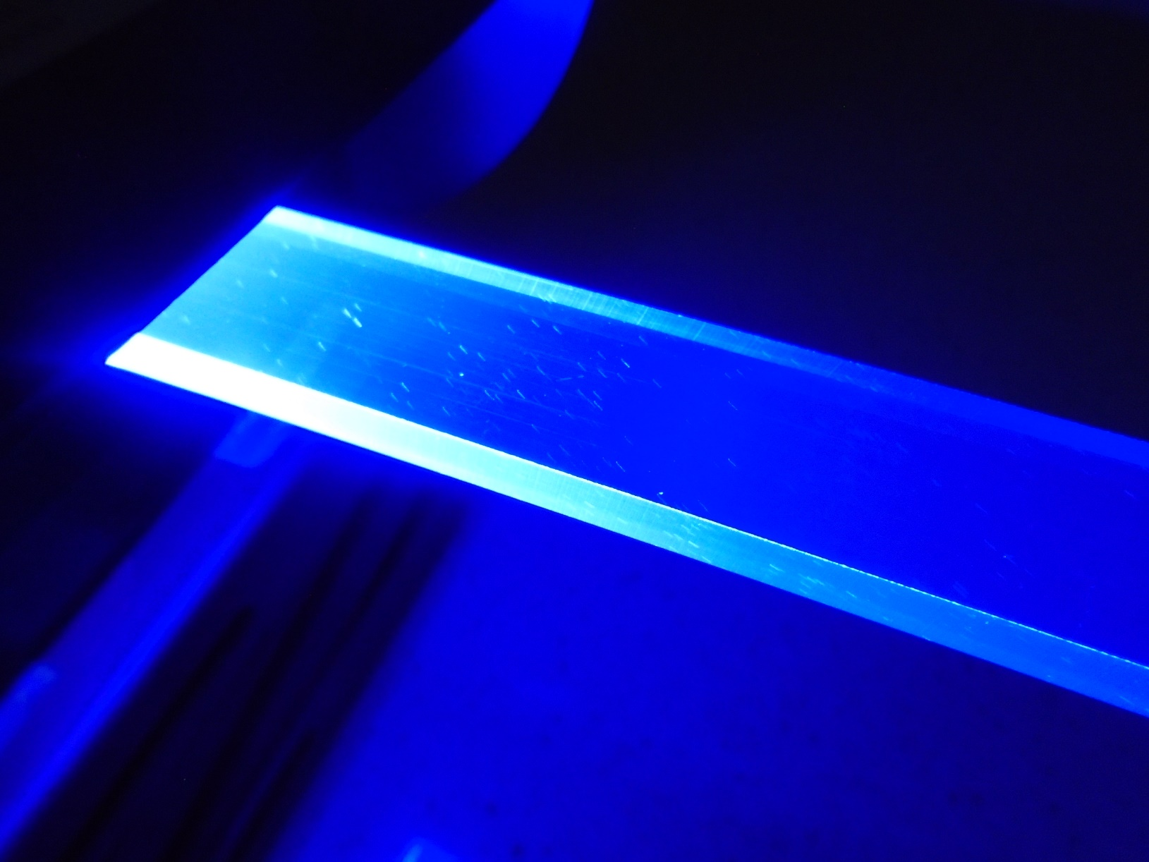
Commercial plastic scintillators

Slide 12
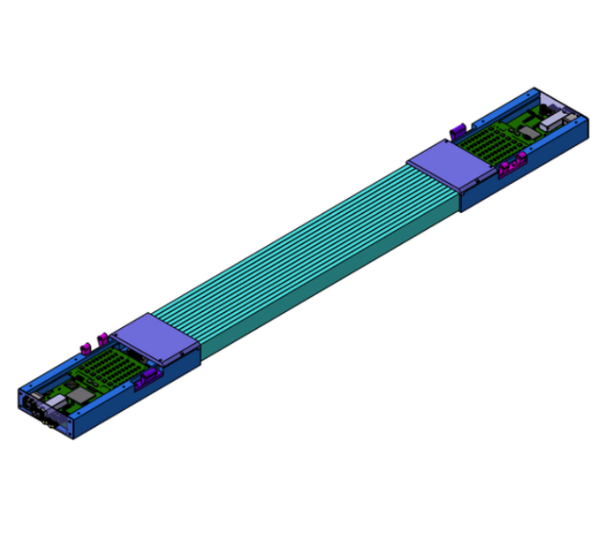
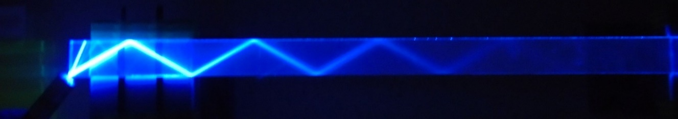

Technical attenuation length
The aim of this measurement was to determine technical light attenuation length of plastic scintillator strips used for J-PET modules construction.
The technical attenuation length (TAL) of a plastic scintillator bar is defined
as the length of scintillator reducing the light signal by a factor of e and depending upon:
bulk transmission of the scintillator,
scintillator thickness,
shape of scintillator,
reflective property of the surfaces.
$I(x)=A_{1}∗e^{\left(−\frac{x}{t_{1}}\right)}$ + y0
A1 – amplitude
x - distance from light detector
t1 - technical attenuation length
y0 - background
500 to 1000 mm long scintillators

Slide 13
Plastic scintillator strips used in J-PET
 | BC-420 | EJ-230 | BC-404 | EJ-200 | UPS-923A | SP32 | Epic PS
Dimensions [mm³] | 5x19x300 | 7x19x500 | 6x24x500 | 6x24x1000 | 6x24x1000 | 6x24x1000 | 6x24x1000
Used in J-PET prototype | 24 strips small barrel with PMTs | 192 strips big barrel with PMTs | 312 strips modular PET with SiPMs | 1m long with WLS and SiPMs | Research for one meter module with SiPMs
Data from manufacturers
Decay time [ns] | 1.5 | 1.5 | 1.8 | 2.1 | 3.3 | 2.5 | 2.4
Light output [% of anthracene] | 64 | 64 | 68 | 64 | 56 | 56 | 50-60
Wavelength of maximum emission [nm] | 391 | 391 | 408 | 425 | 418 | 425 | 415
Light attenuation length [cm] | 110 | 120 | 160 | 380 | 400 | NA | 200
Polymer base | PVT | PVT | PVT | PVT | PS | PS | PS

Slide 14
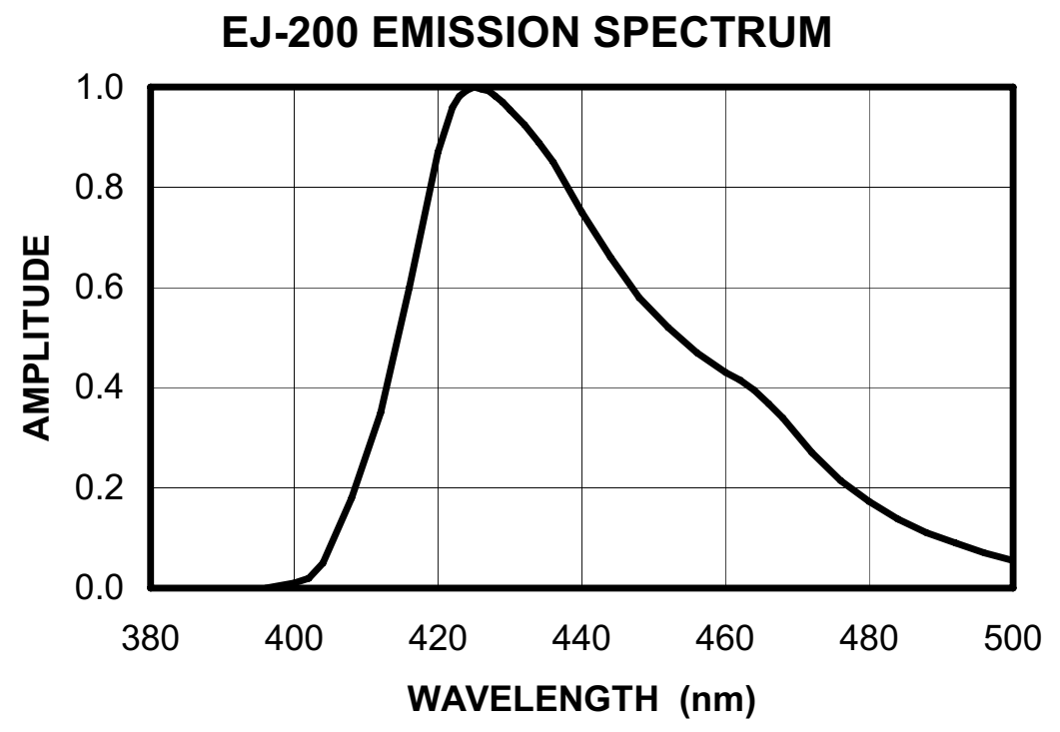
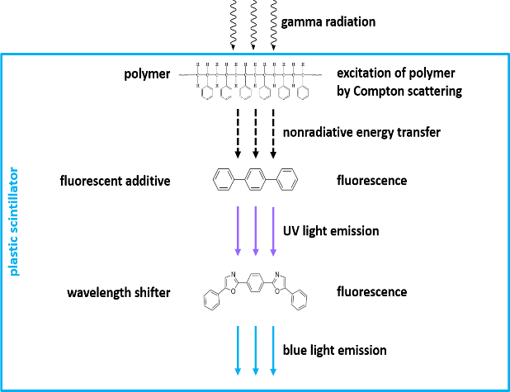
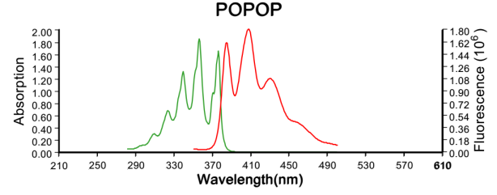
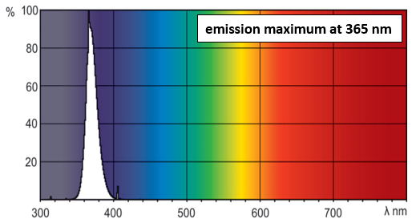
Overlapping of 365 nm UV lamp emission spectra and scintillator absorption
UV light

Slide 15
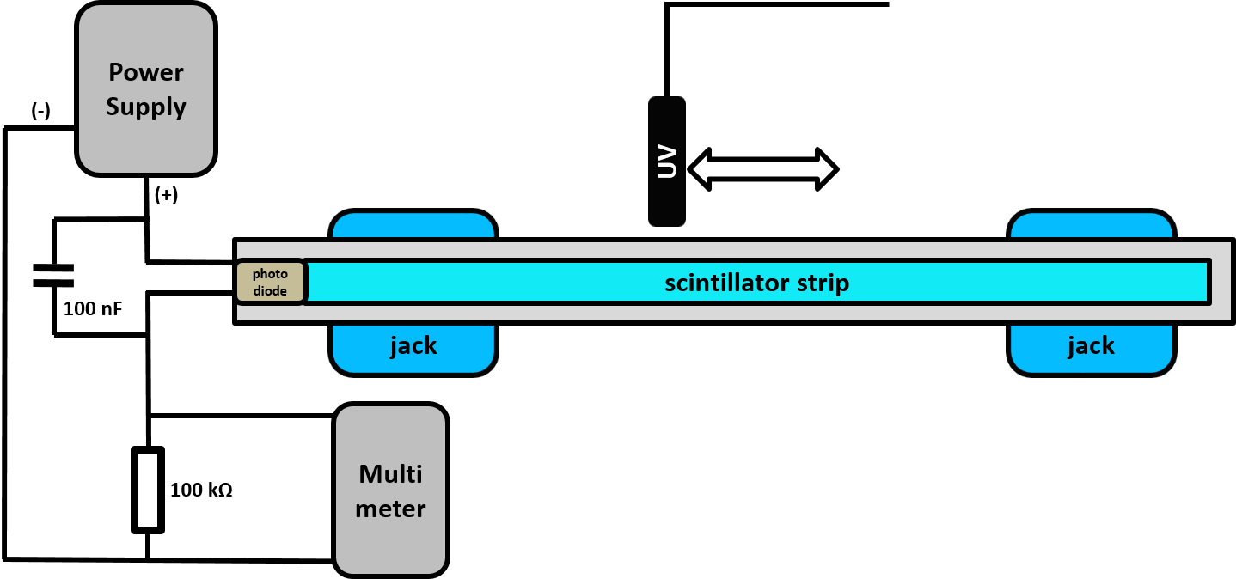
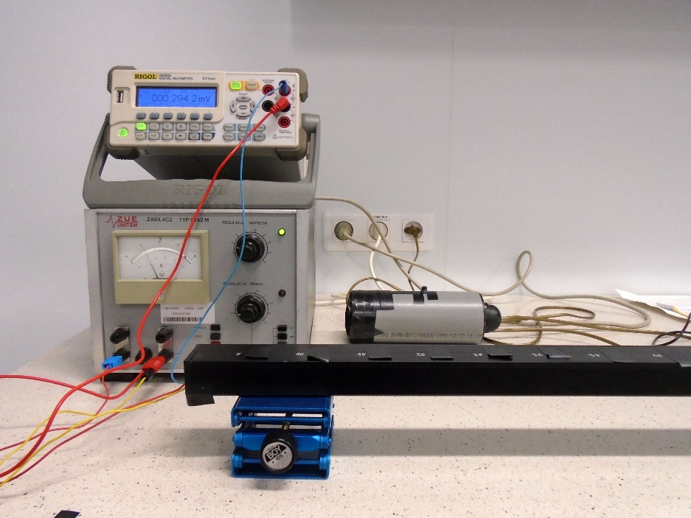
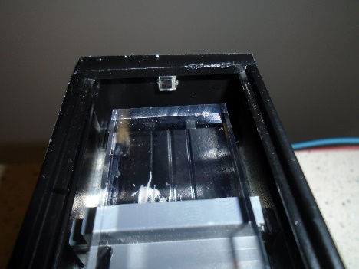
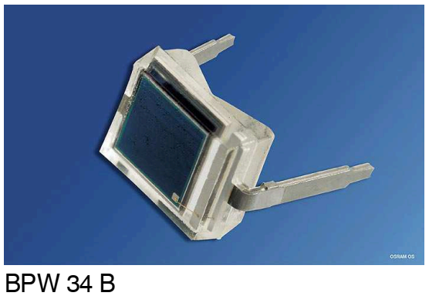
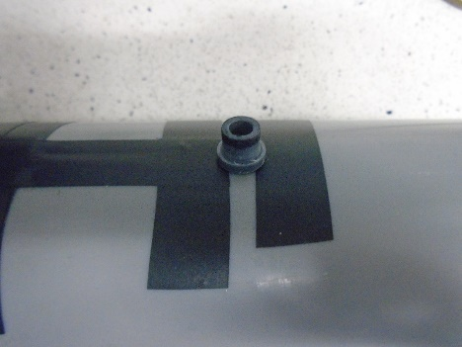
Setup for TAL measurements
In measurement following equipment was used:
UV lamp with 365 nm wavelength
of maximum emission;
silicon PIN photodiode BPW 34 B with 2.73x2.73 mm² active area;
digital multimeter Rigol DM 3064;
power supply ZUE 5352 M;
aluminium rail with 8 mm diameter holes drilled every 50 mm.

Slide 16
Summary results

Slide 17
Summary results
Scintillator 6x24x1000 mm^3 | TAL for LR scan [cm] | TAL for RL scan [cm] | TAL from specification [cm]
EJ-200 PS56 | 145.74 ± 11.65 | 149.59 ± 4.09 | 380
EJ-200 PS57 | 163.55 ± 7.84 | 145.65 ± 4.67
UPS-923A PS1 | 62.59 ± 1.78 | 61.26 ± 0.85 | 400
UPS-923A PS2 | 69.45 ± 1.91 | 66.63 ± 0.76
Epic PS1 | 32.25 ± 1.73 | 36.17 ± 0.93 | 200
Epic PS2 | 41.11 ± 1.56 | 41.25 ± 1.04
SP32 PS1 | 22.67 ± 0.76 | 23.22 ± 0.60 | NA
SP32 PS2 | 24.79 ± 0.67 | 23.92 ± 0.64

Slide 18
Summary
Plastic scintillators with the different chemical compositions were synthesized.
Time-temperature cycles were established
for polymerization in small cylinders as well as for polymerization in the glass mold allowing
to manufacture plastic scintillator strips.
Spectroscopic and optical properties of these polystyrene scintillators were measured. Relative light output, decay time, emission spectra were measured
to develop best composition.
Technical attenuation lengths were measured to choose the best scintillator for J-PET construction.

Slide 19
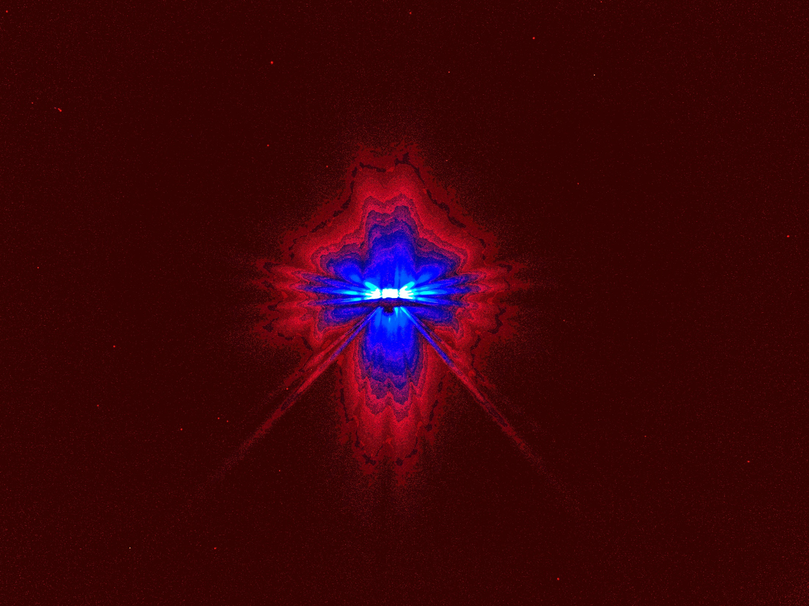
Thank you

