Slide 1


Application of innovative technologies in PET imaging
Dr Grzegorz Korcyl
Inż. Karol Farbaniec
Gabriel Hajduk
Department of Information Technologies
Jagiellonian University in Cracow
3rd Jagiellonian Symposium on Fundamental and Applied Subatomic Physics
The work is supported by the Foundation for Polish Science by grant no. TEAM/2017-4/39 and the Polish Ministry for Science and Higher Education grant no. 7150/E-338/M/2018

Slide 2
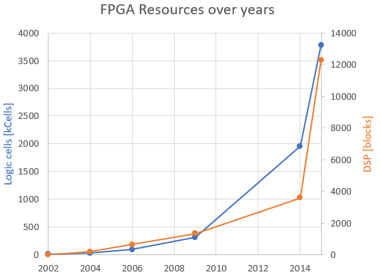
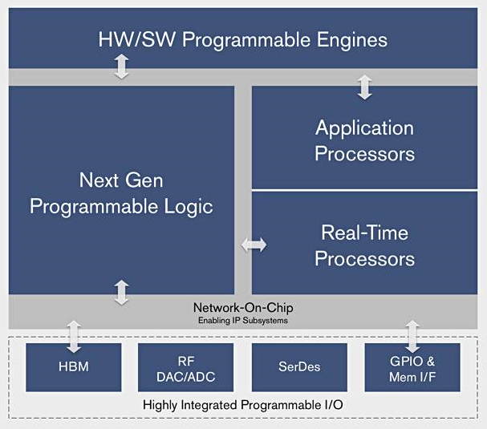
Key concepts
Dynamic evolution of Field Programmable Gate Arrays
  FPGA, CPU, GPU in a single, compact package
  Novel development methodologies
  Applied in Machine Learning, Video processing, High Performance Computing etc.
Exploration of true real-time image
reconstruction mechanisms
High-level processing in real-time
  Shift processing algorithms from offline CPU/GPU to online acquisition system hardware
  Construct Event-By-Event processing pipeline
G. Korcyl, P. Korcyl, “Investigating the Dirac operator evaluation on FPGAs”,
Supercomputing Froniters and Innovations, 2019
Xilinx.com

Slide 3
General scheme
Hierarchical architecture
  Endpoints
    Digitizers
    Buffers
  Concentrators
    Collect data from several Endpoints
  Controller
    Controls the readout
    Collects data from all Concentrators
Two communication directions
  Upstream
    Synchronization
    Control/monitoring requests
  Downstream
    Readout data stream
    Control/monitoring responses

Slide 4
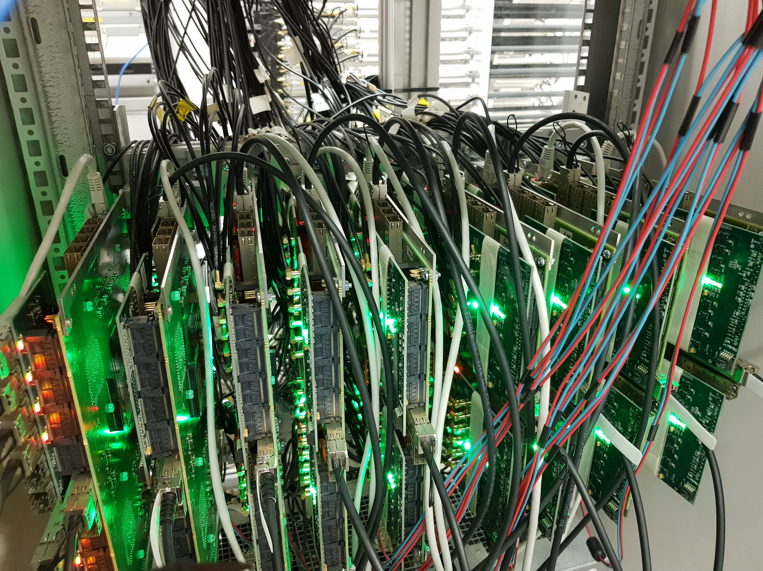
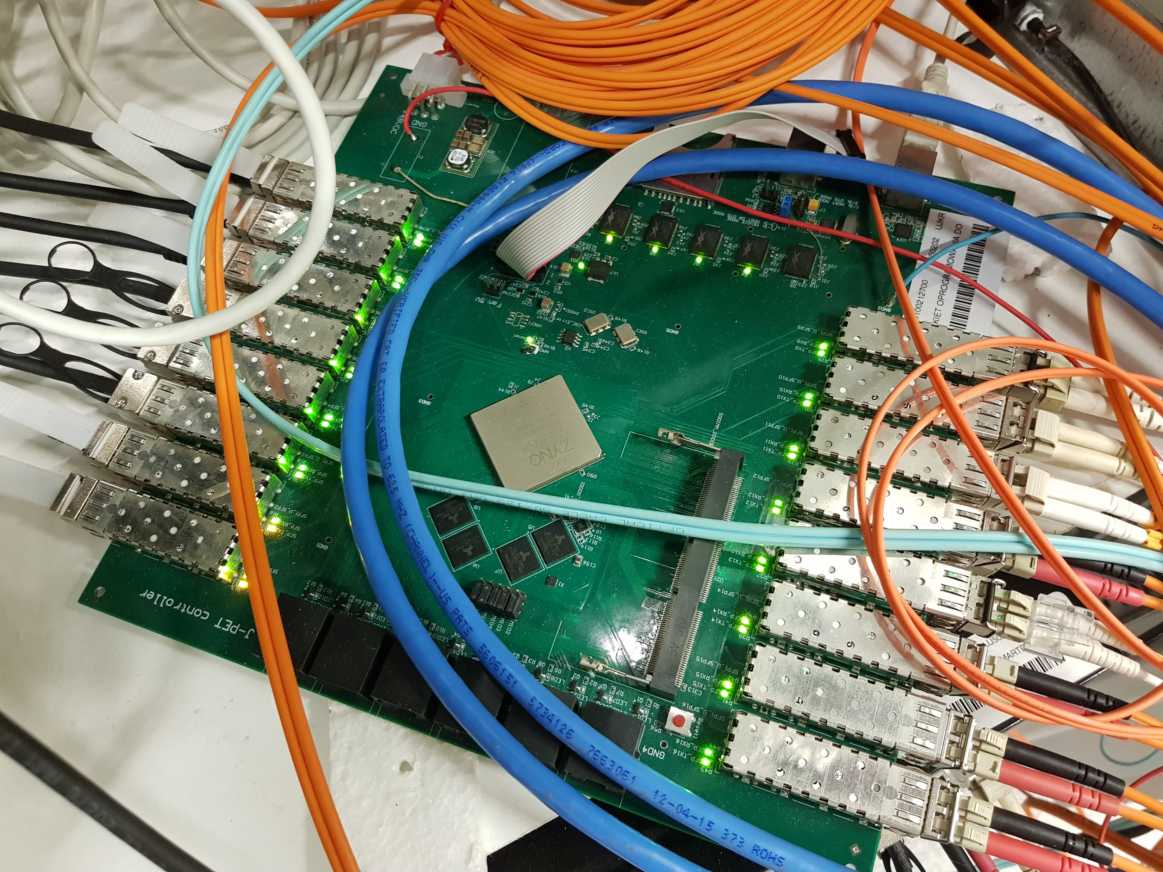
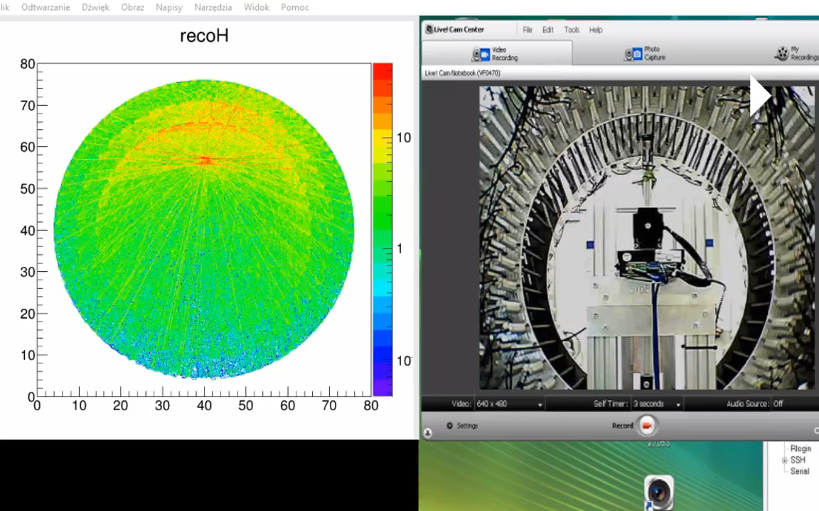
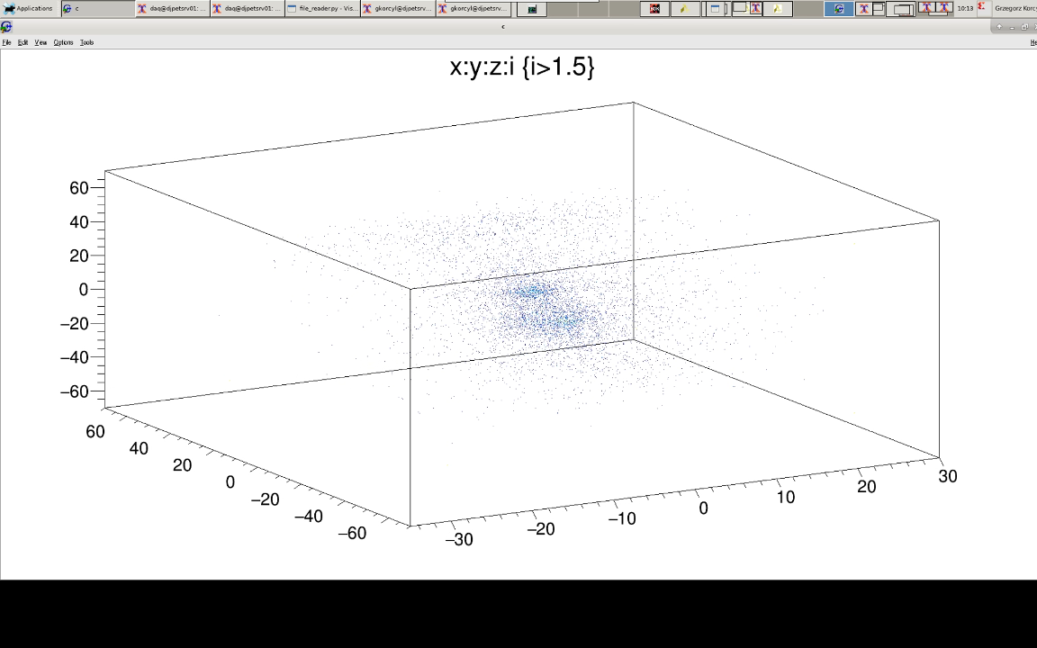
J-PET
192 scintillator strips
1536 analog signals
32 TDC Endpoints
8 Concentrators
1 Controller
  Processing pipeline on Zynq 45
    8 paralel data streams
    Application of calibrations
    Search for geometry and timing coincidences
    LOR and ROR calculation
    Visualization by Linux on integrated ARM core
  Resource utilization: 75%
  Performance: 42 Mhits/s
  Power consumption: 20 W
G. Korcyl, et al., “Evaluation of single-chip, real-time tomographic data processing on FPGA -SoC devices”,
IEEE Transactions on Medical Imaging, DOI: 10.1109/TMI.2018.2837741, 2018
B. Flak, „Data visualization system for PET device”, Master thesis, AGH Kraków, 2018

Slide 5
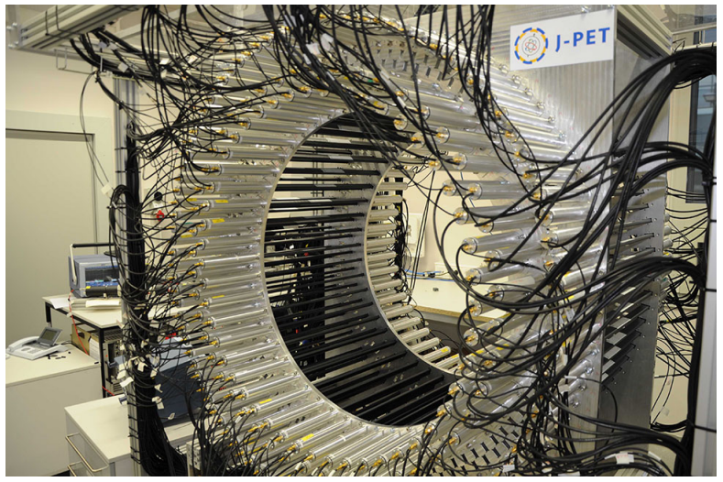
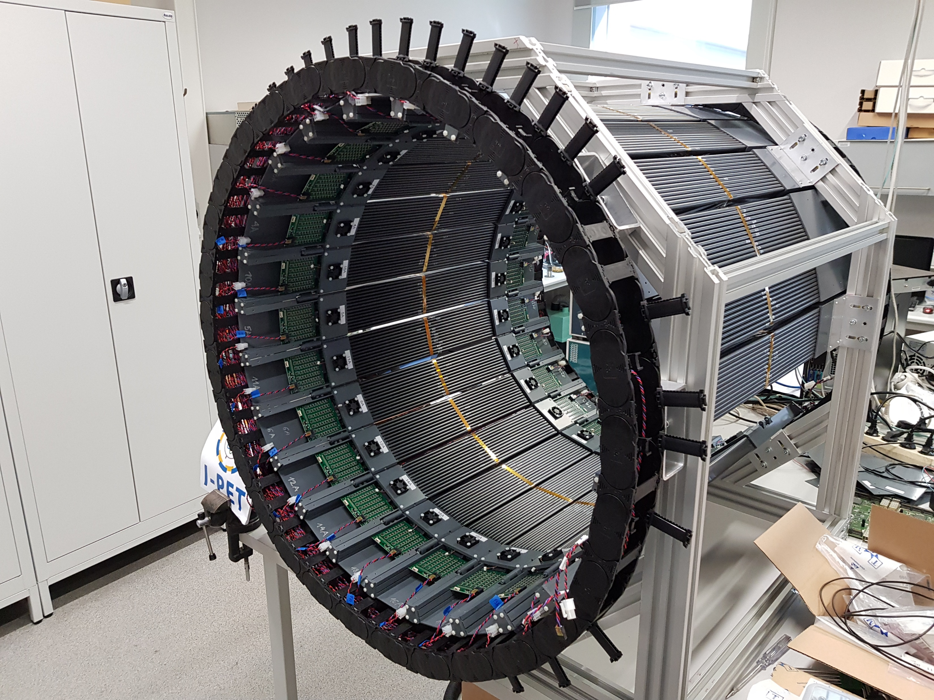
Modular JPET Readout
 | JPET | Modular JPET
Scintillators | 192 | 312 | 1.6x
Analog channels | 1536 | 4992 | 2.9x
Digitizers | 32 | 48 | 6x
Logic [k cells] | 350 | 5400 | 15.4x
Memory [Mb] | 19 | 272 | 14.3x
DSP | 900 | 3972 | 4.4x
ARM cores | 2 | 4 + 2x RT + 1x GPU | >2x

Slide 6


Continuous readout
Synchronous Aurora links for internal com.
Utilization: only 10 % of resources
Concentrator
010101
010101
010101
010101
010101
010101
010101
010101
48 endpoints 12 per concentrator
010101
010101
010101
010101
010101
010101
010101
010101
Controller
10 Gb Ethernet raw data output
50 khz readout reate
Concentrator
Korcyl G. et. al.: A system for acquisition of tomographic measurement data
Patent Nr: US10007011B2, 2018, WO/2015/028594

Slide 7

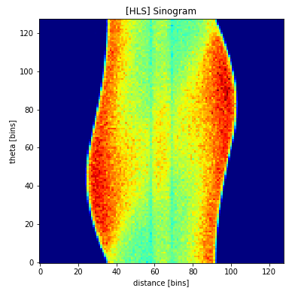
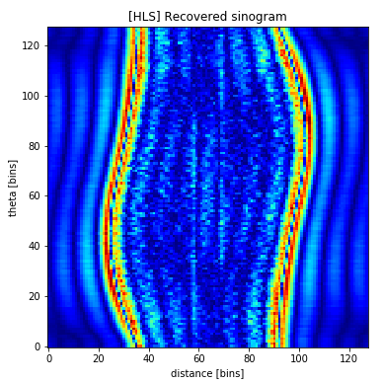
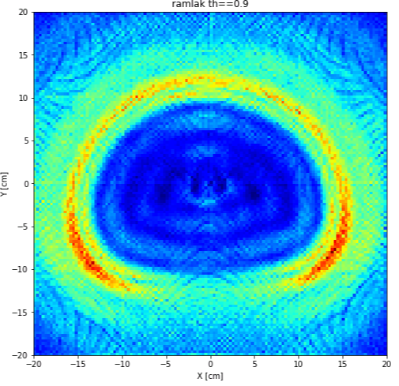
Full processing pipeline
Raw data path preserved
Numerically verified, simulated on NEMA IQ phantom data
Final image generation and visualization on ARM/GPU
Concentrator
010101
010101
Calibrations
Interaction points
010101
010101
010101
010101
010101
010101
010101
010101
010101
010101
010101
010101
2.8 Ghit/s
010101
Coincidences
LOR calculator
Sinogram
generation
Sinogram
filtration
Image
reconstruction
010101
010101
010101
010101
010101
010101
010101
010101
Controller
010101
010101
Calibrations
Interaction points
Sinogram processing pipeline (e.g. 128x128 @ 200 MHz)
010101
010101
010101
010101
Concentrator
K. Farbaniec, „Tomographic data processing and visualization on programmable devices”, UJ, Master thesis, in preparation

Slide 8
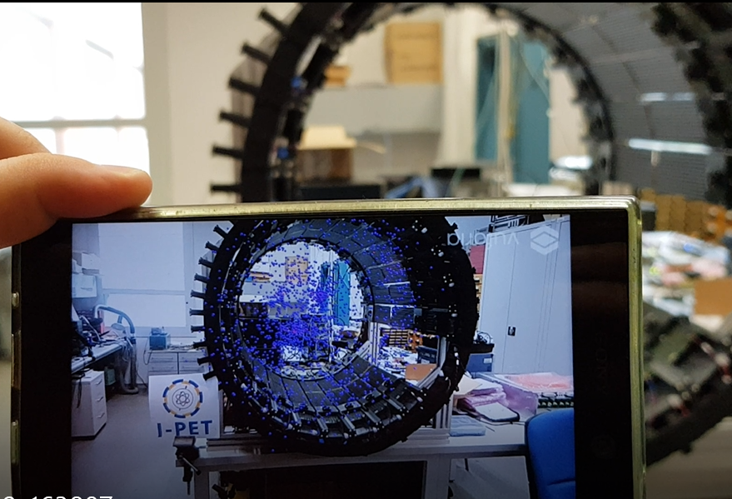
Summary
We have demonstrated that FPGA-based hardware is suitable for high-level tomographic data processing
  First prototype can process data streams from the current JPET scanner
  Naive reconstruction and data visualization on a single device
  Processing pipeline flexible of unusual event selection on hardware level
Hardware processing and Modular JPET
  Scalable system, flexible geometry and event selection
  Expands the spectrum of applications
FPGA devices emerge in many sectors of science
  High computing potential, compact, power efficient
  Just like GPUs few years ago
  We are exploring their capabilities for PET
G. Hajduk, „Wizualizacja danych tomograficznych przy użyciu gogli holograficznych”, PK, Master thesis, in preparation

