Slide 1


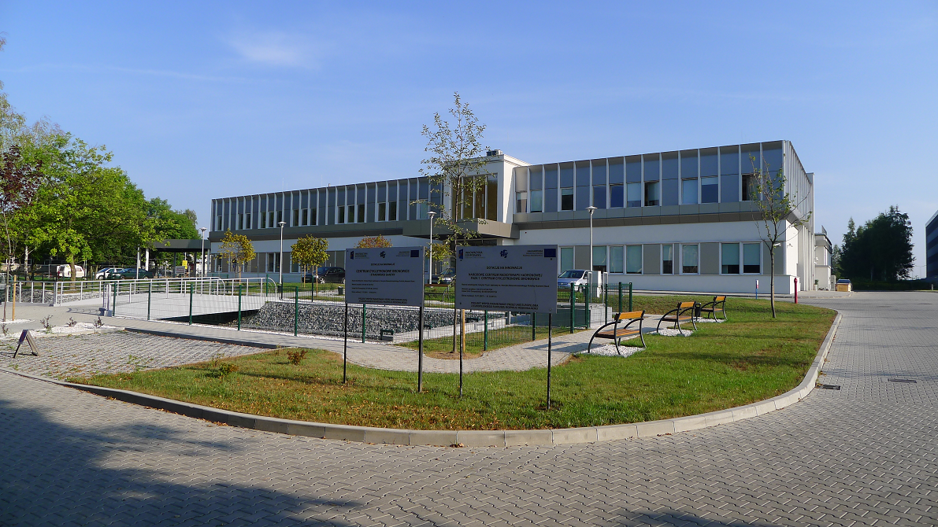
Cyclotron Centre Bronowice IFJ PAN
- physics for science and medicine
Medical part
Technical- scientific part
Renata Kopeć
Kraków, 24th June 2019

Slide 2


Proton radiotherapy in Poland
1994 First proton therapy symposium in Poland at IFJ
2011 The first eye treatment (in cooperation with Clinic of Ophthalmology in Kraków and Center of Oncology in Krakow) using AIC-144 cyclotron;
2010- 2015 Construction of the new facility - the Bronowice Cyclotron Centre project at IFJ PAN Kraków (Paweł Olko)
X 2015 Opening ceremony of CCB facility.
Paweł Olko
Since November 2016 patients are irradiated in gantries at CCB IFJ PAN
in cooperation with Center of Oncology in Krakow.
Marek Jeżabek
General Director IFJ PAN

Slide 3
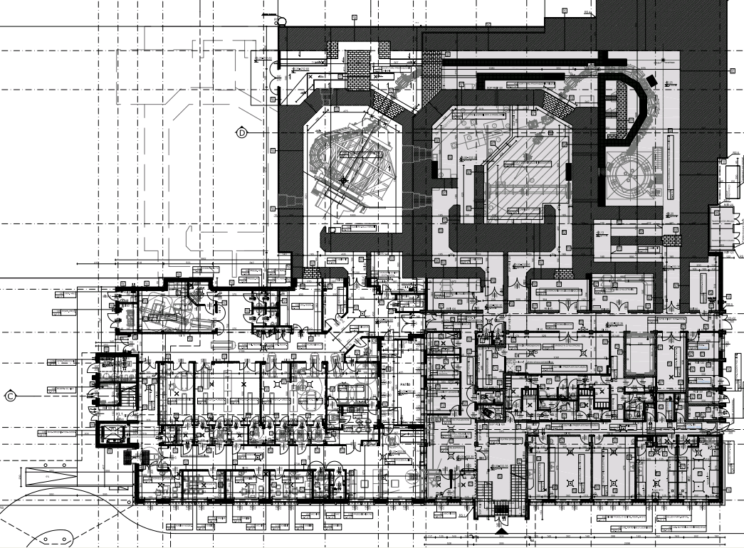
CCB building plan
Beam line
Energy selection system
Eye Therapy Room
Cyclotron
Proteus
C-235
Eksperimental Hall
Gantry 2
Gantry 1
Technical rooms
Medical part
Laboratories

Slide 4
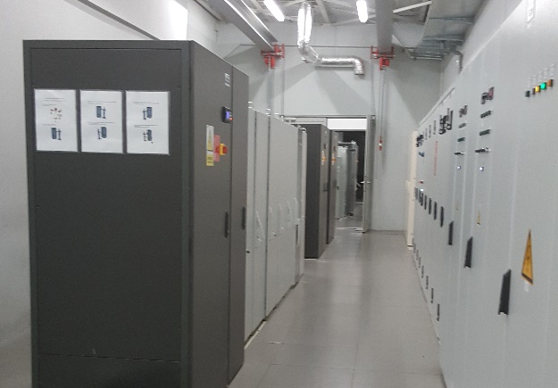
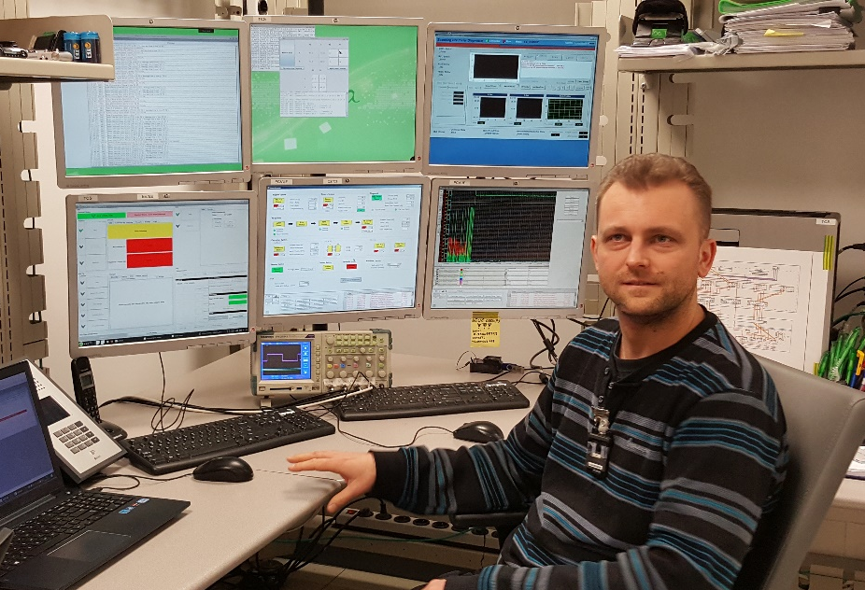
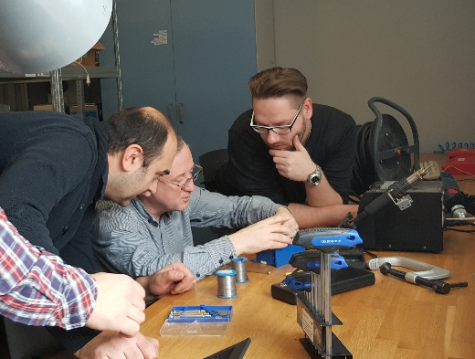
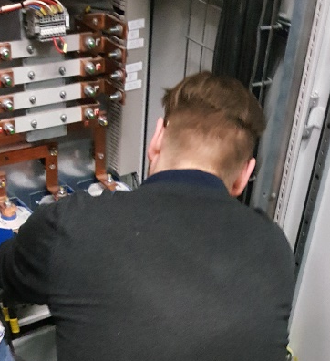
Cyclotron service
More than 70 particle therapy centres: only 3 of them have their own technical support.
Maintenence and service at CCB IFJ PAN: 9 engineers; support - 1 (!!!) IBA engineer.
Selected devices cooperating with a cyclotron: cooling system, power supplies for electromagnets, regulators, measurement systems and others.

Slide 5
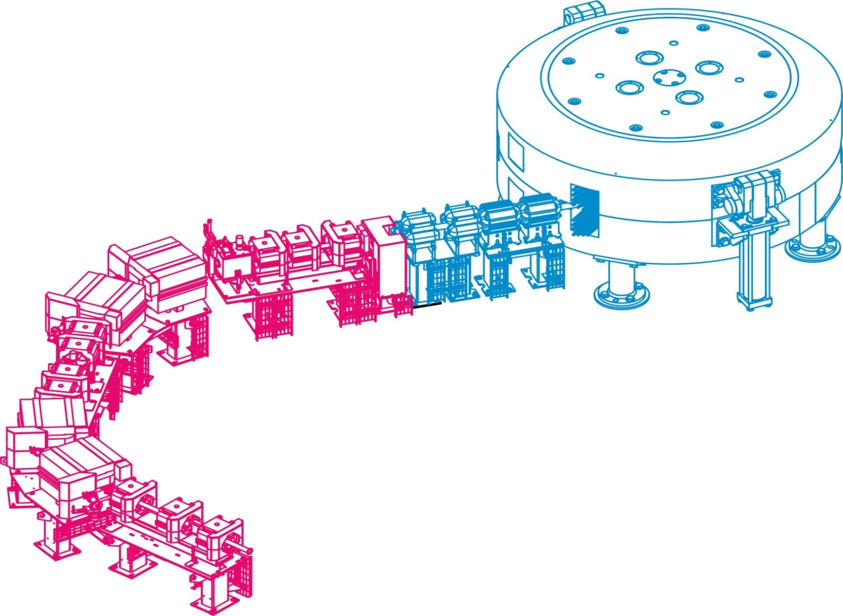
Parameters of proton beam
Beam energy selection system:
Energy degrader ( 70 - 230 MeV)
Quadrupoles (Focusing the beam)
Magnets
Collimators
Time to change Energy: ~1 s
scanning: ~100 µs
Medical parameters | Physical parameters | Proteus C-235
Range | Energy (E) | 70-230 MeV
Dose rate | Beam current (I) | 1-1000 nA

Slide 6
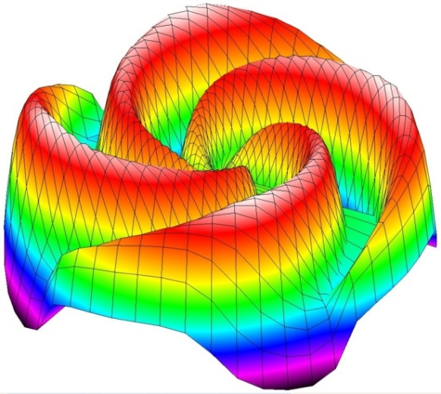
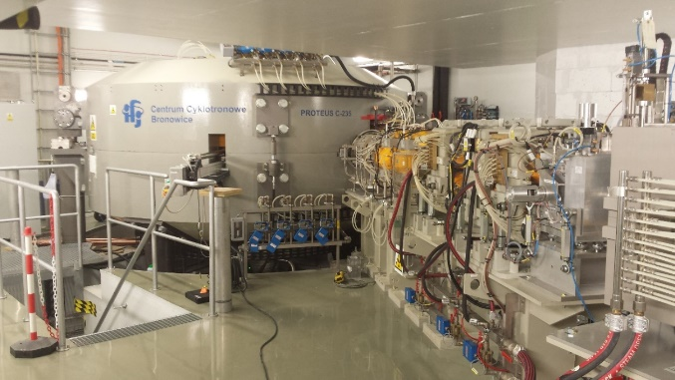
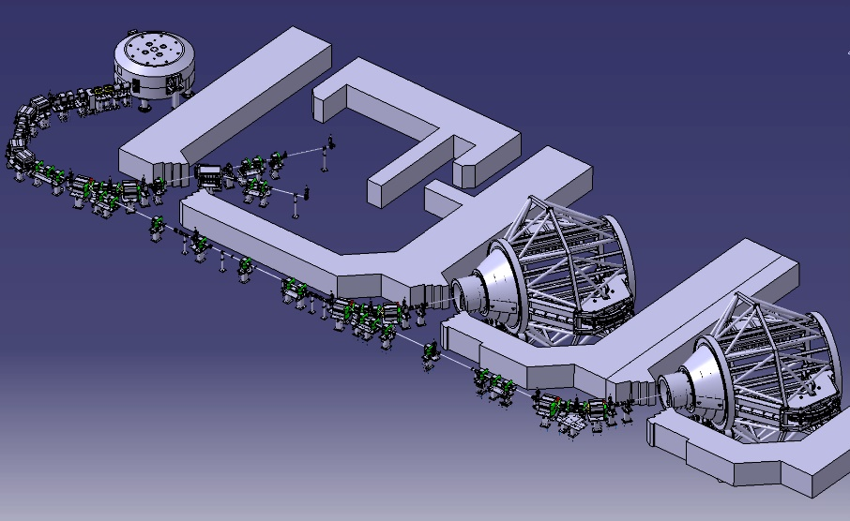
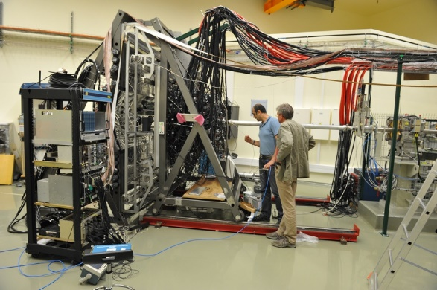
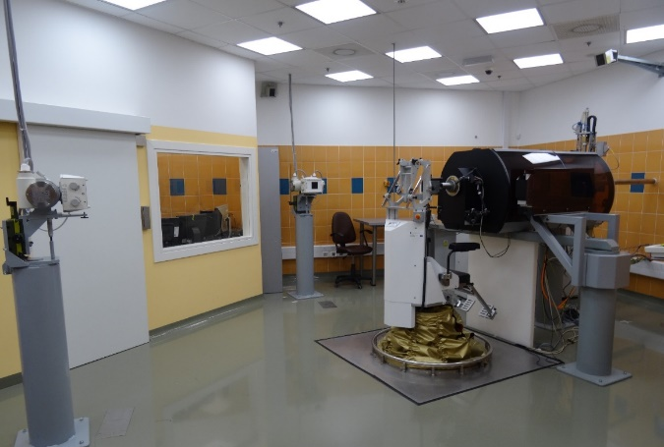
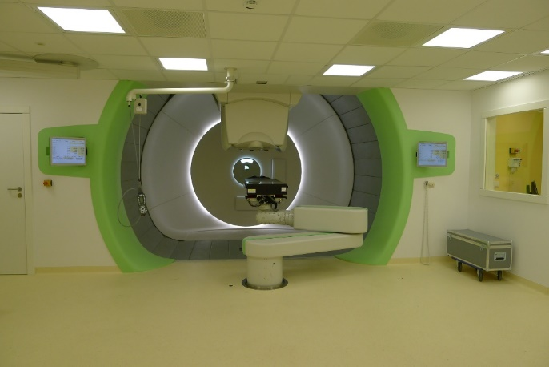
IBA Cyclotron, Proteus C-235:
2 dedicated (scanning) gantries, eye treatment, experimental room
Cyclotron:
Ion Beam Applications S.A. (IBA), Belgium

Slide 7
Physics program recommended by IAC
The following research projects are conducted at the Cyclotron Centre Bronowice (CCB) in cooperation with Division of Nuclear Physics and Strong Interactions (NO2)
Basic research (leaded by prof. Adam Maj):
Gamma decay from high-lying states and giant resonances excited via (p,p’γ)
Dynamics of few-nucleon systems
Study of high-lying single-particle states
Investigation of the mechanism of proton-induced fission and spallation
In-beam testing of detectors constructed for large infrastructures
Investigation of gamma emission in experimental modelling of hadron therapy

Slide 8
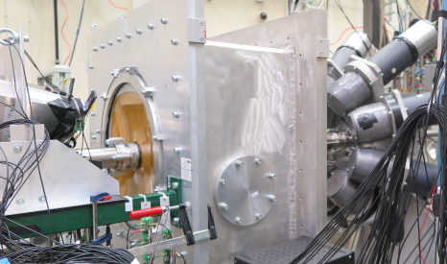
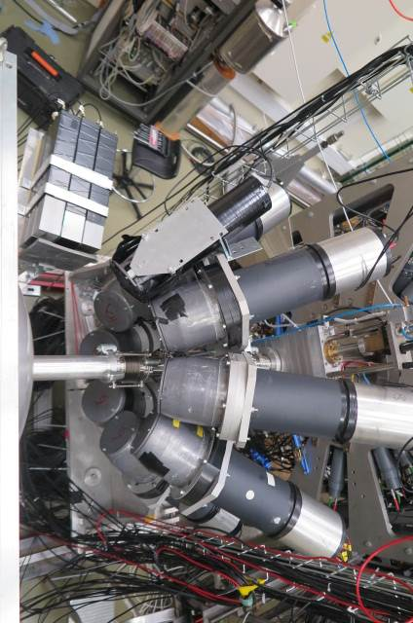
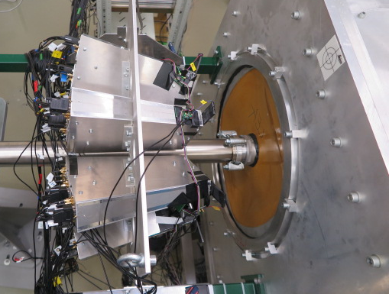
Gamma decay from high-lying states and giant resonances excited via (p,p’γ)
Fabio Crespi, MK et al..
HECTOR (8 BaF₂)
LaBr₃ (large volume 3.5”x8”)
PARIS (cluster of 9 „phoswiches”
LaBr₃/CeBr₃ + NaI)
KRATTA (16 CsI telescopes, at 8-15.3°)
35 cm from the target
plastic scintillators in the front of KRATTA
90 cm from the target
beam
target
coincidence measurement of scattered protons and high-energy gamma rays
Courtesy of prof. Adam Maj

Slide 9
For Science
The following research projects are conducted at the Cyclotron Centre Bronowice (CCB) in cooperation with Division of Applications od Physics (NO6):
Medical physics research (leaded by prof. Paweł Olko):
Dose distribution in proton grid therapy
3D technology for printed compensators and phantoms in proton therapy
Quantification of biological range uncertainties towards an improved patient treatment at CCB Cracow proton beam therapy centre
In vitro studies of glioblastoma multiforme cell lines to study the effects of fractionated Proton Beam Therapy in combination with chemotherapy

Slide 10
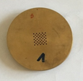
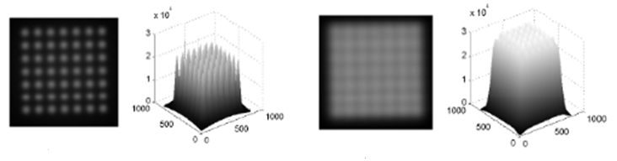
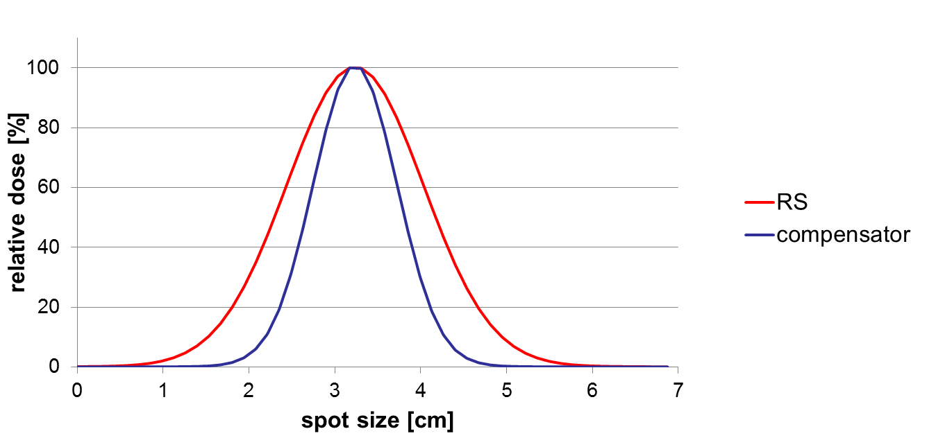
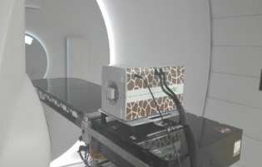
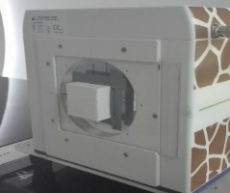
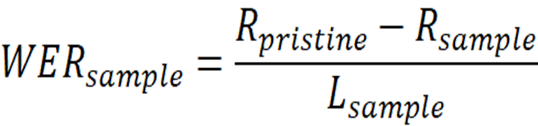
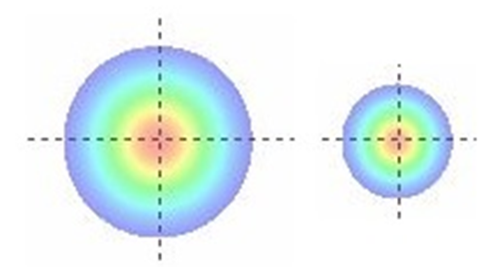
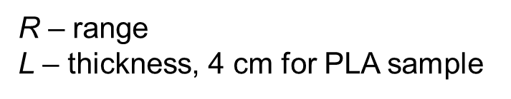

Dose distribution in proton grid therapy
A. Toboła, J. Swakoń
2-D and 3-D dose distributions
The aim of the work is to determine depth dose distributions and unwanted doses to patients due to scattered radiation in grid therapy with collimators.
The first measurements with 60 MeV protons for small radiation fields (13 mm x 13 mm) and 1 mm mesh collimators demonstrated that the 5% uniformity of lateral dose distribution can be obtained at the depth of Bragg peak maximum.
Entrance region
Bragg peak region
3D technology for printed compensators and phantoms in proton therapy
A. Wochnik, J. Swakoń
Water Equivalent Thickness (WET) for different plastic filaments for 3D printers were experimentally determined for their potential use for compensators and dedicated phantoms in proton therapy.
First patient dedicated compensators were printed and tested for their properties of beam formation. The use of compensator reduced the lateral full width at half maximum (FWHM) as compared to Range Shifter by over 60%.
Courtesy of prof. Paweł Olko

Slide 11
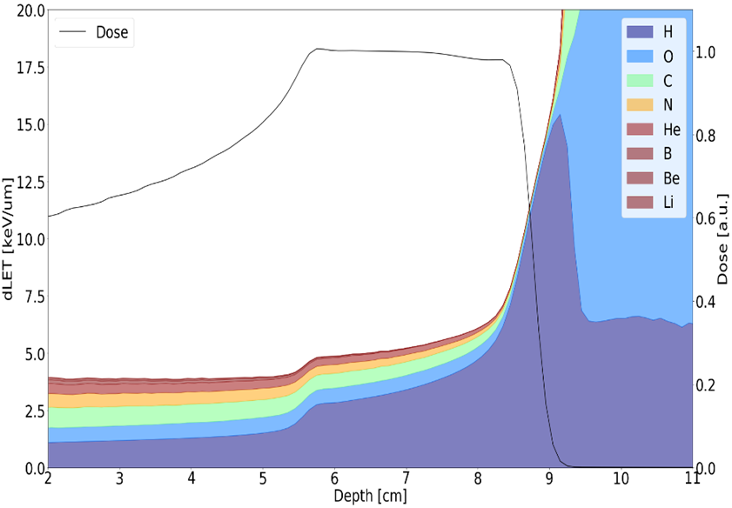
Quantification of biological range uncertainties towards an improved patient treatment in CCB Cracow proton beam therapy centre , A.Ruciński
Excellent agreement of physical dose computations performed with Fred against experimental data in homogeneous and heterogenous media.
Using developed and validated software tools biological dose calculated in patients with variable RBE.
Contribution of nuclear reactions to LET of therapeutic proton beams, L. Grzanka
In proton therapy a constant RBE=1.1 is used for calculation of RBE dose
Calculations using Monte Carlo radiation transport code demonstrated that the stopping power of protons in tissue is significantly enhanced by nuclear reactions.
Dedicated open source software is developed for proton therapy applications in libamtrack library
Courtesy of prof. Paweł Olko

Slide 12
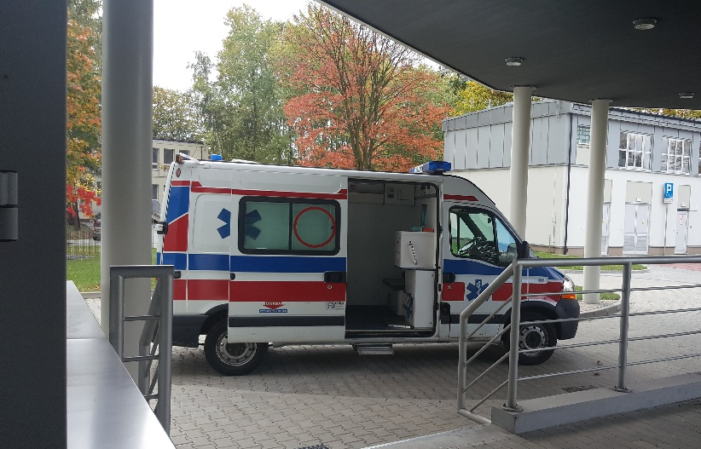

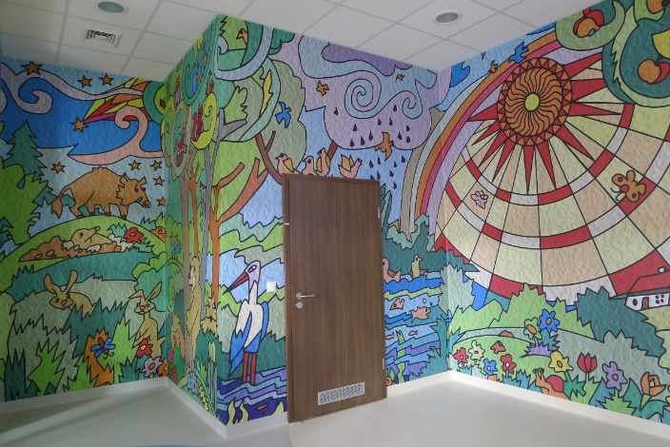


For Medicine- clinical partners
Eye
Prof. B. Romanowska-Dixon
7 km od IFJ PAN
Proton therapy facility:
CCB IFJ PAN
Oncology Centre in Katowice
Oncology Centre in Radom
https://ccb.ifj.edu.pl
Adults
Centrum Onkologii
Prof. B. Sas-Korczyńska
5.5 km from IFJ PAN
Childrens
Dziecięcy Szpital Uniwersytecki
Dr. K. Małecki
30 km by highway
http://terapiaprotonowa.pl
Notes:
Ze względu na skomplikowaną technikę, służącą wdrożeniu schematów leczenia wykorzystujących protony, zastosowanie ich stało się domeną jedynie nielicznych ośrodków badawczych, zajmujących się fizyką, dlatego liczba leczonych pacjentów pozostawała niska. Postęp hamowany był więc przez ograniczenia techniczne.
1990 – bazując na badaniach naukowych otworzono pierwszy szpitalny ośrodek terapii protonowej, w mieście Loma Linda.

Slide 13
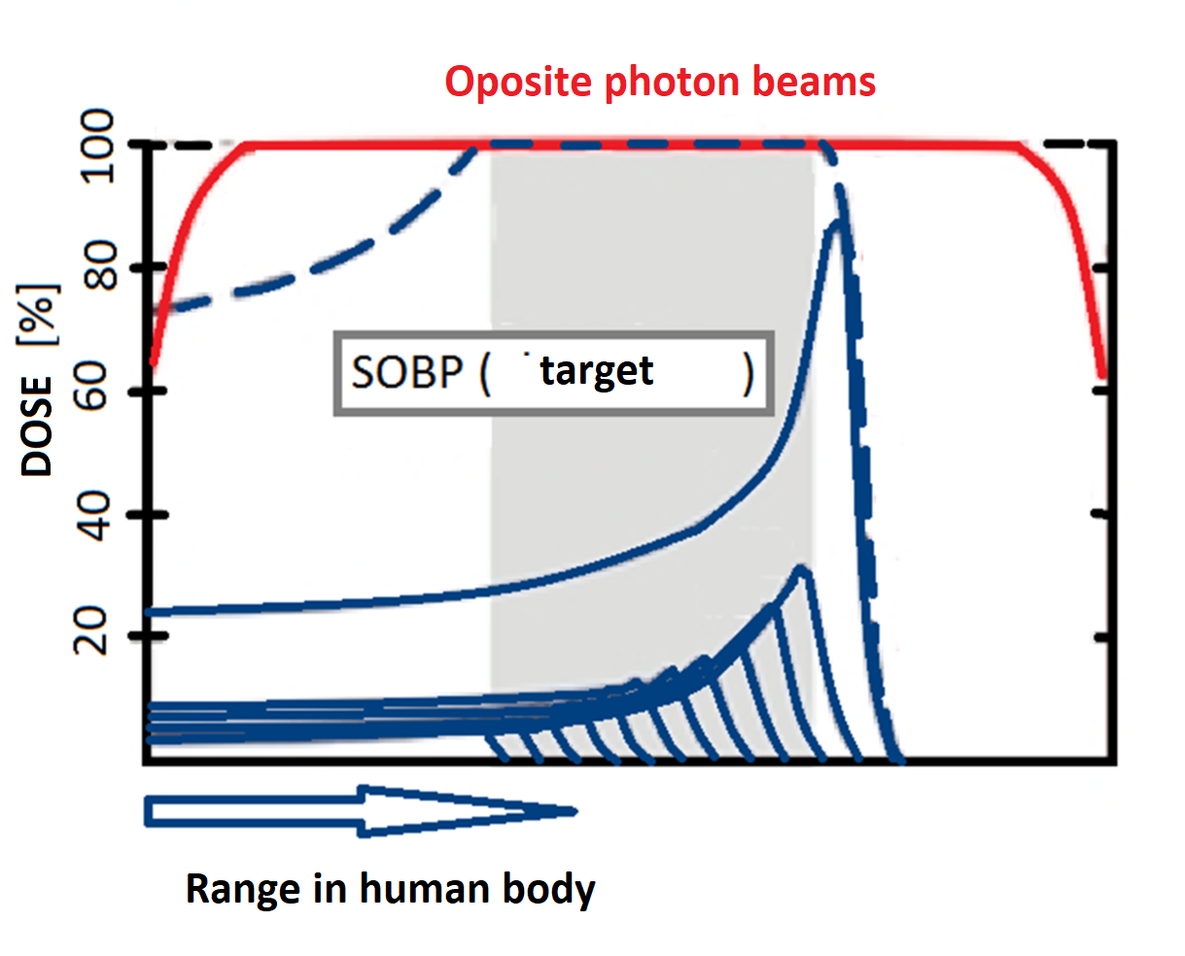
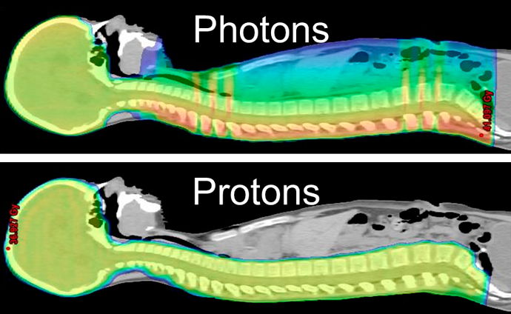
Why proton therapy?
Dose distribution (%) vs depth in the tissue for photons and protons; Improvement of the tolerance and efficacy of radiotherapy
Conformal dose distribution -saving healthy tissue (homogeneous distribution of high dose in a limited volume (CTV, PTV));
Strictly defined range- protection of critical organs (↓dose, ↓ volume);
Increased RBE of protons at the end of the range.

Slide 14
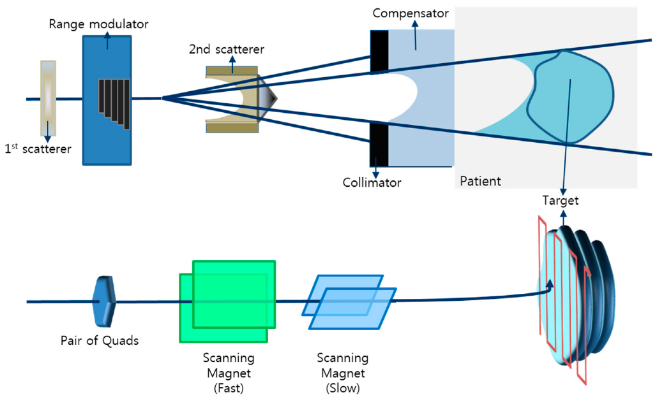
The evolution of proton therapy
Scattered beam
Pencil Beam Scanning

Slide 15

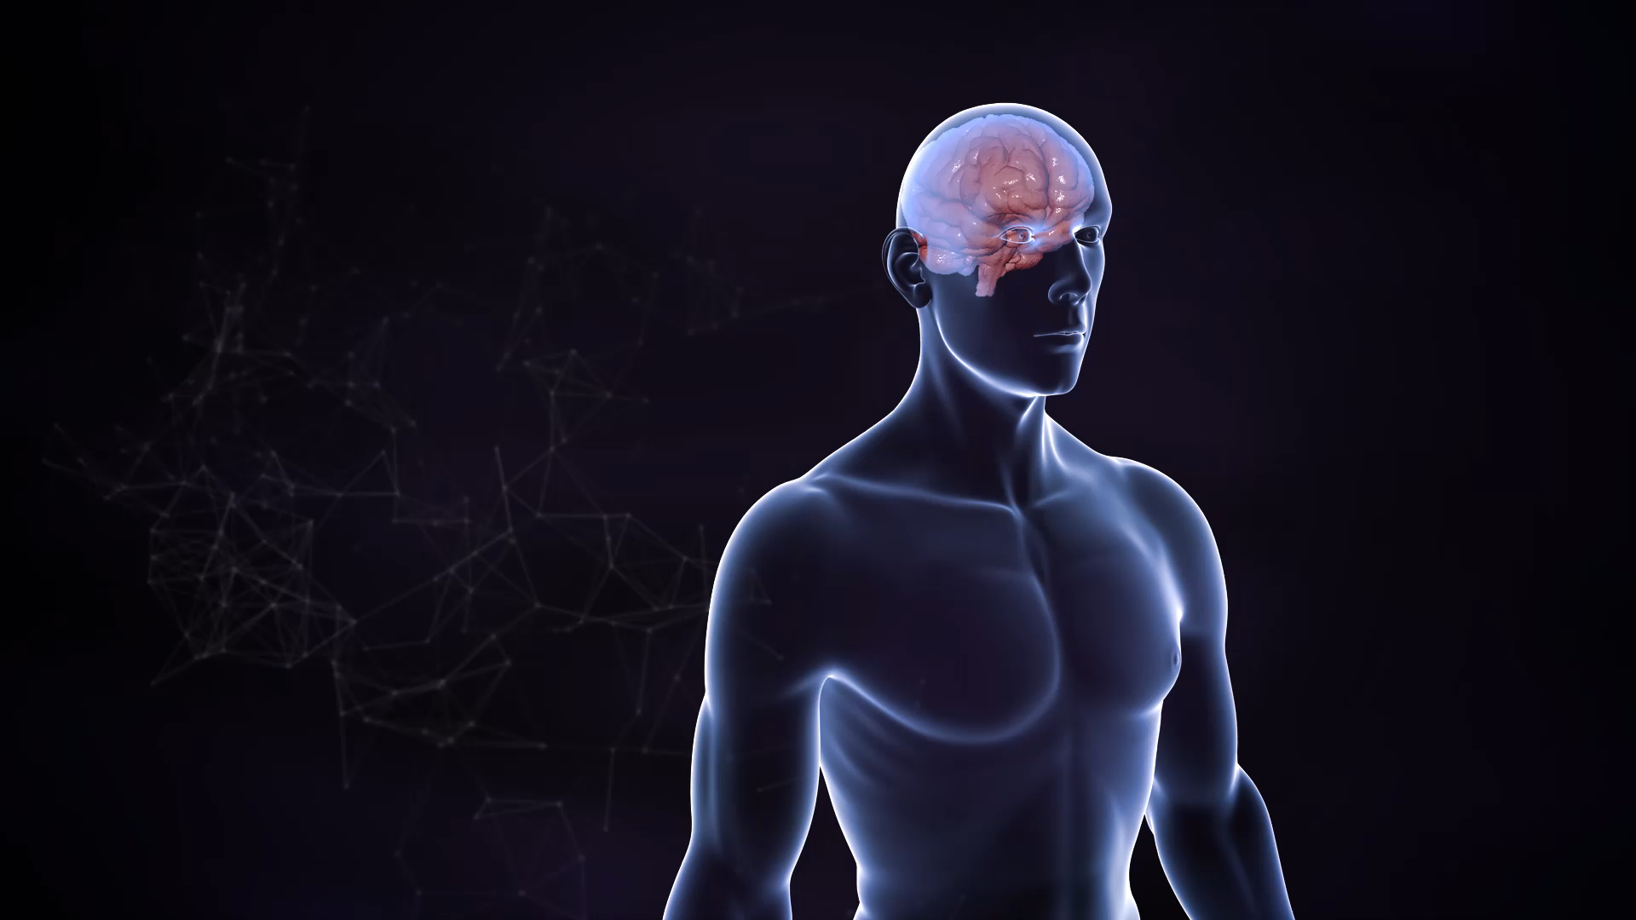
Pencil Beam Scanning (movie)
Courtesy of W. Nidzicki

Slide 16
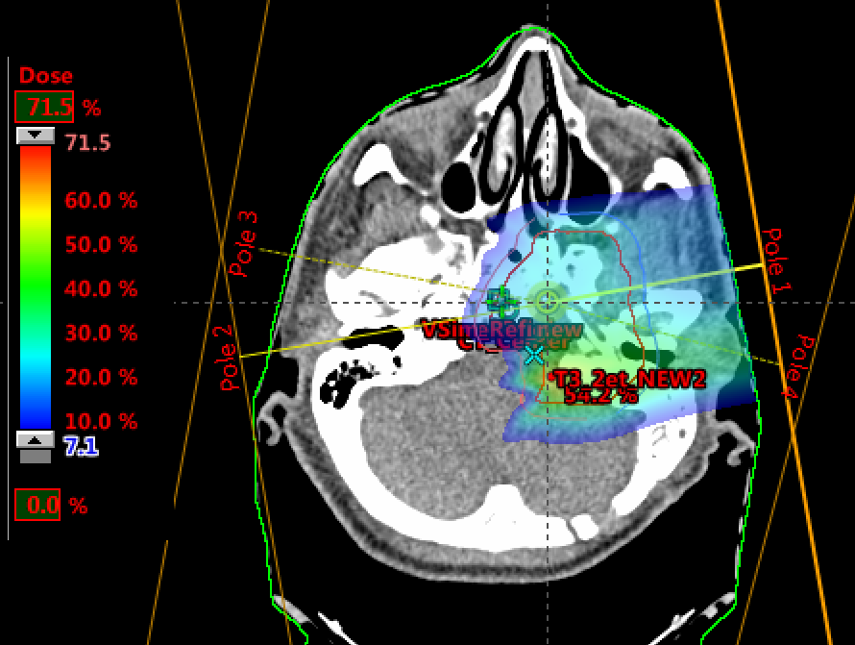
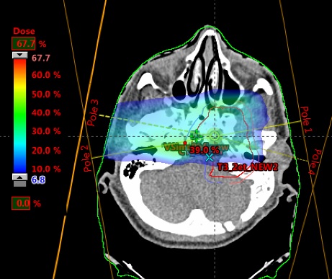
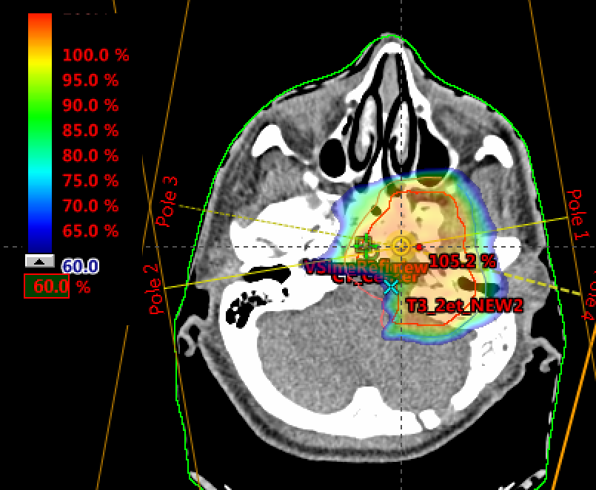
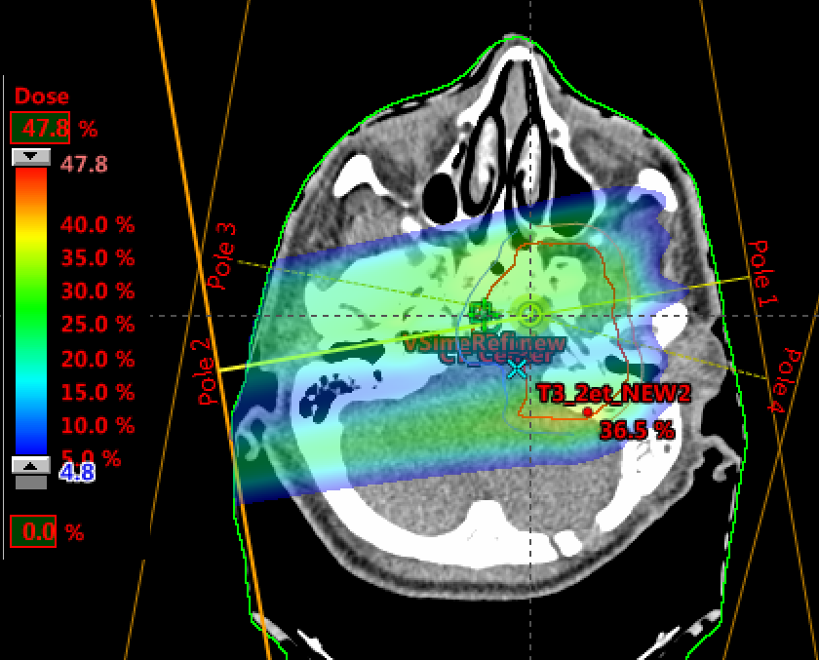
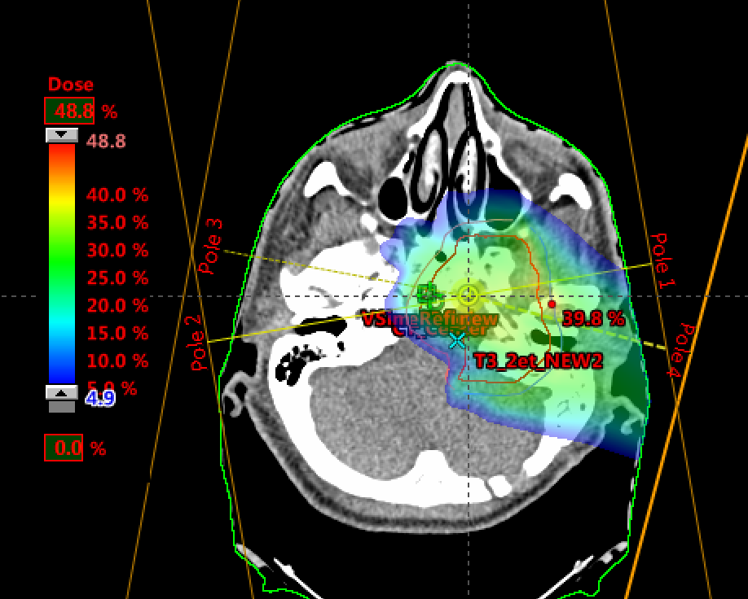
IMPT technique
The principle of intensity modulated proton therapy (IMPT). Non-uniform dose distributions from a number of fields (4 in this case) yield the desired (uniform) target dose.
IMPT treatments advantages:
improved dose conformity and steeper dose gradients,
further reduction of integral dose,
less sensitivity to range uncertainties and other sources of uncertainty
Eclipse Protons for PBS (Varian) ARIA Oncology Information System (Varian) Citrix: remote access for partners

Slide 17
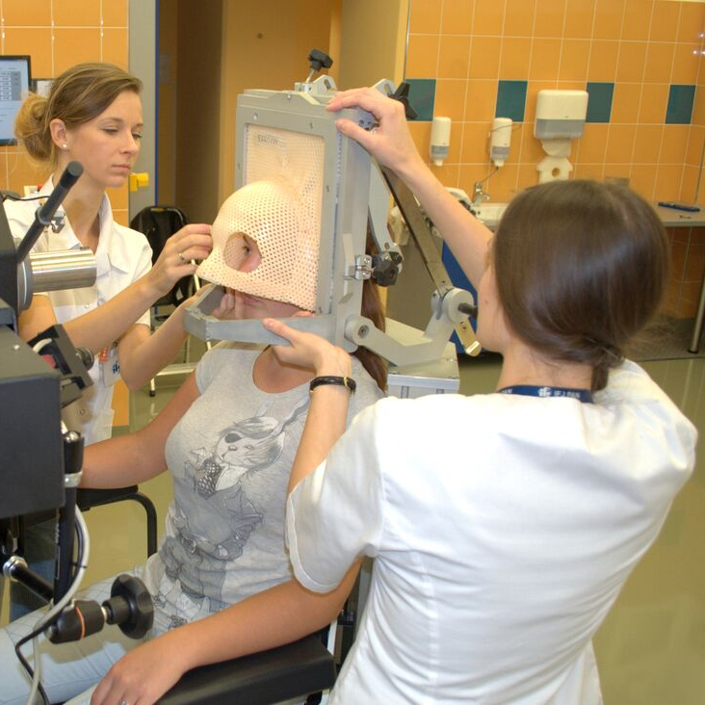

CCB IFJ PAN facility
Eye treatment room
2011: first eye proton radiotherapy in Poland (with AIC-144 cyclotron)
New treatment room at CCB was developed by group of J. Swakon (IFJ)
Since February 2016 occular patients are irradiated in the new treatment room at CCB;
Improved patient positioning, automatic panels for X-ray images;
no limitation of energy (range- will enable the treatment of tumors at any depth)
isocentric treatment chair (HEPHA BFI, France)
CE Medical marking in collaboration with IBA

Slide 18
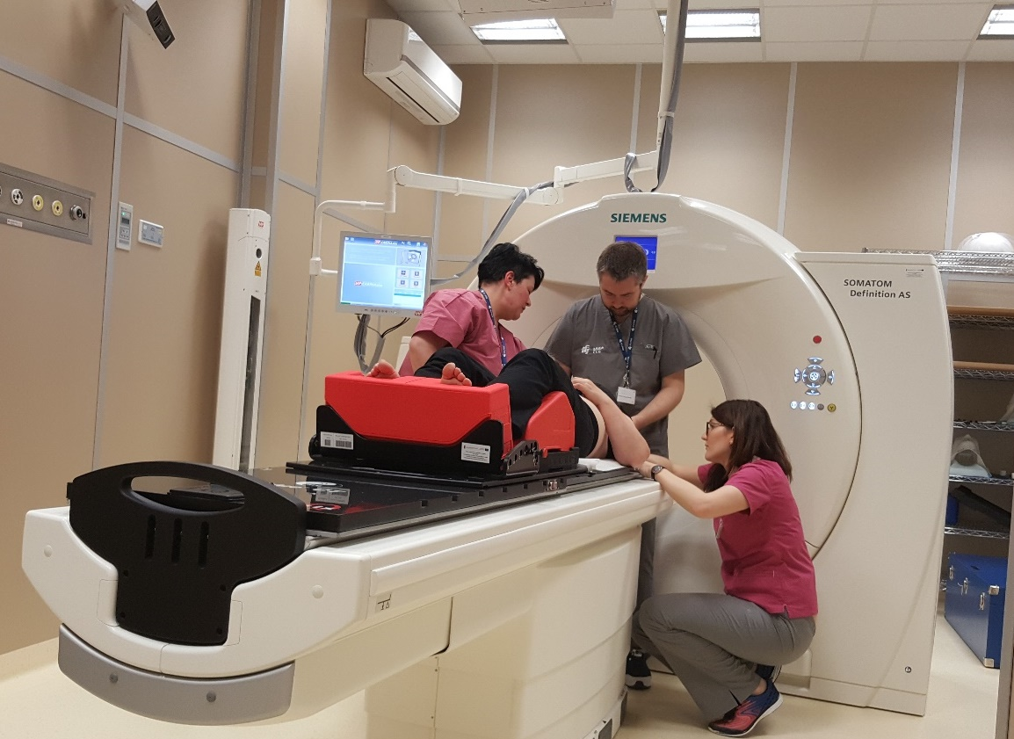
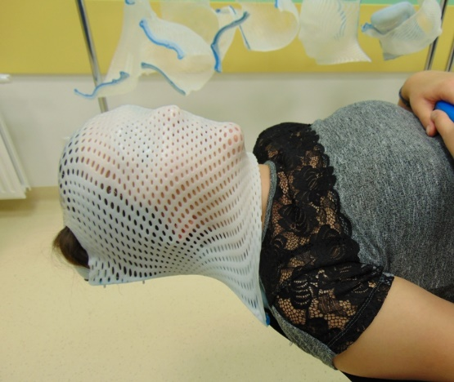
Before treatment
Immobilization Systems
Computed Tomography
TPS/OIS
systems
Dosimetry
and QA
Preparation room, Computed Tomography room, gantries have an identical immobilization systems.
TK and gantries have the same positioning geometry and compatibility with VisionRT and anesthesia equipment
2 gantries with PBS

Slide 19
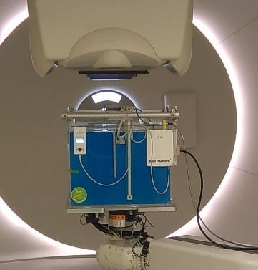
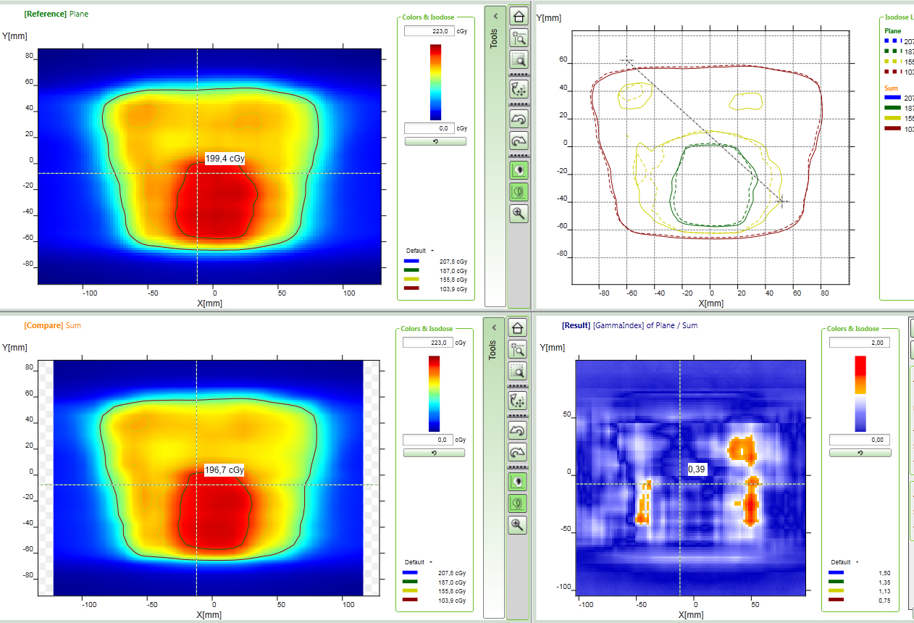
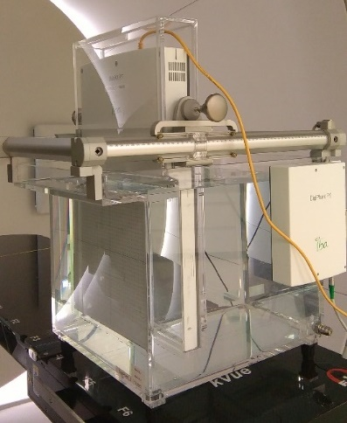
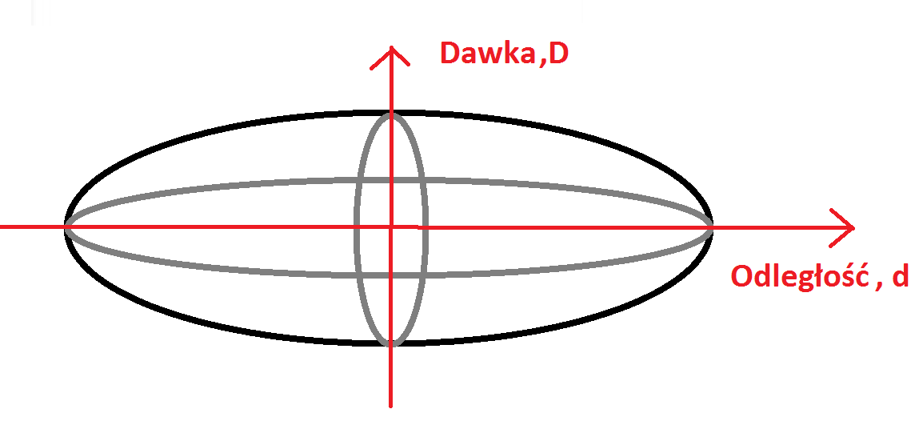
Dose veryfication of treatments plans
Immobilization Systems
Computed Tomography
TPS/OIS
systems
Dosimetry
and QA
Dose veryfication of patient treatment plans:
Dose in water Phantom (Blue Phantom);
Dose distribution in MatriXX Ion Chamber Array (2-D dosimetry) in water Phantom (DigiPhant PT);
Gamma Index 3 %/2mm; 90 %
2 gantries with PBS

Slide 20
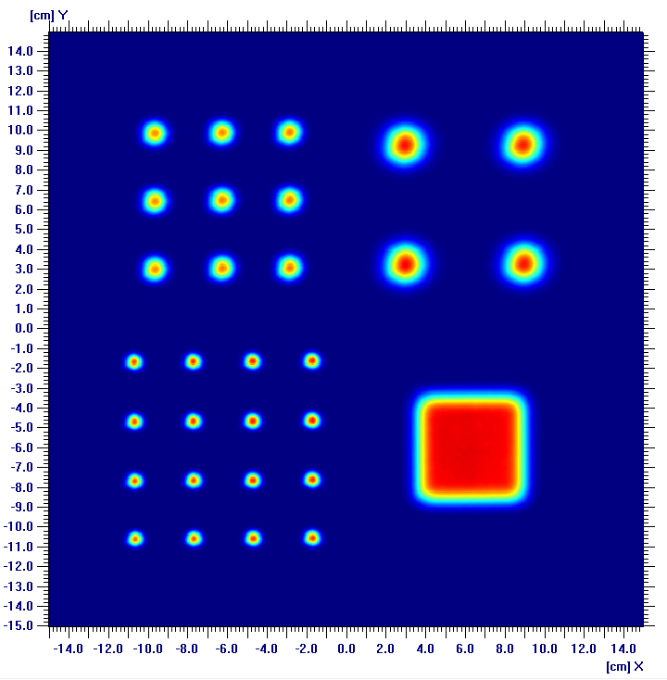
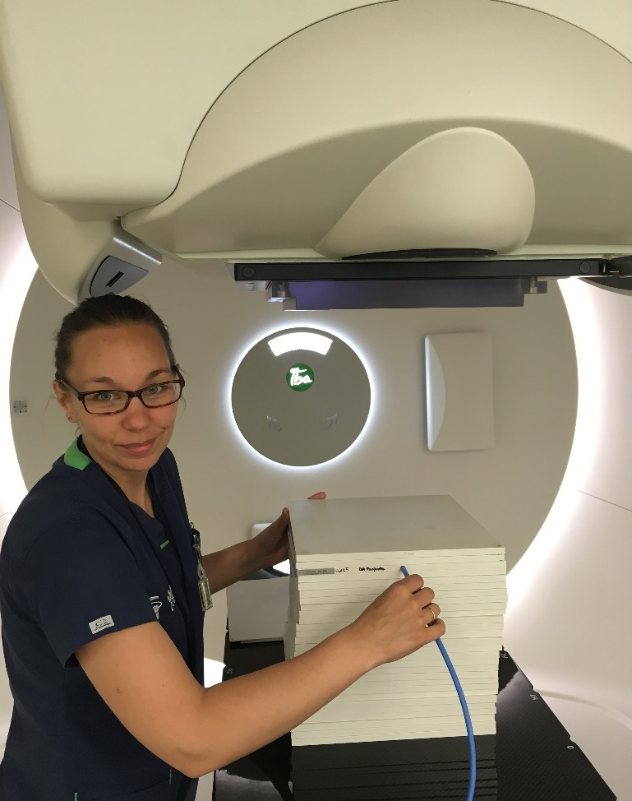
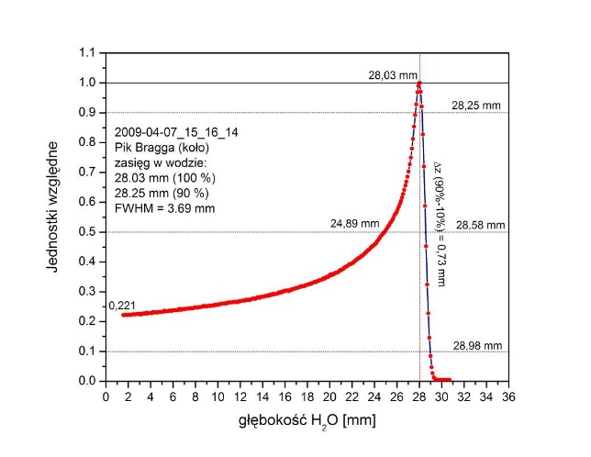
Dosimetry and QA
Immobilization Systems
Computed Tomography
TPS/OIS
systems
Dosimetry
and QA
Daily QA:
Dose repeatbility (output factor control): RW3 phantom ionization chamber 0,125 mm – UNIDOS
Radiation field parameters (Lynx): 5x5 cm2;
Spot measurements for different energies: size, symetry.
Weekly QA:
Bragga peak profile (Giraffe).
2 gantries with PBS

Slide 21
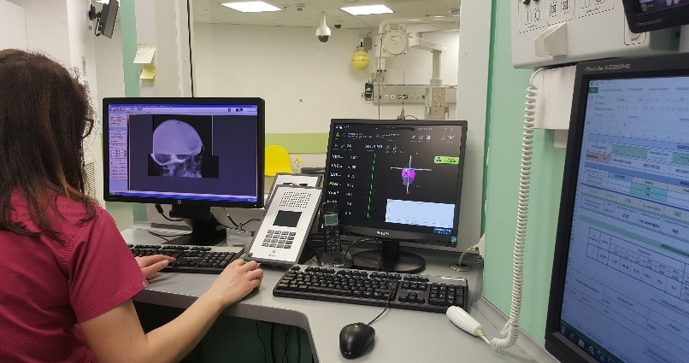
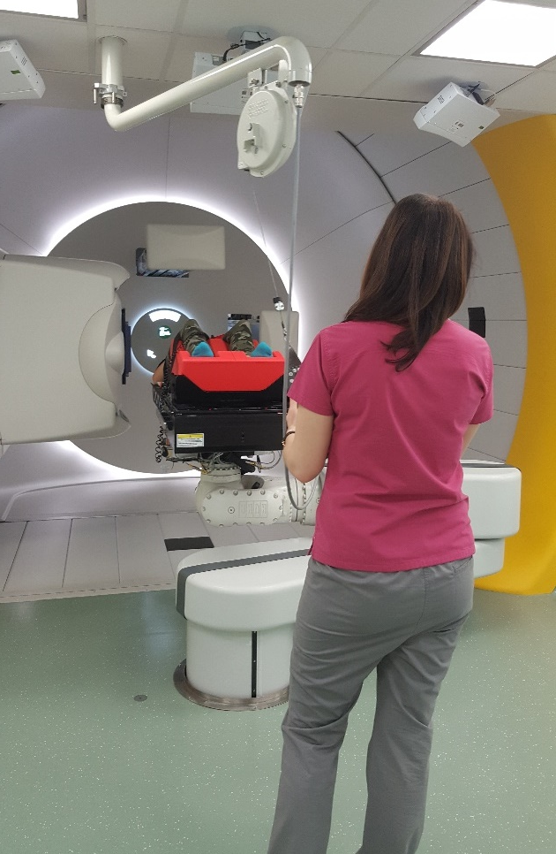
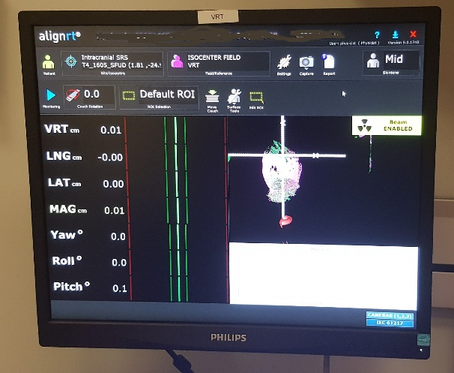
Irradiation
Immobilization Systems
Computed Tomography
TPS/OIS
systems
Dosimetry
and QA
Two dedicated IBA gantries with PBS;
360 degrees
2 spot sizes 1 s = 2.7 mm and 4 mm (at 230 MeV)
irradiat. 1 liter volume to 2Gy in less than 90 s
max. field 30 cm x 40 cm
robotic treatment table, 6 degrees of freedom
Additional equipment: orthogonal kV X-rays positioning, Vision RT optical positioning, gating, anesthetic arm.
2 gantries with PBS

Slide 22
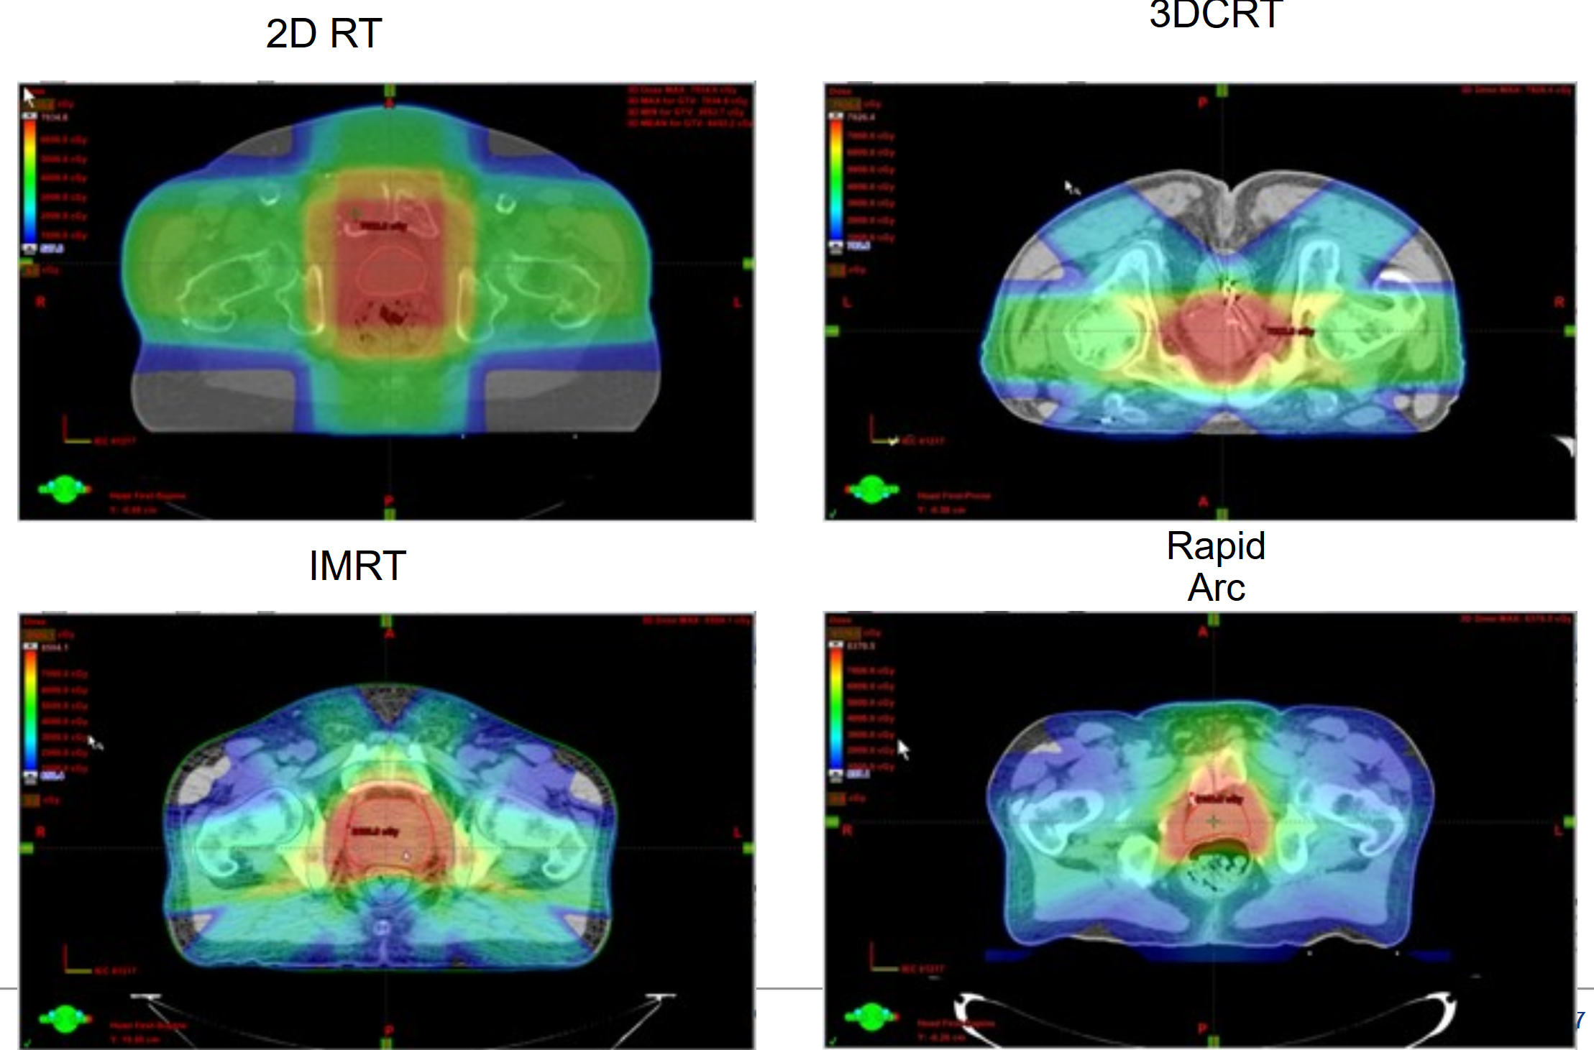
New challenges in proton radiotherapy
Have we achieved the maximum technical capabilities to obtain a conformal distribution in proton radiotherapy?
Excellent physical properties; applications of compensators (T. Kajdrowicz)
Well-known radiobiology;
Possibilities of using IGRT techniques, eg using proton properties for imaging (PET, radiography / proton tomography) (D. Krzempek – see poster)
Possibilities of using adaptive techniques
Radiotherapy of moving organs (K. Czerska);
Dosimetry for ion beam radiotherapy (D. Krzempek);
Hyperfractionation.

Slide 23





New challenges in treatment planning
Irradiation of the "shallow" target:
Spot size is a function of energy
Low energy and range modulator (range shifter)
For pediatric patients (close neighborhood OaR
Effect on the planned dose:
The distance of the used range modulator from the target
Application of 3D printed (in cooperation with) compensator
Modulator
3D Compensator

Slide 24

New challenges- moving organs
Optimization of interplay effect – clinical aspects
K. Czerska

Slide 25









New challenges- moving organs
Proton vs photon deep inspiration breath-hold planning study for left-sided breast cancer patients
PURPOSE
The aim of this study was the investigation of the feasibility of incorporating proton technique
into breast cancer cases. We performed dosimetric comparison between 3D photon technique and an Intensity Modulated Proton Therapy (IMPT) for free (FB) and deep inspiration
breath-hold (DIBH) anatomies.
a
c
b
d
a
b
c
f
Fig. 2 Dose distributions for FB plans (a-photons, b-protons) and DIBH plans (c-photons, e-protons)
Fig. 1 Transverse sections showing the 50% isodose of the prescribed dose for photon (a) and proton (b) FB plans
mgr inż. Katarzyna Czerska
katarzyna.czerska@ifj.edu.pl
This work is part of a PhD project „Optimization of pencil beam scanning proton therapy for moving targets”
Supervisors:
prof. dr hab. P. Olko, IFJ PAN
dr inż. Renata Kopeć, IFJ PAN
KC has been partly supported by the EU Project POWR.03.02.00-00-I004/1

Slide 26
Summary
The first proposal for the CCB project was submitted in September 2006. In years 2010- 2015 the new facility - the Bronowice Cyclotron Centre at IFJ PAN Kraków was constructed.
Completing the project of the Bronowice Cyclotron Center (CCB) was possible due to contribution and cooperation of uncountable persons and institutions.
At the CCB IFJ PAN, a team of over 60 physicists, technicians, engineers, and IT specialists successfully participated in the undertaken challenges.
200 patients finished irradiation in gantries, 12 patients are irradiated, next patients in different stages: during the preparation like: tomographic scans, planning, dosimetry…
CCB is opened for collaboration in the field of basic nuclear physics research.
Notes:
26

Slide 27

I thank my collegues from CCB, especially: T. Kajdrowicz,
K. Guguła, B. Michalec, D. Krzempek T. Horwacik, K. Czerska.
Thank you for your attention!

