Slide 1
Spheroids as a model for tumor radiosensitivity and radiolabeling tests
Ewa Ł. Stępień, Hanieh Karimi,
Bartosz Leszczyński
Departament of Medical Physics
Marian Smoluchowski Institute of Physics
Jagiellonian University
3rd Jagiellonian Symposium on Fundamental and Applied Subatomic Physics
June 23 – 28, 2019, Kraków, Poland

Slide 2
Spheroids
Spheroids are multicellular and tissue –like structured in vitro 3D models
Mimic microenvironment in vivo.
Unlike common 2D in vitro cell models, spheroids reflect the cellular milieu and the pathophysiological conditions inside tumor nodules.
Widely used in drug testing and radiation studies.
500 cells
1000 cells
1500 cells
Notes:
Results obtained from 3D cell spheroids can be better translated to in vivo animal studies or clinical trials. In this presentation I will tell about technical issues related to spheroid generation, comparison of molecular properties of spheroids with simple 2D cell couture techniques and application of spheroids in radiobiology. Most of results will be related with melanoma cancer diagnostic and treatment.

Slide 3
Ross Harrison 1870 – 1959
1910: tedpool neural tube explants cultured several days in „hanging drop”
Ross Harrison. The outgrowth of the nerve fiber as a mode of protoplasmic movement. Journal of Experimental Zoology 9:787-846, 1910.

Slide 4
4736 4272 385

Slide 5
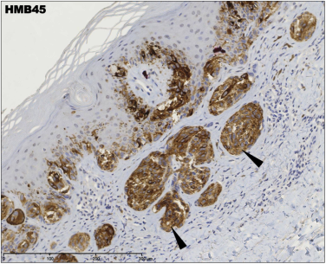
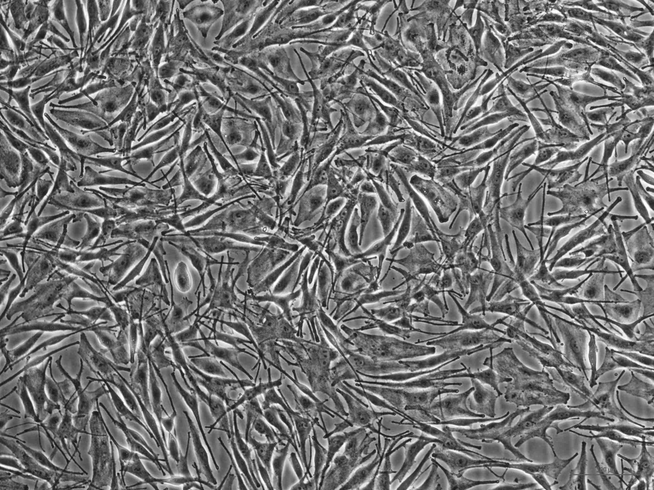
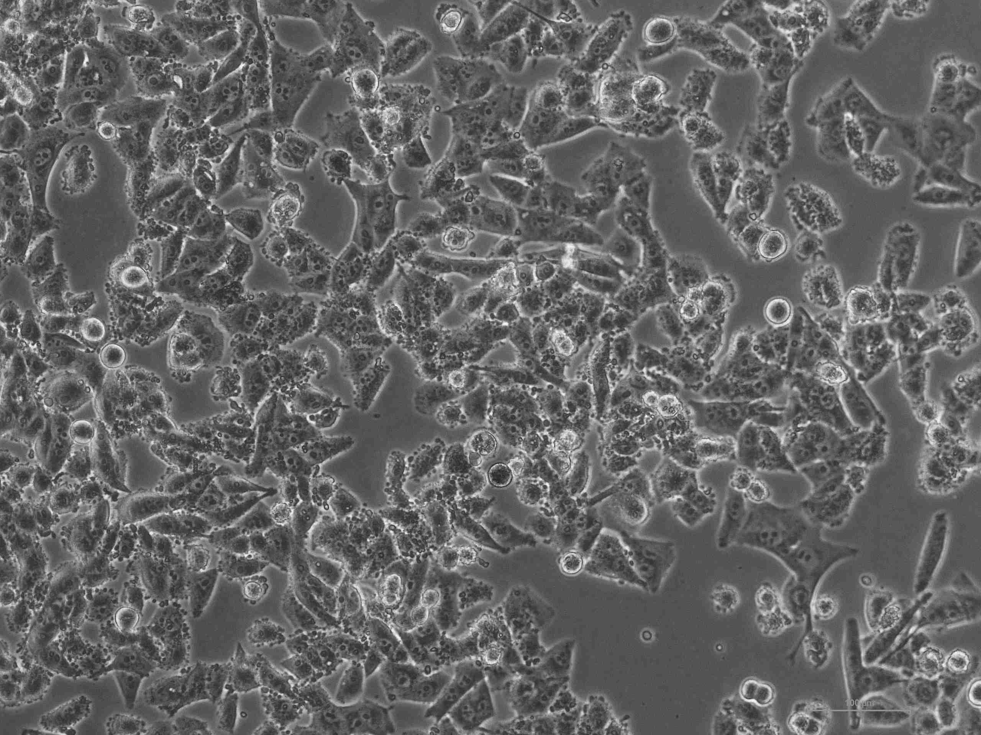
Experimental protocol leading to establishment of melanoma cell lines
radial/vertical growth phase
lymph node metastasis
https://histologyblog.com/2014/01/23/histoquarterly-superficial-spreading-malignant-melanoma/
placed in tissue culture flask for in vitro establishment
subcutanous implant (xenograft) in mouse
Cancer Melanoma cell lines
primary CM line WM-115
matastatic CM WM-266-4
Cancer Melanoma cell lines
matastatic CM WM-1205Lu

Slide 6
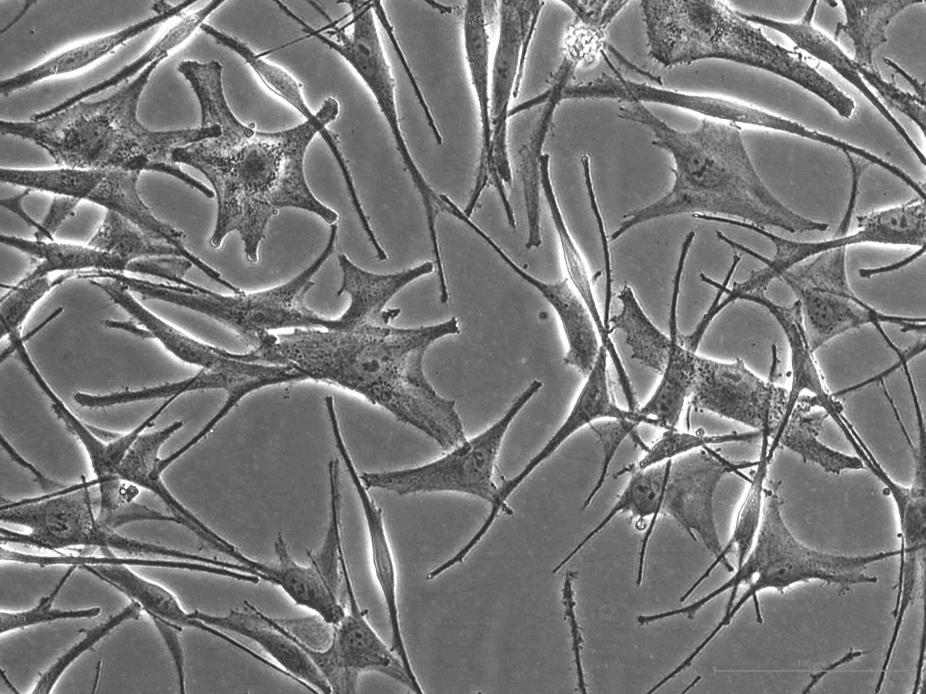
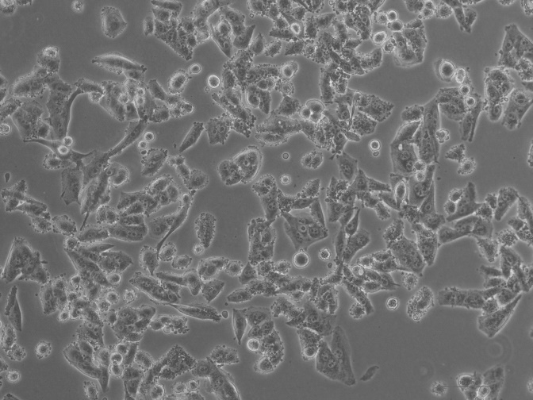
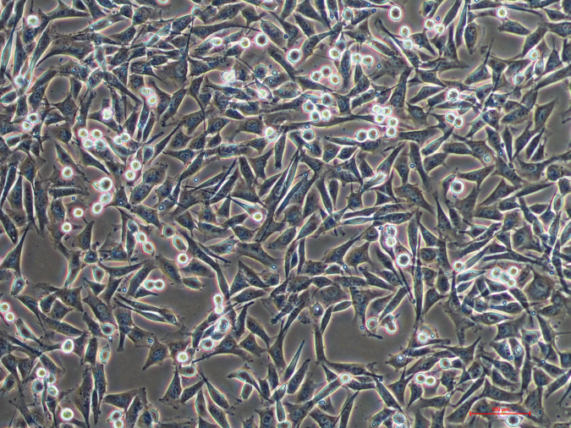
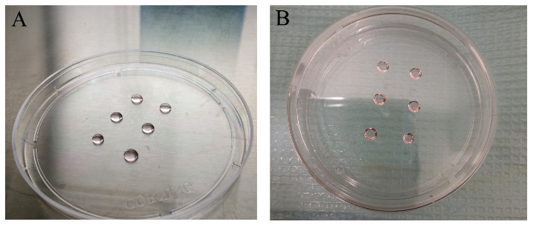
MELANOMA CELL LINE WM-115
MELANOMA CELL LINE WM-266
MELANOCYTES
20 μL

Slide 7
3D tumor models: History, advances and future perspectives
Bnien & Swami. Future Oncol. (2014) 10(7), 1311
Notes:
Poly-Lysine enhances electrostatic interaction between negatively-charged ions of the cell membrane and positively-charged surface ions of attachment factors on the culture surface. When adsorbed to the culture surface, it increases the number of positively-charged sites available for cell binding.
Thermoresponsive polymer poly(N-isopropylacrylamide)(PNIPAM) is very important because of its well defined structure and property specially its temperature response is closed to human body and can be finetuned as well.

Slide 8
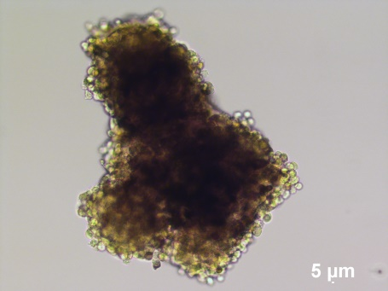
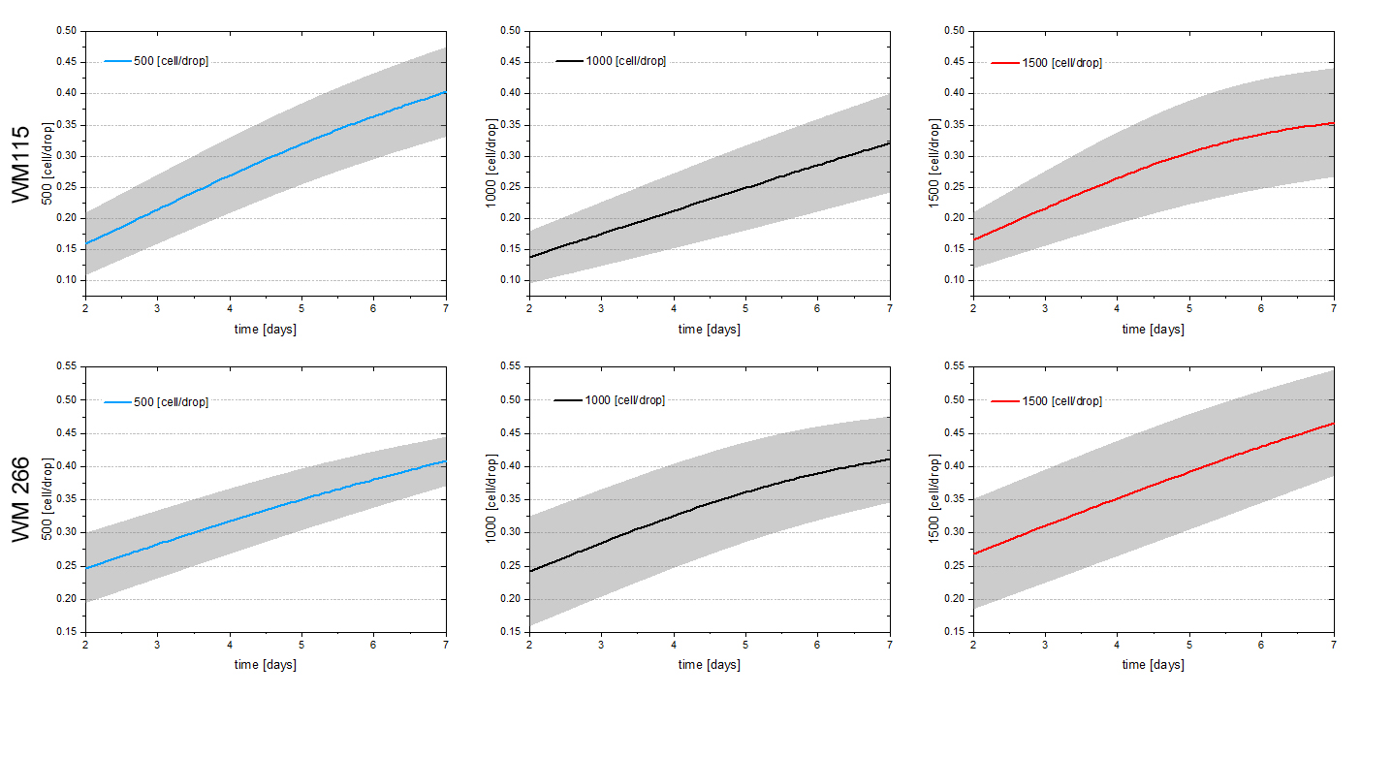

Slide 9
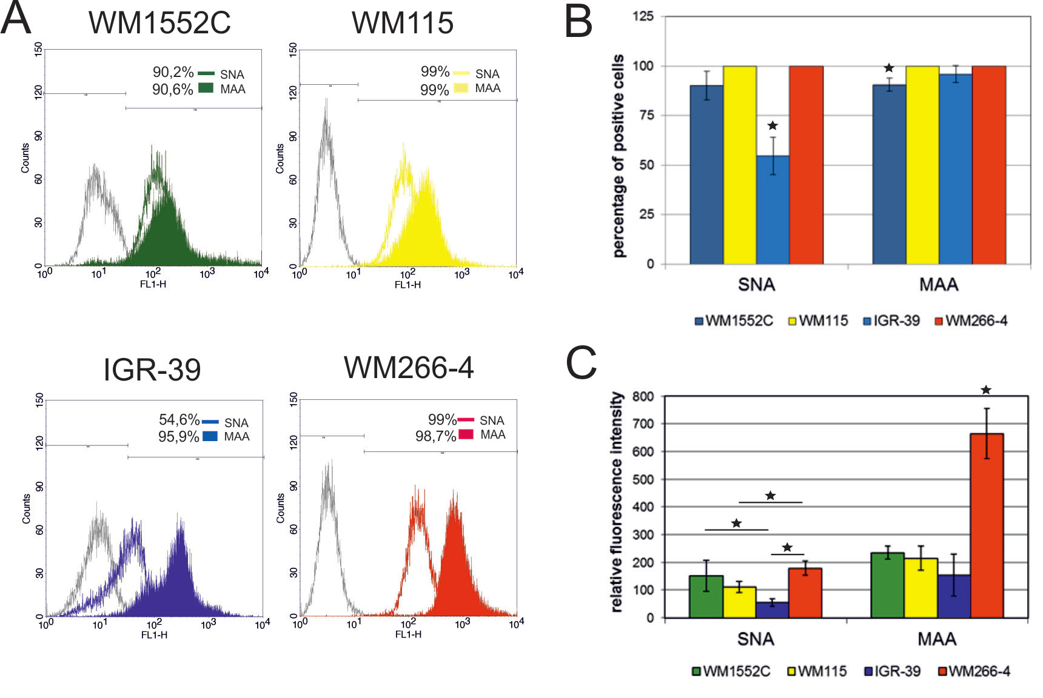
Flow cytometric analysis of SNA and MAA positive oligosaccharides
Kolasińska E et al.Acta Biochim Pol. 2016;63(3):533-41.

Slide 10
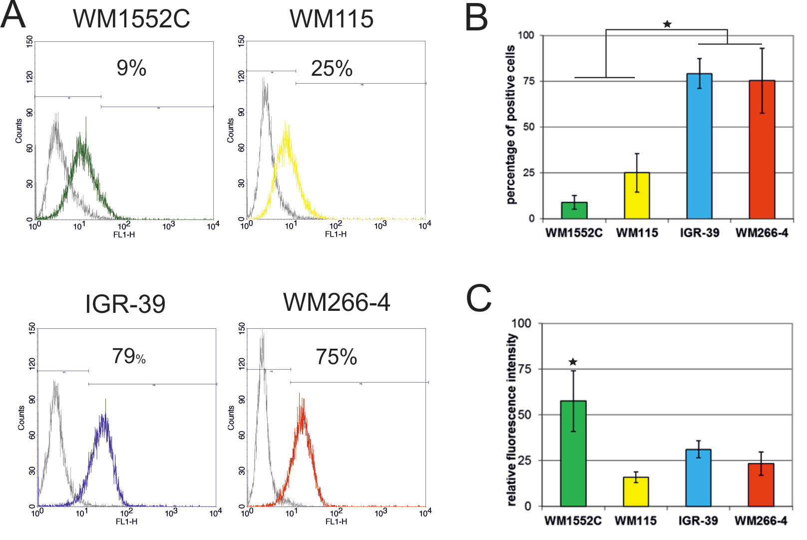
Expression of integrin α5β1
Kolasińska E et al.Acta Biochim Pol. 2016;63(3):533-41.

Slide 11
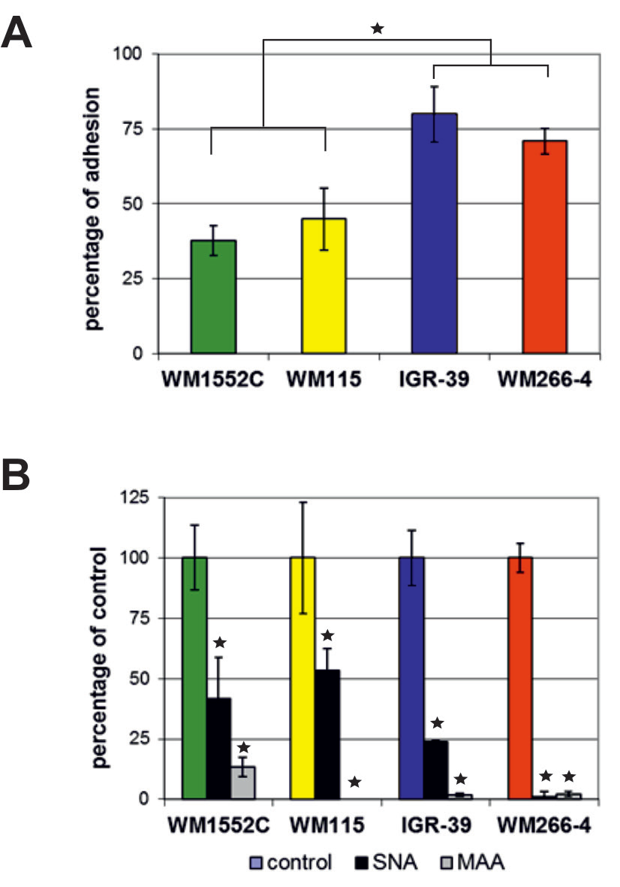
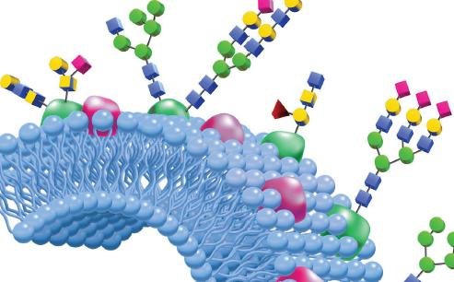
Adhesion properties of melanoma cells. All data are given as percentage of adhesion relative to adhesion on poly-L-lysine (taken as 100%). Cell adhesion to BSA-coated wells served as a negative control.
Effect of SNA and MAA on the adhesion of melanoma cells to FN. The extent of cell adhesion in the presence of the lectins is presented relatively to cell adhesion in their absence that was considered as 100%.
Kolasińska E et al.Acta Biochim Pol. 2016;63(3):533-41.

Slide 12
It is important to know the phenotype of a spheroid model
Phenotypic diffrences between WM-115 and WM-266 treat:
α5β1
protein glycation (SNA and MAA positive oligosaccharides)

Slide 13
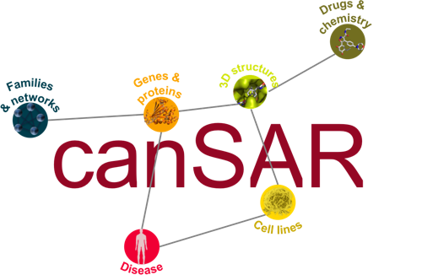
WM-115 /WM-266 Similarities
by Gene mutations
NAME | TISSUE | DISEASE | CORRELATION
WM-115 | skin | malignant_melanoma, melanoma | 1
WM-266-4 | skin | malignant_melanoma, melanoma | 0.97
UACC-62 | skin, haematopoietic_and_lymphoid_tissue | malignant_melanoma, melanoma, lymphoid_neoplasm | 0.97
WM-793 | skin | malignant_melanoma, melanoma | 0.97

Slide 14
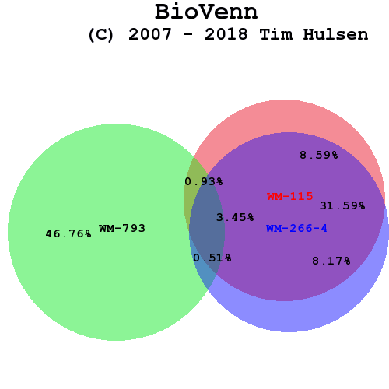
WM-115 /WM-266 Similarities
by Gene mutations
Total number of mutated genes:
WM-115: 529
WM-266-4: 519
WM-793: 613
T. Hulsen, J. de Vlieg and W. Alkema, BMC Genomics 2008, 9 (1): 488

Slide 15
WM-115 /WM-266 Similarities
by Gene mutations
WM-115 vs WM-793 shared mutations
BRAF->ENST00000288602->p.V600E
WM-115 vs WM-266-4 shared mutations BRAF->ENST00000288602->p.V600E
WM-115 vs WM-266-mel shared mutations BRAF->ENST00000288602->p.V600D
WM-115 vs UACC-62 shared mutations BRAF->ENST00000288602->p.V600E

Slide 16
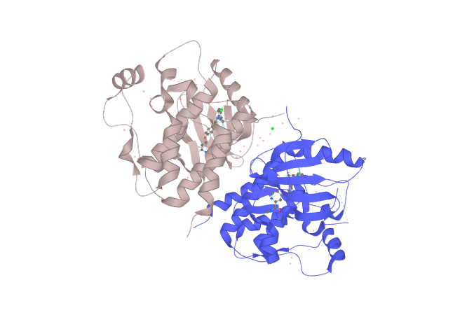
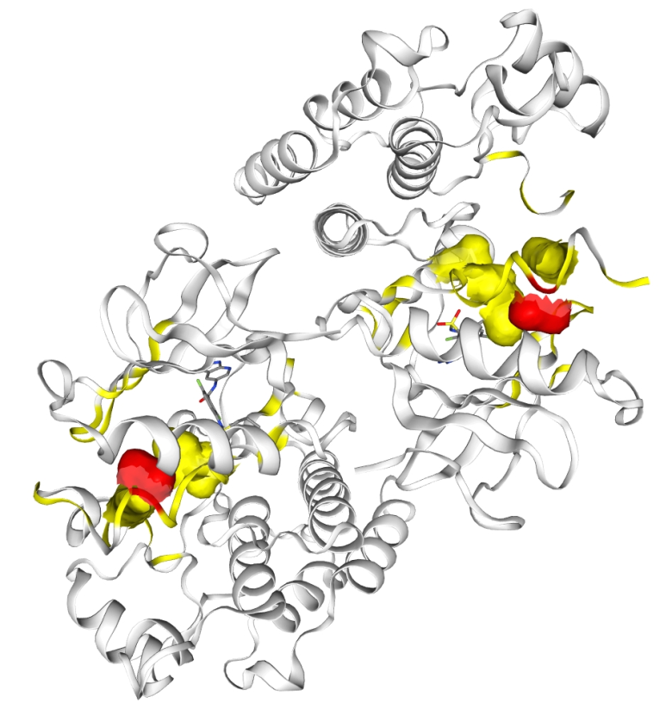
BRAF mutations in melanoma - trancript
Exons: 19, Coding exons: 19, Transcript length: 2,561 bps, Translation length: 806 residues
http://www.ensembl.org/Homo_sapiens/Transcript/Summary?db=core;g=ENSG00000157764;mr=7:140753336-140753337;r=7:140753270-140753400;t=ENST00000288602
Serine/threonine-protein kinase B-raf
1UWH | X-ray | 2.95 Å | A/B | 448-723
https://cancer.sanger.ac.uk/cosmic3d/protein/BRAF

Slide 17
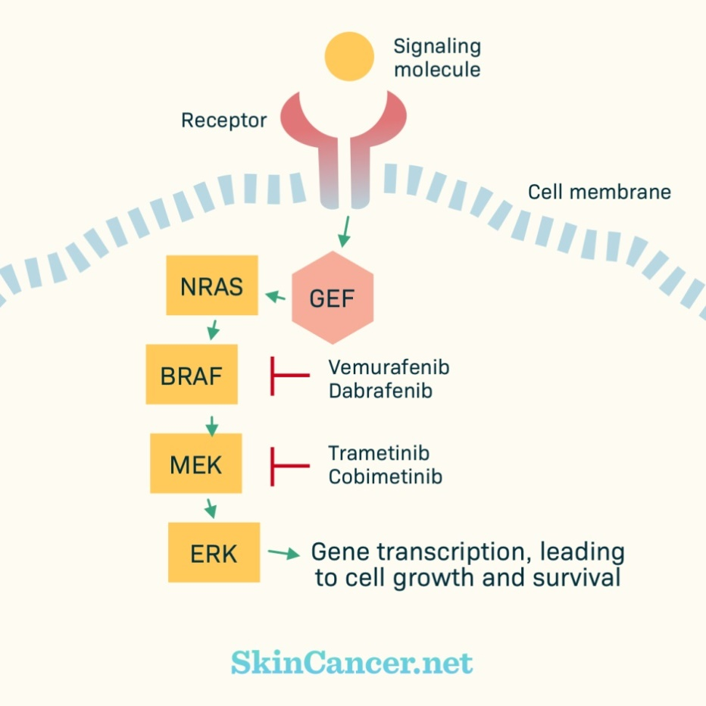
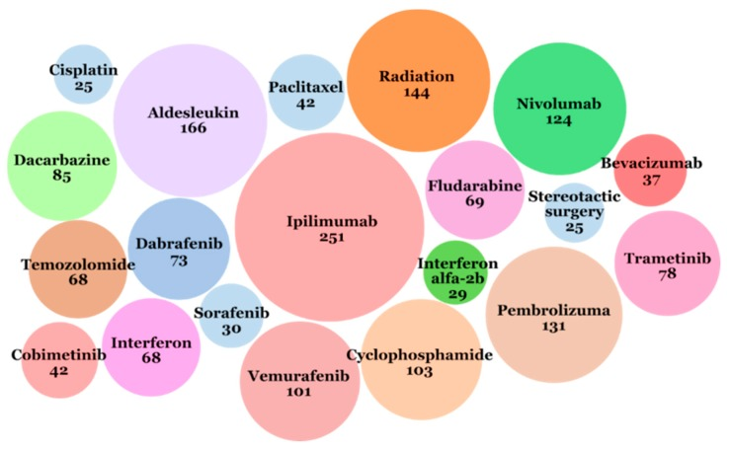
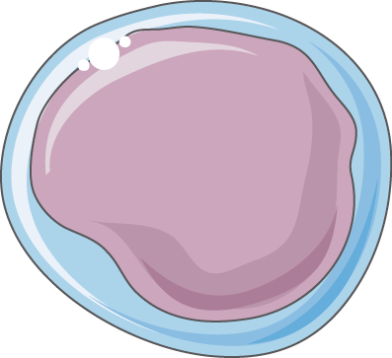
Targeted Therapy for Melanoma Skin Cancer
Twenty interventions that most often appeared in the ICTRP database from 1971 to 2018
CTLA-4
T cell
Wróbel S et al. J Clin Med. 2019 Mar 15;8(3).
Notes:
Ipilimumab (trade name Yervoy) is a monoclonal antibody that works to activate the immune system by targeting CTLA-4, a protein receptor that downregulates the immune system.
Cytotoxic T lymphocytes (CTLs) can recognize and destroy cancer cells. However, an inhibitory mechanism interrupts this destruction.^{[3]} Ipilimumab turns off this inhibitory mechanism and allows CTLs to function.

Slide 18
It is important to know the genotype of a spheroid model
Genotypic similarities between WM-115 and WM-266 treat:
97% corelations in gene mutations
Shared mutations in the crutial gene (BRAF)

Slide 19
Melanoma spheroids - 3D model
CPh
FDA
PI
250 μm
250 μm
1500 cells
1500 cells
1500 cells

Slide 20
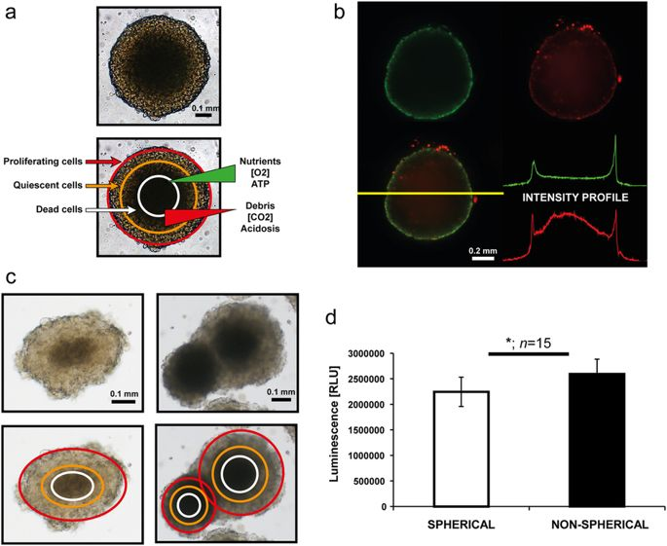
Melanoma spheroids - 3D model
3D melanoma spheroids implanted into a collagen gel matrix
https://www.nature.com/articles/srep19103

Slide 21
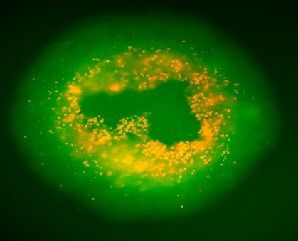
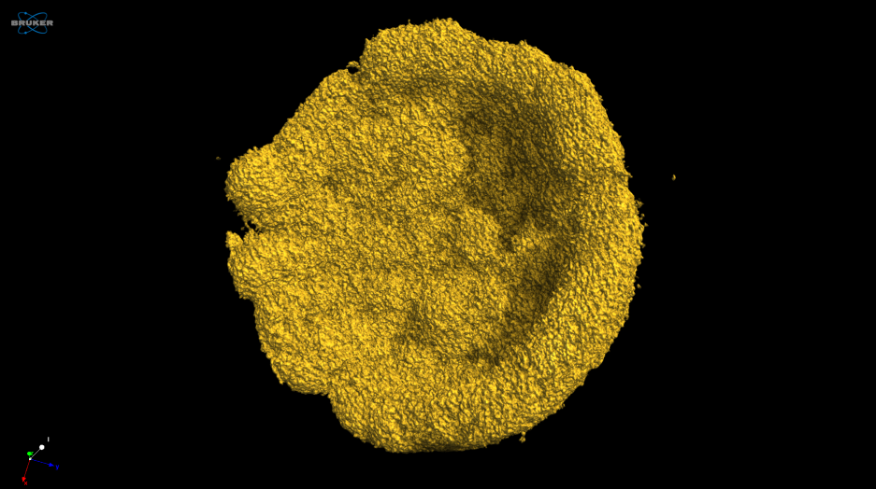
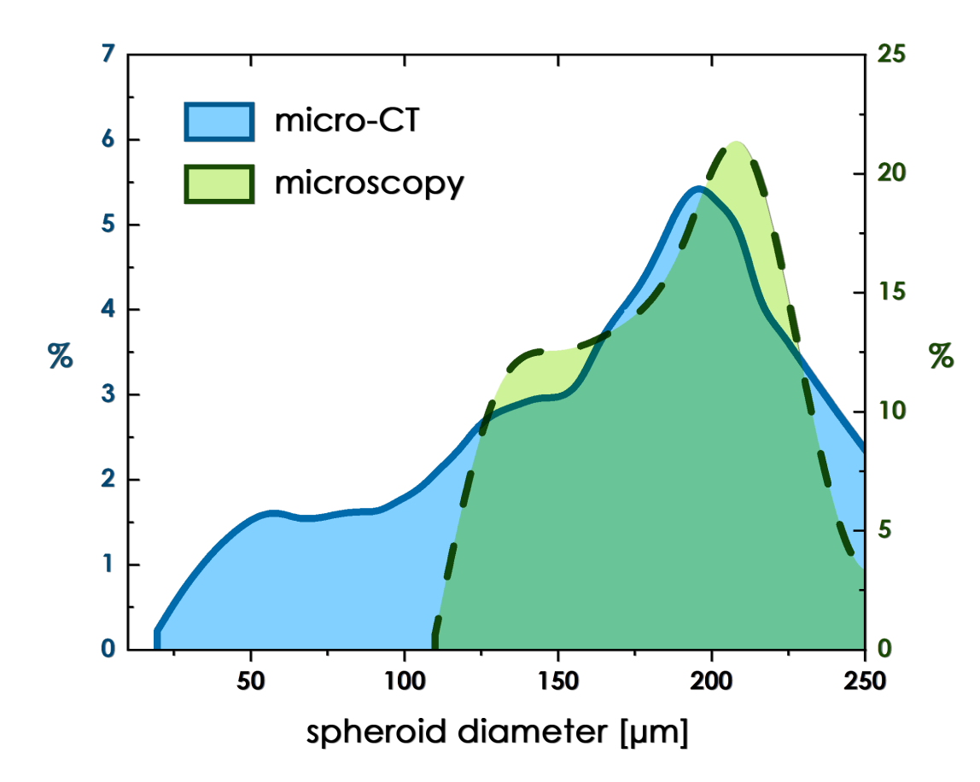
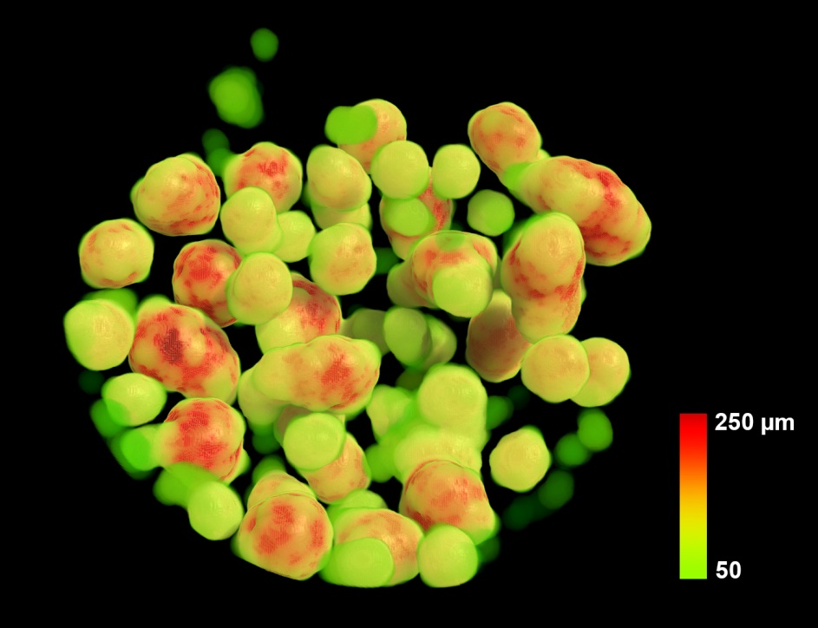
WM-266 spheroids - microCT

Slide 22
Radiation response of multicell spheroids-an in vitro tumour model.
Changes in radiosensitivity of cells in spheroids were demonstrated due to intercellular contact, cell cycle redistribution and hypoxia.
Cells grown in close contact had an enhanced capacity to accumulate and repair sublethal damage.
Sutherland RM, Durand RE.
Curr Top Radiat Res Q. 1976 Jan;11(1):87-139.

Slide 23
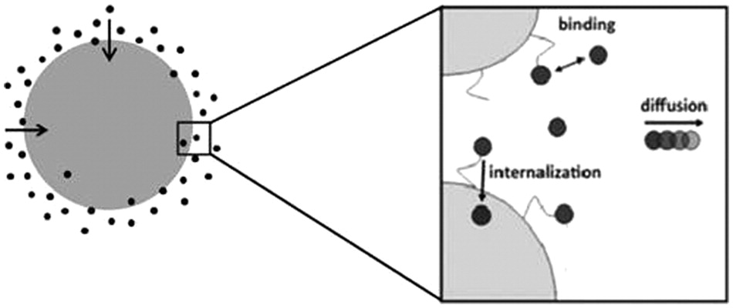
Model of liposome up-take by a cell
The three main processes considered are as follows:
association and dissociation of vesicles,
(b) internalization of bound vesicles, and
(c) diffusion of free vesicles.
Reprinted by permission from the American Association for Cancer Research: Mok, W., Stylianopoulos, T., Boucher, Y., R. K. Jain, Mathematical modeling of herpes simplex virus distribution in solid tumors: implications for cancer gene therapy, Clinical Cancer Research, 2009, 15:7, 2352-2360.
DOI: (10.1177/2211068212458265)

Slide 24
General and multivalent kinetic models of Vesicle Drug Delivery Systems in 2D
DOI: (10.1177/2211068212458265)
Notes:
k_{a} (M⁻¹·s⁻¹) is the association rate constant for a free vesicle binding to a free binding site, and k_{d} (s⁻¹) is the dissociation rate constant for a vesicle dissociating from its binding site

Slide 25
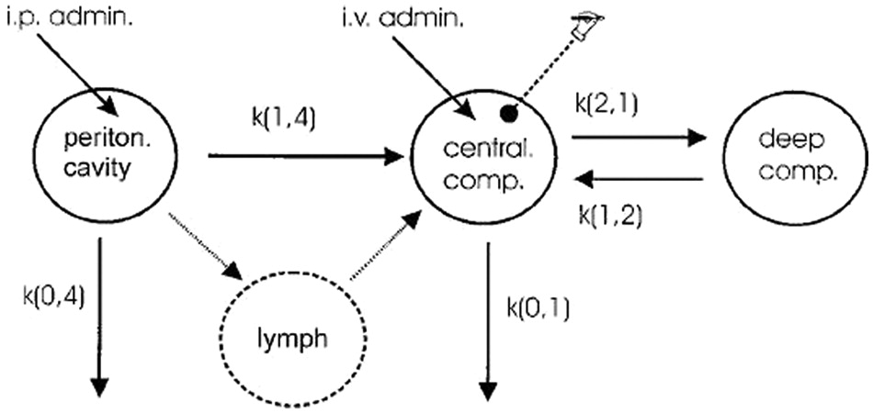
Model in vivo biodistribution of liposomes
Pharmacokinetic model used by Arndt et al.
Cancer Research and Treatment, Pharmacokinetics of sterically stabilized hexade-cylphosphocholine liposomes versus conventional liposomes and free hexadecyl-phosphocholine in tumor-free and human breast carcinoma bearing mice, 58, 1999, 71-80, Arndt, D., Zeisig, R., Fichtner, I., Teppke, A. D., and A. Fahr
DOI: (10.1177/2211068212458265)

Slide 26
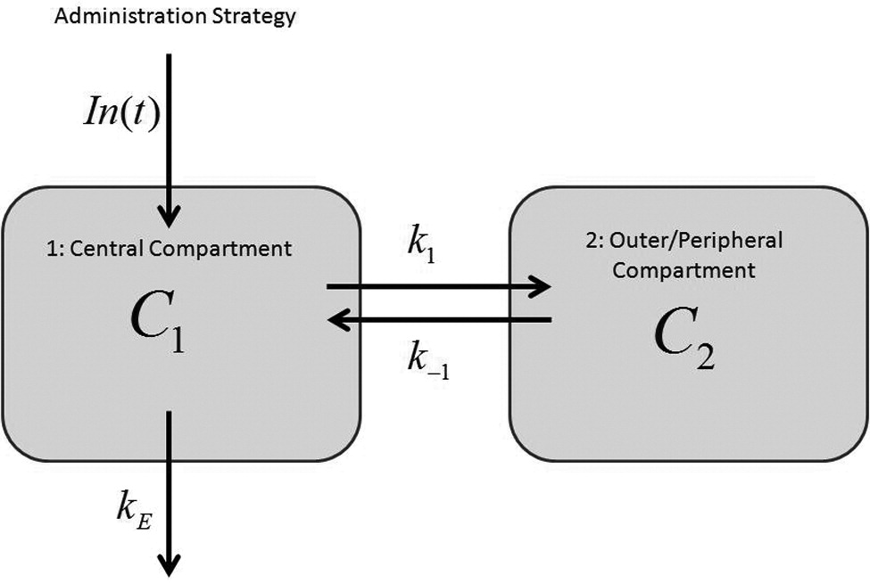
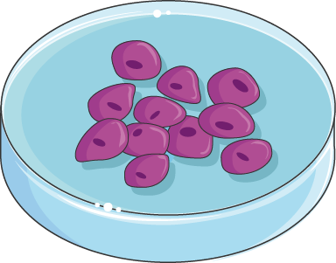
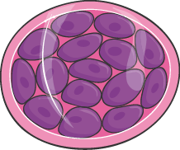
Pharmacokinetics
The open two-compartment model
The central compartment is generally treated as the circulatory system, often referred to as “plasma,” and the peripheral compartment is referred to as the “tissue” that takes up most of the drug.
DOI: (10.1177/2211068212458265)

Slide 27
Tumor spheroids as an in vitro model for determining therapeutic efficacy against proton beam radiotherapy and doxorubicin encapsulated low temperature sensitive liposome
Senavirathna LK et al. Theranostics. 2013; 3(9): 687–691

Slide 28
Concluding remarks
Preclinical study needs to use a model relevant for diseases progress and treatment
Spheroids are very well established for basic and translational research of cancer biogenesis and sensitivity
microCT as a novel aproach for spheroid investigation

Slide 29
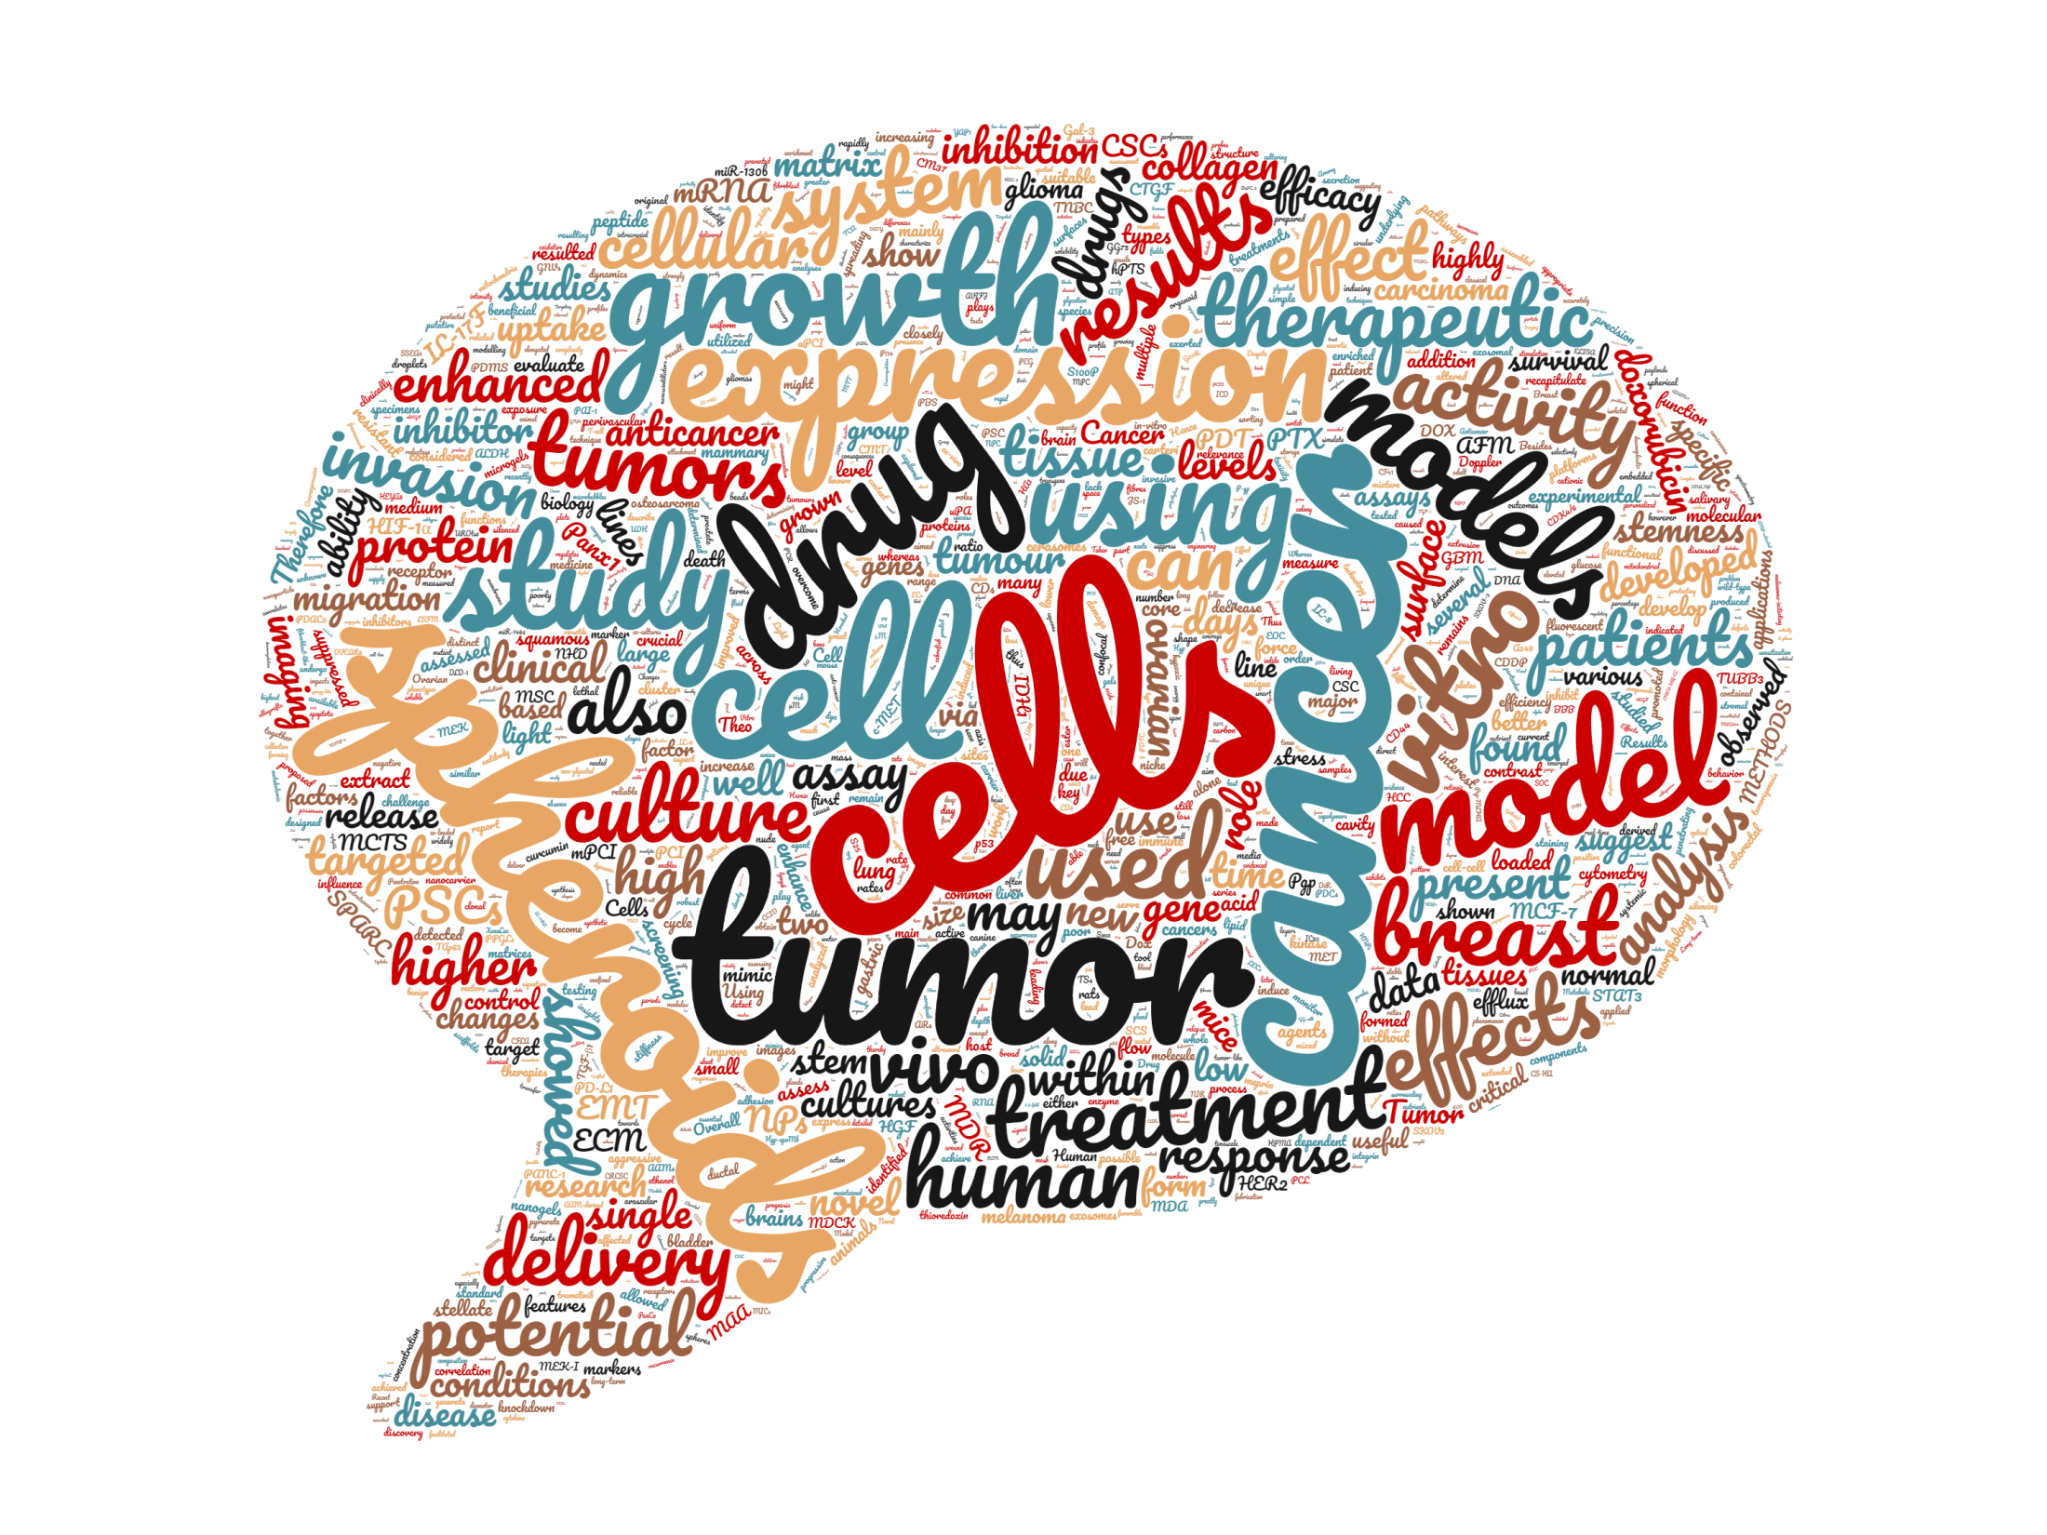

Slide 30
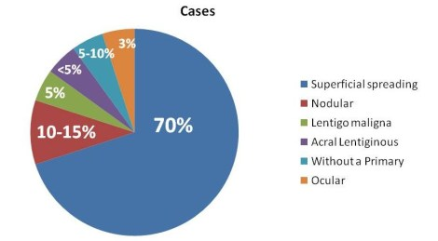
Melanoma types
Superficial spreading melanoma -commonly found on the arms, legs, chest and back. The melanoma cells usually grow slowly at first, and spread out across the surface of the skin.
Nodular melanoma - can grow more quickly than other melanomas. It is also more likely to lose its colour when growing, becoming red rather than black. It is more commonly found on the chest, back, head or neck.
Lentigo maligna melanoma - usually found in older people, in areas of skin that have had a lot of sun exposure over many years. It is often found on the face and neck.
Acral lentiginous melanoma - usually found on the palms of the hands, soles of the feet, or under fingernails or toenails. It is more common in people with black or brown skin. It is not thought to be related to sun exposure.
Notes:
Another rare type of melanoma is desmoplastic melanoma.
Rarely, melanoma can start in parts of the body other than the skin. It can start in the eye (ocular melanoma). Or it can start in the tissues that line areas inside the body, such as the anus or rectum (anorectal melanoma), nose, mouth, lungs and other areas.
Superficial spreading melanoma is the most common type. It is more commonly found on the arms, legs, chest and back. The melanoma cells usually grow slowly at first, and spread out across the surface of the skin.
Nodular melanoma is the second most common type. It can grow more quickly than other melanomas. It is also more likely to lose its colour when growing, becoming red rather than black. It is more commonly found on the chest, back, head or neck.
Lentigo maligna melanoma is less common. It is usually found in older people, in areas of skin that have had a lot of sun exposure over many years. It is often found on the face and neck. It develops from a slow-growing precancerous condition called a lentigo maligna or Hutchinson’s freckle. This looks like a stain on the skin. They are usually slow-growing and less dangerous than the other types of melanoma.
Acral lentiginous melanoma is the rarest type. It is usually found on the palms of the hands, soles of the feet, or under fingernails or toenails. It is more common in people with black or brown skin. It is not thought to be related to sun exposure.

Slide 31
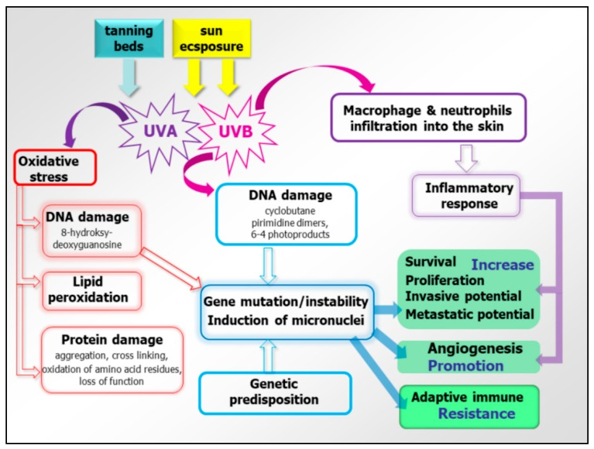
Molecular background of UV radiation and oxidative stress for the melanoma cause
Wróbel S et al. J Clin Med. 2019 Mar 15;8(3).
Notes:
Both sun exposure and tanning beds are sources of UV. Among them, UVA is mostly responsible for oxidative stress, causing DNA and protein damage as well as lipid peroxidation. DNA damage leads to gene instability and mutagenesis, impacting the main cellular processes involved in cancerogenesis, cancer growth, metastasis, and adaptive immune resistance. Likewise, UVB modulate those processes by the activation of inflammatory response.

Slide 32
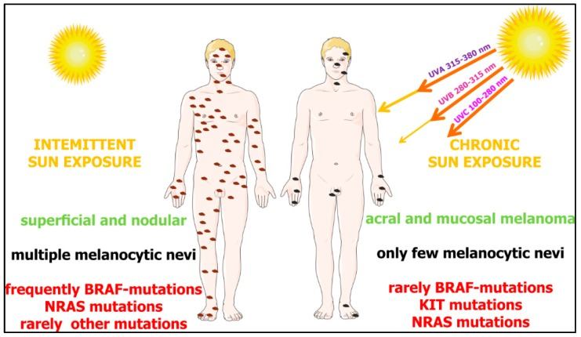
Differential dependence of melanoma subgroups on sun exposure and types of gene mutations
Wróbel S et al. J Clin Med. 2019 Mar 15;8(3).
Notes:
The interplay of genetic and environmental factors on melanoma development. Up to 50% of melanomas derived from the skin without chronic sun damage (intermittently exposed to UV) contain BRAF mutations. The second frequent mutations are present in the NRAS gene (around 25%). In melanomas derived from chronic sun exposure, NRAS and KIT mutations are more common (~15% and ~20%) than BRAF (~10%). According to Janina Staub (2012) with some modifications

Slide 33
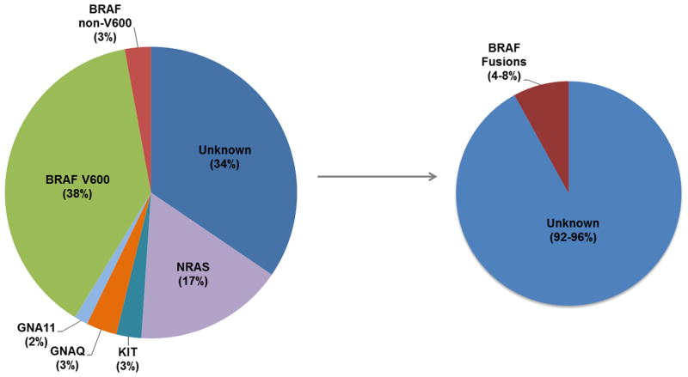
Pie chart demonstrating the percentage distribution of genes with clinically-relevant and recurrent driver mutations in individuals with melanoma, including non-V600 BRAF alterations (left), interrogated on the Vanderbilt melanoma SNaPshot assay.
BRAF fusions occur in approximately 4–8% “pan-negative” cases (right).

Slide 34
Molecular subsets of melanoma
Anatomic location of the primary tumor | Frequency of driver mutations in melanoma
Skin without chronic sun damage | ~50% BRAF ~20% NRAS
Skin with chronic sun damage | ~5% BRAF ~10% NRAS ~2% KIT
Mucosal surfaces | ~5% BRAF ~15% NRAS ~20% KIT
Acral surfaces | ~15% BRAF ~15% NRAS ~15% KIT
Uveal melanoma | ~32% GNA11 ~50% GNAQ ~1% BRAF
*Frequencies of MEK1 and CTNNB1 mutations according to anatomic location are not known at present
Notes:
Source: https://www.mycancergenome.org/content/disease/melanoma/

