Slide 1
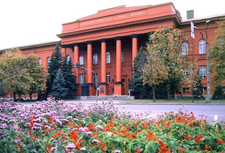

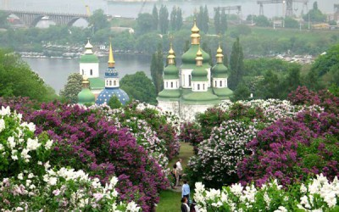
Taras Shevchenko National University of Kyiv
The new capabilities for ensuring radiation protection of individuals undergoing medical exposure
Oleg Bezshyyko
In the frame of the project #9903 of STCU (Bezshyyko O., Golinka-Bezshyyko L., Kadenko I.) and IAEA project RER9147 (Ukrainian part, Bezshyyko O.)
Oleg Bezshyyko, 3rd Jagiellonian Symposium on Fundamental and Applied Subatomic Physics, June 23 – 28, 2019

Slide 2
Outlines
Radiation protection of patients – challenges for the modern Radiation Oncology
QA of radiation therapy – next steps up to a high treatment quality
Anthropomorphic dosimetric phantoms for control of medical radiation exposure
Radiation Therapy Planning Systems (RTPS) – challenges and trends of development
Education of medical physicists in Radiation Oncology – problems and solving
Oleg Bezshyyko, 3rd Jagiellonian Symposium on Fundamental and Applied Subatomic Physics, June 23 – 28, 2019

Slide 3

Cancer - Horrible figures
GLOBOCAN 2018 database
World
global cancer burden is estimated to have risen to 18.1 million new cases and 9.6 million deaths in 2018.
One in 5 men and one in 6 women worldwide develop cancer during their lifetime,
One in 8 men and one in 11 women die from the disease.
Worldwide, the total number of people who are alive within 5 years of a cancer diagnosis, called the 5-year prevalence, is estimated to be 43.8 million.
Poland
Ukraine
Number of new cases – 185 630
Number of deaths – 113 388
Number of prevalent cases (5-year) – 490 121
– 169 817
– 98 226
– 391 171
Oleg Bezshyyko, 3rd Jagiellonian Symposium on Fundamental and Applied Subatomic Physics, June 23 – 28, 2019

Slide 4
Radiation Oncology, radiation therapy – dramatic increase the role of physicists
More than 60% of cancer patients will receive radiation therapy - either alone or in combination with other treatment approaches, such as surgery and chemotherapy.
The fast development of new methods in radiation oncology, in particular, radiation therapy (very complex physics and technics):
    IMRT - Intensity-Modulated Radiation Therapy
    IGRT - Image-Guided Radiation Therapy
    VMAT - Volumetric-Modulated Arc Therapy
    Tomotherapy
    Charged Particle Therapy (proton and 12C ion therapy)
Oleg Bezshyyko, 3rd Jagiellonian Symposium on Fundamental and Applied Subatomic Physics, June 23 – 28, 2019

Slide 5
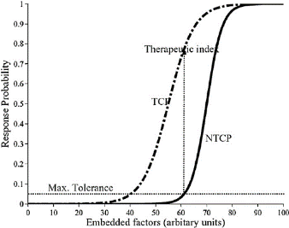
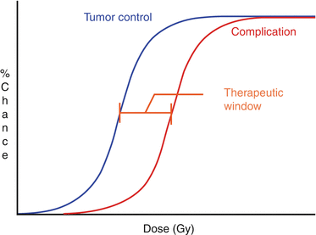
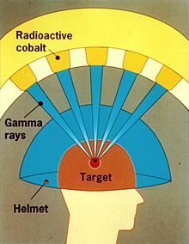
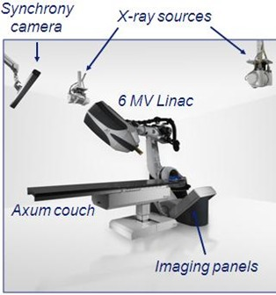
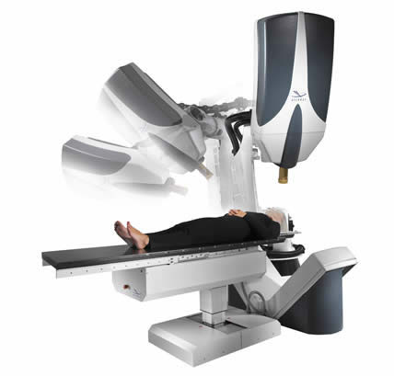
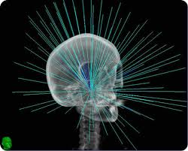
Radiation Oncology, radiation therapy – dramatic increase the role of physicists
The fast development of new methods in radiation oncology, in particular, radiation therapy (very complex physics and technics):
        IMRT, IGRT, VMAT, Tomotherapy, PET, Charged Particle Therapy (proton and 12C ion therapy)
From other side – requirements of high precision:
        Narrow therapeutic window in gamma radiation therapy - precision of delivered dose better than 5%
        Stereotactic radiosurgery (SRS) - spatial precision better than 1 мм
Oleg Bezshyyko, 3rd Jagiellonian Symposium on Fundamental and Applied Subatomic Physics, June 23 – 28, 2019

Slide 6
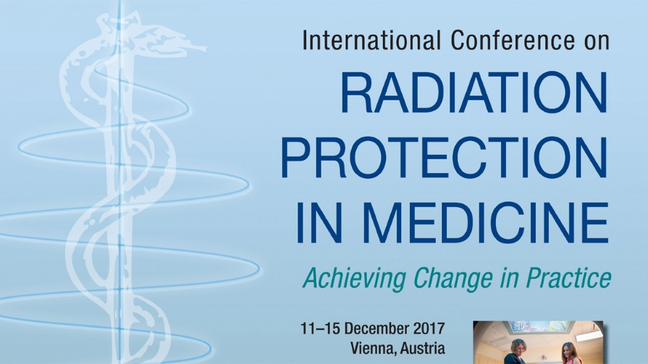
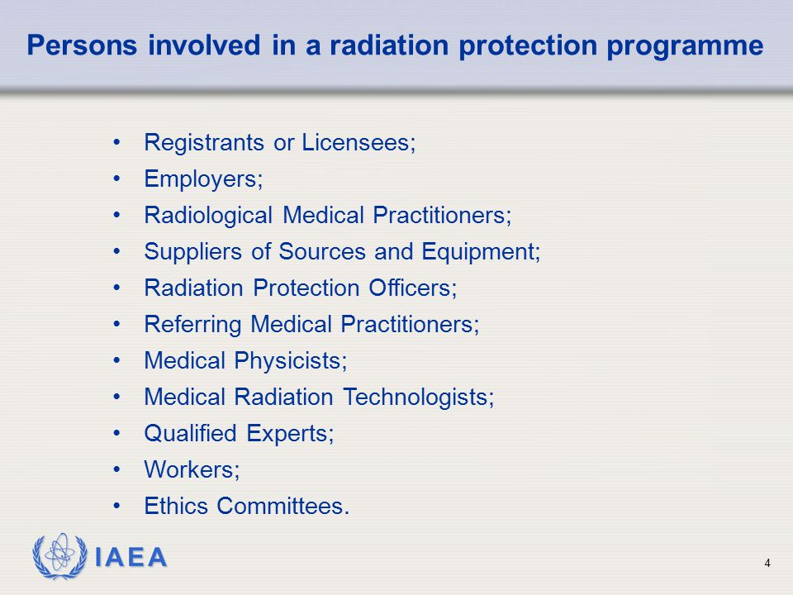
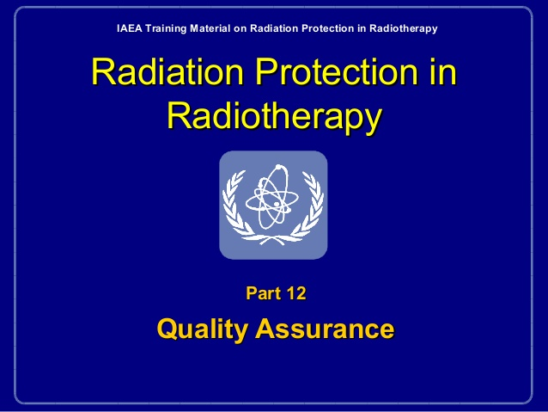
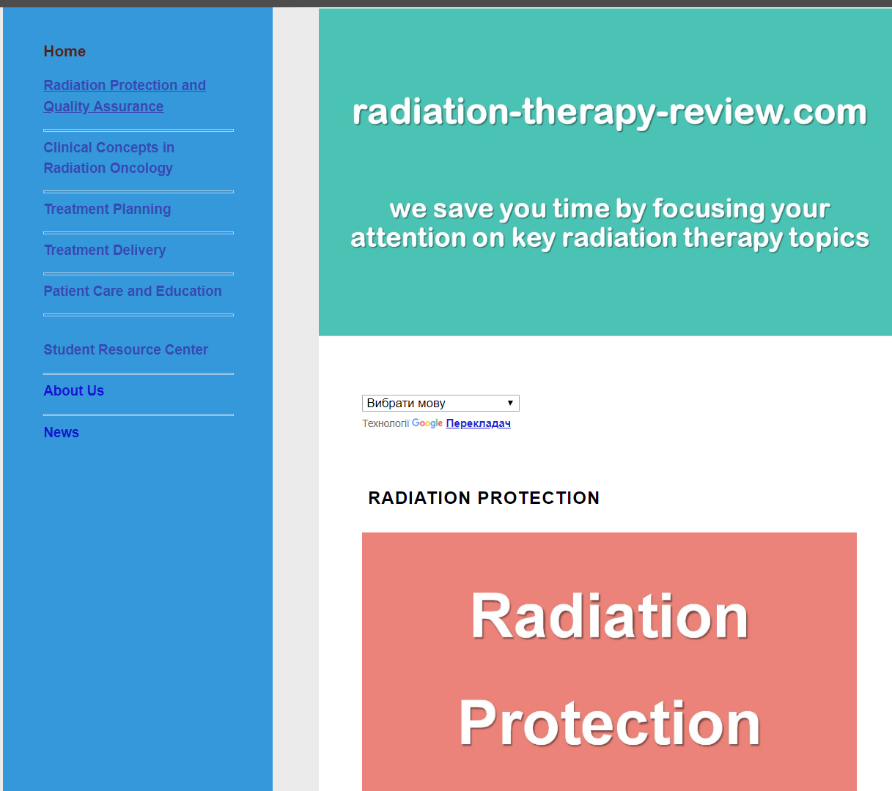
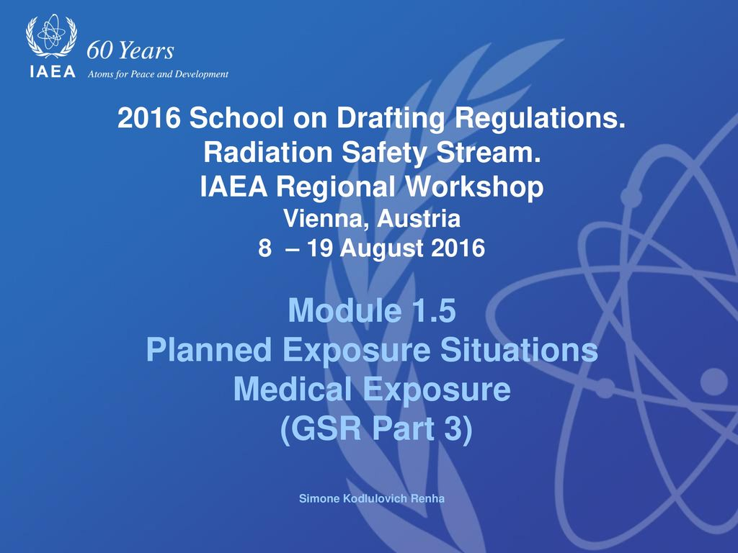
http://www.radiation-therapy-review.com/Radiation_Protection.html
Oleg Bezshyyko, 3rd Jagiellonian Symposium on Fundamental and Applied Subatomic Physics, June 23 – 28, 2019

Slide 7
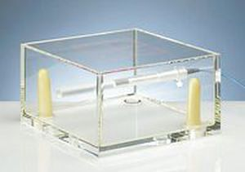
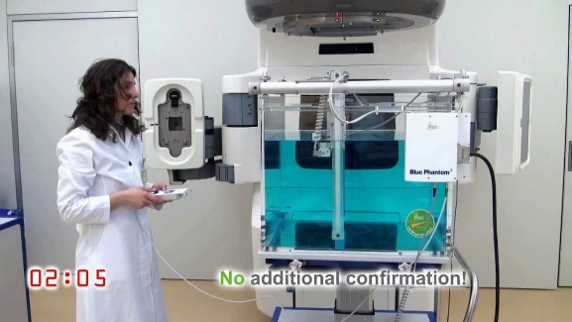

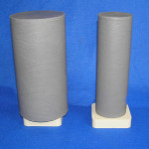
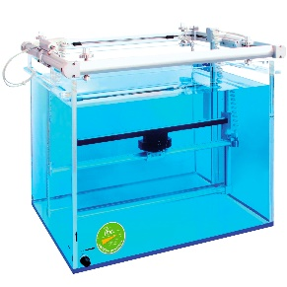
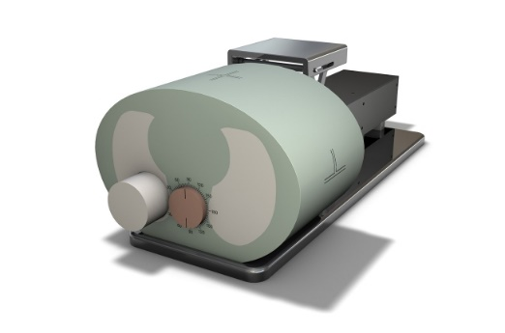
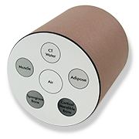
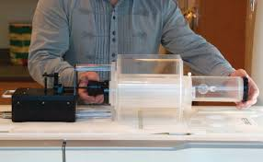
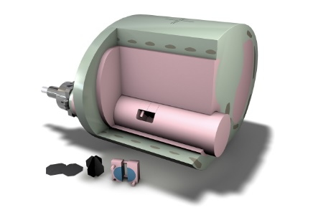
Simple phantoms for dosimetry
But so far, in many cases, for the needs of audits, testing of equipment, techniques, training of staff (medical physicists and physicians in radiation oncology) very simplified dosimetric phantoms are used, especially in countries with limited financial possibilities to support high quality in the cancer treatment:
Basic water phantoms
2. Homogeneous plastic (solid) phantoms
3. Plastic phantoms with simple heterogeneous insertions
Oleg Bezshyyko, 3rd Jagiellonian Symposium on Fundamental and Applied Subatomic Physics, June 23 – 28, 2019

Slide 8
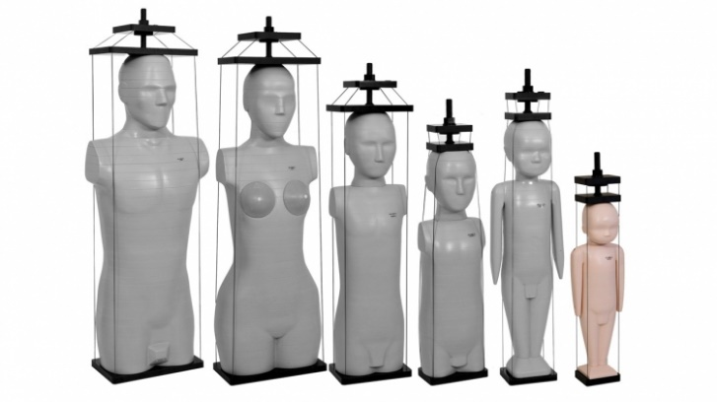
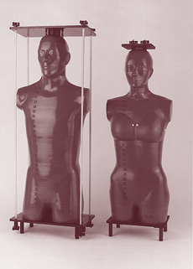
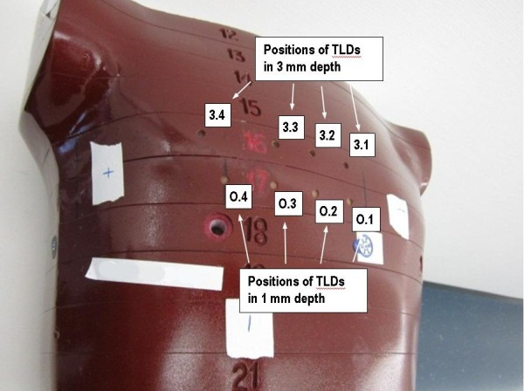
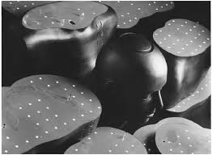
Anthropomorphic phantoms for dosimetry
Simple phantoms are very important for calibration purposes and basic test tasks, but they can’t provide the complex test and audit cases with maximal emulation of patient body peculiarities
For these tasks complex anthropomorphic phantoms with the detailed structure of the patient body are used with places for inserted dosimetry detectors (TLD, radiochromic films etc.)
But a majority of anthropomorphic phantoms are very expensive for use at every oncology therapeutic machine for training and testing purposes (especially for countries with a limited budget for medicine), prices start nearly from 20,000 dollars up to 100 and more thousand dollars
Oleg Bezshyyko, 3rd Jagiellonian Symposium on Fundamental and Applied Subatomic Physics, June 23 – 28, 2019

Slide 9

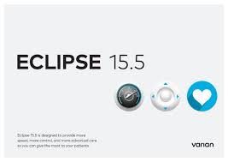

Radiation Therapy Planning Systems - RTPS
RTPS – very important element for support of the cancer medical treatment in the modern oncology facilities: dose calculations with high precision, choice of optimal parameters of therapeutic machines, minimization of irradiation of critical organs with a maximal dose on the tumor zone
The semi-empirical algorithms and Monte Carlo methods are applied to obtain a balance between speed and precision of work. Modern trends are using of GPU hardware and Artificial Intelligence algorithms for dose calculation.
There are many very good commercial RTPS, but they, as a rule, are provided only as a complement to the purchased radiation-therapy equipment, which makes it inconvenient, expensive and often impossible to use such RTPS for training and education of personnel and especially students, as well as for independent checks.
Therefore, development of RTPS, independent on a specific vendor of the equipment for radiation therapy, potentially using an open source approach, is essential for improving the level of training and education as well as the quality standards in radiation therapy in Ukraine and in other similar countries.
Oleg Bezshyyko, 3rd Jagiellonian Symposium on Fundamental and Applied Subatomic Physics, June 23 – 28, 2019

Slide 10
3D fast printing system for production of anthropomorphic phantoms, free RTPS, free software platform for education of medical physicists
In the frame of the project #9903 of Science and Technology Center in Ukraine (STCU)
“Development of versatile test platforms for research of radiation detectors for medical applications” and IAEA project RER9147 “Enhancing Member States' Capabilities for Ensuring Radiation Protection of Individuals Undergoing Medical Exposure” (Ukrainian part)
At the Nuclear Physics Department, Faculty of Physics of Taras Shevchenko National University of Kyiv (Ukraine) the Developments were started:
3D printing system for fast and cheap production of anthropomorphic phantoms
Free Radiation Therapy Planning System for the education of students (specialties medical physics and clinical dosimetry)
Free software platform for education of medical physicists
There are first first stages of Developments
Oleg Bezshyyko, 3rd Jagiellonian Symposium on Fundamental and Applied Subatomic Physics, June 23 – 28, 2019

Slide 11
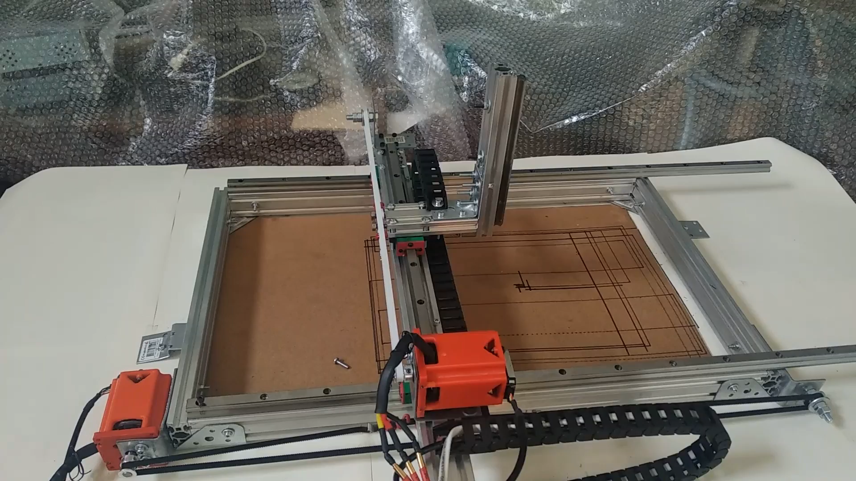
3D fast printing system for production of anthropomorphic phantoms
The main idea of this approach – using of very fast 3D hybrid printer with precise milling part and inkjet heads with tissue equivalent materials
Hybrid monster
3D inkjet heads
+
precise milling heads
Prototype of movement system
Oleg Bezshyyko, 3rd Jagiellonian Symposium on Fundamental and Applied Subatomic Physics, June 23 – 28, 2019

Slide 12
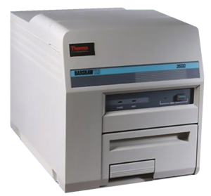
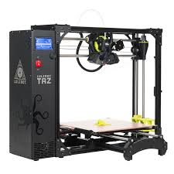

3D fast printing system for production of anthropomorphic phantoms
Plans for future stages (after 2D hybrid printer) – development of cheap clinical Reader for TLD and scanner for radiochromic films
Our estimation and hope – to decrease the cost of dosimetry systems on the base of anthropomorphic phantoms, reduce by an order of magnitude
TLD Reader
Film Scanner
We study the possibility to build in Ukraine the pilot project of systems for education in cancer hospital and audits in hospitals of therapeutic dose (check of all chain: methods-equipment-personal) by regulatory officers and inspectors using detectorized anthropomorphic phantoms, produced by 3D printer.
Oleg Bezshyyko, 3rd Jagiellonian Symposium on Fundamental and Applied Subatomic Physics, June 23 – 28, 2019

Slide 13
Free software platform for education of medical physicists
Special open source software tools for computer aided education of medical physicists and radiation protection specialists are based on the MOODLE platform
System of collective translation of education information is in the plans
Oleg Bezshyyko, 3rd Jagiellonian Symposium on Fundamental and Applied Subatomic Physics, June 23 – 28, 2019

Slide 14
Free RTPS
Development only in the first stage
Will be written on the C++ and Python
QT framework with the modern graphical interface
The using GPU hardware
Artificial Intelligence algorithms for dose calculation
The semi-empirical algorithms and Monte Carlo methods are applied to obtain balance between of speed and precision of work
Forward and inverse planning
Oleg Bezshyyko, 3rd Jagiellonian Symposium on Fundamental and Applied Subatomic Physics, June 23 – 28, 2019

Slide 15
Conclusions
The new capabilities for ensuring radiation protection of individuals, undergoing medical exposure were considered
The Hybrid 3D Printing Technique for fast and inexpensive creation of Anthropomorphic Dosimetric Phantoms was proposed
Main challenges and trends of development for Radiation Therapy Planning systems were considered
Educational software tools to support a high professional level of medical physicists were considered. Short information about development of Open RTPS was represented
Oleg Bezshyyko, 3rd Jagiellonian Symposium on Fundamental and Applied Subatomic Physics, June 23 – 28, 2019

Slide 16



Oleg Bezshyyko, 3rd Jagiellonian Symposium on Fundamental and Applied Subatomic Physics, June 23 – 28, 2019

